Slide 1
FRANCE

Slide 2
FRANCE
coordinator of the project
responsible for
the good working atmosphere and respect between all the participants.

Slide 3
WE
ARE
Up to now, we have all done a great job.
We have been working very well together.
Our project got 87,5/100.
PROUD
TO WORK
YOU
WITH

Slide 4
WHAT IS IMPORTANT FOR US
We trust each other :
If one of us does something wrong, we should tell the partner before it is too late.
We can help each other in the different steps of the project : feel free to ask the rest of the group for help.
We communicate with each other :
We have been using whatsapp for ten months ! It’s easy, quick and efficient. Let’s go on using it !
We must feel free to let the others know our opinion and feelings.
We can debate together and come to an agreement.
Our partnership is a democracy:
Once the group has made a decision, all the partners must respect it.
Every member can ask for help, we will find a solution together.
Anything else ?
Please, feel free to let us know if we have forgotten anything… This is our first experience !

Slide 5
Each partner has been given 80 per cent of the total budget granted by Europe.
70 per cent of this amount should be spent before October,1st 2020.
We were asked to send a mid-term report in October 2020 to check the money has been spent.
The French agency was clear : there should be no money left, otherwise we will be asked to return it to the agency.
THE HOST COUNTRY ORGANISES
Food
Accomodation
Activities
Transport from the airport and back
THE BUDGET
CONCERNING THE MOBILITIES
THE GUEST PARTNERS
THE AMBASSADORS
Check if the budget is OK
Book the plane tickets
Prepare the mobility with their students
Trust the host partner for the planning
Will host other ambassadors when their country hosts the mobility
They are ready to be hosted in families
They will meet their host on the web before the mobility

Slide 6
FRANCE
will be responsible for an online diary,
Daytripper
, with the ambassadors from all countries
to keep a memory of this extraordinary experience
different themes : History, Music, dancing, and differences in our ways of life

Slide 7
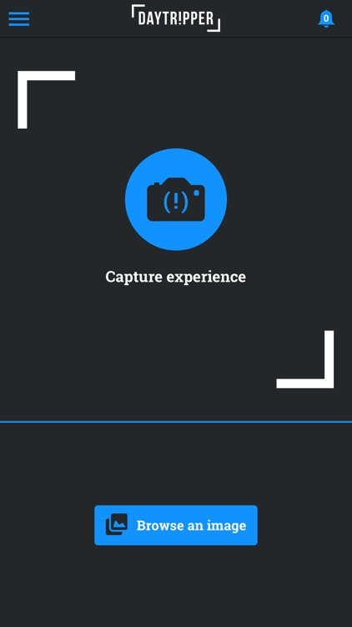
The application DAYTRIPPER aims at giving the students the opportunity to tell and enhance their erasmus experience.
Shoot, tell, share and ... Promote
DAYTRIPPER is a real digital travel book.
It allows students to illustrate their ERASMUS experience (texts, photos, maps,…) and share them with their online community.
Moreover, all the necessary skills used by students during the mobility are listed up. Thanks to this application, pupils can be aware of the progress they have made in different fields.
DAYTRIPPER also allows to get all the information shared anonymously by the ambassadors and use it to assess the mobilities.

Slide 8
DOWNLOAD DAYTRIPPER FOR FREE ON YOUR MOBILE PHONE !
LET’S EXPERIENCE IT TOGETHER
Finally, we don’t really keep much track of our experiences. Most of the times, things are set aside : a hard disk full of pictures, a few lines on a CV… Words don’t easily come to value what we have experienced.
In family, with friends, during a visit, a travel, in a training course, at work(…) with Daytripper!, don’t forget all these little moments that make your life unique and beautiful. Daytripper is the opportunity to easily collect, publish and share experiences through images and related stories, taken from a personal private diary (journal) and this on a web format or a PDF version (stories). The stories can be published on Etwinning and used for the final exhibitions.

Slide 9
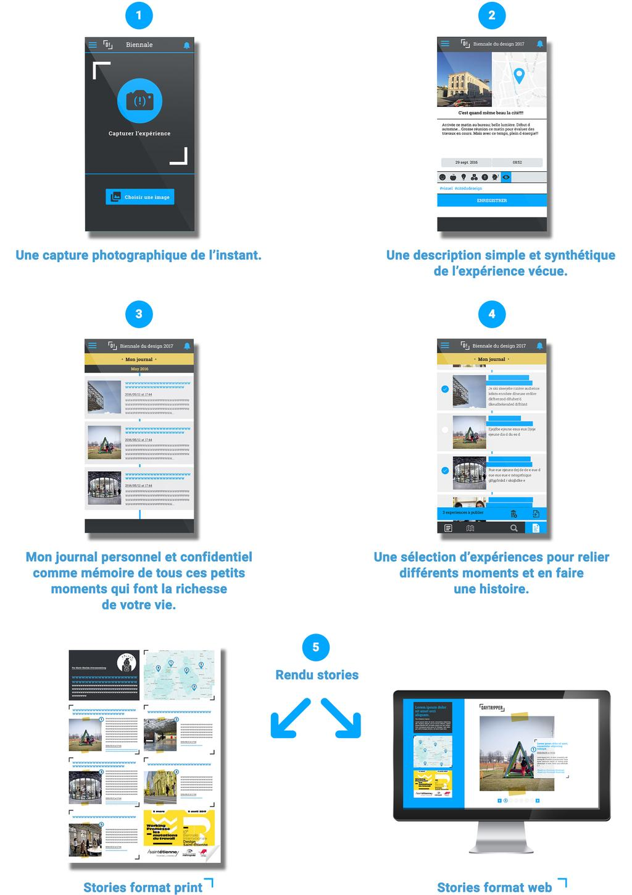
Based upon this personal e-diary, users can easily identify competencies used and acquired during their experiences and profile themselves according to their needs and desires.
Different missions encourage users to publish these experiences, profile themselves and inspire others to seek and pursue full bodied experiences.
Within Daytripper, users have the opportunity to enter communities. In these spaces, they find relevant information depending on their needs : specific information, games, competition…). Thus to accompany their life journey.
Daytripper creates the chance to consciously live and remember your life adventures, small and big.
Different steps
-Through pictures, short text (…), users easily record their experiences on an app’.
- They compile their experiences in order to create « stories » on a synthetic and attractive format (pdf and webdoc).
- They can easily translate their own experiences into « talents » and value them with their profile on a final book
- They share their experiences (« stories ») and profile with peers, tutors, friends, family…

Slide 11
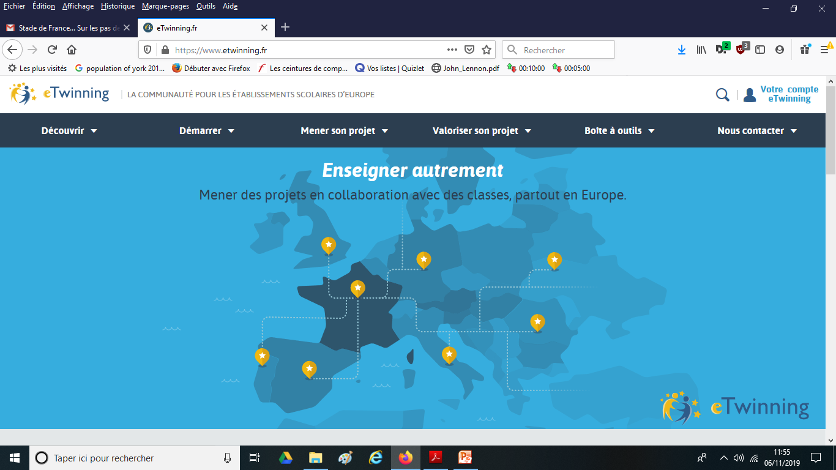
To create an account or to log in

Slide 12
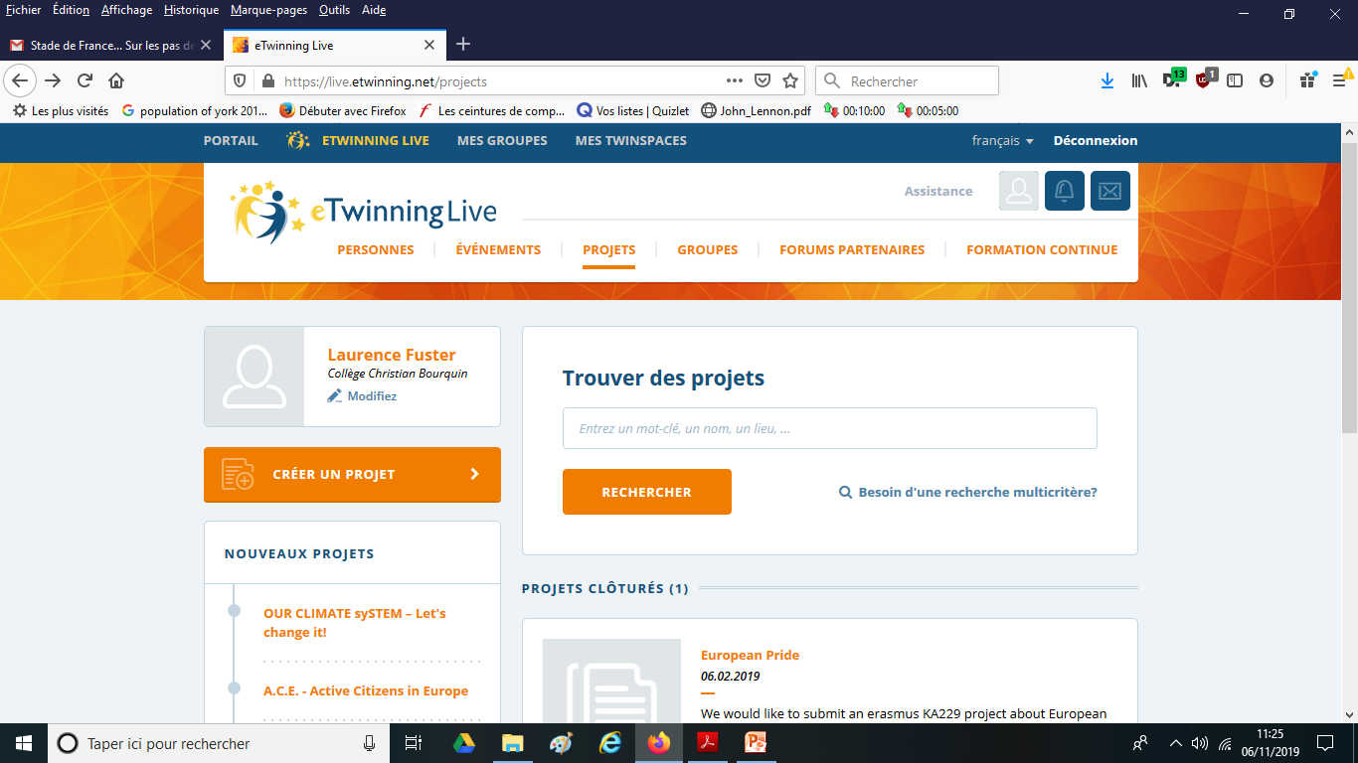
Proud to be European

Slide 14
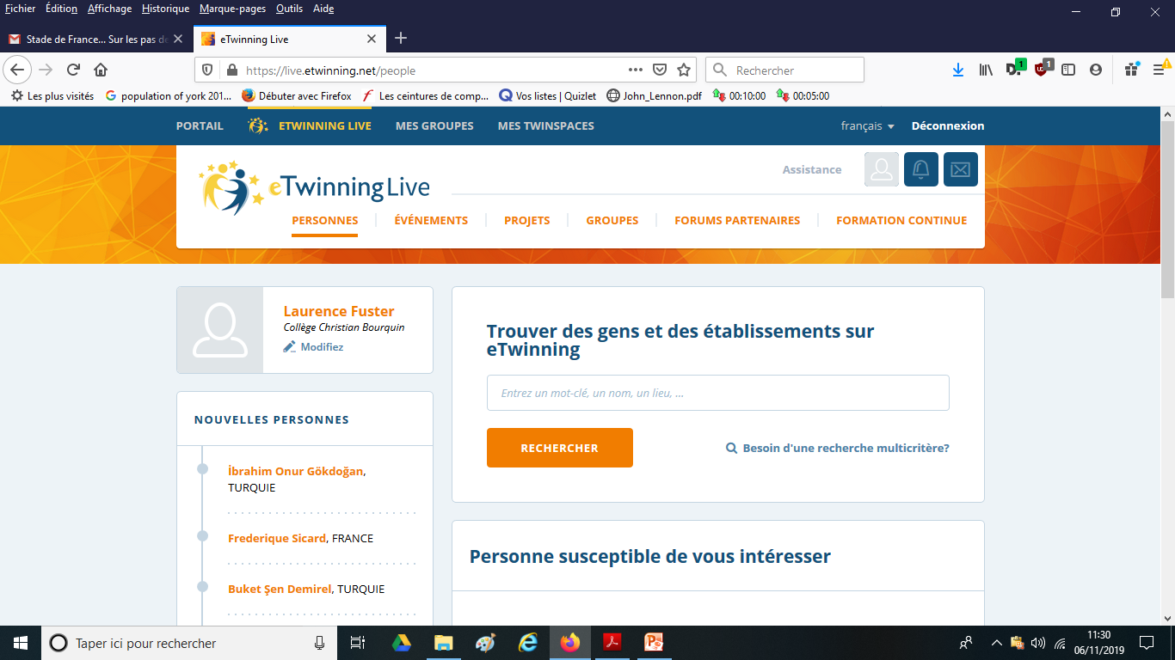
To ask for contact, enter the names of the participants

Slide 16
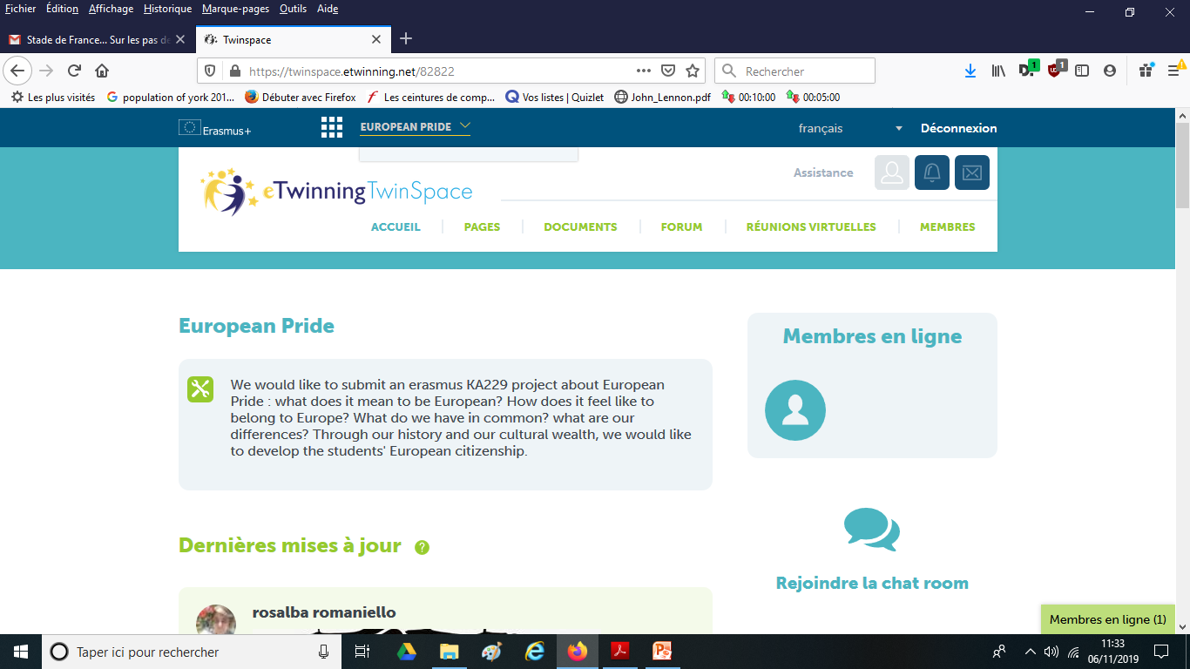

Slide 17
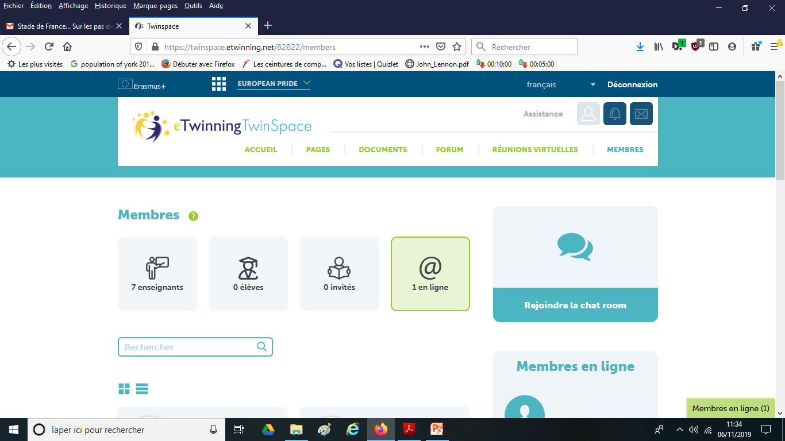

Slide 18
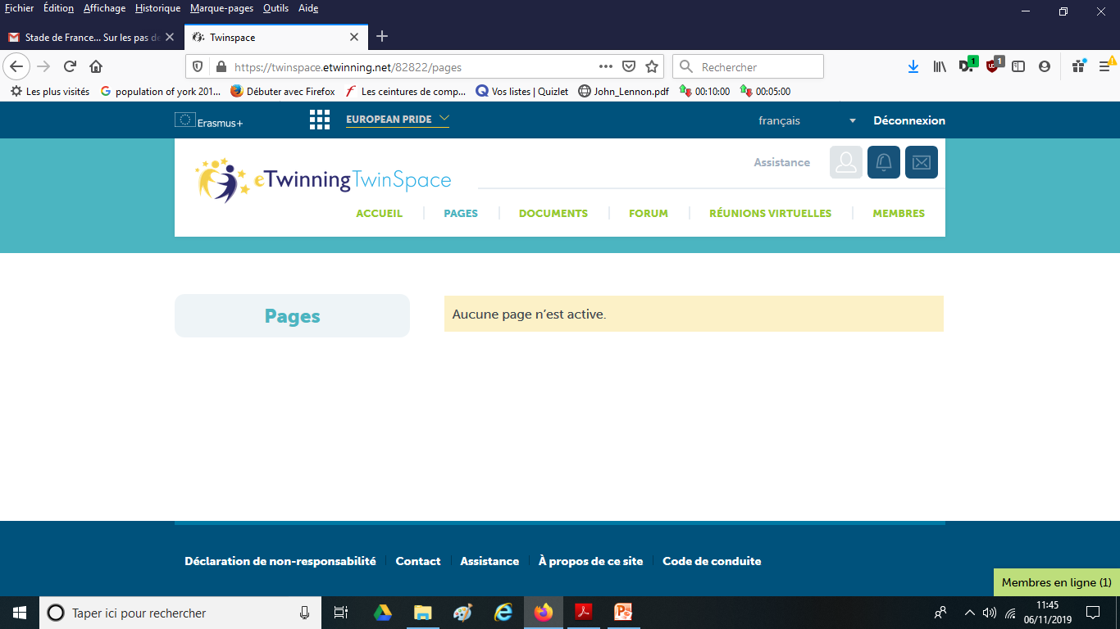
We can create different pages according to the different themes of our work. It will enable everybody to publish work or to communicate easily.

