Slide 1
It’s all about Christmas
2019/20

Slide 2
About the project
The project aims to let students celebrate Christmas together with European friends. During this project pupils will create handmade Christmas cards and send them by post to their friends from different countries. Every postcard will include Christmas wishes both in English and their own languages. The project will help them to know all about how Christmas is celebrated in their peers’ countries (religious services, house and town decorations, traditional dishes, school and local events, traditional songs…)
Aims
- Celebrate Christmas and learn how others celebrate it
- Help children to be aware of different cultures
- Making new friends
- Improving language abilities and competences in English
- Using ICT in a safe, sure and useful way
- Boost collaboration between students.

Slide 3
Work process
- The project will last four months, from October to January.
- Activities and deadlines will be agreed by the partners through collaborative tools.
- Students will create a collaborative project logo
- They will have their own space to know each other, share ideas and collaborate ( forum, chat, video-conference, Skype…)
- They will make their Christmas cards using their favourite technique. Each of them will receive a personal card from his/her peer. These cards will be sent by post to give them the happiness to get them.
- They will make a presentation about Christmas traditions
( traditional dishes, customs, songs, games etc...)in their countries using ICT.
- They will take home traditional Christmas recipes of other countries and cook them with their parents
- Students will work by themselves or in groups according to the activity.
- All the materials connected to planned activities (files, pictures, videos ...) will be uploaded and shared in the twinspace.
Expected results
All the activities will contribute to:
- Enhance students’ motivation in learning
- Broaden cultural horizons
- Developing communication and language skills
- Becoming familiar with ICT
- Learning about copywriting and e-safety
A collaborative ebook will contain Christmas traditions from the countries involved

Slide 4
Μarianthi Arvanitidou 1st Primary School of Komotini- Greece Th. Sofouli 2 komotini, 6910 Greece | Teacher Sara Amâncio Escola Básica Hermenegildo Capelo Rua da Escola Preparatória, nº 2 2950-246 Palmela Portugal
Ana Madalena Boléo Fernandes Escola Patrício Prazeres Rua Matilde Rosa Araújo 1900-057 Lisboa Portugal | ZŠ Akademika Heyrovského 4539, 430 03 Chomutov, Czech Republic
Nicoletta Forestiere I. C. "F. P. Polizzano" Gangi, Italy | Nicolae Iorga School, Ploiesti, Romania, Teacher: Cerassela Anghel
Αnna Fanourgiaki 13th kindergarten of Rethymno, Kapodistriou 43 Kallithea Crete Greece 74133 | Teacher: Rute Sobral e Isabel Rodrigues Escola Básica Hermenegildo Capelo Rua da Escola Preparatória, nº 2 2950-246 Palmela Portugal
The teachers and the schools of our project

Slide 5
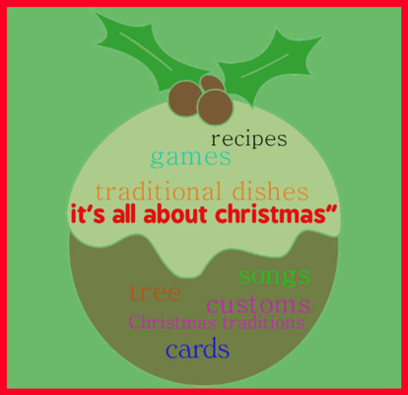
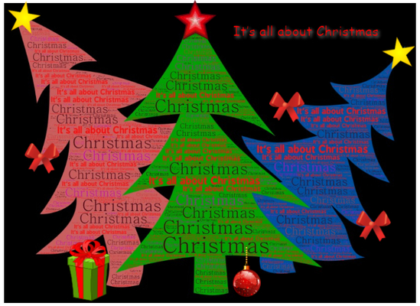
13th kindergarten of Rethymno

Slide 6
Lisbon-Portugal Logos is the winner!
https://www.tricider.com/admin/3TRGdZOsvB3/B4kH0Moo8Jp

Slide 7
Jingle bells in our countries languages
https://twinspace.etwinning.net/97851/pages/page/774566

Slide 8
https://twinspace.etwinning.net/97851/pages/page/733213 Christmas recipes
Melomacarone
Melomacarone
Melomacarone
Melomacarone

Slide 9
https://www.storyjumper.com/book/index/75690225/5ddc21451befb

Slide 10
Baking and eating!
https://twinspace.etwinning.net/97851/pages/page/804425

Slide 11
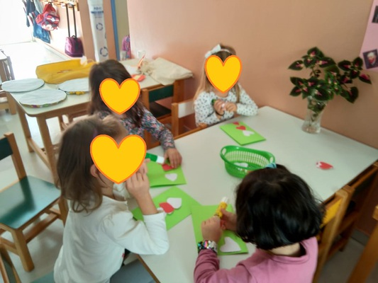
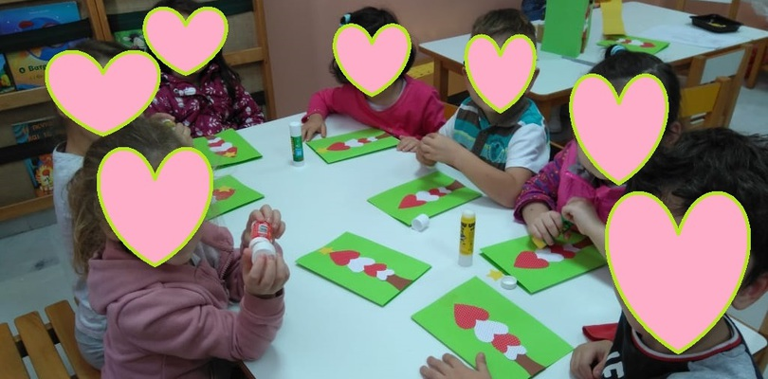
Christmas cards Making Christmas cards

Slide 12
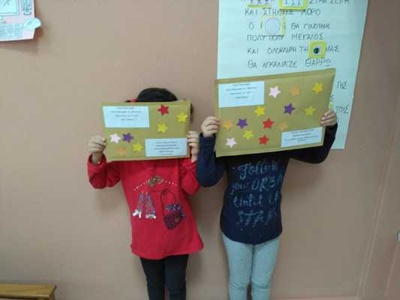
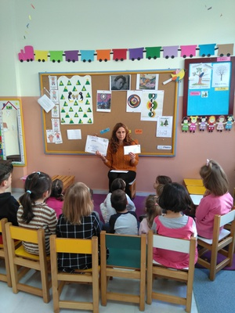
Exchange cards
we send to Světlana Rašková and Cerassela Angel
and we receive from Světlana Rašková,Sara Amâncio and Cerassela Angel

Slide 13
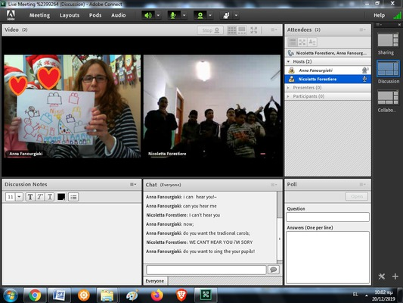
"Online communication"

Slide 14
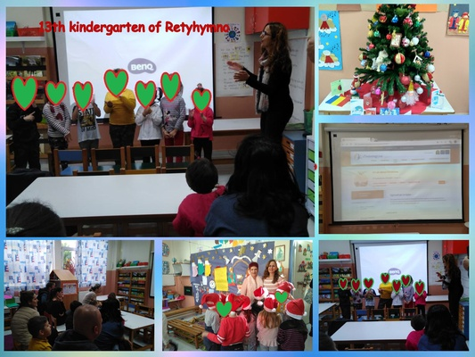
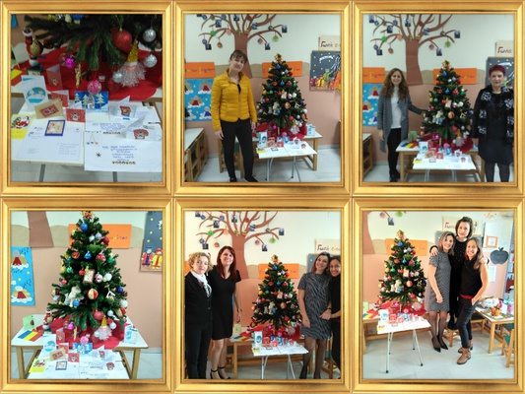
Dissemination of our project
We decorated the cards we received in the corner of etwinnning under our Christmas tree.Thank you my dear friends !
we inform our parents about the project

Slide 15
evaluation from teachers and children
First evaluation from teachers

