Slide 1
This project has been funded with support from the European Commission. This publication [communication] reflects the views only of the author, and the Commission cannot be held responsible for any use which may be made of the information contained therein.

Slide 2
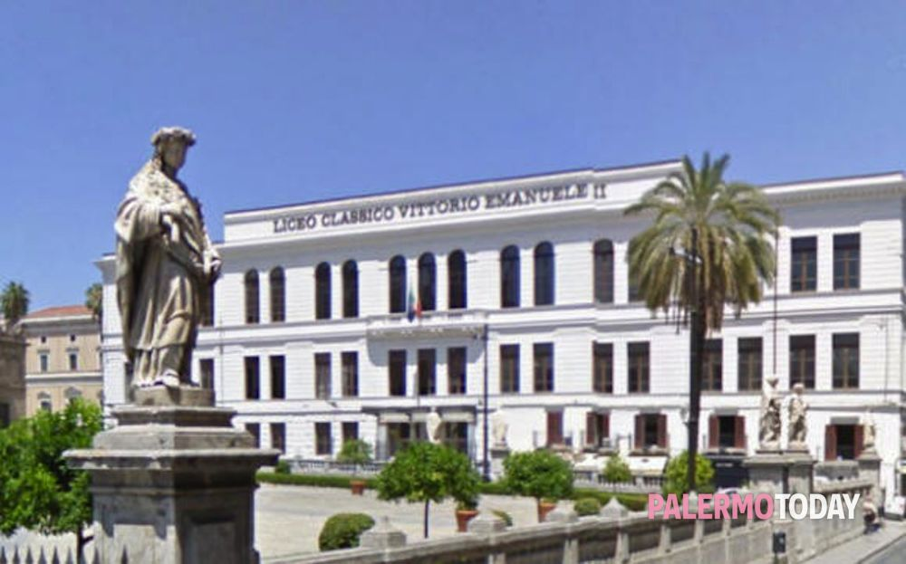
Liceo classico Vittorio Emanuele II, Palermo
Progetto ERASMUS PLUS 2018-2020
WE ARE WHAT WE EAT
Made by:
Pieralice 4A, Davide 4B, Federico 4F, Adriana 4D

Slide 3
The Sicani, Elimi and the Siculi were the first powers to influence Sicilian soil, followed by the Phoenicians, the Carthaginians and the Greeks. Sicily was colonized by the Greeks in the 8th century BC with the most important colony established at Syracuse.
Subsequent centuries saw the arrival of the Hohenstaufen, the Angevin French and latterly, the Aragonese, who initiated five centuries of Spanish domination of Sicily from 1282. The Bourbon influence in Sicily began in 1734, included the merging of the Kingdoms of Naples and Sicily in 1816, and lasted until 1860 when Garibaldi embarked upon his unification of Italy
There then followed six centuries of Roman rule in which Sicily was utilized primarily for its grain fields, but this domination came to a crashing end after the barbarian invasion which resulted in Byzantine, and later Arabic, rule.
The Normans took possession of Sicily in 1071 resulting in a period in which the Kingdom of Sicily was both wealthy and politically powerful. A continued acceptance of Arab administration and Arab and Byzantine craftsmen left behind a phenomenal legacy of art and architecture

Slide 4
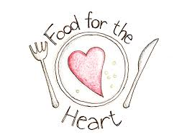
Traditional cuisine is an expression of cultural identity and it reflects our country’s history.
We grow up eating the food of our cultures. Many of us associate food with feelings and memories, for this reason there is more of a connection between food and culture.

Slide 5
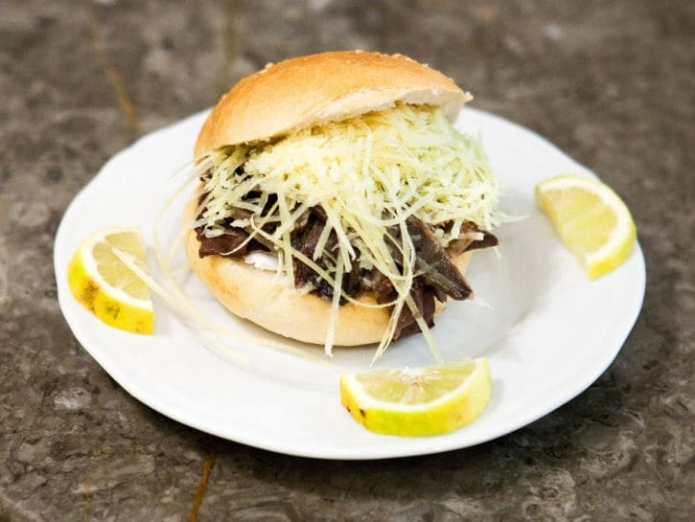
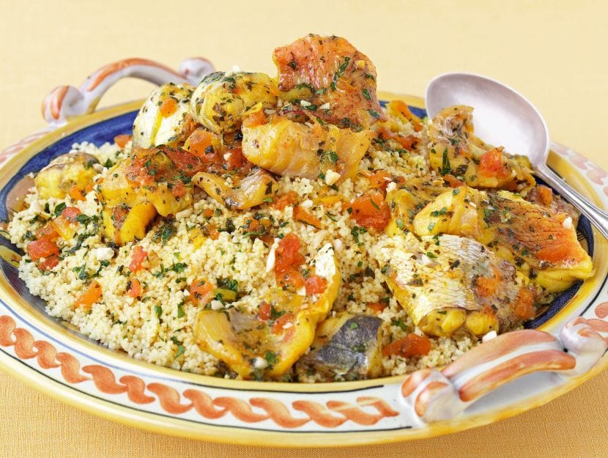
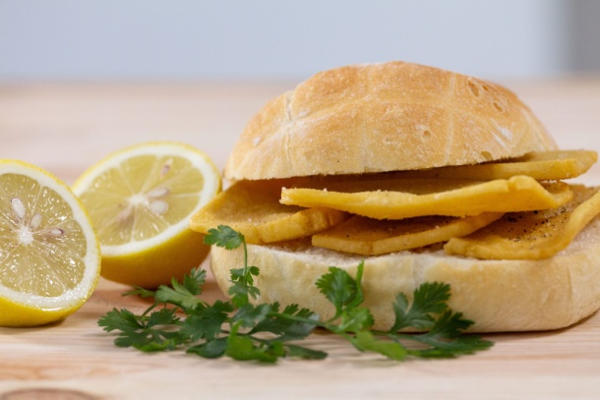
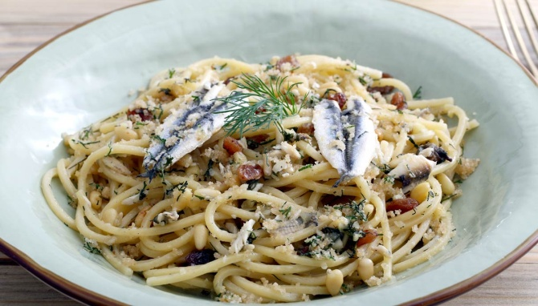
What food tells about Sicily
Sicilian cuisine shows traces of all cultures that have existed on the island over the last two millenia.

Slide 6
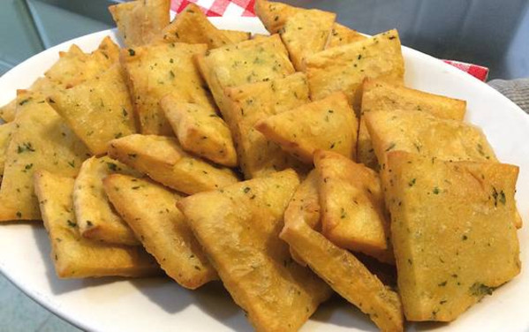
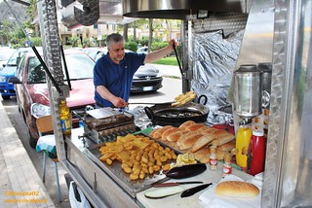
They can be found everywhere, in fixed or itinerant fryers, on busy roads, in popular districts or in the historic center.
panelle
Panelle are a poor but very tasty food. They are one of Palermo's most renowned street foods, and are the fried variant of chickpea porridge.
This sort of small squash testifies the history of the Mediterranean peoples. Already the Arabs mixing chickpea flour with water obtained a sort of dough which, cooked in a pan to obtain a thick and creamy mixture, was crushed and fried in small pieces.
Panellaro

Slide 7
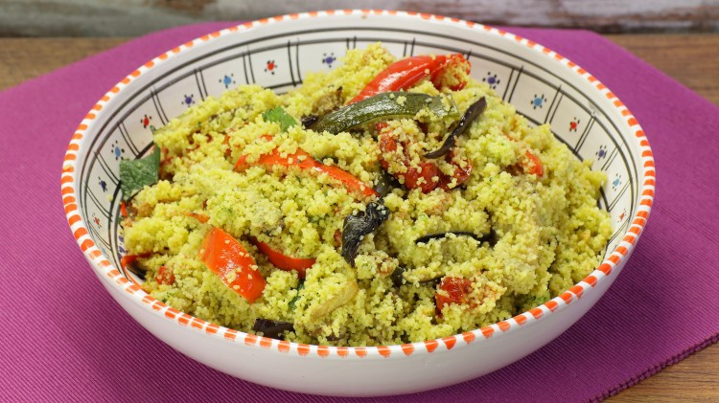
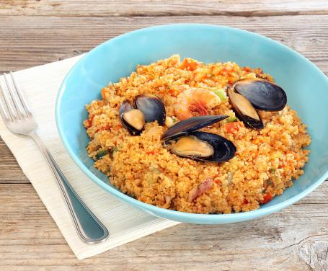
In doing so, the Trapani sailors copied the various stages of preparation of this complex dish and replaced the meats and vegetables used by the Africans with their catch, thus creating this amazing dish called Couscous.
COUSCOUS
The origins of the Trapanese fish couscous date back to the 16th century. When the fishermen moved so much that they started fishing even in North African waters.
At that time, the fishermen of Trapani fed on fish soups made with unsold fish, while the African ones fed on a dish, then unknown to the people of Trapani, which was the mixed vegetable couscous combined with lamb or chicken .

Slide 8
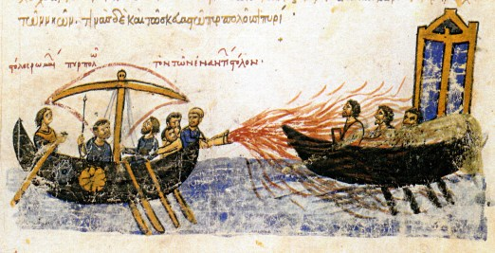
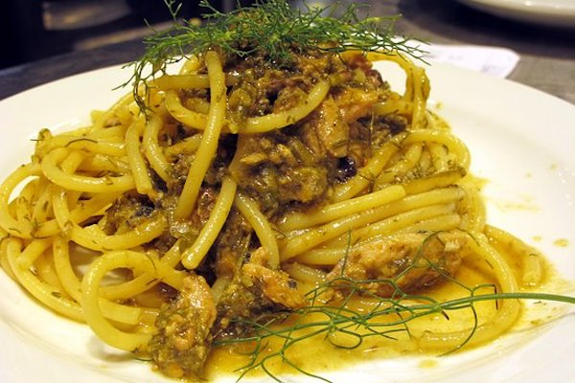
PASTA CON LE SARDE
Historians place this dish in the 9th century AD, during the battles in Sicily by Arab Muslims against the Byzantine empire, focusing in particular on Eufemio da Messina, a brilliant commander of the Byzantine fleet.
Tradition says that a Saracen chef from Eufemio, in the days following the landing, found himself feeding the sailors and troops exhausted by sieges. Having only sardines not very fresh available, he collected wild fennel plants and used them to cover the strong smell of the fish, finally added pine nuts, saffron and raisins; he combined all these ingredients with pasta.

Slide 9
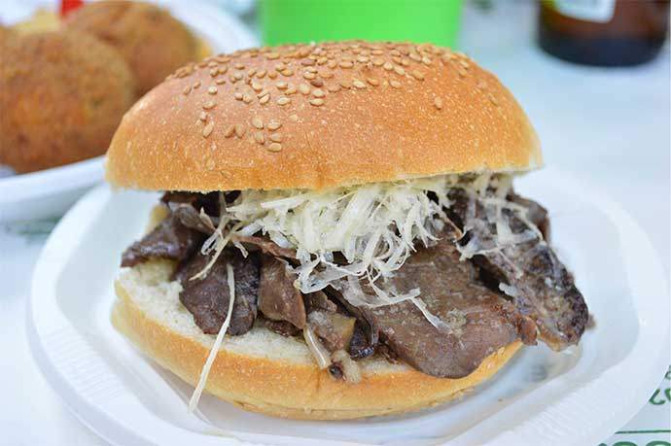
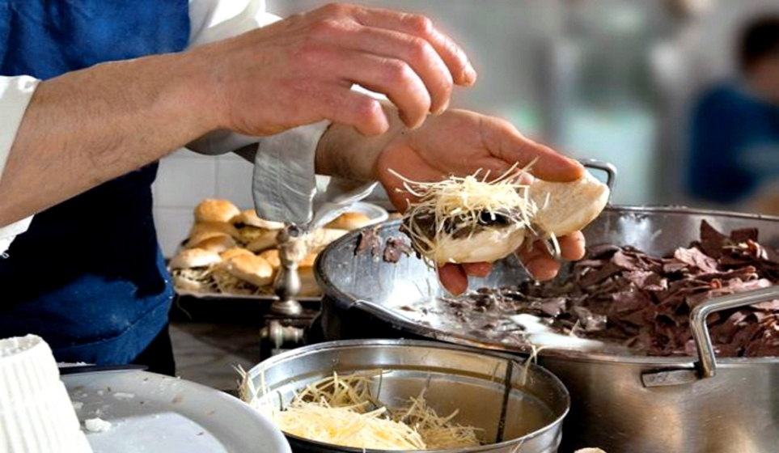
PANINO CON LA MILZA
It is said that the origin of this Palermitan delicacy dates back to when the Jewish butchers sold the entrails of the animals to the Gentiles.
Later, when the Jews were expelled from King Ferdinand II in 1492, the Palermitans developed their particular taste for this delight, which was therefore elaborated with a sandwich covered with sesame seeds, called giuggiulena, by the Arab giulgiulan.

Slide 10
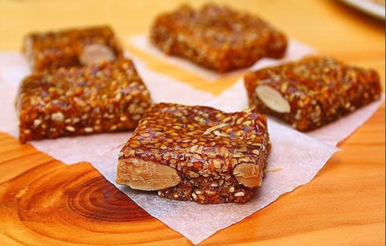
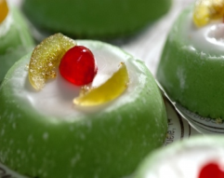
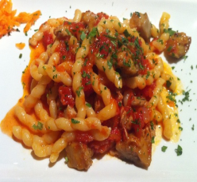
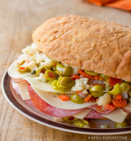
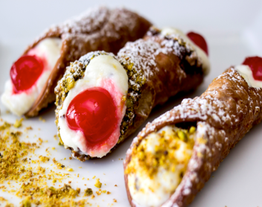
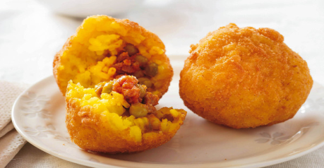
Typical Sicilian Recipes

Slide 11
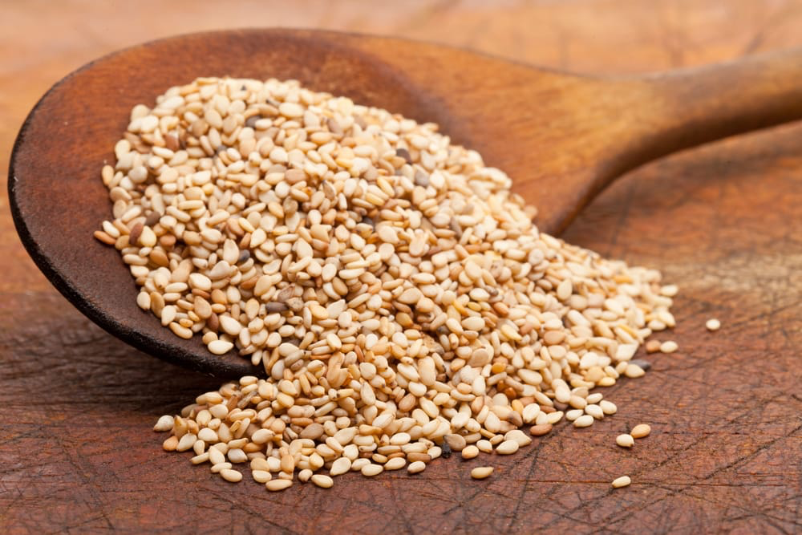
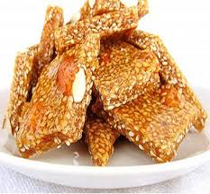
Giuggiulena or sesame’s Cubbaita
Ingredients
500 g sesames’ seed
300 g honey
150 g sugar
130 g toasted almonds

Slide 12
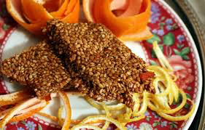
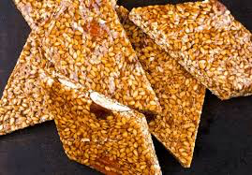
Method
Pour honey in a pan e make melt on a low heat.
Add sugar and mix continuously.
When the blend will reach the boiling temperature, add sesame’s seed and minced almonds.
Cook on a low hit, mixing often, until when sesame’s seed will get ambered and everything is well mixed.
Pour the blend in a marble flat surface oil greased and level in a fast way
The final thicknrss has to be included between 5 and 10 millimeters.
Split with a knife and let it cool

Slide 13
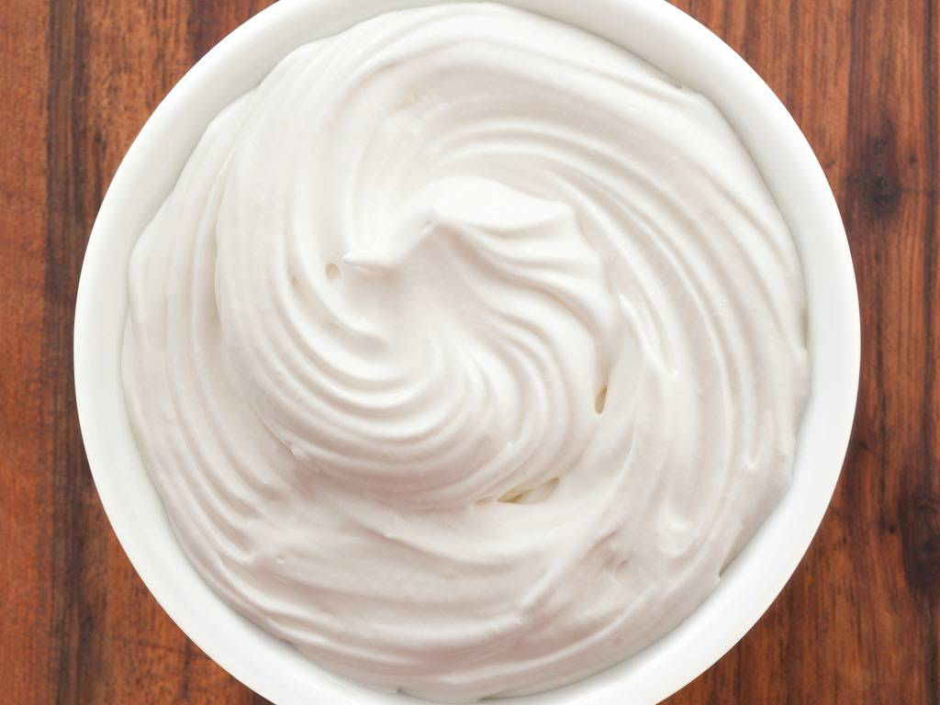
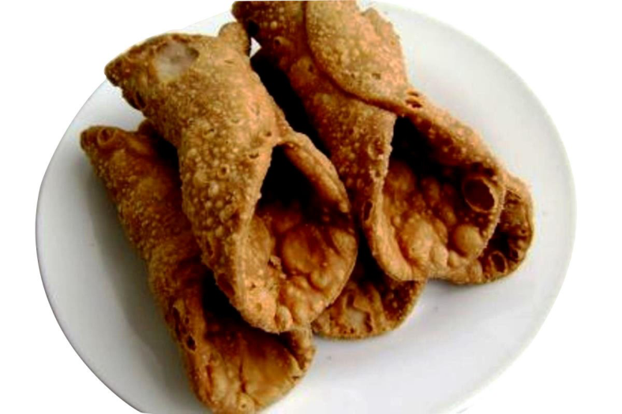
Cannolo
Ingredients
Dough:
2 ½ whole eggs
2 ½ pounds all- purpose flour
2 ounces sugar
2 ounces vegetable shortening
Pinch salt
Pinch ground cinnamon
Marsala wine, as needed
Soyben oil, for deep-frying
Ricotta cream
6° ounces ricotta impastata
20 ounces sugar
Liquid cream, as needed
1 teaspoon vanilla extract
1 to 2 drops cinnamon oil
1 ounce diced candied citron
1 ource chocolate chips

Slide 14
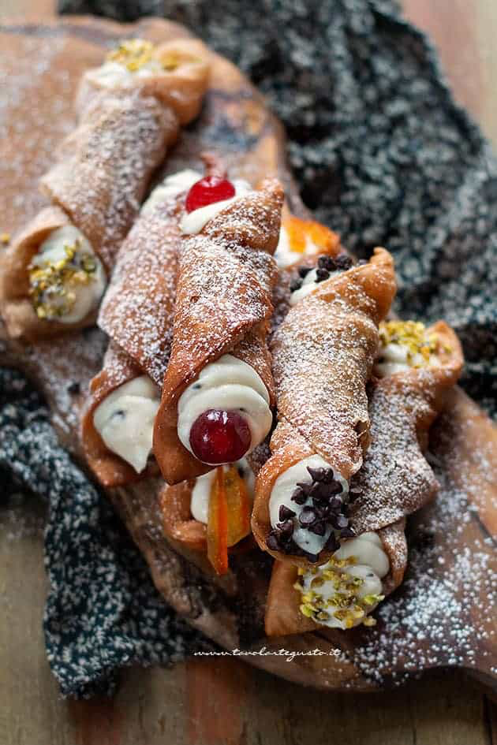
Method:
Mix together all the ingredients except the marsala. Add the marsala, as needed, to form a stiff dough. Run the dough through a dough sheeter. Cut the dough into ovals, roughly 3 by 5 inches. Wrap the dough around a wooden stick. Seal well with egg sealer. Let rest overnight
Preheat the deep fryer filled with soybean oil to 375 degrees F
Fry the shells until golden brown, 10 to 15 minutes, and cool down on paper towel-lined sheet pan. Once cool, remove the metal sticks and store in an air tight container untile ready for use.
For the ricotta cream: Mix the ricotta cheese with sugar. Add the crea mas neeed. Add the vanilla extract, cinnamon oil, citron, and chocolate chips. Refrigerate untile needed
Fill each cannoli with the ricotta cream with a pastry bag or spoon.

Slide 15
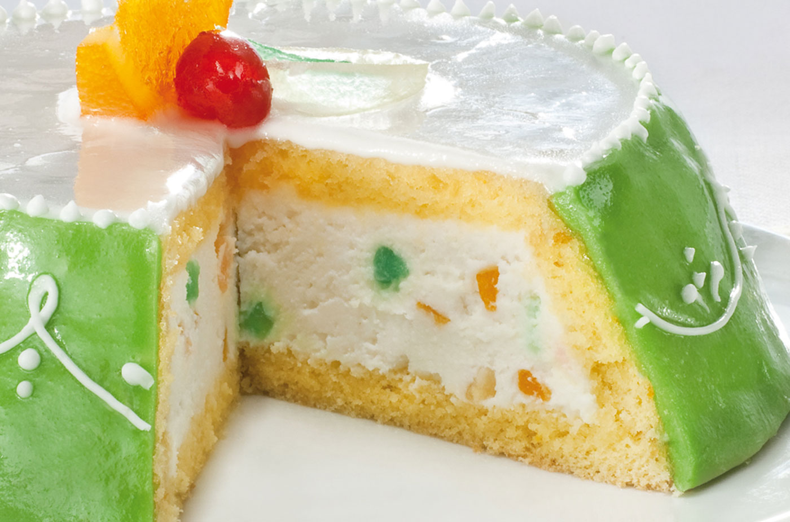
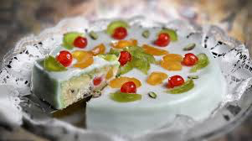
Sicilian Cassata
Ingredients:
½ cup currants
¼ cup Arametto or rum or other liqueur
2 litres premium vanilla ice cream
1 cup finely chopped glacé pineapple
Zest of 1 lemon
1 cup unsalted pistacchio nuts
1 cup fresh or frozen raspberries

Slide 16
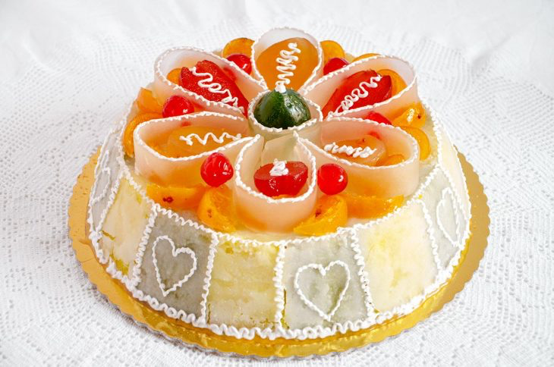
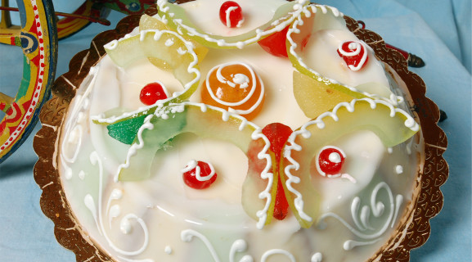
Method:
Mix currants with amaretto or rum. Stand while preparing other ingredients. Scoop ice crea minto a large bowl and microwave for 40-60 seconds or leave to soften on bench for 10 minutes. Work with a heavy spoon to soften on bench for 10 minutes. Work with a heavy spoon to soften just enough for ingredients to be mixed through
Add all other ingredients and work quickly to combine evenly. Return mixture to freezer container or individual moulds, cover and freeze for at least 4 hours.
Serve in slices or scoops. If destre, garnish with diced pistachions and spoon around vanilla syrup or maple syrup.
Cassata will keep in the freezer for up to 2 months.

Slide 17
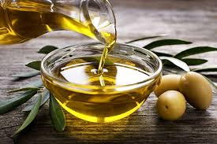
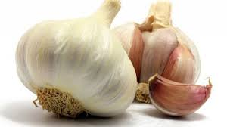
Muffuletta recipe
Ingredients:
Olive Salad
• 5 oil-packed Calabrian chiles or 1 fresh Fresno chile, chopped
• 1 shallot, finely chopped
• 2 garlic cloves, finely chopped
• 1 cup Castelvetrano or green Cerignola olives, pitted, chopped
• ¾ cup Picholine or Spanish olives, pitted, chopped
• ½ cup chopped drained piquillo peppers or roasted red peppers from a jar
• ⅓ cup olive oil
• 3 tablespoons chopped drained capers
• 3 tablespoons red wine vinegar
• 1 tablespoon chopped oregano
• Kosher salt, freshly ground pepper

Slide 18
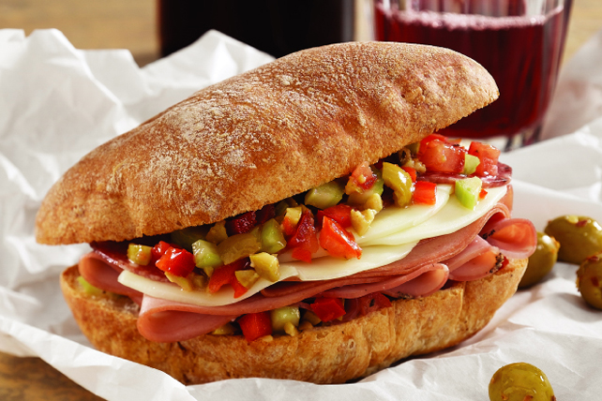
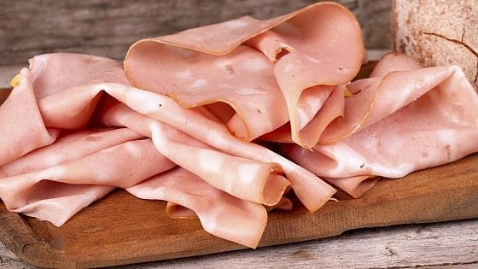
Assembly:
Split bread in half along the equator line.
Divide olive salad, including any liquid, between halves.
Lay salami on bottom half of bread, followed by capocollo, provolone, mozzarella, mortadella, and prosciutto.
Close sandwich and wrap tightly in plastic.
Place between 2 baking sheets and weigh down with a heavy pot or two

Slide 19
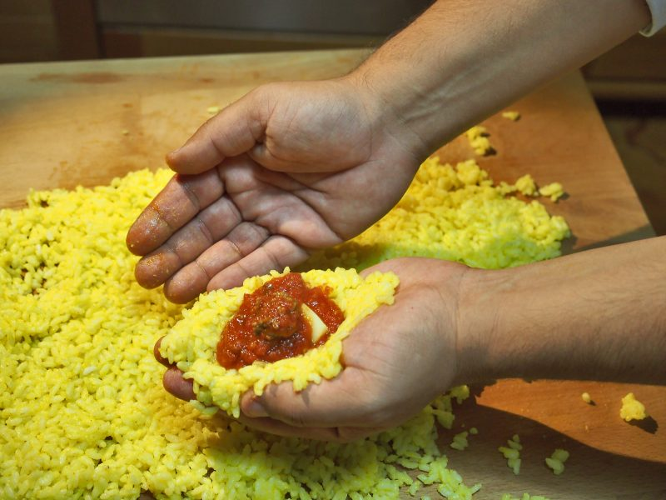
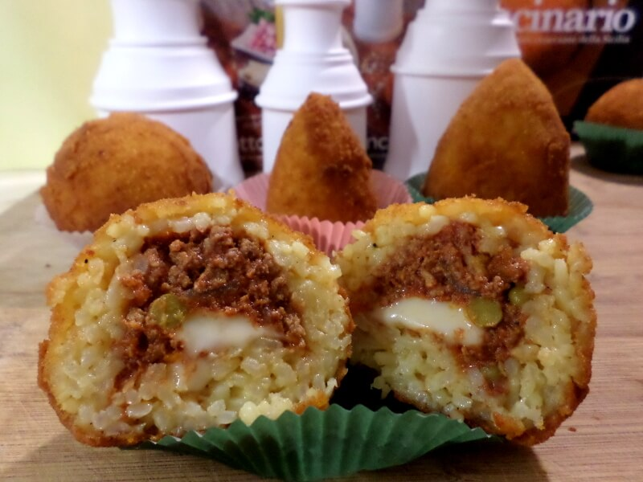
ARANCINA
INGREDIENTS:
1,300 kg super thin arborio rice (today you can find the rice suitable for arancine and vegetable or meat pies) . With these doses you will get about twenty meat rice balls
Approx. three liters of meat broth or vegetable broth
1 onion
100 g of butter
2 sachets of saffron (even better saffron strands)
250 g grated Parmesan cheese
200 g diced primosale cheese
Corn oil for frying
abundant breadcrumbs
FOR THE MEAT SAUCE :
400 g of minced beef meat
1 onion
100 g tomato paste
50 g grated Parmesan cheese
2 bay leaves
2 cloves
200 g fresh peas net of skins ( frozen peas are fine too )
Extra virgin olive oil
½ glass of white wine
Salt and pepper to taste

Slide 20
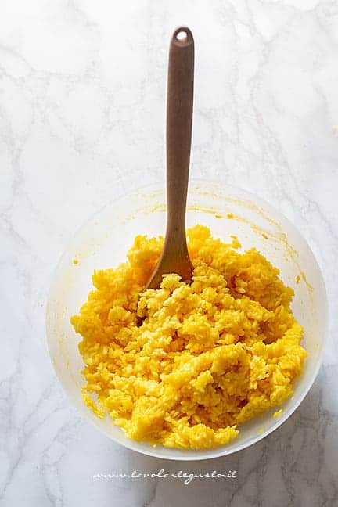
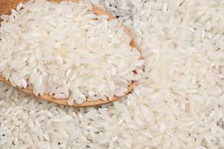
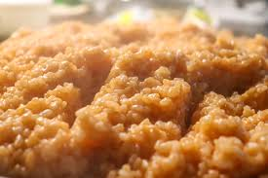
DIRECTIONS FOR THE RISOTTO
Prepare the risotto about twelve hours before making meat rice balls (it must be cold, because in order to obtain excellent meat rice balls the dough has to be quite hard and sticky) .
Prepare the broth in which we will melt the saffron .
Sauté the finely chopped onion in a large saucepan (it must not get brown)
add the rice and toast it
constantly stirring
add the hot broth little by little and cook the rice.
Get off the fire and add the grated Parmesan cheese and the butter .
Cook until creamy for a few minutes, then pour it into a large plate and let it cool .

Slide 21
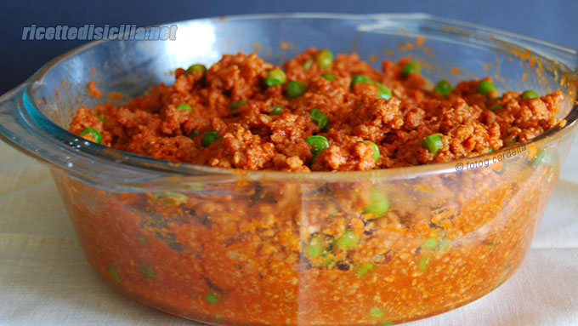
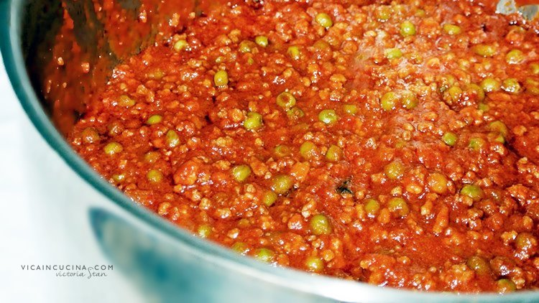
LET’S PREPARE THE MEAT SAUCE :
Gently fry the onion with olive oil in a pan .
Add the minced meat and sauté over high heat , being careful to separate it well with a wooden spoon, then simmer with white wine until reduced.
Add salt , pepper , bay leaves , cloves and the tomato paste melted in a little water ( the meat sauce , must be thick in the end , almost dry) and , when cooked , the Parmesan cheese .
Cook the peas ( if you use the frozen ones you defrost them in salted hot water with 1 bay leaf and a pinch of sugar) , drain them
add them to the cold meat sauce .

Slide 22
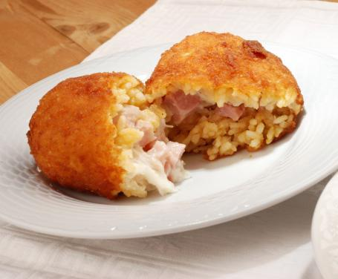
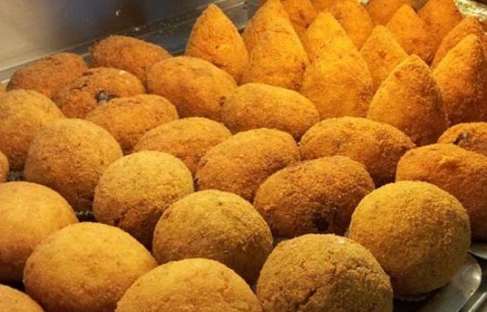
LET’S MAKE THE MEAT RICE BALLS:
Take a spoonful of rice and put it on the palm of the hand so as to form a hollow where we will put a spoonful of meat sauce and in the center , a cube of primosale cheese.
Take another spoonful of rice and cover the meat sauce very well, being careful not to pop it out.
Shape the meat balls squeezing this compound with your hands in order to consolidate it.
Roll them into the breadcrumbs always compacting the meat ball and set aside . Proceed until you run out of the ingredients .
Fry the meat balls in abundant hot oil until they are golden brown ( the best results are obtained with a deep fryer) .

Slide 23
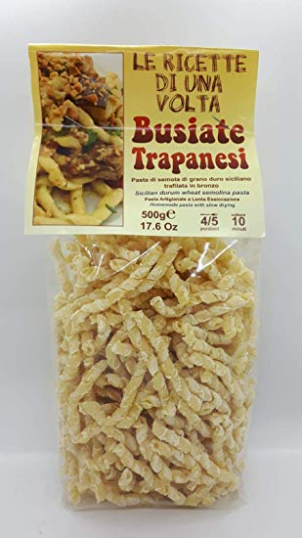
Busiate
Ingredients
• 12 oz busiate pasta (340g)
• ½ lb tomatoes (250 g)
• 2 cups fresh basil leaves (40-50 g)
• ⅓ cup blanched almonds (60 g)
• 2 tbsp Pecorino cheese , grated
• 3 tbsp Extra virgin olive oil
• ½ - 1 garlic clove , core removed
• Salt to taste
• Ricotta Salata OR

Slide 24
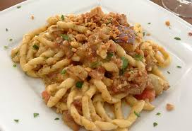
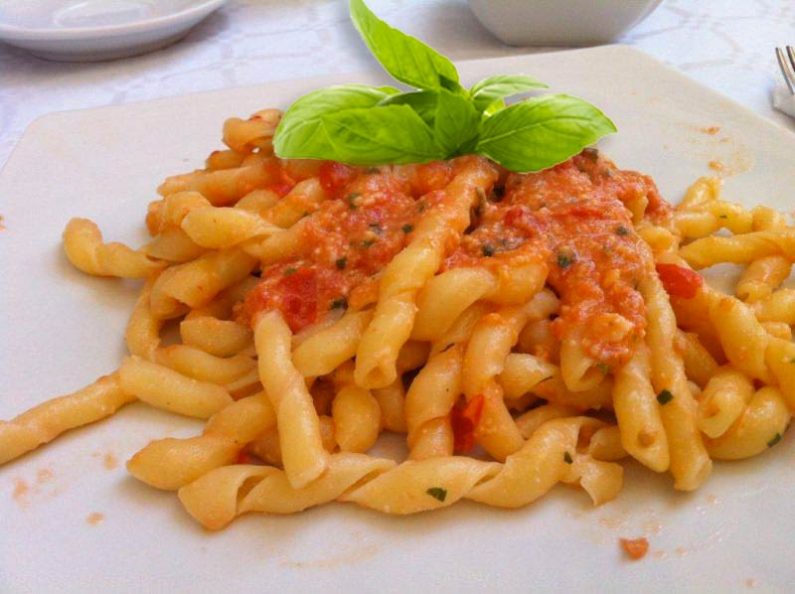
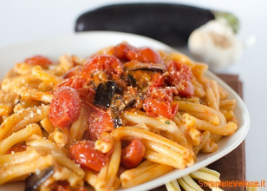
Instructions
Make Pesto Alla Trapanese
Blanch Tomatoes: Put a large pot of water to boil (you’ll use it for boiling pasta afterwords).
Cut an x into the top of each tomato.
Once water is boiling immerse tomatoes for 60 seconds.
Transfer tomatoes into a bowl with cold water.
Peel of tomato skin.
Remove extra water and seeds.
Place all ingredients except Pecorino cheese and extra virgin olive oil in a food processor or a countertop blender.
Pulse a couple of times until you get even, slightly crumbly texture.
Add Pecorino cheese and extra virgin olive oil.
In the meantime cook busiate in salted hot boiling water until ‘al dente’ (according to instructions on the package).
Once pasta is ready reserve some cooking liquid and drain the rest.
Return pasta to the pot, add pesto, toss everything for a mere minutes until all the flavors combine. If pasta seems too dry add some cooking liquid you’ve previously set aside.
Serve immediately!
Top with ricotta salata (salted ricotta cheese) or pecorino cheese or toasted breadcrumbs or simply plain as it is.

Slide 25
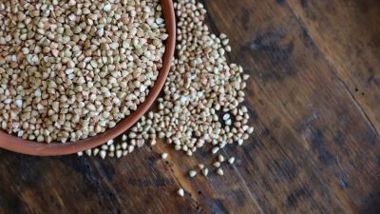
The Mediterranean Diet

Slide 27
WHAT IS IT?
The Mediterranean diet is a set of skills, knowledge, practices and traditions characterized by a nutritional model remained constant over time and space, consisting mainly of olive oil, cereals, fruit and vegetables, a moderate amount of fish, dairy and meat, and many condiments and spices, all accompanied by wine or infusions. However, the Mediterranean diet (from the Greek: diaita, or way of life) is much more than just food. It promotes social interaction, since the common meal is the basis of social customs and festivities shared by a given community, and has given rise to a considerable body of knowledge, songs, maxims, tales and legends.

Slide 28
The Diet is grounded in respect of the territory and biodiversity, and ensures the conservation and development of traditional activities and crafts linked to fishing and farming in the Mediterranean communities in Italy, Spain, Greece or Morocco. Women play a vital role in the transmission of expertise, as well as knowledge of rituals, traditional gestures and celebrations, and the safeguarding of techniques. We will focus on three main ingredients in the Mediterrean diet, each one being a key part, in their own unique way, of this way of life: olive oil, wine and lemon. These dishes at first were consumed because of their nutritional value but became with time a way to mark the unique flavor that this region put on his food.

Slide 29
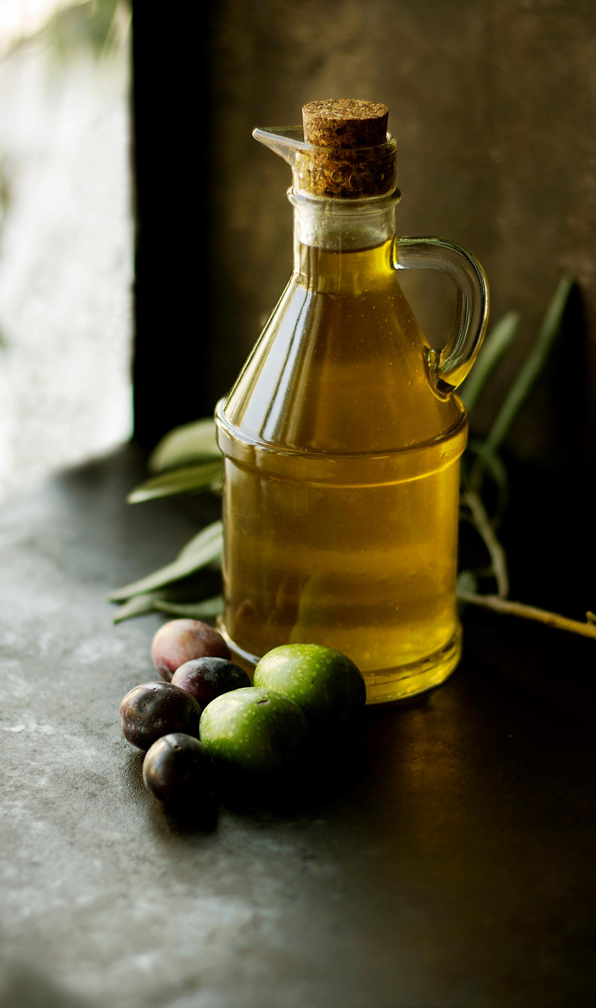
OLIVE OIL
Olive oil is at the core of the Mediterranean Diet. In fact, some food historians deﬁne the Mediterranean Diet as the “traditional eating patterns in areas around the Mediterranean Sea where olives are grown.” Olive Oil is used daily in Mediterranean countries in stews, fried food, salads and even desserts. Extra Virgin Olive Oil from Spain contains vitamin E, important for its antioxidant properties. It is also rich in phenols, the substance that makes it such a significant source of antioxidants. In fact, Mediterranean countries have the longest life expectancy in Europe at around 82.2 years, thanks in large part to the Mediterranean Diet and lifestyle.

Slide 30
LEMON
Originally it was used to kill bacteria, today it’s added for the taste. Apart from the fact that it’s a source of vitamin C, which is also an antioxidant, vitamin C also increases iron absorption when consumed with foods rich in iron such as meat and beans. The interesting thing though is the fact that Ancient Greeks added lemon to their meat probably without really knowing that it increases iron absorption.

Slide 31
WINE
Red wine has certain properties that research has shown are beneficial for heart health. If you drink alcohol in moderation, add a little red wine in place of other alcoholic beverages. The cardio protection red wine provides is attributed to the antioxidants from flavonoids found in the skin of the grapes. The flavonoids reduce your risk of heart disease by lowering bad cholesterol, increasing good cholesterol, and reducing blood clotting. Although red wine can indeed be part of a healthy lifestyle, a fine line determines what amount is considered healthy. The recommended daily intake is one glass for women and one to two glasses for men. Excessive drinking can become very dangerous

Slide 32
HEALTH BENEFITS
Research into the traditional Mediterranean diet has shown it may reduce our risk of developing conditions like type 2 diabetes, high blood pressure and high cholesterol, which are all risk factors for heart disease. Researchers have also found that people who closely follow a Mediterranean diet may live a longer life and be less likely to put on weight. Research puts this down to the monounsaturated fats present in the Mediterranean diet, and the focus on fruits and vegetables. An Italian study has linked the antioxidants and fiber content in the Mediterranean diet with good mental and physical health.

