Slide 1
Cornwall

Slide 2
Gillingvase

Slide 3
Perranporth

Slide 4
Cardinham

Slide 5
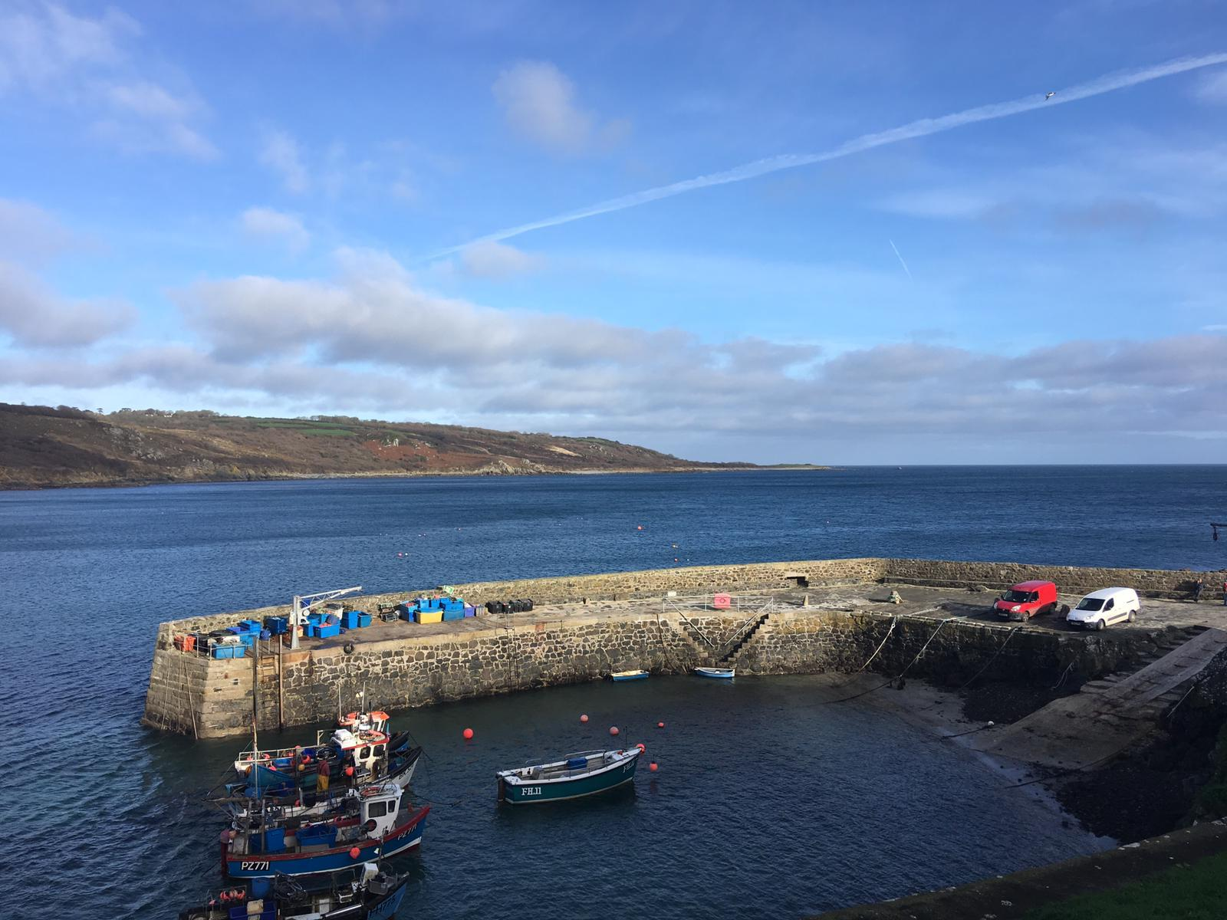
Port Isaac

Slide 6
Perranporth

Slide 7
Trelissick

Slide 8
Porthtowan

Slide 9
Perranporth

Slide 10
River Fal

Slide 11
Perranporth

