Slide 1
Minna Canth
The Finnish feminist writer

Slide 2
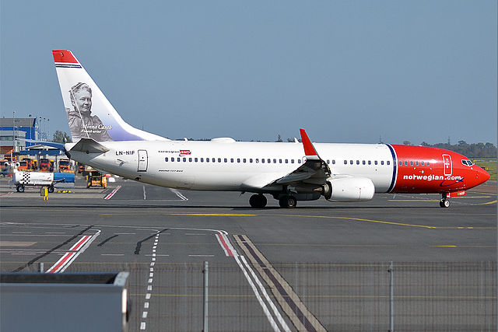
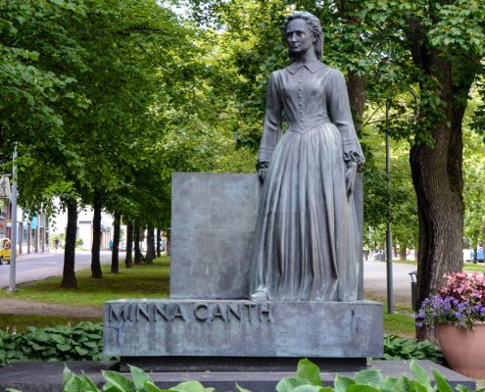

Slide 3
Life and background
Born in 1844, Tampere
She lived in Kuopio
Studied in Jyväskylä
Widowed mother of seven
A practical feminist
Notes:
Born in 1844 in Tampere
She lived in Kuopio for most of her life
Studied in Jyväskylä to be a teacher, she was one of the first women to get to study the field
She was a single mother of 7 kids after her husband died
She's been called a practical feminist, since she has actively participated in various movements on women's issues

Slide 4
Career
Impact on gender equality and education
She spoke for women in her writing and managed to even change laws
For the time, her writings were controversial
Notes:
Canth had a huge impact on developing equality and the education system in Finland
She spoke for women, and for example made such impact with her writings that a law was changed so that women had power over their belongings
She wrote controversial texts that shook the people, and she was once fired for her articles

Slide 5
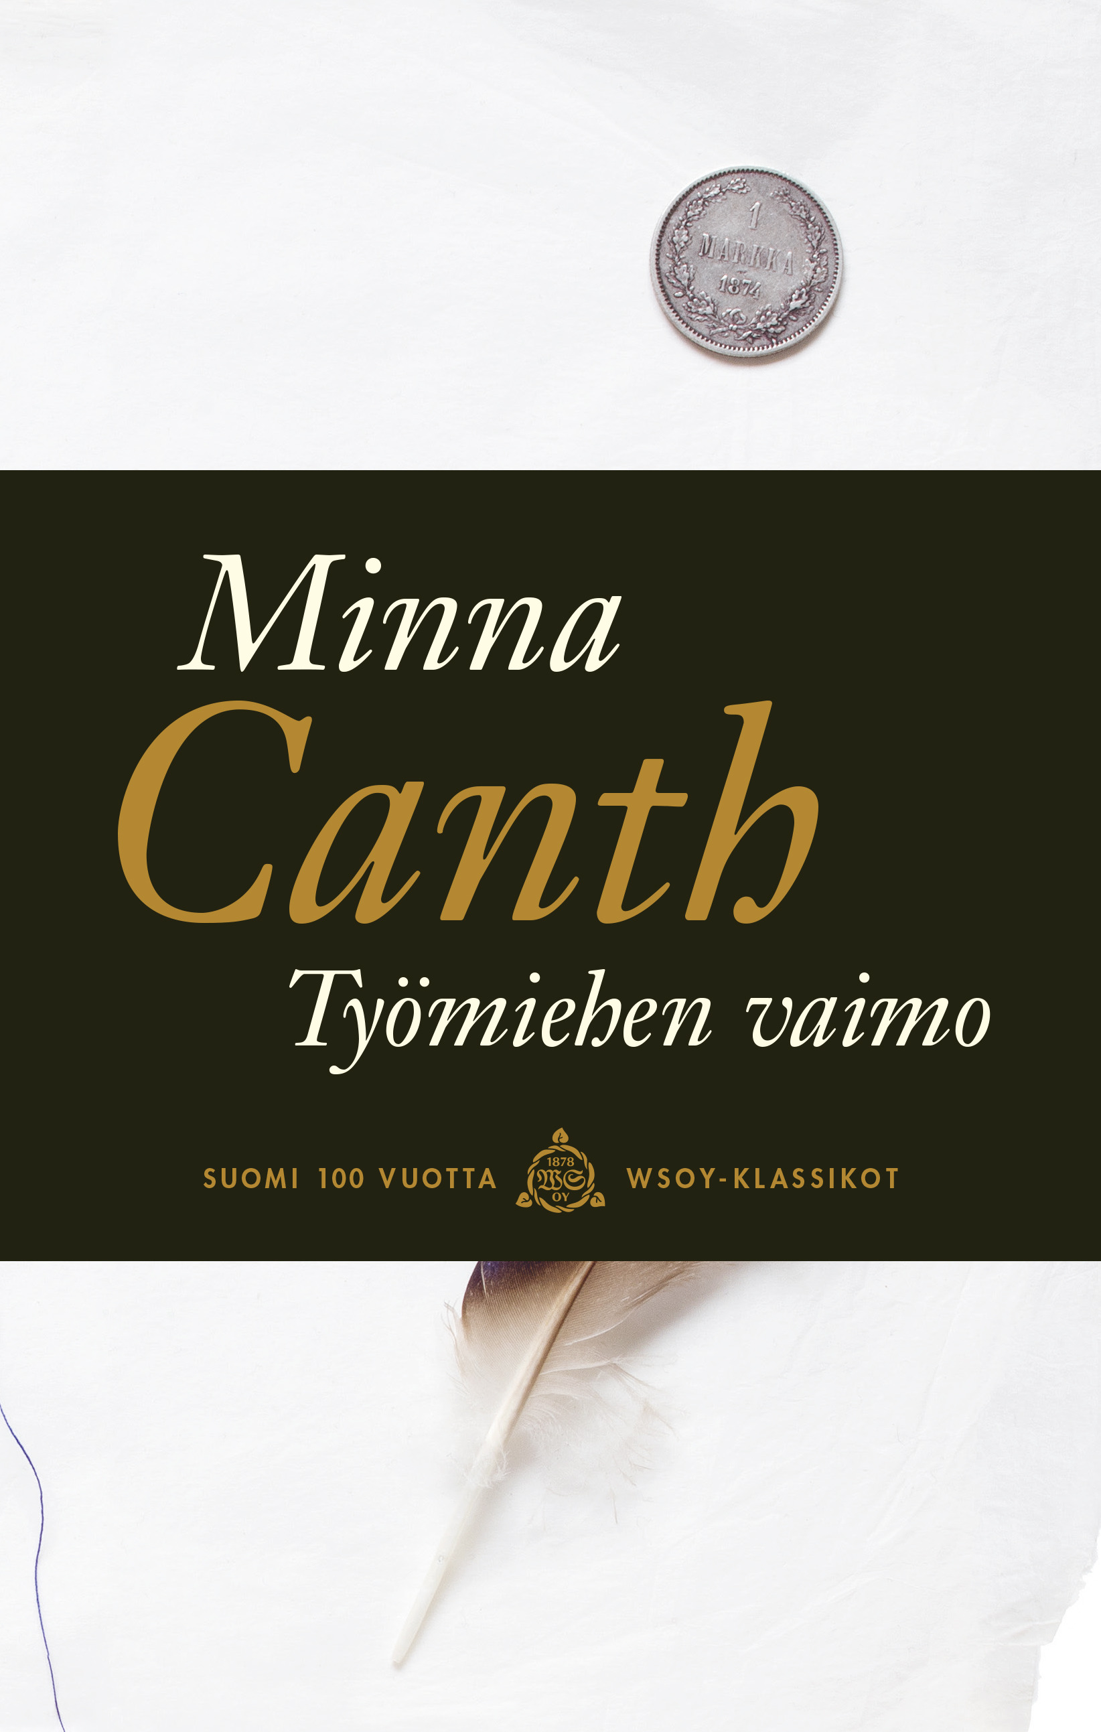
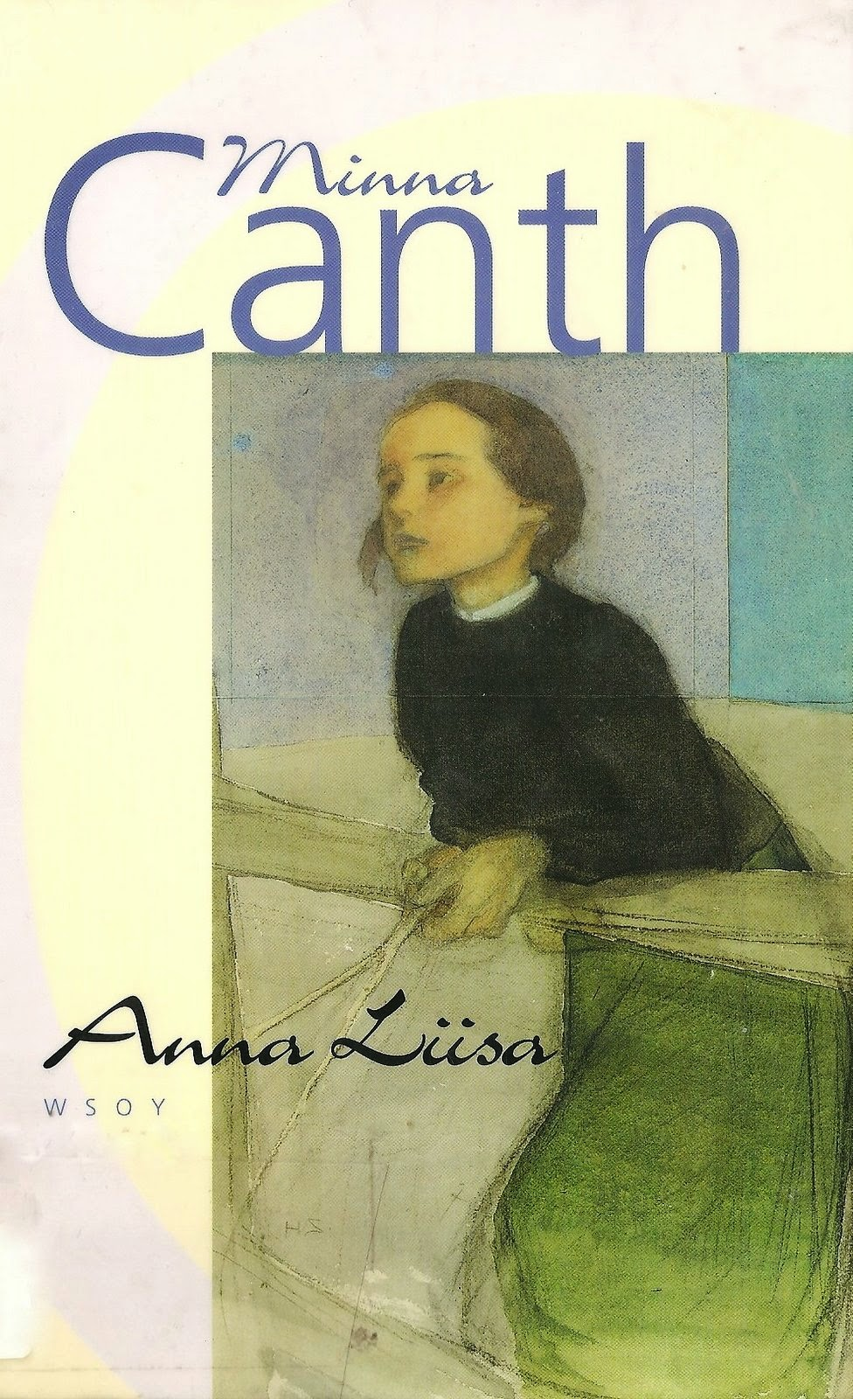
Most famous works
Työmiehen vaimo
(The worker's wife), 1885
- tells a story about a woman who marries an alcoholic man, and he as the head of family spends all their money, leaving her wife and her child to poverty
- was actually influencial: the Finnish law was changed because the story was so raw and touching
Anna Liisa
1895
- a scary play that potrays a woman's role in the society; she murders a child that was concieved before marriage, and she is expected to carry all the guilt, leaving her lover with no consequenses whatsoever just because he is a man
- considered Canth's best work

Slide 6
Best quotes
”Naiskysymys ei ole ainoastaan naiskysymys vaan ihmiskunnan kysymys.”
= "The 'question concerning women' concerns not only women but the whole humanity."
”Nuoruus on ilon ja runouden aikaa. Runous tuottaa iloa, ilo runoutta. Ja ilo on välttämätön, terveellinen sekä sielulle että ruumiille.”
= "Youth is the time for joy and poetry. Poetry brings joy, joy brings poetry. And joy is both necessary and healthy to not only to the soul, but the body as well."
”Siihen päätökseen olen tullut, että kaikki juominen, yksin vedenkin, on vahingollista. Poikkeuksen tekee vain kahvi.”
= "I've come to the conclusion that all drinking, even water alone is harmful.
The only exception is coffee."
"Eläkööt kaikki intelligentit miehet! Tyhmät saavat kernaasti kuolla"
="Long live all those (men) with intelligence! The stupid ones can die for all I care."

Slide 7
Sources and materials
http://www.minnansalonki.fi/exhibits/show/kirjailija-canth/minnacanth 21.4.2019
http://kanttila.fi/portfolio-items/minnacanth/?portfolioCats=41%2C30%2C37%2C31%2C38 21.4.2019
http://www.helsinki.fi/sukupuolentutkimus/klassikkogalleria/canth/index.htm 21.4.2019
Minna_Canth.jpg free to use, 21.4.2019
https://images.app.goo.gl/V8G9LLejjYLBdHGFA free to use, 21.4.2019

