Slide 1
Cornish Folk Tales and Stories
By Harry, Alicia, Thomas, Tilly, Maddi and Lucy

Slide 2
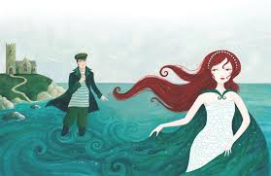
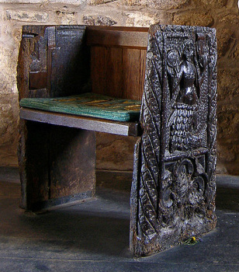

Slide 3
Mermaid of zennor
The Mermaid of Zennor is a popular Cornish folk tale that was first recorded by the Cornish folklorist William Bottrell in 1873.This story started when a very finely dressed and beautiful lady began to attend the church services. Her presence at the church, although welcome, was a mystery to the locals who had no idea who she was or where she came from. However, it was noted she had a lovely voice and was a woman of rare beauty and as such, she became the subject of much local speculation One day he followed her home, and disappeared; neither was ever seen again in Zennor Church.
The villagers wondered what had become of the two, until one Sunday a ship cast anchor about a mile from pendour cove. Soon after, a mermaid appeared, and asked that the anchor be raised, as one of its flukes was resting on her door, and she was unable to reach her children. The sailors obliged, and quickly set sail, believing the mermaid to be an ill omen But when the villagers heard of this, they concluded that the mermaid was the same lady who had long visited their church, and that she had enticed Mathey Trewella to come and live with her.The parishioners at St. Senara's commemorated the story by having one end of a bench carved in the shape of a mermaid. A shorter account of the legend was related to Bottrell on a subsequent visit to Cornwall. The mermaid had come to church every Sunday to hear the choir sing, and her own voice was so sweet that she enticed Mathey Trewella, son of the churchwarden, to come away with her; neither was seen again on dry land. The famed "mermaid chair" was the same bench on which the mermaid had sat and sung, opposite Trewella in the singing loft.

Slide 4
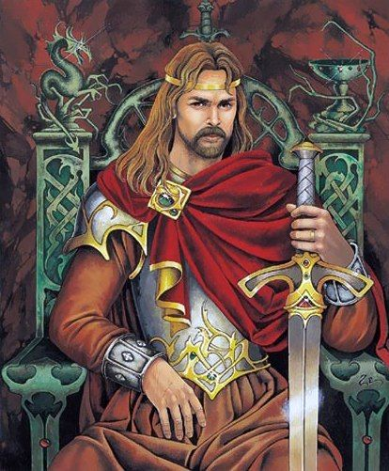
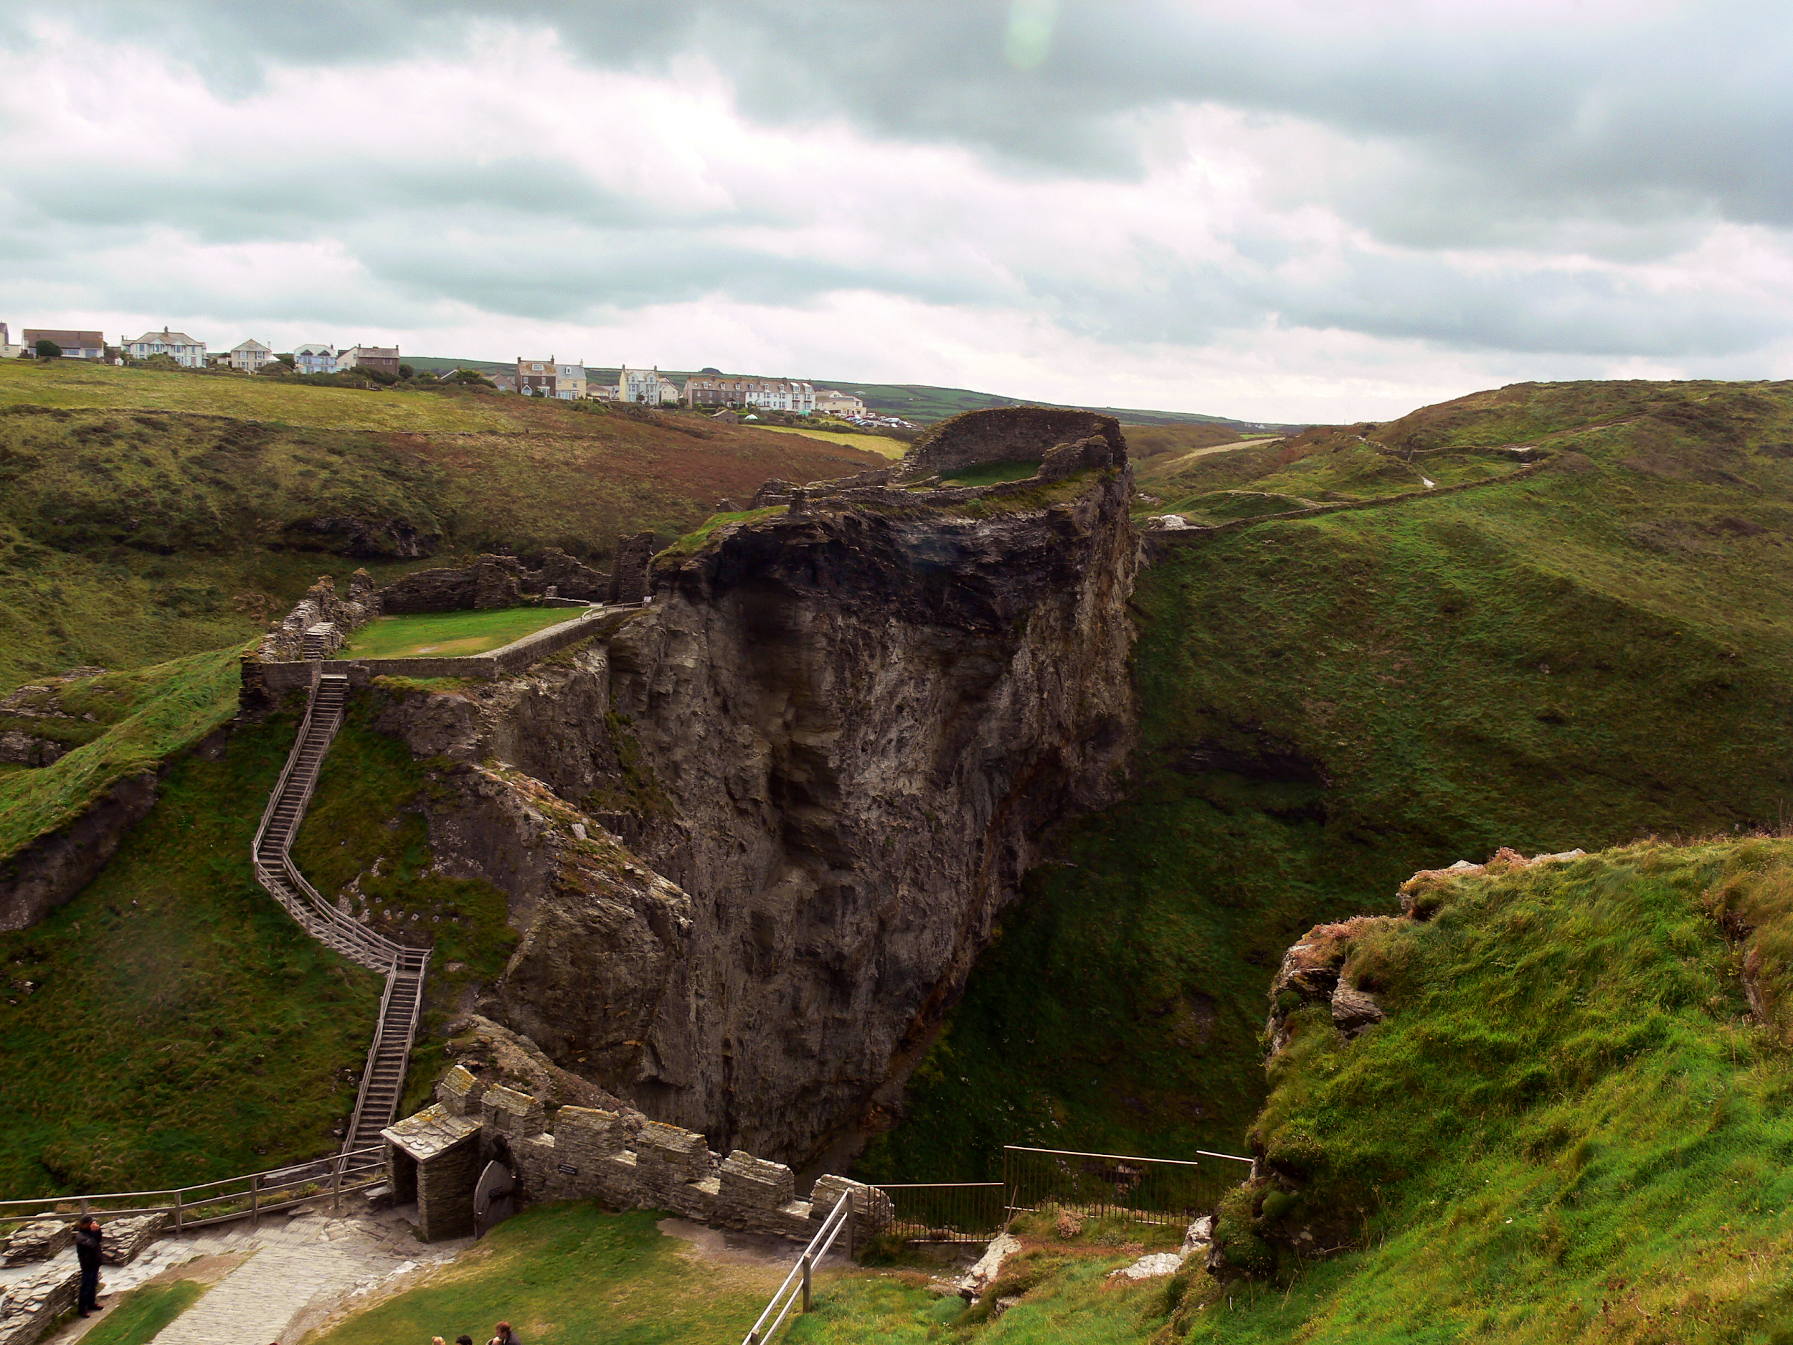

Slide 5
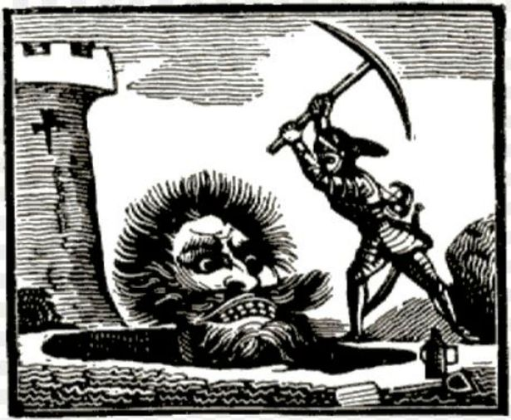

Slide 6
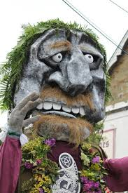
The legend of St Agnes and Bolster the Giant
Bolster was a legendary giant who was said to live near the cliffs, allegedly able to stand with one foot on the Beacon and the other on Carn Brea. He terrorised the land, rumoured to eat children, sheep, cattle and people at random.
Legend says a knight, Sir Constantine, and other local dignitaries challenged Bolster to a fight to the death at Chapel porth, and that the giant overcame all who challenged him. The legend continues to say that he fell in love with a beautiful young girl called Agnes who steals his heart, and she was the one to finally vanquish the giant. She asks him to fill a nearby hole in the clifftop with his blood to prove his love for her, knowing that there is a crack in the hole which runs out to the sea. Bolster cuts himself to fill the hole and dies due to blood loss. Now a hero, her name was given to the area we know today as St.Agnes, and a Bolster festival is held every year on the Sunday before the early Spring Bank Holiday in May.

Slide 7
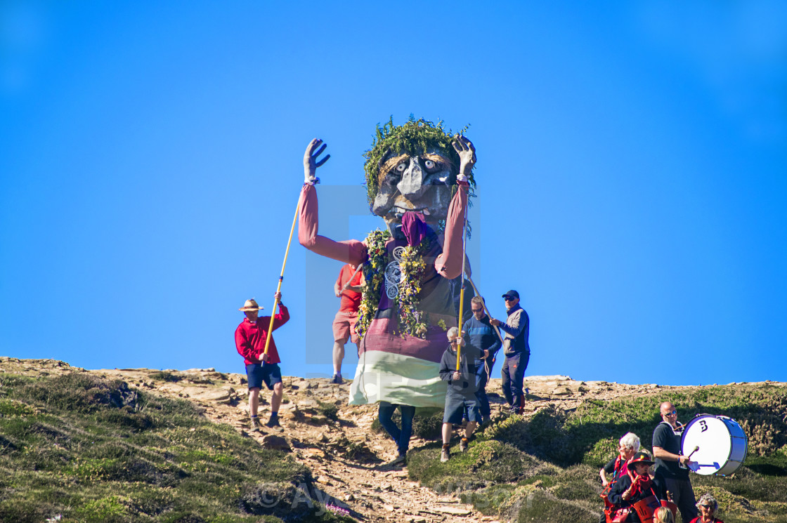

Slide 8
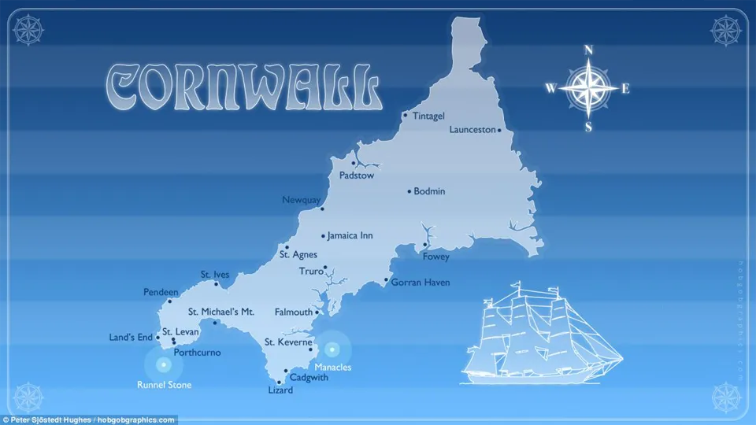
Cornwall and its cultural heritage?
How?
Why?
What?
Where?

Slide 9
