Slide 1
Erasmus+

Slide 2
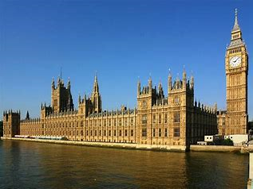
Houses of parliament
The Palace of Westminster is the meeting place of the House of Commons and the House of Lords, the two houses of the Parliament of the United Kingdom. Commonly known as the Houses of Parliament after its occupants, the Palace lies on the north bank of the River Thames in the City of Westminster, in central London, England.
These are symbolic for democracy in our society as all the decisions that make this country what it is are done here. Democracy plays a big role in our country as it demonstrates that you need to have your own voice and the freedom to express it.

Slide 3
Eden Project
The Eden Project is a popular visitor attraction in Cornwall, England, UK. Inside the two biomes are plants that are collected from many diverse climates and environments.
The Eden project brings world culture and nature to the heart of Cornwall. This has effected us as many primary schools bring their students here. In doing so this has allowed us to develop our knowledge of nature and its history from around the world. It is also located in a china clay pit which has a great deal to do with mining heritage in Cornwall.

Slide 4
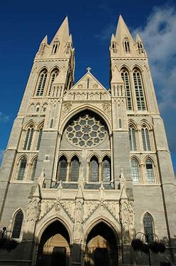
Truro Cathedral
The Cathedral of the Blessed Virgin Mary, Truro is a Church of England cathedral in the city of Truro, Cornwall. It was built between 1880 and 1910 to a Gothic Revival design by John Loughborough Pearson on the site of the parish church of St Mary. It is one of only three cathedrals in the United Kingdom with three spires.
This is the only reason why Truro is a city not a town and why it is also the capital of Cornwall. This gives us pride for where some of us live. Due to it being a place of worship it has affected how we were brought up as most of the schools teach Christianity, along with other faiths.

Slide 5
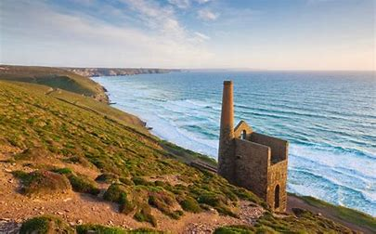
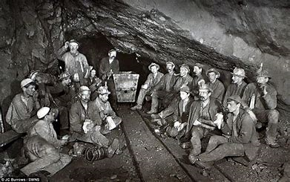
Cornish Mines
Cornwall and Devon provided most of the United Kingdom's tin, copper, and arsenic until the 20th century. Originally tin was found as alluvial deposits of cassiterite in the gravels of stream beds. Eventually tin was mined underground; underground mines sprang up as early as the 16th century. Tin lodes were also found in outcroppings of cliffs.
Mining in Cornwall and Devon, in the southwest of England, began in the early Bronze Age, around 2150 BC, and ended with the closure of South Crofty tin mine in Cornwall in 1998. Tin, and later copper, were the most commonly extracted metals. Some tin mining continued long after the mining of other metals had become unprofitable. Historically, tin and copper as well as a few other metals have been mined in Cornwall and Devon. As of 2007 there are no active metalliferous mines remaining.

Slide 6
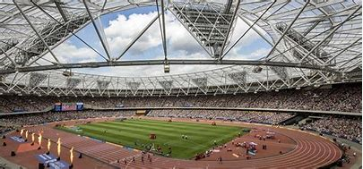
Olympic Stadium
London Stadium in Stratford, London, England, was the home of the 2012 Summer Olympics and Paralympics, hosting the track and field events and opening and closing ceremonies. It was subsequently renovated as a multi-purpose stadium, with its primary tenants being West Ham United Football Club and UK Athletics. The stadium is in the Lower Lea Valley, 6 miles east of central London.
When the Olympics were occurring it gave us excitement and made us come together as a country to compete as one.

Slide 7
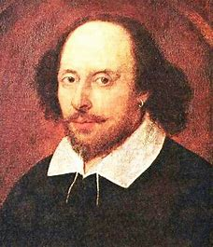
Shakespeare
William Shakespeare was an English poet, playwright and actor, widely regarded as both the greatest writer in the English language and the world's pre-eminent dramatist. He is often called England's national poet and the "Bard of Avon". His extant works, including collaborations, consist of approximately 39 plays, 154 sonnets, two long narrative poems, and a few other verses, some of uncertain authorship. His plays have been translated into every major living language and are performed more often than those of any other playwright.
Shakespeare is always taught in secondary school and at least one of huis works is used in our GSCEs. This has made us appreciate his wok. Additionally, he made up several words that are now widely used in our language.

Slide 8
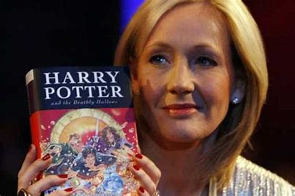
JK Rowling
Joanne Rowling, CH, OBE, FRSL, FRCPE, writing under the pen names J. K. Rowling and Robert Galbraith, is a British novelist, philanthropist, film producer, television producer and screenwriter, best known for writing the Harry Potter fantasy series. The books have won multiple awards, and sold more than 500 million copies, becoming the best-selling book series in history. They have also been the basis for a film series, over which Rowling had overall approval on the scripts and was a producer.
This has affected us , as it has made some of us , particularly Ayana, into avid readers and love books.

Slide 9
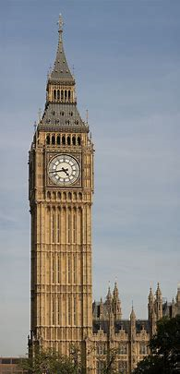
Big Ben
Big Ben is the nickname for the Great Bell of the clock at the north end of the Palace of Westminster in London and is usually extended to refer to both the clock and the clock tower. The official name of the tower in which Big Ben is located was originally the Clock Tower, but it was renamed Elizabeth Tower in 2012 to mark the Diamond Jubilee of Elizabeth II.

Slide 10
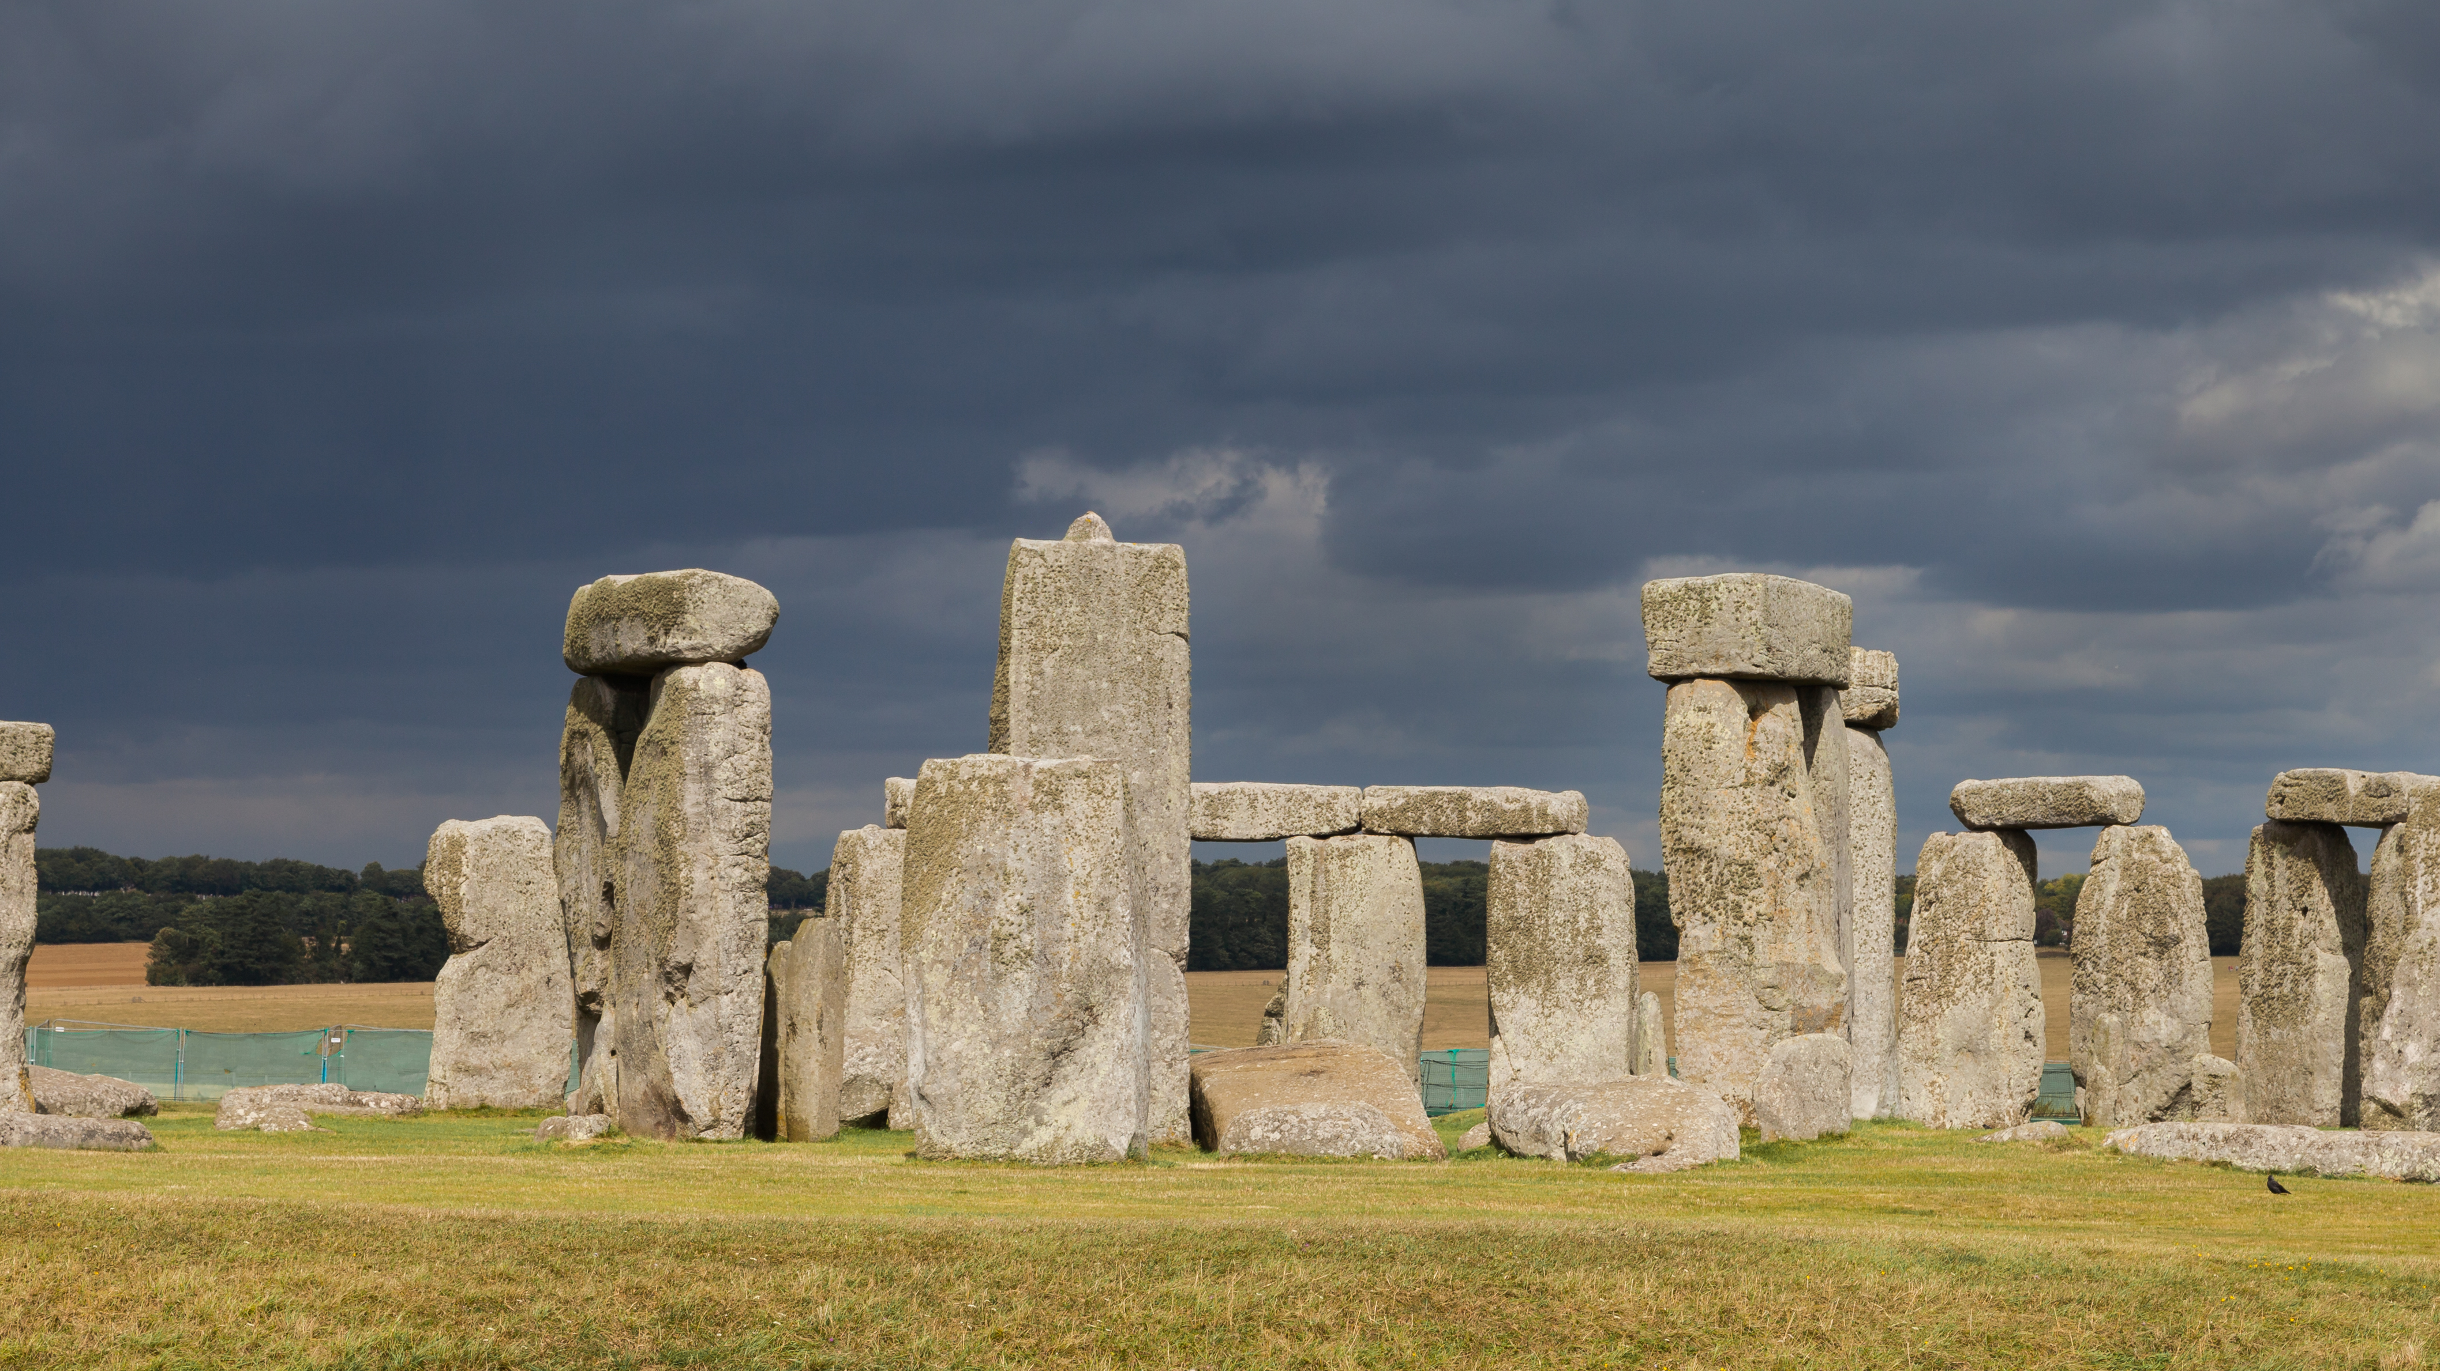
Stonehenge
Stonehenge is a prehistoric monument in Wiltshire, England, 2 miles west of Amesbury. It consists of a ring of standing stones, with each standing stone around 13 feet high, 7 feet wide and weighing around 25 tons. The stones are set within earthworks in the middle of the most dense complex of Neolithic and Bronze Age monuments in England, including several hundred burial mounds

