Slide 1
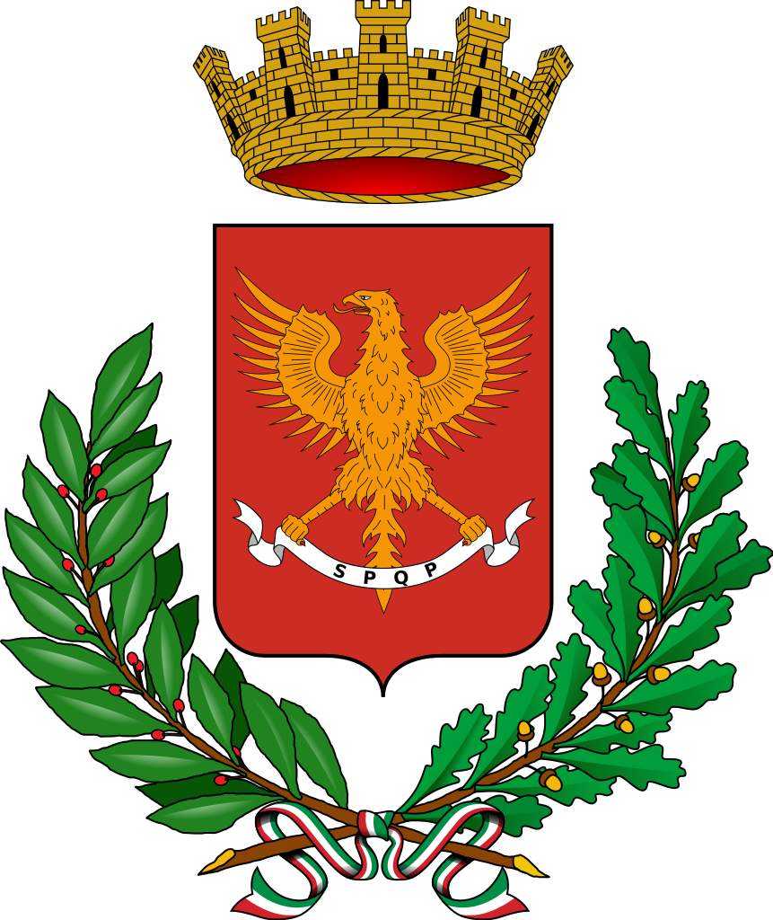
Cultural heritage
by R. Pace, G. Mazzola, A. Tusa, R. Di Salvo and D. Pillitteri.

Slide 2
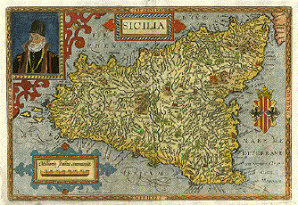
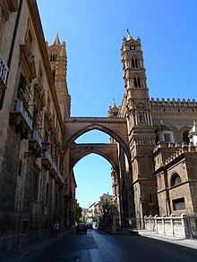
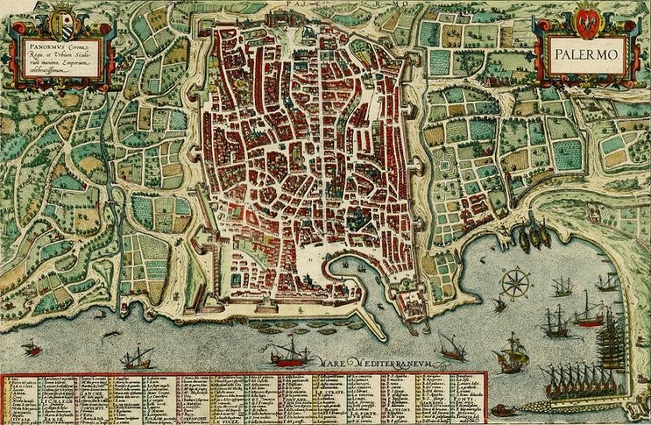
SICILY AND SICILIANS
The Sicilians are very friendly and hospitable people that are very proud of their culture and try to give a good impression of themselves. The center of their culture and of the family is table and food.

Slide 3
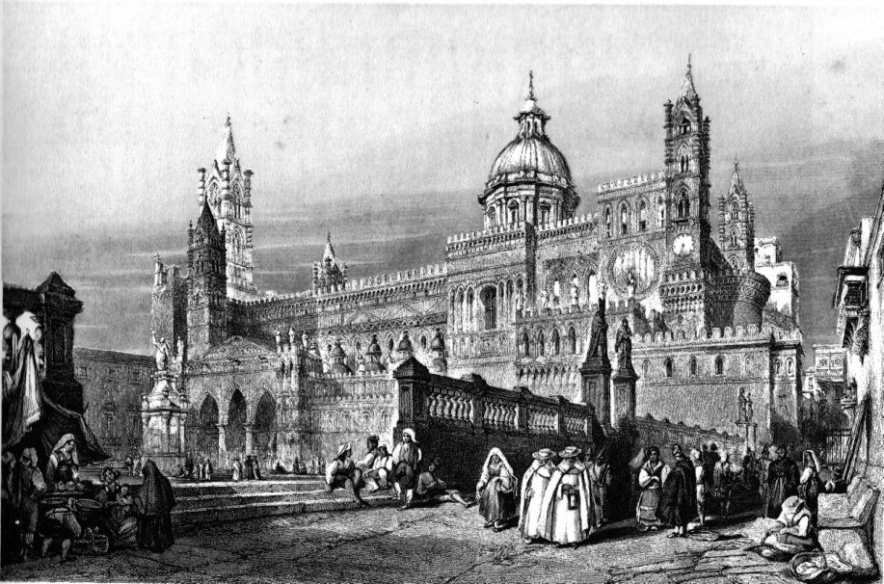
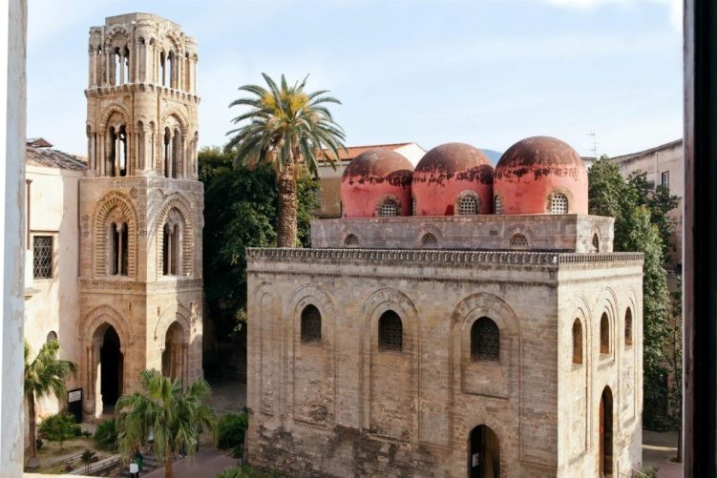
Sicily has been dominated by about 20 populations that have enriched it with their cultures. Still today in Palermo (capital of Sicily) the parts of the historical center are different among them because every part is composed by monuments of different arts.

Slide 4
SICILIAN MUSIC
Sicilian music was shaped by the island's history. Sicily's historical connections lie not primarily with mainland Italy, but with the Greek, Arab, and Spanish cultures. This music includes lullabies, dance music, festival music, epic storytelling and religious music. The Siciliana, a slow and lilting Italian style of music in triple meter, is loosely but not definitively associated with Sicily since the 1600s.

Slide 5
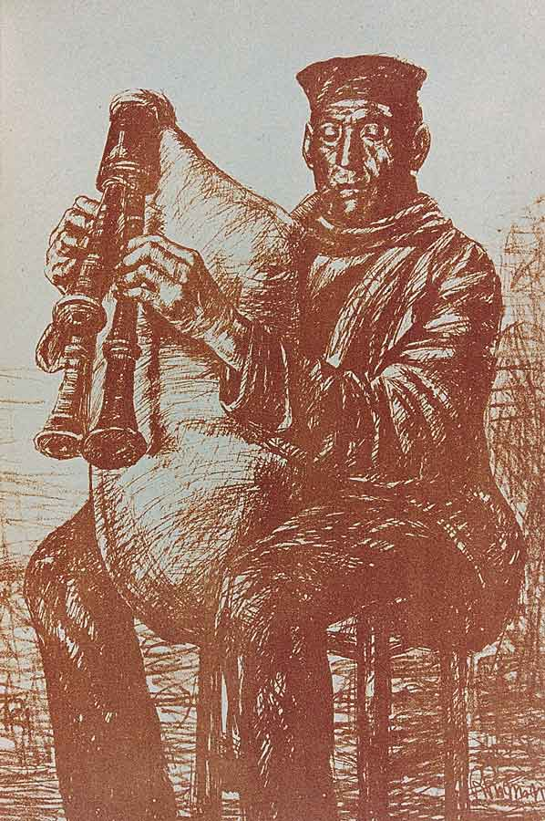
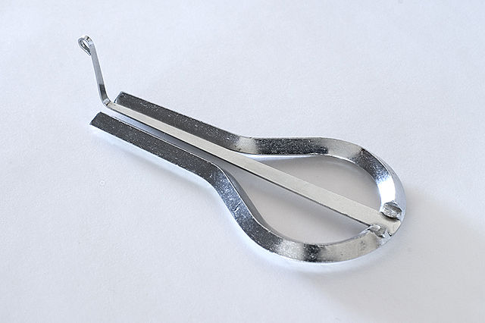
Sicily is home to several different types of folk music instruments, many of which can also be found in other parts of Southern Italy. Some of these instruments are: ciaramedda (a type of bagpipe), friscaleddu (a type of flute), marranzanu (jaw harp) and organetto, a diatonic folk accordion.

Slide 6
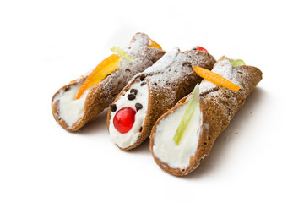
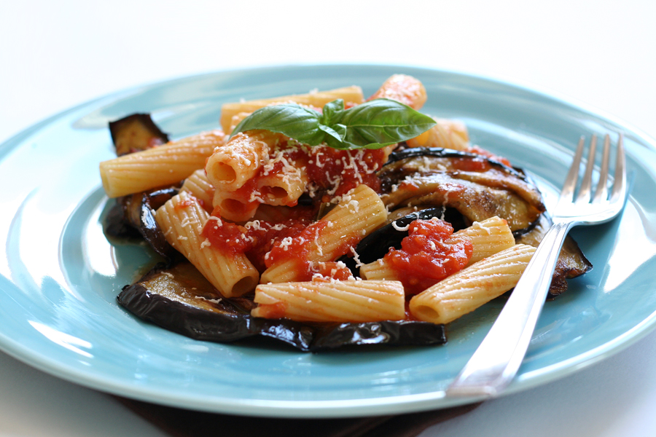
SICILIAN CUISINE
It shows traces of all cultures that have existed on the island of Sicily over the last two millennia. Although its cuisine has a lot in common with Italian cuisine, Sicilian food also has Greek, Spanish, French and Arab influences.

Slide 7
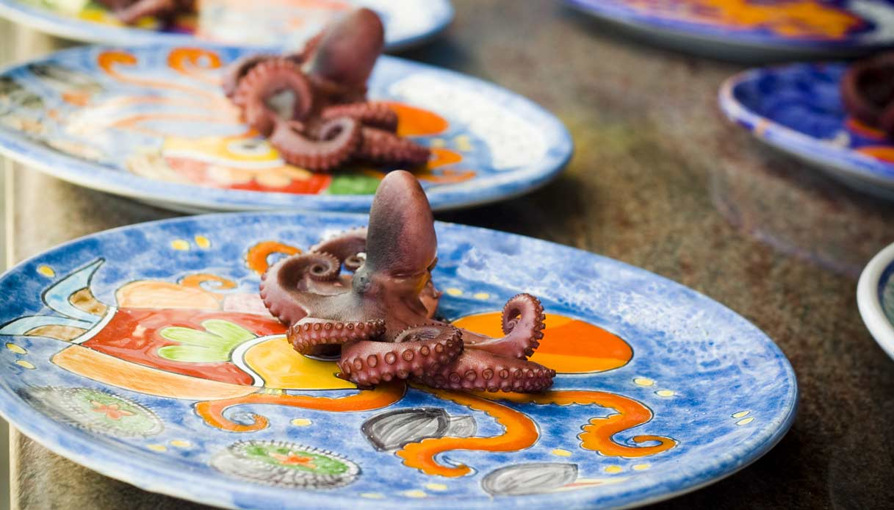
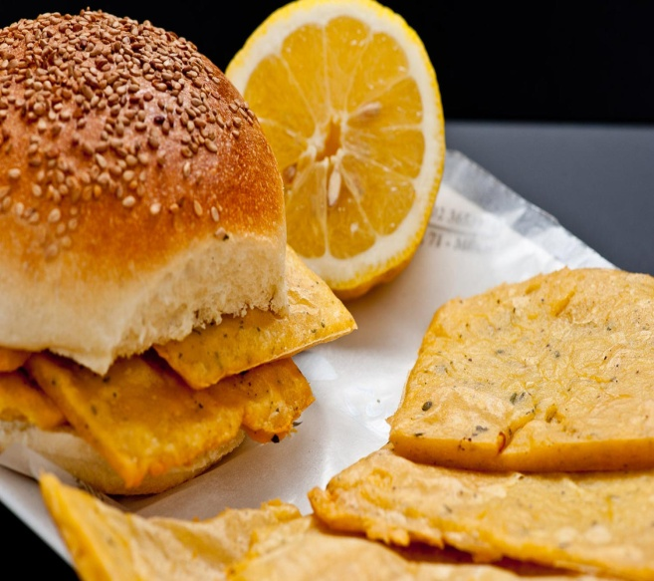
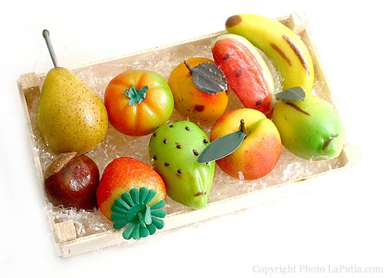
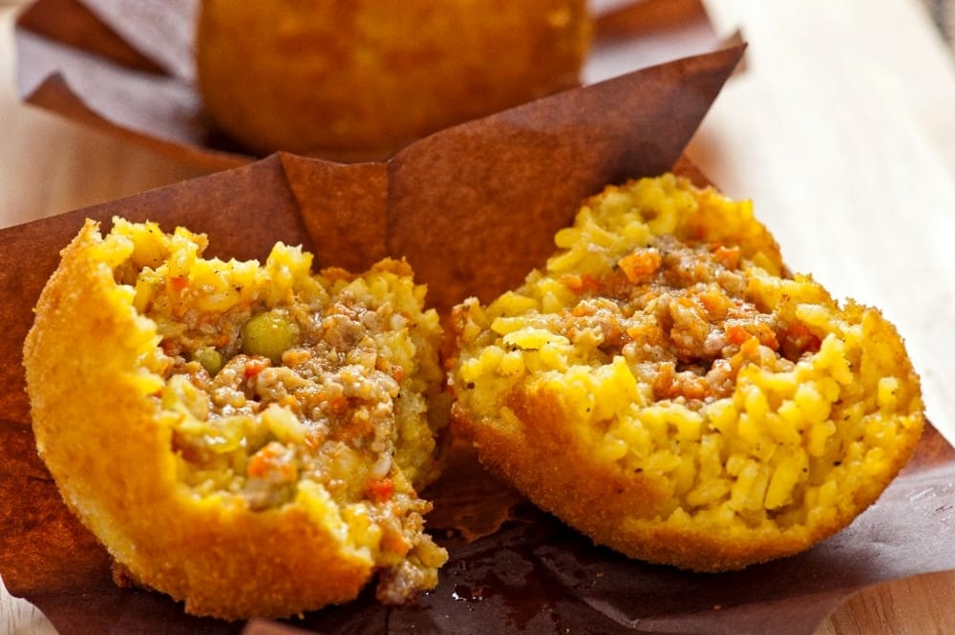
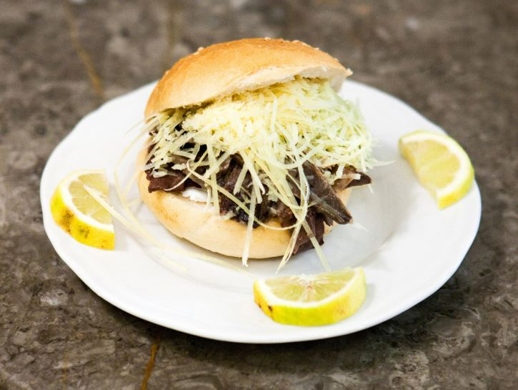
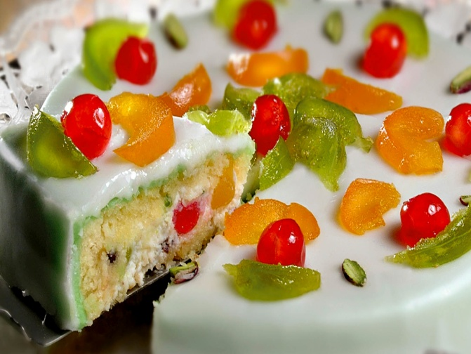
Palermo’s typical food

Slide 8
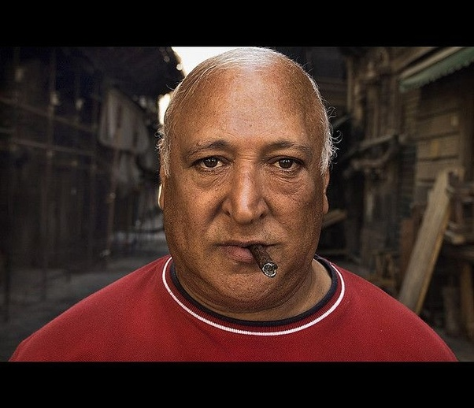
SOMATIC FEATURES
You may think that a cultural heritage can only be tangible. But the somatic traits of a population, their habits and features are a cultural heritage too. For example Italy is one of the most varied country in the world regarding the somatic feature.

Slide 9
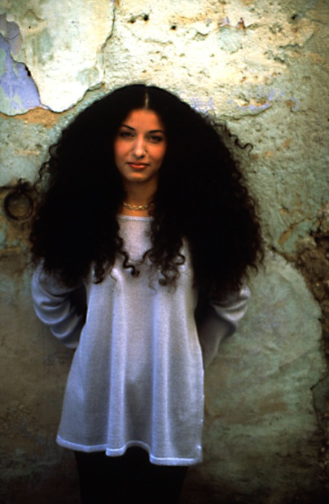
In the north of Italy for instance in Friuli, Veneto or Trentino, prevails the Central European type that has light hair and skin. In the south of Italy prevails the Mediterranean type more or less like Greek, Spanish and Portuguese.

Slide 10
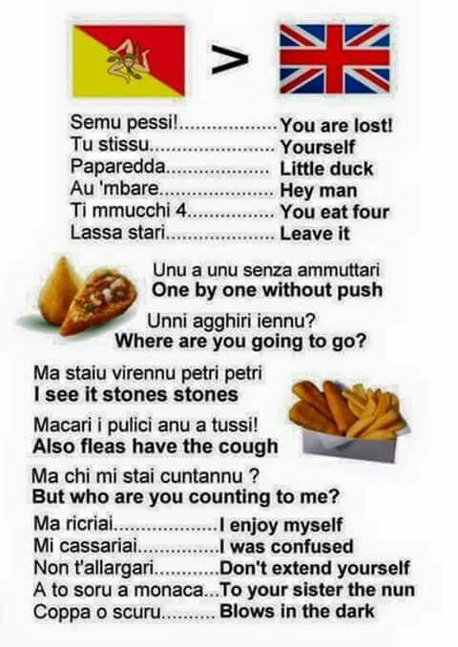
SICILIAN LANGUAGE
Every colonization or ruling of Sicily have left an evident linguistic mark on the islands language. Sicilian would probably be classed as an Italic-Romance tongue. However, although great influences on the Sicilian language come from Latin, in many ways Sicilian represents a unique blend of Greek, Arabic, French and Spanish lexis and grammar as well.

Slide 11
Together over time the Sicilian language evolved into an independent language, one that could not be given the name of dialect. Coming from such a rich history and culture, the Sicilian language deserves the same recognition, respect and equality as any other.

