Slide 1
Michael Morpurgo
By Harry, Flora, Olivia and Sam
Notes:
Bok, Hallo, Hei, Hola, Ciao and Hello. I’m Harry, this is Olivia, Flora and Sam. Welcome to our presentation on our chosen national writer: Michael Morpurgo.

Slide 2
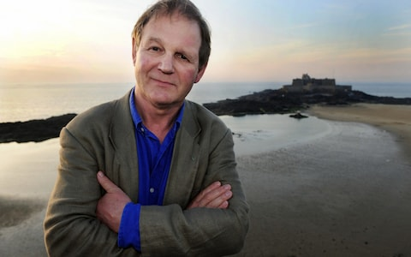
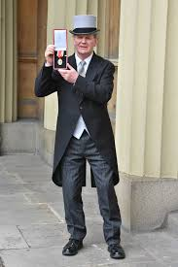
Sir Michael Morpurgo:
Children’s Laurette from 2003 to 2005
MBE in 1999
OBE in 2006
Knighted (made ‘Sir’) in 2018
Notes:
Michael Morpurgo is a highly regarded author in our country, and we want to give you just a flavour of why he is so highly looked upon.
Above, you can see him now on a beach in Cornwall (where we are from). Next to this you can Michael receiving his knighthood in 2018 or becoming a ‘Sir’. Below this are a range of novels and texts published by Morpurgo- a writer renowned for writing stories aimed at children and young adults. As a result of his work, he has won many an award to celebrate his talent with the prime example of being Children’s Laurette in the 2000’s.

Slide 3
Who is he?
75 years old- born 5th October 1943
His father was in the Army
Michael joined Army
Went to university
Became a teacher
Began writing books
Notes:
But, who is he? Well, Michael is now 75 years old and still going strong. Having been born during the war, it is only natural that his father was in the army. Once he was old enough, he too joined the Army. He rose through junior ranks very quickly before realising that he had a passion for teaching. So he left the army and went to university where it applied him with the skills to become a teacher. This led on to him writing books as a profession.

Slide 4
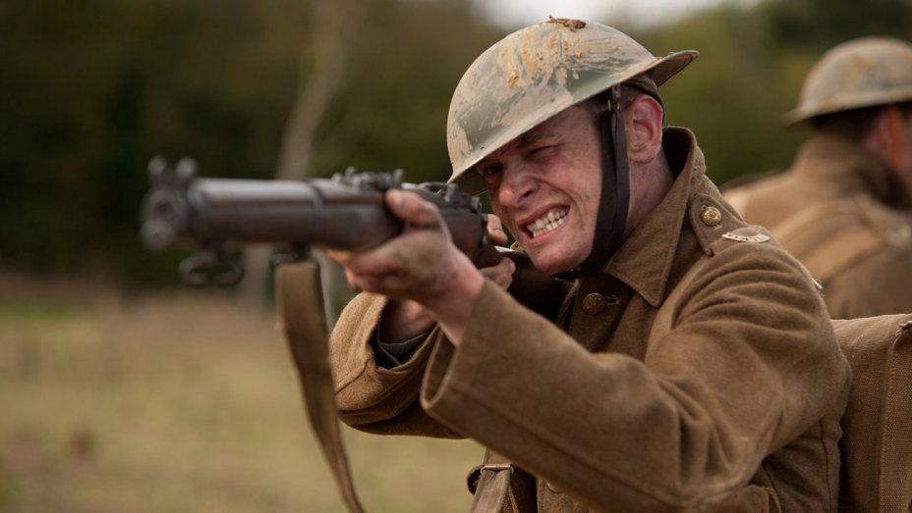
His work
War Horse
<- Book (1982)
Film Adapted version (2011)
Private Peaceful
Book (2003)
Film (2012)
Kensuke’s Kingdom
Book (1999)
Butterfly Lion
Book (1996)
Notes:
Here are just a few of his most known novels. War Horse from 1982, a story about the connection between horse and soldier in the War. Private Peaceful, a novel highlighting the effects of World War 1. Kensuke’s Kingdom, a story about a stranded boy on an island. Finally, Butterfly Lion; a tale about a young boy growing up in Africa.

Slide 5
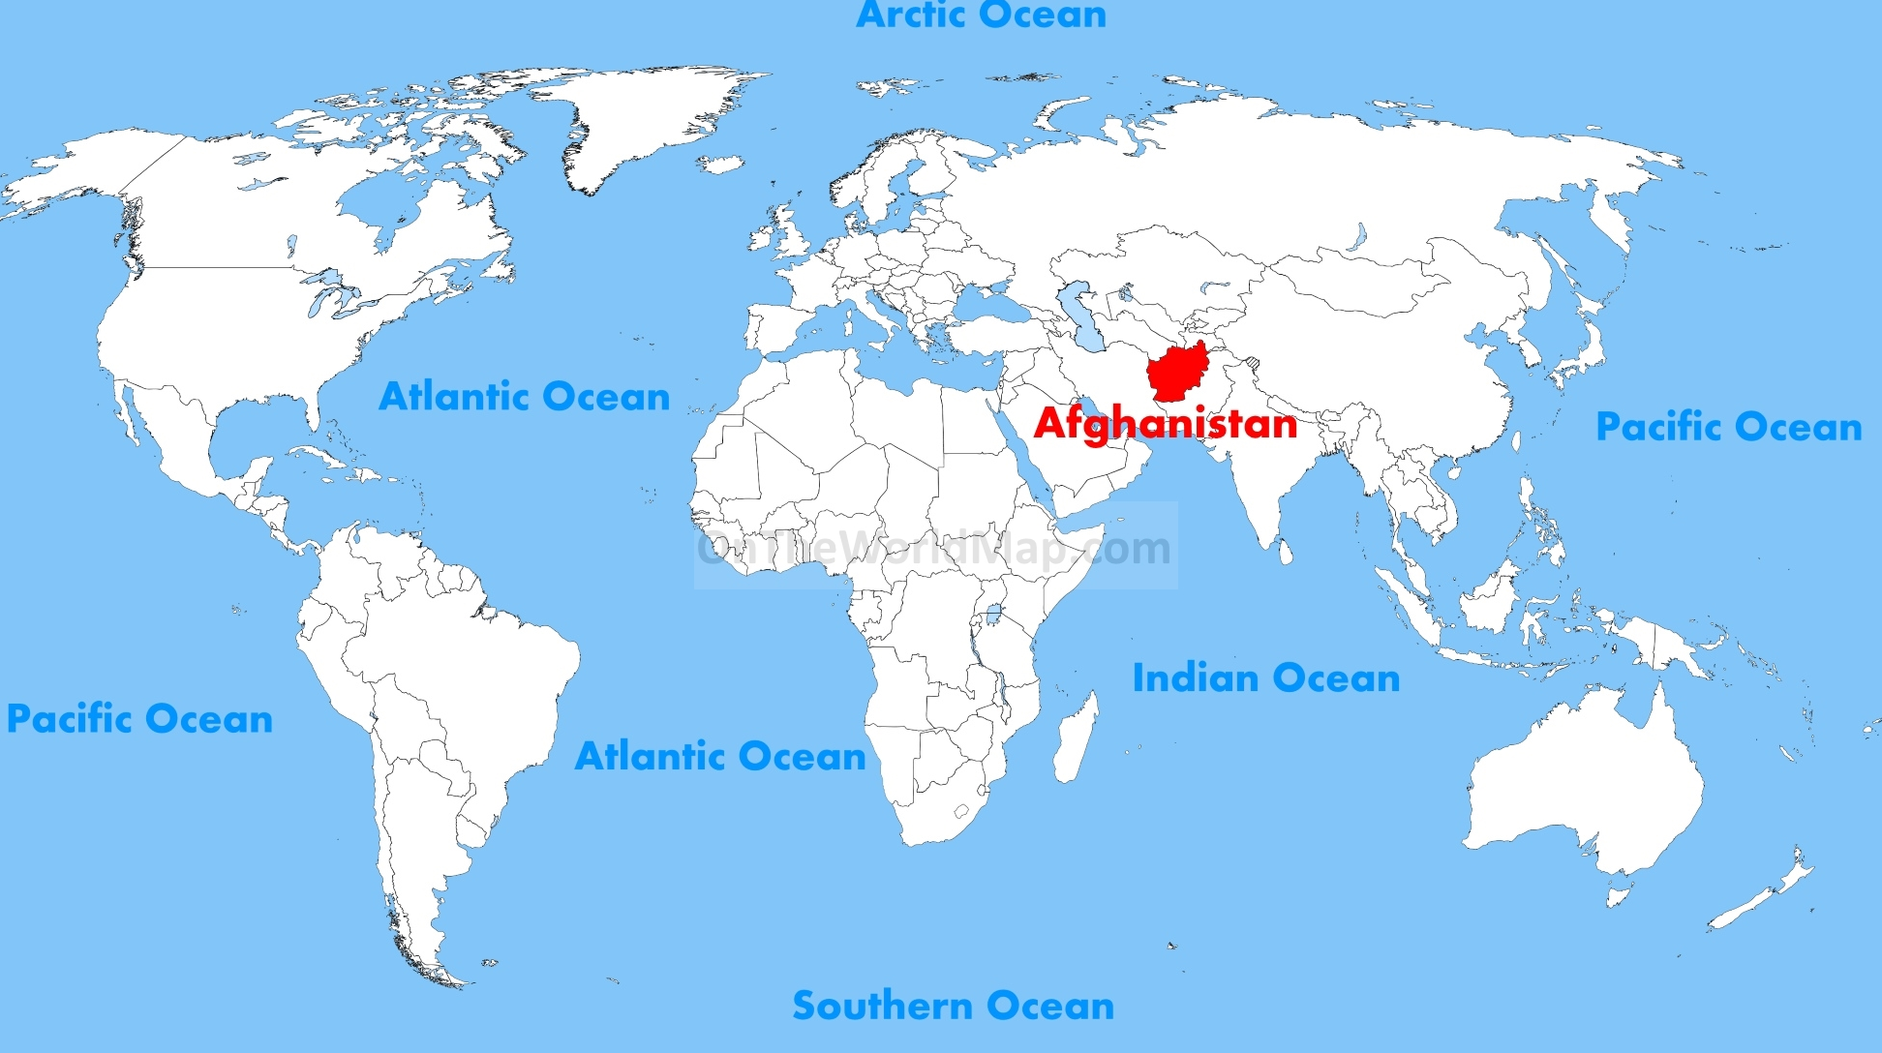
Shadow
Aman and his mother flee to the UK, seeking refuge from the Talibans in Afghanistan
Notes:
This is the book we have chosen to focus on- Shadow. A novel highlighting the many issues that come with migration especially in our country.

Slide 6
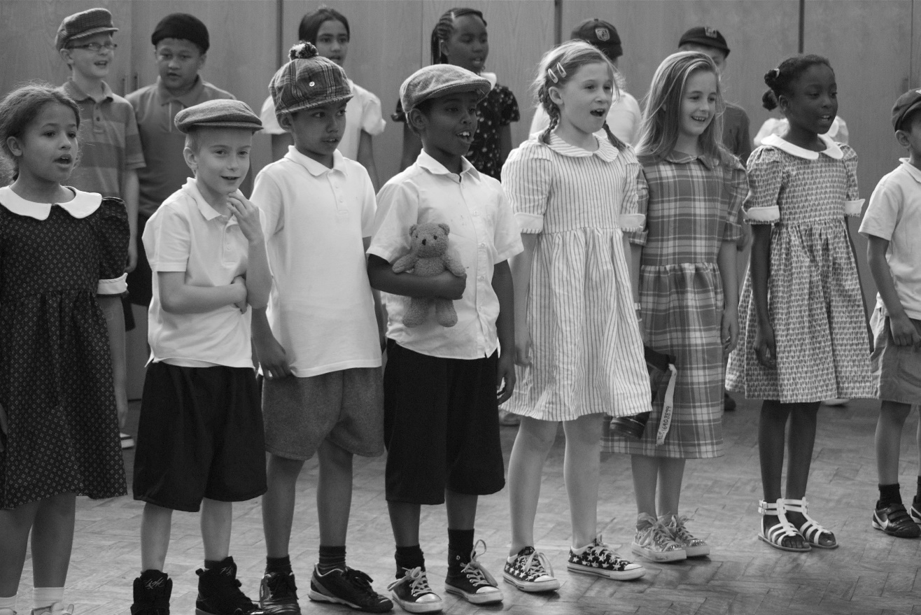
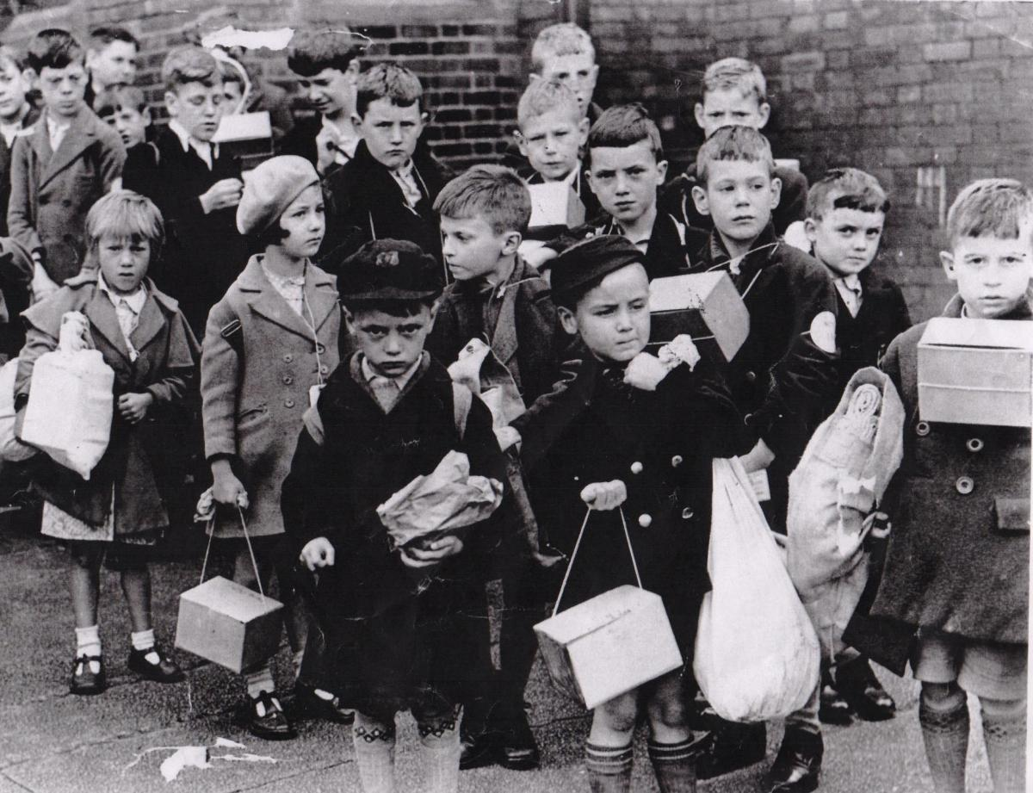
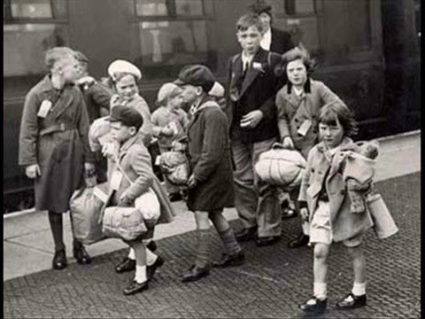
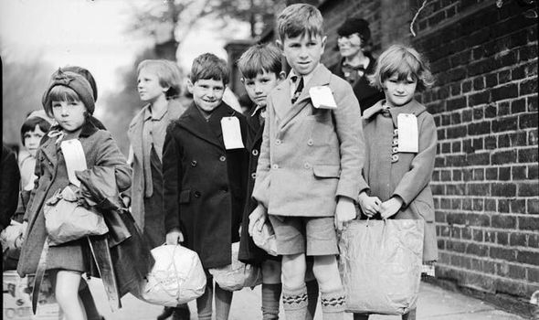
Morpurgo was an evacuee so knew what it was like to relocate, migrate and adapt to new environments.
British Evacuees in WW2
Notes:
Michael himself knew what it was like to relocate having been an evacuee himself during WW2. Here are a few pictures showing what it was like within our own country during that time

Slide 7
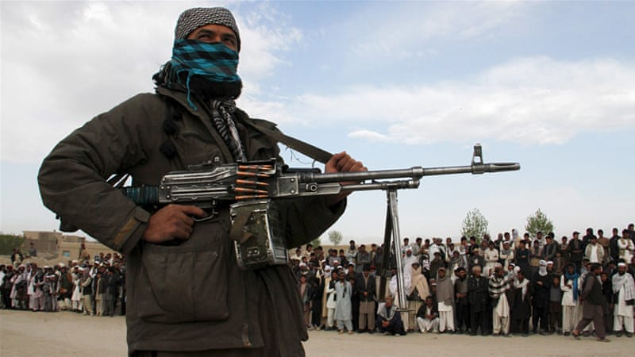
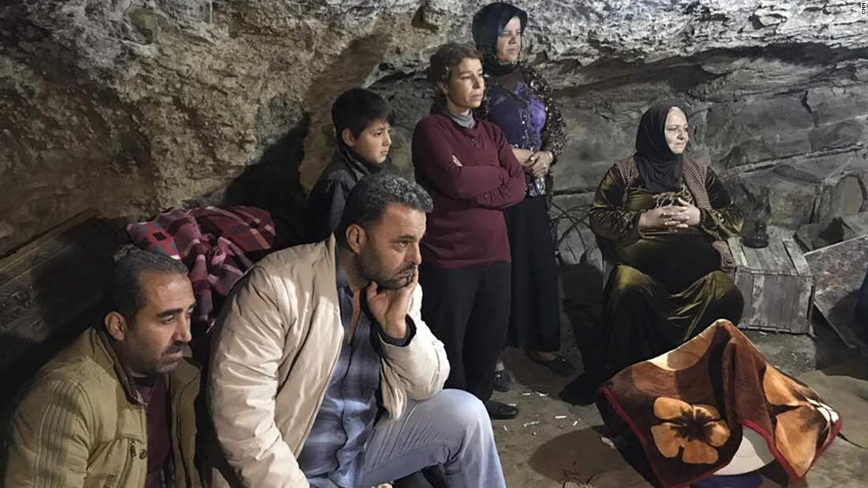
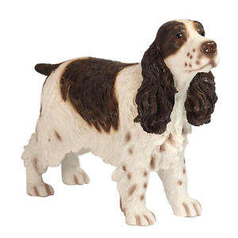
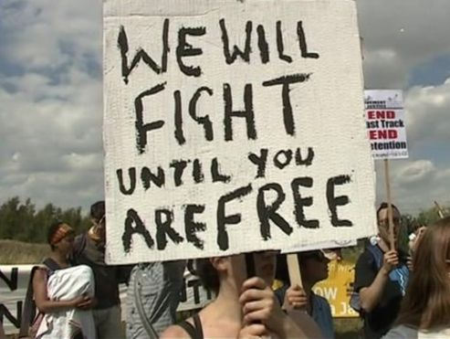
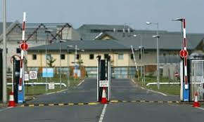
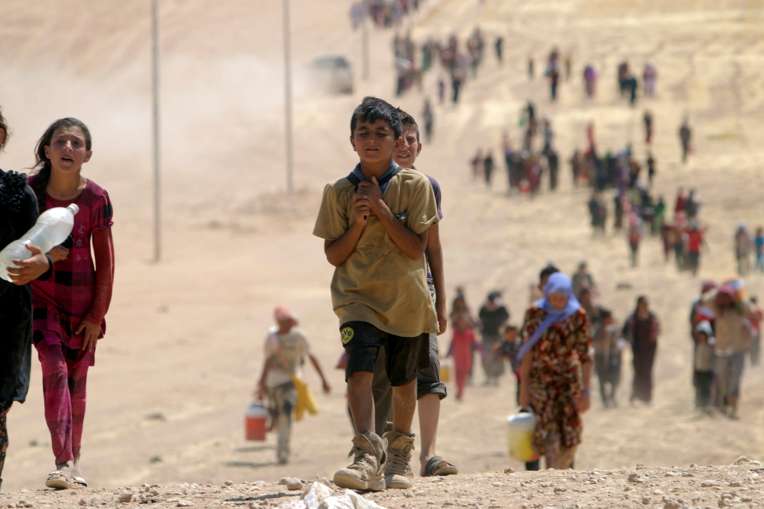
Shadow storyline
Notes:
Above is the story of Shadow in a picture board format. It starts off with Taliban gunmen attacking local Afghans in Afghanistan, in particular Aman and his family. One day, Aman discovers a stray dog (Shadow) nearby that leads them to safety during the conflict. They escape to a cave to hide from the Talibans. From here, Aman and his mother have a big decision to make- stay or leave. In the end they decide to leave Afghanistan to flee the conflict with Shadow tagging along the entire way. On the way to a distant relative in Manchester, England, British Army soldiers pick them up and identify Shadow as their own. As a way of saying thanks to Aman and his mother, they take them to the UK to save the struggles of travelling across Europe. Upon entry to the UK, they are locked away in a Migrant Detention centre. After months of pain, anguish and torment the voices of protestors begin to get heard by the government. Aman and his mother are freed and they live a normal life in UK residence.
This an example with a happy ending but unfortunately, the United Kingdom is home to many of these detention centres with thousands of migrants locked away behind their gates. We appear to the outside world as saints but we do have many dark traits.

Slide 8
Afghanistan refugees
Notes:
To show what Aman and his mother must have struggled through; here are just a few examples of refugees like them.

Slide 9
Morpurgo’s views on Migration
“They came here fleeing from tyranny and hoping this would never happen again. We should love having them here and welcome them”
“Vinieron aquí huyendo de la tiranía y esperando que esto nunca volviera a suceder. Deberíamos amar tenerlos aquí y darles la bienvenida "
«Sono venuti qui fuggendo dalla tirannia e sperando che questo non sarebbe mai più accaduto. Dovremmo amare averli qui e dargli il benvenuto»
”He tulivat tänne pakenemaan tyranniasta ja toivoen, että näin ei koskaan tapahtuisi. Meidän pitäisi rakastaa saada ne tänne ja toivottaa heidät tervetulleiksi.
„Sie kamen vor der Tyrannei hierher geflüchtet und hofften, dass dies nie wieder passieren würde. Wir sollten es lieben, sie hier zu haben und sie willkommen zu heißen. “
"Došli su ovamo bježeći od tiranije i nadajući se da se to više nikada neće dogoditi." Trebali bismo ih voljeti ovdje i pozdraviti ih”
Notes:
However, Michael Morpurgo doesn’t just sit there and watch what is going on in the world around him. The next 3 slides contain some powerful things that he has had to say about the matter of migration.

Slide 10
Morpurgo’s views on Migration
“The migrant crisis the world faces today is not new. What is hard and uncomfortable to remember and believe, is always salutary and important to acknowledge”
“La crisis migratoria que enfrenta el mundo hoy en día no es nueva. Lo que es difícil e incómodo recordar y creer, siempre es saludable e importante de reconocer.”
«La crisi dei migranti che il mondo affronta oggi non è nuova. Ciò che è duro e scomodo da ricordare e credere, è sempre salutare e importante da riconoscere.»
”Maahanmuuttajakriisi, johon maailma on vastannut, ei ole uusi. Mikä on vaikeaa ja epämiellyttävää muistaa ja uskoa, on aina tervetullutta ja tärkeää tunnustaa.”
„Die Migrationskrise, der die Welt heute gegenübersteht, ist nicht neu. Was schwer und unangenehm ist, sich zu erinnern und zu glauben, ist immer heilsam und wichtig zu erkennen.“
“Migrantska kriza s kojom se svijet danas suočava nije nova. Ono što je teško i neugodno pamtiti i vjerovati, uvijek je korisno i važno priznati.”

Slide 11
Morpurgo’s views on Migration
“Wherever there has been war or hunger, homelessness or poverty, there will be refugees. Among those who suffer most in such circumstances are children, children alone or unwanted in the world.”
“Dondequiera que haya guerra o hambre, personas sin hogar o pobreza, habrá refugiados. Entre los que más sufren en tales circunstancias están los niños, los niños solos o no deseados en el mundo.”
«Ovunque ci sia stata guerra o fame, senzatetto o povertà, ci saranno dei rifugiati. Tra coloro che soffrono di più in tali circostanze ci sono bambini, bambini soli o indesiderati nel mondo.»
”Siellä missä on ollut sotaa tai nälkää, kodittomuutta tai köyhyyttä, on pakolaisia. Niiden joukossa, jotka kärsivät eniten tällaisissa olosuhteissa, ovat lapset, yksin lapset tai ei-toivotut maailmassa.”
„Wo es Krieg oder Hunger, Obdachlosigkeit oder Armut gegeben hat, wird es Flüchtlinge geben. Unter denen, die am meisten unter solchen Umständen leiden, sind Kinder, Kinder allein oder unerwünscht auf der Welt.“
“Gdje god je bilo rata ili gladi, beskućništva ili siromaštva, bit će izbjeglica. Među onima koji najviše trpe u takvim okolnostima su djeca, djeca sama ili neželjena u svijetu.”

Slide 12
Thank You
Hvala vam
Danke dir
Kiitos
Grazie
Gracias
Notes:
Thank you for listening to our presentation on Michael Morpurgo.

