Slide 1
Migration - UK

Slide 2
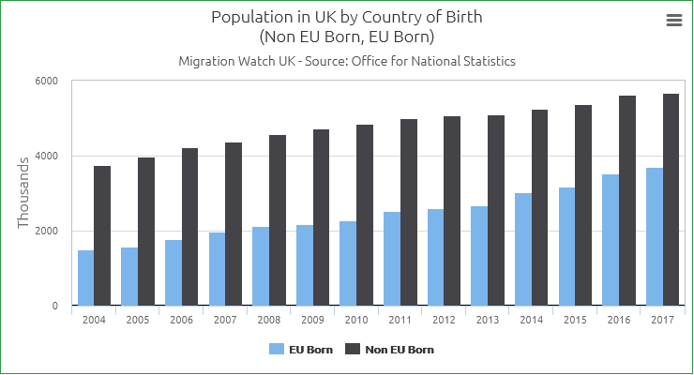
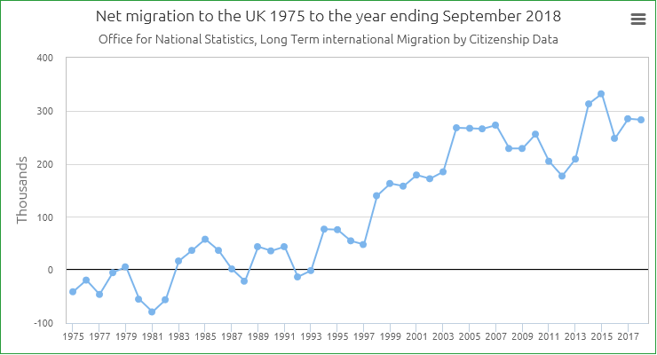
Immigrants in the UK
The number of passenger arrivals to the UK for all reasons in 2018 reached a record 142.8 million (an increase of 5.7 million, or 4%). There were increases for British, other EEA and Swiss nationals (up 4% to 122.3 million), and non-EEA nationals (up 3% to 20.5 million).

Slide 3
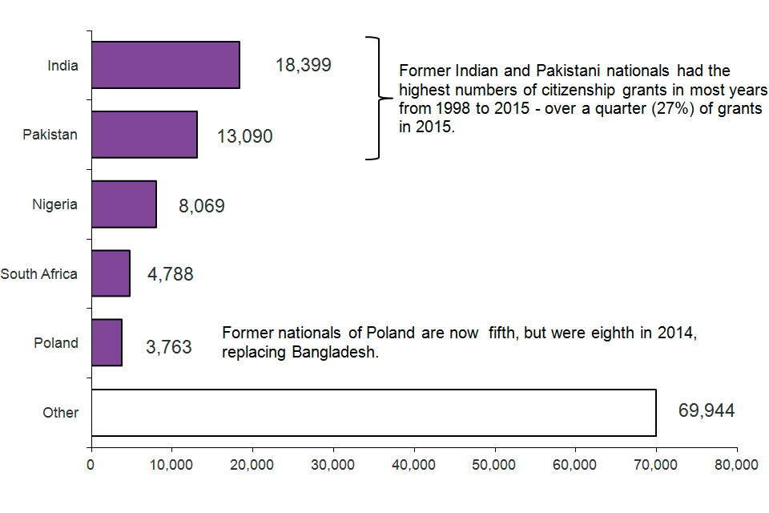

Slide 4
Emigration from the UK
In the year ending September 2018, 345,000 people left the UK
4,000 people a week trying to leave UK
Most people are relocating within the Commonwealth – in Australia, Canada and South Africa. They are almost all young professionals and skilled workers aged 20-40.

Slide 5
What jobs are done by immigrants in the UK?

Slide 6
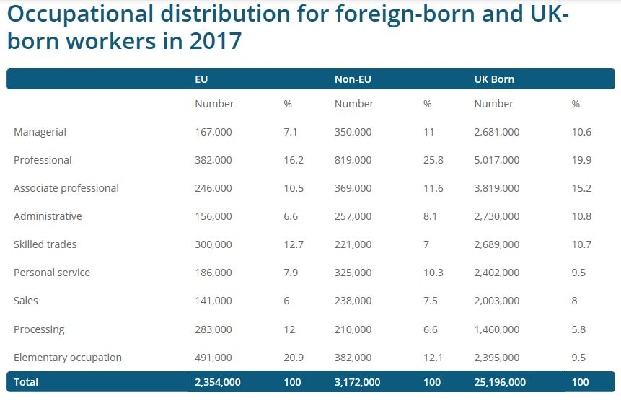

Slide 7
Challenges immigrants face in a new country
Learning a new language
Raising children and helping them succeed in school in a different culture
Securing work
Securing housing
Accessing basic services e.g. hospitals, police
Transportation
Cultural barriers

Slide 8
Challenges immigrants face in the UK
A rise in nationalist and racist views
Increased in unjustified discrimination against immigrants
Small amounts of immigrants are actually granted entry

Slide 9
What are the benefits of immigration?
In the UK, foreign immigration has helped us more than hindered
For many years, we lived under a French king and many of our own words are French
Immigrants bring new cultures, food, and ways of life to our country

