Slide 1
Croatian legends
-Borna Živić
-Tamara Mikić
-Ines Gadanec
-Vanesa Ivanković

Slide 2
Legend of Đurđevački Picoki
It's an old story about a long siege of Osman army of Ulam-beg and his intention to keep people of Đurđevo trapped in the old town so they would surrender because of starvation.
Over 40 years people of Đurđevo have a festival to relive the legend

Slide 3
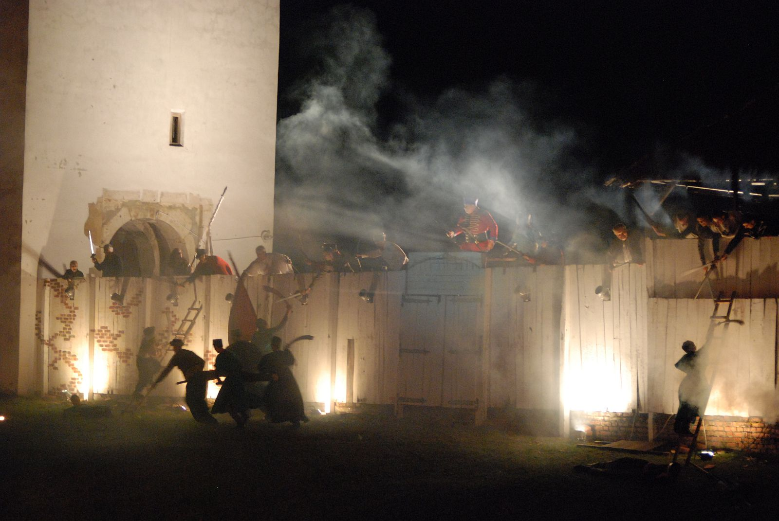
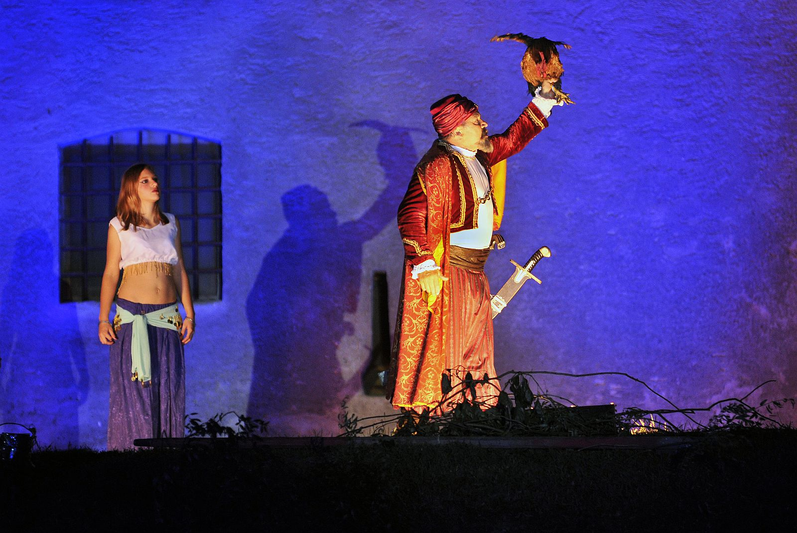

Slide 4
Rusalke
Ruslalke were seductive water nymphes familiar by their beautiful voice.
One of the oldest tales says that one Rusalka left her life in the water because she was in love with a prince (Mortal).
To survive on dry land she had to give away her voice.

Slide 5
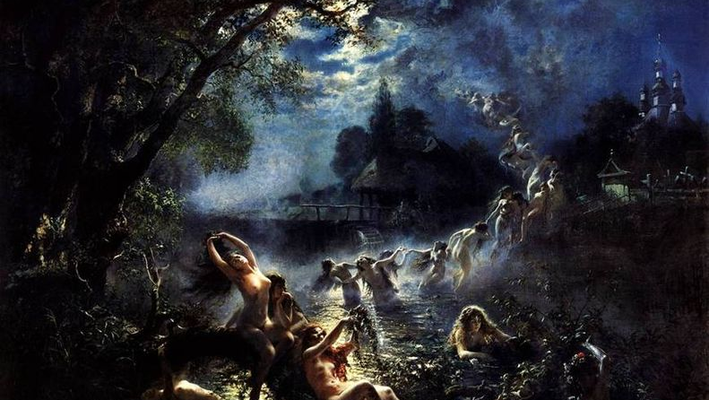

Slide 6
Water spirits
Such as Rusalke, water spirits and Malics lived in lakes, and specially the ones alongside watermills in which they had a tendency to sort fish by sending eels to regular migrations.
Young miller assistant was in love with the miller's daughter but the miller wanted his daughter to marry a rich man from a nearby castle.

Slide 7
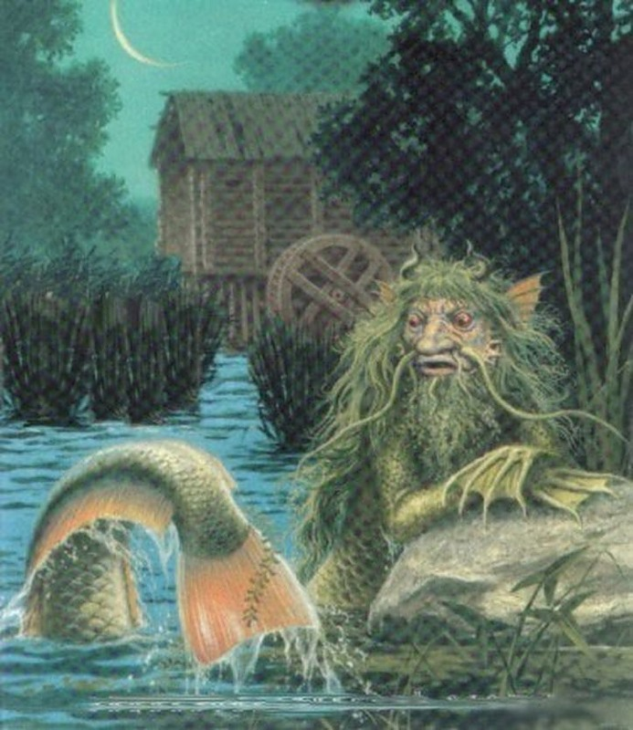
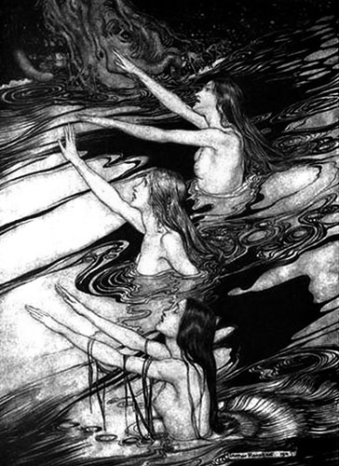

Slide 8
Hitchhiker from tunnel Učka
She stands by the road towards the tunnel waiting for a car where the driver is alone...raises her thumb. Her etherical beauty and dark long hair cannot be resisted.
This story has had a large influence on people and the media in Croatia.
Even some reporters from italy came to Učka to investigate this story.

Slide 9
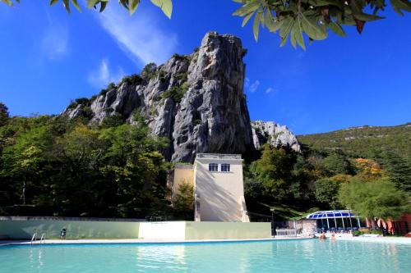
Legend of the rock Gorostas
The story is about a good girl who decided to take her own life because she was accused of imorality.
Today we have Istrian spa at that place and much before that old romans had a spa on that exact spot.

Slide 10
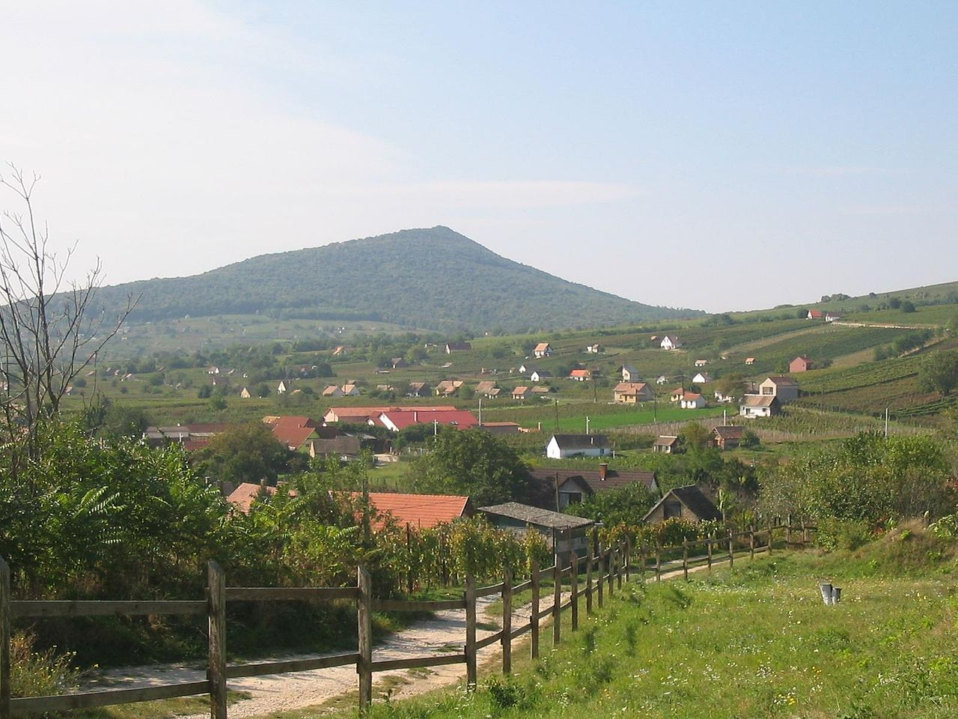
THE LEGEND OF ARŠANJ WITCHES
Near Baranja there is Haršanj hill. On that hill, every night, at midnight, witches gather.
The main witch, white and disheveled, sits on the throne waiting for vassals.

Slide 11
Thank you very much for you attention!

