Slide 1
Ivan gundulić and Silvije strahimir krančević
treasure of Croatian literature

Slide 2
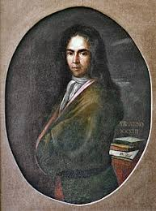
Ivan gundulić
LIFE
Ivan Gundulić (also Gianfrancesco Gondola) was the most prominent Baroque poet from the Republic of Ragusa.
His work embodies central characteristics of Roman Catholic Counter-Reformation: religious fervor, insistence on "vanity of this world" and zeal in opposition to "infidels".
Gundulić was born in Dubrovnik into a wealthy Ragusan noble familiy on 8 January 1589.

Slide 3
He recived an excellent education.
He probably studied the humanities and philosophy.
After that he studied Roman law and jurisprudance in general, where he held
numerous offices for the Great Council of the Republic.
At the age of nineteen, he became a member of Great Council.
Twice, in 1615 and 1619, he held the temporary function of governor of Konavle.
At he age of thirty he married with Nicoleta Sorkočević who bore him three sons, Francesco, Mato, and two doughters, Mara and Giovanna.
Gundulić died on 8 December 1638 in Dubrovnik.

Slide 4
WRITING
He began his literary career by writing poems and staging melodramas that become popular in Duborvnik.
But Gundulić published only his larger works.
Gundulić's most famous play is Dubravka, a pastoral written in 1628, where he rhapsodies on the former glory of Dubrovnik and contains some of the most famous verses in Croatian literature:

Slide 5
ODA SLOBODI
O lijepa, o draga, o slatka slobodo,
dar u kom sva blaga višnji nam Bog je do.
Uzroče istini od naše sve slave,
uresu jedini od ove Dubrave.
Sva srebra, sva zlata, svi ljudski životi
ne mogu bit plata tvoj čistoj ljepoti!
FREEDOM ANTHEM
Oh beautiful, oh dear, oh sweet freedom,
the gift of which all treasures from God don't compare.
The cause of truth of all our glory,
the only beauty of this Dubrava.
All the silver, all the gold, all the humans lives,
can't be ornament of your pure beauty.

Slide 6
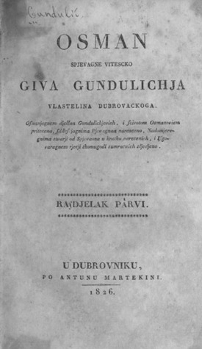
In his greatest work, Osman, Gundulić presents the contrast between Christianity and Islam, Europe and the Turks, West and East, and what he viewed as freedom and slavery.
Osman had 20 cantos, but the 14th and the 15th were never found.
Osman is firmly rooted within the rich literary tradition of the Croatian Baroque in Dubrovnik and Dalmatia and is considered as one of its apogees.
By presenting the contrast of struggle between Christianity and Islam, Gundulić continued Marko Marulić's glorification of the fights against invading Ottoman Turks.

Slide 7
Silvije strahimir kranjčević
LIFE
Silvije Strahimir Kranjčević was a Croatian poet.
His reflexive poetry, reaching it's zenith in the 1890s, was a turning point that ushered modern themes in Croatian poetry.
Kranjčević was born in Senj on 17 February 1865.
As a teenager, he completed his secondary education in a Gymnasium, but did not graduate from it.
Soon after joining the elite Germanico-Hungaricum Institute in Rome, where he was supposed to become priest, he changed his mind and left.

Slide 8
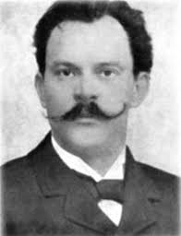
He attended the one-year course for language and history teachers in Zagreb.
With the diploma for a teacher in "citizen schools", he left to work in Bosnia and Herzegovina where he taught and wrote poetry.
Kranjčević died in Sarajevo on 29 October 1908.

Slide 9
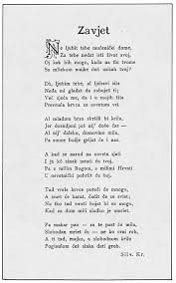
WRITING
He published his first poem, Zavjet(The Pledge) in 1883, a couple months before leaving for Rome.
Kranjčević sent another two poems from Rome in 1884 to magazine called Sloboda(Freedom).
When he came back from Rome, he published Noć na Foru (A Night at the Forum).
Politically, he was a follower of the Croatian Party of Rights. The dark moods of his poems are related to the Hungarian oppression of Croatia.

Slide 10
His first poetry book, Bugarkinje (1884), was published in his native Senj. It already announced his three main themes: Homeland, Man and Universe.
His next poetry book, Selected Poems, came more than a decade later, in 1898.
The 1890s marked the zenith of his poetic work.
It would be followed by two more books, Trzaji(Quivers) in 1902 and Poems in 1908.
One of the most beautiful croatian patriotic songs at all is Moj Dom (My Home)

Slide 11
MOJ DOM
Ja domovinu imam; tek u srcu je nosim,
I brda joj i dol;
Gdje raj da ovaj prostrem, uzalud svijet prosim
I... gutam svoju bol!
.....
Kroz požar, koji suklja, da oprži mi krila,
Ja obraz pronijeh njen;
Na svojem srcu grijem već klonula joj bila
I ljubim njenu sjenu.
MY HOME
I have a homeland; only in the heart i carry her,
And her hills and her valleys;
Where tospread this paradise, in vain I beg the world
And...swallow my pain!
.....
Trought the fire, which gushing, to sear my wings,
I took her cheek;
On my heart I already heating her weary pulse
And I kiss her shadow.

Slide 12
Tehnical school of Nikola Tesla Vukovar, Croatia
Palermo, Italy 2019
Andrea Ožvat
Dominik Požarko
Mateo Pipinić
Sergej Karas

