Slide 1
Our city Prievidza
Matej Oršula, Matej Szelle a Filip Strenanka

Slide 2
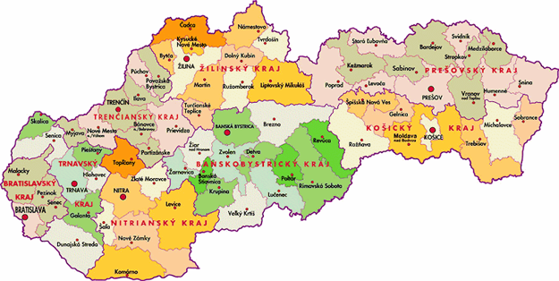
Location of Prievidza
Prievidza leis between cities: Nováky, Handlová, Bojnice and Nitrianske Pravno
This small city lies in the centre of Slovakia.

Slide 3
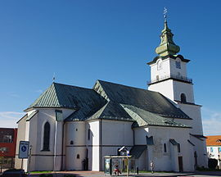
Monuments of Prievidza
Church of Saint Bartolomej
Church is in gothic style, built in 14th century
Interesting thing in church there are sunny clocks.

Slide 4
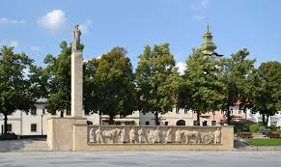
Wall of SNP This monument was created by akademic spulptur Rudolf Pribiš about year 1950. He made it from sandstone. It is dominant of Freedom Square.

Slide 5
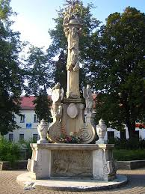
Trinity monument for memory of plague disaster
These monuments were built all over the world by different architects.
This one in Prievidza was built by Dionýz Stanetti.
This epidemic killed 3860 people and only 1571 infected people
survived it.

Slide 6
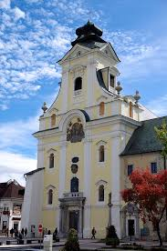
Monastery with the church called Piaristov
This monastery was built in year 1676
This church was built by unknown builder
It´s built in barocco style

Slide 7
Thanks for attention

