Slide 1
NATIONAL MATHS GAME ABOUT GEOMETRY
Giovannipio Oliva, simone meccariello, simone monaco, fiore gallo, giovanni mainolfi
IIS E. FERMI – MONTESARCHIO- ITALY

Slide 2
Hide and seek
What is?
rules
Hide and Seek is a traditional game. It is played in groups, outdoors or indoors.
A boy turns to a wall (called a den) with his eyes closed and begins to count while the other participants are hiding. Once the boy has finished counting, he will have to work hard to find the other participants to win; otherwise the participants to win will have to save themselves by making den.

Slide 3
https://youtu.be/XoLrLza6h6E

Slide 4
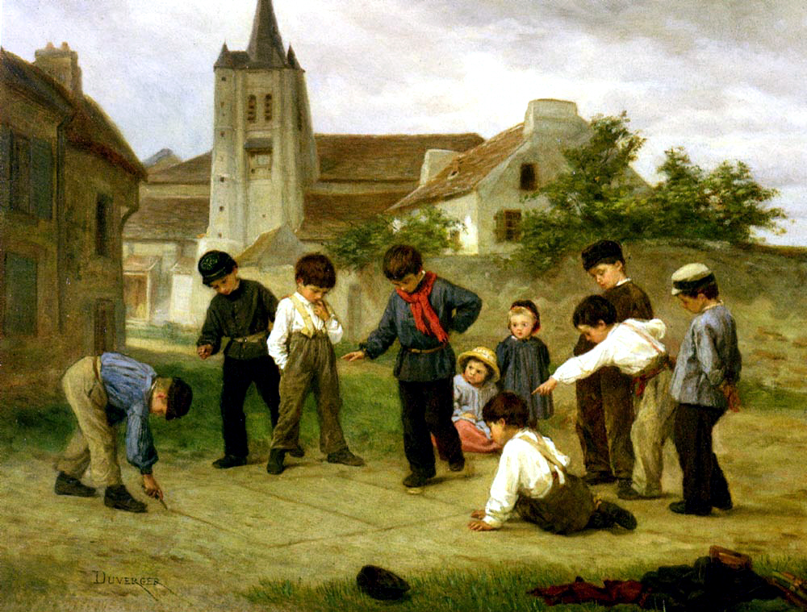
THE GAME OF THE BELL
What iS?
RULES
It is a game and it is one of the oldest and most famous street games. It is even said to date back to around 3,000 years ago. It was used by the ancient Romans to train them to stand on one leg while marching in armor.
The game of the bell consists in drawing a numbered pattern on the ground or made up of a certain number of squares. On these squares a stone must be thrown that the player must try to reach by hopping on one leg, inside them.

Slide 5
https://youtu.be/NIq-Skp92TY

Slide 6
Capture the Flag
WHAT IS?
Rules
From a minimum of ten players to a maximum of thirty - forty participants divided by teams can participate in the game.
The players of the two teams corresponding to the number called must run towards the flag holder to "steal the flag" and take it to their "home", avoiding being touched by the opponent. The team of the player who "steals the flag" and manages to bring it to his "home" gets the point.

Slide 7
https://youtube.com/shorts/sHYsk616Osk?feature=share

