Slide 1
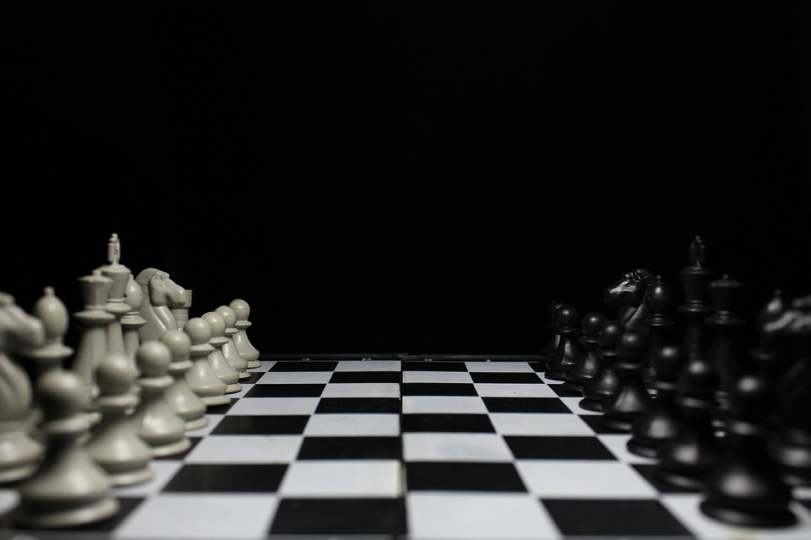
The chess’ rules

Slide 2
The rules of chess govern the play of the game of chess. While the exact origins of chess are unclear, modern rules first took form during the Middle Ages. The rules continued to be slightly modified until the early 19th century, when they reached essentially their current form. The rules also varied somewhat from place to place. Today, the standard rules are set by FIDE which is the Fédération Internationale des Échecs, the international governing body for chess. Slight modifications are made by some national organizations for their own purposes. There are variations of the rules for fast chess, correspondence chess, online chess, and Chess960.

Slide 3
Chess is a two-player board game using a chessboard and sixteen pieces of six types for each player. Each type of piece moves in a distinct way. The object of the game is to checkmate the opponent's king. Games do not necessarily end in checkmate; a player who expects to lose may resign. A game can also end in a draw in several ways.

Slide 4
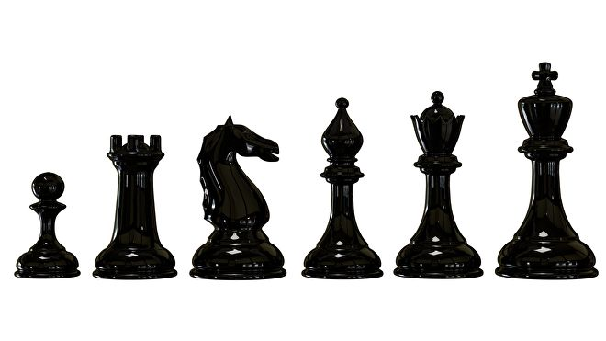
We know that in the chess game there are some pieces that compose the chessboard. Now we are going to show you what they are and how they move on the chessboard.
They are classified in black and white and there are 16 pieces per colour:
8 pawns
2 rooks
2 knights
2 bishops
1 queen
1 king

Slide 5
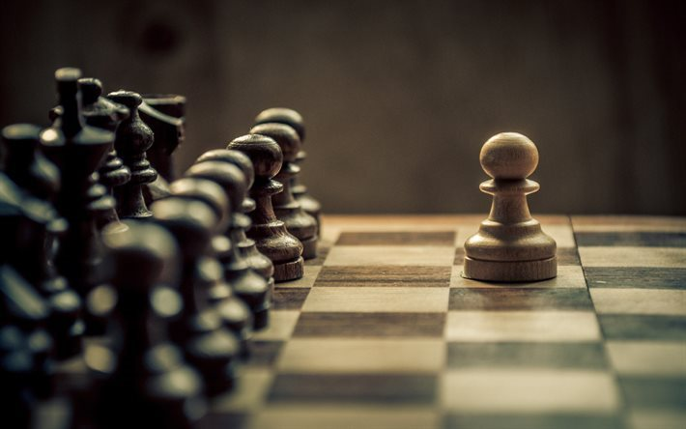
The pawns
Pawns move one square forward in a straight line. They cannot move horizontally, diagonally or backwards.
An exception to this is if a pawn is yet to be moved during the game. If a pawn has not yet moved, it may be moved two squares forward as a single move. Both squares must be empty. The player can also choose to move the piece a single square.
The only time a pawn may move diagonally is when capturing an opponent’s piece. Pawns may capture an opponent’s piece on either of the diagonal spaces to the left or right ahead of the piece. As part of capturing the piece, the pawn will move diagonally to replace the captured piece. A pawn cannot capture an adjacent piece on any other square, or move diagonally without capturing.

Slide 6
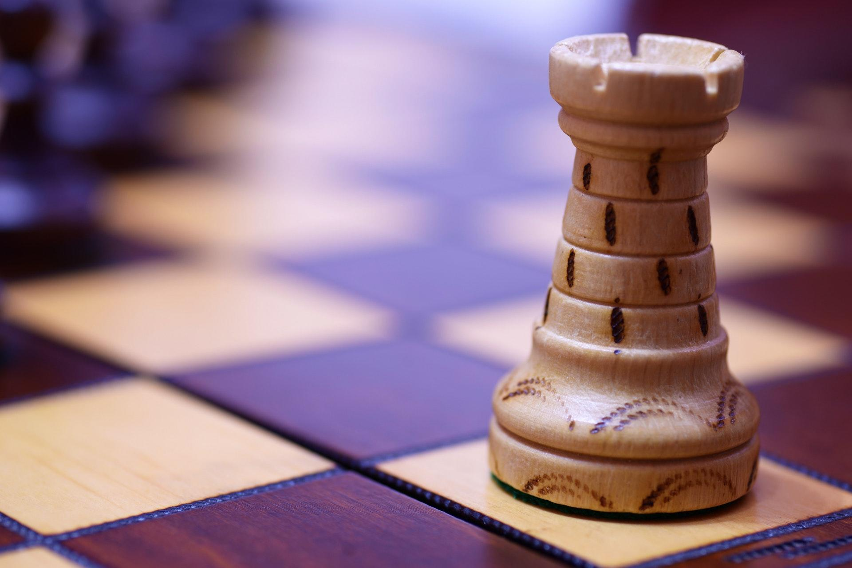
THE ROOKS
The rook, sometimes called the castle, can move any number of squares horizontally along its current row or column. It cannot pass through pieces of the same colour, and can capture pieces of the opposite colour by moving onto an occupied space. It cannot move diagonally for any reason.

Slide 7
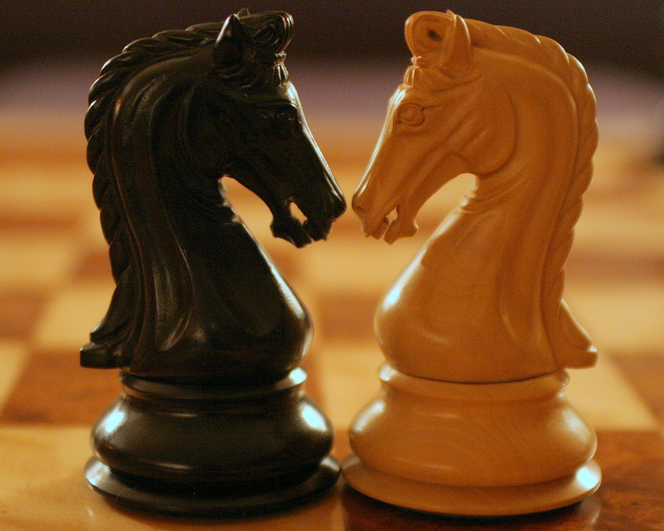
THE KNIGHTS
Knights are the only chess pieces that may be moved ‘through’ other pieces by ‘jumping’ over them. It captures pieces as normal by landing on a space occupied by a piece of the opposite colour and cannot move to a square occupied by a piece of the same colour, but may move over pieces of either colour during its move.
Knights move in a fixed ‘L’ pattern: two squares forward, backward, left or right, then one square horizontally or vertically, or vice versa - one square forward, backward, left or right, followed by two squares horizontally or vertically to complete the ‘L’ shape.
This means that the knight can always move to the closest square that is not on its current row, column or directly adjacent diagonally.
The knight must move the full distance - it cannot move just two squares in a straight line without also moving one to the side, for instance.

Slide 8
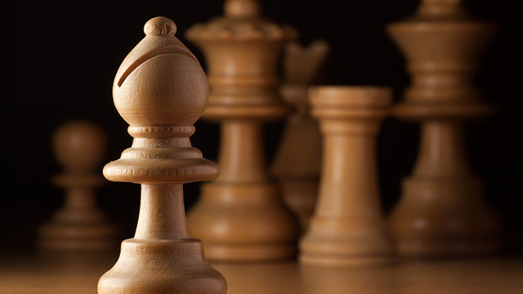
The bishops
The bishop can move any number of squares diagonally - this means it always moves along the diagonal line of squares matching the current colour of its square. This means that each player begins the game with one bishop that can move on each colour. A bishop cannot move horizontally or vertically for any reason. It cannot move through pieces of the same colour, and captures a piece of the opposite colour by moving onto its square.

Slide 9
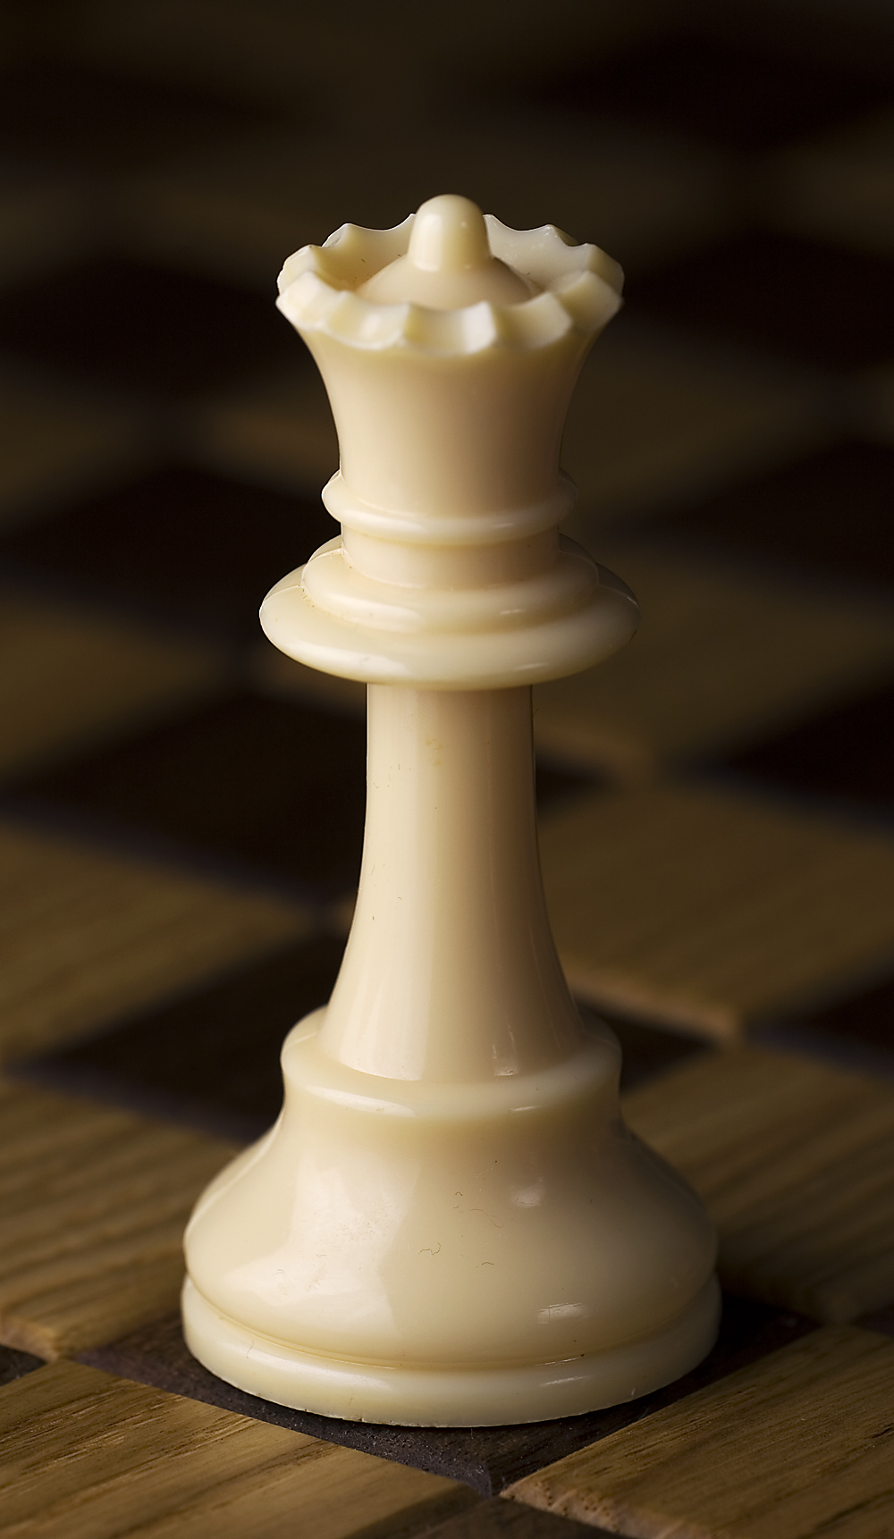
THE QUEEN
The queen may move any number of squares horizontally, vertically or diagonally. These movements must be made in a single straight line during a single turn. (In other words, you can’t move three squares diagonally, followed by three spaces vertically.) The queen cannot move through pieces of the same colour, and captures a piece of the opposite colour by moving onto its square.

Slide 10
THE KING
The king moves a single space horizontally, vertically or diagonally. The king cannot move into a space that would grant a check or checkmate to the opponent player.
As an exception to all other chess pieces, the king is never captured - a player loses the match when the king is placed into checkmate, which would lead to an unavoidable capture on the opponent’s next turn.

Slide 11
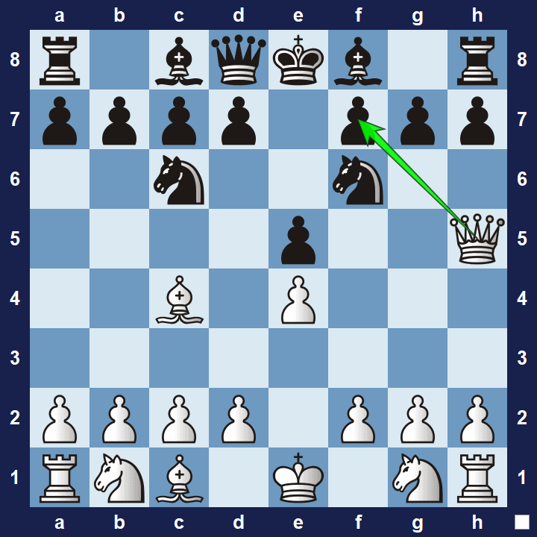
The end of the game
If a player's king is placed in check and there is no legal move that player can make to escape check, then the king is said to be checkmated, the game ends, and that player loses. Unlike other pieces, capturing the opponent's king is not allowed.
Resigning: Either player may resign at any time, conceding the game to the opponent. A player may resign by saying it verbally or by indicating it on the score sheet
Black has no legal moves, white wins

Slide 12
Italia
IIS Enrico Fermi Montesarchio (BN)

