Slide 1
Chess Theory
Riga 25th Secondary School

Slide 2
Theory
Chess theory consists of opening knowledge, tactics (or combinations), positional analysis (particularly pawn structures), strategy (the making of long-range plans and goals), and endgame technique (including basic mates against the lone king).

Slide 3
Tactics
In chess, a tactic refers to a sequence of moves that limits the opponent's options and may result in tangible gain.

Slide 4
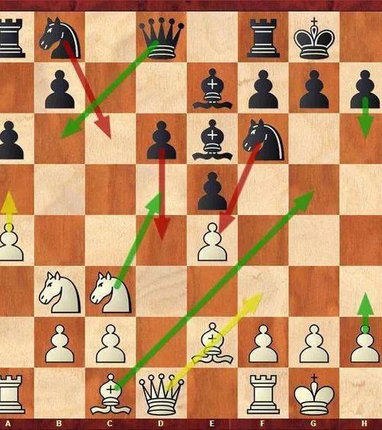
Strategy
Chess strategy is the purposeful attempt to gain an advantage over your opponent. Unlike tactics, chess strategy involves long-term goals, usually related to king safety, pawn structure, space, piece activity, etc.

Slide 5
Phases in chess game
There are three recognized phases in a chess game:
Opening
Middle game
Endgame

Slide 6
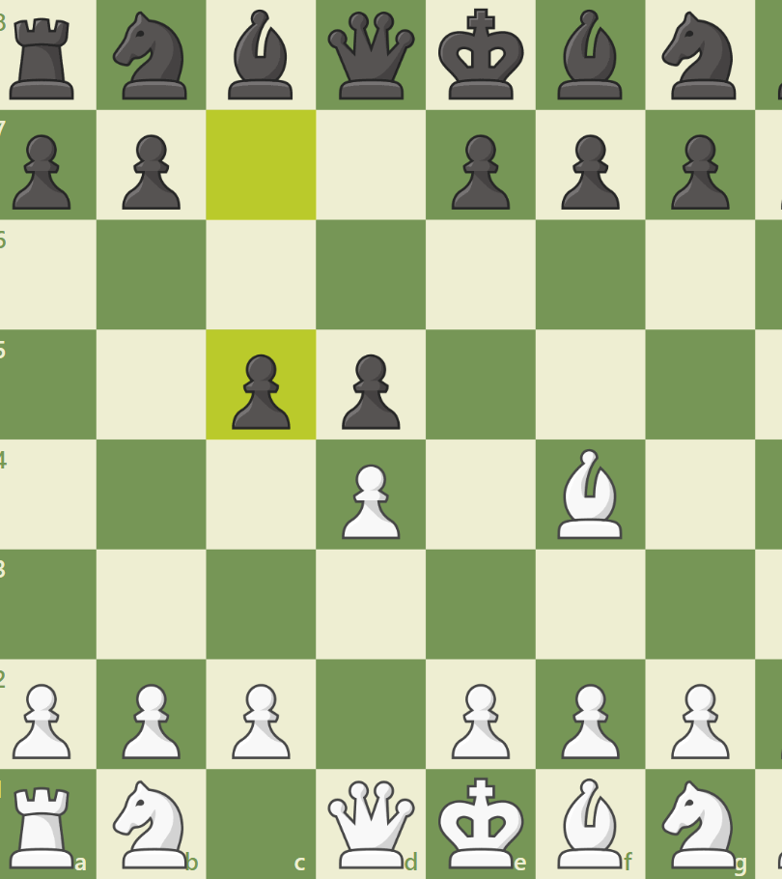
Opening phase
Where piece development and control of the center predominate.

Slide 7
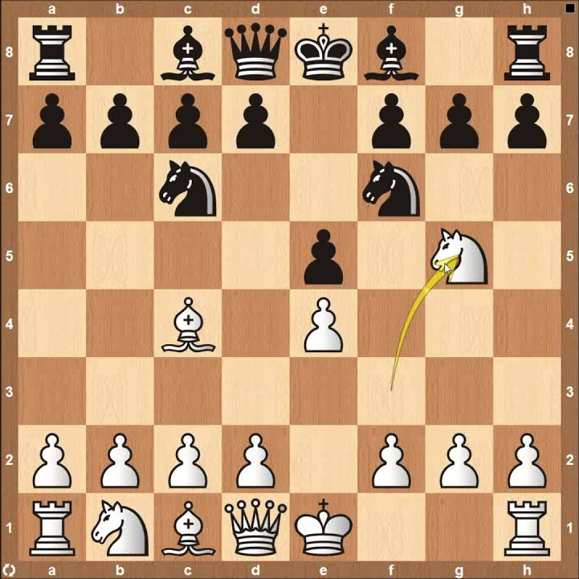
Most popular openings
Some of the most known openings as white:
English Opening, Queen’s Gambit, Vienna Game, London System, Ruy Lopez;
as black:
Sicilian Defense, French Defense, Caro-Kann Defense, Pirc Defense, Indian Defenses;

Slide 8
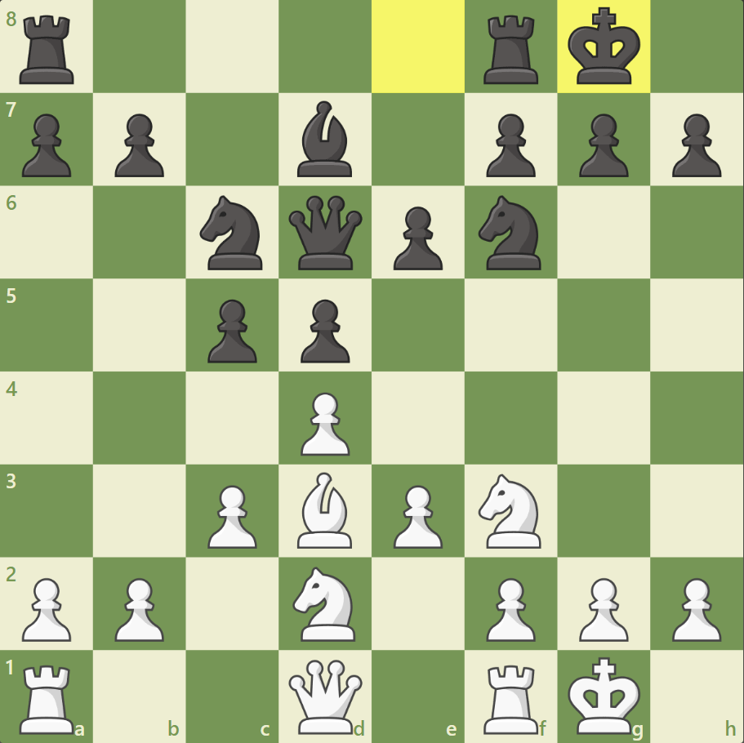
Middlegame phase
Where maneuvering in defense and attack against the opponent’s king or weaknesses occurs leading into having the advantage of the game

Slide 9
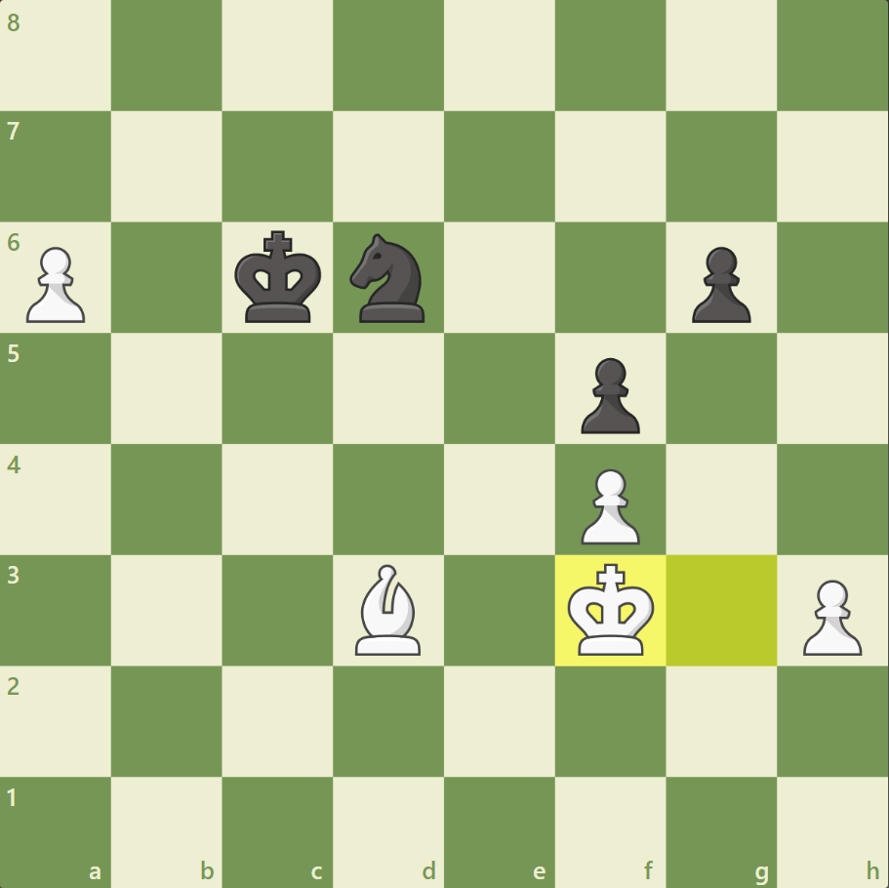
Endgame phase
Where, generally after several piece exchanges, pawn promotion becomes the dominant theme.

