Slide 1
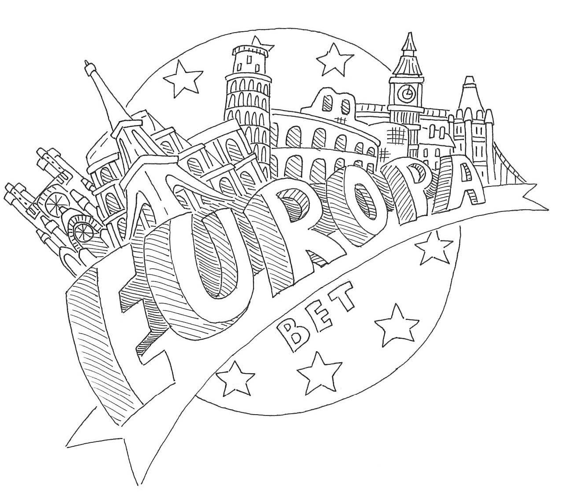
HERITAGE IMAGES
Milena Bania
Katarzyna Cieślik
Krzysztof Figiel
Mikołaj Gawlik
Agnieszka Grabowska
Natalia Gumułka
Jakub Kot
Adrianna Łopusiak
Wiktoria Sikora
Józef Suruło

Slide 2
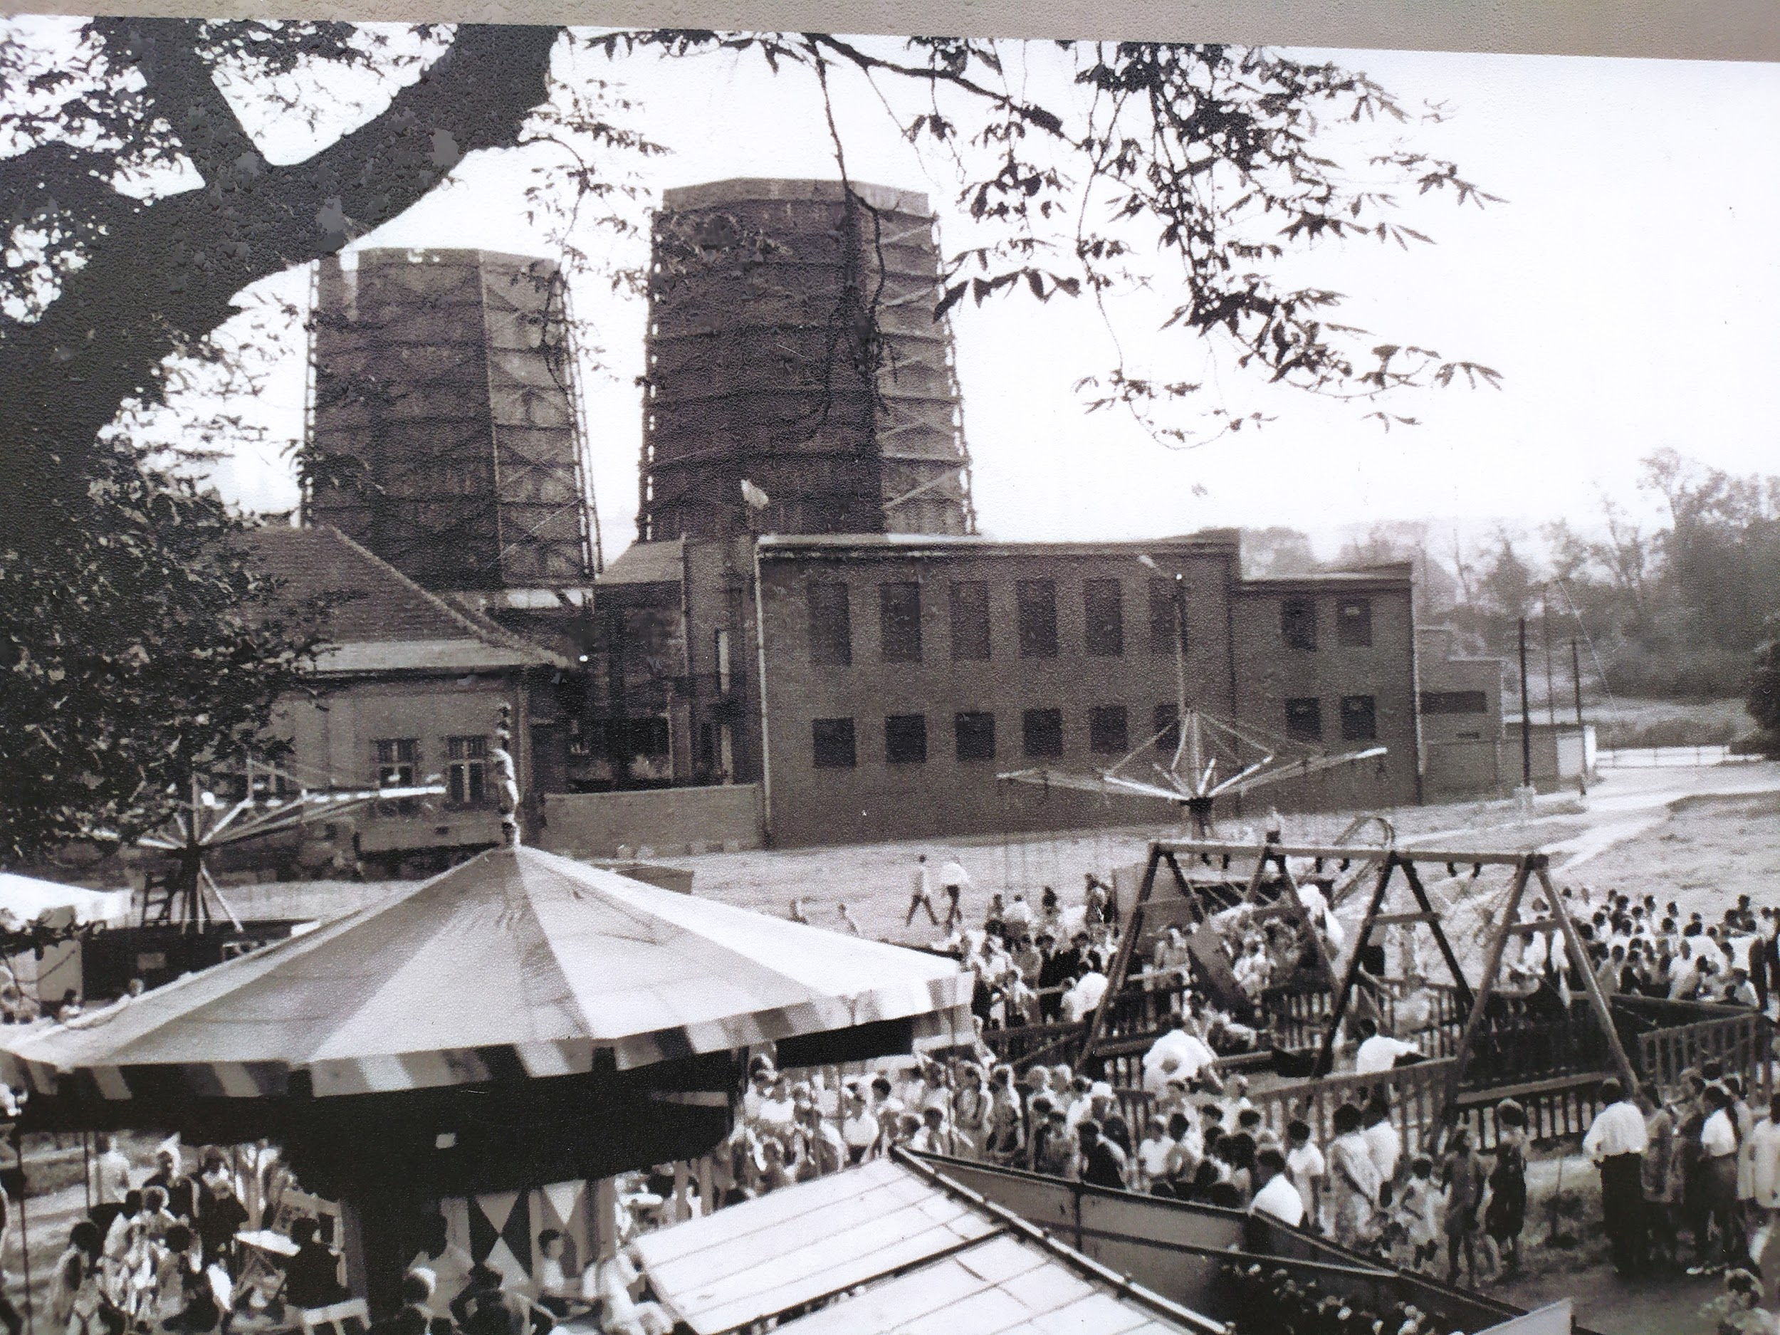

Slide 3
Wieliczka Days
In our gloomy world there is sometimes an opportunity to do something different than usual. Once a year there are "Wieliczka Days" celebrated in our town. For the local people it is a chance to have fun and to meet up. As we can see in this old photo there are for example carousels at the event which is especially attractive for younger generations. The theme park is situated next to the Salt Mine - the place Wieliczka is most famous for and there are a lot of attractions there, various kinds of food, contests and presentations. This event has become a tradition for the residents, every year a different music star gives a concert during "Wieliczka Days".
Katarzyna Cieślik

Slide 4
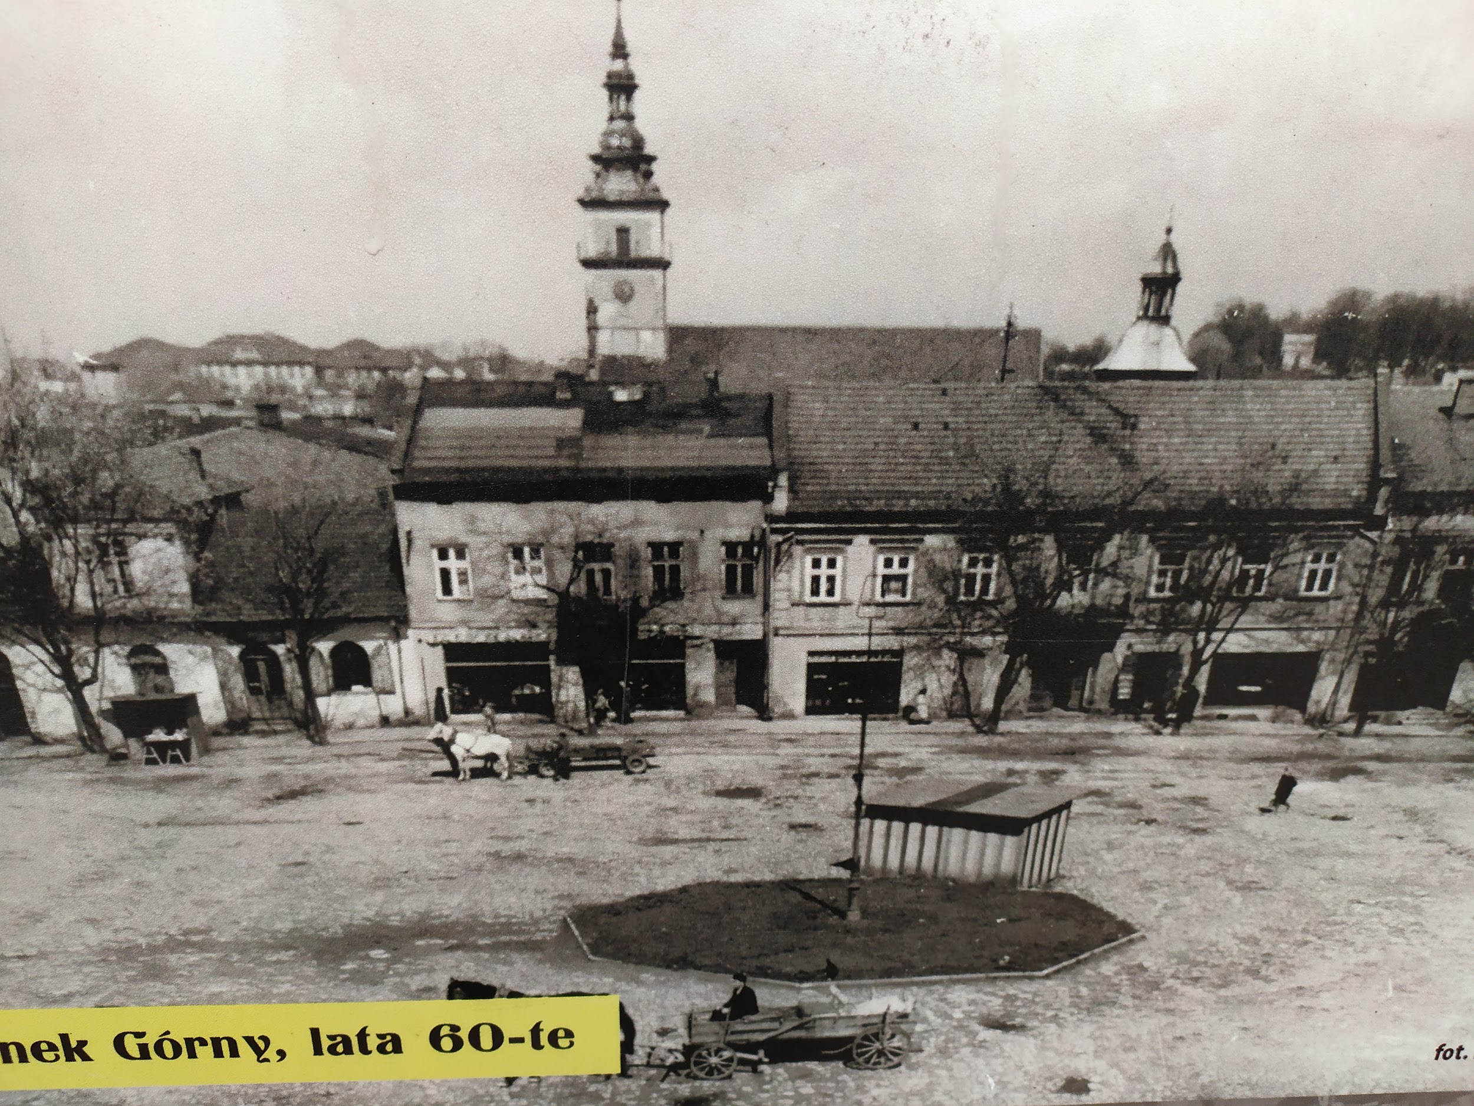

Slide 5
Main Square
The picture was taken in the 1960s and it shows the main square in Wieliczka. This place was very important because it was where business meetings were held as well as local celebrations and exhibitions. People used to come here from the surrounding villages to sell and buy goods. In the centre there are a few buildings which could be used as stores. In the background there is a church which used to be the centre of life in the past. Faith and church services were really important. People who attended them could also go to the nearby market square and do business. In the photo we can also see a horse and a cart used to carry goods to and from the market. Transport was completely different those days, there were very few cars.
Wiktoria Sikora

Slide 6
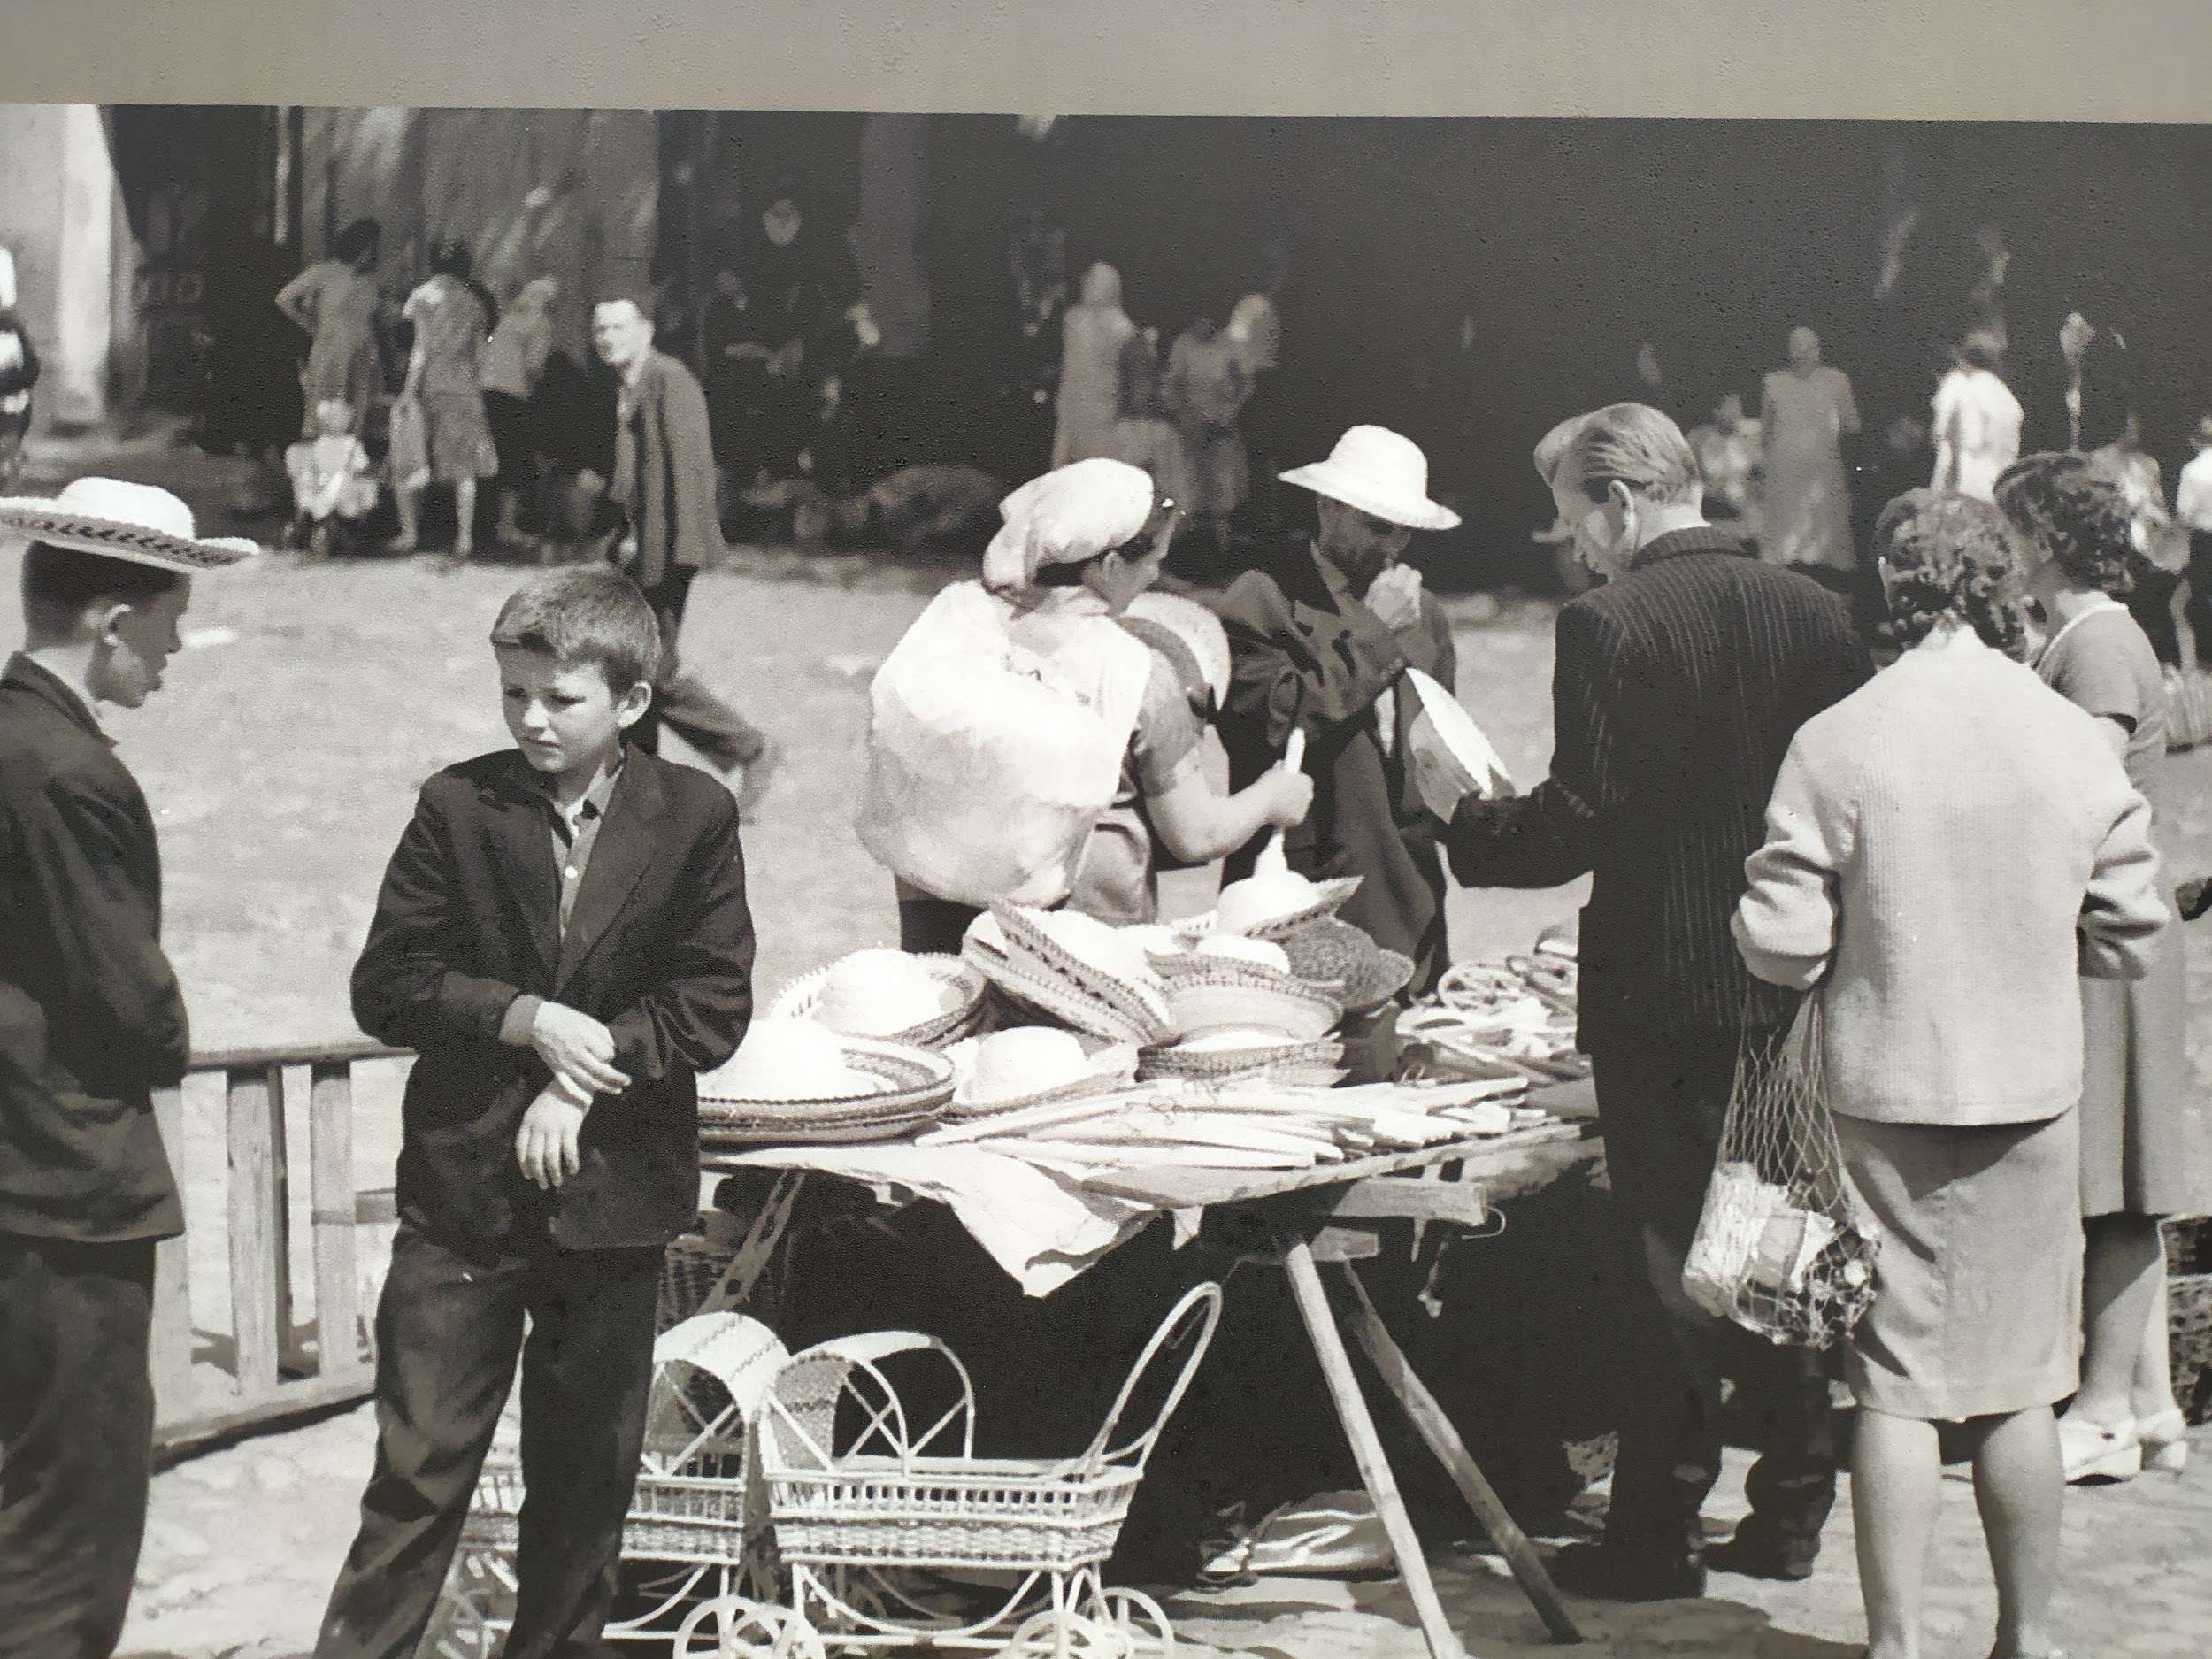

Slide 7
Local Market
In the photograph we can see a local market in Wieliczka. At the times of the Polish People's Republic (communist times) shops didn't prosper very well so people gathered mostly in local markets, set up their stalls and traded various goods, usually self-produced. People brought among others: food, clothes, farm animals, paintings, souvenires, etc. In such places you could often come across some crooks or thieves who only looked around for potential victims.There were also street beggars who hoped that other people would give them some money. Such markets used to bustle with life. This form of trade has survived to these days however after the fall of communism they ceased to be as popular as in the past.
Krzysztof Figiel

Slide 8
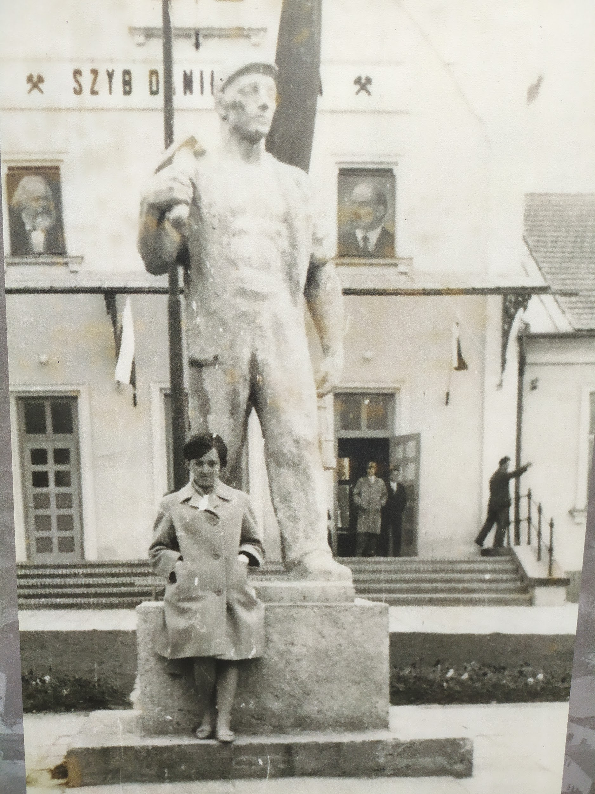

Slide 9
Statue of a miner
In the picture we can see a statue of a miner, in front of the mining shaft, in the 60s. The salt mine is the main facility in Wieliczka, this is what the city is famous for, it is recognizable. The statue shows a miner wearing his uniform and ready to go to work. It illustrates the work of that time - physical, hard and tedious. It fits very well into the background - the mine, it used to beautify this place for many years. In those days it created the atmosphere, it was common, to put statues in the city, usually of someone who deserved it thanks to their attitude to hard work for the city. This way, the inhabitants could show their gratitude for the deeds of hard working people. Every city needs their own heroes.
Mikołaj Gawlik

Slide 10
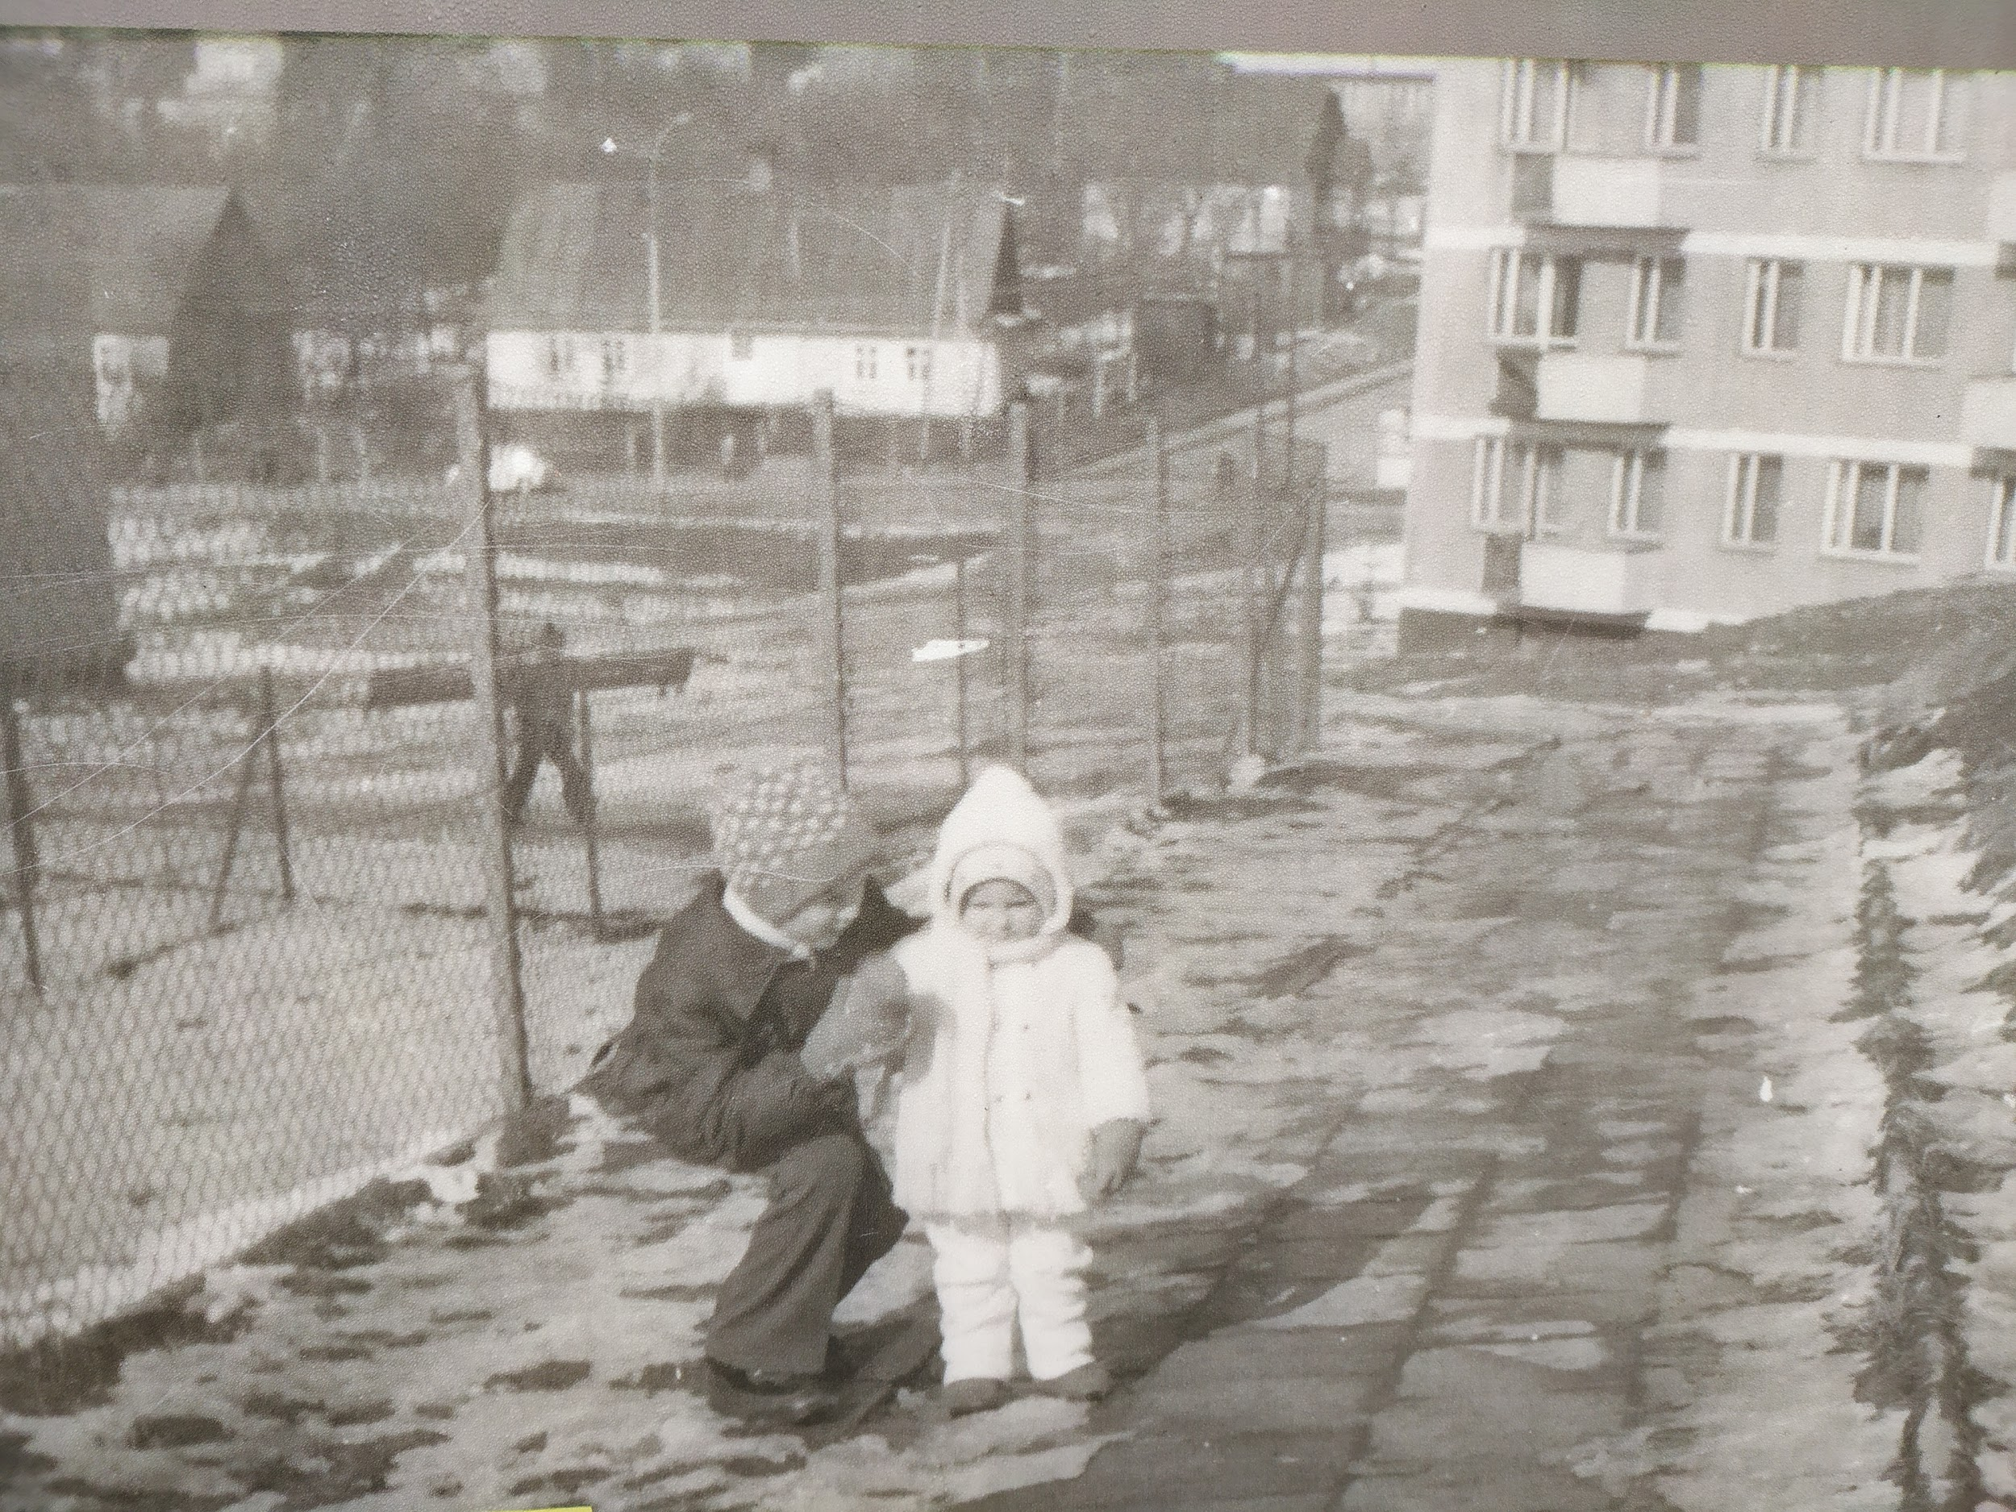

Slide 11
The development of the city
In the photo there are two kids near a construction site. It was taken in 1960s when a lot of people from villages came to Wieliczka to look for a job. The town needed to build new flats and create new housing estates for them and their families. It was a good time for the city because lots of people wanted to be miners. Sienkiewicza residential area is one of the biggest in the town and the photo presents it during construction works.
Jakub Kot

Slide 12
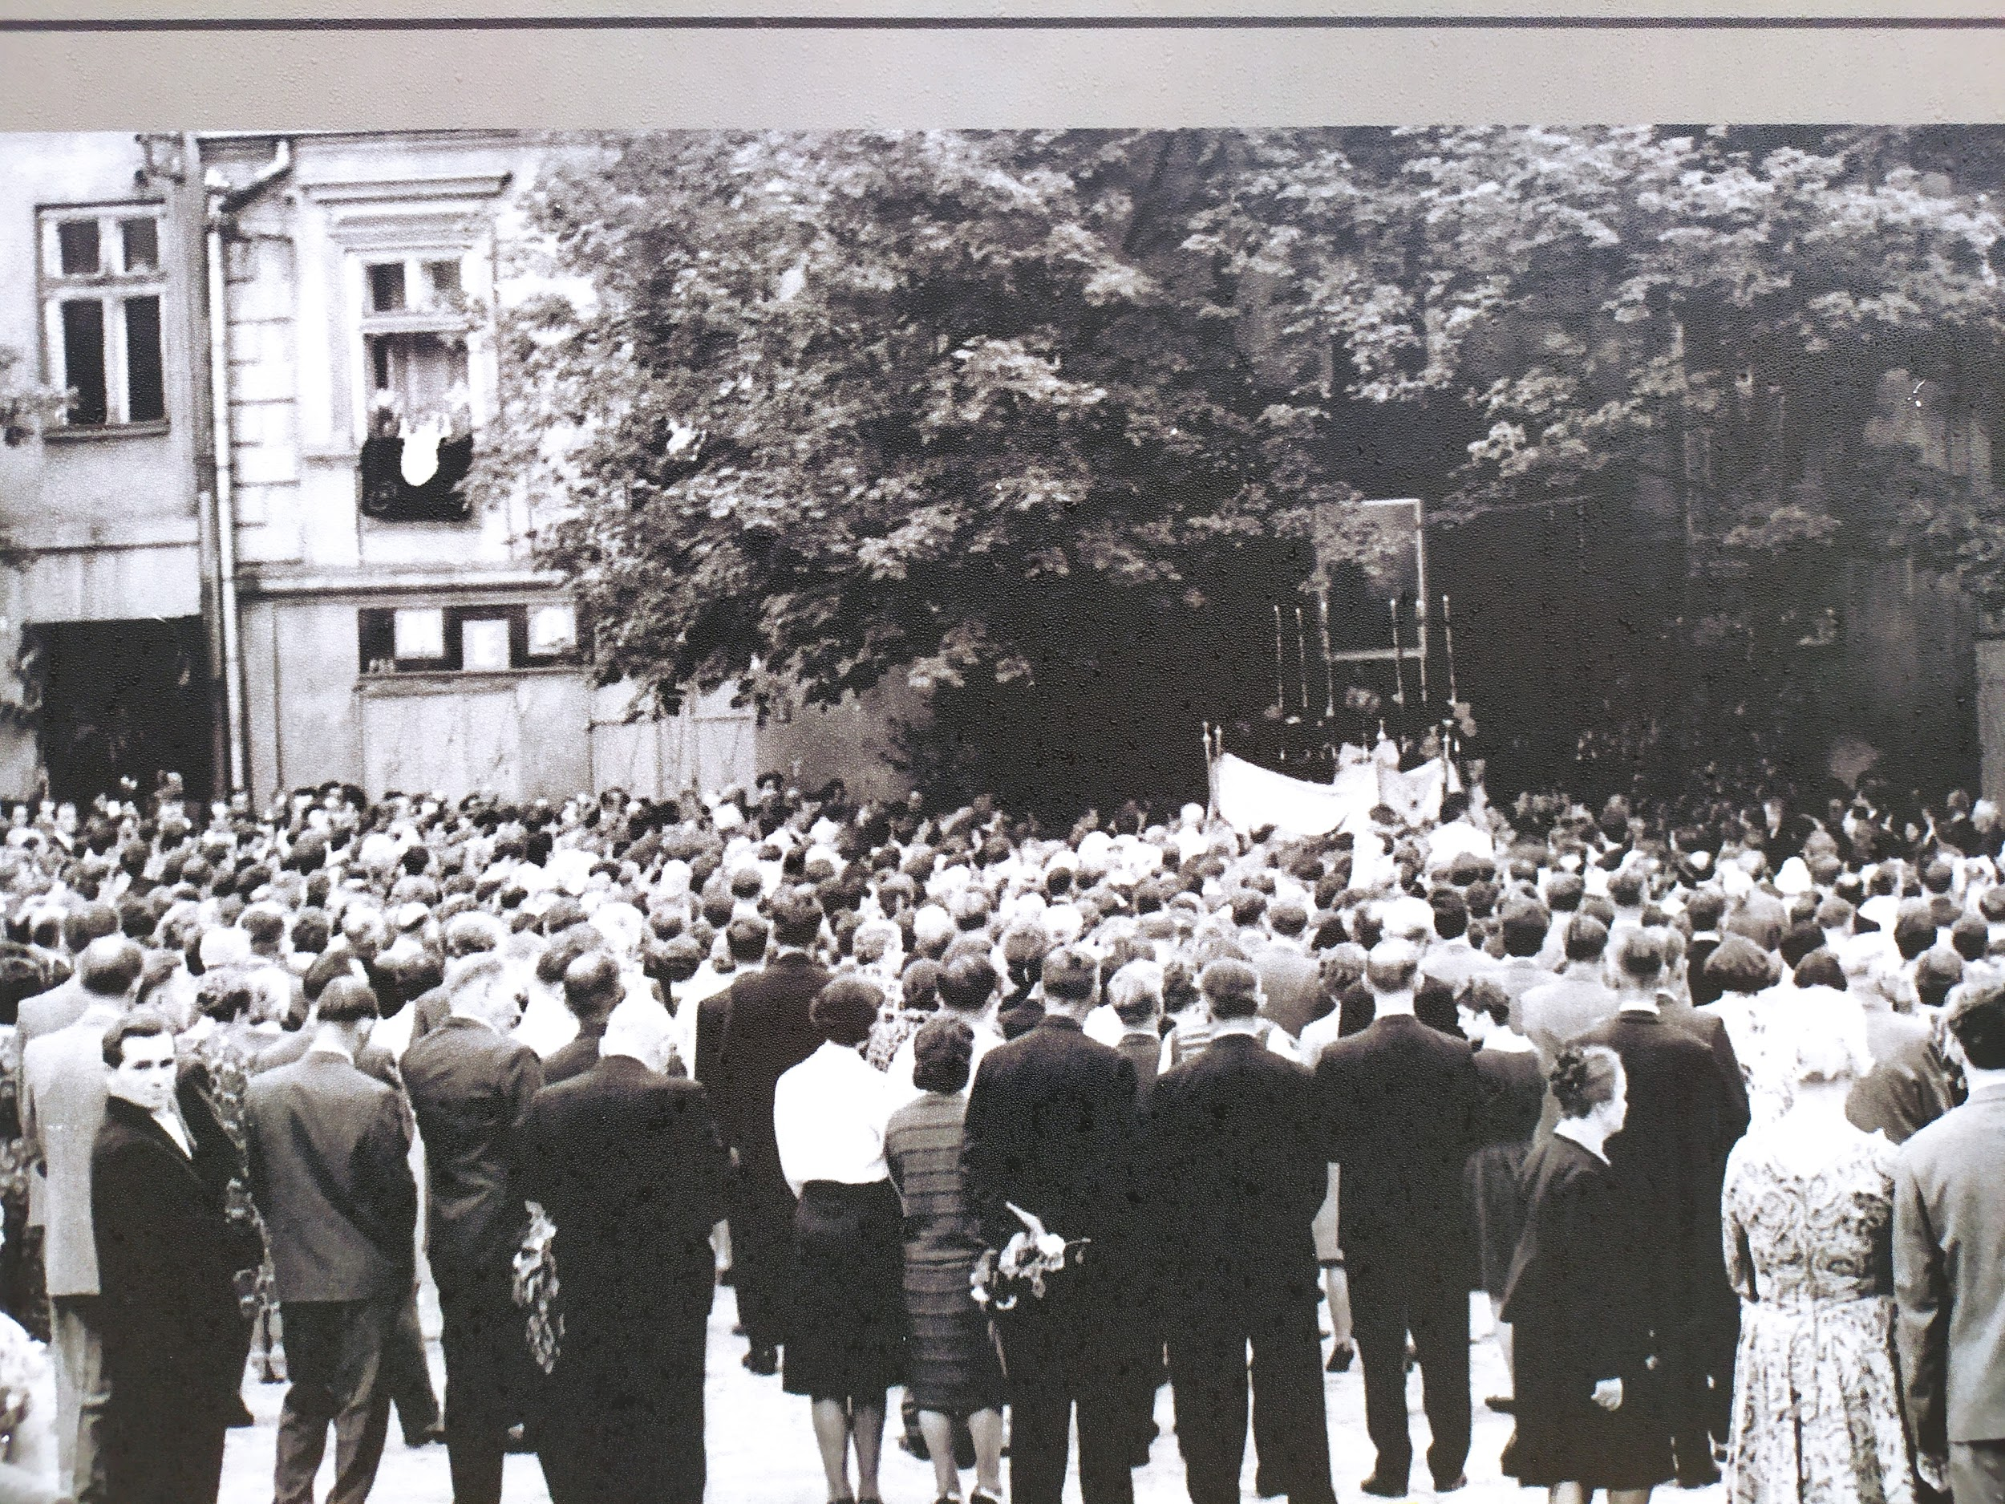

Slide 13
Corpus Christi Procession
The Corpus Christi procession which is a celebration to honour Jesus Christ in the Blessed Sacrament. It takes place in May or June and in Poland it is a a day off. It is a really important event for Catholics who follow the priest with the monstrance to the four altars. One of them is presented in this old photo - decorated with flowers, candles and an ikon. At the end of the procession there is a special blessing for all the people gathered around the altar. The people are dressed elegantly which proves the importance of the celebration. Although we can't see it in the photograph there is a tradition of throwing fresh flowers on the road by little girls dressed in folk costumes.
Agnieszka Grabowska

Slide 14
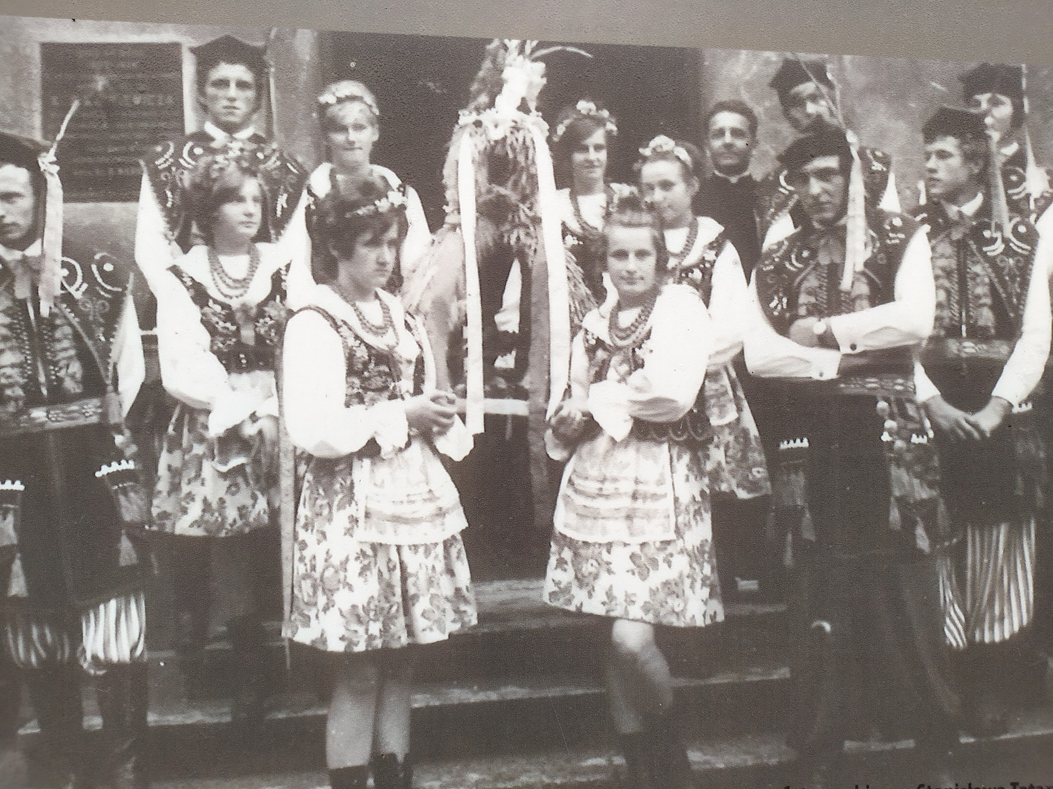

Slide 15
Harvest Festival
In the picture you can see a group of people posing for the picture. They are dressed in Cracovian folk costumes and the girls in front are holding a harvest gift decorated with ribbons. Harvest Festival was a folk festival celebrated at the end of each summer when people thanked for the corps they were able to get and asked for even better ones in the coming year. Wreaths and bouquets with various plants were brought to the church, where the priest sprinkled holy water on them. Although there is not much joy on the faces of these people, it is an important holiday when people should be happy for having any kind of harvests. Nowadays the festival is still popular in some parts of the country.
Natalia Gumułka

Slide 16
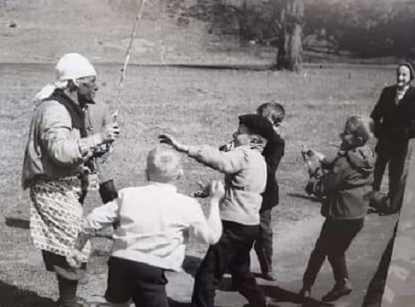

Slide 17
Siuda baba
"Siuda Baba" is part of an old Polish folk custom celebrated on Easter Monday in Lednica Górna and in Wieliczka. Each year a man dresses up as a poorly clothed woman and darkens his face with soot. Siuda Baba walks from house to house to collect donations and smears girls' faces with soot along the way. It is believed that it brings good luck for the coming year and a smeared girl should expect to get married soon. It's based on a legend which says that in Lednica Górna Siuda Baba had to guard a fire in a sacred grove on a hill named Kopcowa Góra. She spent the majority of her time watching the fire burning and that's why her face was covered in dirt. The only way she could free herself was by capturing a maiden to take her place.
Milena Bania

Slide 18
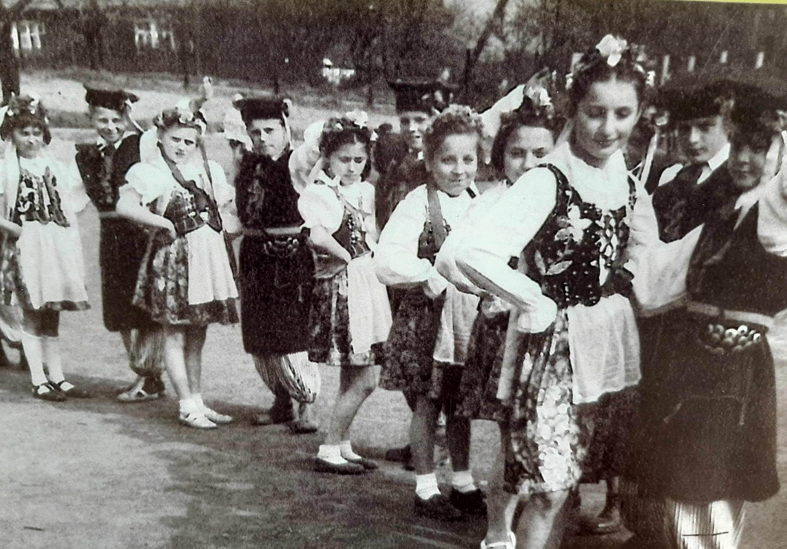

Slide 19
Regional Costumes
The photo shows a group of young people - children and teenagers in Wieliczka next to the primary school number 1. They are dressed in Cracovian regional costumes and maybe belong to a folk band. The children are dancing in pairs. The presented activities are aimed at cultivating folklore traditions. It was very important for people at that time because the II world war ended and they wanted to go back to a normal life. This photo was taken during PRL (communist times). The government imposed a great deal of orders and watched the citizens and their actions. The people wanted to pass the traditions on children, teach them about the culture of the region where they lived .
Adrianna Łopusiak

Slide 20
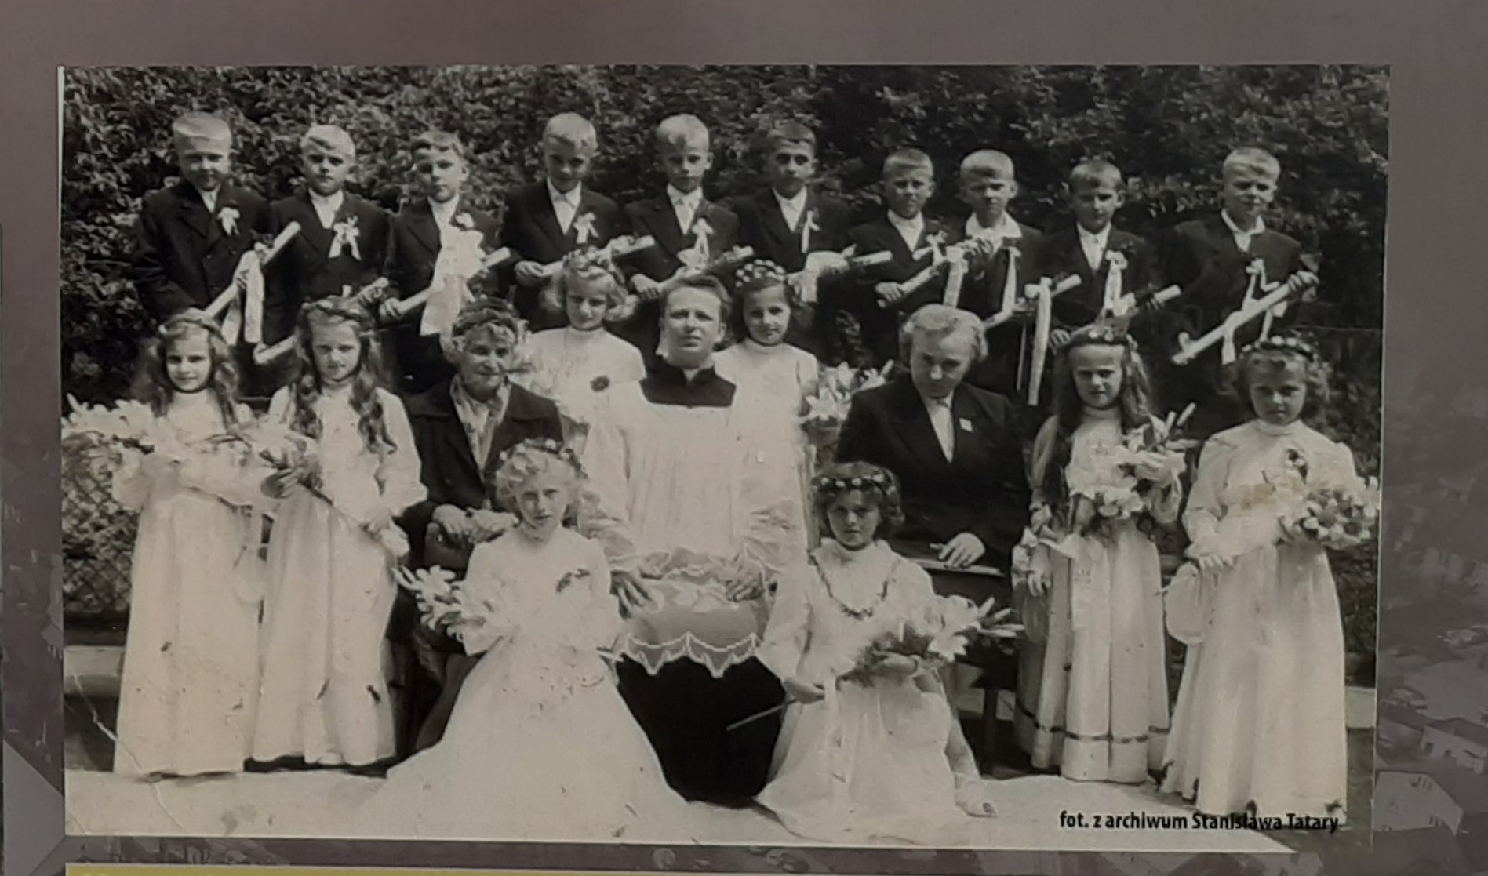

Slide 21
First Holy Communion
The old picture shows children who participated in their First Communion. It was in the 1960s in the Polish People’s Republic (political system imposed by the Soviet Union after World War II. It was clearly an important event for that grup of children who dressed in white clothes took Communion for the first time. Hundreds of people took part in it. After the holy mass the local brass band performed a concert during which people dressed in traditional folk clothes from the Cracow region danced Polish national dances. After the ceremony children went home for family dinner and they got presents. Celebrating First Communion has always been an important element of Polish culture.
Józef Suruło

Slide 22
Thank you for your attention
Source:
Knowledge of class 3F students :)

