Slide 1
HERITAGE VS. ENTERPRENEURSHIP
And how we do it in Poland

Slide 2
Polish Heritage
Cultural property | Intangible culture | Natural heritage
16 UNESCO sites | Polish cuisine | 23 national parks
519 museums | folklore | 121 landscape parks
105 Monuments of Culture | religion history | 1469 nature reserves
Cracow Historic Centre and Wieliczka Salt Mine were the first two sites inscribed on the UNESCO World Heritage List in 1978

Slide 3
Tourism in poland
(according to the Polish Central Statistical Office)
In 2017 the number of arrivals to Poland was 83.8 million people making Poland the 16th most visited country in the world.
Cracow was visited in 2018 by 13.5 million people both from Poland and abroad.
Wieliczka Salt Mine in 2018 broke a record of the number of visitors (1.7 million).
Tourists from abroad spent in Poland 8,7 billion dollars in 2017 only.
Tourists in Cracow spent in 2018 over 4 million euro a day!

Slide 4
LOCAL ENTERPRENEURS

Slide 5
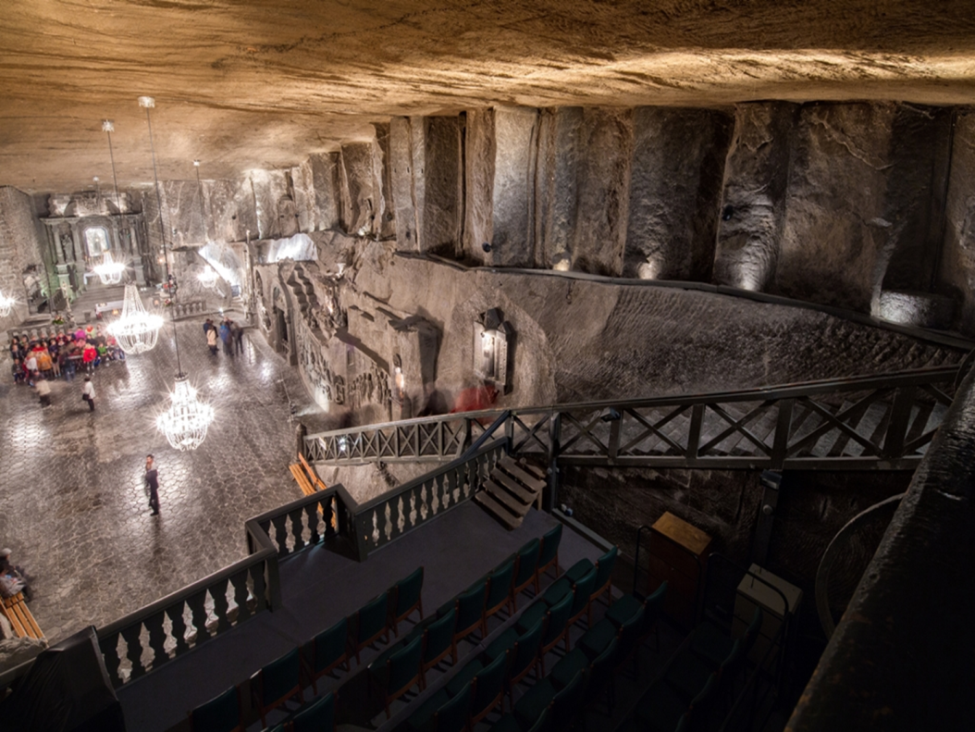
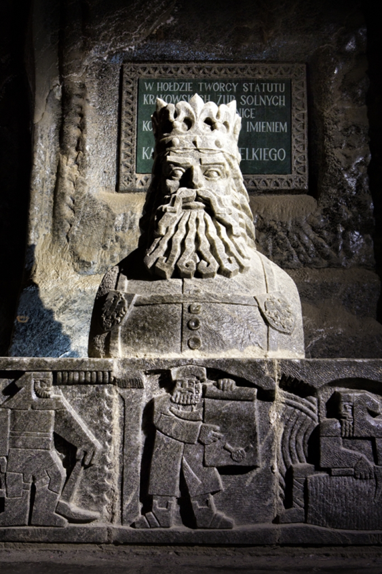
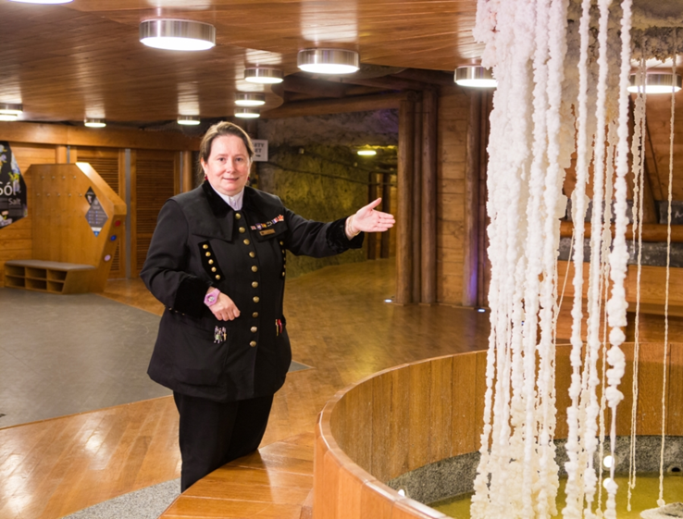
Wieliczka salt mine

Slide 6
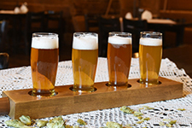
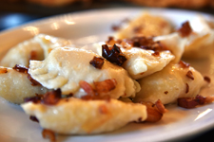
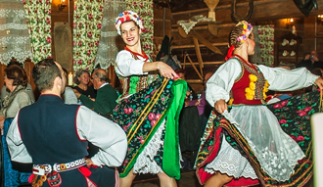
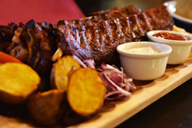
Karczma pod wielką solą

Slide 7
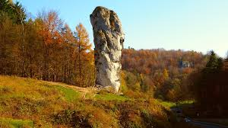
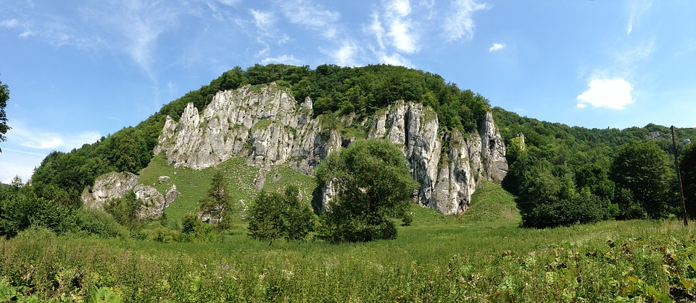
Ojcowski Park narodowy

Slide 8
How we teach heritage?
TRIPS | HISTORY | CONFERENCES | LITERATURE
CUISINE | FESTIVALS | PATRIOTISM | CLUBS

Slide 9
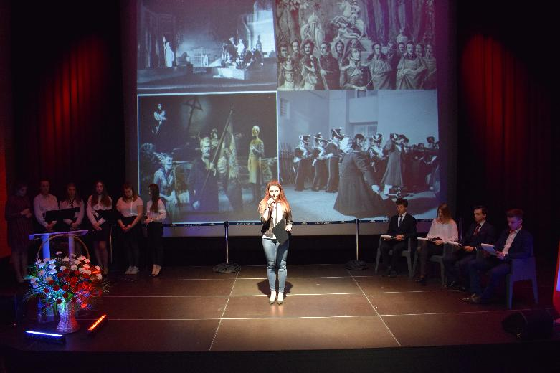
Patron Day

Slide 10
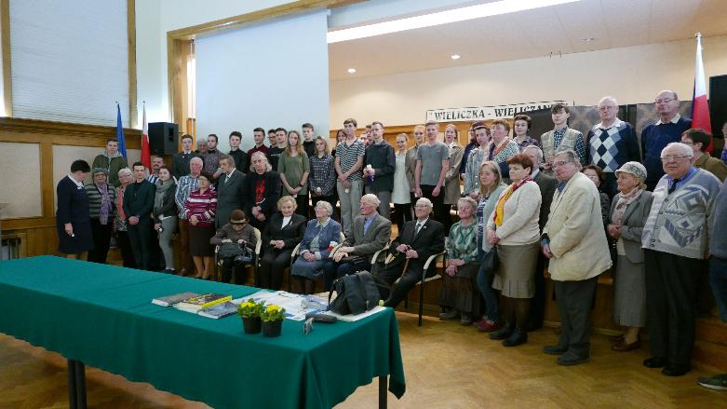
Meetings with Combatants

Slide 11
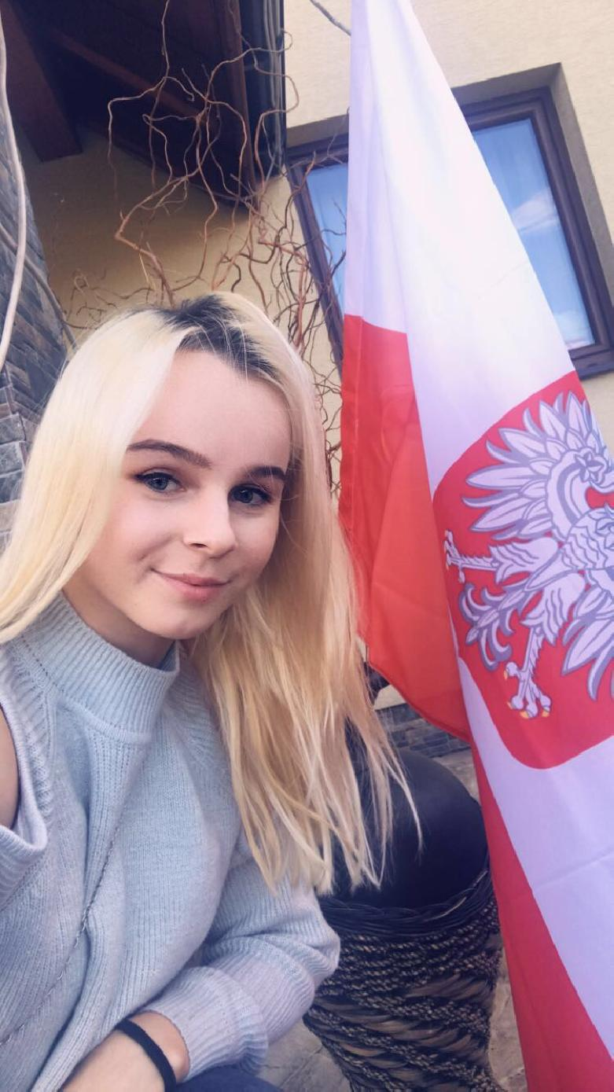
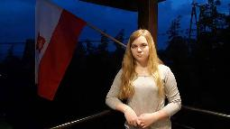
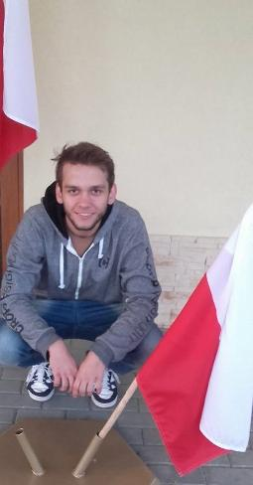
Flag Day

Slide 12
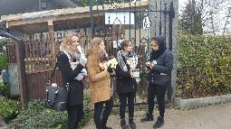
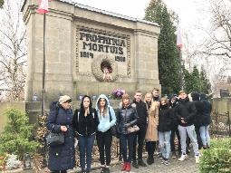
Fundraising campaigns

Slide 13
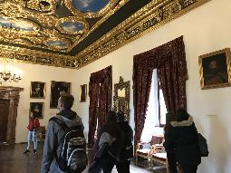
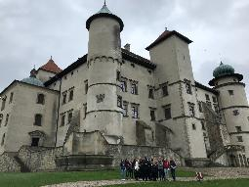
Trips to museums

Slide 14
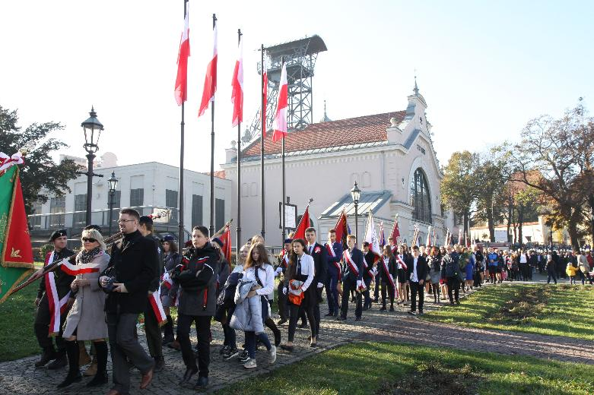
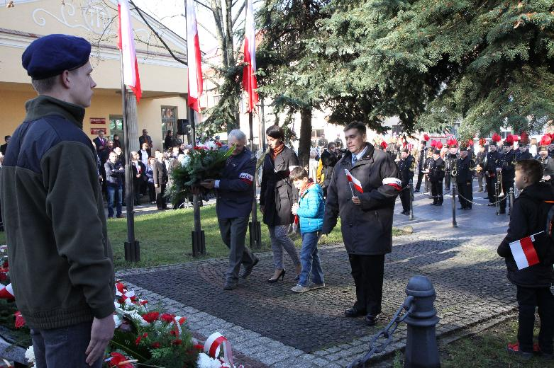
National holidays

Slide 15
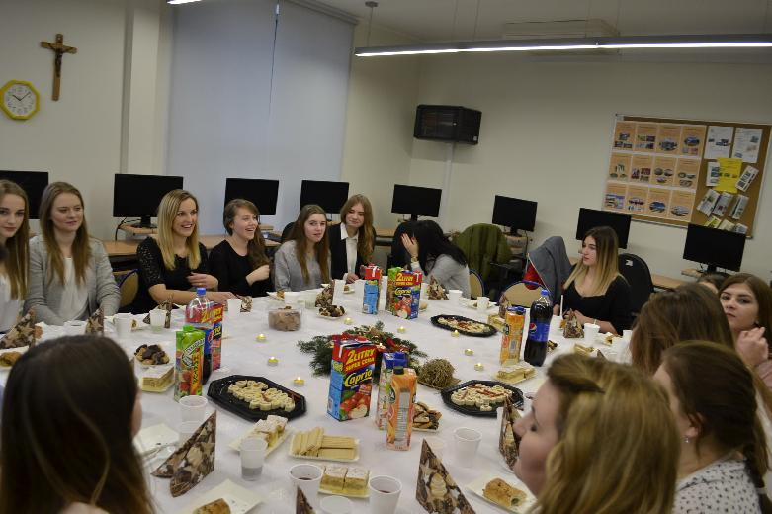
Festivals & traditions

Slide 16
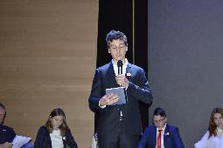
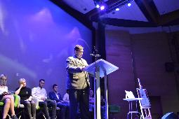
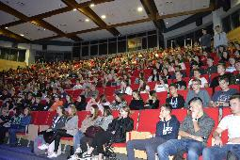
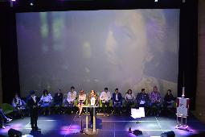
National reading Day

Slide 17
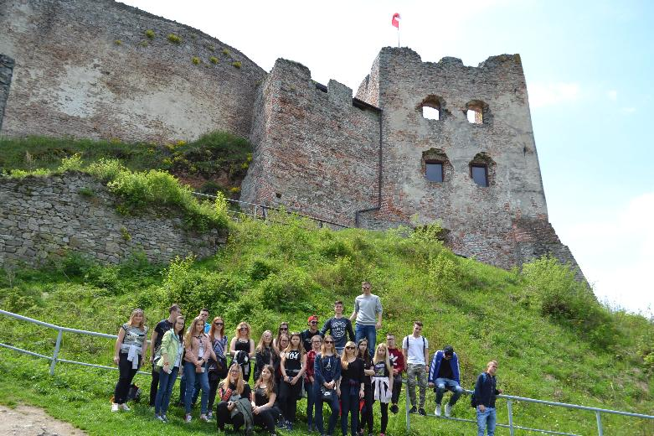
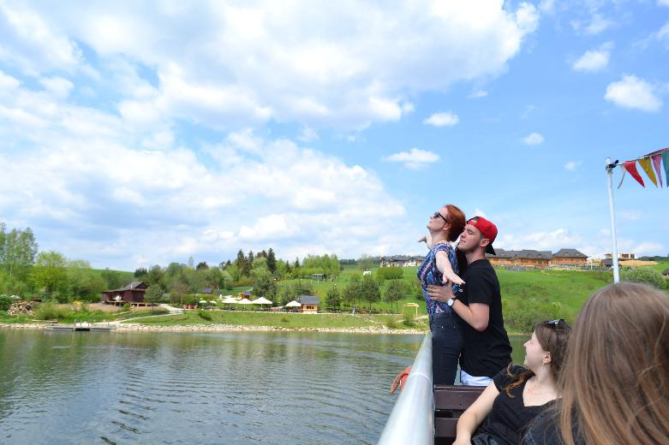
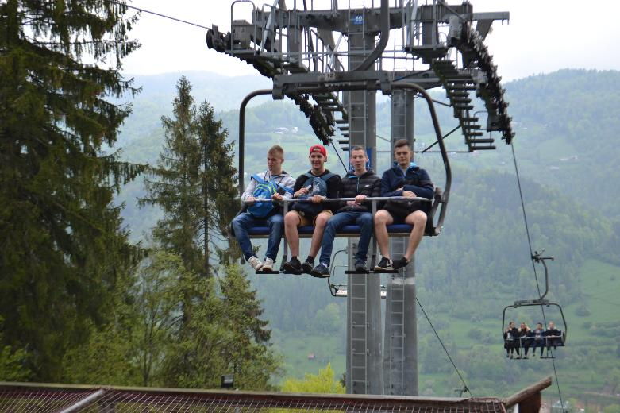
nature excursions

Slide 18
How we teach enterpreneurship?
School subject
Global money week
(money management, budget, investments)
My company in my commune
(Start-up contest)
Global Enterpreneurship Week
(teaching business at the whiteboard)
Enterpreneurship Olympiad
(2019 Managing Diversity)

Slide 19
We teach professionals in
Hospitability
Economy
Tourism
Catering
IT

Slide 20
„You don't stumble upon your heritage. It's there, just waiting to be explored and shared.”
Robbie Robertson

