Slide 1
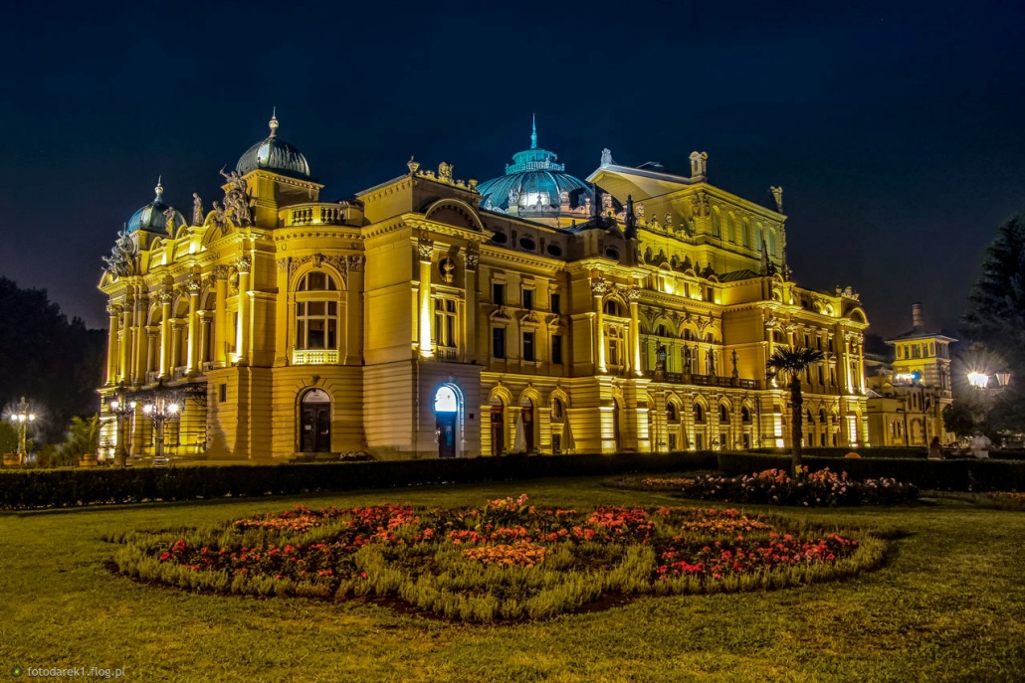
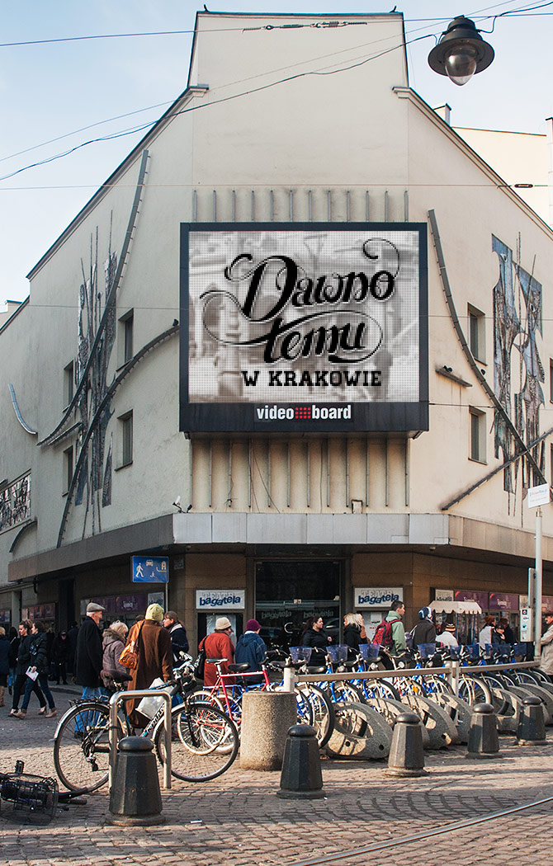
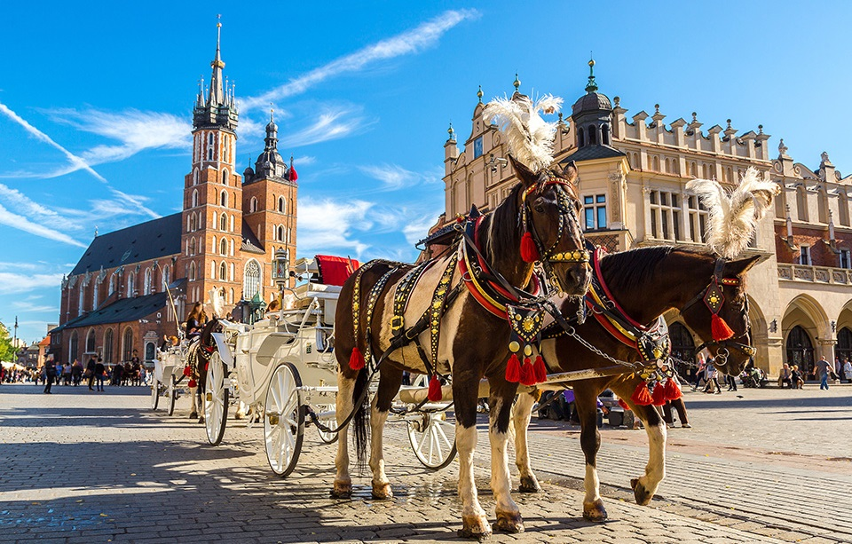
Cracow
The most beautiful things to see

Slide 2
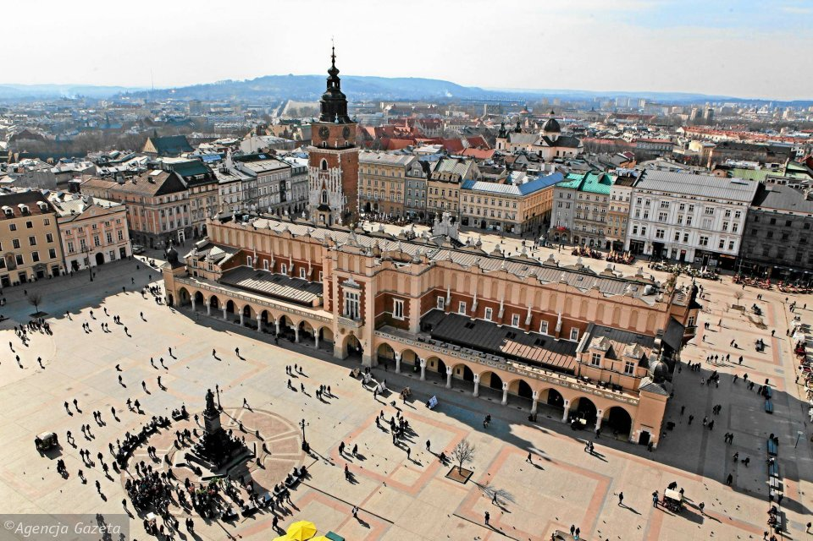
Main Square

Slide 3
That is the most popular place in the city
There are many monuments
Every year many events are organized there
An underground museum and National Museum is located on Main Square
You can eat or drink something in one of the restaurants
It is good place for young residents and tourists, because many discos are near Main Square

Slide 4
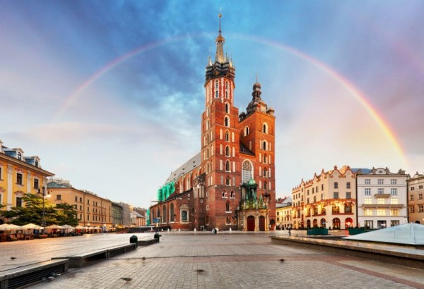
St Mary's Basilica

Slide 5
St Mary’ Basilica was build in XIV century in Gothic style
Every day, hourly you can hear trumpet call – the Hejnał Mariacki.
It was an information before the danger.
It is located in the Main Square
It is one of the most important and one of the biggest sights in Cracow

Slide 6
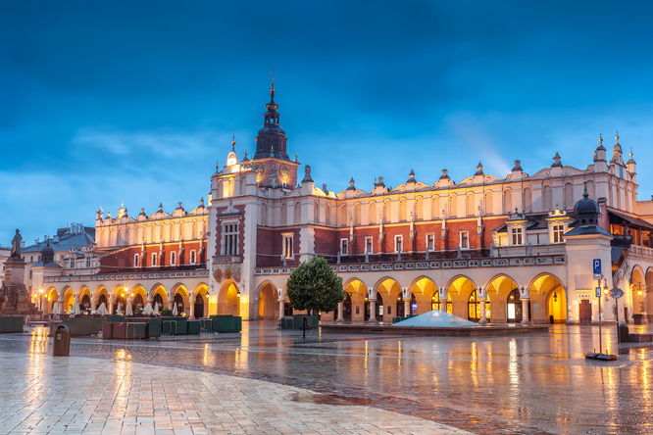
Cloth Hall

Slide 7
Is hailed as the world’s oldest shopping centre
It was build in XIV century by Kazimierz Wielki - one of the Polish kings
Is located in the middle of Cracow’s Main Square
It is build in Renaissance architecture
Now you can buy the souvenirs there

Slide 8
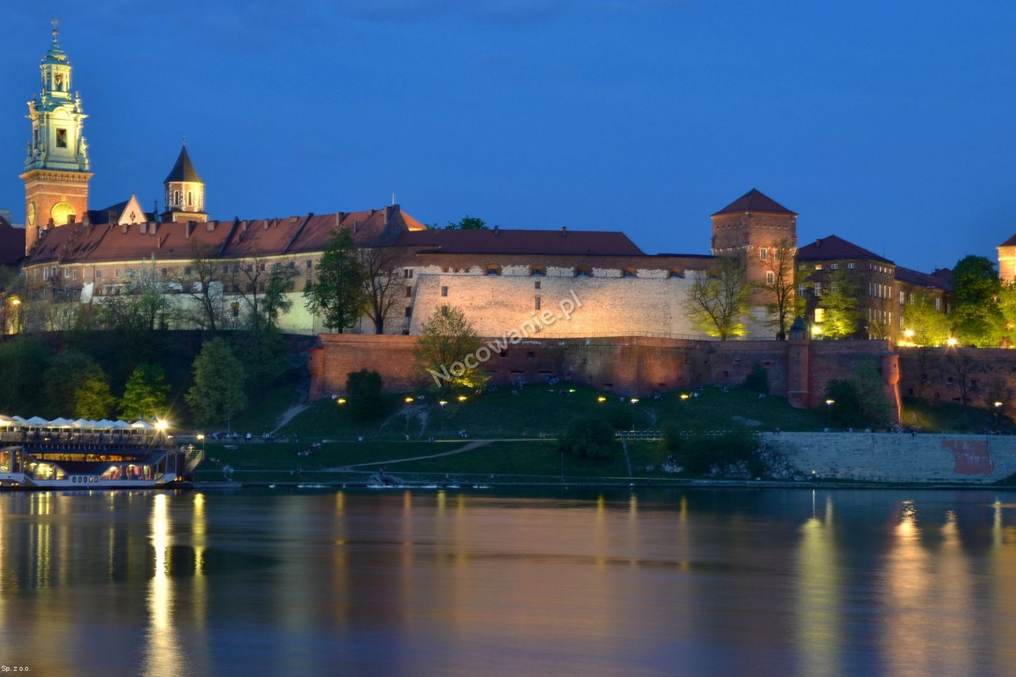
Wawel castle

Slide 9
It was one the home of the Polish kings and Queens
The castle, is build in Gothic, Renaissance, Rococo and Romanesque style
Now there is a museum and you can see there how lived the Polish kings
There is also a very good view of a whole Cracow
It is located on the Vistula river, near Main Square

Slide 10
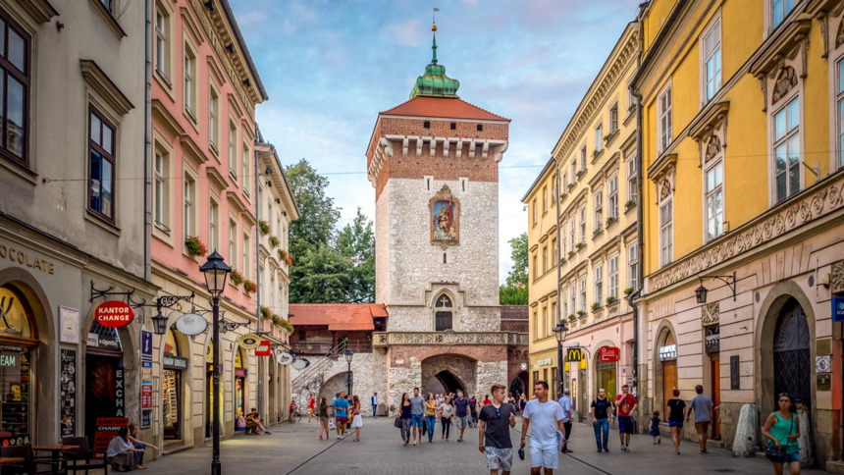
St. Florian’s Gate

Slide 11
From the Middle Ages St. Frlorian’s Gate was the main gate out of seven gates that leads to the town
Name come from St. Florian’s Church but has been call Glory Gate
Kings after wins battles, important and well known people were passing into the town through that gate
It has 34,5 meters height

Slide 12
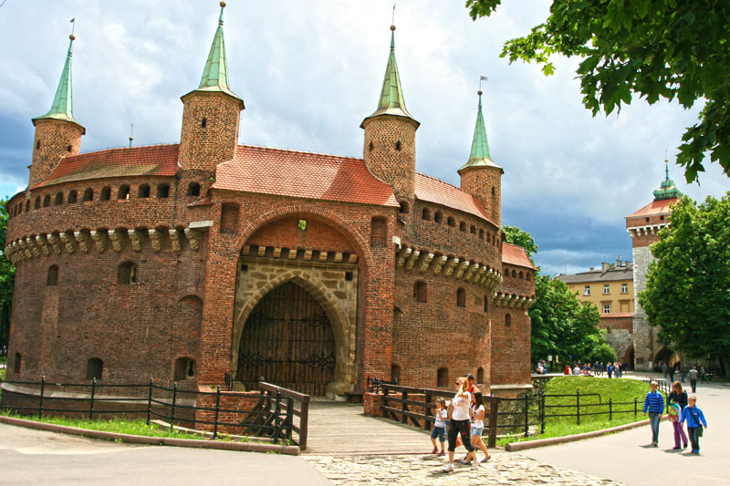
Barbican

Slide 13
The gothic style building is located next to the St. Florian’s Gate
Barbican was build on a circle plan, with seven towers
Walls width is about 3 meters
Poles created Barbican becouse they suspected an attack by Ottoman Empire

Slide 14
Thank you for your attention ☺

