Slide 1
- An Educational Visit - Europos Parkas
Let us bring Europe together for heritage – Let’s BET for heritage
ERASMUS+ KA229
Druskininkai “Ryto” Gymnasium
June 4th, 2019

Slide 2
A Brief Presentation of Europos Parkas

Slide 3
Educational Activities for Students Blue – Japanese sculptures Red – sculptures of women Yellow – moving installations

Slide 4
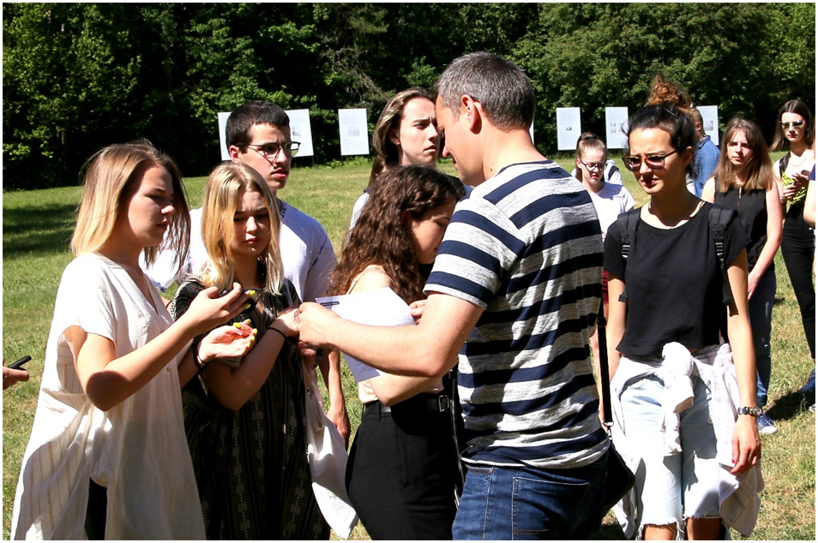
First, students were divided into six international groups and were asked to find some sculptures and art installations.

Slide 5
Then, with the help of the map students tried to find sculptures moving installations.

Slide 6
Dissemination of the Project Activities

Slide 7
Dissemination of the Project Activities

Slide 8
We are waiting for you back to Lithuania! Druskininkai “Ryto” Gymnasium This project has been funded with support from the European Commission. This information reflects the views only of the author, and the Commission cannot be held responsible for any use which may be made of the information contained therein.

