Slide 1

Educational Visits to M.K.Čiurlionis Museum & V.K.Jonynas Gallery
Let us bring Europe together for heritage – Let’s BET for heritage
ERASMUS+ KA229
Druskininkai ¨Ryto¨Gymnasium
June 6th, 2019

Slide 2
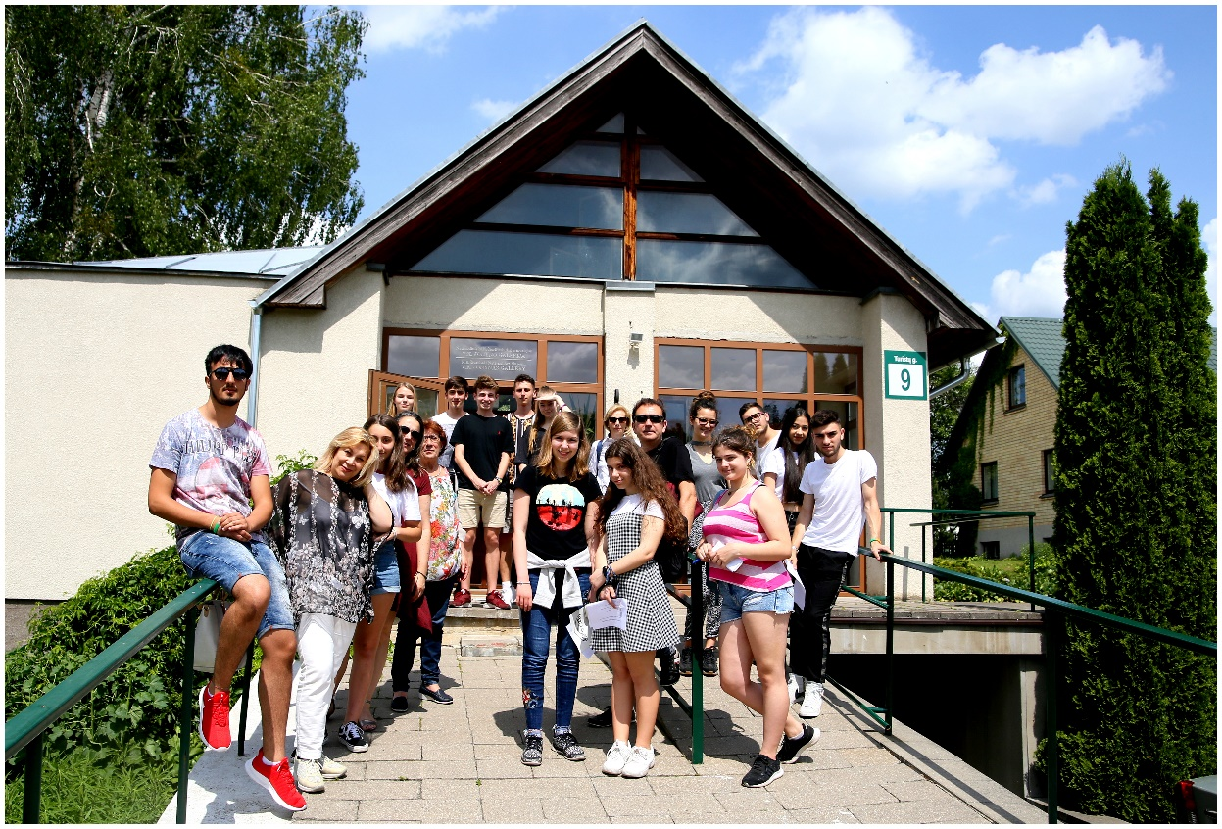
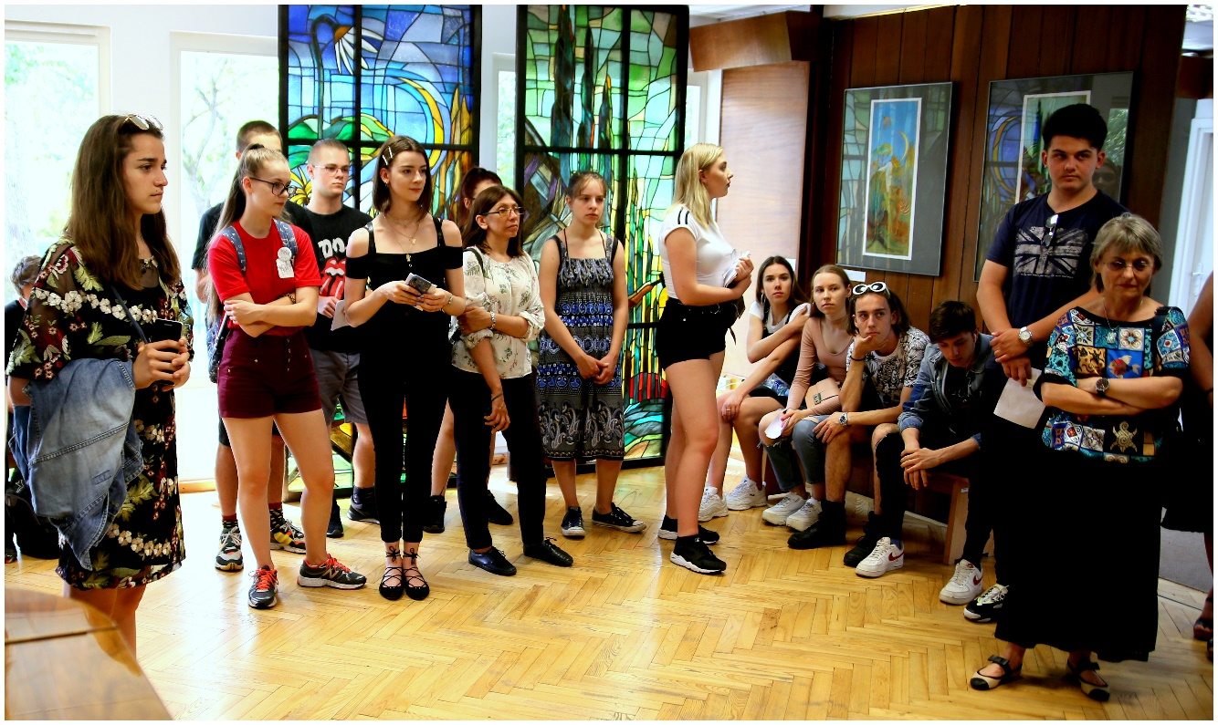
Project participants were divided into two international groups for the visits to two different museums.

Slide 3
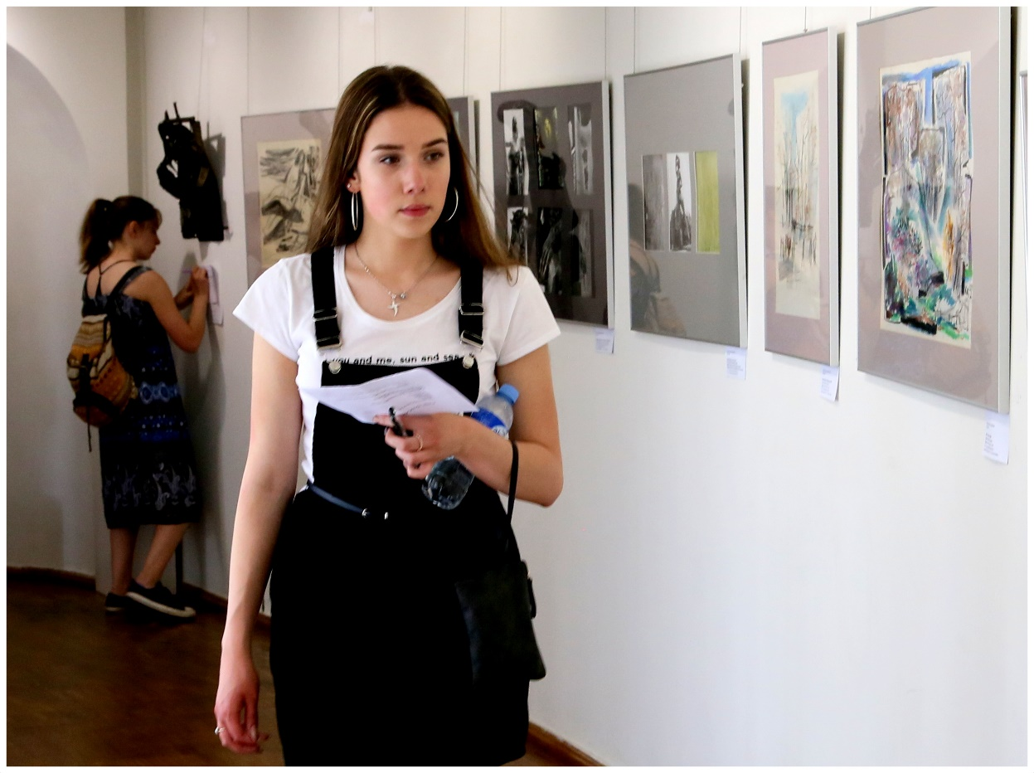
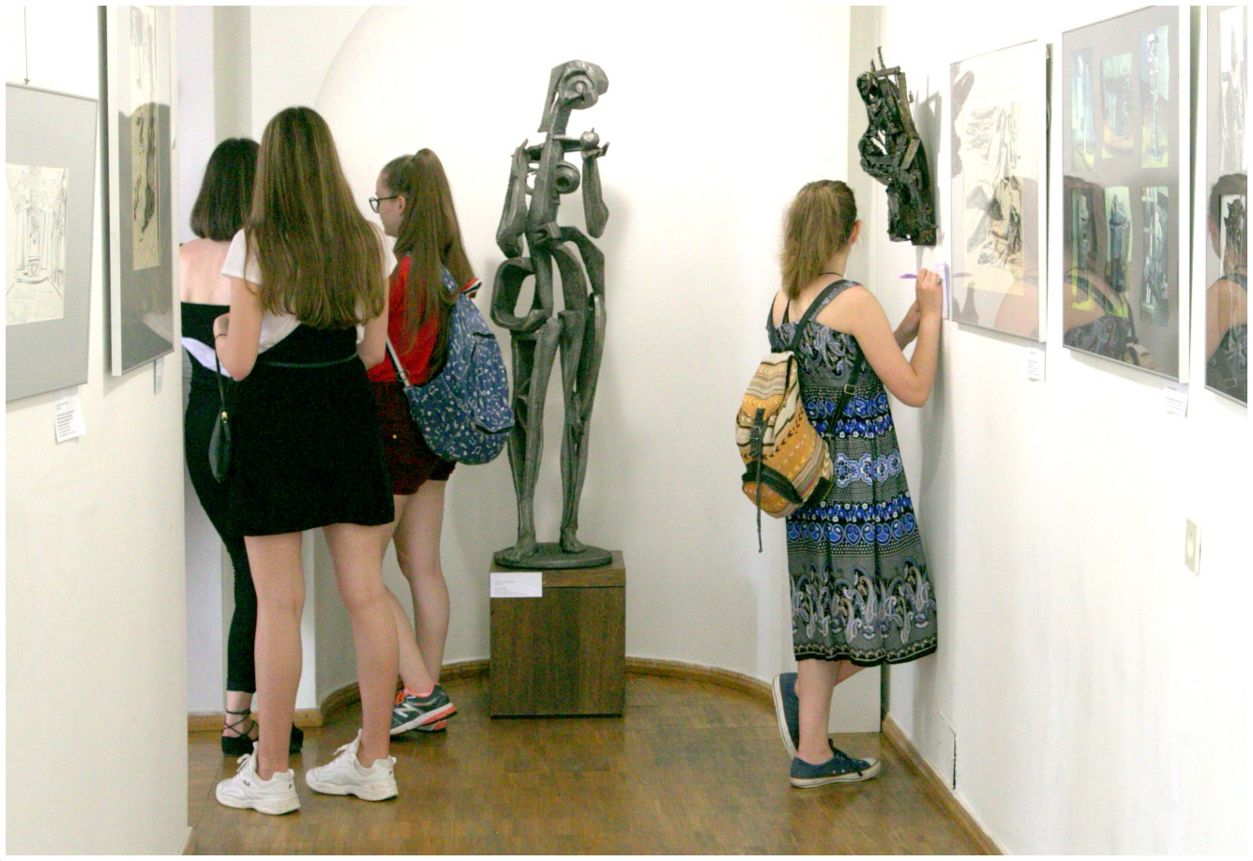
In V. K. Jonynas Gallery students worked on the Questionnaire about Different Types of Arts.

Slide 4
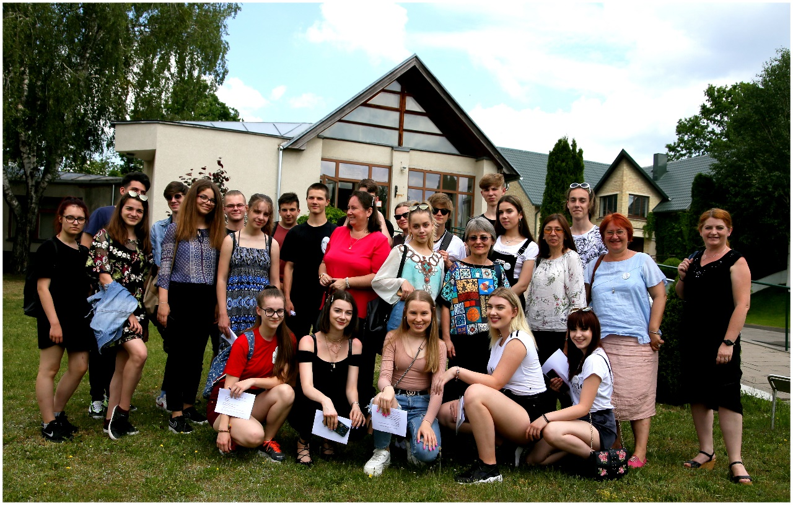
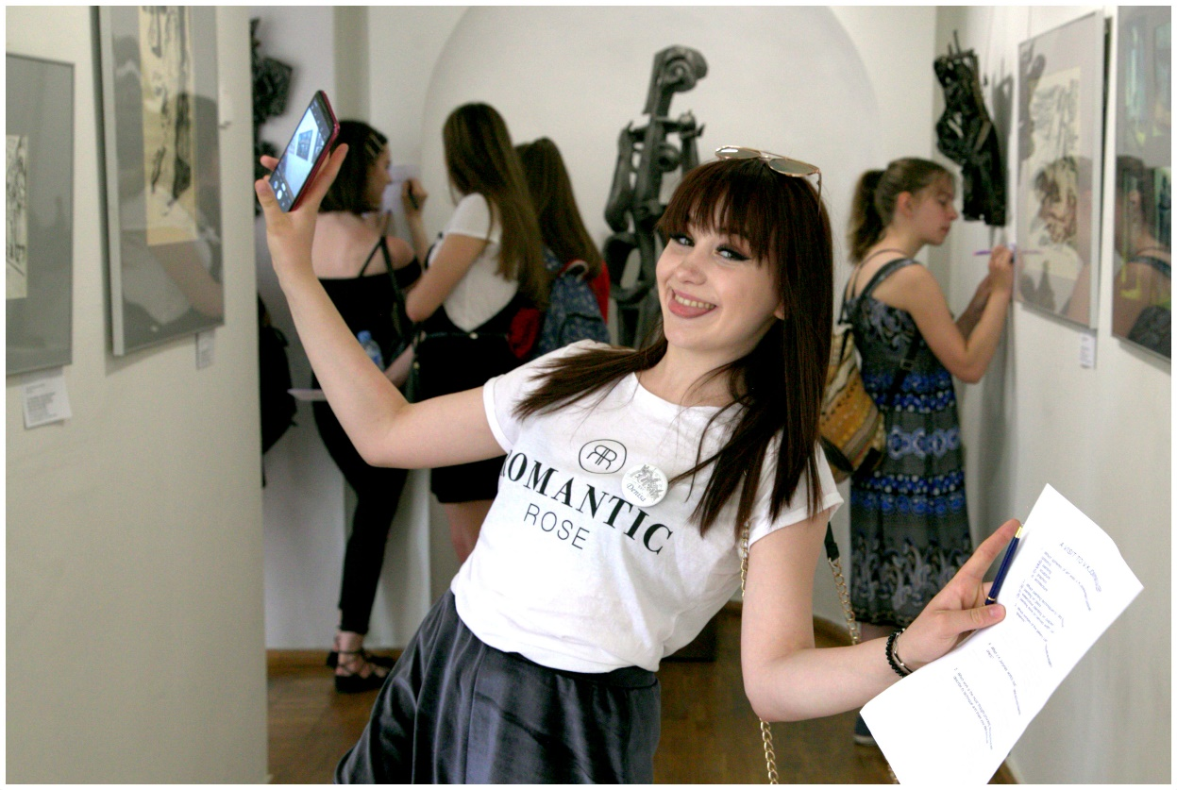
After students fulfilled the task, our Art teacher Virginijus Sutkus moderated a discussion about the activities.

Slide 5
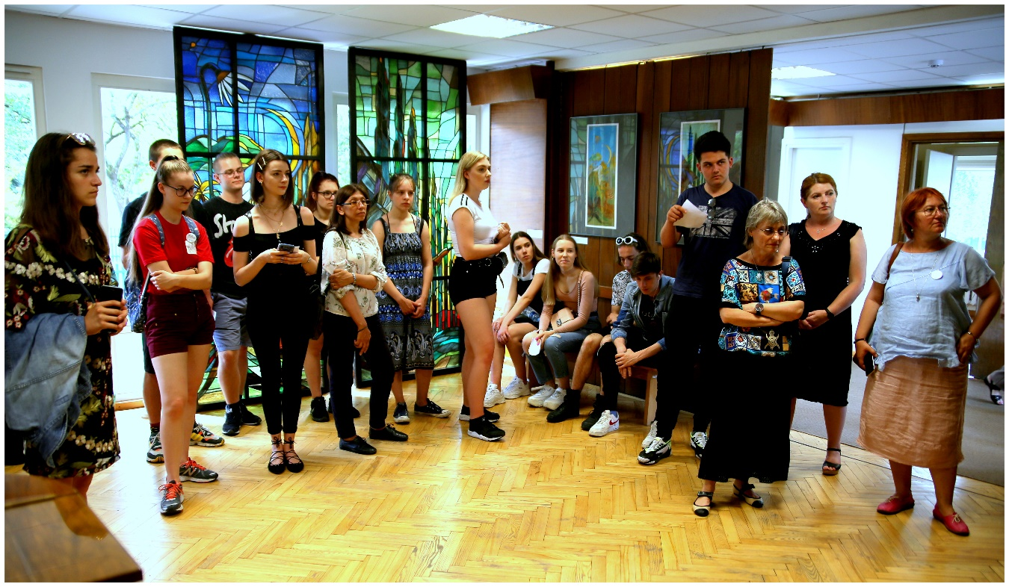
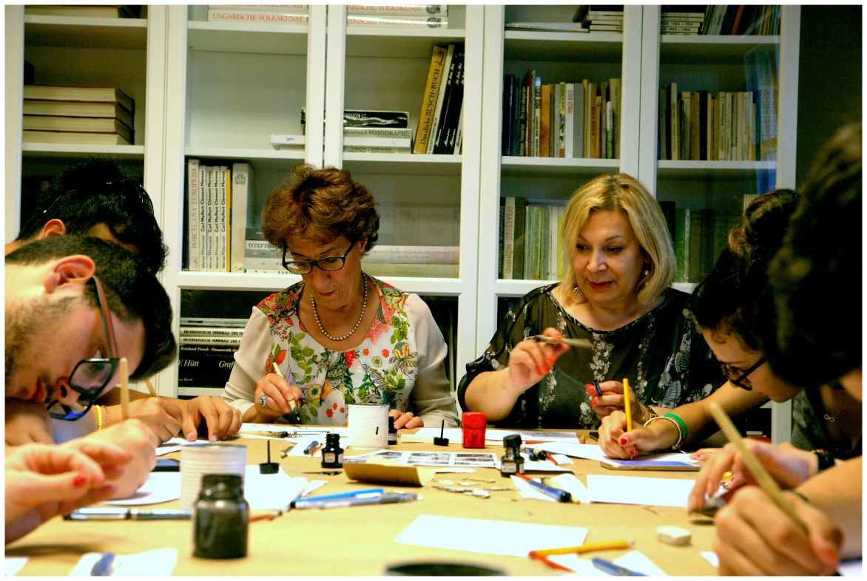
In M.K.Čiurlionis Museum Project Participants had a guided tour and later worked on creativity.

Slide 6
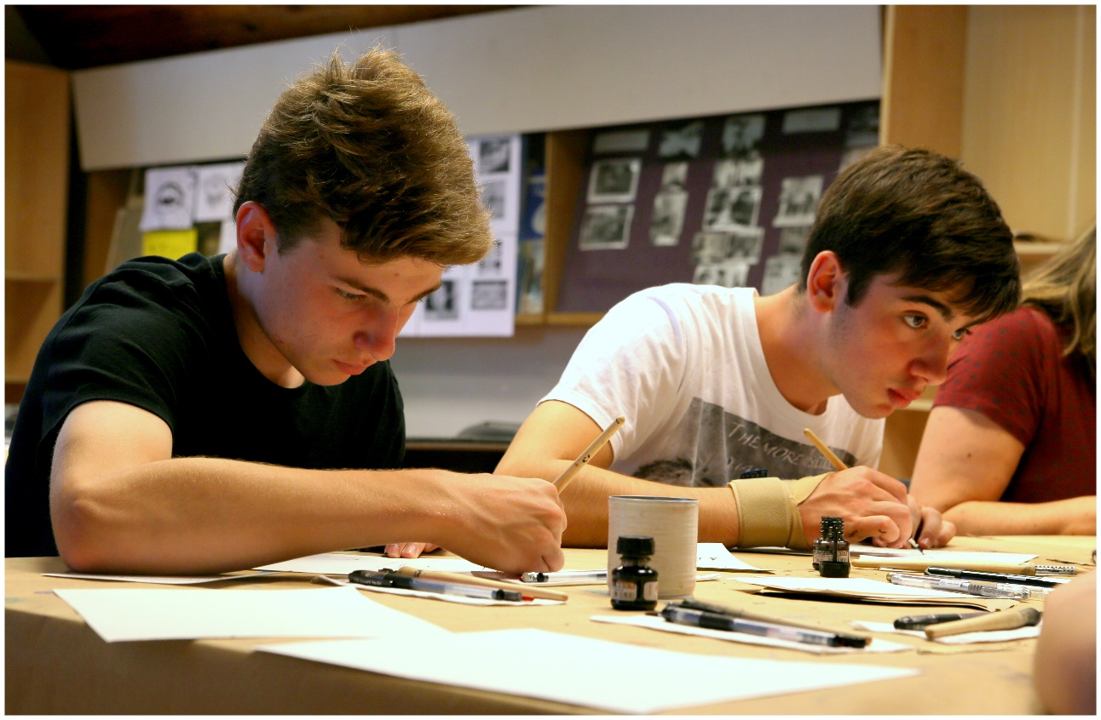
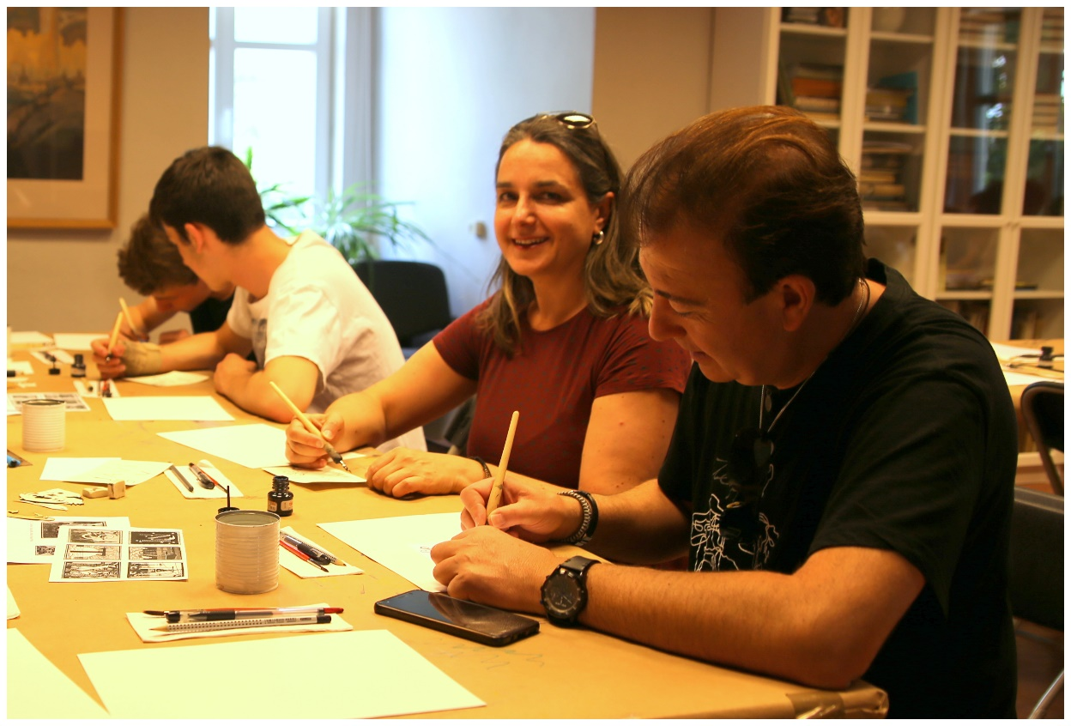
Creative Activities in M.K. Čiurlionis Museum

Slide 7
Thank you for being with us!
This project has been funded with support from the European Commission under the Erasmus+ Programme. This publication reflects the views only of the author, and the Commission cannot be held responsible for any use which may be made of the information contained therein.

