Slide 1
Let’s BET for heritage!

Slide 2
What is heritage?
Heritage is the full range of our inherited traditions, monuments, objects, and culture. Most importantly, it is the range of contemporary activities, meanings, and behaviors that we draw from.
Heritage includes, but is much more than preserving, excavating, displaying, or restoring a collection of old things. It is both tangible and intangible, in the sense that ideas and memories--of songs, recipes, language, dances, and many other elements of who we are and how we identify ourselves--are as important as historical buildings and archaeological sites.

Slide 3
HERITAGE
Heritage is, or should be, the subject of active public reflection, debate, and discussion. What is worth saving? What can we, or should we, forget? What memories can we enjoy, regret, or learn from? Who owns "The Past" and who is entitled to speak for past generations? Active public discussion about material and intangible heritage--of individuals, groups, communities, and nations--is a valuable facet of public life in our multicultural world.
Heritage is a contemporary activity with far-reaching effects. It can be an element of far-sighted urban and regional planning. It can be the platform for political recognition, a medium for intercultural dialogue, a means of ethical reflection, and the potential basis for local economic development. It is simultaneously local and particular, global and shared.
Heritage is an essential part of the present we live in--and of the future we will build.

Slide 4
Partners
2
Objectives of our project
3
Project presentation
4
Blue team
5
Pink team
15
Yellow team
19
Red team
25
Green team
29

Slide 5
Let us Bring Europe Together for heritage Parteners
IES Nosa Señora dos Ollos Grandes-Lugo/ Spania
Istituto di Istruzione Superiore "G. Galilei"- Avezzano/ Italia
Powiatowe Centrum Ksztalcenia Zawodowego i Ustawicznego w Wieliczce- Wieliczka/ Polonia
Druskininku Ryto gimnazija- Druskininkai/ Lituania
Colegiul Economic Buzau- Buzău/ România

Slide 6
Objectives of our project
To teach our pupils interesting things about natural and cultural heritage of people, particularly in Europe and the understanding of how that heritage shapes their identity and their values.
To highlight the importance of environment as an essential element in our lives, delving into its knowledge, valuation and appreciation, becoming aware of the risks that threat its integrity and of its importance as source of important resources, not only economic, but also social, cultural and spiritual ones, in the search of their sustainable use.
To put into practice new methodological tools, using as starting point local natural and cultural resources. Thus, there will be a holistic and multidisciplinary approach to the educational activity in an open, flexible and coordinated way, which makes it possible to teach 21st century competences and allows learning to become a more interesting and playful activity.
To explore the potential of a higher exposure to natural and cultural heritage on our pupils' self esteem level and social and emotional intelligence and, therefore, reducing conflict, promoting coexistence and harmony and helping to reduce school failure.
To promote creativity and entrepreneurship as the needed attitudes for the promotion and the valuation of environment and material and immaterial cultural heritage.

Slide 7
Title
Can heritage and natural environment influence or define people’s identity?
Number of students | 50
Type of activity: Indoor/ outdoor | Indoor activity
Aims | To highlight the importance of heritage as an essential element in our lives, delving into its knowledge, valuation and appreciation.
Competences required | Soft skills Teamwork Creativity IT skills
Skills developed | Teamwork IT skills Creativity Analyze
Time | 60 minutes
Method | Nonformal game
Material needed | Paper and markers
Technology use | Computers and Internet connection

Slide 8
Description | Starting point is a reflection minute about heritage and its influence on every person. What makes you who you are now? Students have to answer this question first individually and then in groups. They can use computers and they would have access to Internet connection. The task is to make a short magazine with text in both English and their own language and representatives photos.
Reflection and evaluation | Reflection can be made after each group present their work. The magazine as a final product is the evaluation tool for the activity.

Slide 9
Blue team

Slide 10
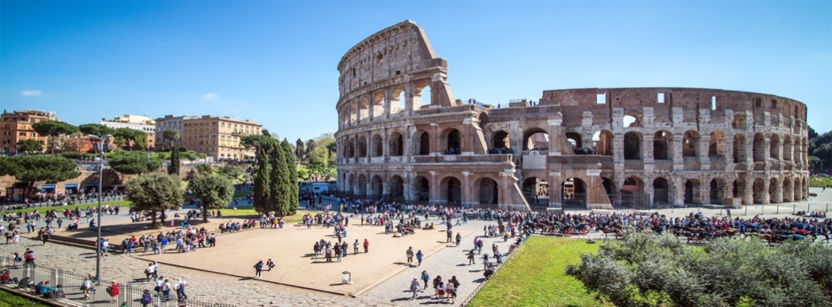
ITALY
Italy officially the Italian Republicis a country in Europe. Located in the heart of the Mediterranean Sea In the first century BC, the Roman Empire emerged as the dominant power in the Mediterranean Basin and became the leading cultural, political and religious centre of Western civilisation. The legacy of the Roman Empire is widespread and can be observed in the global distribution of civilian law, republican governments, Christianity and the Latin scrit.
COLOSSEO

Slide 11
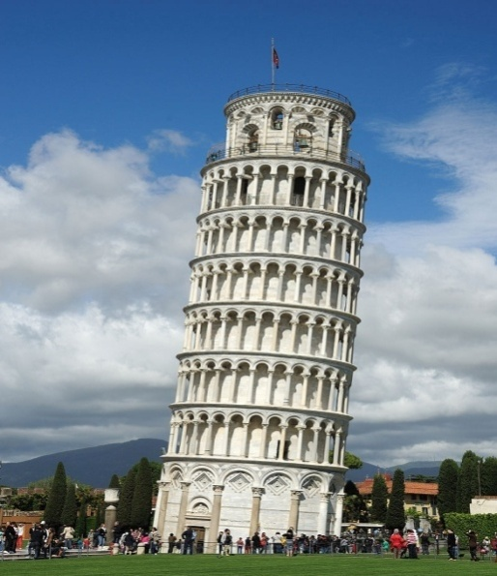
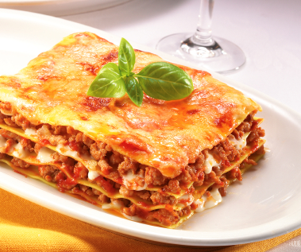
TORRE DI PISA
The Leaning Tower of Pisaor simply the Tower of Pisais the campanile, or freestanding bell tower, of the cathedral of the Italian city of Pisa, known worldwide for its unintended tilt. The tower is situated behind the Pisa Cathedral and is the third oldest structure in the city's Cathedral Squareafter the cathedral and the Pisa Baptistry.
LASAGNE
Pasta in the form of sheets or wide strips.

Slide 12
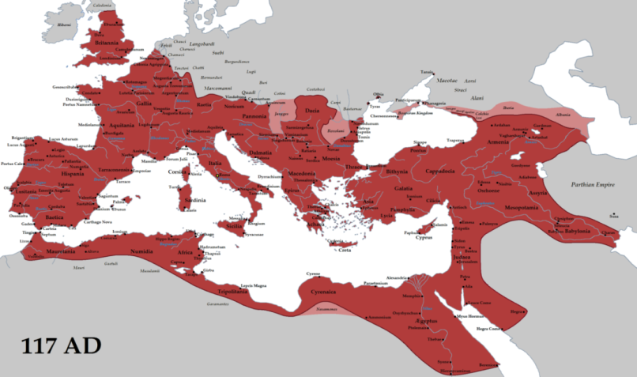
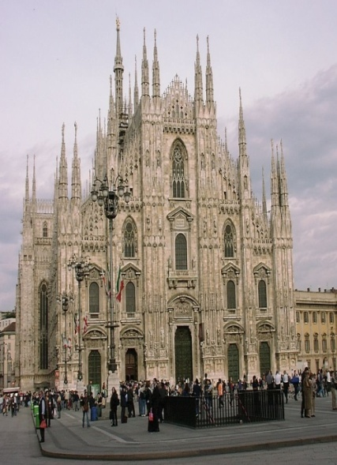
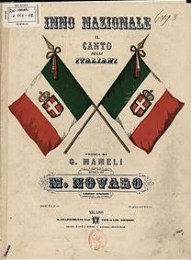
ROMAN EMPIRE
The Roman Empire was among the most powerful economic, cultural, political and military forces in the world of its time, and it was one of the largest empires in world history. At its height under Trajan, it covered 5 million square kilometres.
DUOMO DI MILANO
Domul din Milano, in italy Duomo di Santa Maria Nascente, is the cathedral church of Milan, Lombardy, Italy.
NATIONAL SONG
"Il Canto degli Italiani"is the national anthem of Italy. It is best known among Italians as the "Inno di Mameli".

Slide 13
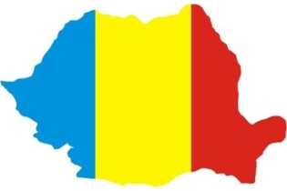
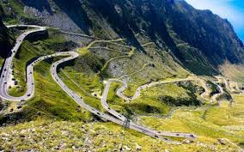
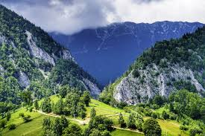
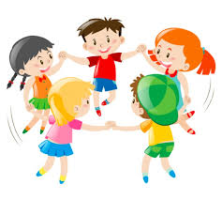
MY COUNTRY, ROMANIA
My life is related to the history of this country, its beautiful nature and the picturesque places and the physical and spiritual beauty of the people living in it, their skill and their crafts.
Romania is the house where I grew up... Romania is the country, the carved gates and the aspen from the road ...

Slide 14
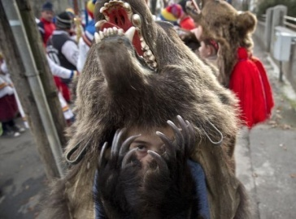
We have differents traditions :
The pre-wedding ceremony is one of the most beautiful Romanian traditions. The bride is helped by her mother and friends close to her family to prepare for the wedding. The bridegroom goes to take his future wife home and take her to the church. He is traditionally accompanied by his close friends. Before that, the knight of honor symbolically beckons the groom. Usually a knife or even an ax for this tradition is used.
The winter holidays are marked by the most beautiful Romanian traditions. In the winter, customs and folk customs, which come from the past, are celebrated in winter, but are followed in holiness even today. In the village, on Christmas Eve, a number of children gather together to chase the villagers.

Slide 15
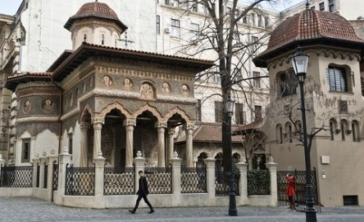
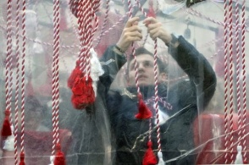
One of the most beautiful Romanian traditions is the celebration of spring. Mărţişorul is an ancient symbol, which marks the arrival of warm weather on the Romanian lands. In folk beliefs, this talisman has magical powers. Men give marriage to women, and they wear them in their chests or hands throughout March.
Easter celebration is one of the most beautiful Romanian traditions. For this celebration, eggs are coloured, lamb dishes are traditionally cooked, and cakes are baked. Romanians greet the streets with "Christ has risen and" has truly risen ". The most beautiful places to celebrate the tradition of Easter are the churches in Bucharest, reports Inyourpocket.

Slide 16
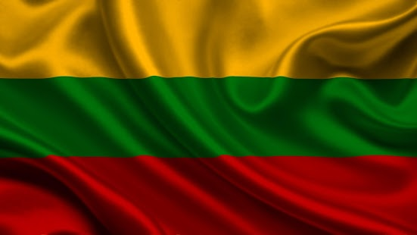
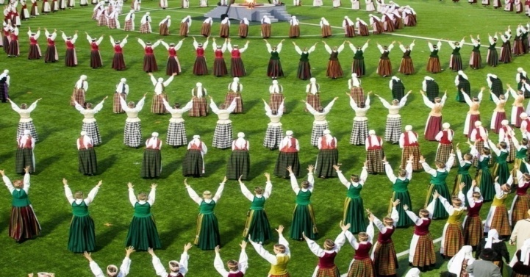
Lithuania
The flag of Lithuania
Lihuanians traditional food is cuisine (Cepelinai)
I still remember the smell of Cepelinai the childhood when I was at my grandfathers house.
The oldest Lithuanian folk dances are dances sutartines. The most common figures are walking in rows, facing each other, or going in a circle. Sutartines were mostly danced by women. The name of such a sutartine would usually derive from the first line of the song or its refrain. This type of sutartines were still danced in north-eastern Lithuania in the early 20th century.
One of the traditional songs in Lithuania is Ant kalno mūrai. (liaudies)
Ant kalno mūrai, joja lietuviai,
Ant kalno mūrai, joja lietuviai.
Joja, joja lietuvaičiai,
Neša, neša vainikaitį,
Vainiką rūtų, vainiką rūtų.
Štai ir prijojo uošvės dvarelį.
Kelkis, kelkis, motinėle,
Žadink savo dukružėlę
Žirgelių girdyt, žirgelių girdyt.

Slide 17
The most interesting part and most important to me is 1944-1953 events. Active guerrilla warfare against Soviet Union. Everything was structured and people had they’re task assigned by officers. People made bunkers and other fortified encampments. It was risky and 20,000 partisans half of them from 16 to 21 years old died from Soviet Union, people didn’t have many weapons or resources but still they tried to resist occupants. Soviet Union and NKVD put a lot of effort to destroy them even bribing, torturing and transferring more soldiers to Lithuania.

Slide 18
Still Lithuanians resisted them to the death trying to make Lithuania independent and free. They didn’t manage to make it but they’re efforts are remembered to this day and our modern special forces (Called Aitvaras) are using those tactics. Operating in small numbers and without officers. Even Russian ‘’Specnaz’’ special forces are terrified of Aitvaras. These events are really important to us and it’s our heritage

Slide 19
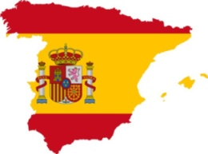
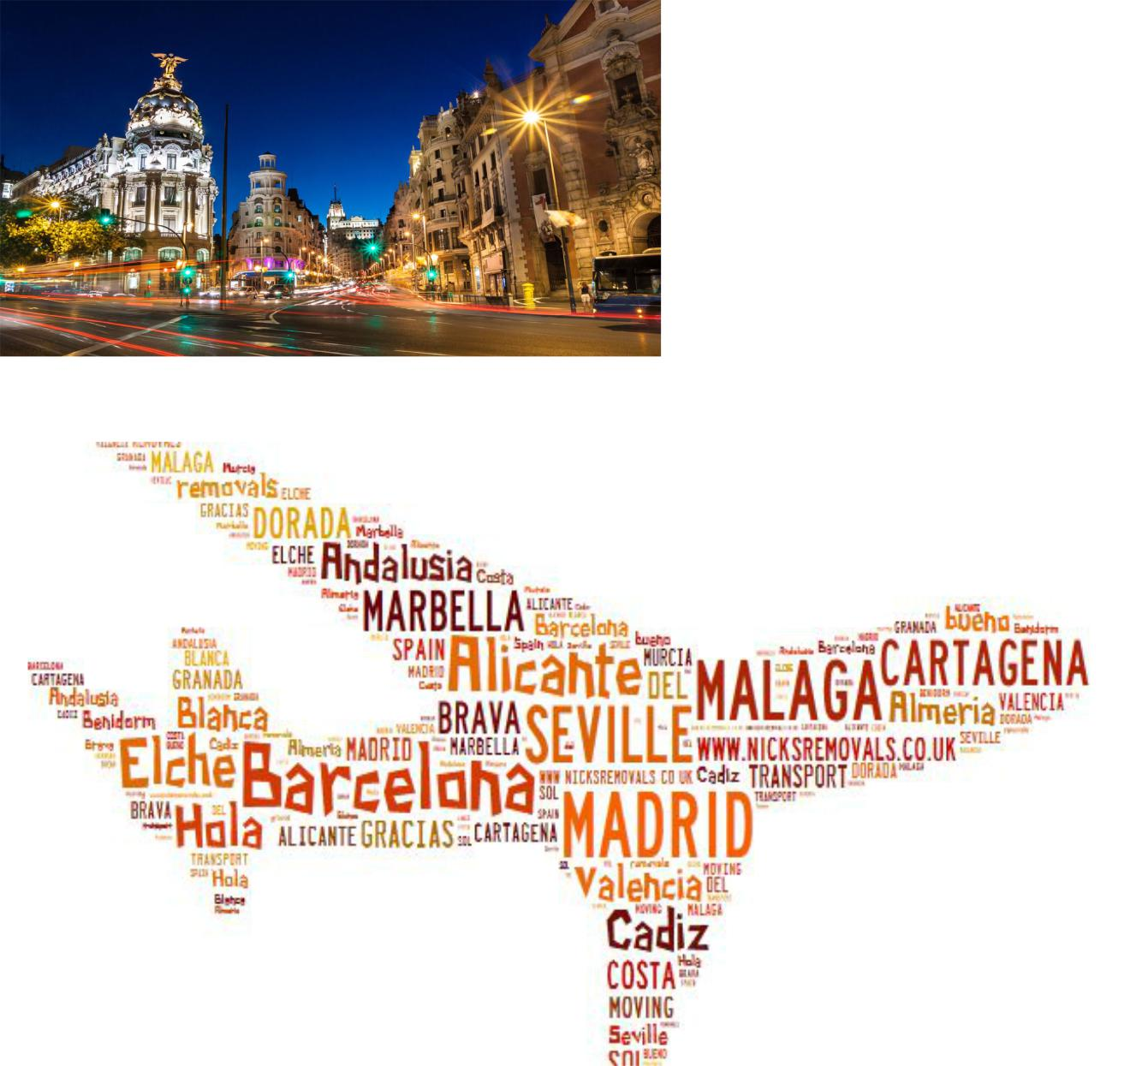
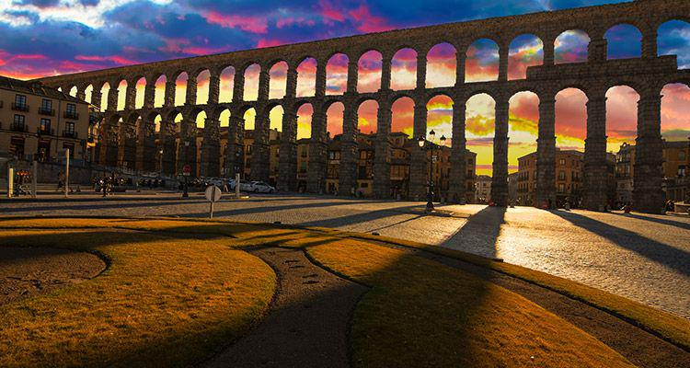
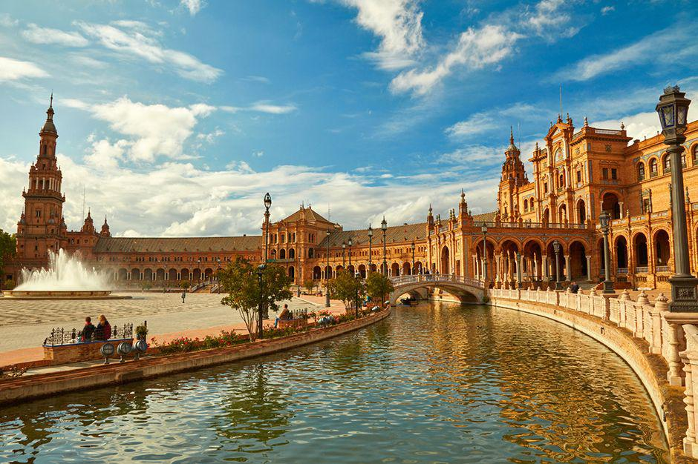
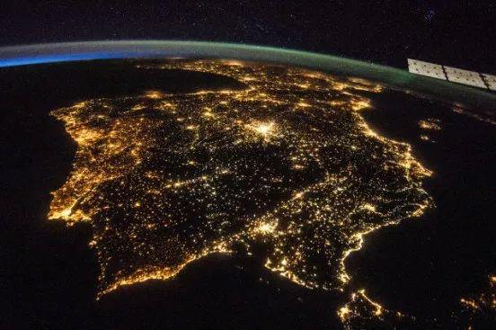
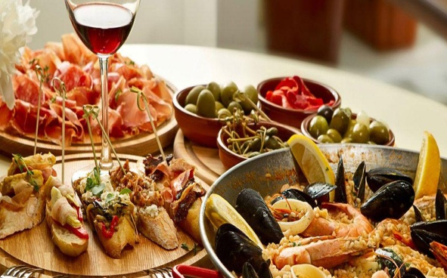
Spain

Slide 20
There are many things that make a Spaniard Spanish. May it be the culture, the language, or the habits; there is always something that distinguishes us from other European peoples.
What makes me a Spanish person is my daily routine. Whereas a Romanian or a Frenchman would get up early and go to bed early as well, Spaniards often get up as late as possible and stay up a bit too late. Not only does this affect our life, but that also boosts our culture. Spanish cuisine is very well-known, and for a reason. Spaniards nearly always have nice, big dishes for lunch and dinner, while a Brit would probably just have a couple sandwiches. Spanish gastronomy has many tasty dishes beyond paella. Other cultures also lack the concept of tapas, small dishes often eaten when going for a drink.
Not all Spaniards are equal, though. There are really strong differences between Spanish communities. When speaking about food, like in the previous paragraph, southern regions always lean towards Mediterranean diet, in spite of northern regions rather cooking big, hot, spoon recipes instead. This is kind of strange once you realise that both of them are well-known for the same: beautiful mountain landscapes and the best beaches in the world.
There are many other aspects that define the Spanish culture, such as the music. Whether it is typical Andalusian flamenco or modern trap, there are all kinds of bands, genres and songs. Some of the modern examples of music are the solo singer Rosalía, who mixes flamenco and pop in her songs, or the rock band Vetusta Morla, which is known internationally.

Slide 21
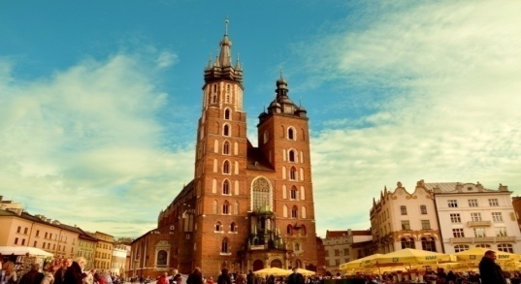
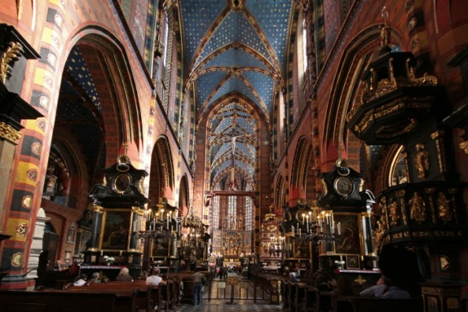
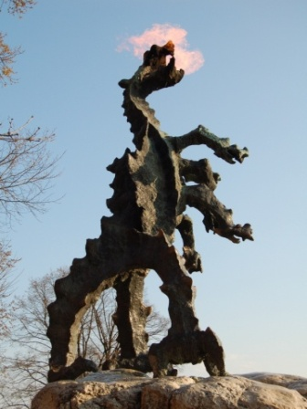
Poland
Cracow
Krakow is the second largest and one of the oldest cities in Poland. Kraków was the official capital of Poland until 1596 and has traditionally been one of the leading centres of Polish academic, economic, cultural and artistic life. City is situated on Vistula River in the Lesser Poland region.
Places in Krakow worth to see
St. Mary's Basilica
Dragon od Wawel Hil

Slide 22
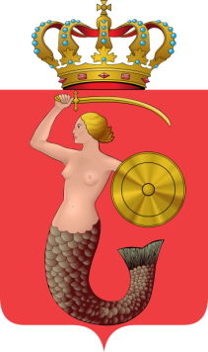
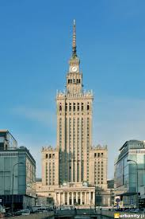
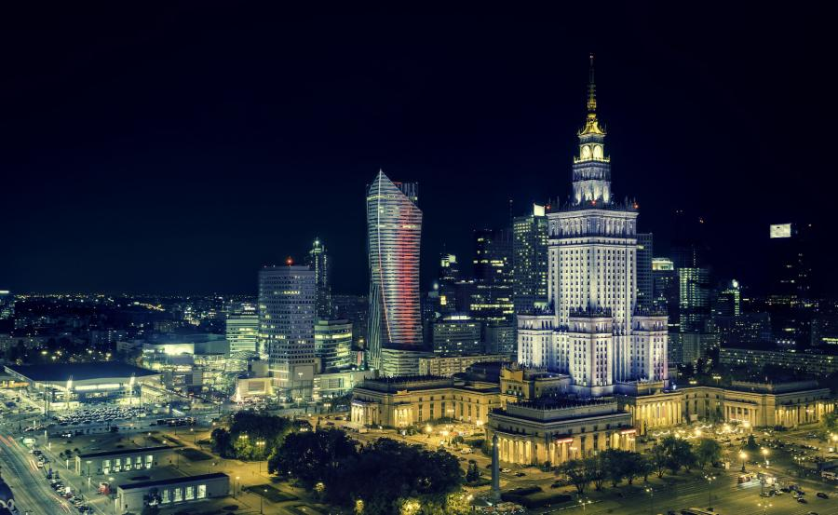
Warsaw
Warsaw is the capital and largest city of Poland. The metropolis stands on the Vistula River in east-central Poland. Warsaw is an alpha global city, a major international tourist destination, and a significant cultural, political and economic hub Its historical Old Town was designated a UNESCO World Heritage.
Places in Warsaw worth to see
Palace of Culture and Science

Slide 23
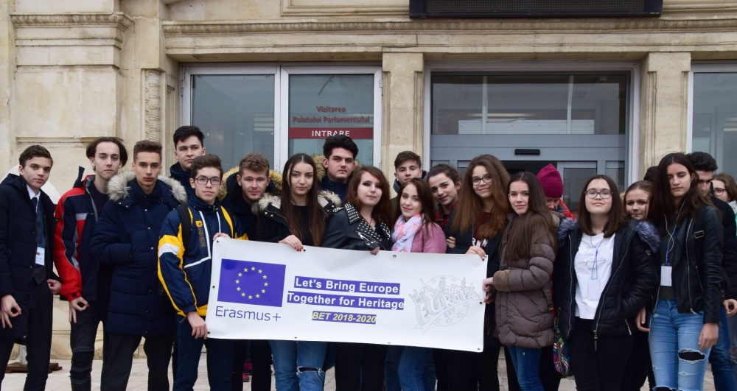
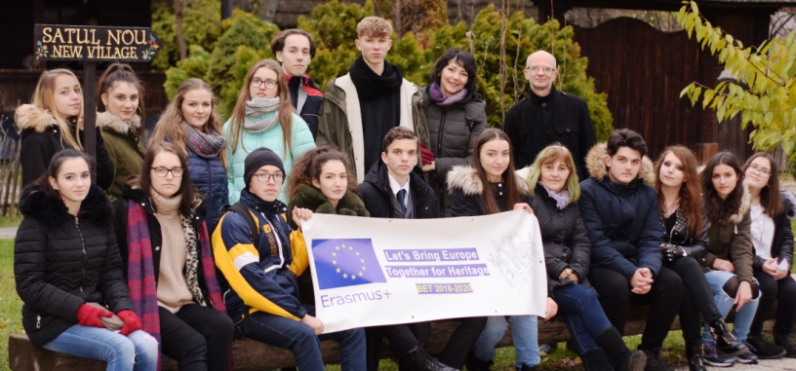
THE END
Realised by: Molnar Renata Diana
Popa Radu Daniel

