Slide 1
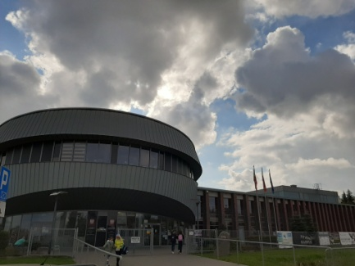

Wieliczka

Slide 2
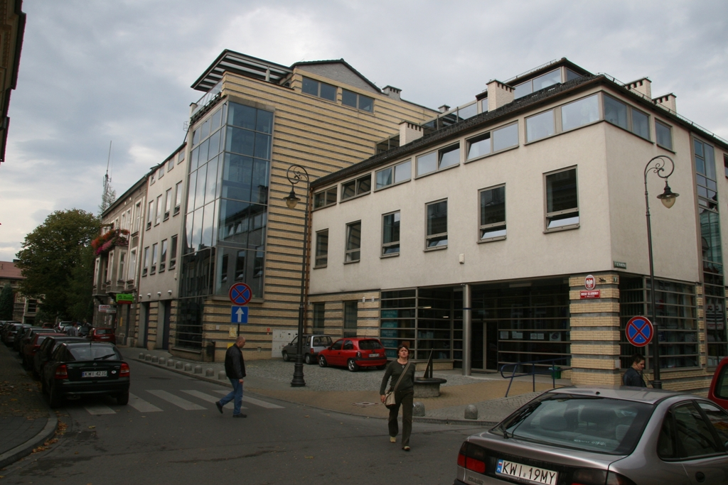
The tax office in Wieliczka town centre

Slide 3
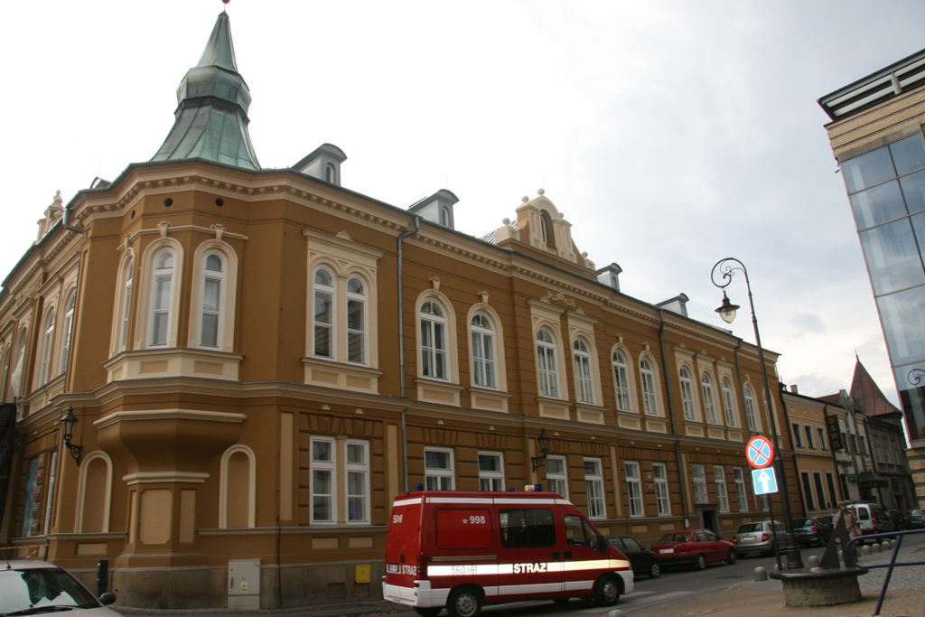
The Centre /House of Culture and Tourism

Slide 4
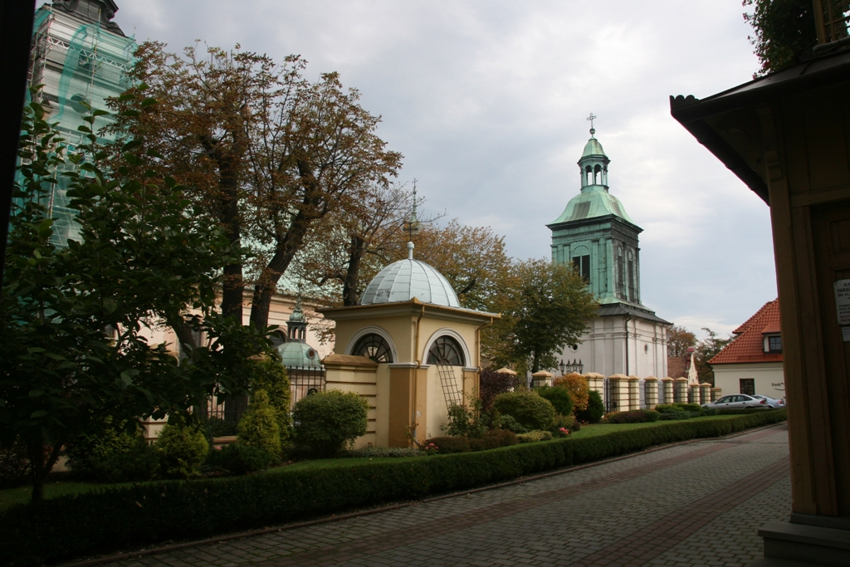
The Saint Clement church area

Slide 5
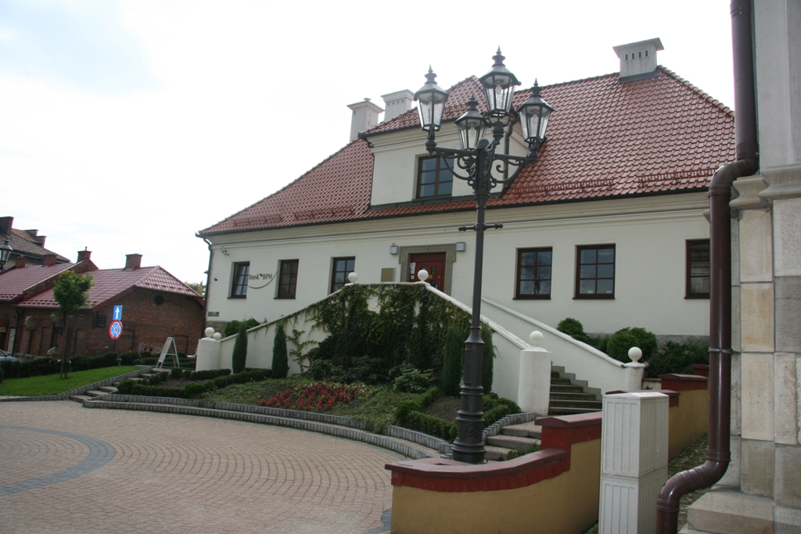
A local bank

Slide 6
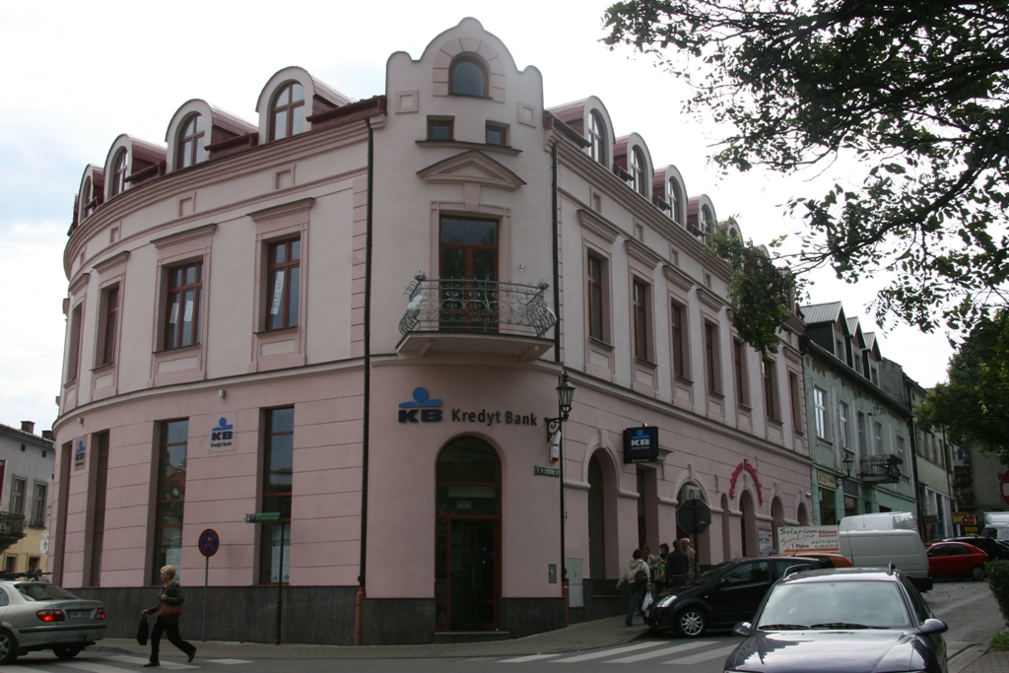
A local bank

Slide 7
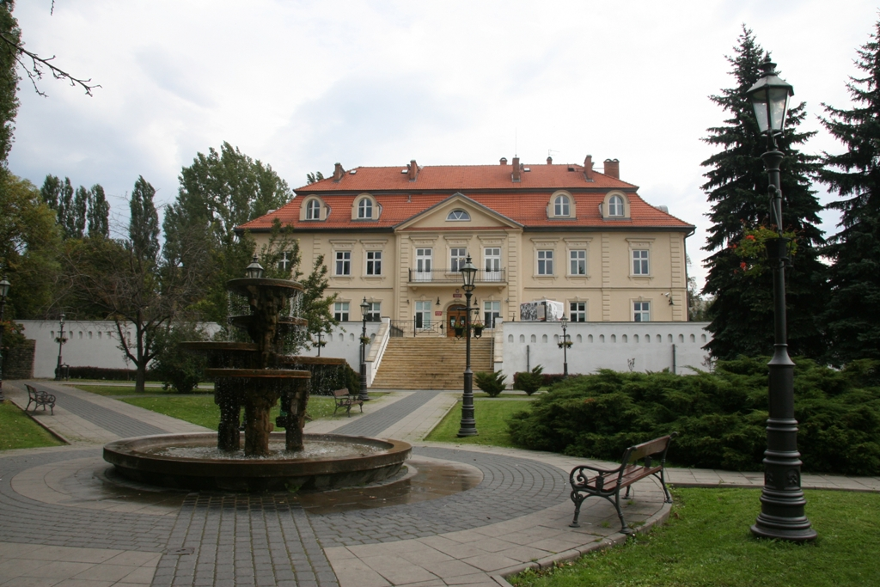
The Institute of National Remembrance

Slide 8
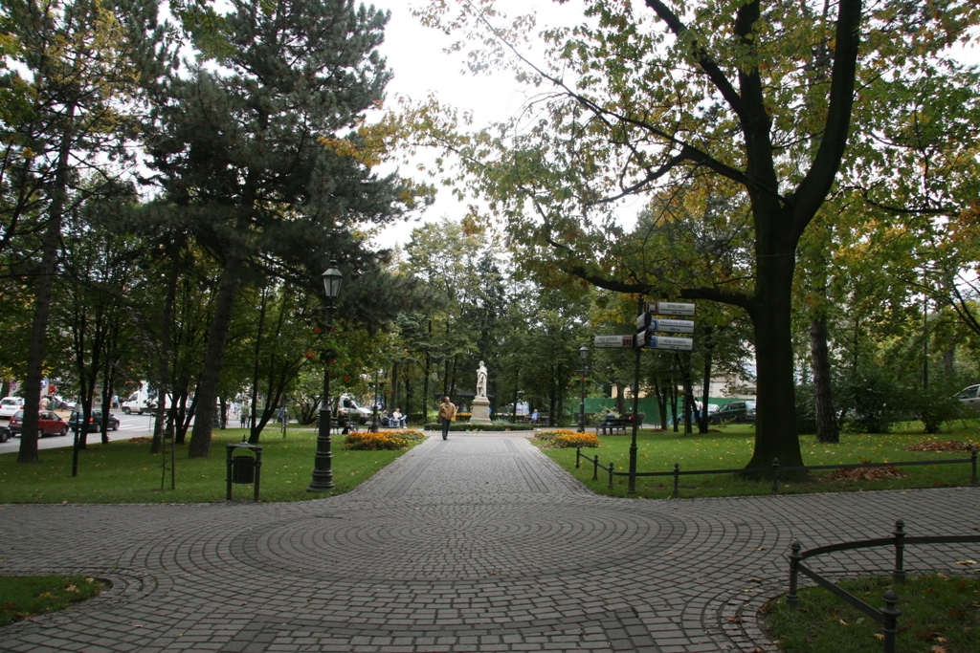
Planty, a pedestrian zone

Slide 9
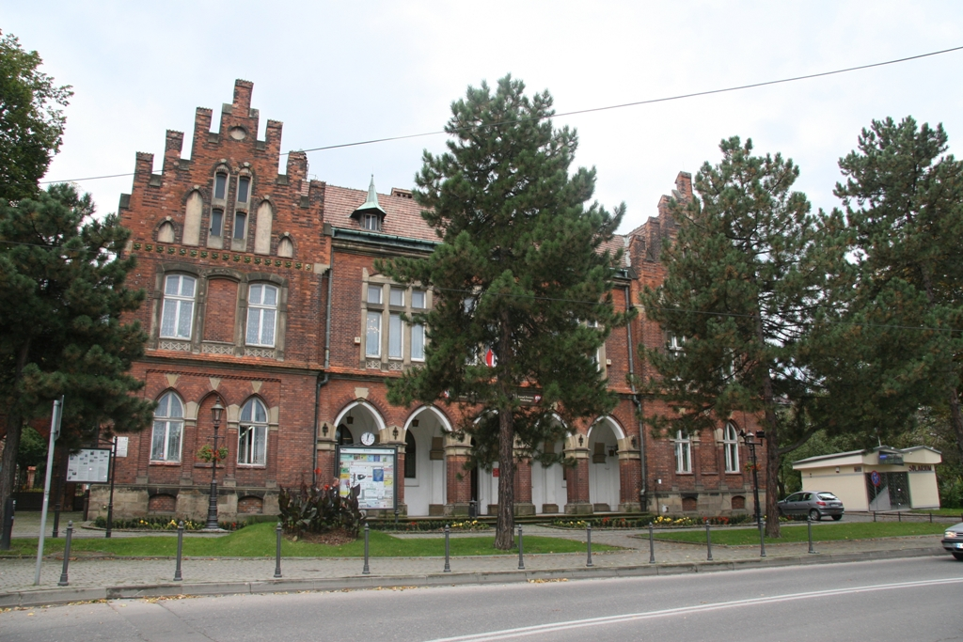
The former miner's school, now local authorities building

Slide 10
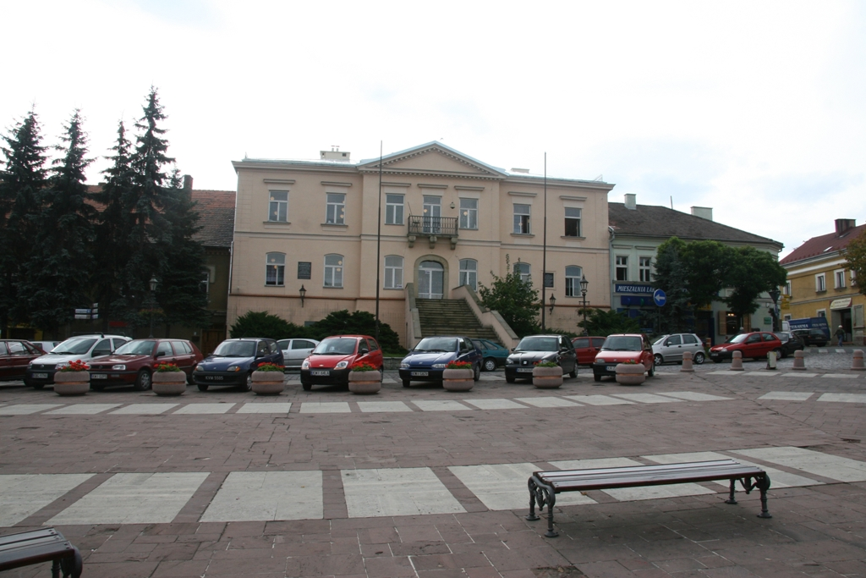
Our main school residence till February 2014

Slide 11
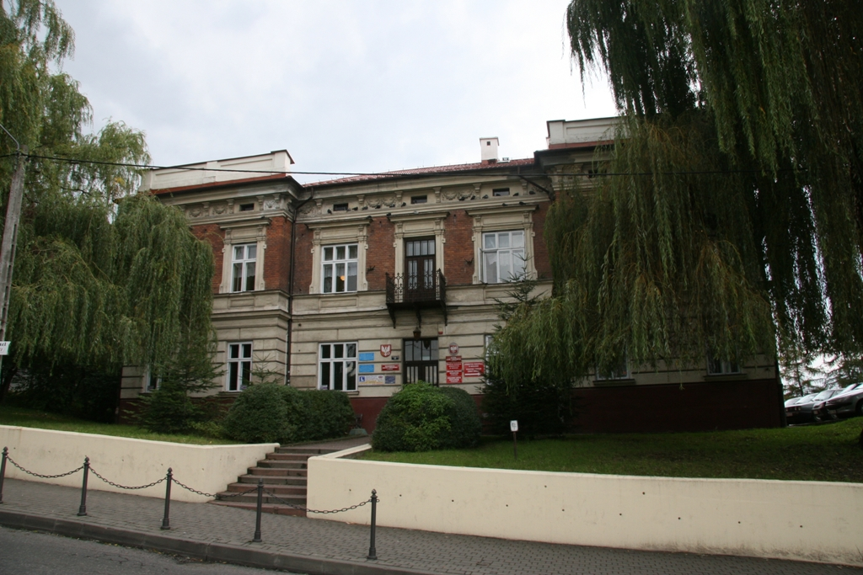
Our second school building till 2014

Slide 12
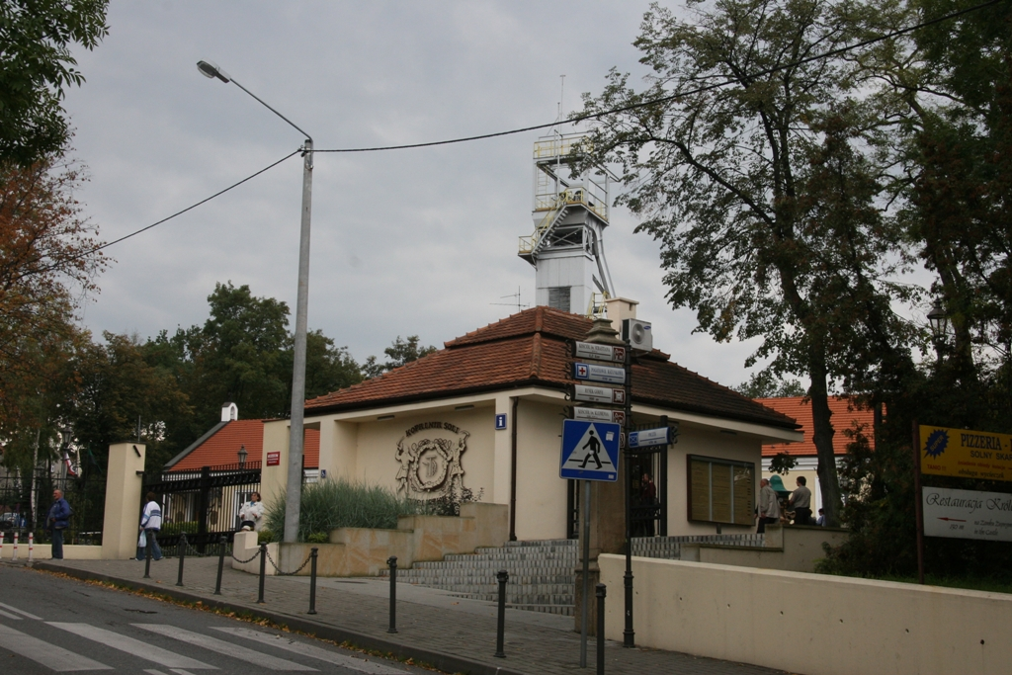
The Salt mine area

Slide 13
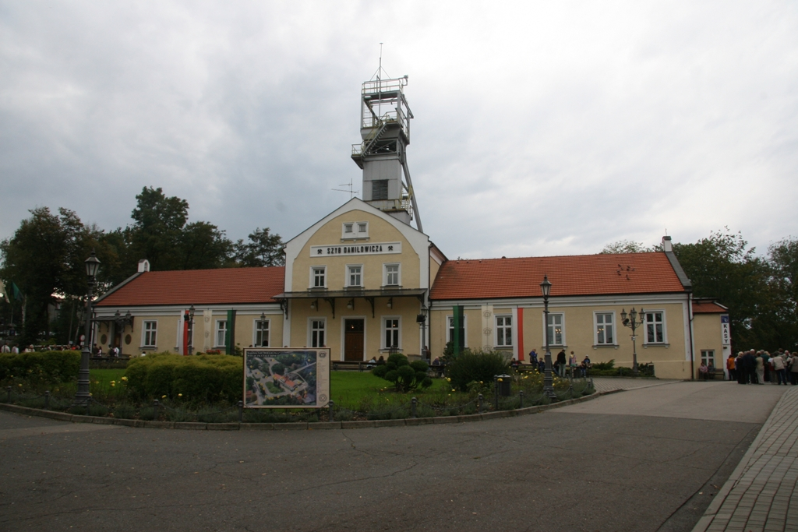
The Daniłowicz shaft (XVIIth century)-the main entrance to the
historic salt mine

Slide 14
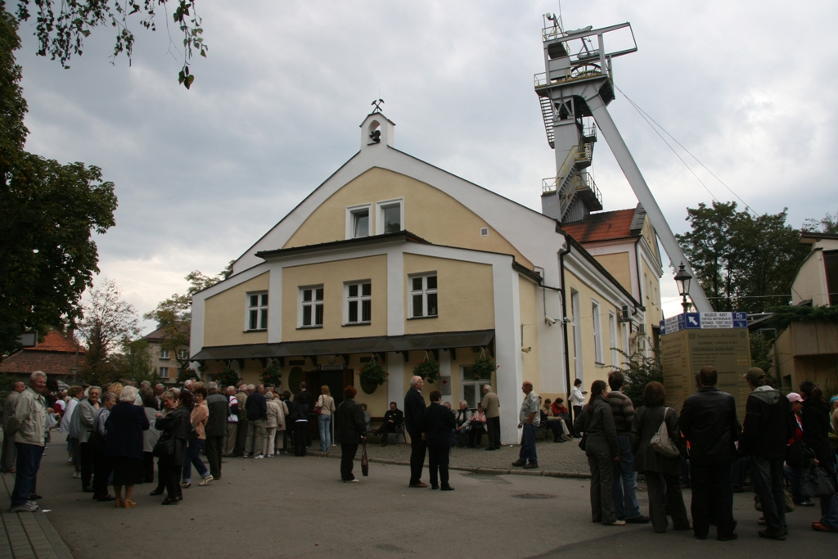
The salt mine is one of the most popular tourist attractions in Poland

Slide 15
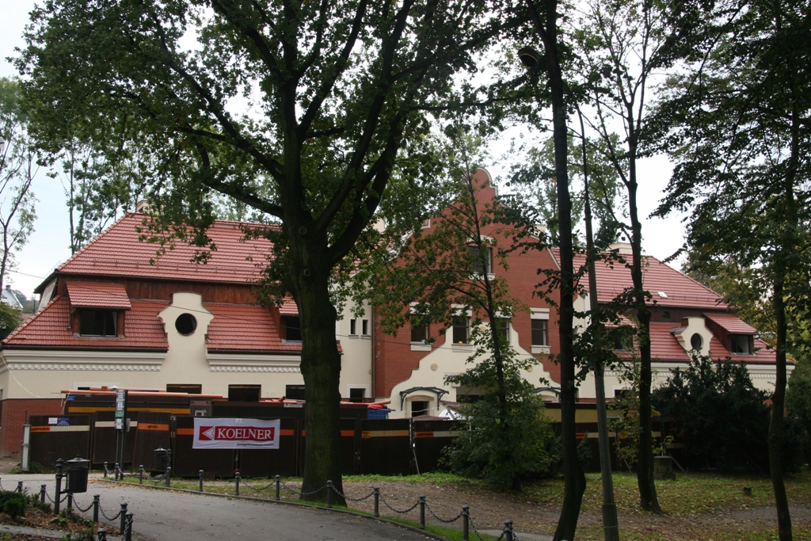
The Grand Sal 4 star hotel under construction

Slide 16
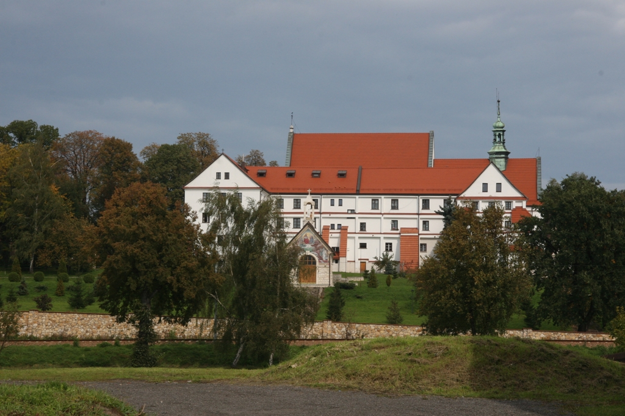
The XVIIIth century Franciscans monastery

Slide 17
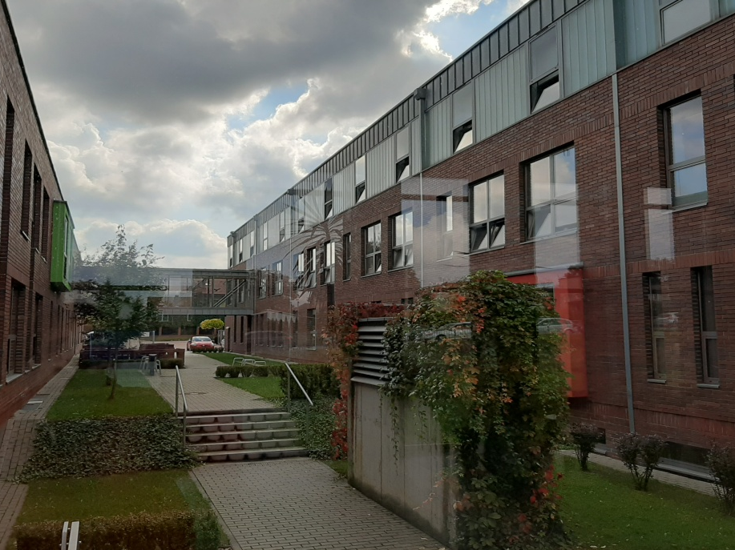
Our current school building since 2014

Slide 18


Slide 19


Thank you for watching

