Slide 1
A National festival of Lithuania
Druskininkai Rytas Gymnasium
2018-11-29
Romania, Buzau

Slide 2
Traditional festivals in Lithuania
Epiphany
Shrove Tuesday
Palm Sunday
Easter
Midsummer Night
State Day of Lithuania
The Assumption Day
September Equinox
Christmas Eve and Christmas

Slide 3
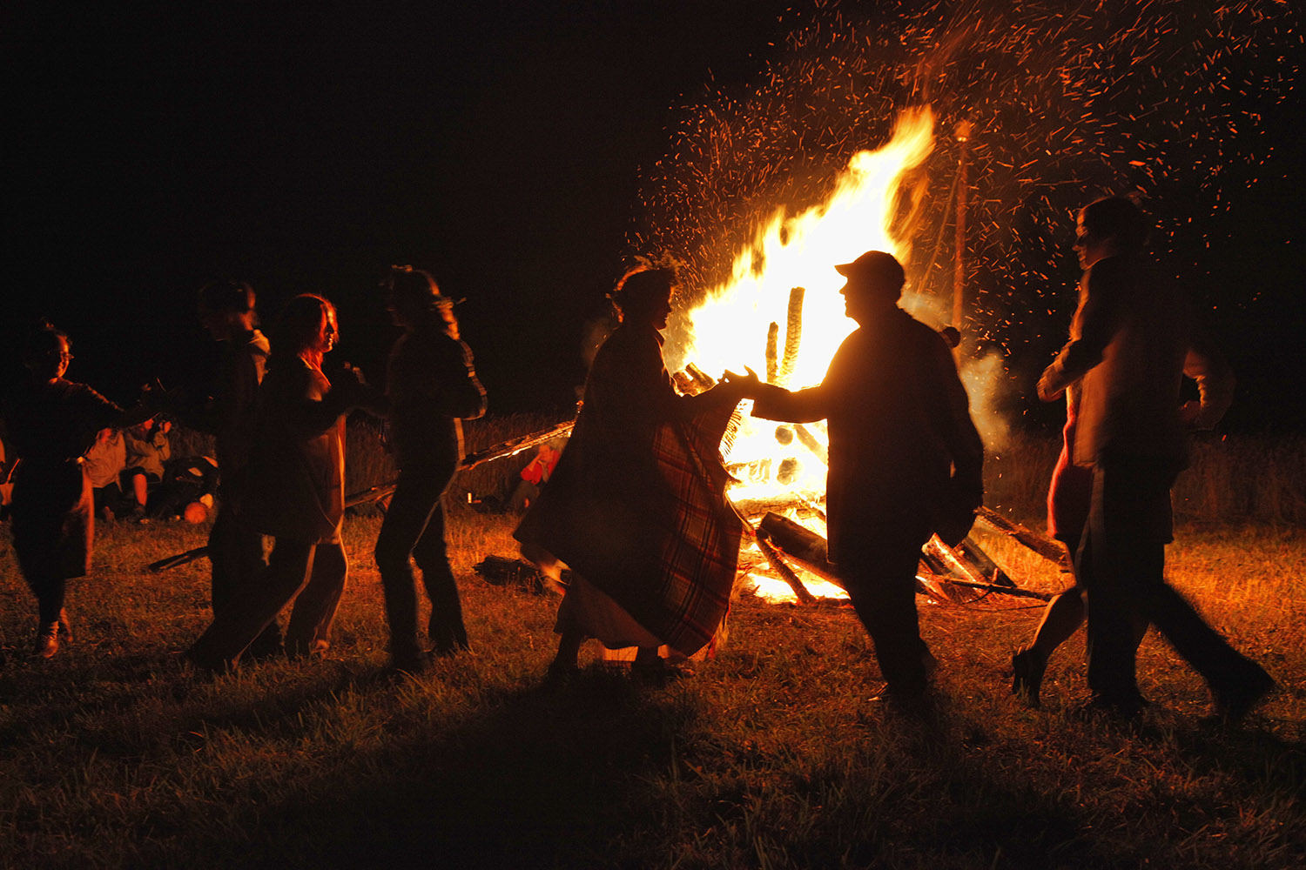
Joninės
Midsummer Night

Slide 4
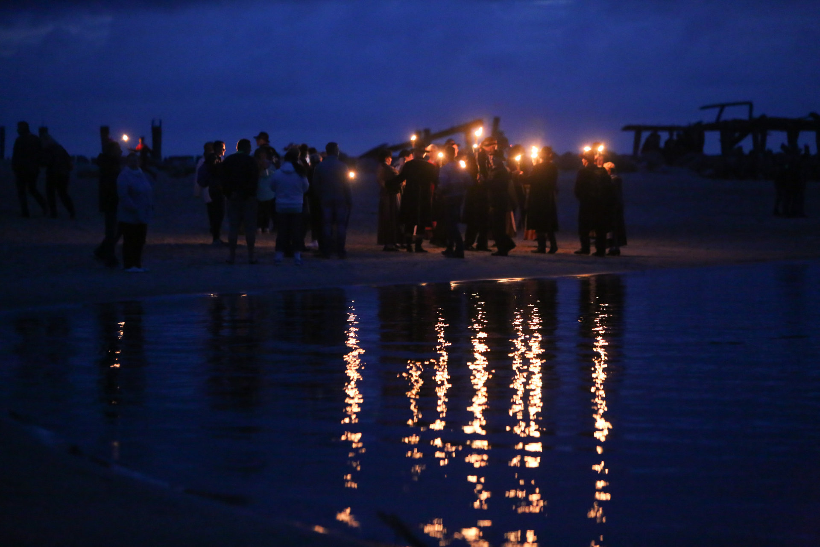

Slide 5
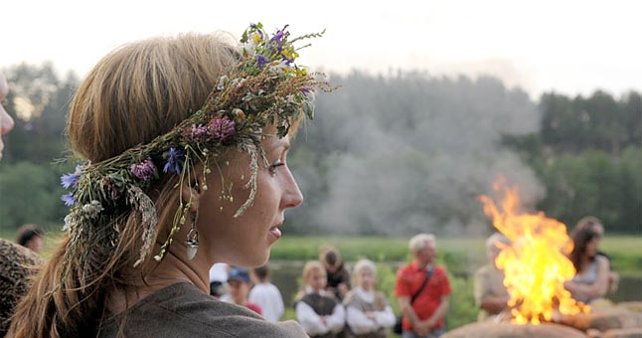
Origin
- Pagan festival, later on converted to christianity.
- Associated with main elements: fire, water, flora.

Slide 6
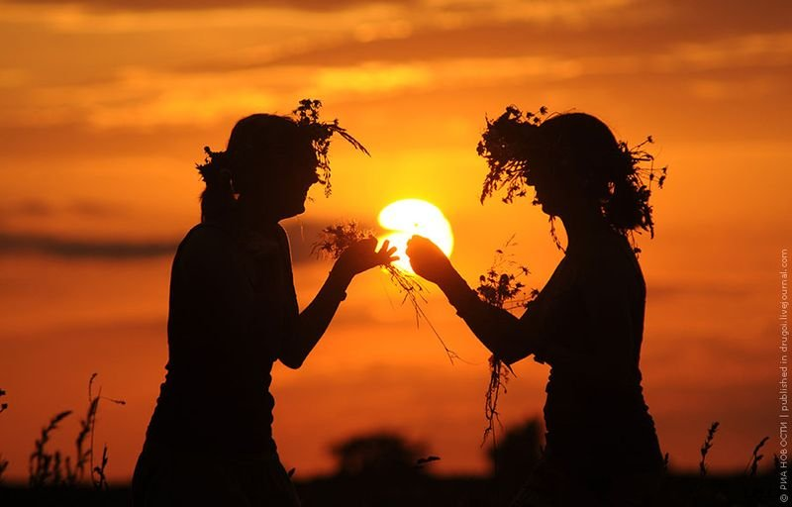

Slide 7
Traditions and rituals
Flower crown weawing
Searching for a fern blossom
Guessing the weather based on the sky
Gathering herbs at night
Love fortune-telling
Lighting up bonfires
Washing your face with dew

Slide 8
THANK YOU FOR YOUR ATTENTION! #LTteam – Rusnė & Karolis This project has been funded with support from the European Commission. This information reflects the views only of the author, and the Commission cannot be held responsible for any use which may be made of the information contained therein.

