Slide 1
The „Wieliczka” Salt Mine Managing heritage
Kopalnia Soli „Wieliczka” Trasa Turystyczna www.kopalnia.pl

Slide 2
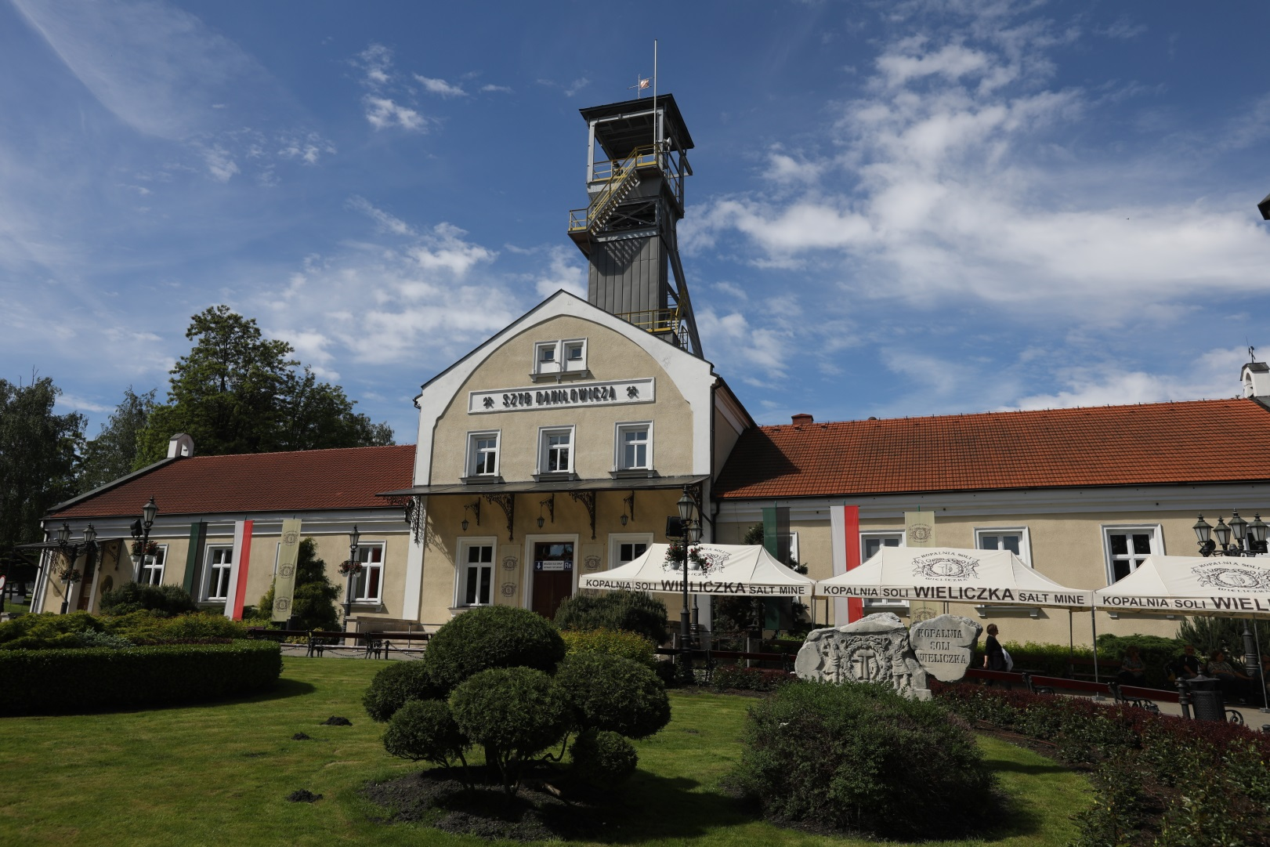
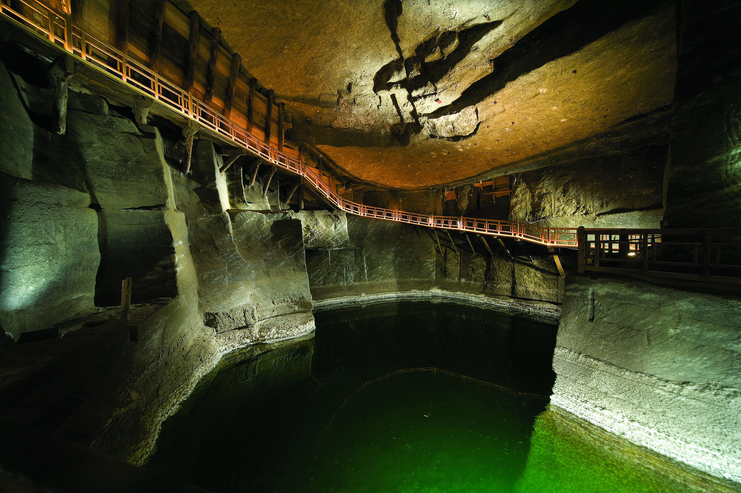
The „Wieliczka” Salt Mine - a brief history
Kopalnia Soli „Wieliczka” Trasa Turystyczna www.kopalnia.pl
28.02.2020

Slide 3
The „Wieliczka” Salt Mine - a brief history
The production of salt in Wieliczka has a long tradition dating back to the Neolithic times. Salt was evaporated in small vessels, on modest hearths as early as 6,000 years ago. In the second half of the 13th century, after the discovery of rock salt deposits, extraction of the valuable raw material began. Salt trading was a source of huge profits and was carried out on an international scale.
Throughut 700 years of excavation, mine grew to nine levels, with a maximum depth of 327 metres. The shutting down of salt production took place in stages. In 1964, the mining of rock salt in Wieliczka was completely discontinued in favour of the industrial production of evaporated salt using the wet mining method (this was discontinued in 1996, today salt from Wieliczka is produced only as a result of evaporation of salt water).
Kopalnia Soli „Wieliczka” Trasa Turystyczna www.kopalnia.pl
28.02.2020

Slide 4
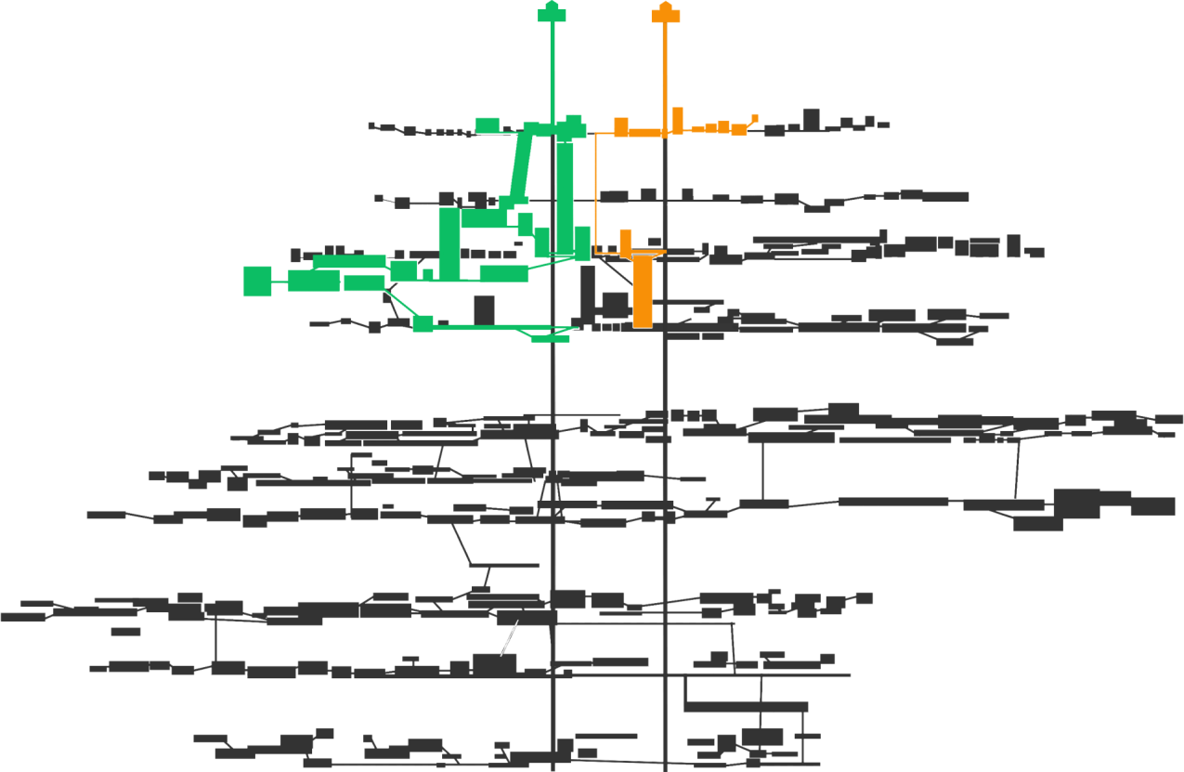
The „Wieliczka” Salt Mine - 9 levels, 245 km of galleries, 2000 chambers
Kopalnia Soli „Wieliczka” Trasa Turystyczna www.kopalnia.pl
28.02.2020

Slide 5
The „Wieliczka” Salt Mine - a brief history
Throughout history, the way of thinking about the “Wieliczka” Salt Mine has changed from an industrial place to a world-famous tourist attraction, a place of unusual events and a health resort.
Already in the 19th century the Mine was a popular tourist attraction.
Today it is visited every year by nearly 2 milion guests –1 861 843 tourists visited „Wieliczka” Salt Mine in 2019.
Kopalnia Soli „Wieliczka” Trasa Turystyczna www.kopalnia.pl
28.02.2020

Slide 6
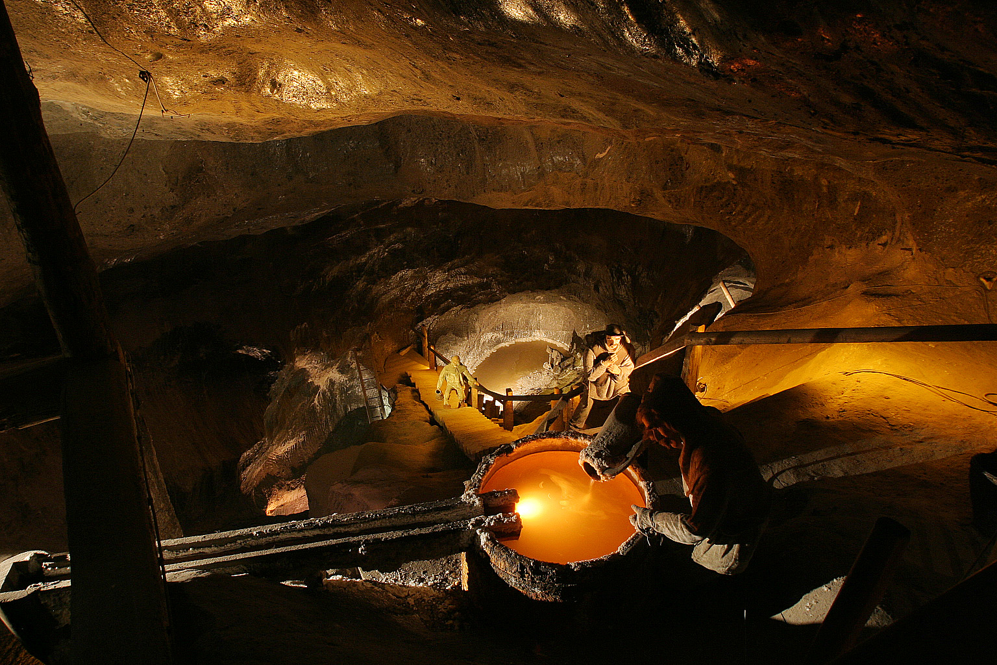
The „Wieliczka” Salt Mine - a brief history
Kopalnia Soli „Wieliczka” Trasa Turystyczna www.kopalnia.pl
28.02.2020

Slide 7
The „Wieliczka” Salt Mine - a brief history
The “Wieliczka” Salt Mine was among the first twelve sites entered on the UNESCO World Cultural and Natural Heritage List in 1978.
218 chamber workings and 190 gallery and chamber complexes, located between the 1st and the 5th level of the mine (historic workings and protected workings of natural value with protective zones, as well as functional workings) have been designated for preservation.
Kopalnia Soli „Wieliczka” Trasa Turystyczna www.kopalnia.pl
28.02.2020

Slide 8
The „Wieliczka” Salt Mine today
Today, the most important goal set by the miners working here is to preserve for future generations and make available to the public the monument to the history and culture of the Polish nation, a unique monument to the world’s natural and technical heritage and a place of worship. Their work is a continuation of the achievements of tens of generations of free, educated miners whose traditions they want to maintain and develop.
The goal is realised by variety of actions.
Kopalnia Soli „Wieliczka” Trasa Turystyczna www.kopalnia.pl
28.02.2020

Slide 9
The Tourist Route
Where miners struggled with the forces of nature, a unique labyrinth of salt workings was carved out. The Tourist Route leads through its most historic part. It is a place full not only of natural wonders – underground landscapes, but also cultural treasures and fascinating stories.
On the Tourist Route, the mine shows a dazzling face. Tourists visit chambers bathed in the glow of crystal chandeliers, admire majestic wooden structures and discover salt works of secular and sacred art. The culmination of the expedition is a visit to St Kinga’s Chapel.
Kopalnia Soli „Wieliczka” Trasa Turystyczna www.kopalnia.pl
28.02.2020

Slide 10
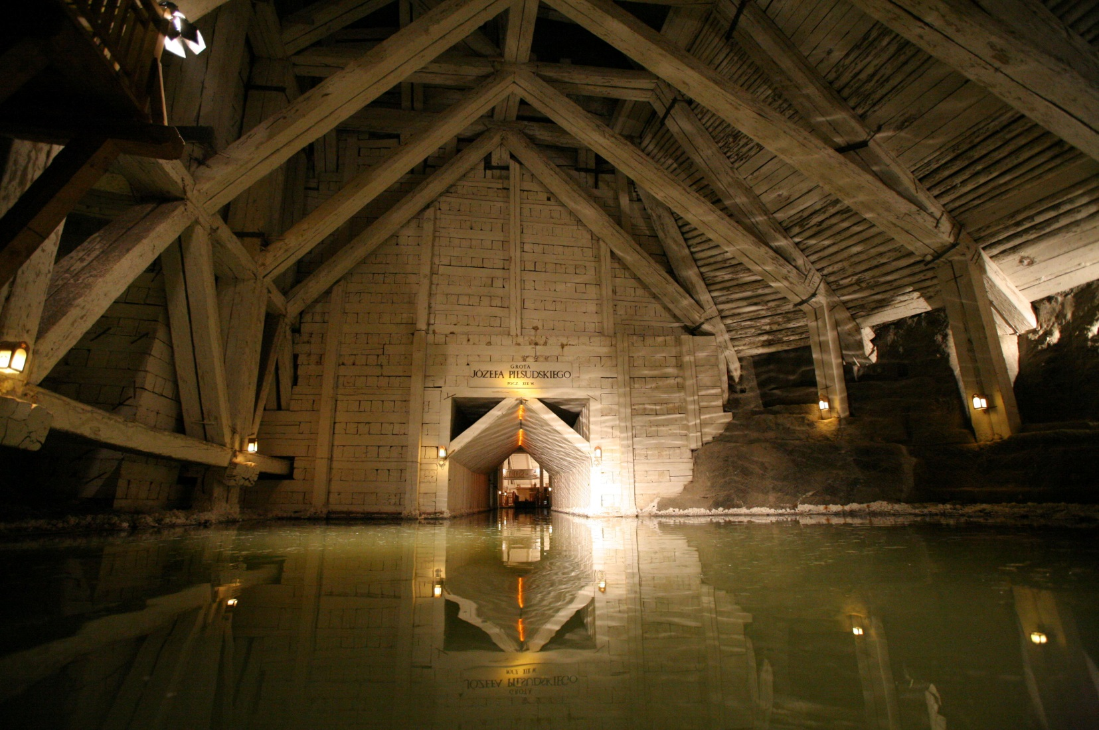
The Tourist Route
Kopalnia Soli „Wieliczka” Trasa Turystyczna www.kopalnia.pl
28.02.2020

Slide 11
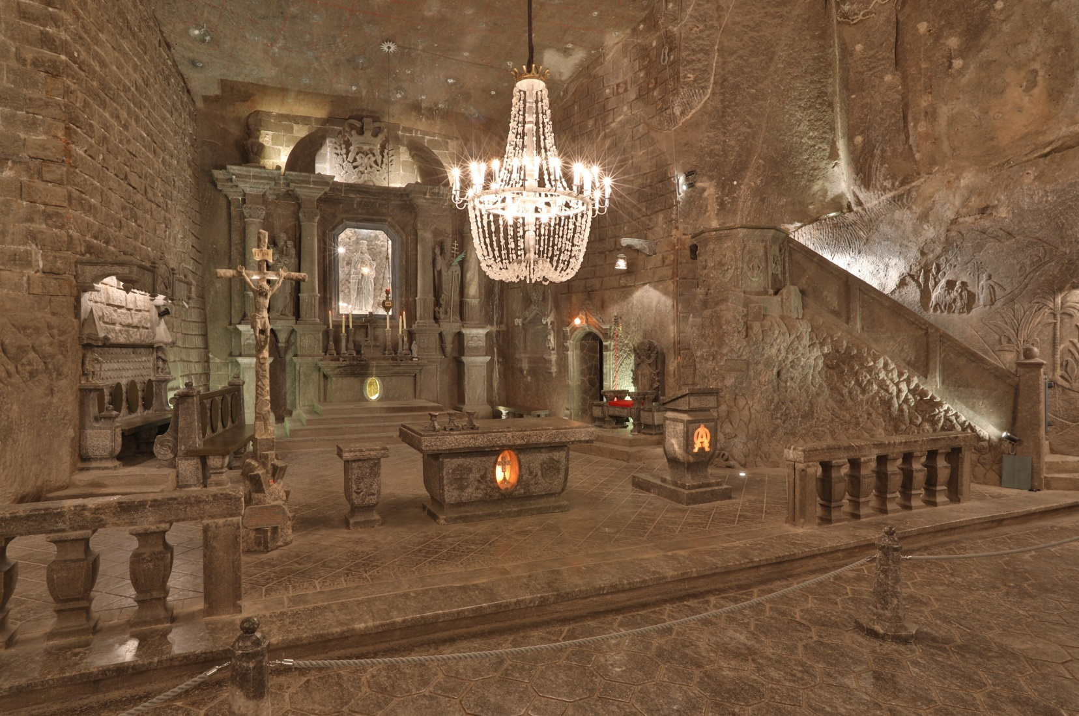
The Tourist Route
Kopalnia Soli „Wieliczka” Trasa Turystyczna www.kopalnia.pl
28.02.2020

Slide 12
The Miners’ Route
On The Miners’ Route every tourist is given a lamp, a helmet and a uniform. On the way, you become an apprentice of the mining trade, who learns the secrets of geology and mining techniques: checking the atmosphere, braiding ropes, crushing salt rocks and transporting the excavated material. An experienced foreman who leads the expedition gladly helps with a good word and gives advice on how to perform the tasks.
Kopalnia Soli „Wieliczka” Trasa Turystyczna www.kopalnia.pl
28.02.2020

Slide 13
The Miners’ Route
Kopalnia Soli „Wieliczka” Trasa Turystyczna www.kopalnia.pl
28.02.2020

Slide 14
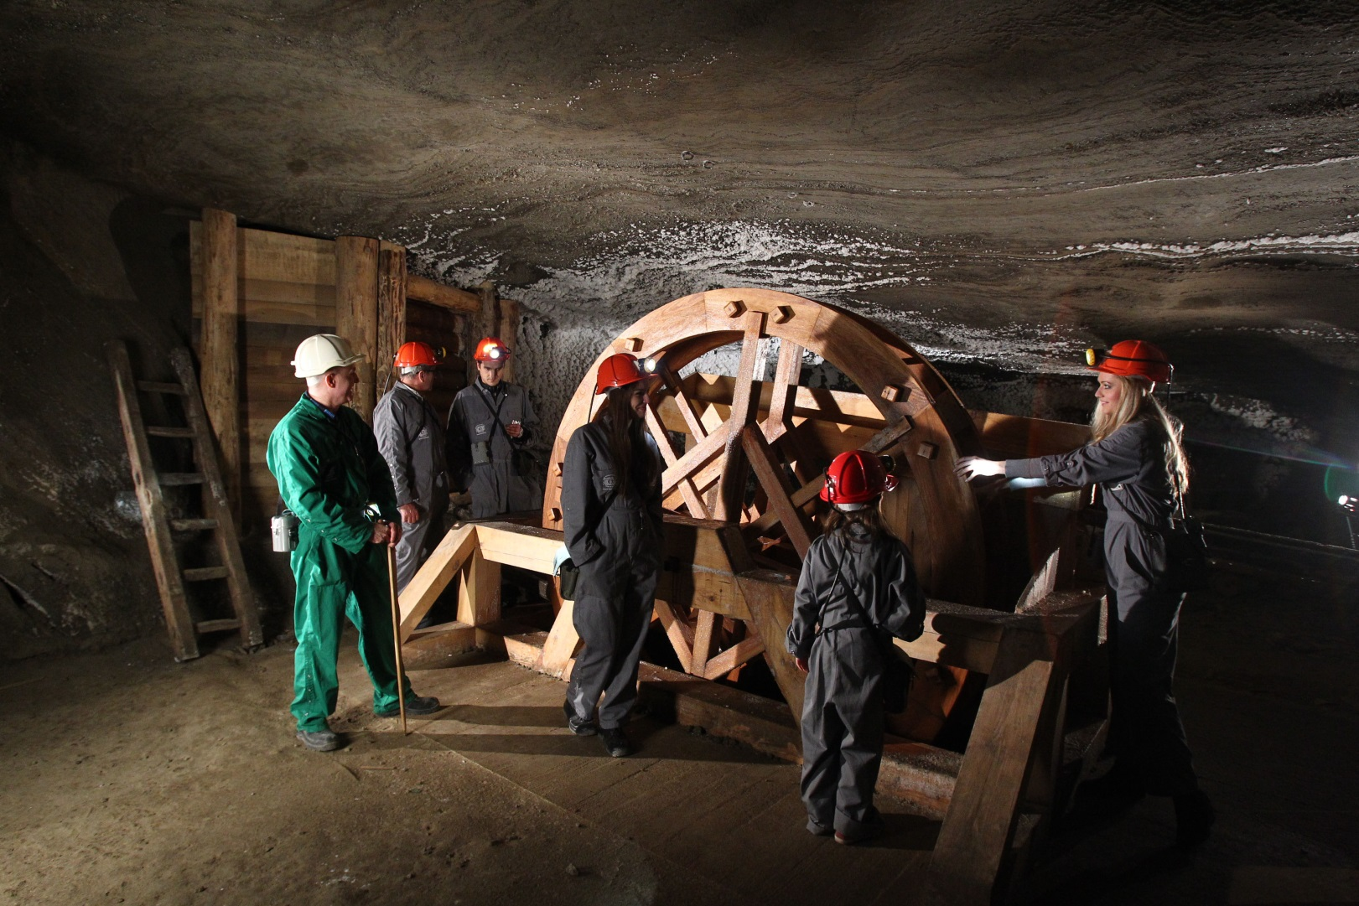
The Miners’ Route
Kopalnia Soli „Wieliczka” Trasa Turystyczna www.kopalnia.pl
28.02.2020

Slide 15
The „Wieliczka” Salt Mine - Routes for children
The „Wieliczka” Salt Mine offers different tours for children. The most popular one is the route „Solilandia” where the kids meet creatures from the Mine’s legends like the ghost – The Treasurer.
Thanks to this offer, the youngest visitors could learn about the heritage of the Mine in the way suitable for their age.
Kopalnia Soli „Wieliczka” Trasa Turystyczna www.kopalnia.pl
28.02.2020

Slide 16
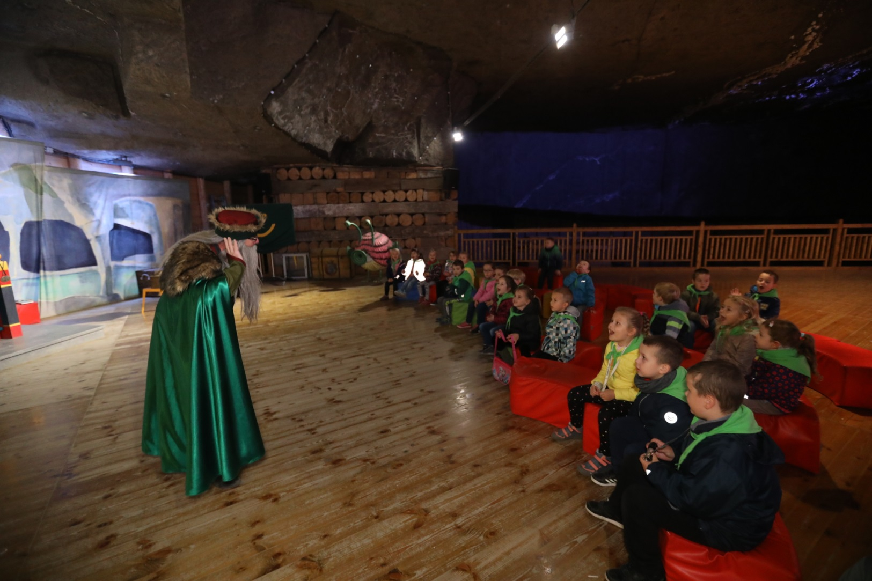
The „Wieliczka” Salt Mine - Routes for children
Kopalnia Soli „Wieliczka” Trasa Turystyczna www.kopalnia.pl
28.02.2020

Slide 17
The „God Bless” Pilgrims’ Route
The „God Bless” Pilgrim’s Route is the religious route of the Wieliczka Mine.
The visitors see the chapels on the route, including the oldest chapel devoted to St. Anthony, made in the XVII century.
During that trip, the pilgrims can take part in the mass celebrated in the underground chapel.
Kopalnia Soli „Wieliczka” Trasa Turystyczna www.kopalnia.pl
28.02.2020

Slide 18
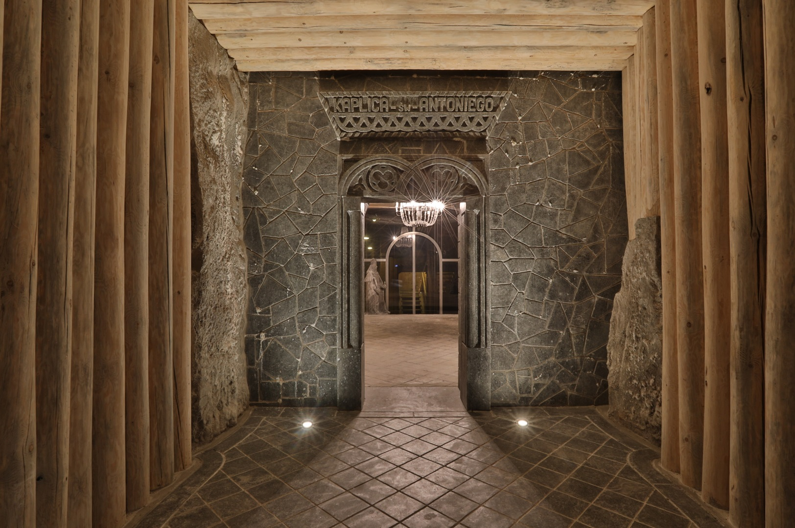
The „God Bless” Pilgrims’ Route
Kopalnia Soli „Wieliczka” Trasa Turystyczna www.kopalnia.pl
28.02.2020

Slide 19
The „Wieliczka” Salt Mine - Education
Not only the Mine educates children throughout dedicated trips. It also spreads the knowledge about the miners’ tradition and the health values of salt by organizing annual programmes for children from local kindergartens: „Zdrowie na 5+” („A+ Health”) and Dzień Górnika („The Miner’s Day).
During lessons, children through games and activities learn about history of the „Wieliczka” salt mine, importance of salt and healthy lifestyle.
Kopalnia Soli „Wieliczka” Trasa Turystyczna www.kopalnia.pl
28.02.2020

Slide 20
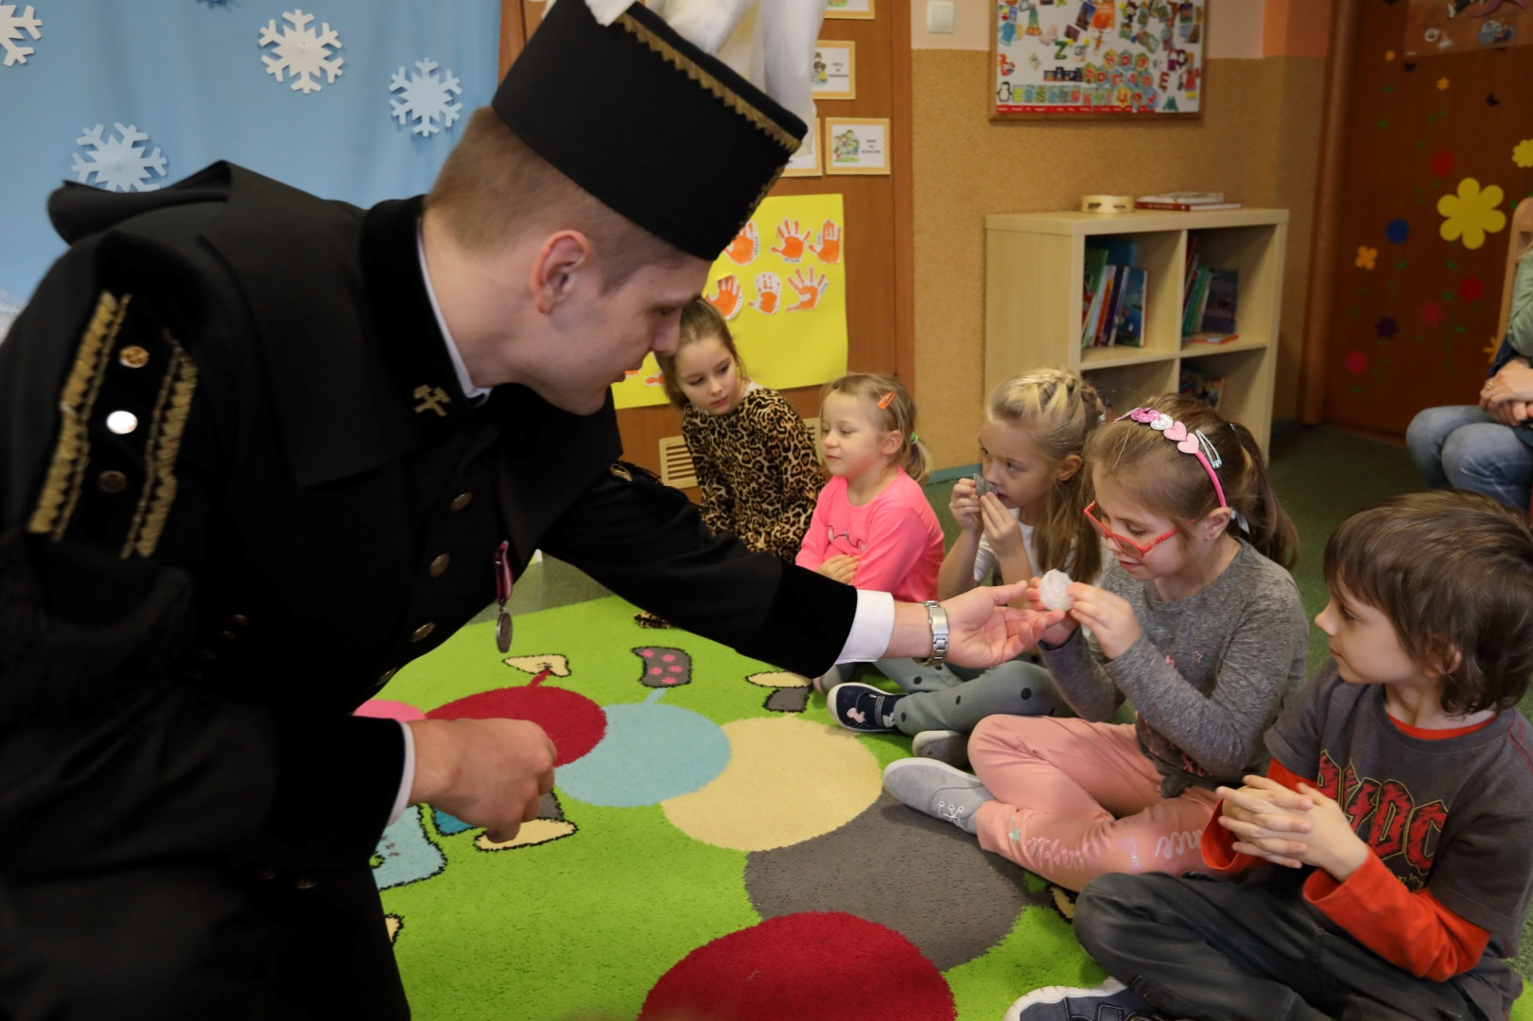
The „Wieliczka” Salt Mine - Education
Kopalnia Soli „Wieliczka” Trasa Turystyczna www.kopalnia.pl
28.02.2020

Slide 21
The „Wieliczka” Salt Mine Health Resort
- Underground and on the surface
In the underground Health Resort, patients have at their disposal chambers on Level III of the mine – Lake Wessel, Eastern Mountains Stable, Dragon and Boczkowski – as well as specialist clinics on the surface in the building of the former Salt Mill. In 2011, the Wieliczka sanatorium was the first in Poland to be granted the status of an underground health resort.
In 2019 over 7 000 patients stayed in the „Wieliczka” Salt Mine Health Resort.
Kopalnia Soli „Wieliczka” Trasa Turystyczna www.kopalnia.pl
28.02.2020

Slide 22
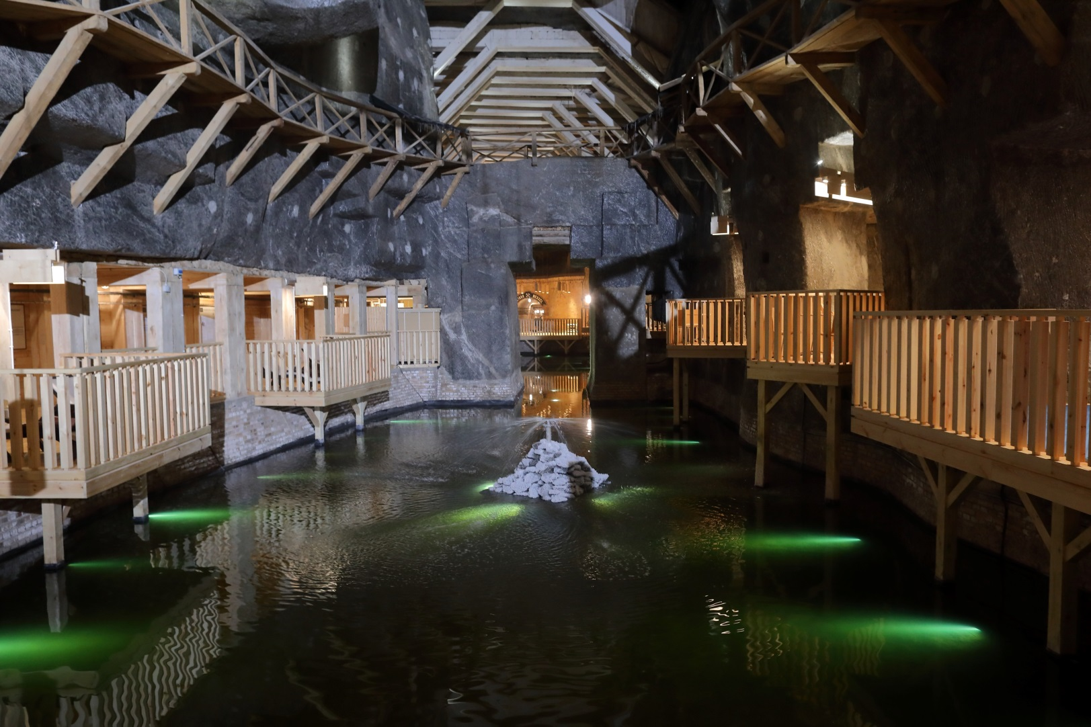
The „Wieliczka” Salt Mine Health Resort
- Underground and on the surface
Kopalnia Soli „Wieliczka” Trasa Turystyczna www.kopalnia.pl
28.02.2020

Slide 23
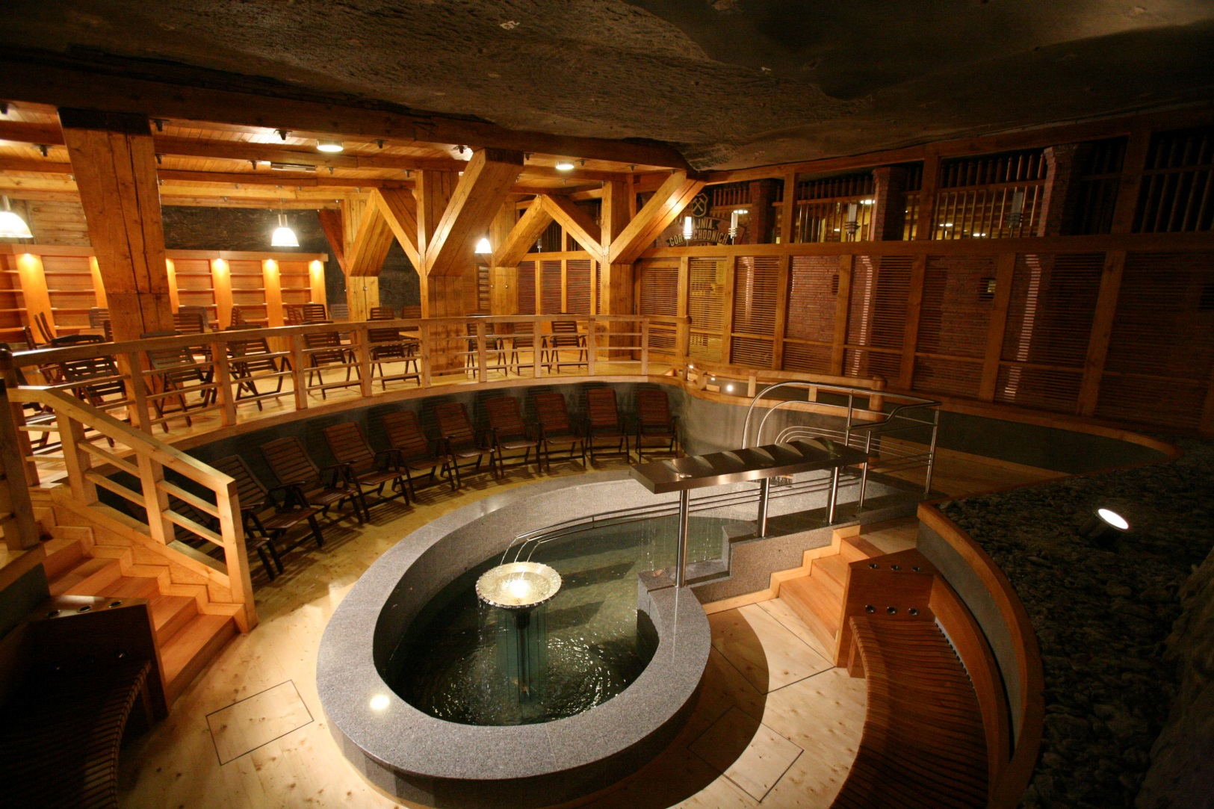
The „Wieliczka” Salt Mine Health Resort
- Underground and on the surface
Kopalnia Soli „Wieliczka” Trasa Turystyczna www.kopalnia.pl
28.02.2020

Slide 24
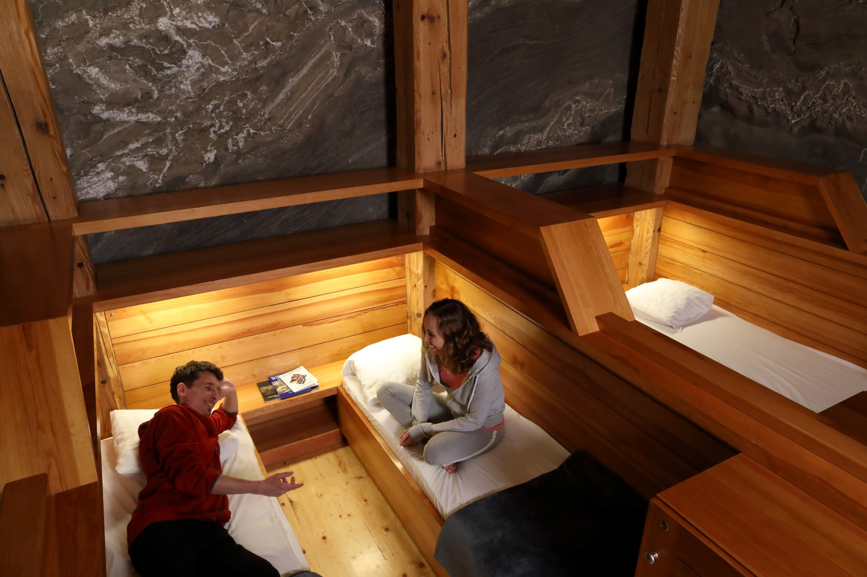
The „Wieliczka” Salt Mine Health Resort
- Underground and on the surface
Kopalnia Soli „Wieliczka” Trasa Turystyczna www.kopalnia.pl
28.02.2020

Slide 25
Graduation Tower
In the Graduation Tower visitors inhale the salt aerosol from the Wieliczka’s brine. It is a perfect place for people suffering from asthma or allergies. You can take a walk around the Graduation Tower or sit on a bench and relax.
234 331 guests visited The Graduation Tower in 2019.
3 200
Kopalnia Soli „Wieliczka” Trasa Turystyczna www.kopalnia.pl
28.02.2020

Slide 26
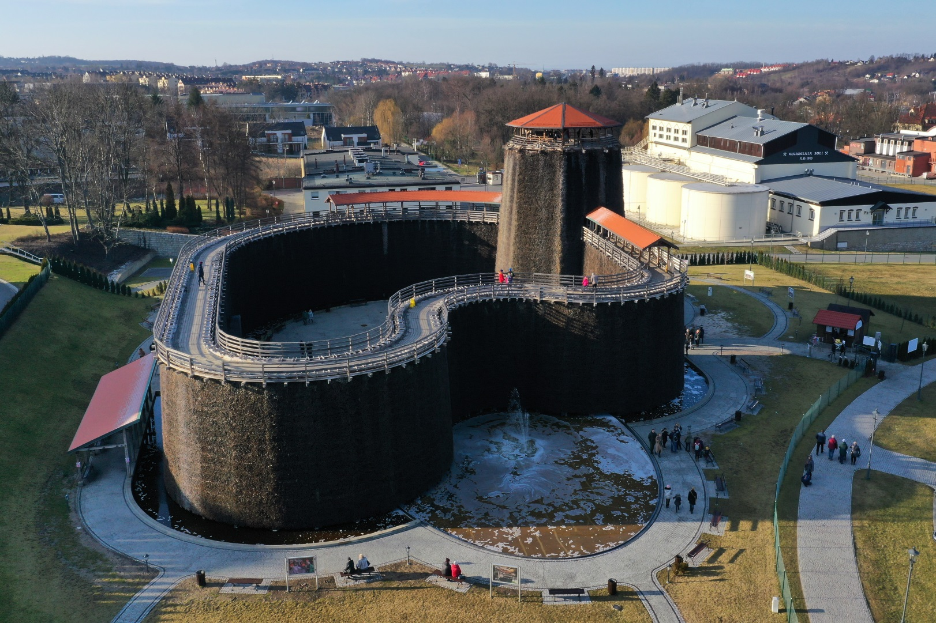
The Graduation Tower
Kopalnia Soli „Wieliczka” Trasa Turystyczna www.kopalnia.pl
28.02.2020

Slide 27
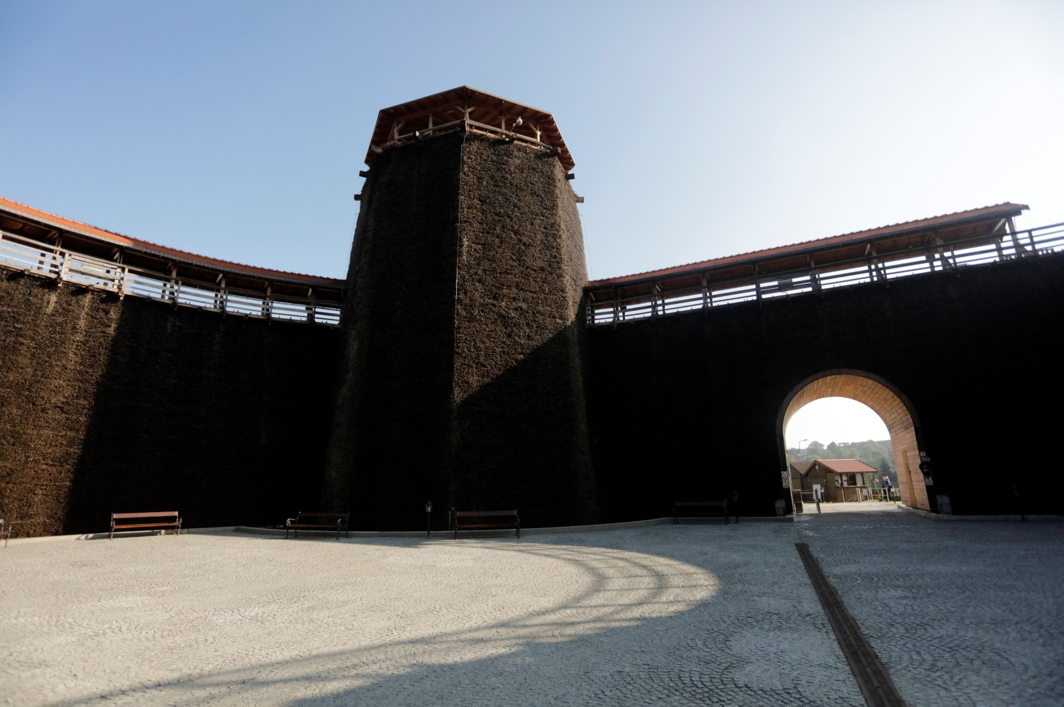
The Graduation Tower
Kopalnia Soli „Wieliczka” Trasa Turystyczna www.kopalnia.pl
28.02.2020

Slide 28
Event Organisation
Every year events like concerts, theatre plays, parties, balls and weddings take place in the „Wieliczka” Salt Mine. In 2019 over 300 events were organised, with over 35 thousand guests participating.
The most spectacular ones take place in Warszawa Chamber, 125 metres below the surface. One of the most famous events are „The New Year’s Concerts” organised annually at the first weekend of January.
The Mine’s chambers can host also companies’ events, often connected with visit on the Tourist Route, like:
Trainings and conferences
Company meetings
Special occasion dinners
Kopalnia Soli „Wieliczka” Trasa Turystyczna www.kopalnia.pl
28.02.2020

Slide 29
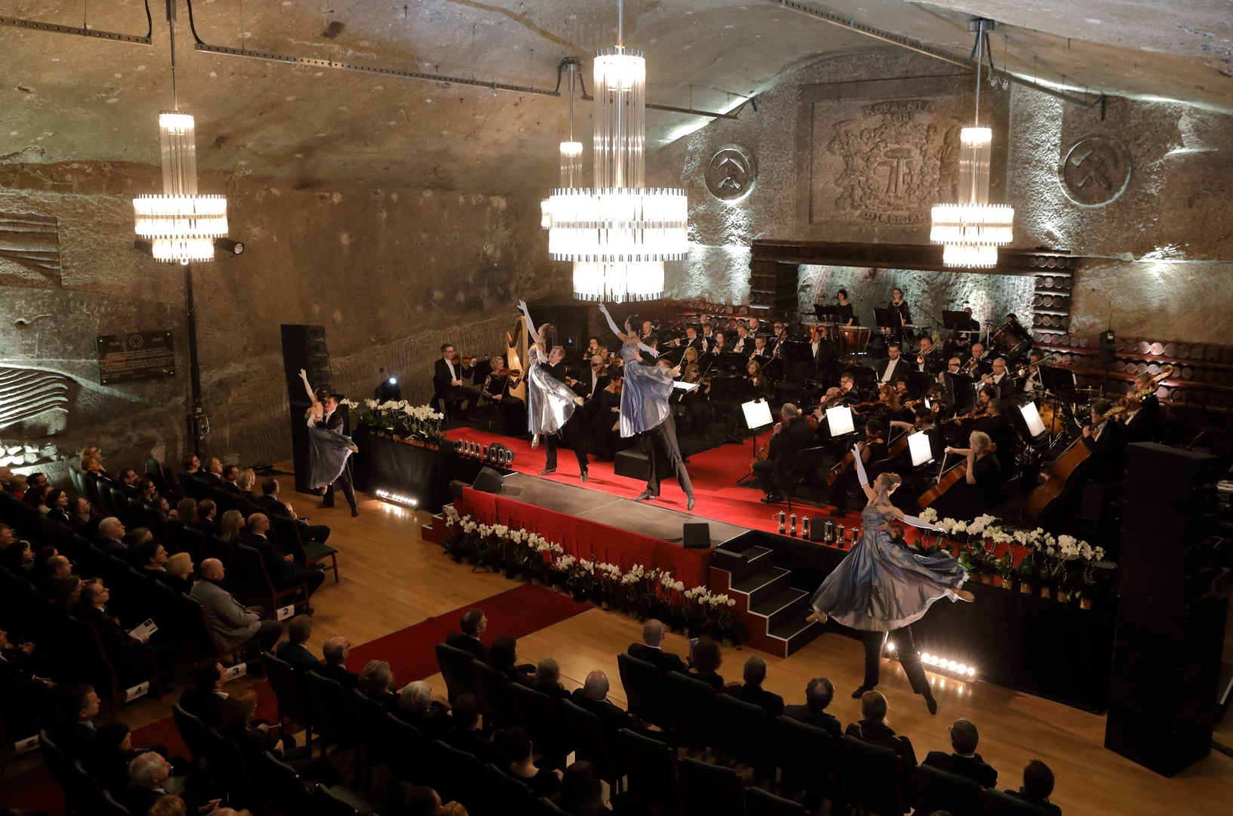
Event Organisation
Kopalnia Soli „Wieliczka” Trasa Turystyczna www.kopalnia.pl
28.02.2020

Slide 30
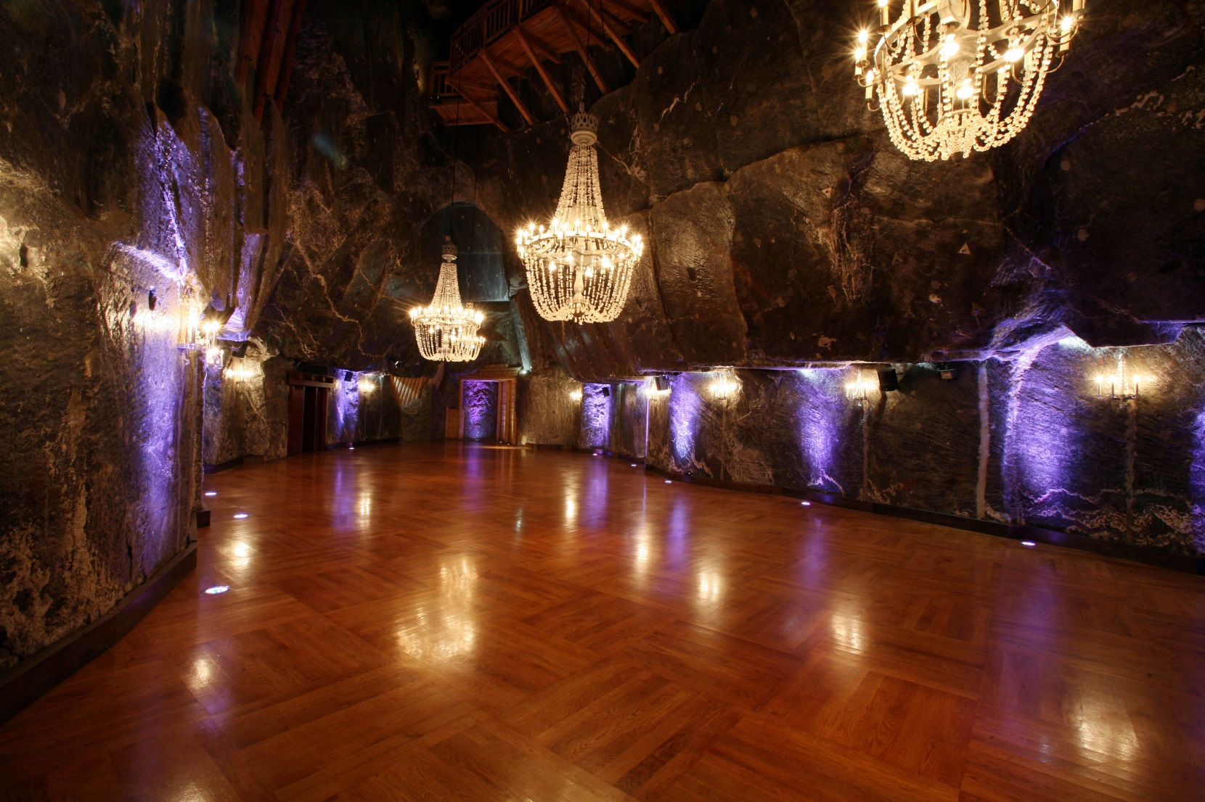
Event Organisation
Kopalnia Soli „Wieliczka” Trasa Turystyczna www.kopalnia.pl
28.02.2020

Slide 31
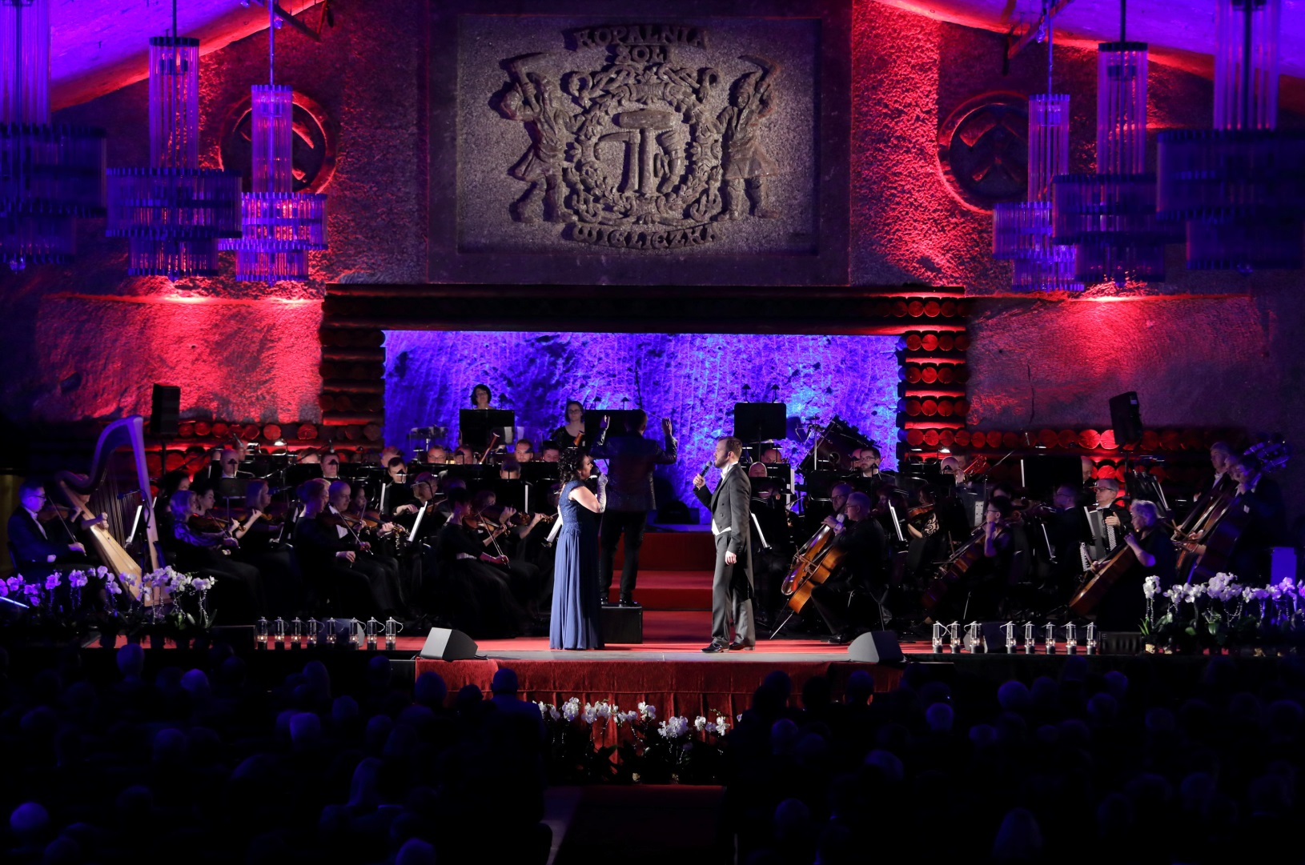
Event Organisation
Kopalnia Soli „Wieliczka” Trasa Turystyczna www.kopalnia.pl
28.02.2020

Slide 32
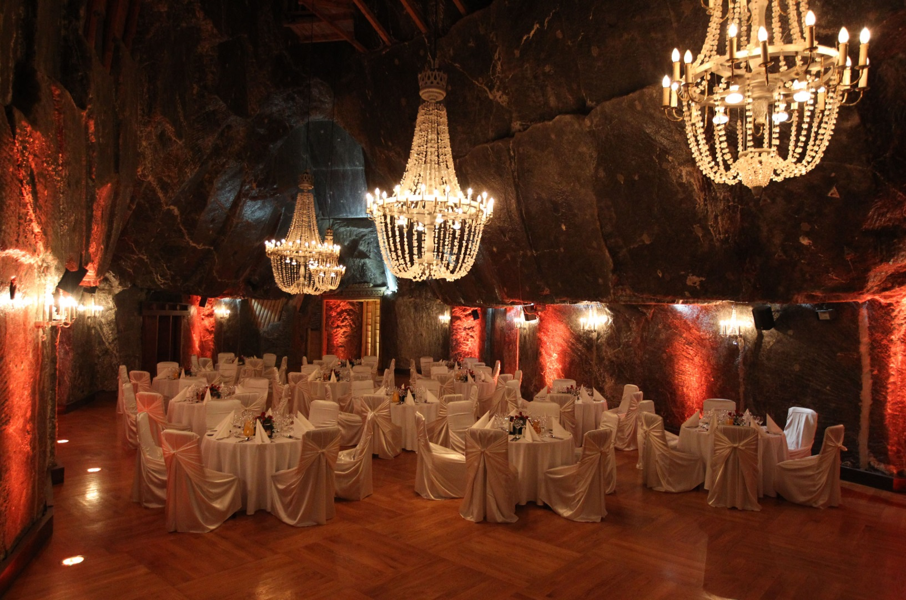
Event Organisation
Kopalnia Soli „Wieliczka” Trasa Turystyczna www.kopalnia.pl
28.02.2020

Slide 33
Media in the Mine
Thanks to the numerous media representatives from all around the world knowledge about the „Wieliczka” Salt Mine can reach the farthest corners of the world.
In 2020 the Mine was visited by the journalists from over 50 countries. The Mine was shown in TV, talked about in the radio and described in press and blogs. The undergrounds are also interesting for filmmakers and often become the movie set.
Kopalnia Soli „Wieliczka” Trasa Turystyczna www.kopalnia.pl
28.02.2020

Slide 34
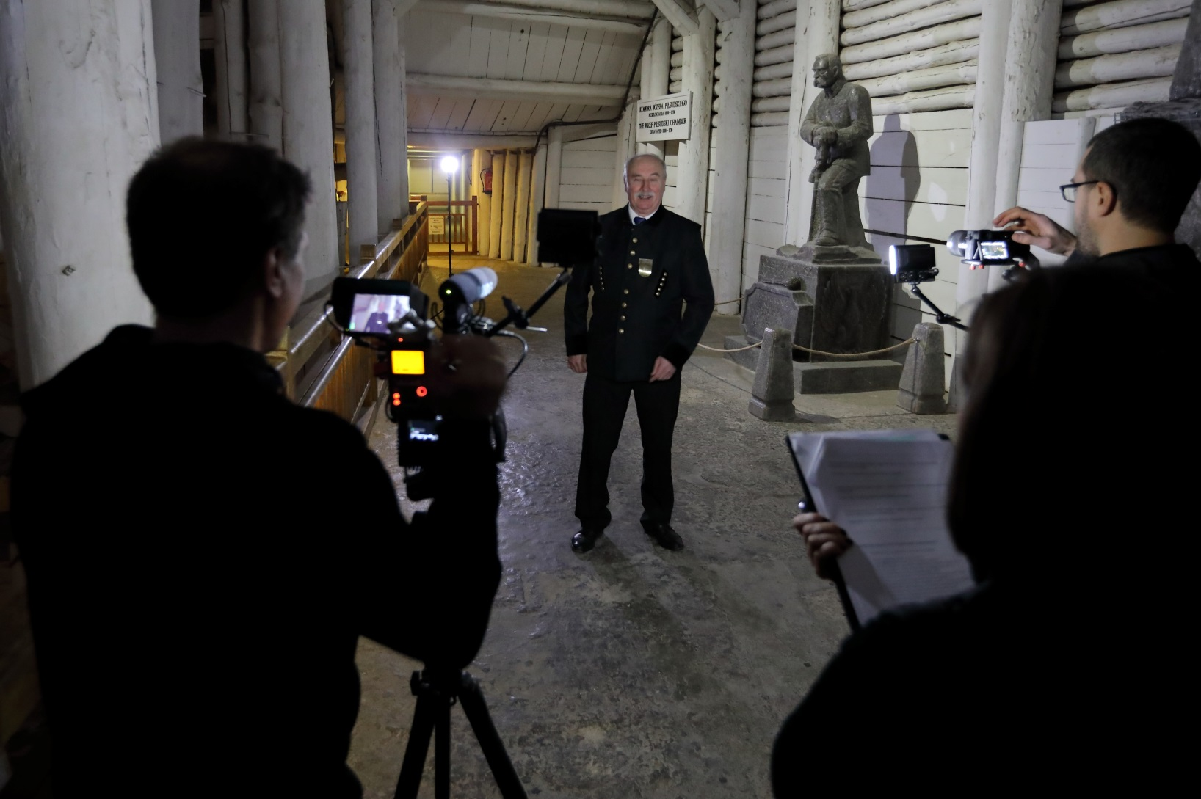
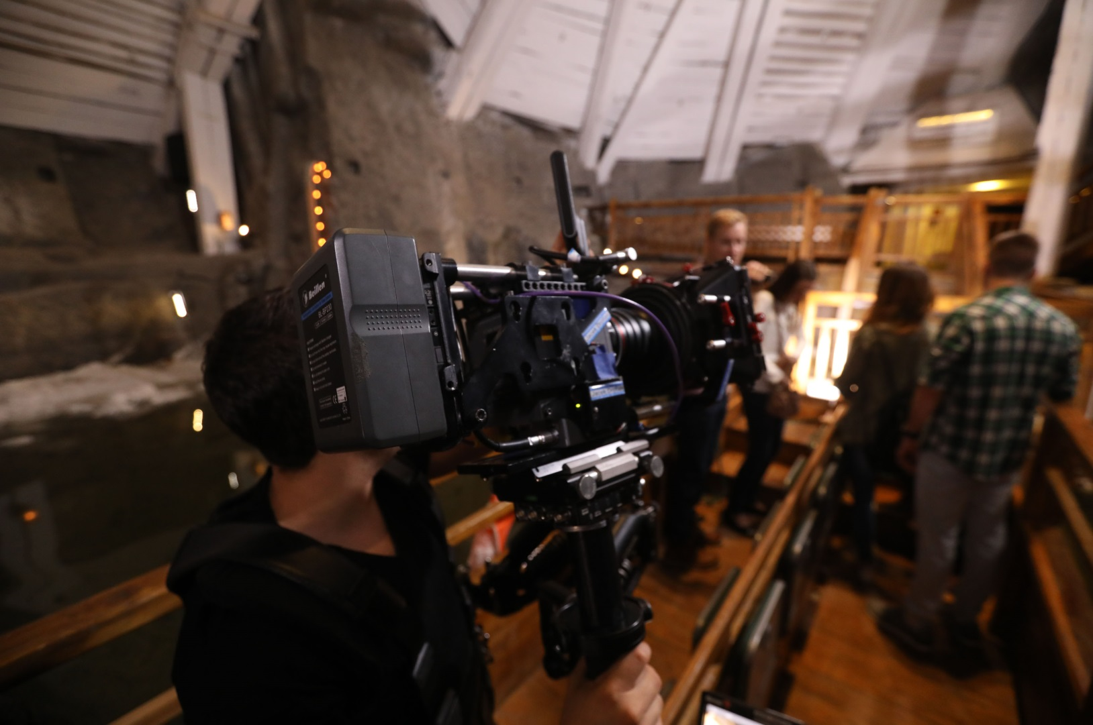
Media in the Mine
Kopalnia Soli „Wieliczka” Trasa Turystyczna www.kopalnia.pl
28.02.2020

Slide 35
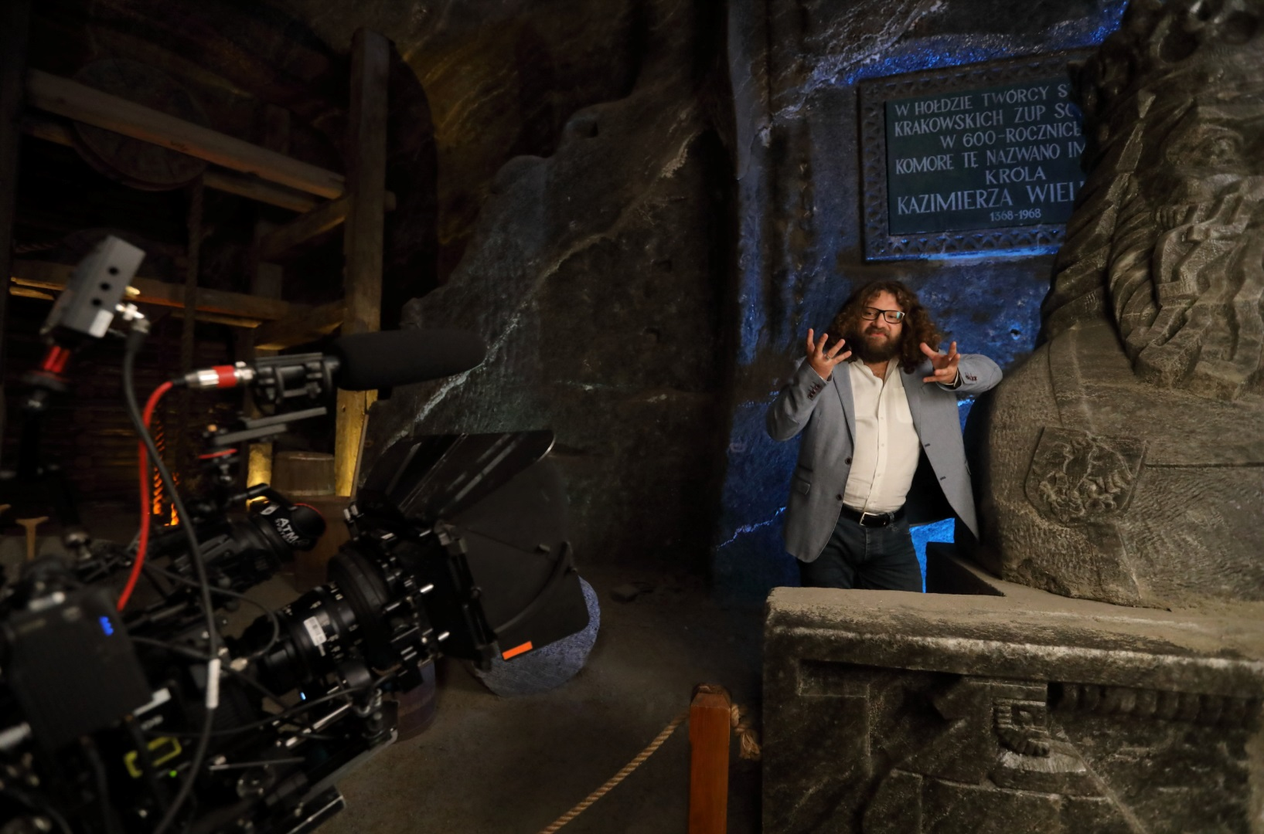
Media in the Mine
Kopalnia Soli „Wieliczka” Trasa Turystyczna www.kopalnia.pl
28.02.2020

Slide 36
Thank you for your attention.
Kopalnia Soli „Wieliczka” Trasa Turystyczna www.kopalnia.pl
28.03.2019

