Slide 1
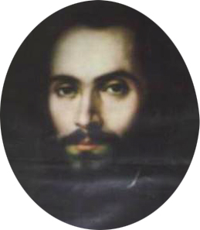
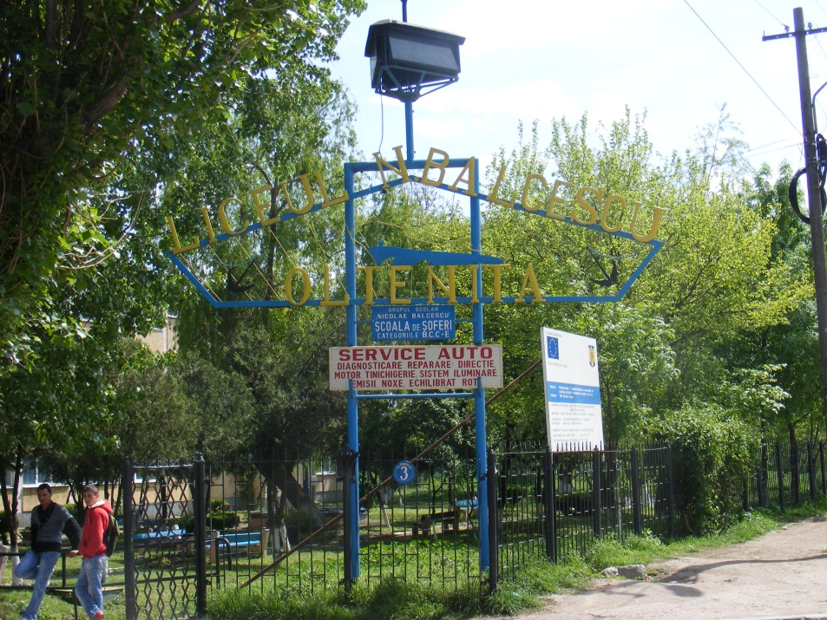

Slide 2
SCHOOL PLAN
Theoretical pathway – 4 classes of IX grade
Mathematics-Computers -1 class;
Natural Sciences - 1class;
Intensive English Philology-1 class;
Social Sciences -1 class.
Technological pathway - 10 classes of IX grade
Economic-Administration–2 classes
Electromechanical – 1 class;
Electronics-Automation – 1 class;
Mechanics – 5 classes;
Textile and Leather - 1class

Slide 3
IMPLEMENTED PHARE PROJECTS
1. “ THE SECOND CHANCE” PROGRAM
RESULTS:
● Planning and equipment provision to higher levels of three workshops:
auto mechanic;
auto tinware ;
clothing-textile.
2. MODERNIZATION PROGRAM OF VOCATIONAL AND TECHNICAL EDUCATION
RESULTS:
●endowment and equipping of school workshops;
●endowment with laboratory equipment .

Slide 4
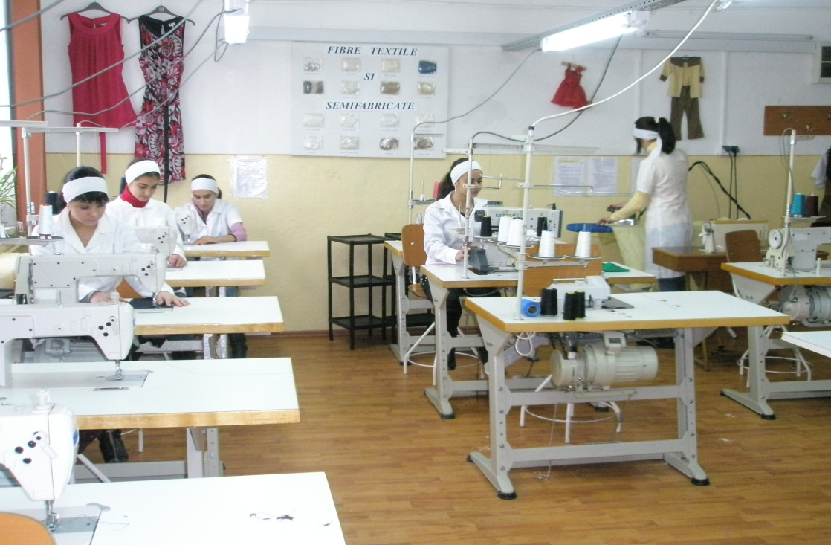
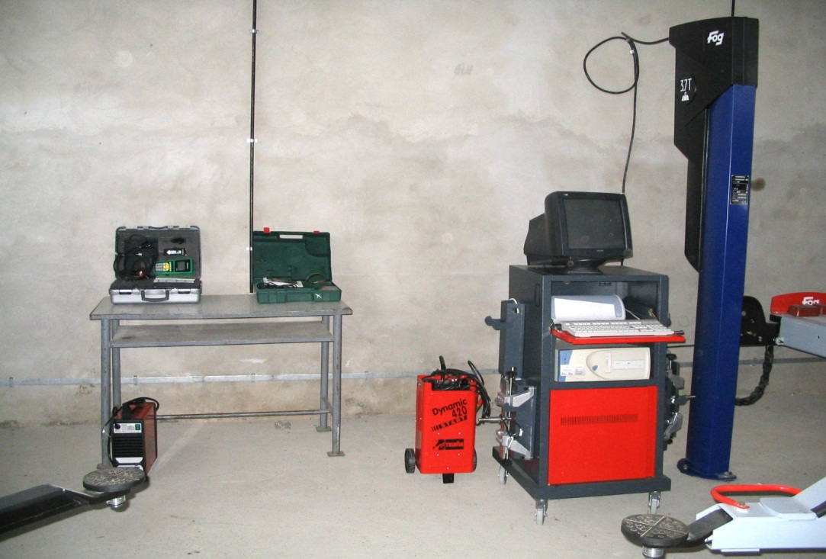
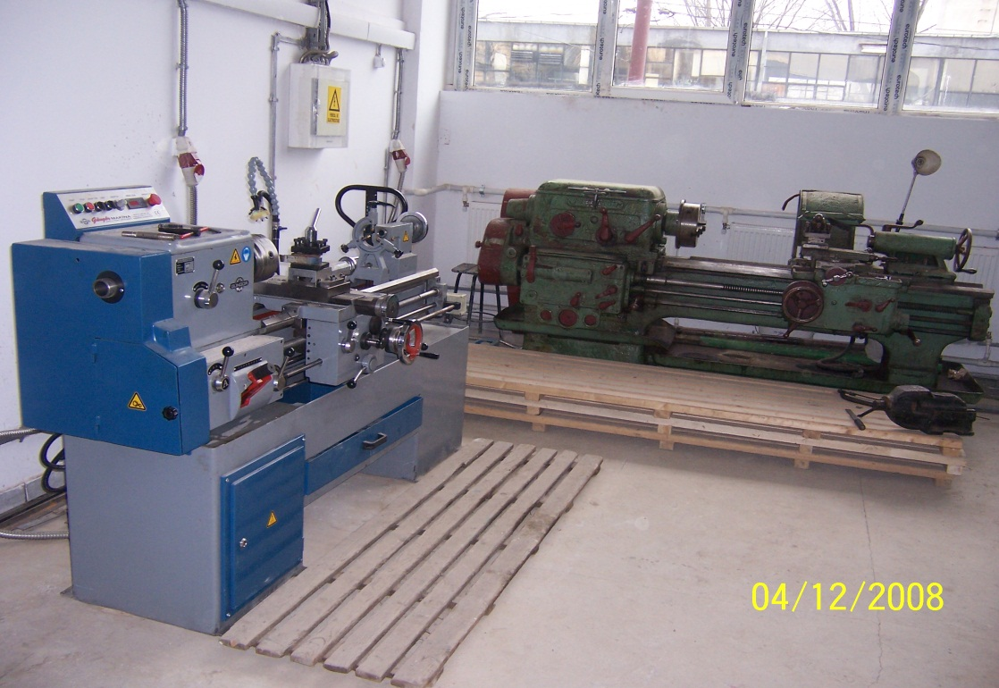
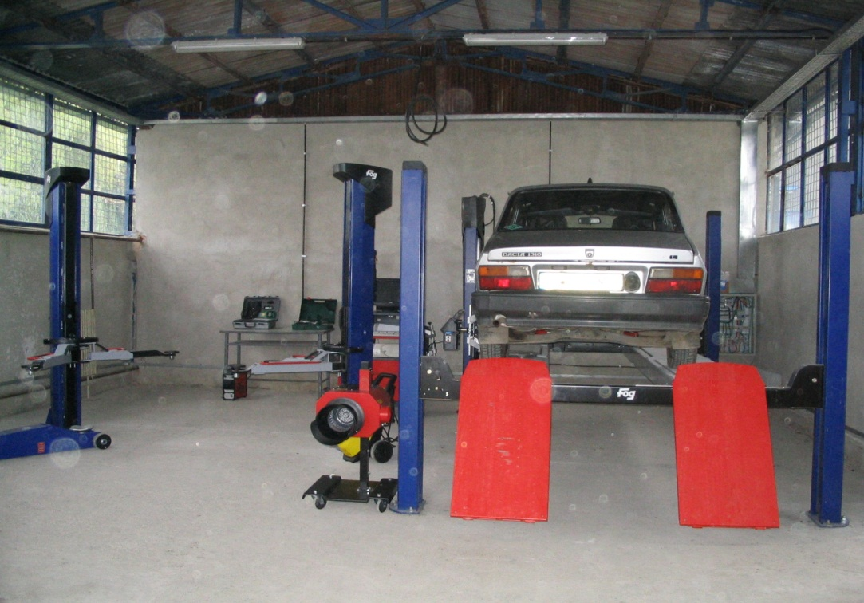
PHARE ENDOWMENT

Slide 5
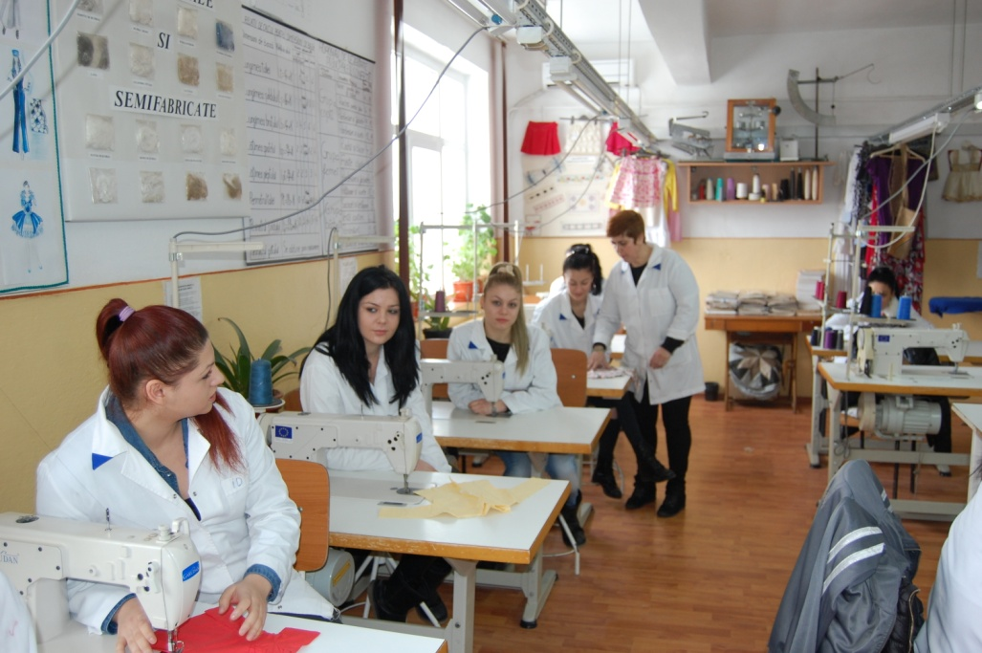
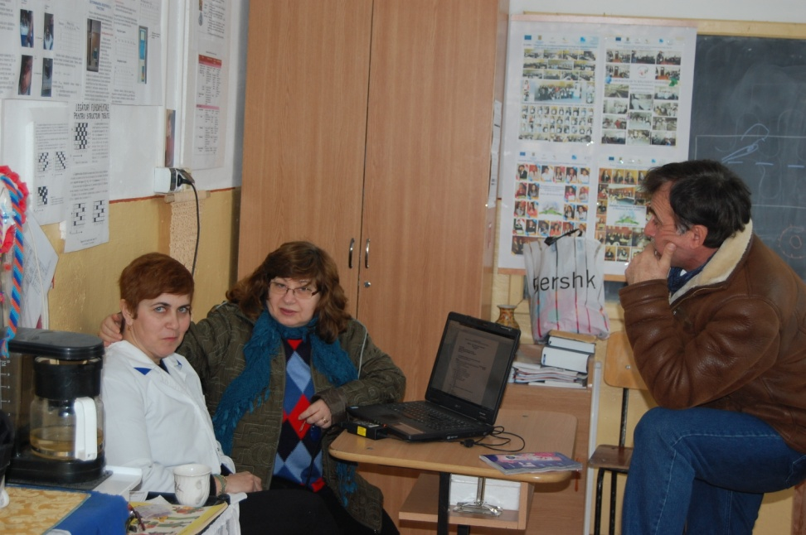
TEXTILES WORKSHOP

Slide 6
LICEUL TEHNOLOGIC
“NICOLAE BĂLCESCU”
PICTURES FROM OUR HIGH SCHOOL :

Slide 7
LICEUL TEHNOLOGIC
“NICOLAE BĂLCESCU”
LABORATORIES

Slide 8
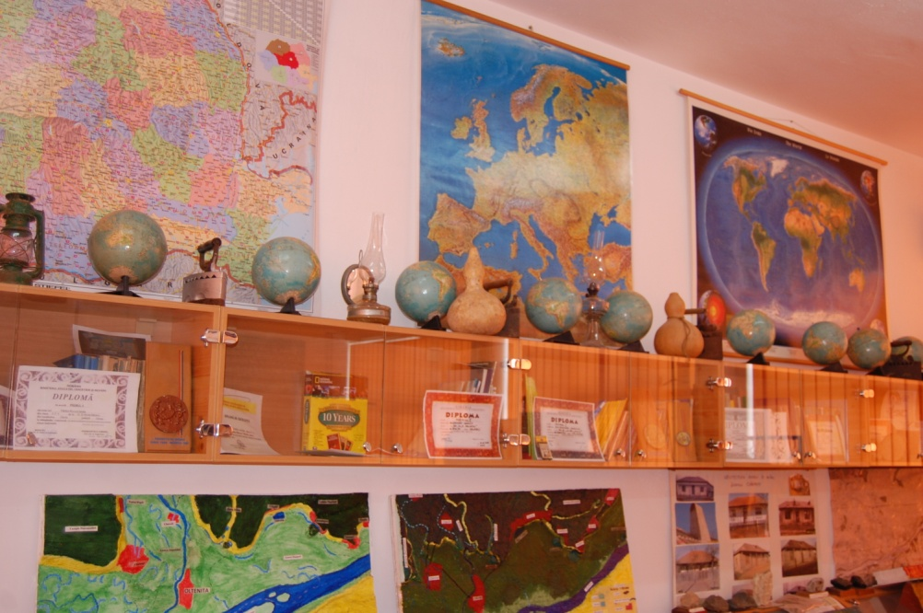
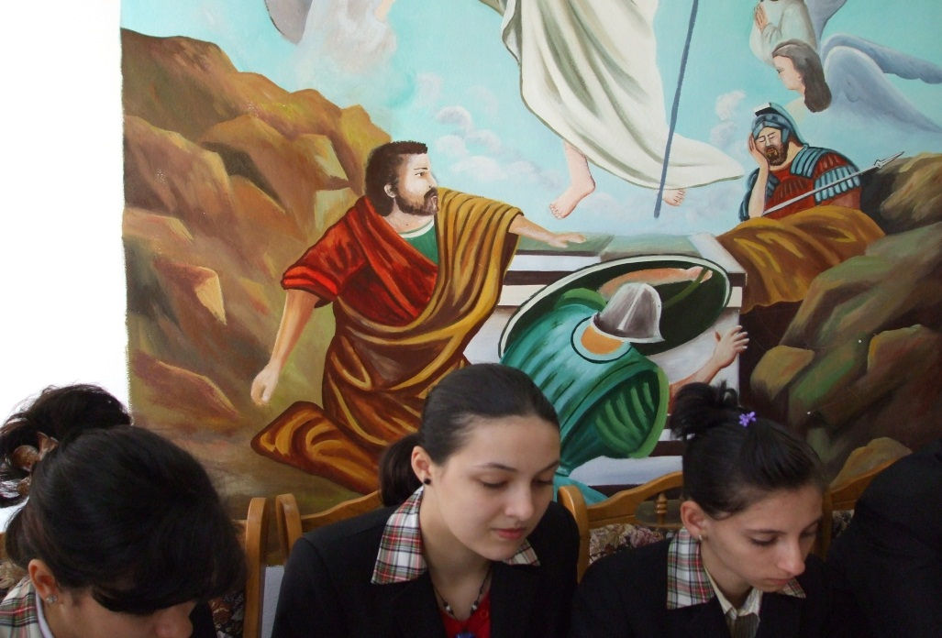
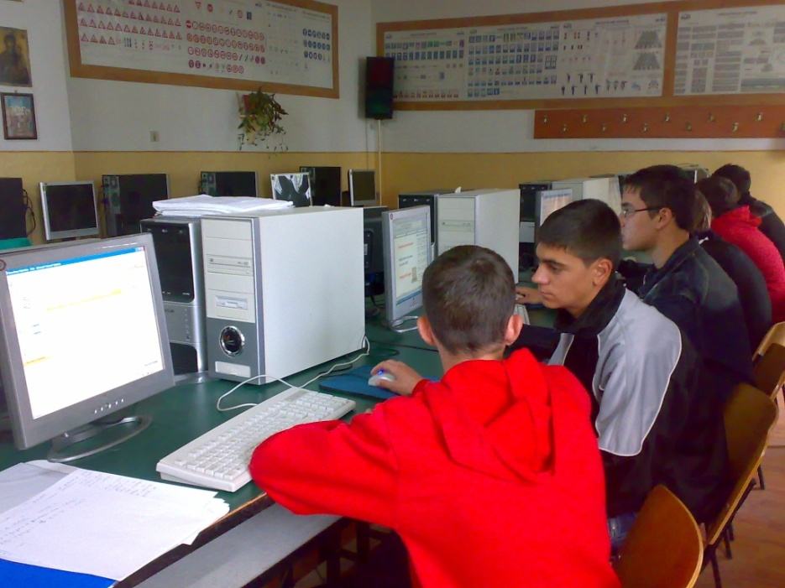
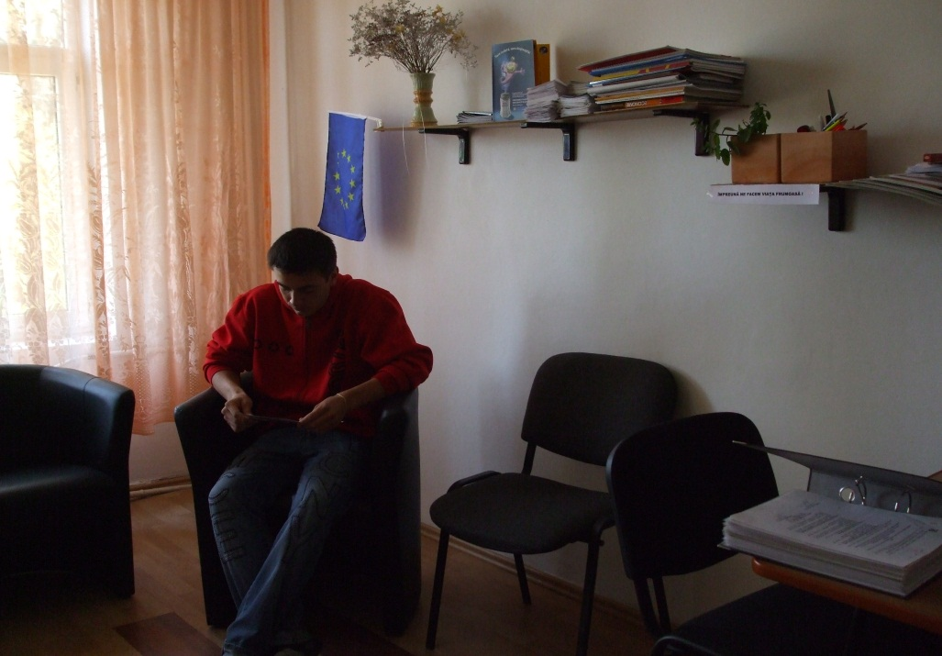
LICEUL TEHNOLOGIC
“NICOLAE BĂLCESCU”
OFFICES

Slide 9
Extracurricular activities
LICEUL TEHNOLOGIC “N.BALCESCU” OLTENITA SCHOOL YEAR 2011-2012

Slide 10
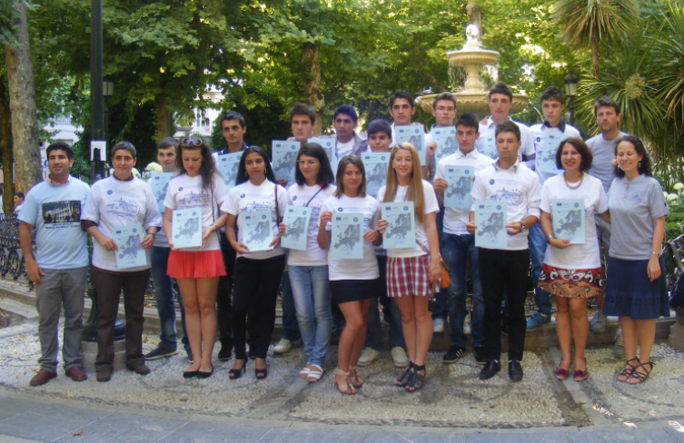
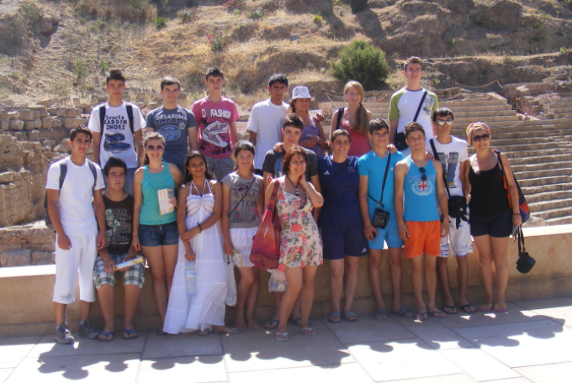
Mobility – Leonardo da Vinci-Granada- Spania- June 2012

Slide 11
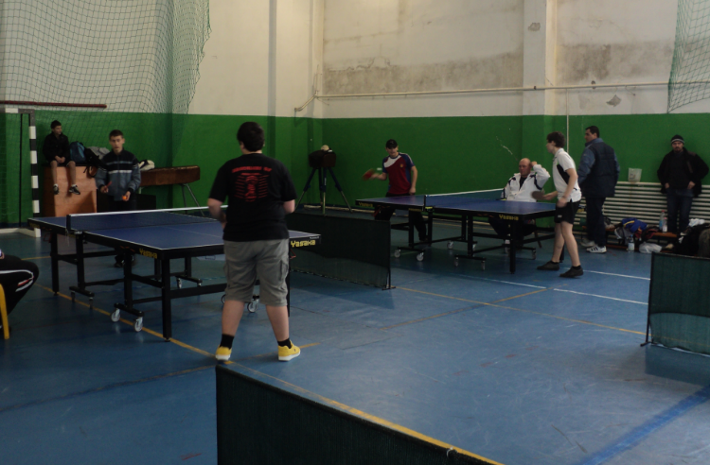
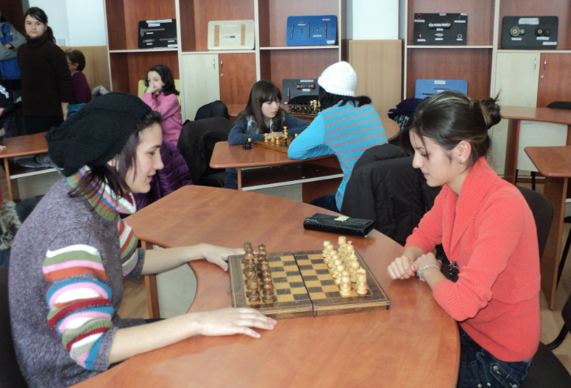
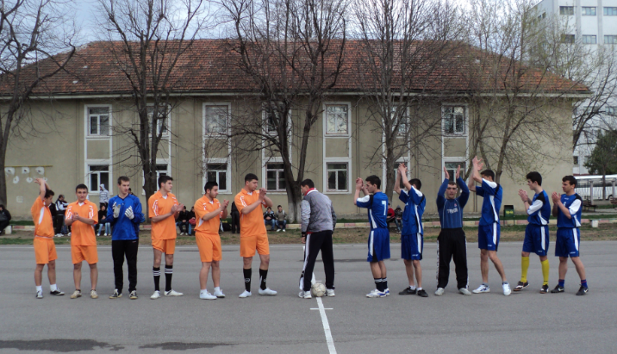
Sports activities
Sports and Artistic activities

Slide 12
PROJET GLOCAL TOUR

