Slide 1
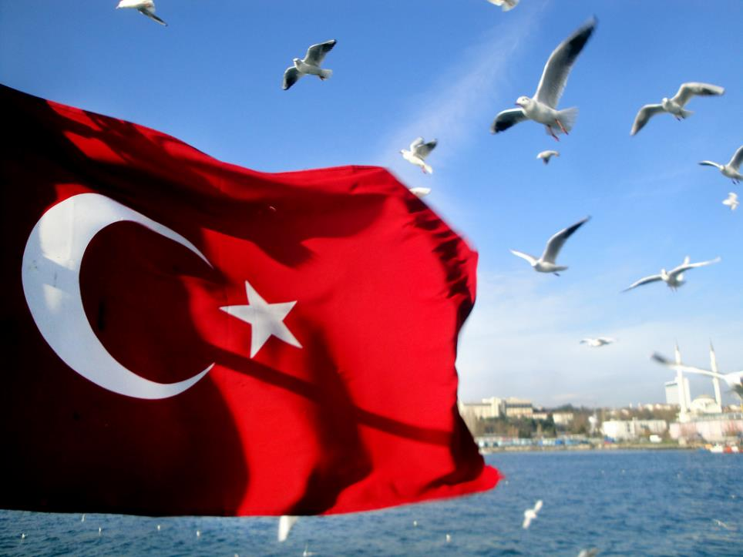
REPUBLIC OF TURKEY

Slide 2
MUSTAFA KEMAL ATATÜRK
Mustafa Kemal Atatürk was a Turkish army officer, reformist statesman, and the first President of Turkey. He is credited with being the founder of the Republic of Turkey.

Slide 3
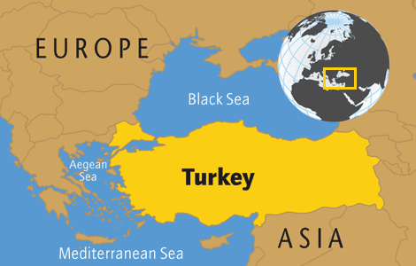
Geographically, Turkey sits in two continents, Europe and Asia, although around 97% of it's land area is on the Asian side.

Slide 4
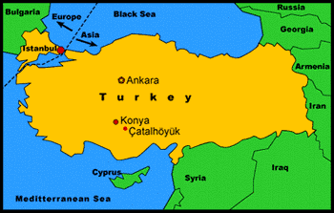
There are eight countries that share a border with Turkey including Armenia, Azerbaijan, Iran, Iraq, Syria, Bulgaria, Greece, and Georgia.

Slide 5
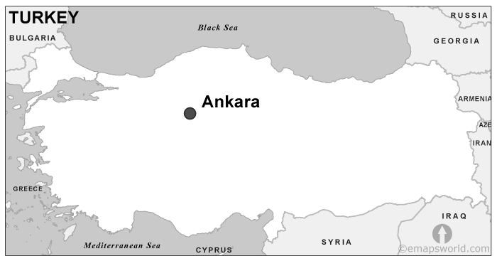
Istanbul is the most crowded city in Turkey and the third most populous urban area in Europe. But it is not the capital, Ankara is the capital of Turkey.

Slide 6
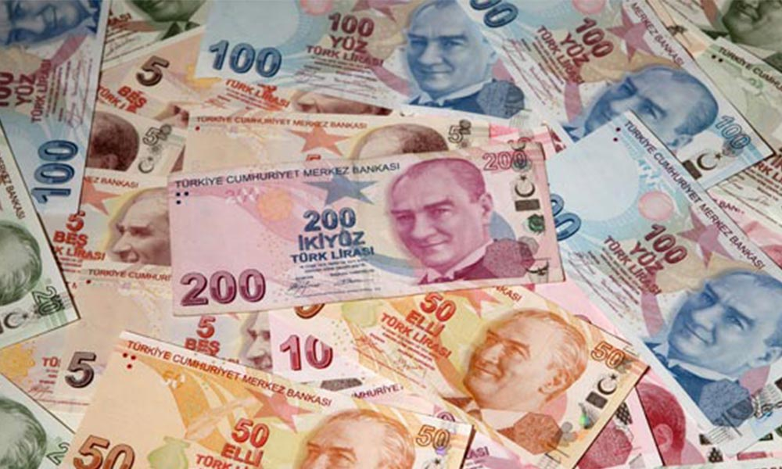
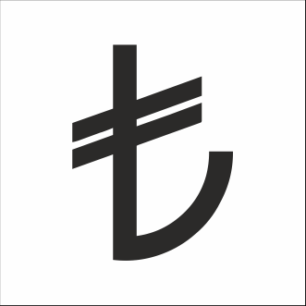
The currency used in the country is called the Turkish Lira.

Slide 7
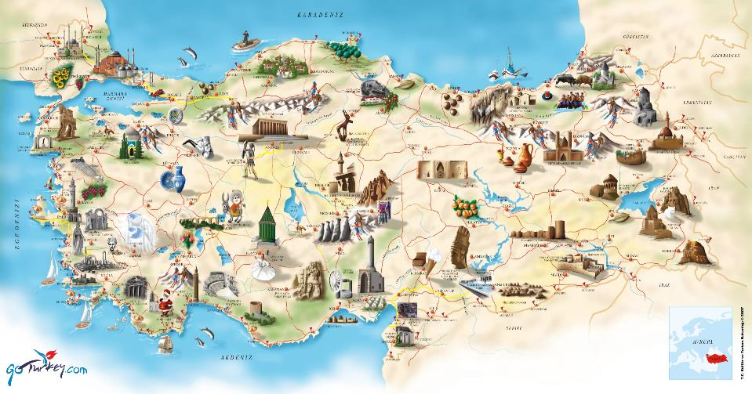
Turkey is a popular tourist destination and home to over ten World Heritage Sites

Slide 8
BOSPHORUS
The Bosphorus is a strait that forms part of the boundary between Europe and Asia.

Slide 9
BASILICA CISTERN
Basilica Cistern, the largest of several hundred ancient cisterns that lie beneath the city of Istanbul.

Slide 10
PRINCE ISLANDS
Princes’ Islands are a group of nine islands of the Asian
coast of Istanbul,Turkey

Slide 11
TROY
Troy is an ancient city in northwestern Turkey

Slide 12
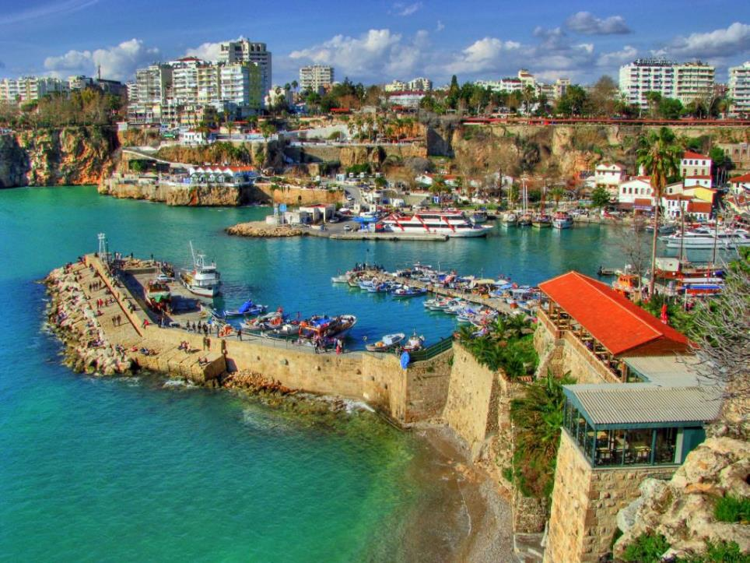
ANTALYA
Antalya is a city on the Mediterranean coast and it is Turkey's biggest international sea resort, located on the Turkish Riviera.

Slide 13
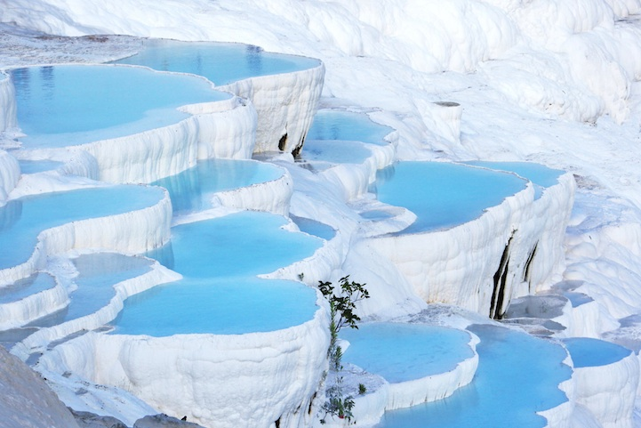
PAMUKKALE
Pamukkale, meaning "cotton castle" in Turkish, is a natural site in Denizli, Turkey.

Slide 14
Ephesus/Ἔφεσος
Ephesus was an ancient Greek city in İzmir.

Slide 15
CAPPADOCIA
Cappadocia is a historical region in Central Anatolia, largely in the Nevşehir, Kayseri, Aksaray, and Niğde Provinces in Turkey.

Slide 16
THE SUMELA MONASTERY
The Sumela Monastery is a Greek Orthodox monastery in the Maçka district of Trabzon Province

Slide 17
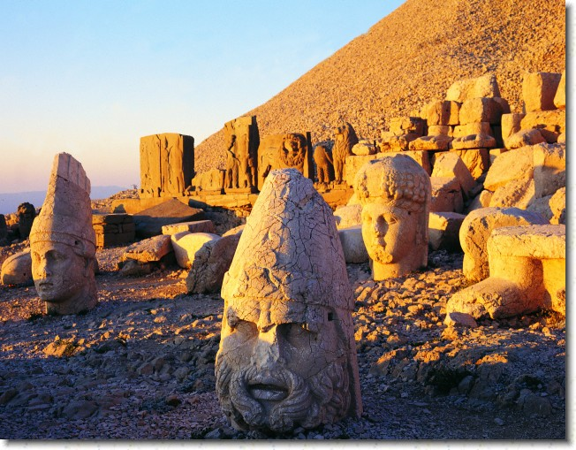
MOUNT NEMRUT
The sanctuary at the top of Mount
Nemrut was built by Antiochos I for
himself as a funerary monument.

Slide 18
MOUNT ARARAT
Greater Ararat, the highest peak in Turkey and the entire Armenian plateau.

Slide 19
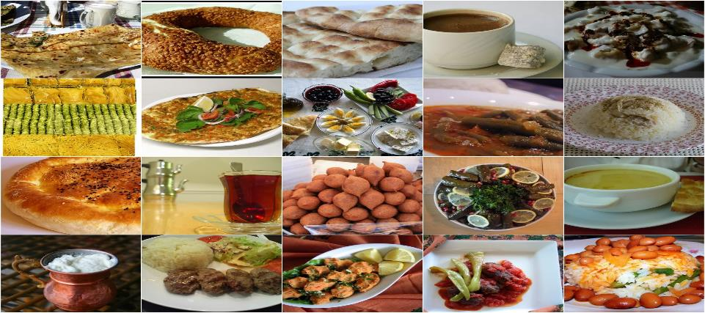
TURKISH CUISINE
Turkish cuisine is largely the heritage of Ottoman cuisine.

Slide 20
TURKISH COFFEE

Slide 21
MANTI

Slide 22
TURKISH KEBAB

Slide 23
BAKLAVA

Slide 24
TURKISH DELIGHT

Slide 25
KÜNEFE

Slide 26
SPORTS IN TURKEY

Slide 27
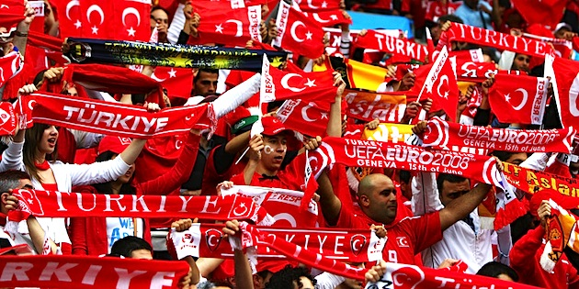
FOOTBALL
Football is the most popular sport in Turkey.

Slide 28
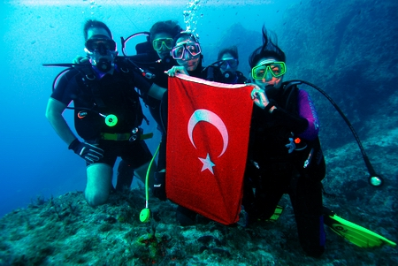
SCUBA DIVING
Mediterranean and Aegean coasts are
the best places to dive.

Slide 29
RAFTING & CANOEING
Turkey's rivers provide perfect conditions for canoeing and rafting.

Slide 30
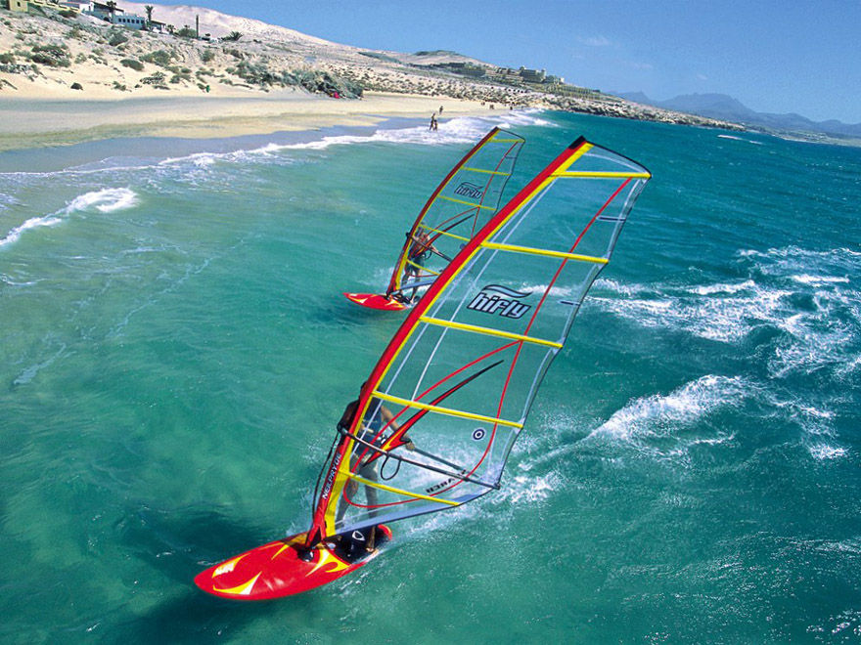
WINDSURFING
The bays
around Cesme, Bodrum and Datca
peninsula, as well as Antalya, have
ideal wind conditions for windsurfing.

Slide 31
CAVING (SPELUNKING)
The most beautiful and interesting caves are located in the Turkey.

Slide 32
SKIING
Winter sports resorts in Turkey are generally located in forested mountains

Slide 33
MOUNTAINEERING

Slide 34
TREKKING

Slide 35
HORSEBACK RIDING

Slide 36
MOTOCROSS

Slide 37
FAMOUS TURKISH SPORTSMANS
He played in
Sacramento Kings
San Antonio Spurs
Orlando Magic
Toronto Rapters and Los Angeles Clippers.

Slide 38
ARDA TURAN
He plays for Spanish club
Atlético Madrid

Slide 39
Thank you for listening…

