Slide 1
TUSCANY

Slide 2
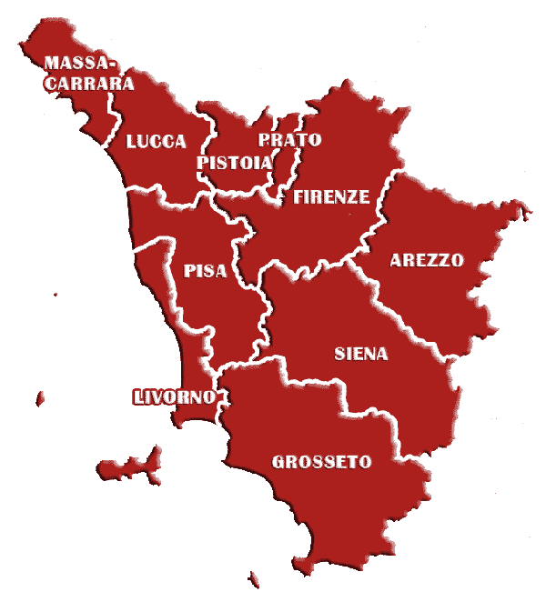
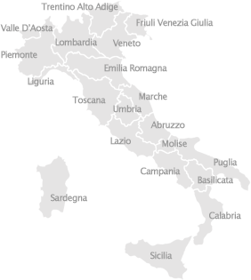
Tuscany is in the north-centre of Italy on the Tyrrhenian sea

Slide 3
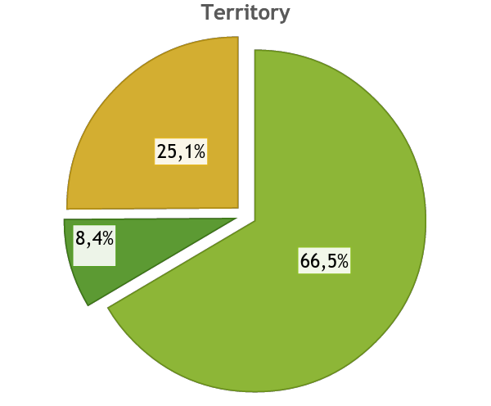
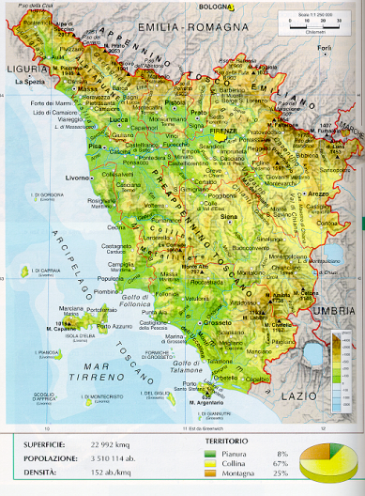
The territory of Tuscany is mostly hilly (66.5%); it includes some plains (about 8.4% of the territory) and major mountain ranges (25.1% of the region).

Slide 4
HISTOry

Slide 5
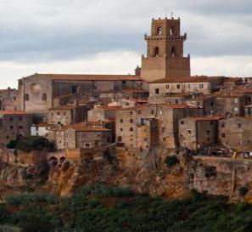
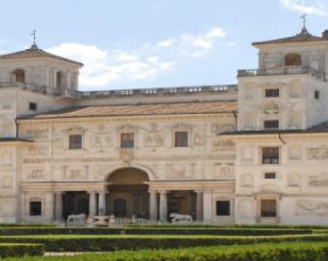
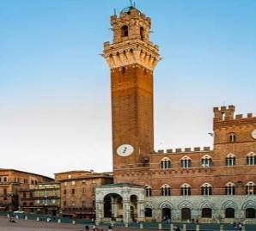
The History of Tuscany can be resumed in three main periods:
The Etruscan period and the roman empire (6th and 5th centuries BC)
The Renaissance and the Medici’s period (14th and 15th centuries)
The Austrian rule and the revolution to the kingdom of Italy (19th century)

Slide 6
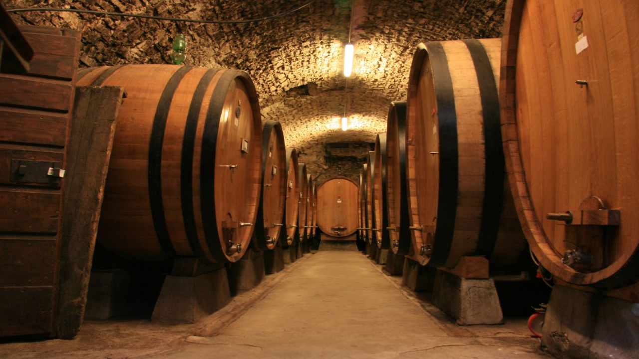
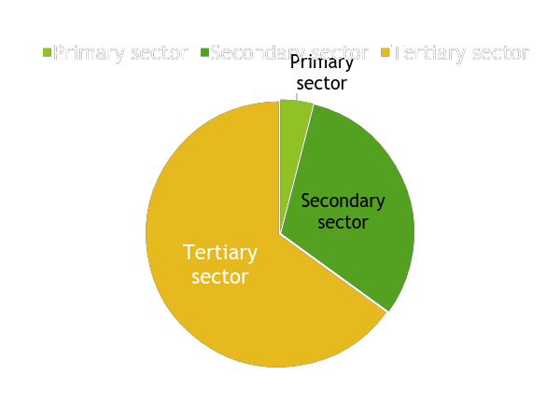
Economy

Slide 7
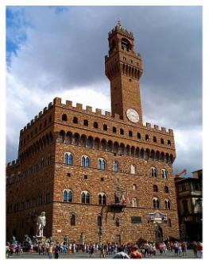
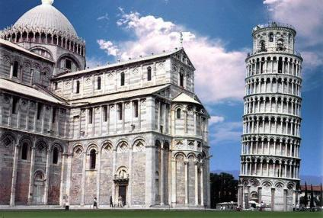
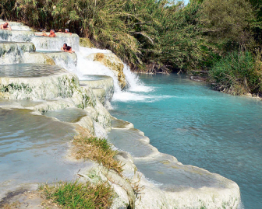
Tertiary sector
It’s the leading economical sector due to tourism for:
Historical Towns
Famous beaches
SPA sites and resorts
Hills area

Slide 8
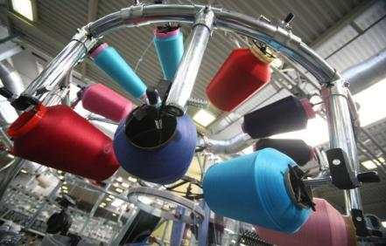
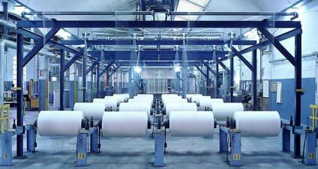
Secondary Sector
Secondary sector in Tuscany is based on:
Few big factories (e. g. Piaggio)
Many small and medium industries (paper district, leather district, fabric and tissue district)
Handicraft

Slide 9
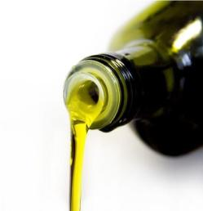
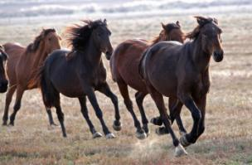
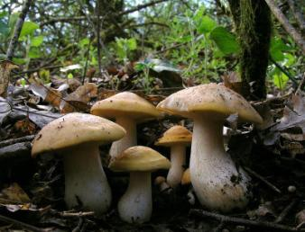
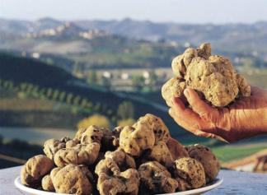
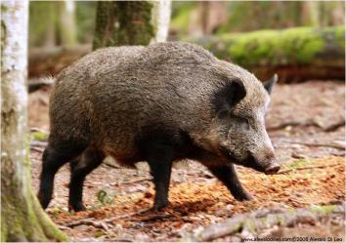
PRIMARY SECTOR
Niche agriculture products (precious wines and oils)
Breeding (cows, horses, pigs)
Exploitation of spontaneous soil products (mushrooms, truffles and chestnuts)

Slide 10
TOURISTS INVITATIONS

Slide 11
Most important cities

Slide 12
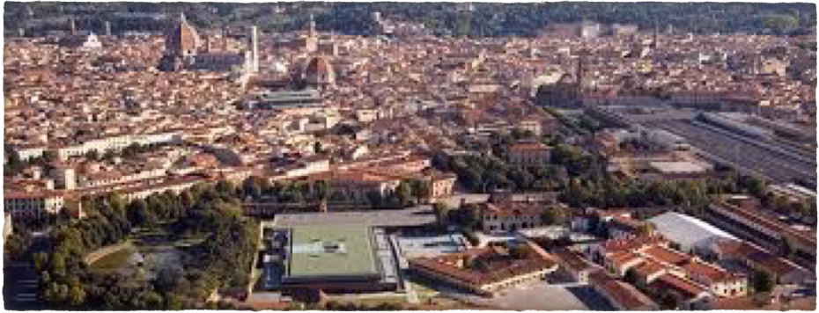
Florence
Florence is the capital city of Tuscany. Florence is considered the birthplace of Italian Renaissance.

Slide 13
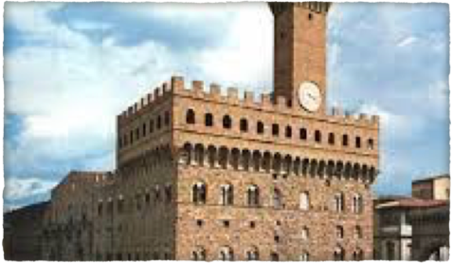
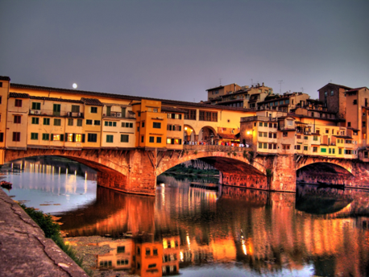
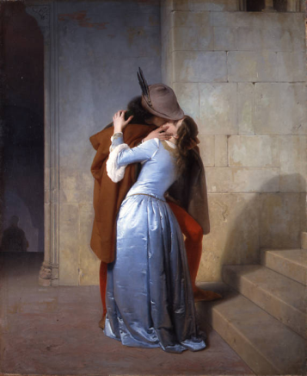
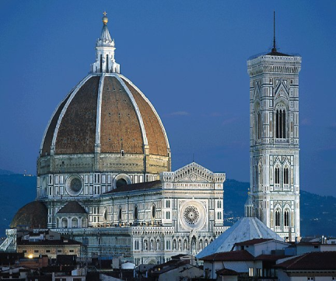
Florence

Slide 14
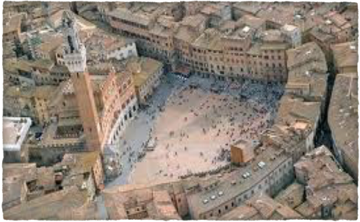
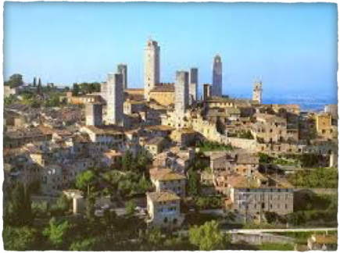
Siena is famous for its historic and artistic heritage, but above all for the famous Palio.
Siena

Slide 15
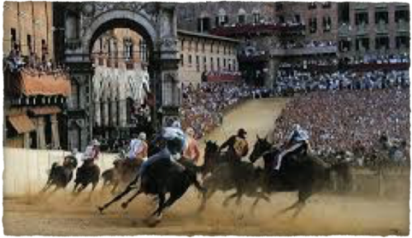
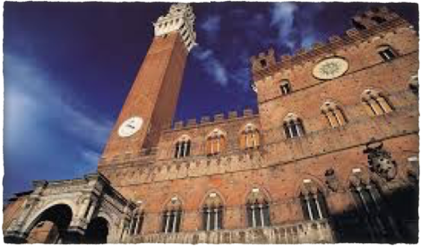
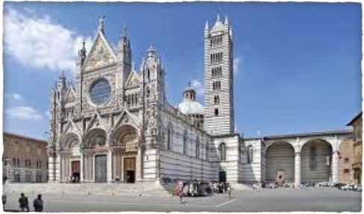
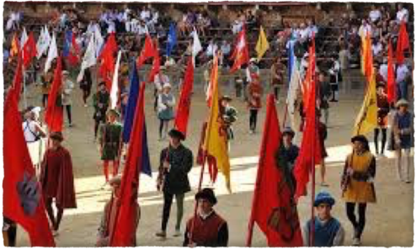
Siena

Slide 16
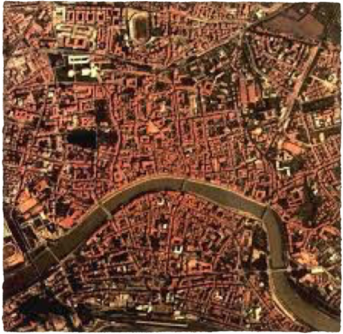
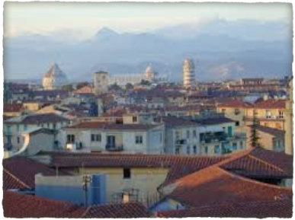
Pisa
Pisa is known worldwide for its Leaning Tower, in Square of Miracles. The city contains a lot of churches, several palaces and various bridges across the Arno river. The city is also important for the Universities, in particoular Normale.

Slide 17
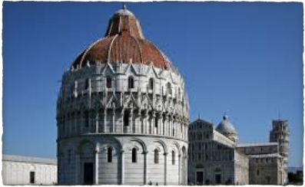
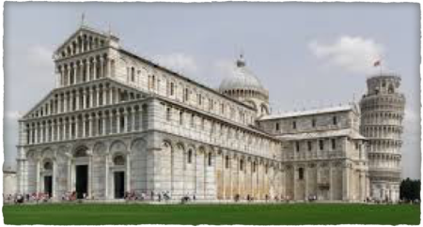
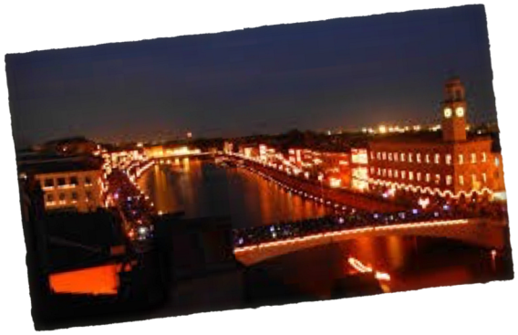
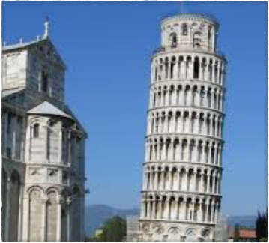
Pisa

Slide 18
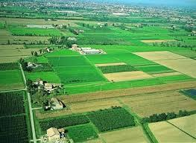
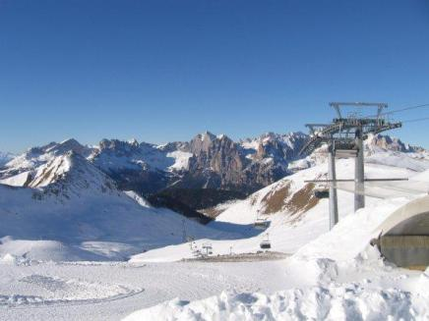
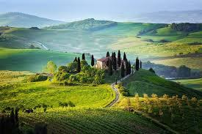
Tuscany is famous for its original landscapes that vary from wonderful sea to multicolored hills…

Slide 19
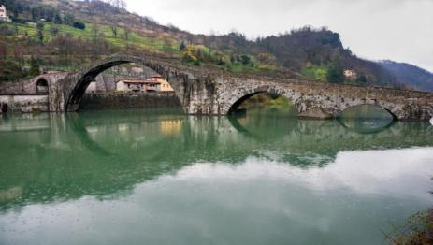
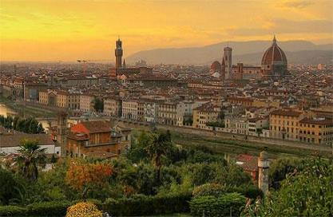
…for its culture and art…

Slide 20
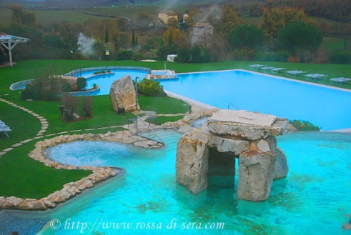
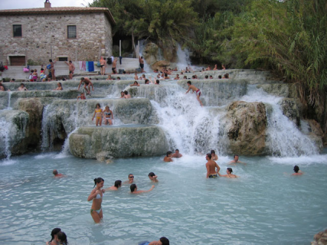
…for its SPA sites…

Slide 21
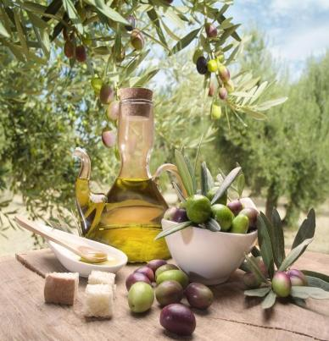
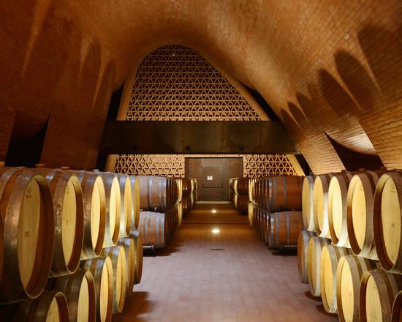
...and for its delicious food, great wine and good olive oil.

Slide 22
Greetings to all of you! We’re waiting for you in our beautiful Region!!!

Slide 23
THANKS FOR your attention!!
Edited by: 3°CMA PISA

