Slide 1
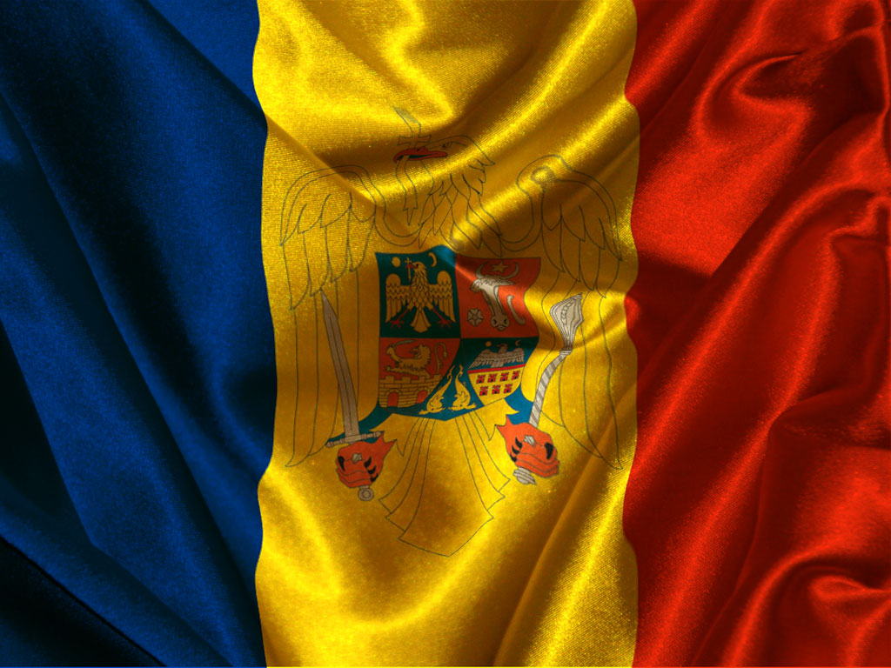

Slide 2
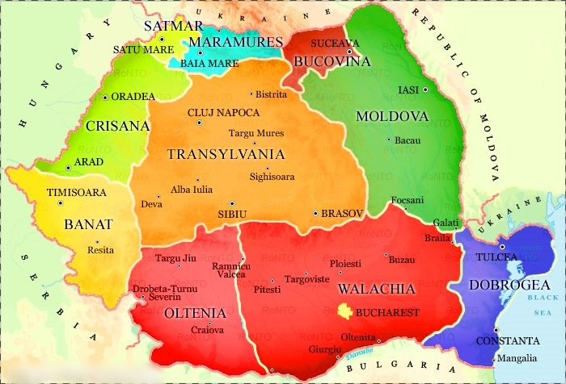

Slide 3
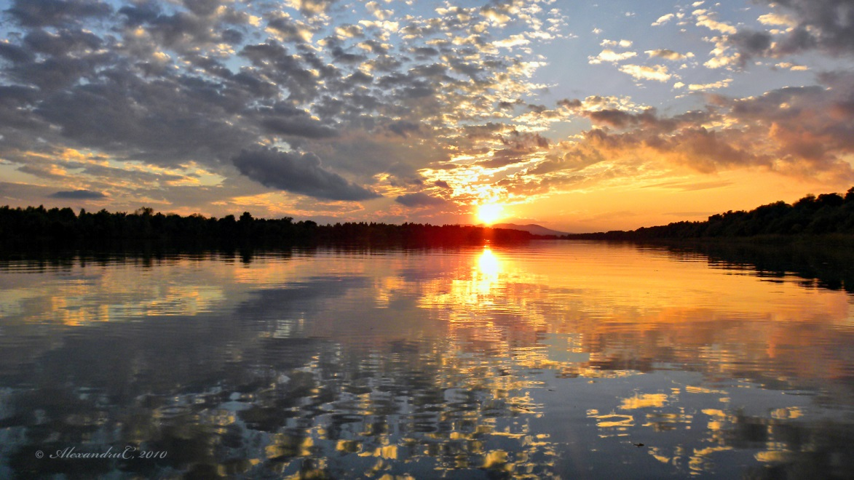
Dobrogea
Murfatlar wineyards
Tulcea City
Constanţa City
Danube Delta

Slide 4
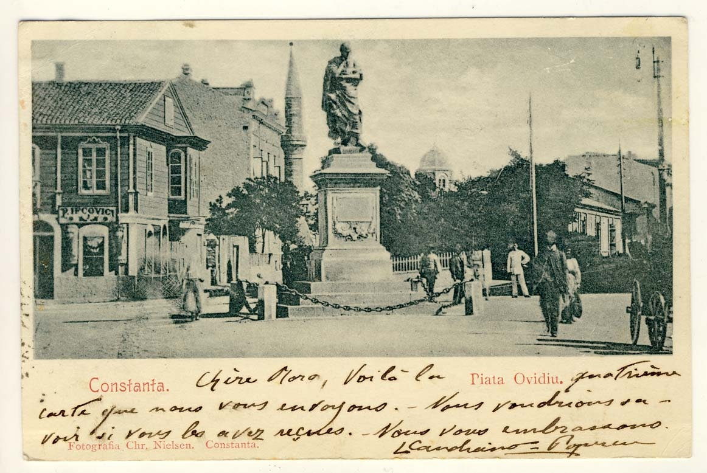
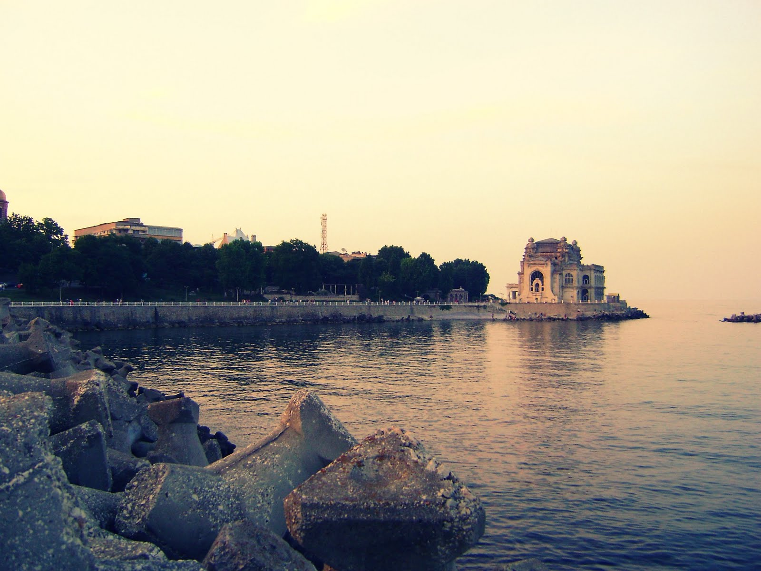
The Dobrogea Plateau (Romanian: Podişul Dobrogei) is a plateau in Eastern Romania located in the Dobruja region, surrounded to the north and west by the Danube and to the east by the Danube Delta and the Black Sea.
Its average altitude is around 200-300 metres, higher in the northern part. The highest point is the Ţuţuiatu/Greci Peak in the Măcin Mountains, at a height of 467 m.
The climate is slightly warmer and more arid than in the rest of Romania and as such, its flora and flora contains some Mediterranean species.
The Casimcea River and Taița River flow through it from west to east. There are several lakes, including some lagoons, the most important being Oltina Lake, Bugeac Lake, Mangalia Lake, Techirghiol Lake, Siutghiol Lake, Taşaul Lake, and Razim Lake.

Slide 5
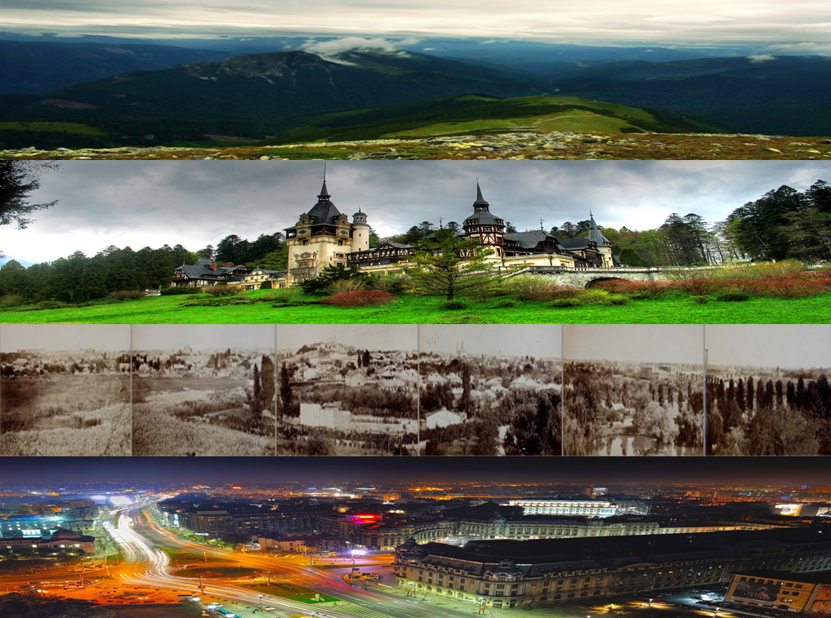
Muntenia
Carpatian Mountains
The Peleş Castle
Bucharest 1848
Modern Day Bucharest
Muntenia also known in English as Greater Wallachia) is a historical province of Romania, usually considered Wallachia-proper (Muntenia, Țara Românească, and the seldom used Valahia are synonyms in Romanian). It is situated between the Danube (south and east), the Carpathian Mountains (the Transylvanian Alps branch) and Moldavia (both north), and the Olt River to the west. The latter river is the border between Muntenia and Oltenia (or Lesser Wallachia). Part of the traditional border between Wallachia/Muntenia and Moldavia was formed by the rivers Milcov and Siret.

Slide 6
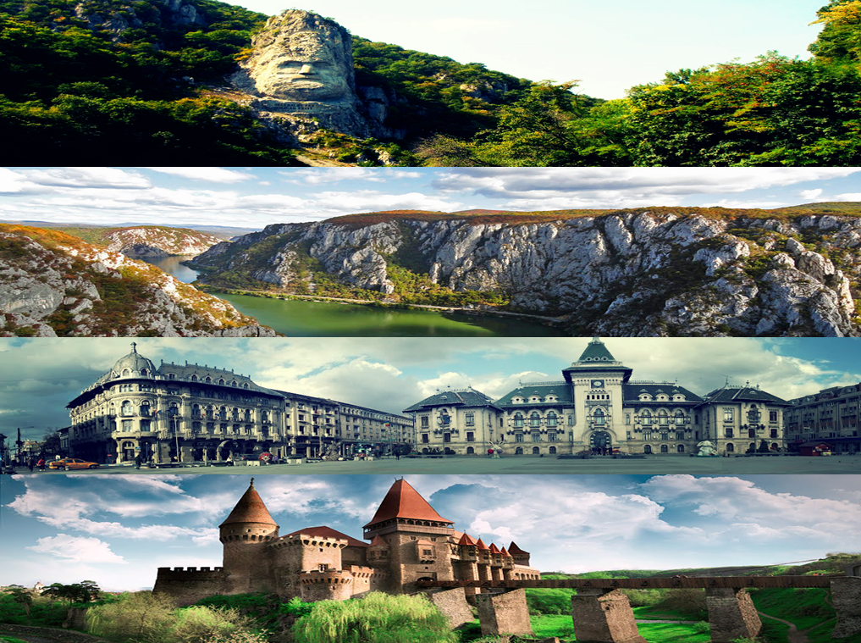
Oltenia
The Statue of Decebal
The Danube
Craiova City
The Castle of Corvin

Slide 7
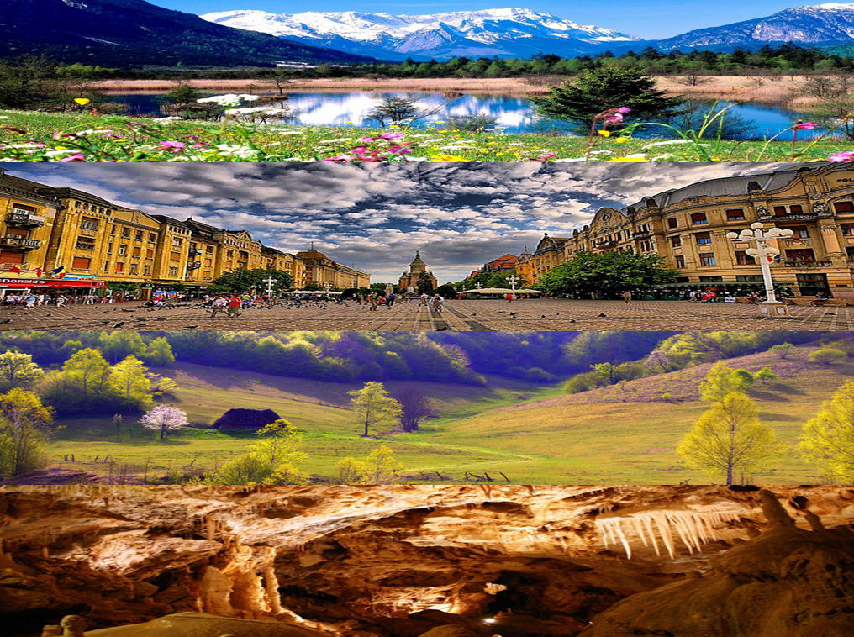
Banat & Crişana
Banat & Crişana
Timişoara City
Apuseni Mountains
The Bear’s Cave

Slide 8
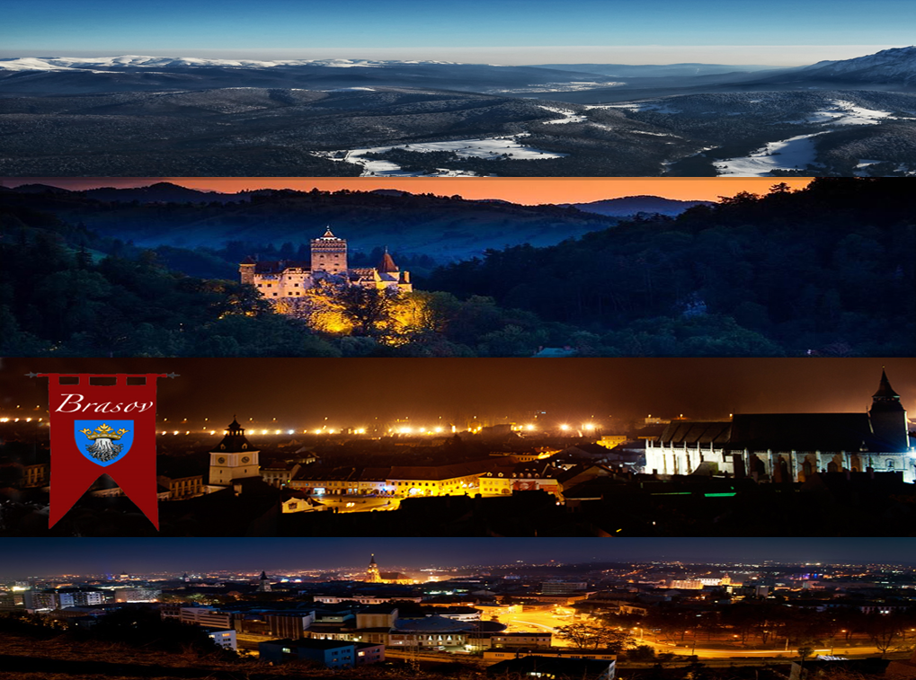
Transylvania
Most of the Transylvanian cities are very old settlements. Some of them we inherited from the Romans. Each of them has a captivating story to tell to the interested traveler. Medieval towns and villages dot the countryside of Transylvania. This region of the world has seen many turbulent times, however the people of Transylvania proudly and openly welcome you to share their history, and culture.
Transylvania is by far the most romantic and inspiring of Romania's provinces. Its very name brings to mind visions of mountain peaks rising up to the sky above wooded valleys and sparkling streams, visions of high-roofed wooden churches, legendary castles and a troubled history.
The Carpatian Mountains
Bran Castle
Braşov City
Cluj-Napoca City

Slide 9
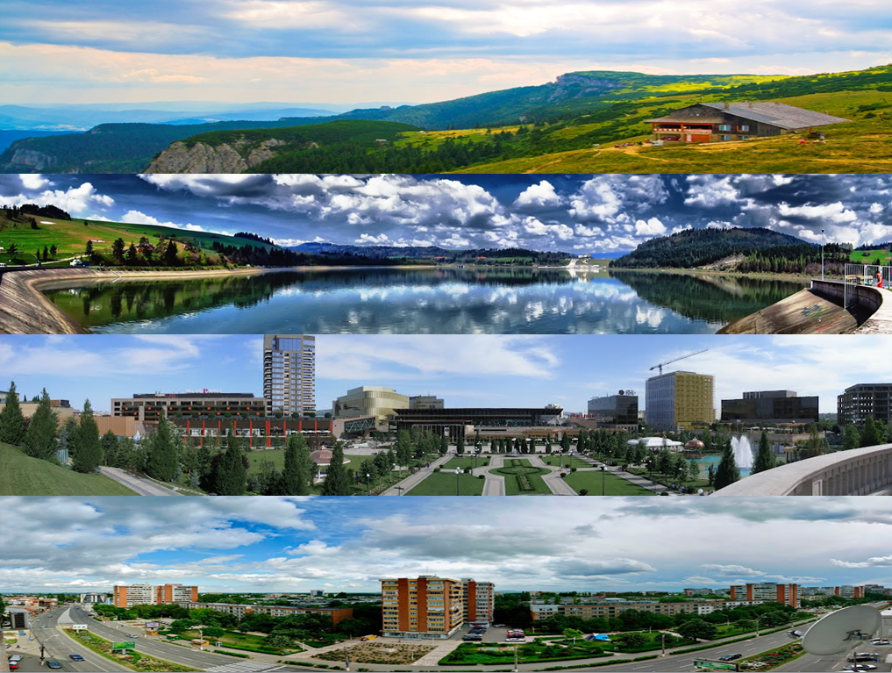
Moldova
Dochia Cabin
Postăvaru Lake
Iaşi
Galaţi

Slide 10
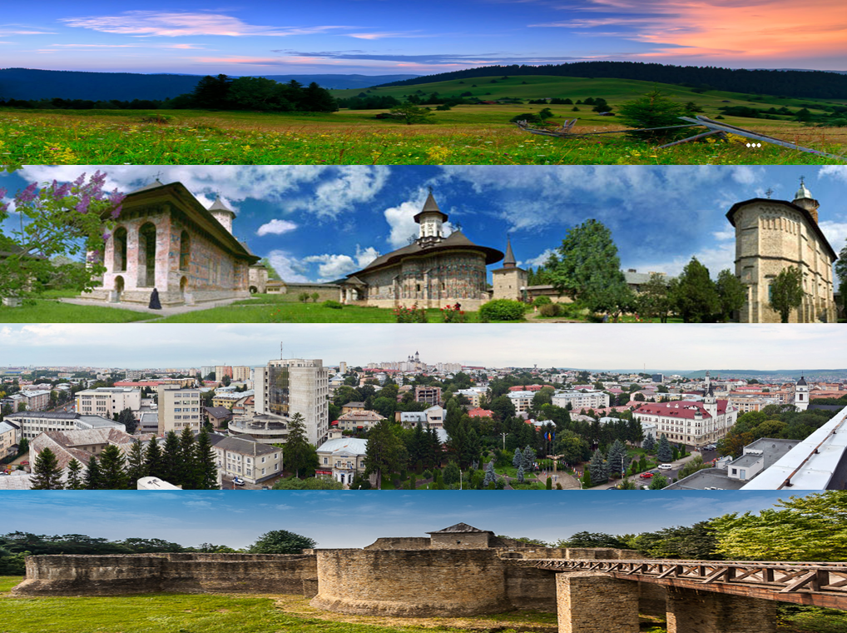
Bucovina
Bucovina plains
Voroneţ Monastry
Suceava City
Suceava chair-fort

Slide 11
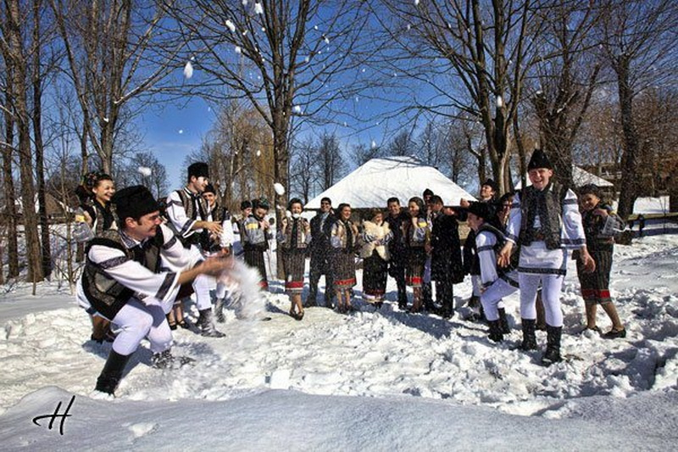
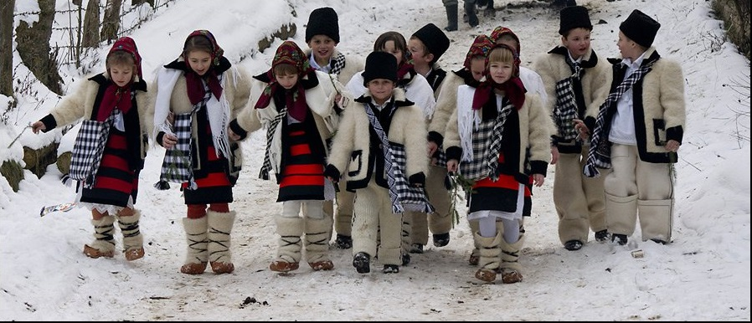
Bucovina is one of the most beautiful and visited touristic arias in Romania. This are, which is faimous in all over the world was given in 1975 the Pomme d’Or international prize by The International Federation of Travel Writers and Tourism Journalists.
No other place in the world than beautiful and wealthy Bucovina in Northern Moldavia. Beautiful and wealthy because it has natural landscapes that seem to come out from fairytales, churches and painted monasteries, the Chair Fortress of Stefan the Great, specific customs and rituals for the area, milk and meat products, honey and many more.
Here a group of Orthodox monasteries with their exterior mural paintings are to be seen. These Painted Monasteries are part of UNESCO's World Heritage for their rarity and beauty. Another group are the Wooden Churches of Maramures, unique examples that combine Gothic style with traditional timber construction.

Slide 12
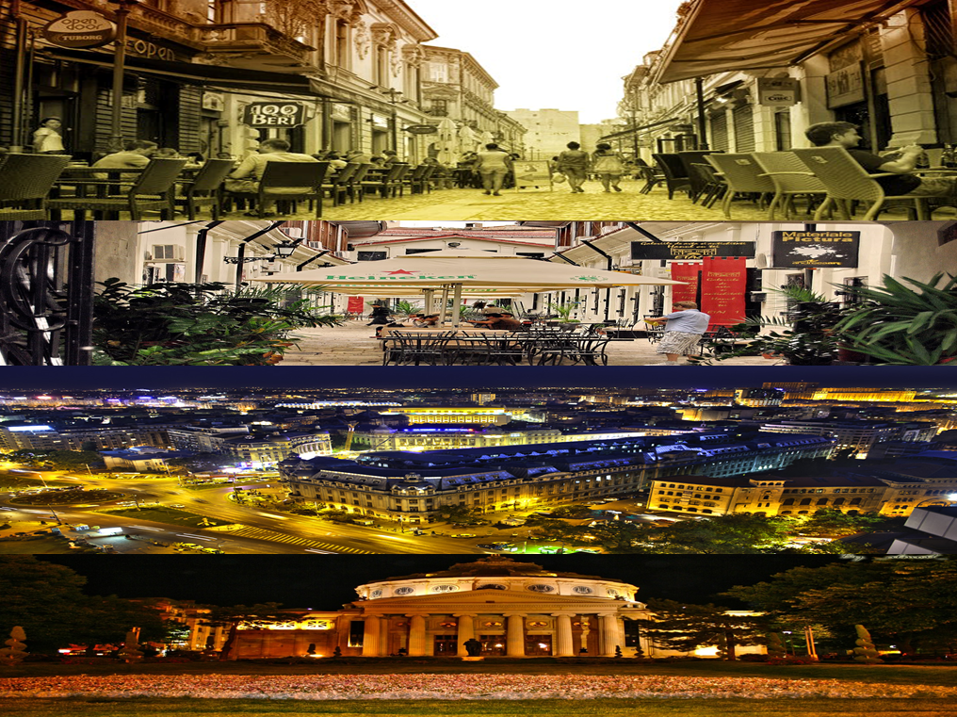
Bucharest
The old city center
Lipscani
Calea Victoriei
The Romanian Athenaeum

