Slide 1
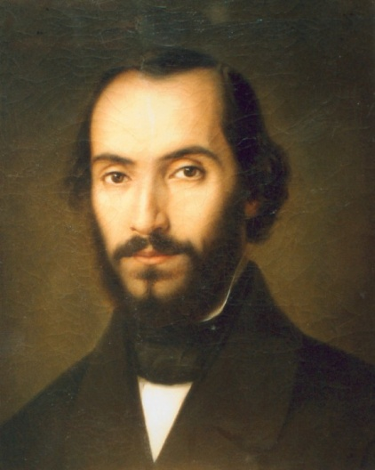
Social science class
11th grade
Nicolae Balcescu High school
Oltenita-Romania
Employability-”A challenge for youth-dreams and reality

Slide 2
Presentation-here we are!!

Slide 3
The pupils from the project
Andy-17 years
friendly

Slide 4
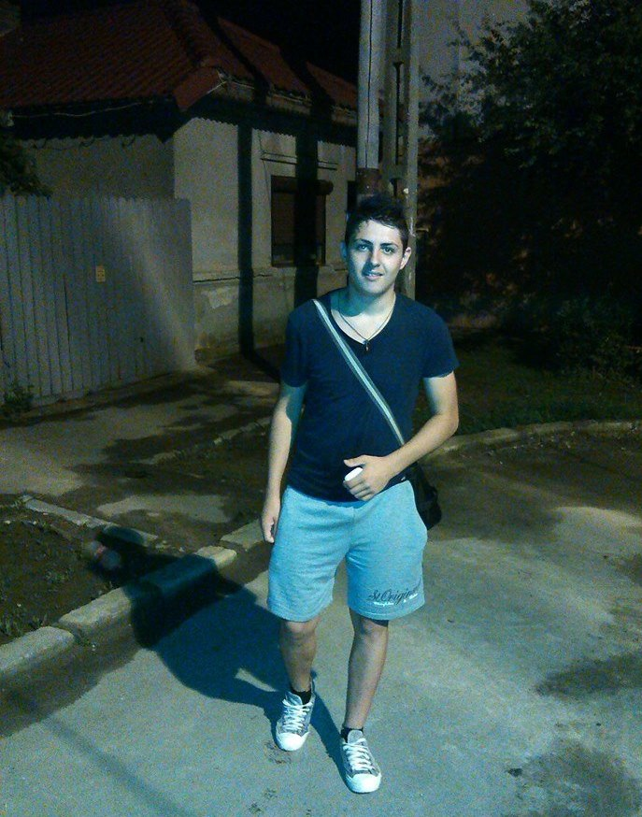
Gabriel -17 sportive guy

Slide 5
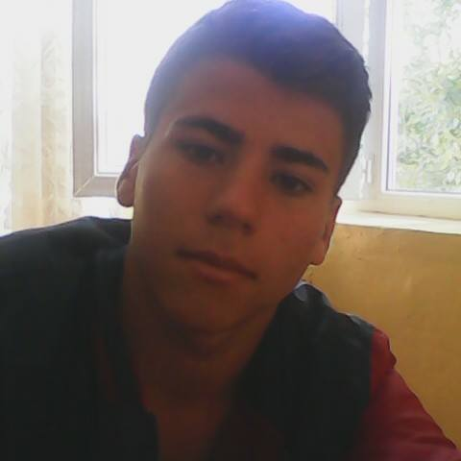
Ionel-17 funny

Slide 6
Iulian-17 cheerful his passion

Slide 7
Victor-17 spontaneous

Slide 8
Filofteia-sociable

Slide 9
Our domain
Geography –we learn
about all the countries
from the world

Slide 10
Europe-your countries are not unknown to us

Slide 11
Romania –our beautiful country
Nicolae Balcescu
High school

Slide 12
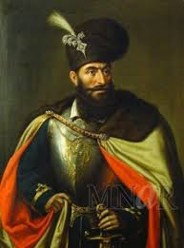
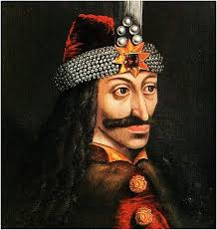
The second domain-History
Stefan cel Mare-Stephen the Great
Mihai Viteazul-Michael the Brave
Vlad Tepes-Vlad the Impaler

Slide 13
A different lesson-debate

