Slide 1
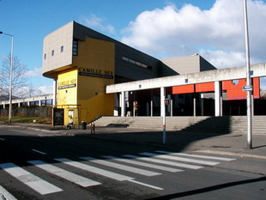
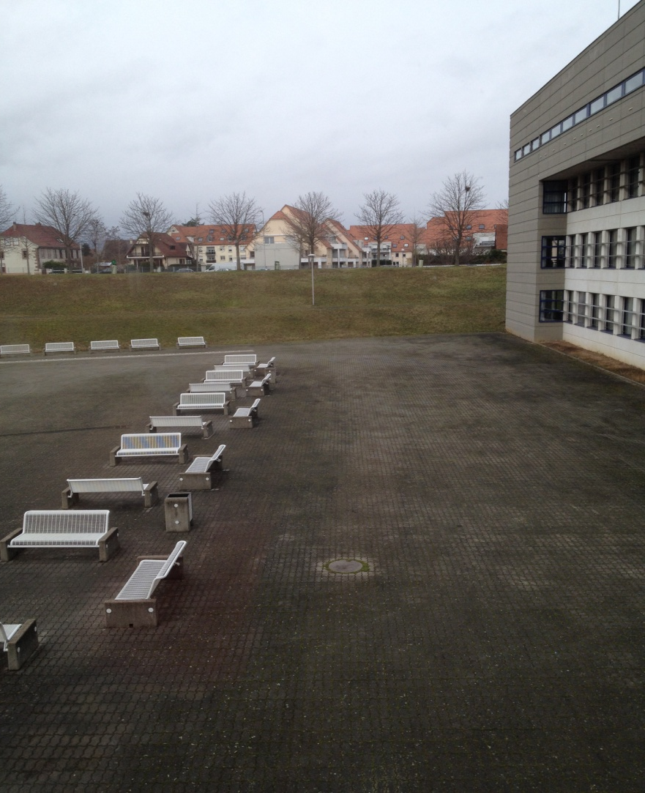
Presentation of Camille Sée
High School

Slide 2
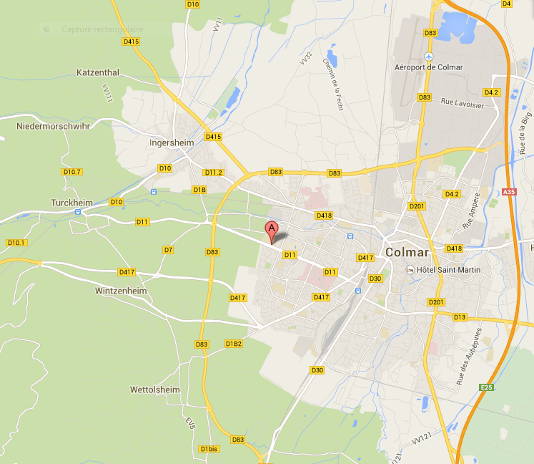
The position of our High school :

Slide 3
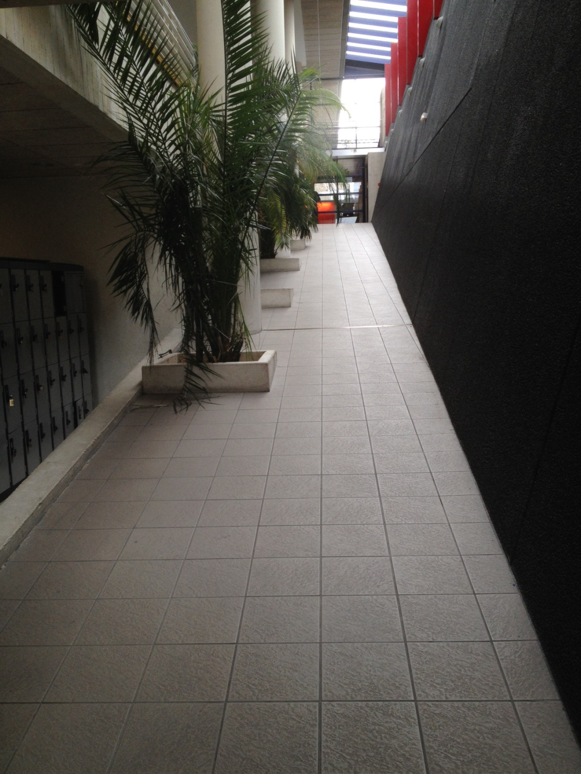

Slide 4
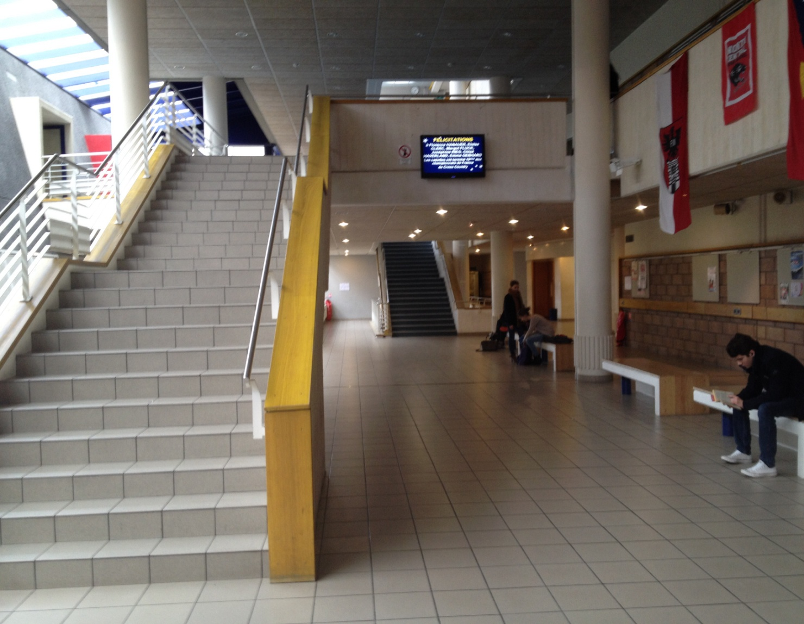
Hall

Slide 5
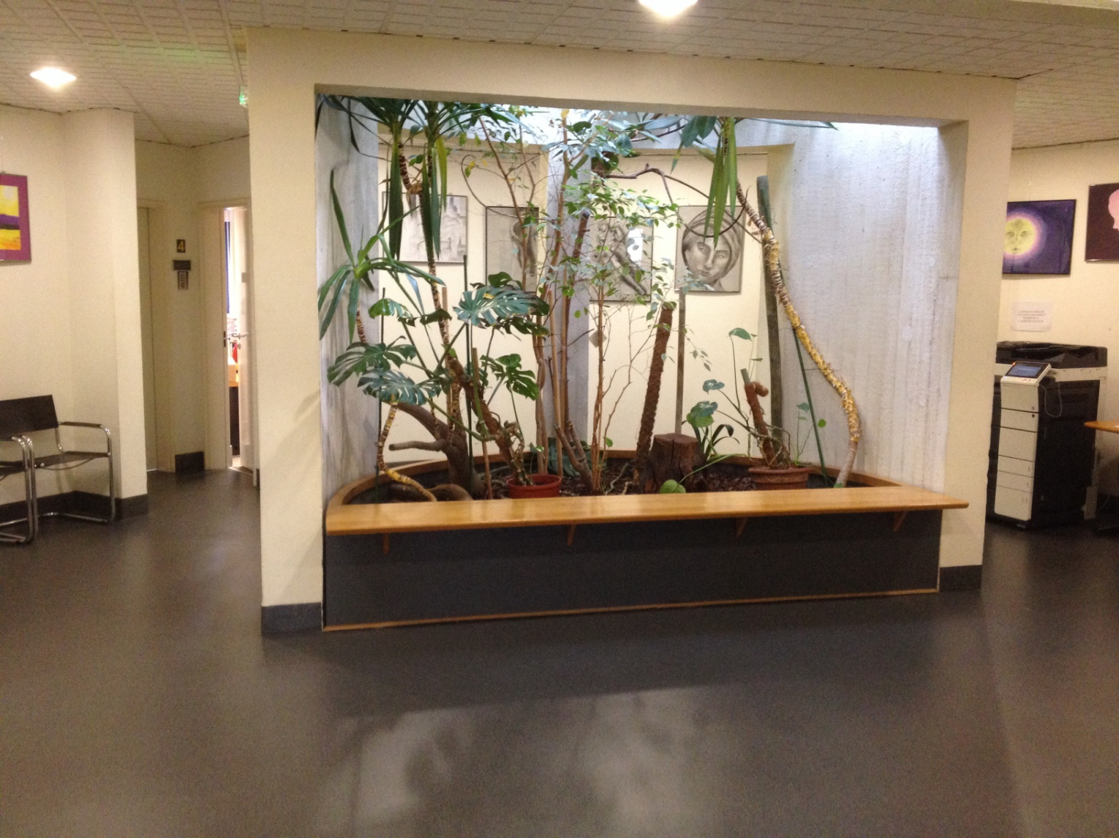
The administration

Slide 6
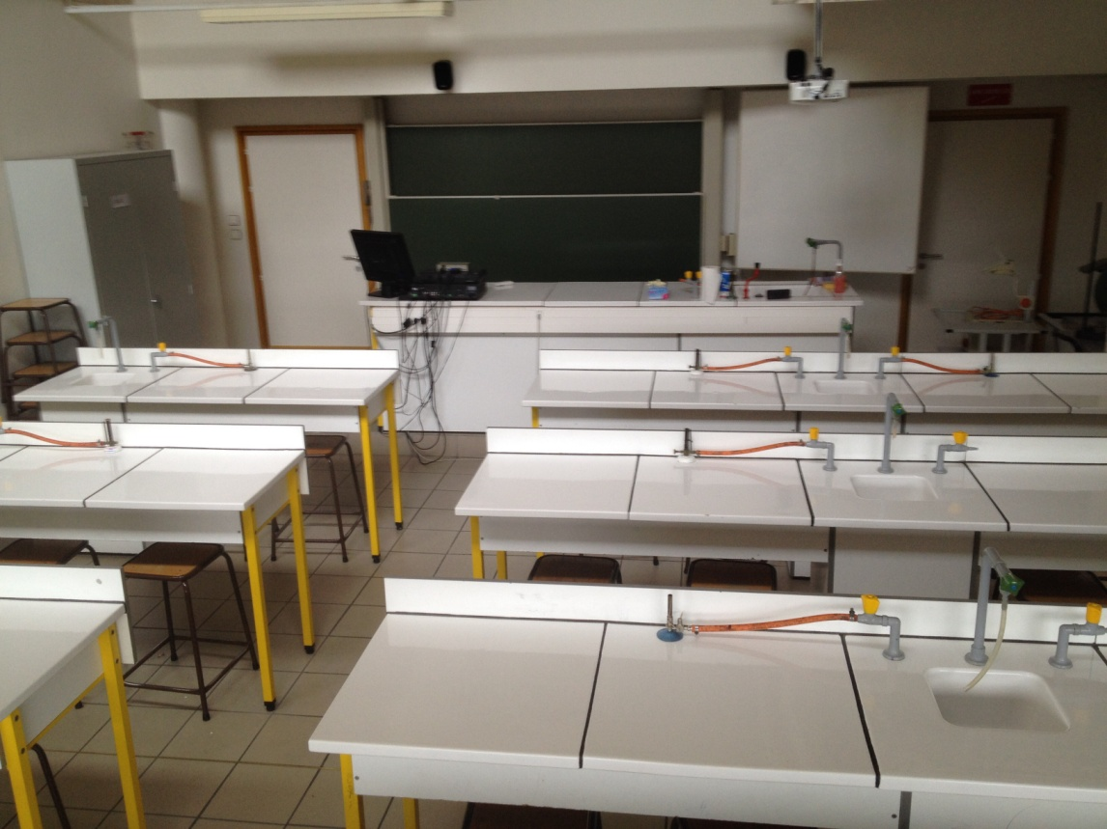
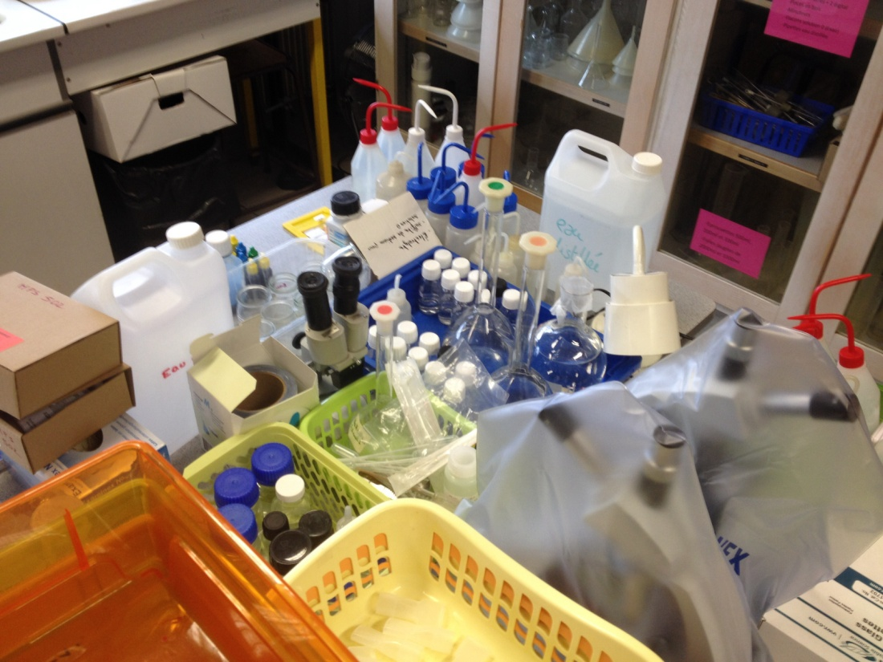
Laboratory rooms

Slide 7
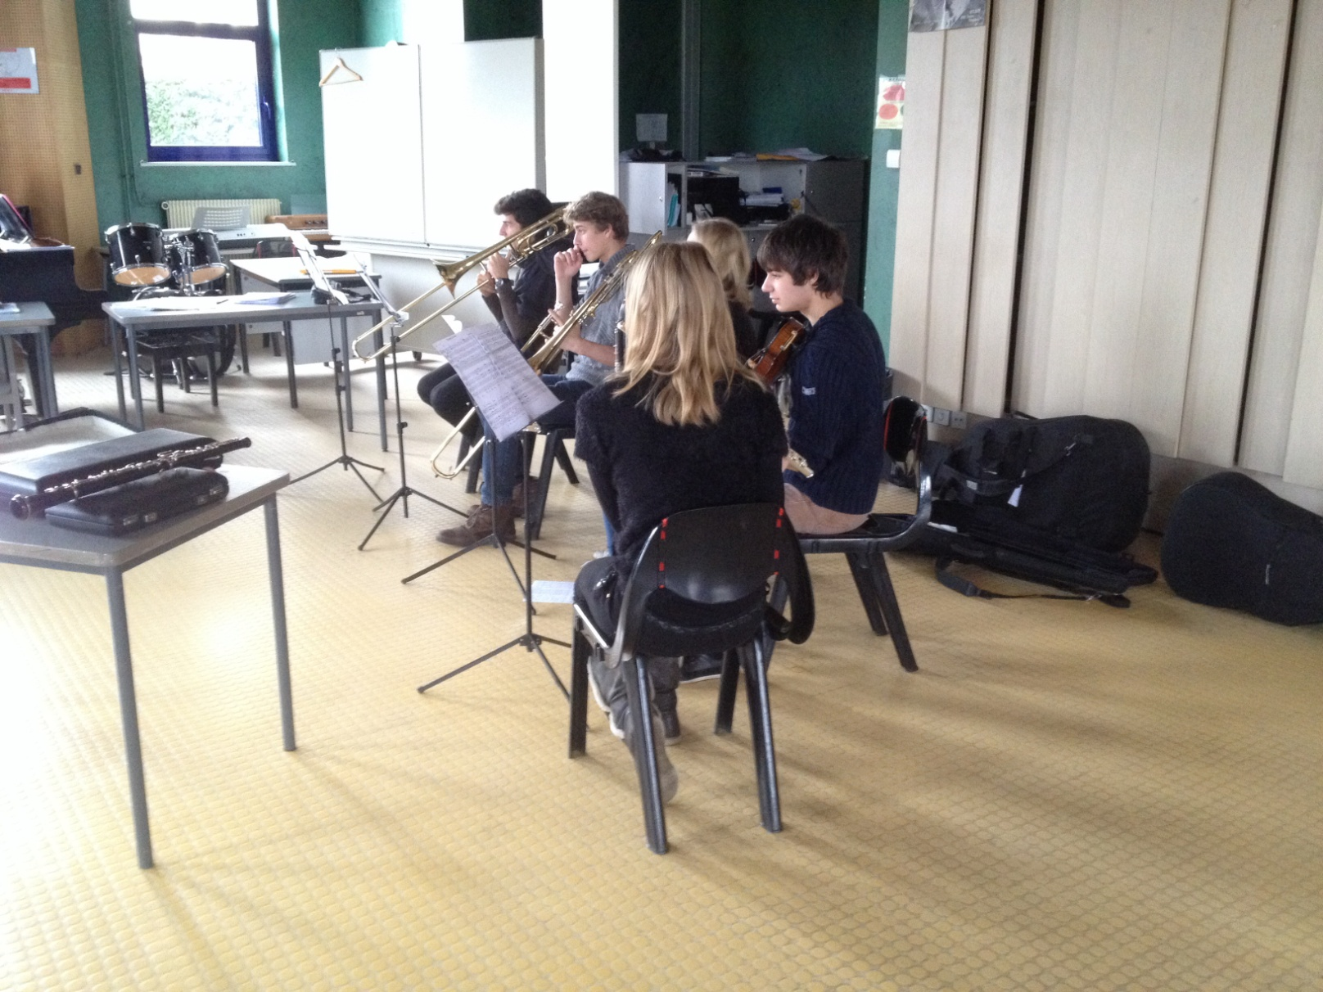
Music room

Slide 8
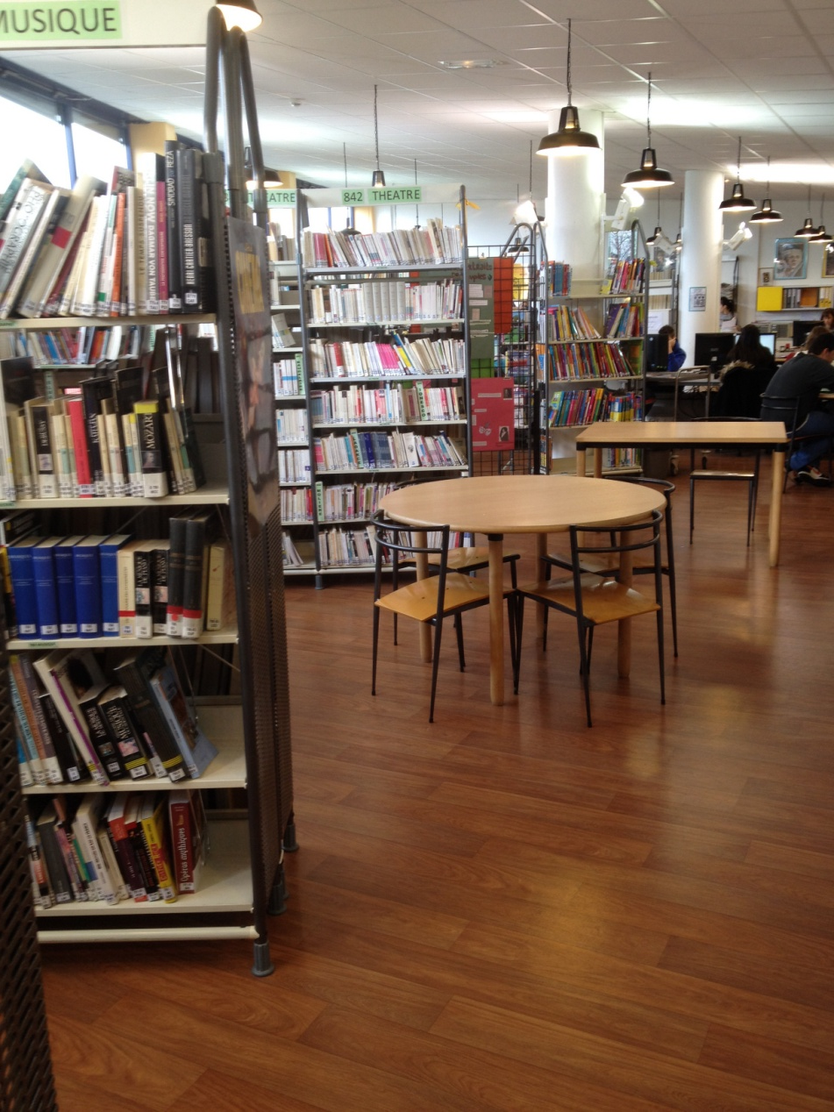
Library

Slide 9
We can learn other language :
-Arabic - Turkish
-Chinese
-Portuguese
-Latin
-Greek
And we all have a economic lesson.
We have some exploration options :
Music option
Sport option
Theatre option
European option/Abibac
Visual Arts option

Slide 10
We have some partner :
-The United States
-Ireland
-Finland
-Germany
-Austria
- And soon Norway

