Slide 1
Hurricane Harvey
By: Dominik Lučić

Slide 2
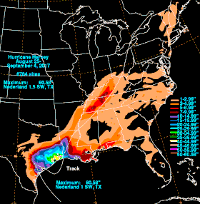
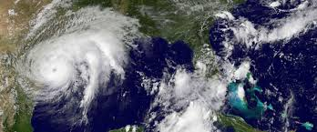
Something about Hurricane Harvey
It was formed on August 17th 2017 and dissipated on September 3rd 2017.
Highest winds were about 130 mph or 2015 km/h.
Harvey took 63 direct lives and 28 indirect lives.
Areas affected were: Windward Islands,Suriname, Guyana, Nicaragua, Honduras, Belize, Cayman Islands, Yucatan Peninsula, Southern and Eastern United States (especially Texas and Lousiana)

Slide 3
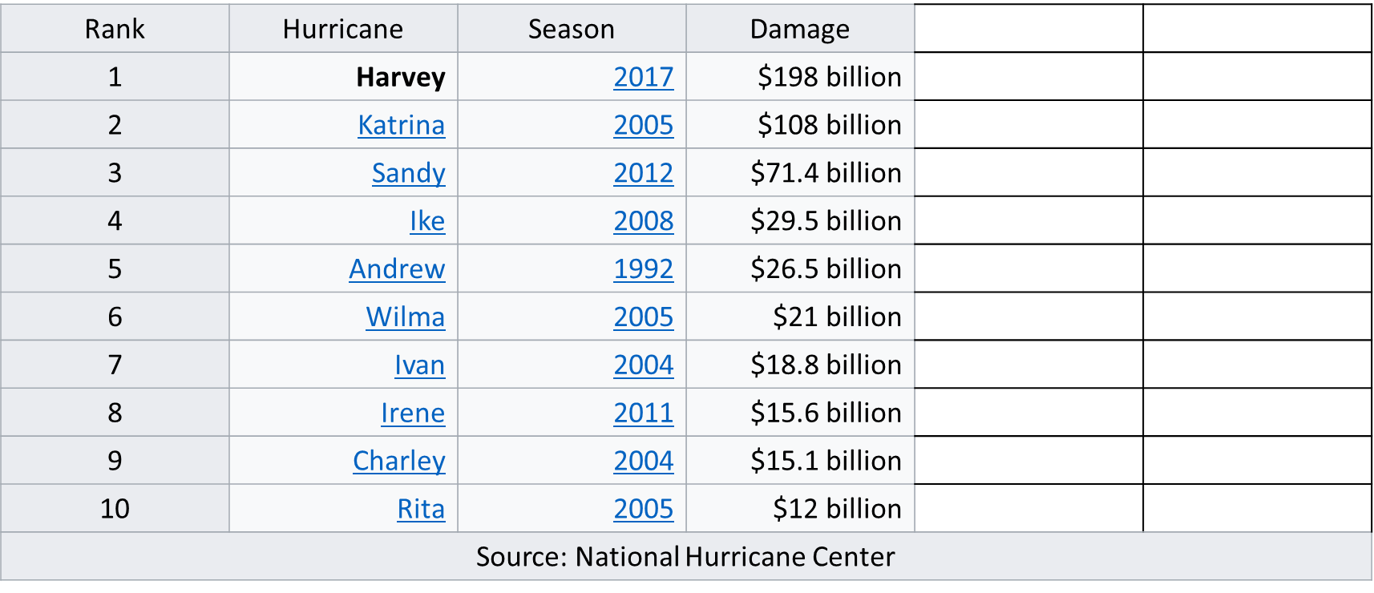
It Was the worst Atlantic Hurricane in United States

Slide 4
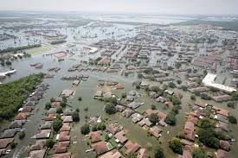
Economic loss estimates
Moody’s Analytics initially estimated the total economic cost of the storm at $81 billion to $108 billion or more; most of the economic losses are damage to homes and commercial property.USA today reported an AccuWeather estimate of $190 billion. Texas state governor Greg Abbott estimated that damages will be between $150 billion and $180 billion.
Most imporantly it took 91 victims that we can’t bring back or repair.

Slide 5
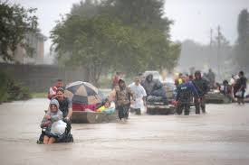
The plan to get rid of it
Donald Trump signed law H.R. 601, it designeted 15 billion for Hurricane Harvey relief.
Everyone who could helped in floods.

Slide 6
My only question is how could something like that happen in 21st century where we had all technology and resources. Some people didn’t do their duty and 91 people aren’t with us anymore.
The End
Sources: wikipedia

