Slide 1
Croatian inventions
GOOD | BAD
Tie | Torpedo
MP3 Player
Vegeta

Slide 2
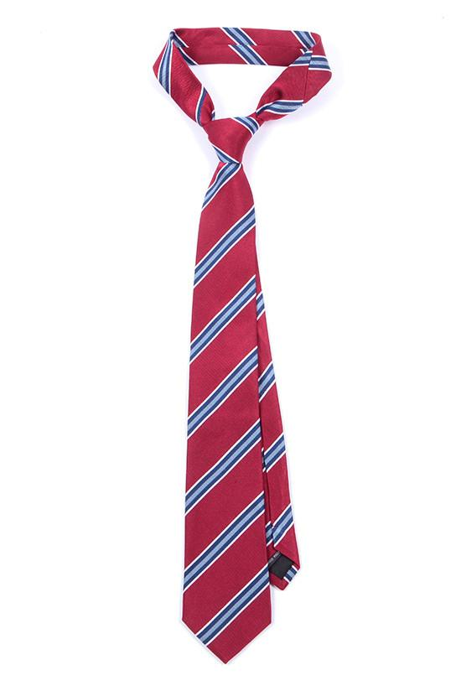
Tie
Tie was made in 17th century, Croatian soldiers were wearing it in battle so it became a fashion trend.

Slide 3
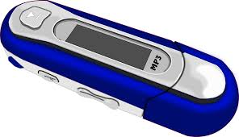
MP3 Player- Tomislav Uzelac
Tomislav Uzelac was a Croatian programmer that made MP3 Player.
This is a really good invention because it is great for relaxing.

Slide 4
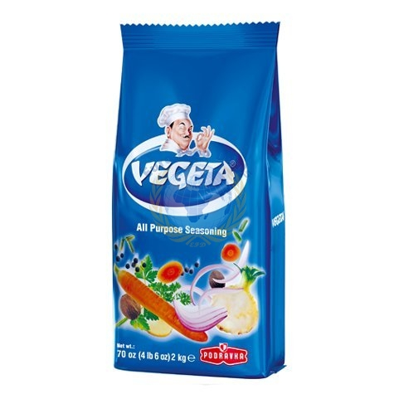
Vegeta
There isnt much information about this spice except it was made by Zlata Bartl

Slide 5
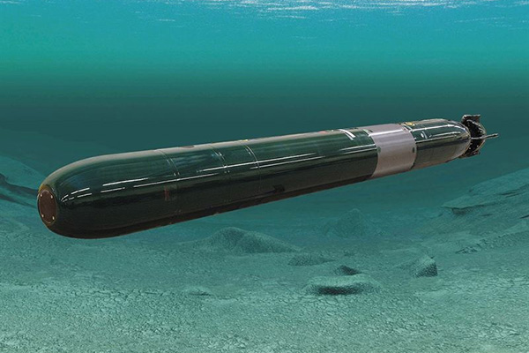
Torpedo- Ivan Vukić
Torpedo is a seeking missile that is used for destroying ships.
This is bad invention because it is used in wars.

