Slide 1
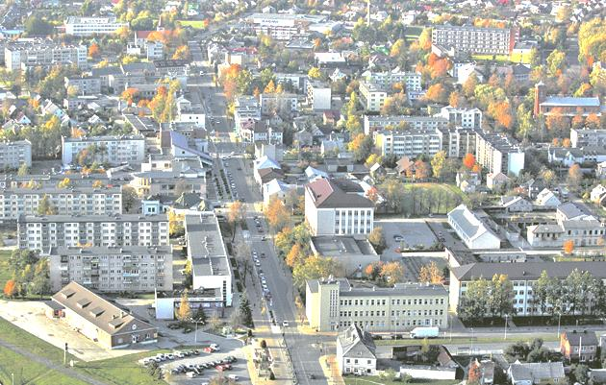
My native town is Mažeikiai

Slide 2
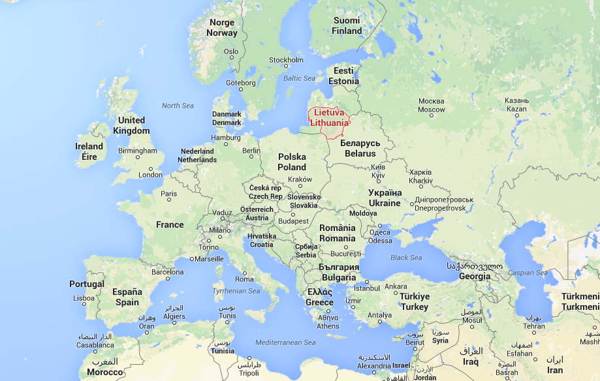
We are in Europe. Our neighbours are Latvia, Belarus, Poland and Russia

Slide 3
Our town is situated in the North-West of Lithuania

Slide 4
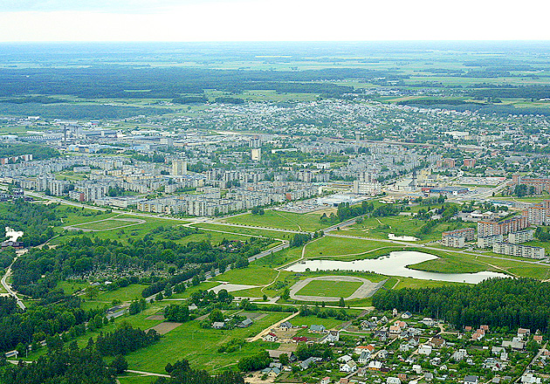
There aren’t any mountains, only a flat landscape

Slide 5
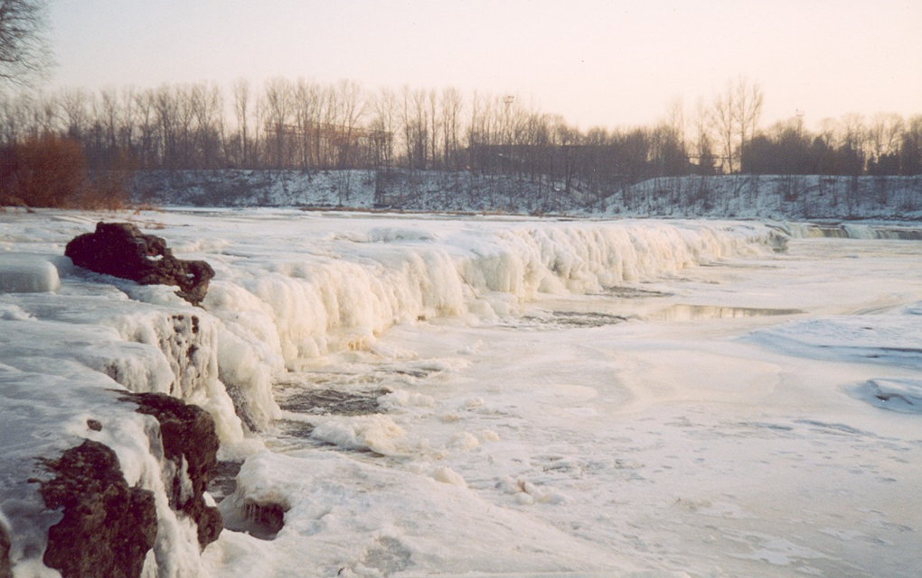
We have a beautiful river Venta. This photo in winter

Slide 6
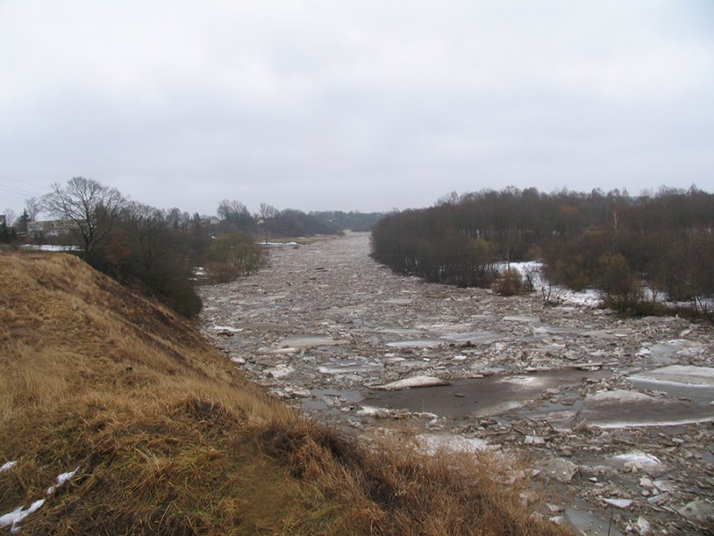
Our river Venta in spring looks dangerous

Slide 7
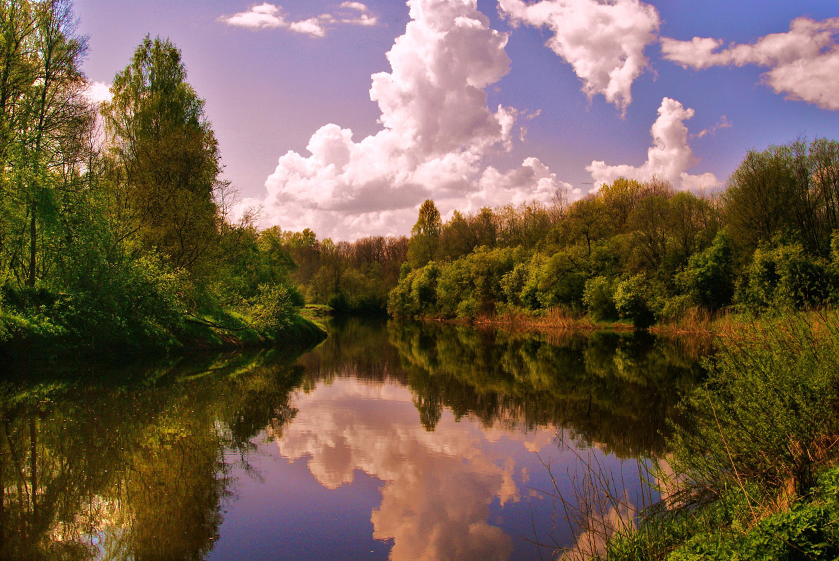
Look! The scenery is wonderful in summer, isn’t it?

Slide 8
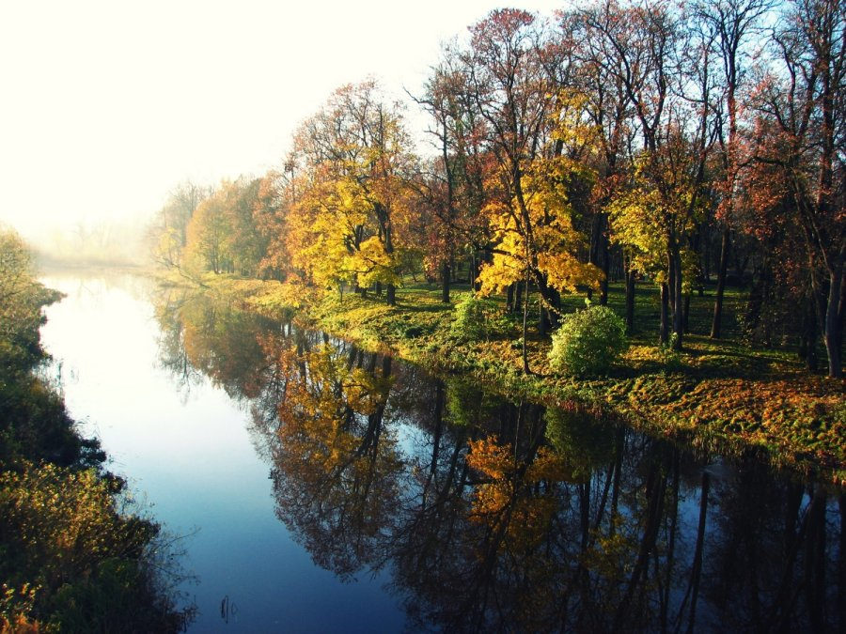
Our river Venta in autumn is colourful

Slide 9
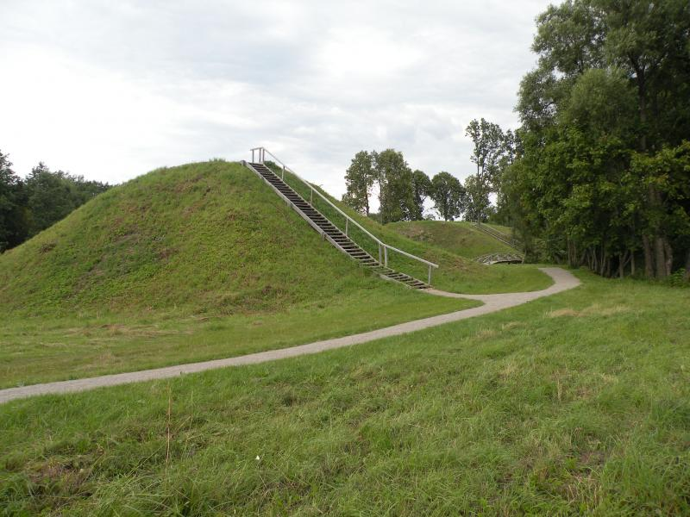
There is Daubariai mound near our town

Slide 10
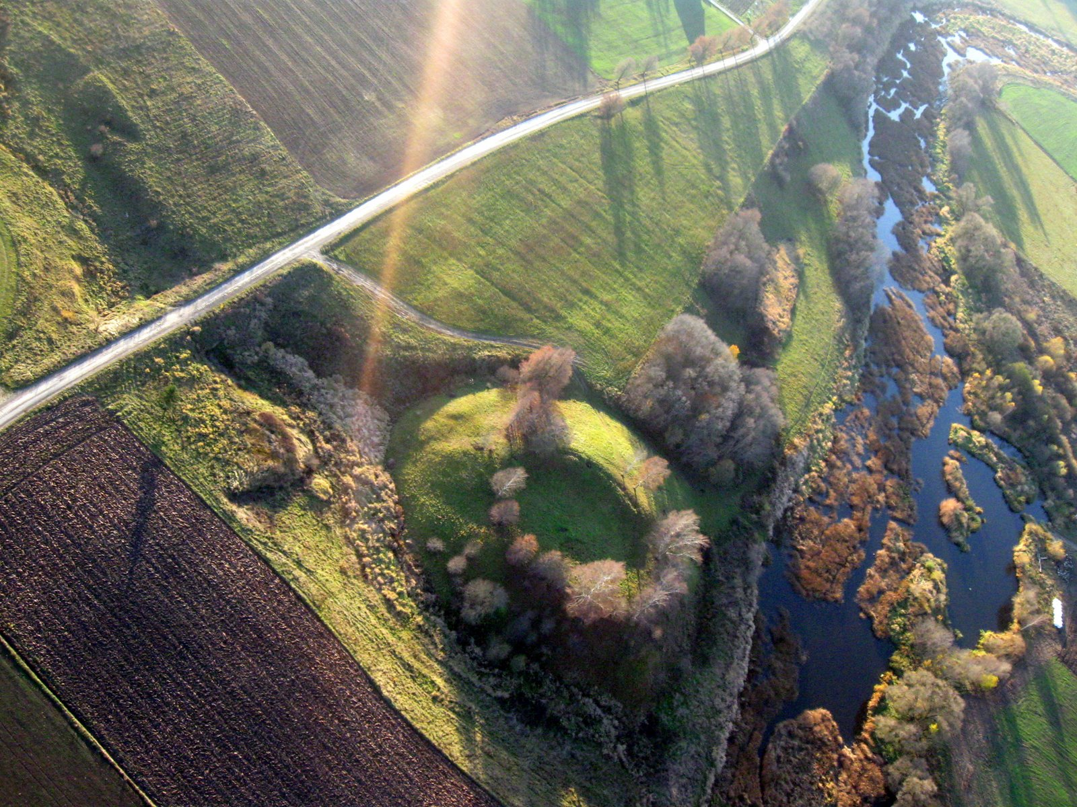
The mound's view from the sky

Slide 11
There are two manors in Mažeikiai region

Slide 12
Renavo manor is mentioned since XVI century

Slide 13
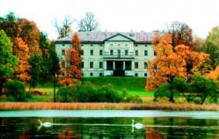
Plinkšių manor was build in 17century and is situated near Plinkšes lake

Slide 14
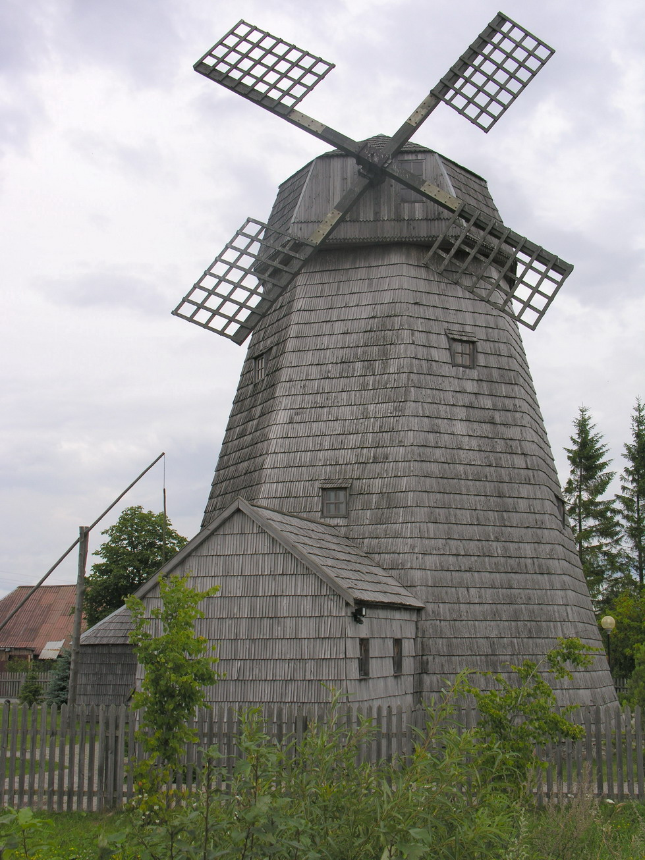
There is a windmill in Purpliai near my town. It was build in 1898 and now is a museum.

Slide 15
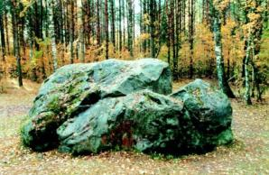
Geidžiai mythological stone has got lots of legends

Slide 16
The history of my town
Mažeikiai name was mentioned in the 13th century.
Now Mažeikiai is 725 years old.
Mažeikiai was called because a man Mažeika lived here and the railway station was built.

Slide 17
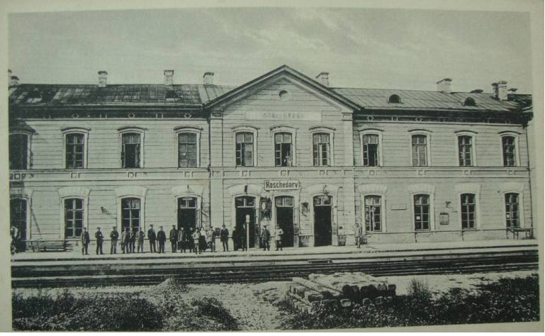
The railway station in the past (1290)

Slide 18
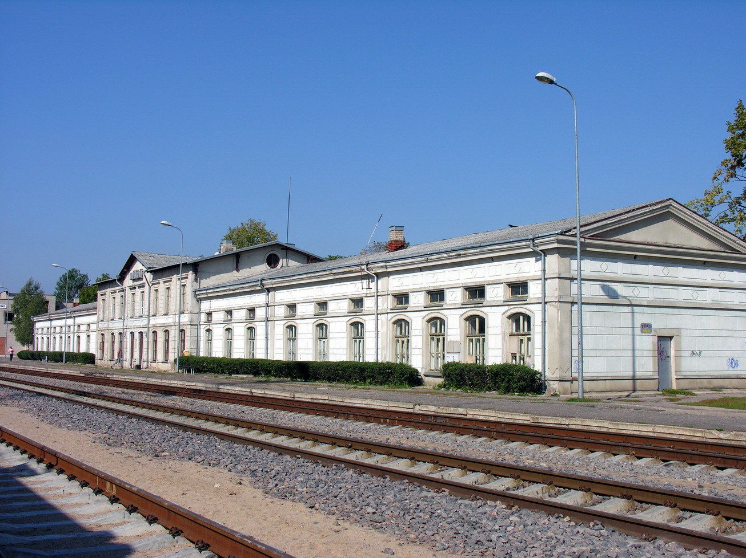
The railway station now (2015)

Slide 19
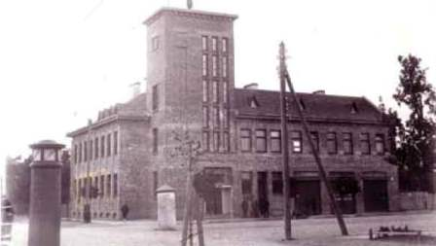
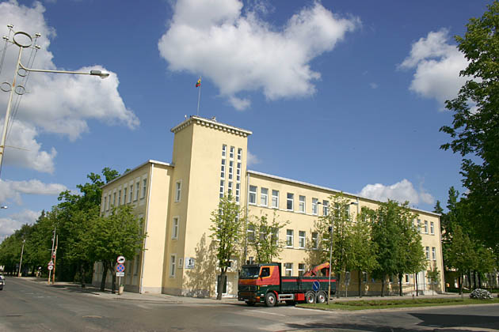
My town Mažeikiai is changing
In 1930 The same building in 2015

Slide 20
There are about 40.000 people in my town

Slide 21
My town is crowded

Slide 22
Mažeikiai has got a modern face

Slide 23
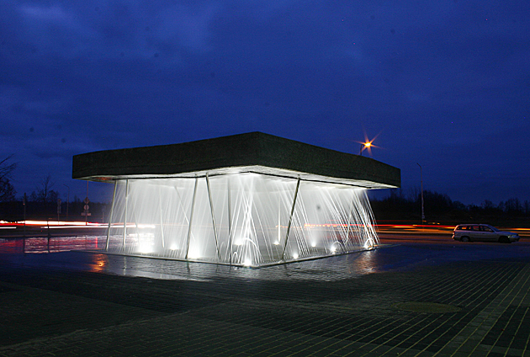
This is a modern fountain. It works during the summer

Slide 24
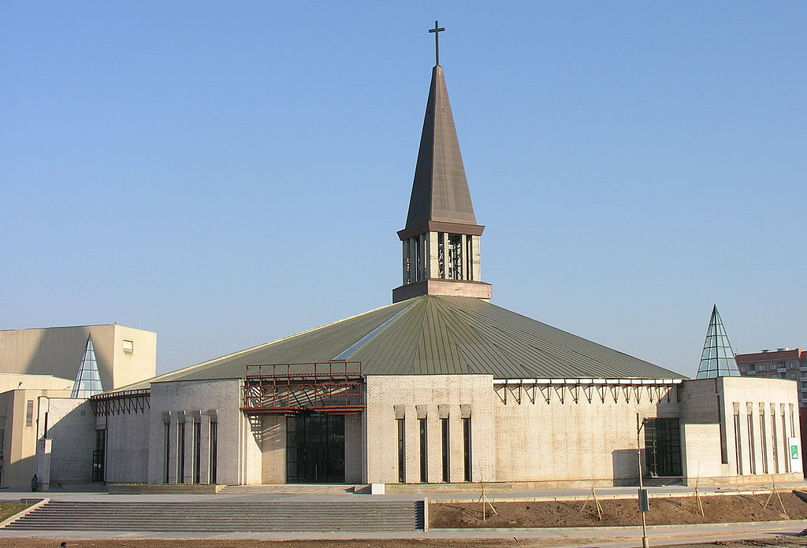
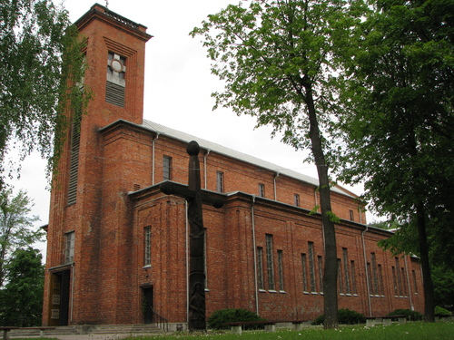
My town has got some churches
A modern Catholic
church
An ancient Catholic
church

Slide 25
Special Forces protect us

Slide 26
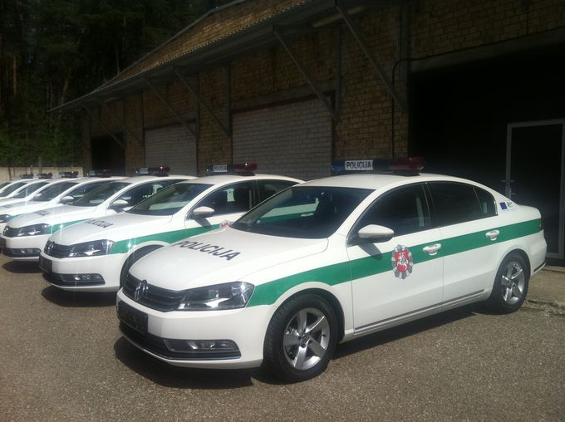
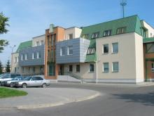
Mažeikiai Police departament

Slide 27
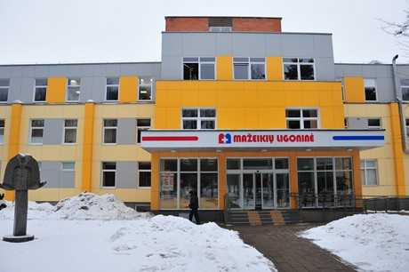
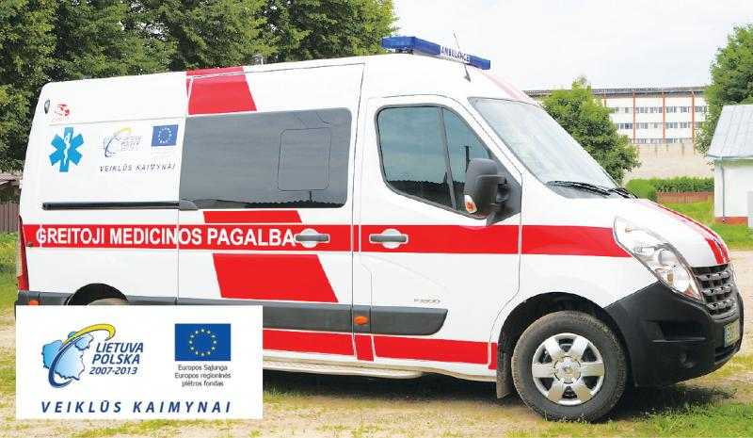
Mažeikiai Hospital forces

Slide 28
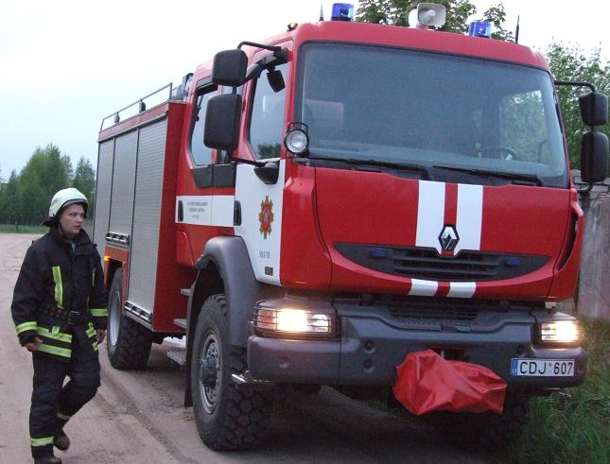
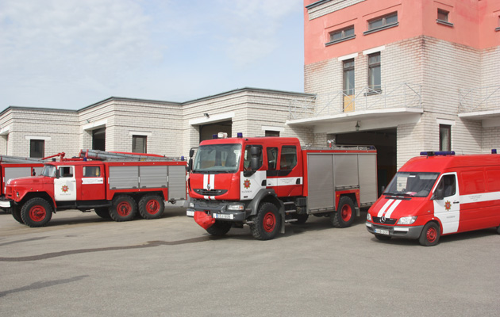
Mažeikiai Fire station

Slide 29
Public transport helps to travel

Slide 30
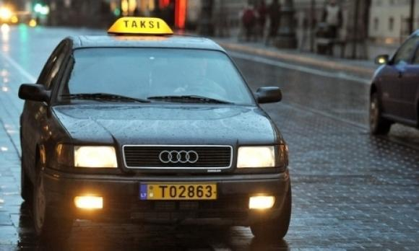
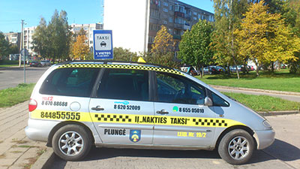
You can call a taxi

Slide 31
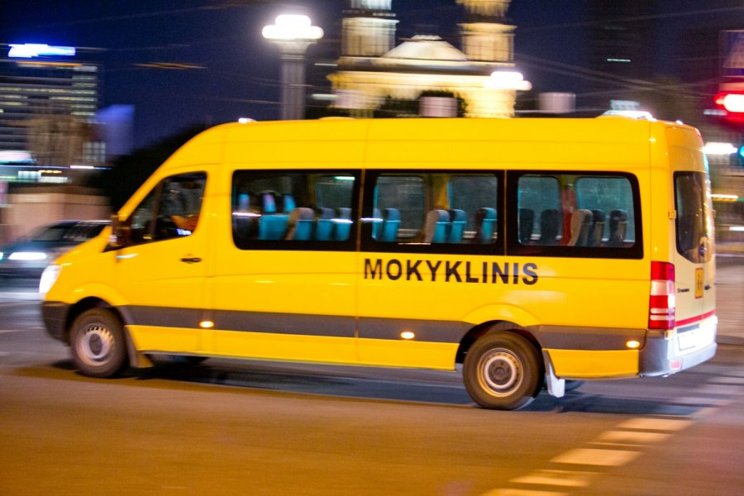
Drive to school by school bus

Slide 32
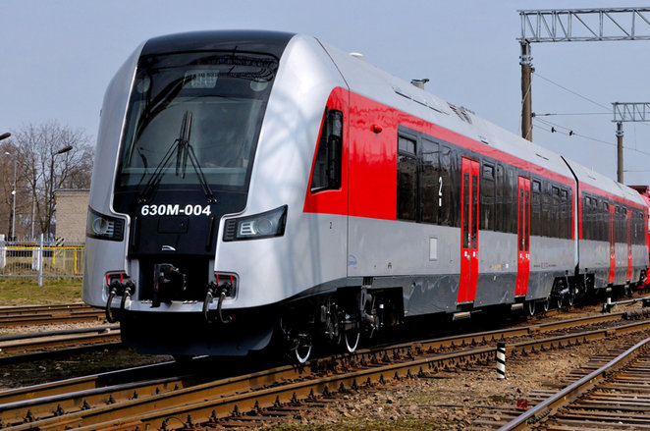
Visit other towns by train

Slide 33
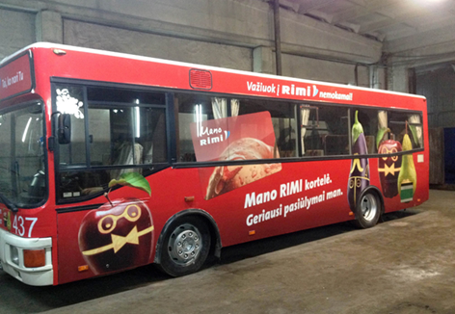
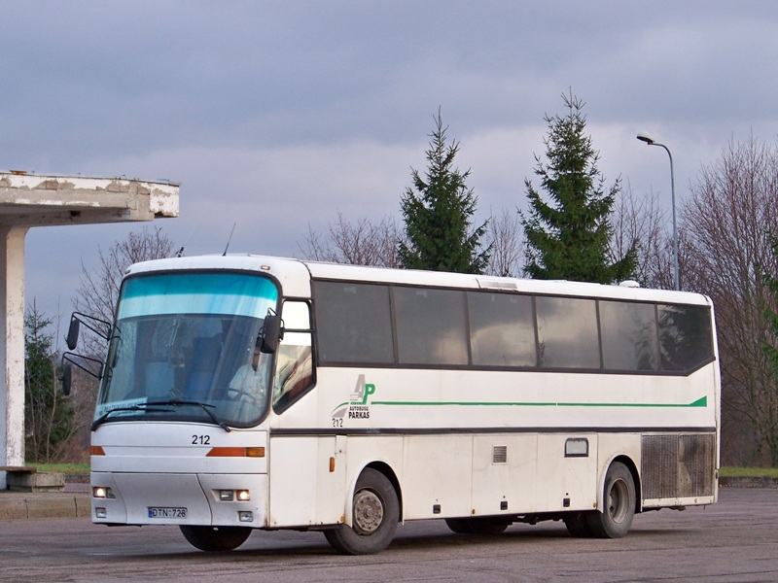
We love school trips by coach

Slide 34
Mažeikiai is an industrial town

Slide 35
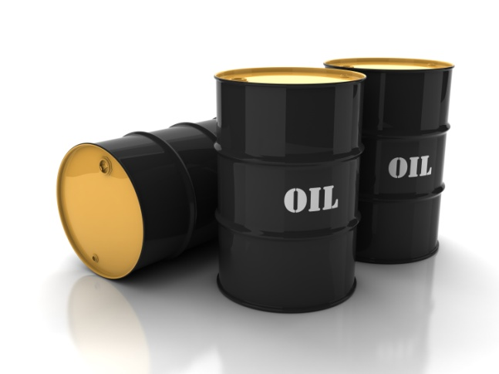
An oil refinery factory „Orlean“

Slide 36
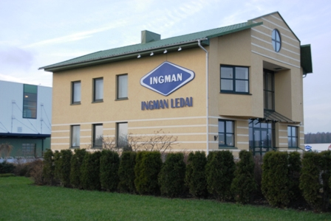
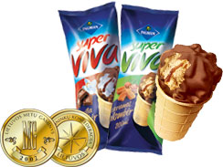
A factory that makes ice cream

Slide 37
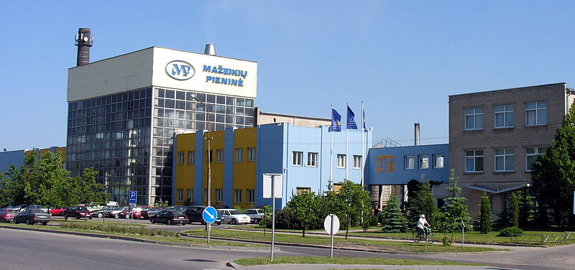
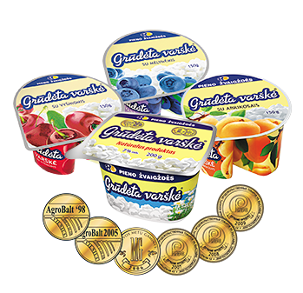
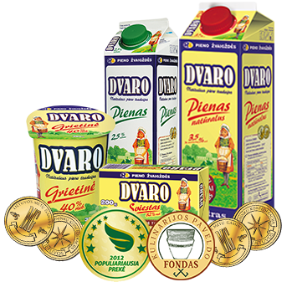
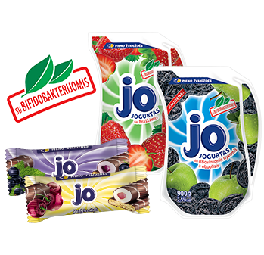
A dairy products factory

Slide 38
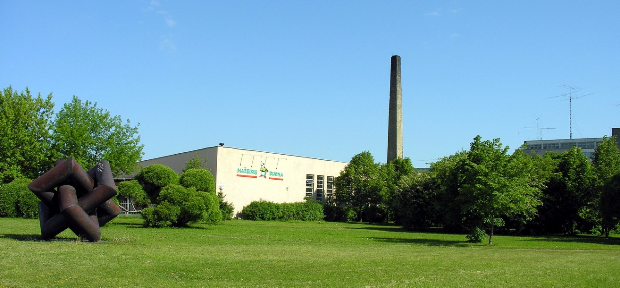
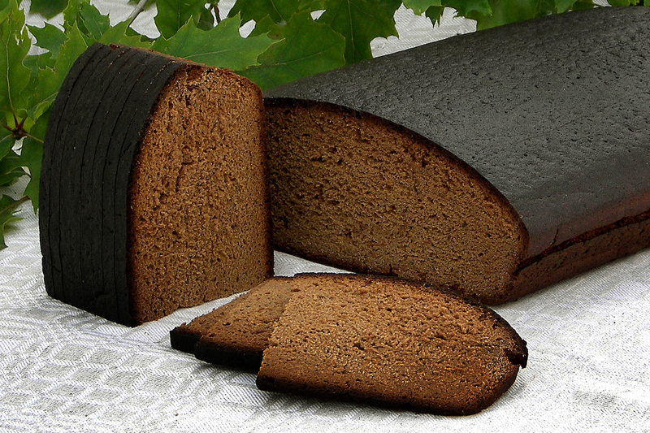
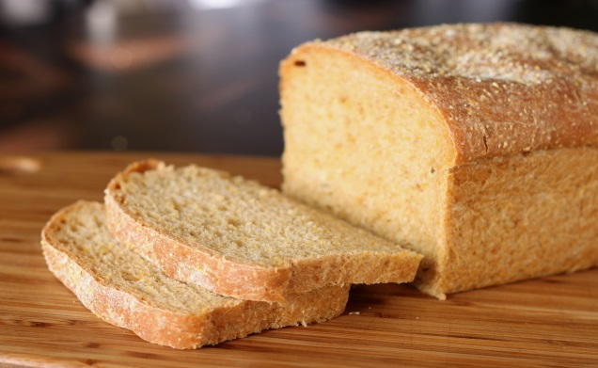
It’s a factory that makes bread

Slide 39
Education system in Mažeikiai

Slide 40
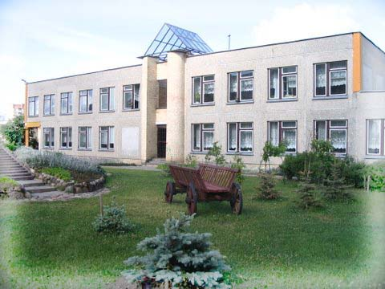
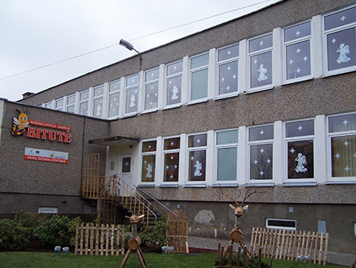
There are 9 kindergartens

Slide 41
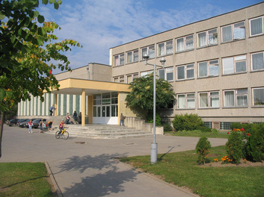
4 basic schools
We study at Pavasaris Basic School.
Our school in 2013
Our school now.

Slide 42
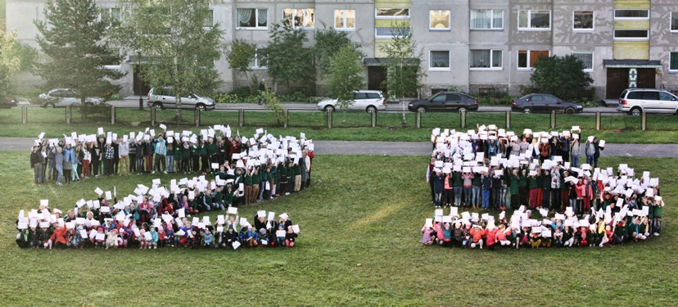
This year we are celebrating our school`s 25th anniversary

Slide 43
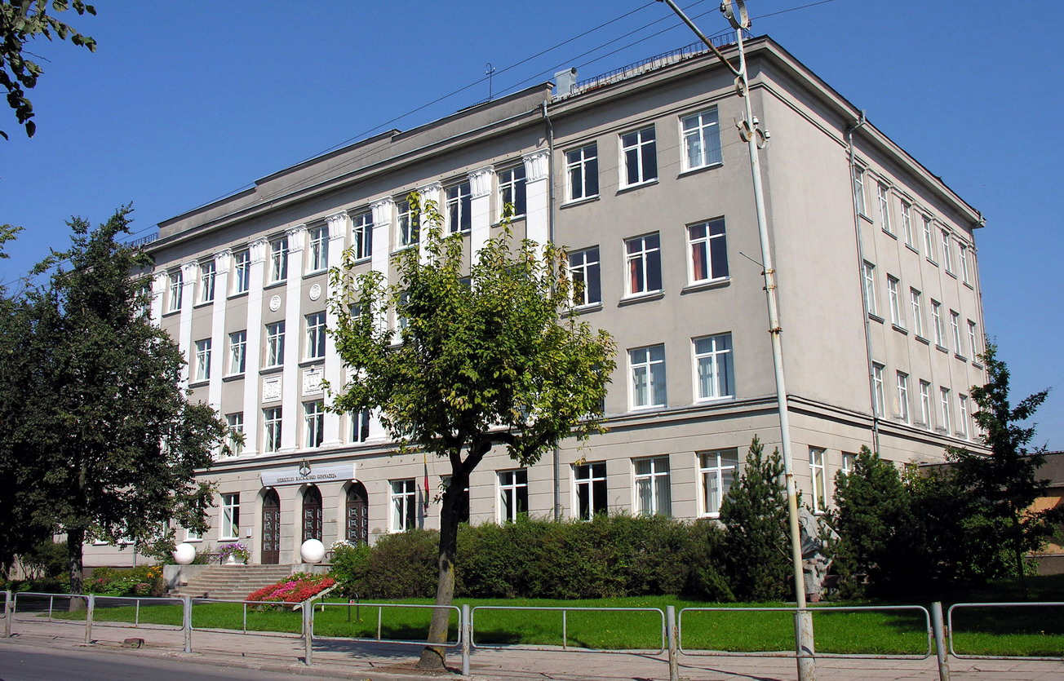
There are 2 gymnasiums in my town

Slide 44
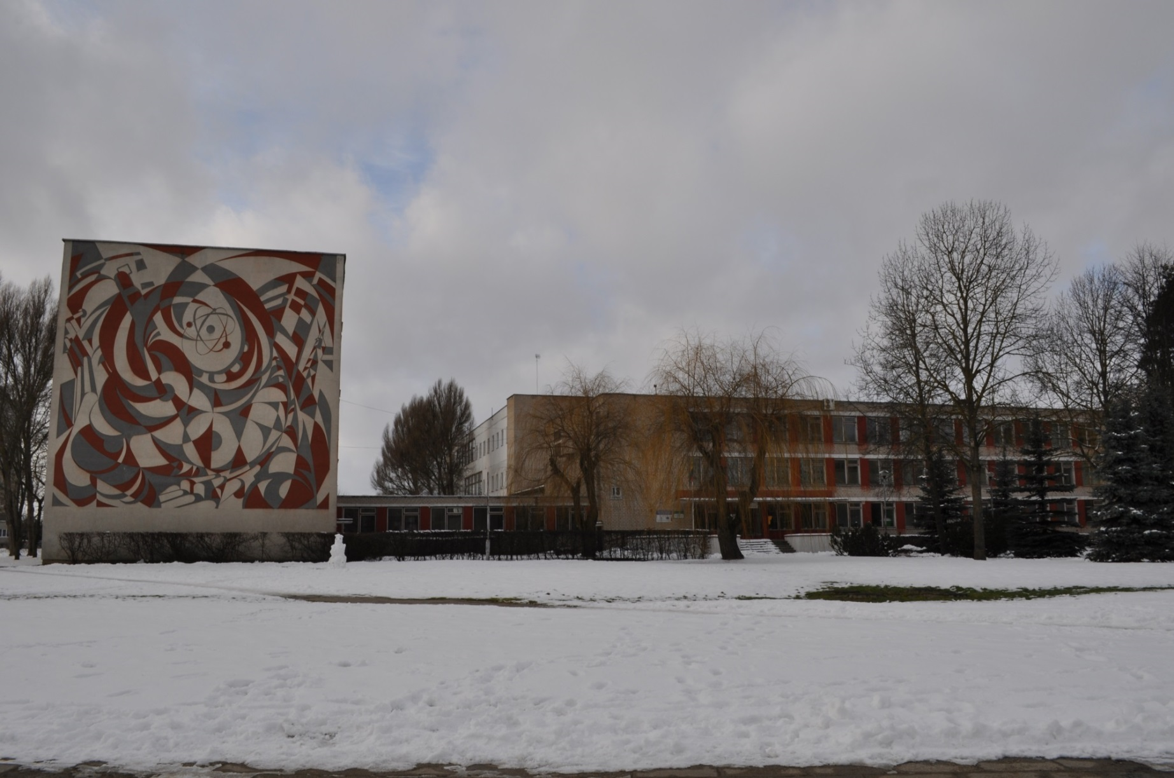
We have a polytechnical school too

Slide 45
After school we can go to...

Slide 46
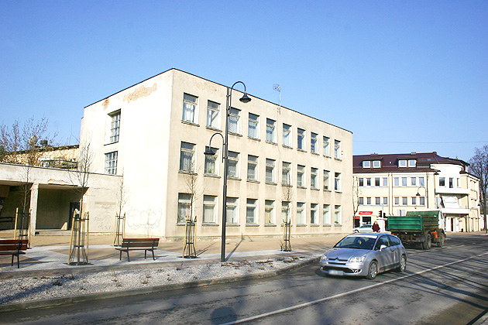
If you like books, go to the library

Slide 47
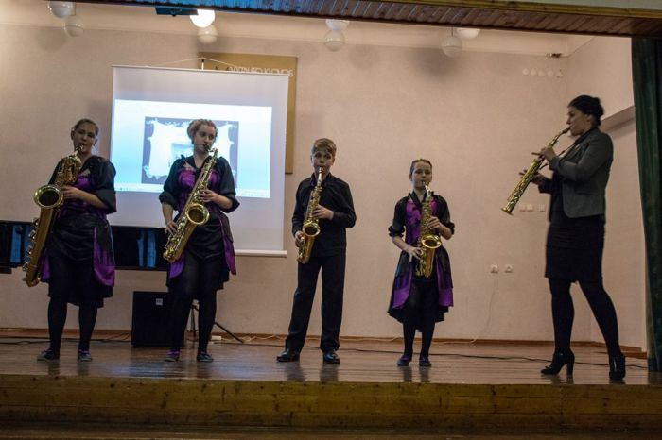
If you like music, the music school is waiting you

Slide 48
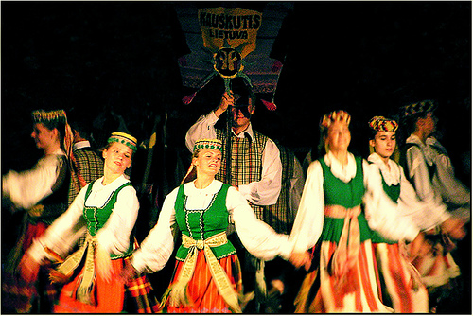
You can’t live without dance, go to the dance club

Slide 49
Sport activities in Mažeikiai
Football Karate
Basketball

Slide 50
Or visit our museum

Slide 51
Places to go with friends

Slide 52
Go for a walk in the park

Slide 53
You can play bowling here

Slide 54
We often meet in the Ice Arena

Slide 55
My friends love films at the cinema

Slide 56
Or spend time in the swimming pool

Slide 57
We have four seasons, so
we can spend time out
with friends all year

Slide 58
In winter we play with snow

Slide 59
You can go sliding on the frozen pond

Slide 60
You can collect violets in spring

Slide 61
Or tidy your environment. It is an action Do 2014

Slide 62
In summer
Go biking
or skating

Slide 63
In summer
You can go fishing or
swimming in the river Venta

Slide 64
In autumn
We tidy our environment

Slide 65
and collect mushrooms in the forest

Slide 66
Our dreams about our town...

Slide 67
We are dreaming about less pollution

Slide 68
More parks!

Slide 69
To have pen friends from foreign countries!!!

Slide 70
Thank you for your attention!

