Slide 1
My school is in Lithuania

Slide 2
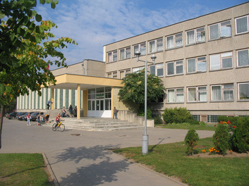
We study at Pavasaris Basic School
which creates a welcoming, safe and caring environment where everyone feels valued, supported and involved.
Our school in 2013
Our school now.

Slide 3
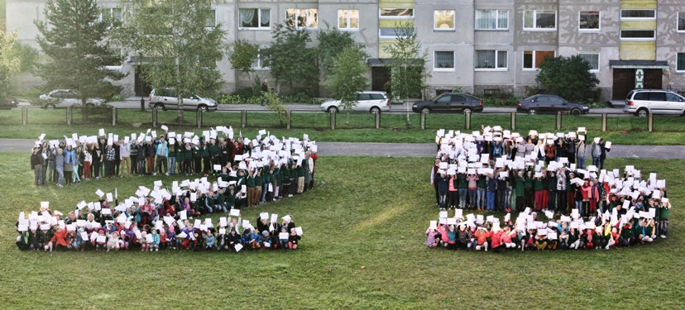
This year we are celebrating our school`s 25th anniversary

Slide 4
At the first of September we start our school year

Slide 5
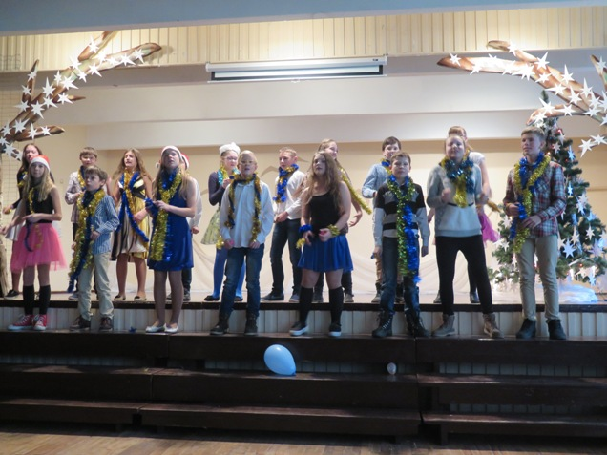
The school has nice and deep-rooted traditions. No school festival can be imagined without our young dancers and singers.

Slide 6
Our school`s aims are to satisfy a wide range of sporting interests and abilities, as well.

Slide 7
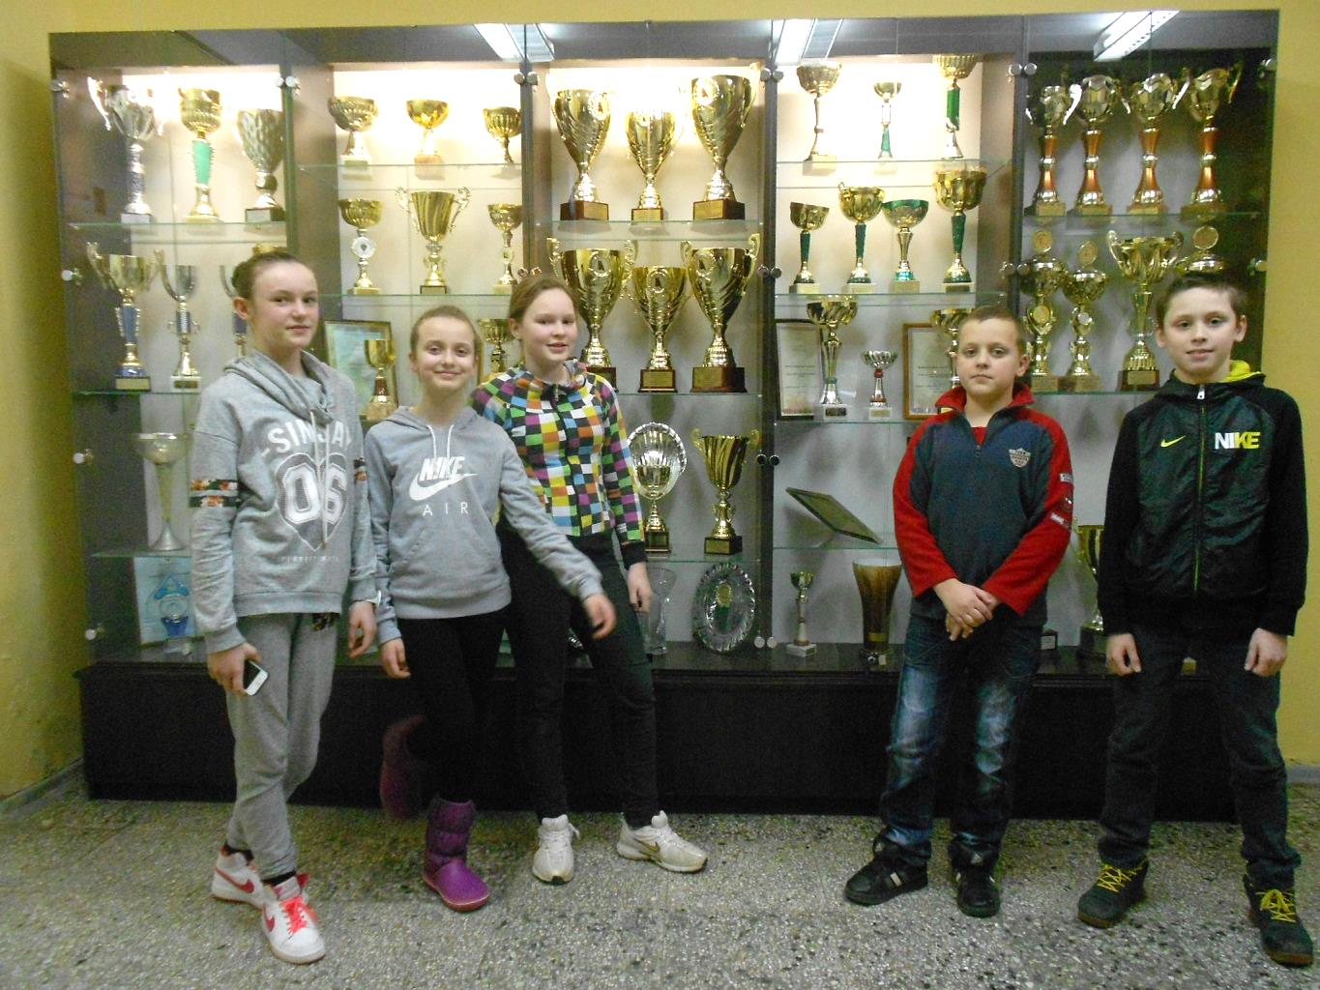
Our students compete in a variety of sports and get prestigious awards for their victories.

Slide 8
The clubs of Ecologists, Foresters and Exact Sciences are available at our school too.

Slide 9
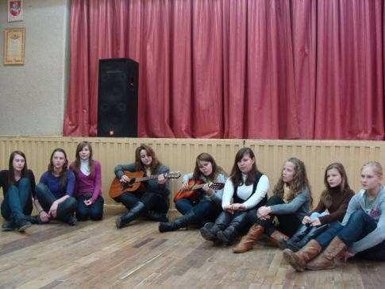
We celebrate lots of annual festivals
Christmas Charity Concert
The Green Song Contest

Slide 10
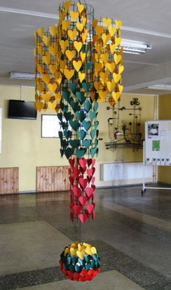
Every year we celebrate our country‘s Independence Day on 16th February

Slide 11
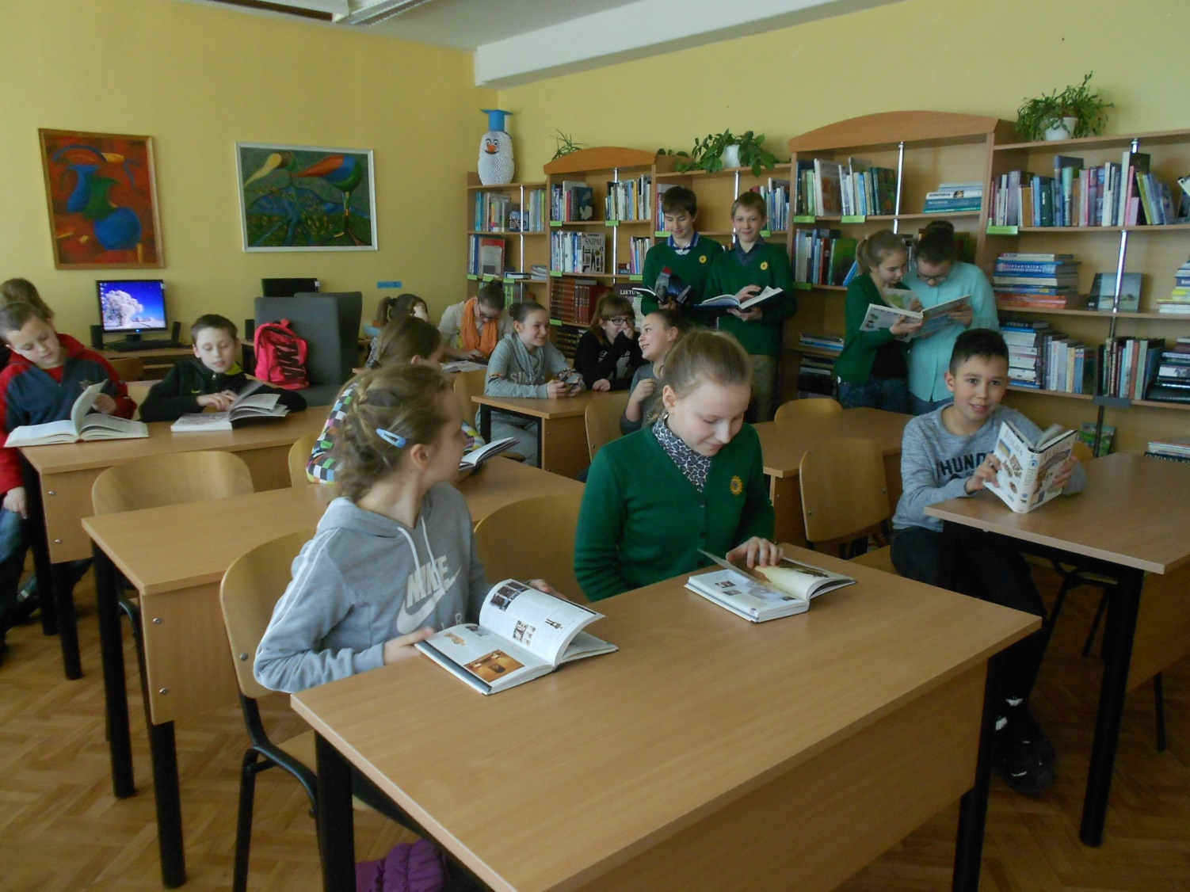
We spend our free time in the library

Slide 12
Thank you for your attention!

