Slide 1
Seismic magnitude scales
Milosevic Andrei
Necula Beatrice

Slide 2
The Richter magnitude scale
The Richter scale was designed in 1935 by Charles Richter and Beno Gutenberg. This scale measures the strength of the earthquakes and the measurements are made using seismographs. The Richter magnitude scale is a logarithmic scale, which means that the magnitude of the earthquake increases 10 times from one degree to another.

Slide 3
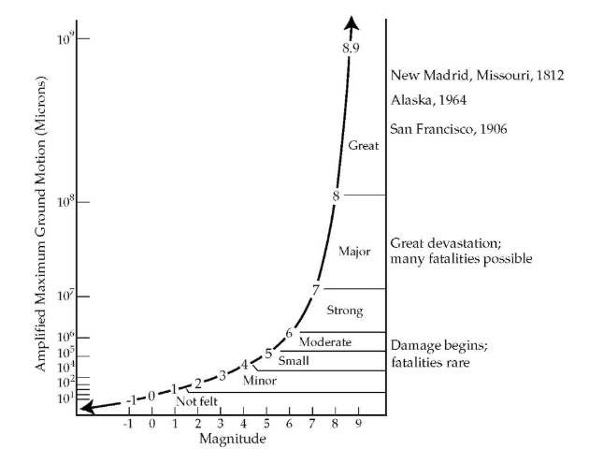

Slide 4
The Mercalli intensity scale
The Mercalli intensity scale, invented by Giuseppe Mercalli, is a scale that determines the intensity of an earthquake based on personal, subjective observations during an earthquake. This scale determines the intensity of an earthquake depending on its effects on buildings and the environment. The determination of the value is made subjectively, comparing with the descriptions in the chart below, not being measured by devices.

Slide 5
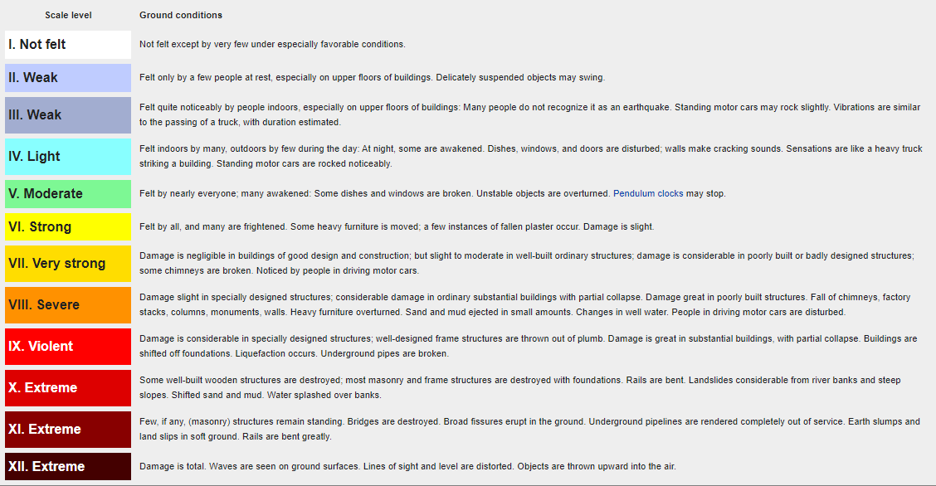

Slide 6
The end
Sources:
https://en.wikipedia.org/wiki/Modified_Mercalli_intensity_scale
https://www.cutremur.net/p/scarile-de-magnitudine-si-intensitate.html
cutremure.3x.ro

