Slide 1
Digital Learning Resources
Kristi Salum
HITSA 2019

Slide 2
Vision and strategic goals for 2020 The Estonian Lifelong Learning Strategy 2020
A change in the approach to learning – individualization, learning skills, development of creativity and entrepreneurship for every learner.
Competent and motivated teachers and school boards
The concordance of lifelong learning opportunities with the needs of the labour market
A digital focus in lifelong learning - digital technology is applied to learning and teaching process more effectively and efficiently, the digital skills of the entire population have improved and access to the new generation of digital infrastructure is guaranteed.
Equal opportunities and increased participation in lifelong learning

Slide 3
The realization of the goals
The availability of digital learning resources that support the aims of the national curricula and learning outcomes.
The plethora of digital learning assets provides an opportunity to improve the quality of learning resources, develop digital competences and integrate new knowledge with different subject and life areas, as well as teach and solve learning and problems.
http://www.regionalaustralia.org.au/home/wp-content/uploads/2017/02/New-Ideas.gif

Slide 4
With digital learning resources, you can choose the time to learn, adjust the level of difficulty and the pace of learning.
In order to use appropriate digital learning material, both the teacher and the learner must be able to find, adapt or create the digital learning material and share it with others, i.e. be digitally competent.
http://www.teachhub.com/sites/default/files/field/image/teaching-strategies-keep-class-interesting.jpg

Slide 5
A digital learning strategy may include any of or a combination of any of the following
adaptive learning
badging and gamification
blended learning
classroom technologies
e-textbooks
augmented reality
learning analytics
learning objects
virtual reality
mobile learning
personalized learning
online learning (or e-learning)
open educational resources (OERs)
technology-enhanced teaching and learning
https://png.clipart.me/istock/previews/2321/23212211-cartoon-mobile-phone.jpg

Slide 6
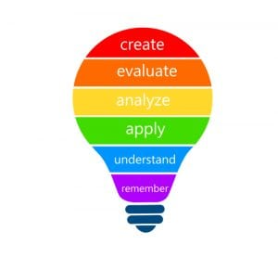
Digital learning is meant to enhance the learning experience rather than replace traditional methods altogether.
Common pedagogies, or practices of teaching, that combine technology and learning:
Blended/hybrid learning
Online learning
Flipped learning
1:1 learning (BYOD)
Differentiated learning
Individualized learning
Personalized learning
Gamification
Understanding by Design (UBD)
Universal Design for Learning (UDL)
Bloom´s taxonomy
https://apasseducation.com/wp-content/uploads/2018/04/shutterstock_1059376079-300x277.jpg

Slide 7
Digital learning resources
Digital learning is any type of learning that is accompanied by technology or by instructional practice that makes effective use of technology.
The term 'digital learning resource' is used to refer to materials included in the context of a course that support the learner's achievement of the described learning goals.
Different learning objects are:
Self-contained
Reusable
Portable between learning systems
https://www.teachsecondary.com/images/made/images/uploads/6-digital-resources_630_465_84_int_s_c1.jpg

Slide 8
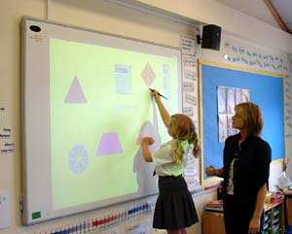
Digital learning material
…is a learning material distributed in digital form (presentation, video or audio lecture, task, test, etc.) that contains text, graphic, and multimedia elements and may be more or less interactive.
… can be designed to support one specific activity (a task) or a complete and independent one, it does not require the use of any other material (a learning object).
https://www.americaninno.com/wp-content/uploads/wpallimport/files/2/files/2012/09/whiteboard.jpg

Slide 9
Digital learning resources
Learning materials:
E-tests
E-books
Learning objects
E-courses
Learning games
Sometimes it is hard to tell the diferent between learning material and learning software (mobile learning apps).
Learning software:
Desktop apps
Web apps
Mobile apps

Slide 10
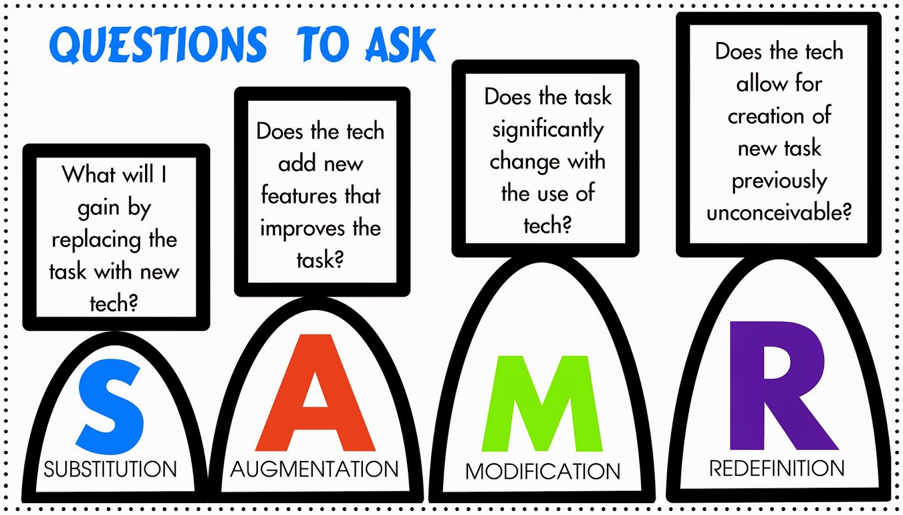
Carrington`s wheel, SAMR model
http://4.bp.blogspot.com/-z1HSLyqdmXA/VAnTeOlTflI/AAAAAAAANQk/eCi_5vJ3UA0/s1600/samrquestionimage.jpeg

Slide 11
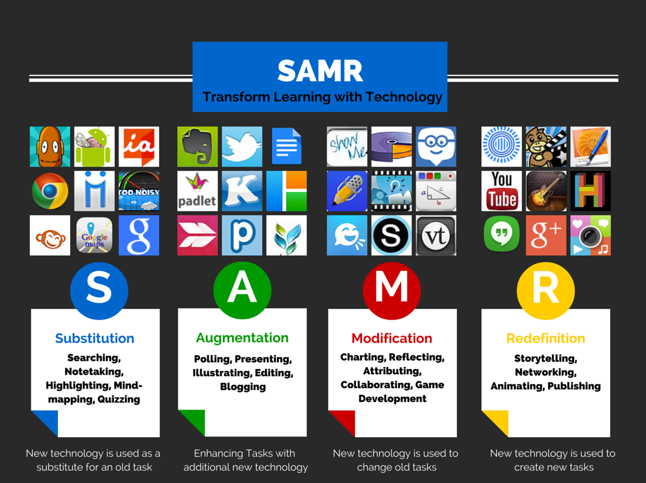
https://media-market.edmodo.com/media/public/379ebc081e295b0999c85b9b0a365477da29c610.png

Slide 12
High quality digital learning material
supportive of learning
has high-quality content
motivating
customizable
interactive
copyrighted
user friendly
technically correct and compatible
easily found (tags, metadata)
https://encrypted-tbn0.gstatic.com/images?q=tbn:ANd9GcTPiyn1I5hGcRfFCew4hE96-KOXcqnOtWigODDfOMicznA2frqPEw

Slide 13
ADDIE model
Steps for developing learning material:
Analysis – target group, content, resources
Design –goals, outcomes, methods, structure, plan
Development – content ready, testing, publication
Implementation - using
Evaluation – improving
Learner-centered!

Slide 14
LORI (Learning Objective Review Instrument)
Content Quality - balanced presentation of ideas, and appropriate level of detail
Learning Goal Alignment - learning goals, activities, assessments, and learner characteristics
Feedback and Adaptation - adaptive content or feedback
Motivation - ability to motivate, and stimulate the interest of, an identified population of learners
Presentation Design - design of visual and auditory information for enhanced learning
Interaction Usability - easy of navigation, predictability of the user interface
Accessibility - support for learners with disabilities
Reusability - ability to port between different courses or learning contexts without modification
Standards Compliance - adherence to international standards and specification

Slide 15
Outcomes
Good digital learning material takes into account the different learning styles of learners when choosing media and preparing learning tasks, including instructions, guidelines for learning and the use of study materials, if necessary.
Learning outcomes describe the minimum level of knowledge, skills and attitudes that the learner must acquire and be able to demonstrate as a result of learning. Learning outcomes are formulated in a learner-centred way - what the learner can do at the end of the study material and under what conditions.
Well-defined goals and learning outcomes help the author of the study material and its user decide on the content of the study material and the suitability of the learning process.

Slide 16
Structure
It is advisable to create a clear system between the parts of the study material (menu, navigation buttons, table of contents).
Scope – introduction, objectives, learning outcomes, preliminary knowledge, technical requirements, etc.
Content – educational material presented as a combination of text, graphics, animation, audio and video
Activity – activities for embedding, practicing, self-checking and implementing the learning process (tasks, self-tests, etc.).
Thinking – reflection and discussion (questions about text and thinking).
Extra – references to additional material.

Slide 17
Design
The author of the study material has to think about which design techniques to use and follow them throughout the course (layout, colour schemes, principles in graphics: drawing, picture, graph, text style and size selection).
The essential details of the study material must be easy to find, distinct from the background and large enough. Text and background colours should be as contrasting as possible. Black text is best used on a white background.
The material to be created must reach and bind the target audience and be easy to read. The typeface and text are selected so that important information is stressed.
https://finchamdesign.co.uk/wp-content/uploads/2018/02/designmatters1.jpg

Slide 18
The study material is stylistically and linguistically correct.
It is necessary to take into account the license terms of the material when using the work of other authors in the study material. The work used may be copyrighted (©), partially protected (Creative Commons), or public domain.
A list of all the sources used must be provided in the study material (normally at the end).
https://eduwells.files.wordpress.com/2014/10/creative-commons-eduwells.png

Slide 19
Technical principles
The study material is technically operational when the links open, the necessary resources work as intended, the web-based literature cited is available.
High-quality learning material can be used with as many different types of devices, web browsers, and operating systems as possible without disrupting the presentation or functionality of content (compatibility).

Slide 20
The learner can be motivated by the diversity of the material, the possibility of receiving feedback, vital and interesting examples and engaging interactive tasks.
Digital learning material is true to the subject (does not contain factual errors).
Learning content is presented as briefly as possible and as lengthily as necessary. Appropriate distribution of learning content and activities must ensure transparency and avoid distraction, texts, audio or video clips that are too long.

Slide 21
The learning material is interactive when it responds to the learner's activities (options, text input, etc.), the learner has the opportunity to direct the operation of the study material (watching video, entering simulation data, multiple choice and automatic feedback tests, etc.).
The interactive elements of high-quality digital learning material are user-friendly and functional from both design and technical implementation, and the user interface must alert the learner on how to act.

Slide 22
When compiling the study material, it is important to pay attention to the following questions:
What data will be added to the homepage of the study material? The title, author(s), year of creation, and license to use the study material are usually written on the home page.
What is the structure of the study material? It is recommended to use a two to three level structure.
Which parts does the chapter consist of? Possible components of the study material chapter are title, goal, learning outcome, introduction, new concepts, content, examples, sub-sections, summary.

Slide 23
How to emphasize terms, definitions? For example, you can use marginal notes or distinguish text with design techniques.
What visual aids should I use? Graphic organizers, illustrations, drawings, concept maps, animations are suitable for visualization.
Which parts are related to the study material? Different content can be linked to hyperlinks, which preferably open in a new browser window.
It is important to ensure that the choice and volume of media used in digital learning material is purposeful. When making decisions, it is worth remembering the principle “as much as necessary, as little as possible”.

Slide 24
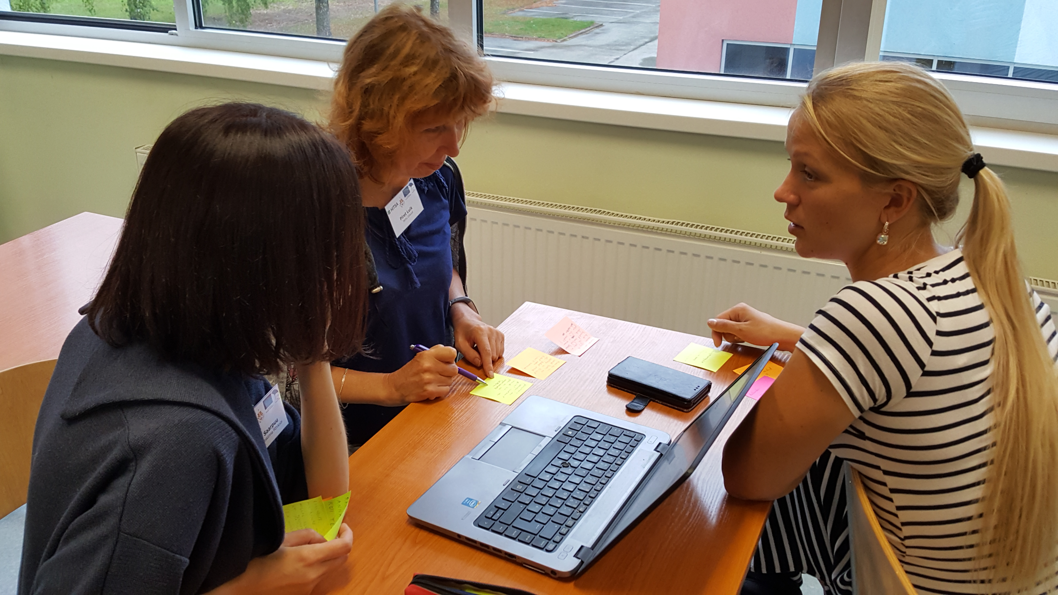
Testing & Feedback:
Technical testing - the author of the material
Content Testing - Colleagues
Target Testing - Target Audience

Slide 25
There are a plethora of tools and resources online that can be used to create and enhance a digital learning environment.
Resources and tools that 21st century teachers can use for digital learning:
Social Readers (RSS)
Communities (Google+)
Channels (Youtube)
Cloud-based Word Processors (i.e. Google Drive)
File-sharing platforms (i.e. Dropbox)
Notes organizers (Evernote)

Slide 26
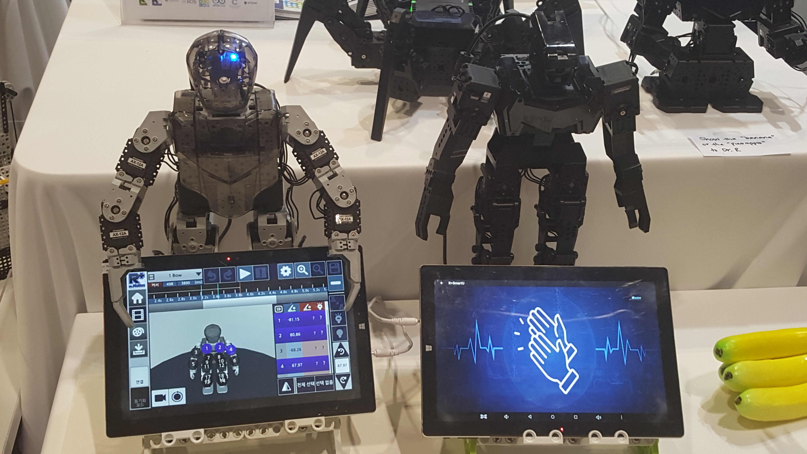
Types
Self-check test
Presentation
Demonstration
Graphic organizer
Audio material, sound sharing platform
Guidance Material
Simulation
Test
Worksheet
Video footage
Learning Game
Task or exercise; drill and practice

Slide 27
More
Collections: webpage, e-book, e-course, e-learning object
Methodological materials: lesson plans, lesson scenarios, evaluation models
Project plans, creative work, guides

Slide 28
EXAMPLES
Self-check tests:
Learning Apps https://learningapps.org/createApp.php
Kahoot https://kahoot.com/
Presentations:
MS PowerPoint
Libre Office Impress
Keynote (Apple)
Prezi: http://prezi.com
Google Esitlus: https://docs.google.com/presentation/
...

Slide 29
Graphic organizers:
Concent map
Mind map
Consequence map
Audio:
Audio lecture
Illustrative audio material: bird song, nature sound, everyday sound
Video:
Video lecture
Learning video
Animation

Slide 30
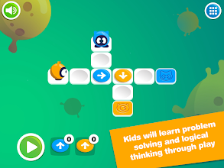
Guides
Simulations
Worksheets
Tests: Socrative https://www.socrative.com/
Learning games:
Coding games
Logical games
Strategy games
Simulation games
https://lh3.googleusercontent.com/0hXFJf6oRZ4Iz3-4IhQ3rXXsRY276SWauKPXKPJvHIplPzbl9q0SnGnuMfxoZSGXQz0=w412-h220-rw

Slide 31
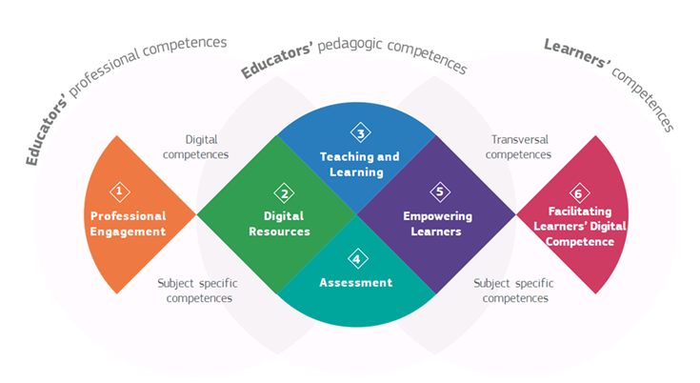
Collections, e-books, courses
Collections http://progetiiger.ee
E-books https://courses.cs.ut.ee/t/digiopik/
Courses
Methodological materials:
Lesson plans
Lesson scenarios
Evaluation models – DIGCOMP
Data - Hello, Spring! nature observations

Slide 32
h5p
H5p https://h5p.org/documentation/for-authors/tutorials
https://blending.education/wp-content/uploads/2017/05/H5P_Logo-blue-1384x923.jpg

Slide 33
Thank You!

