Slide 1
Hanneke Bibian

Slide 2
Pecha Kucha
introduction
Our main goal for today is to make a Pecha Kucha about the similarities and differences of your own culture and that of other countries.

Slide 3
Pecha Kucha

Slide 4
What’s typically Dutch….
from your point of view.
from the point of view of foreigners.

Slide 5
Make your own Pecha Kucha
Listen to the example

Slide 6
The next step
Make contact with a pupil from another country.
Present your Pecha Kucha.
Start a conversation about the different subjects.
Talk about the differences you noticed.

Slide 7
Make your own Pecha Kucha
Make pairs.
Make your own Pecha Kucha.
Look at our suggestions.
Your starting point is your own world. …

Slide 8
Suggestions for the Pecha KUcha
Who am I?
What does my neighbourhood look like?
What does my country look like?
What does my school look like?
How does my language sound?
What is the favourite dish of my country?
What remarkable customs does my country have?
How do foreigners look at my country?
What is the most important export product?
What is my country proud of?

Slide 9
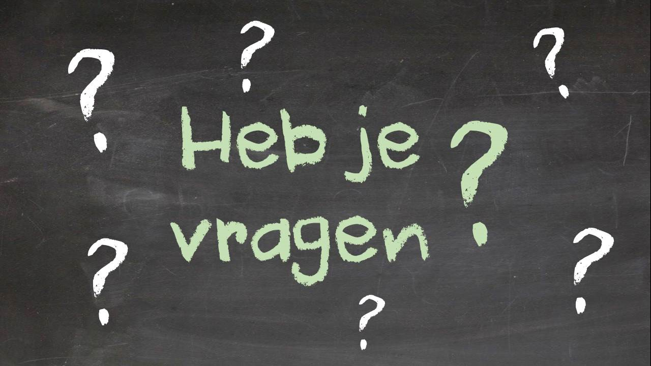
questions

Slide 10
Your turn!

