Slide 1
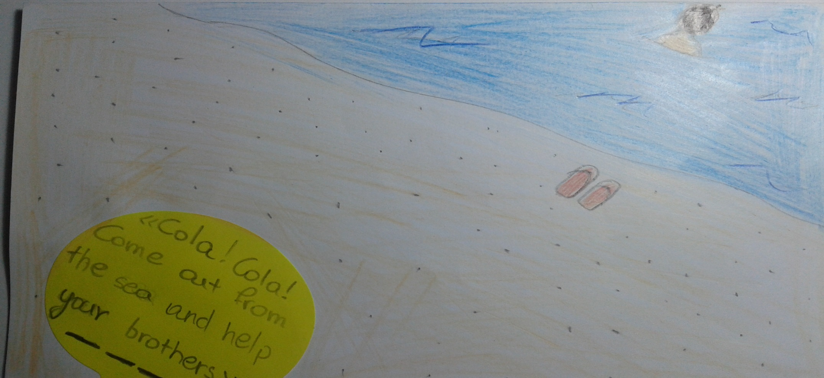
The story of “Cola Pesce”
Once upon a time in a place called Messina, a child called “Cola” spent all his time swimming in the sea. His mother would call him to come out and help his brothers but he wouldn’t listen.

Slide 2
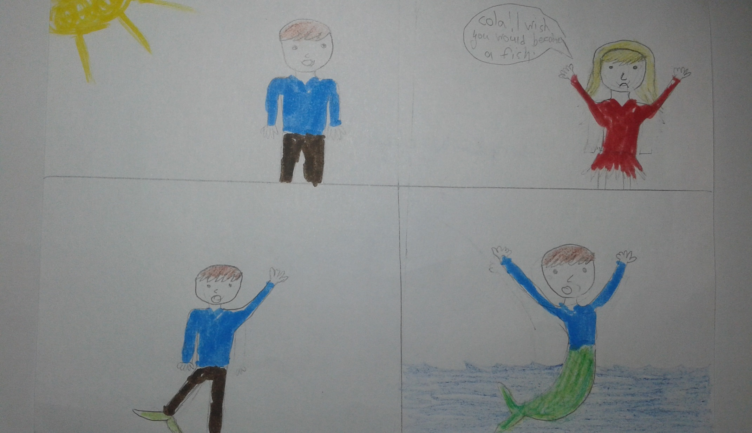
One day, she lost her patience and said: “Cola! I wish you would become a fish!” At that moment, the gates of heaven were opened and her wish was heard and so, Cola transformed into half man and half fish!
He didn’t go back to her and so she died of the pain.

Slide 3
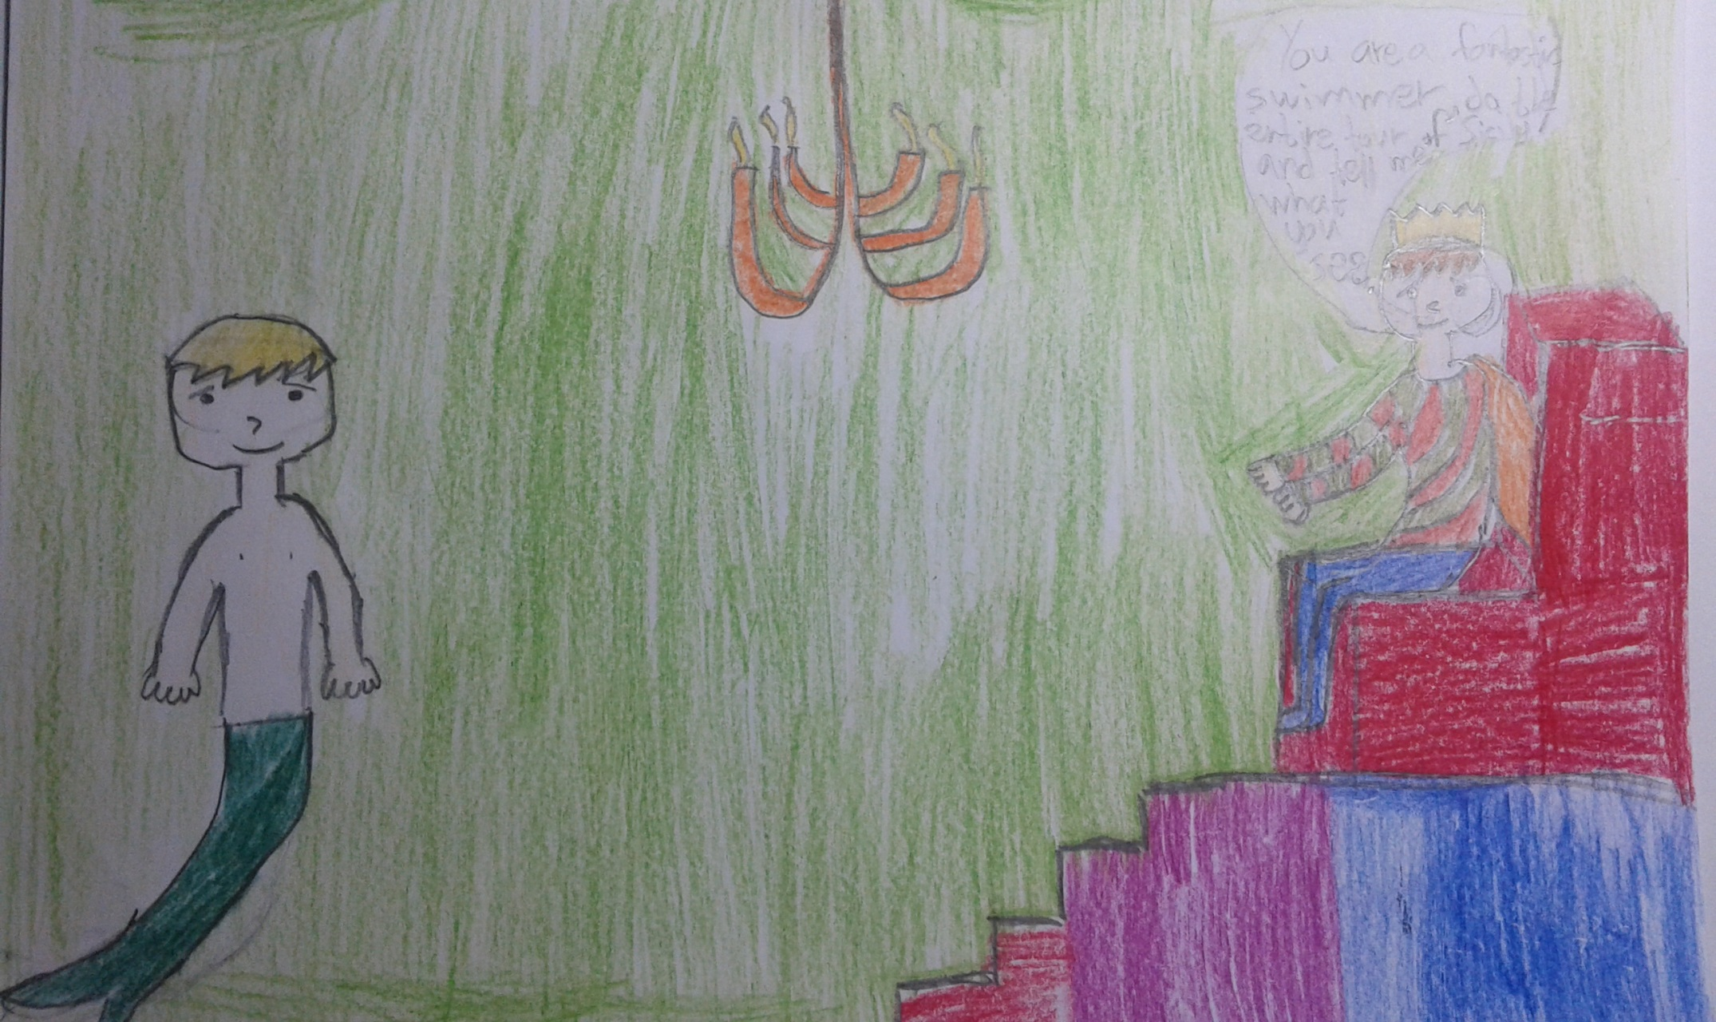
Cola became very popular and one day the king expressed the desire to meet him. So, Cola went to the royal palace at his request. ” Cola, you are a fantastic swimmer, swim around the entire island of Sicily and come back to tell me what you saw!” the king said.

Slide 4
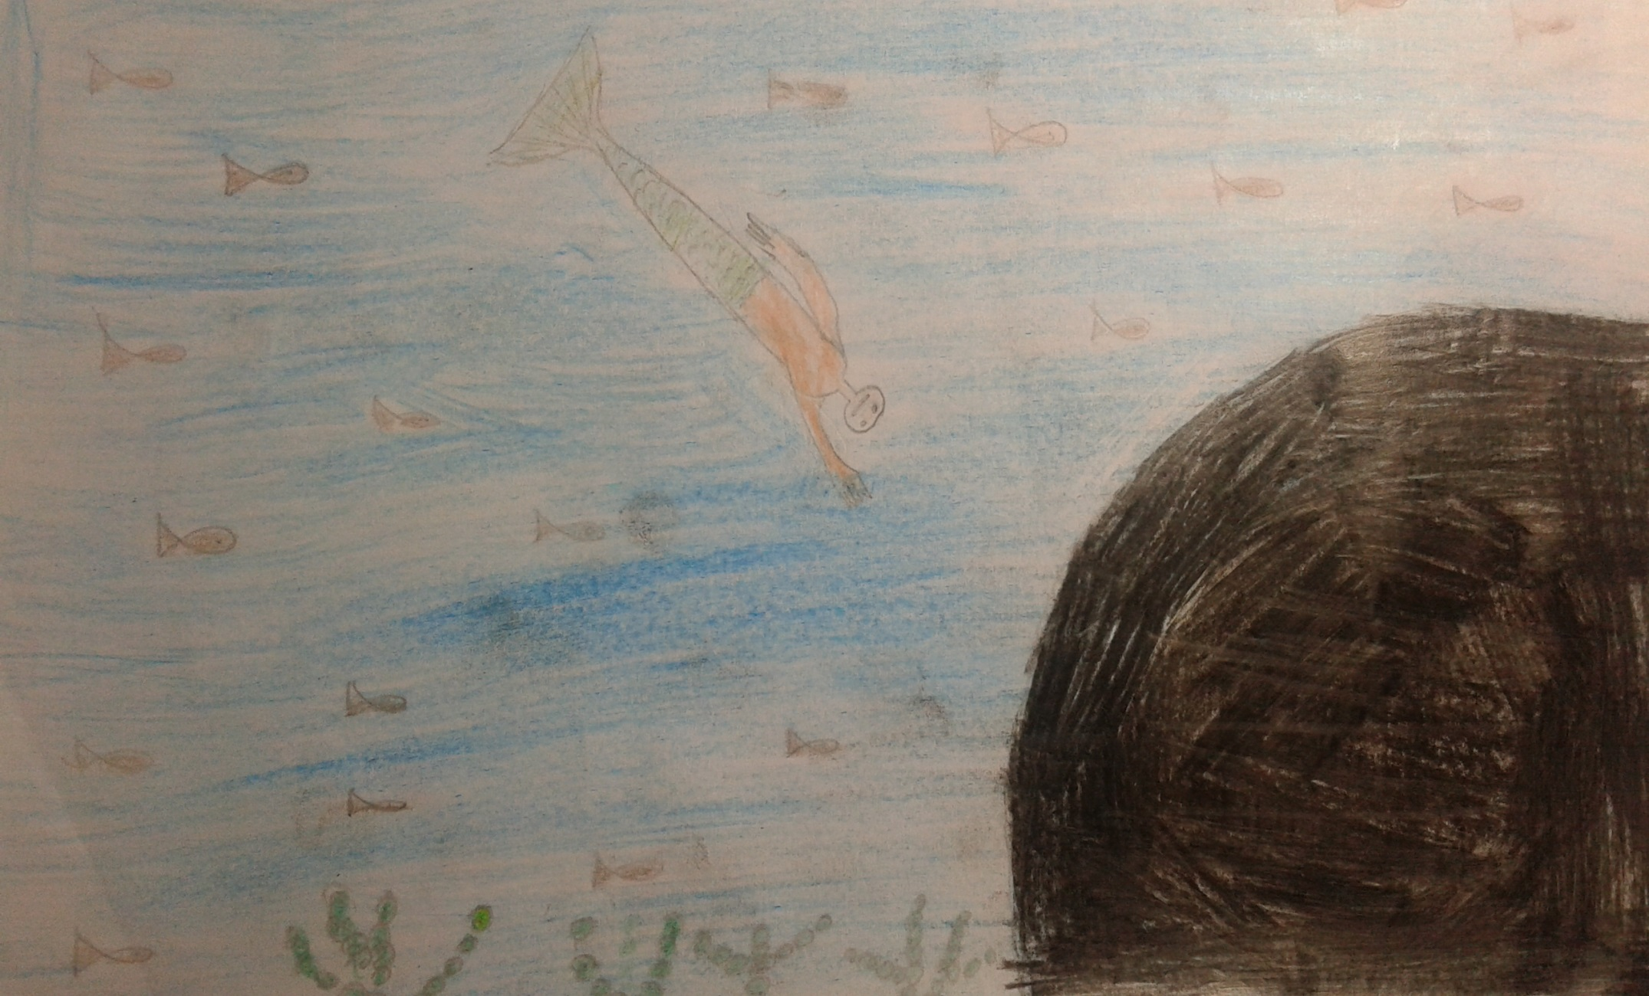
Cola threw himself into the water and swam around the entire island of Sicily and a few days later he returned to report to the king. He said "I saw corals , fantastic caves and many kinds of fish!”

Slide 5
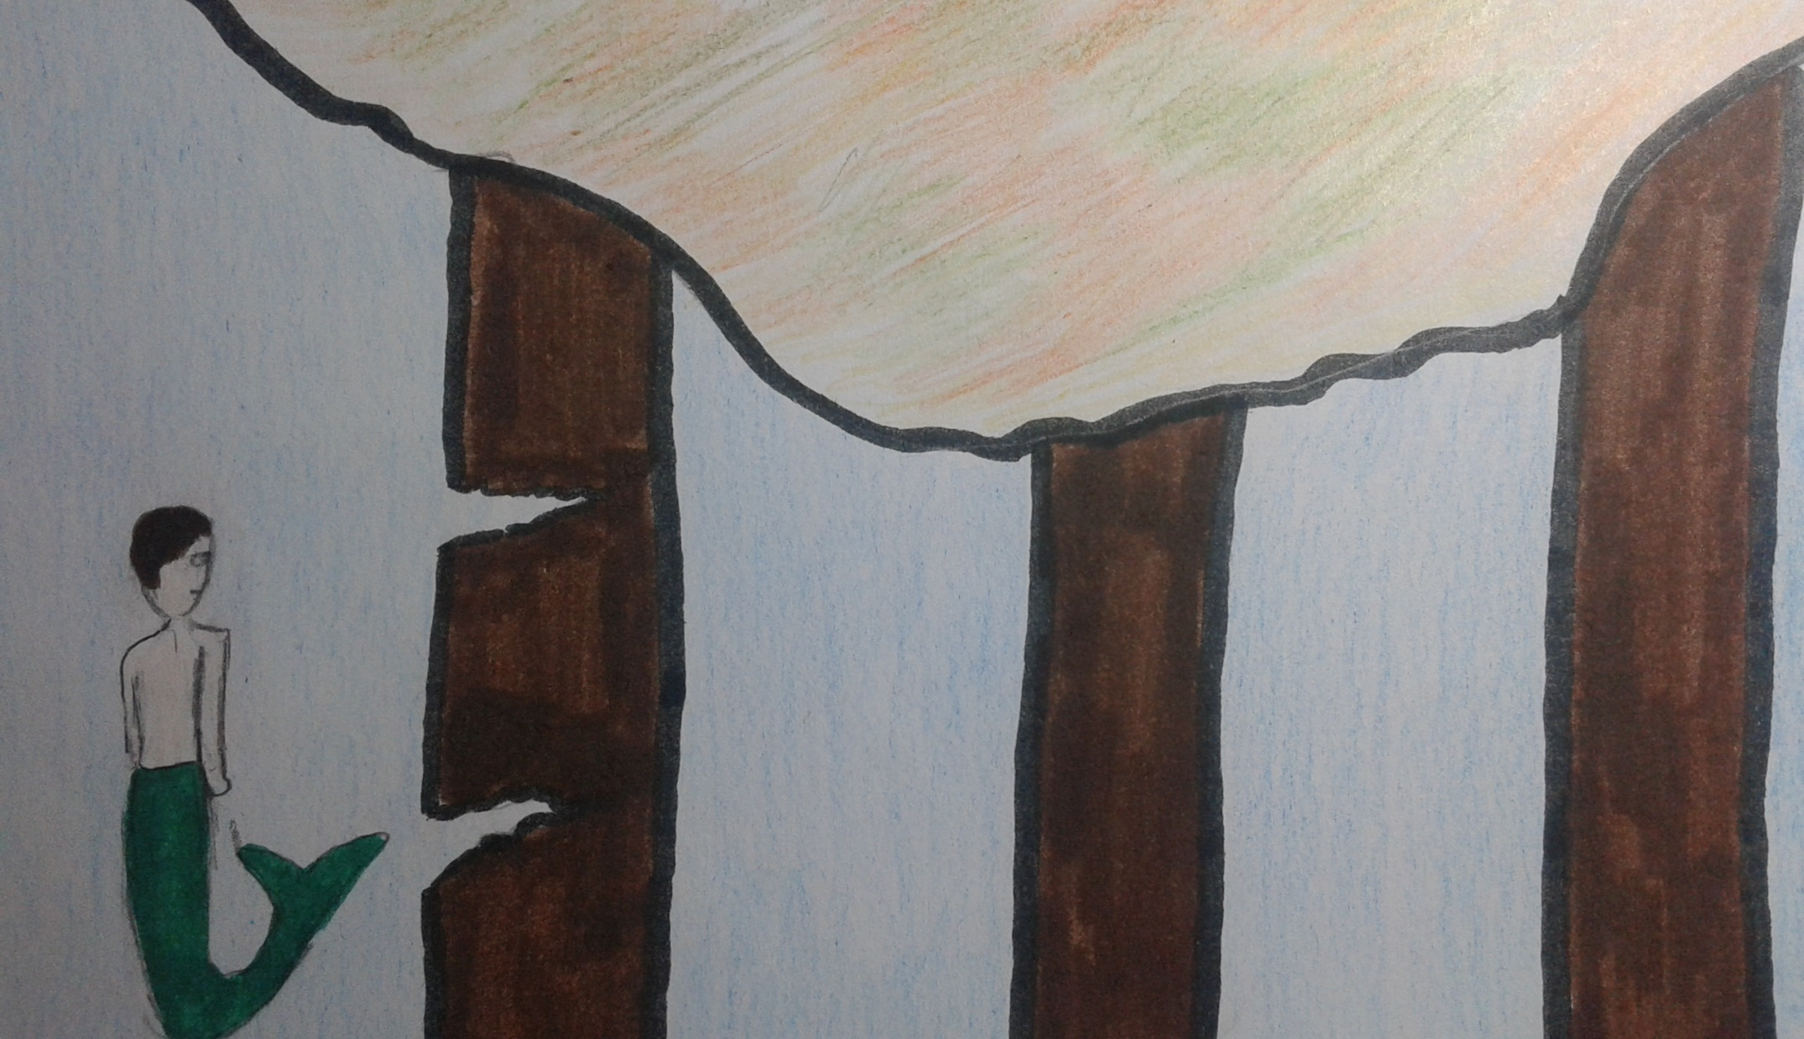
The king wanted to learn more things so he asked Cola to go back and find out why Sicily floated and did not sink into the sea.
Two days later, Cola returned to the king and said” Sicily is supported by three pillars, one is broken, the other is chipped and the third one is in perfect condition.

Slide 6
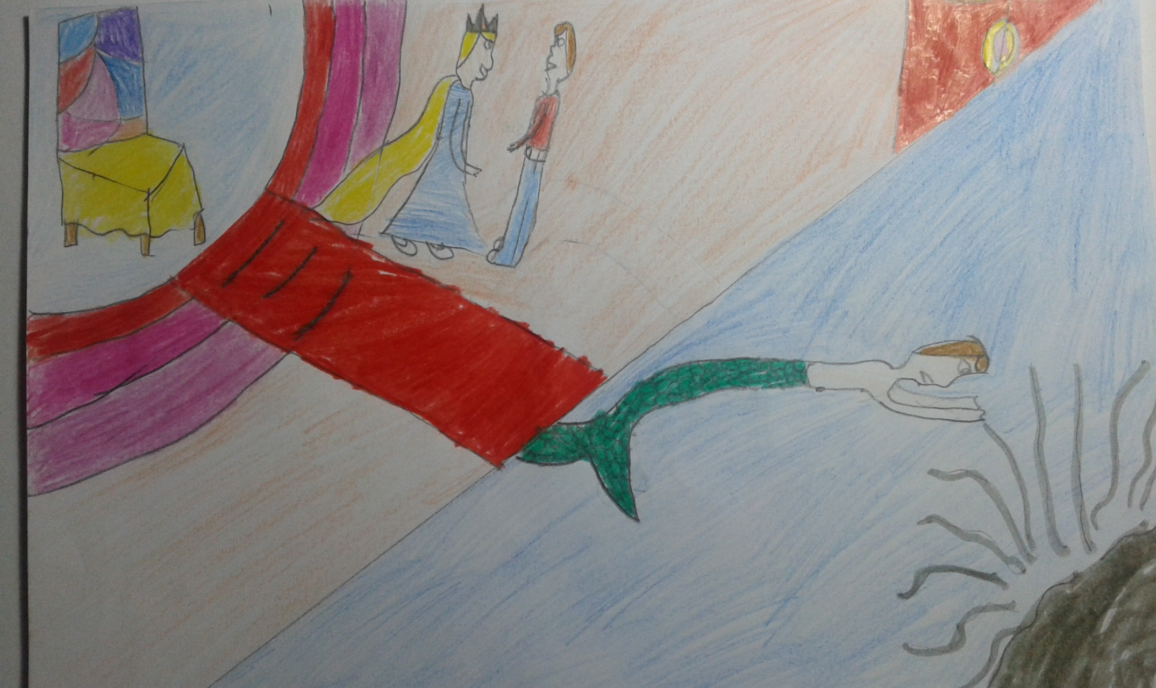
The king, again asked Cola to dive back in and see how deep the sea was near the lighthouse.
Two days later, he came up to the surface and reported to the king saying that he couldn’t see anything because there was smoke coming out from a rock.

Slide 7
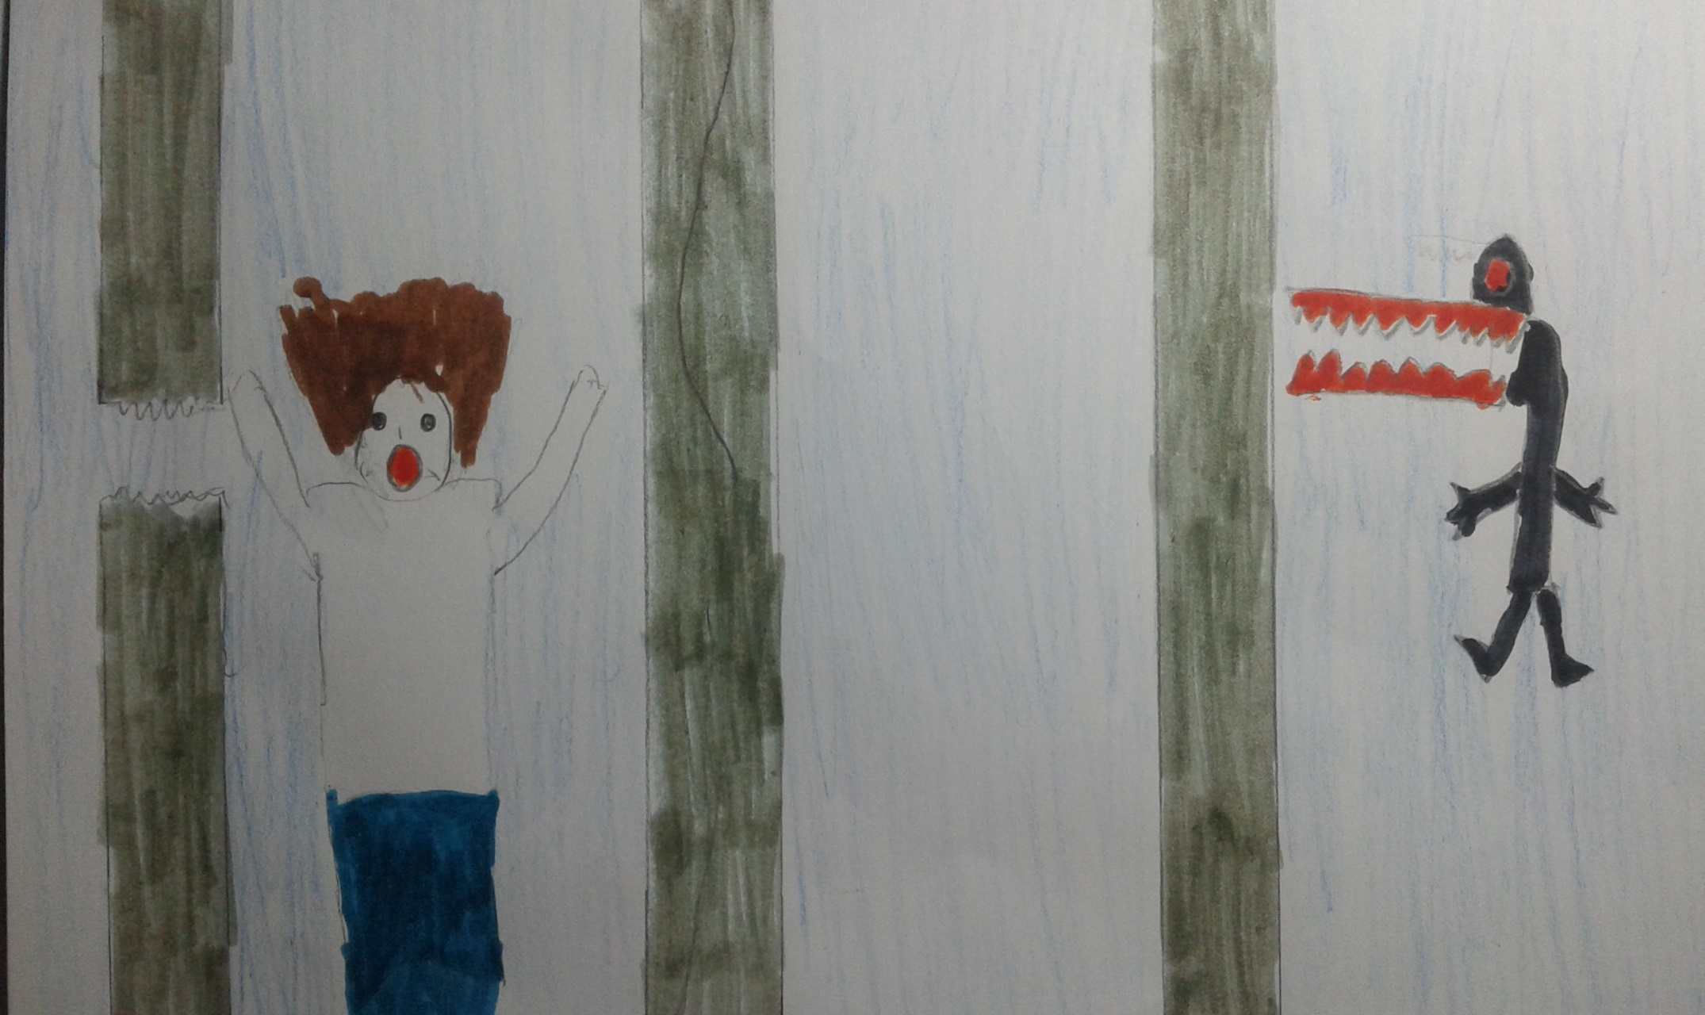
The king insisted he dive back into the water to find out how deep the sea was near the lighthouse. So, Cola dived back into the water. When he returned he was very frightened because he had seen a terrible monster and had hidden behind one of the pillars which supported Sicily.

Slide 8
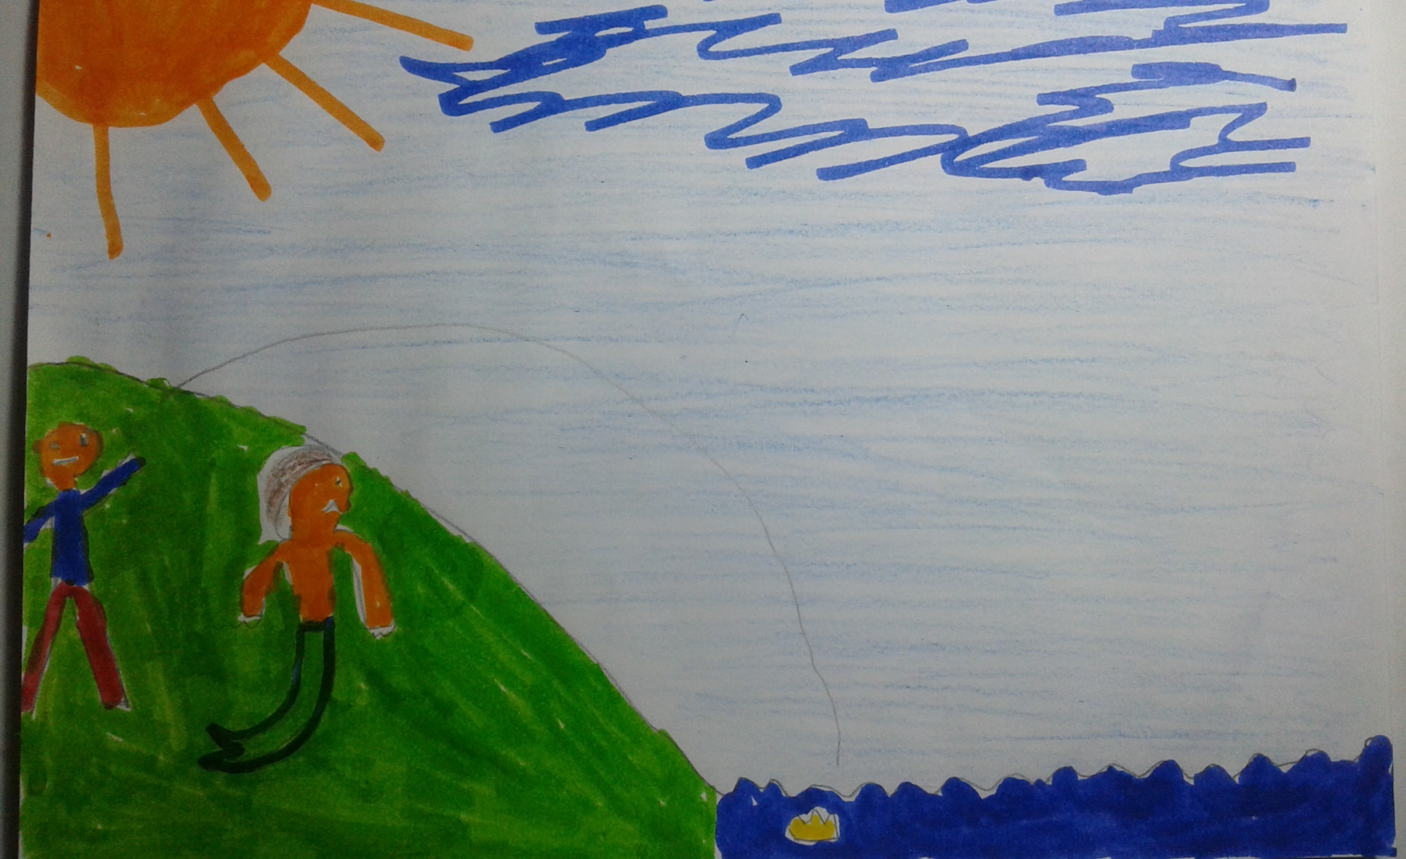
Cola didn’t want to go back into the water, he was very scared of the monster but the king threw his crown into the water and ordered him to fetch it.

Slide 9
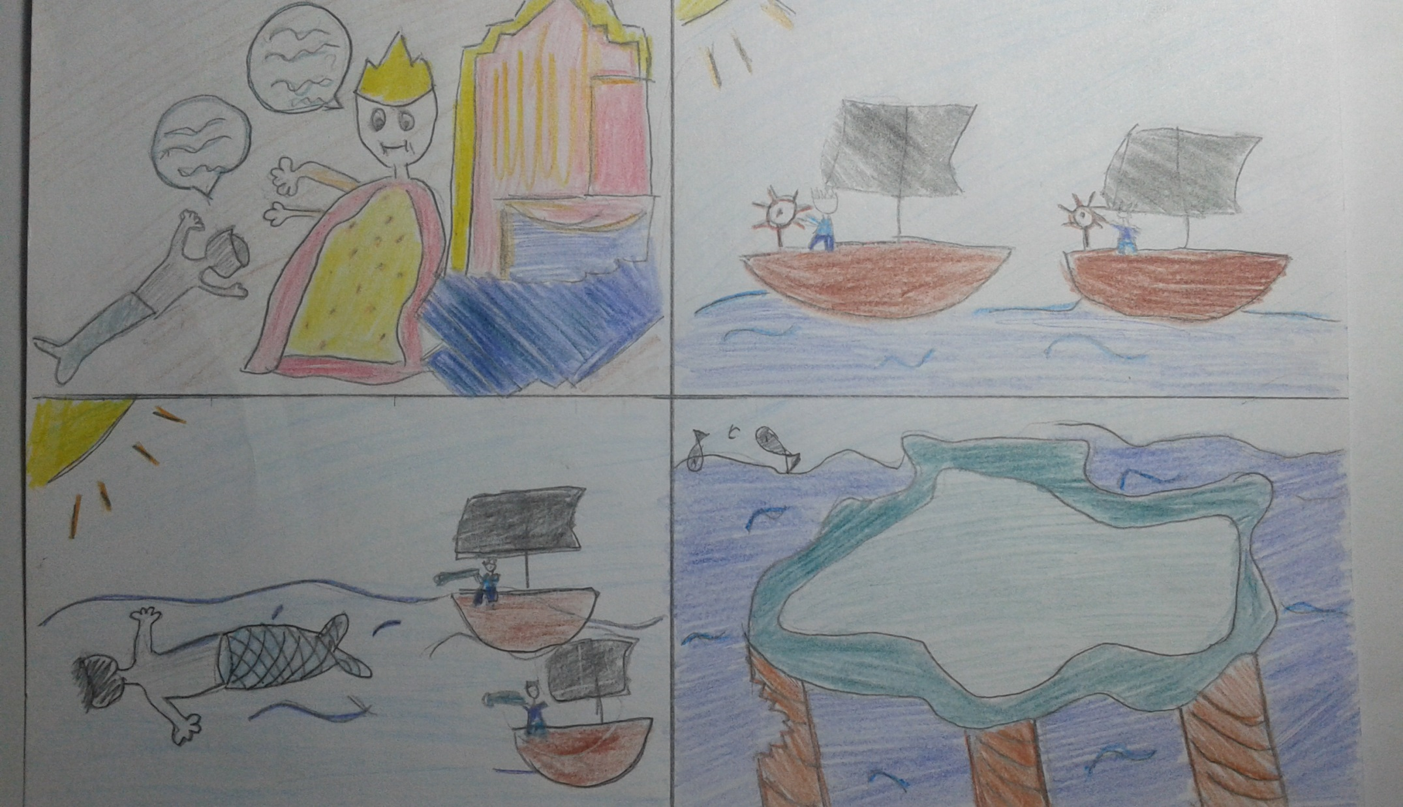
Cola obeyed but he never returned. The king, worried, sent some sailors to seek him.
They finally found him supporting Sicily. One of the pillars had broken and he had to stand in its place to prevent Sicily from sinking into the sea. Cola is still there today.

Slide 10
Illustrated by: Pupils of 6th class (Στ’1) at the 22nd Primary School of Thessaloniki, Greece.
1. Theodora and Kate
2. George and Vicky
3. Theodore and Alex
4.George and Kostas
5. Evangelia and Maria
6. Nefeli and Lida
7. Lefteris and Aris
8. Nikolas
9. Mariliza and Alice

