Slide 1
Тhe education system in the Republic of NORTH Macedonia

Slide 2
Structure of the educational system
Pre-school education
Primary education
Secondary education
University education

Slide 3
Legal provisions
Pre-school education – Ministry of Labor and Social Policy
Primary education, Secondary education and University education -Ministry of Education

Slide 4
Educational programs
Pre-school education – Program for Early Learning and Development
Primary education, Secondary education – Cambridge Program

Slide 5
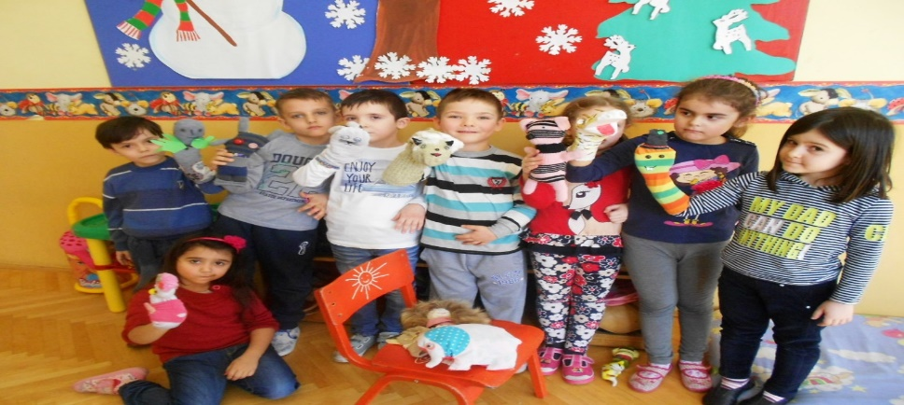
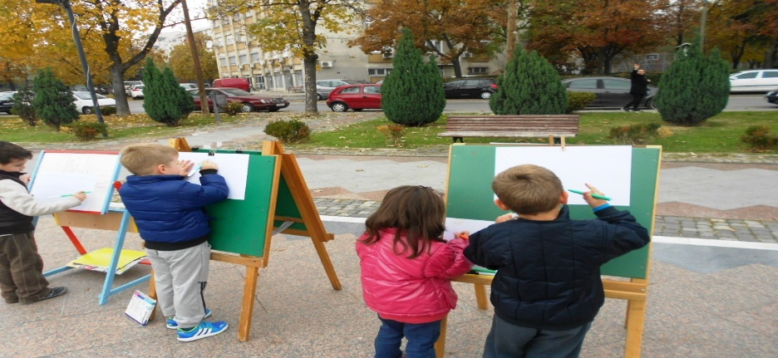
Program for Early Learning and Development
Educational work in the kindergarten is carried out according to the national Early Learning and Development Program and is based on the Standards for Early Learning and Development
The standards for Early Learning and Development represent our expectations that children should know and be able to do on a specific age

Slide 6
Compulsory development domains
2.
HEALTH AND MOTOR DEVELOPMENT
4.
DEVELOPMENT OF LANGUAGE BASICS OF WRITING AND COMMUNICATION
1. APPROACH TO LEARNING
5.
COGNITIVE DEVELOPMENT AND SKILLING OF GENERAL KNOWLEDGE
3.
SOCIO-EMOTIONAL DEVELOPMENT

Slide 7
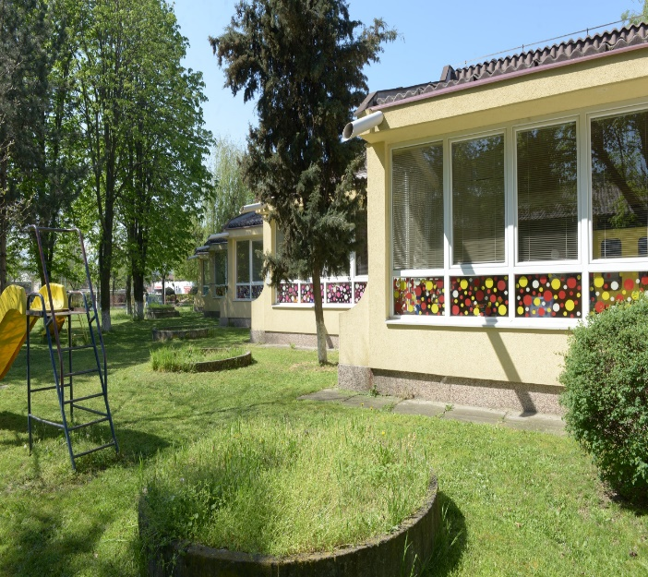
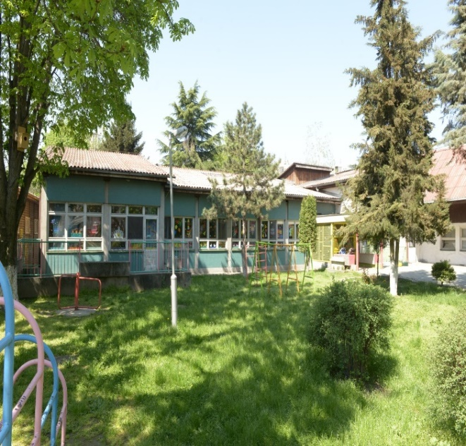
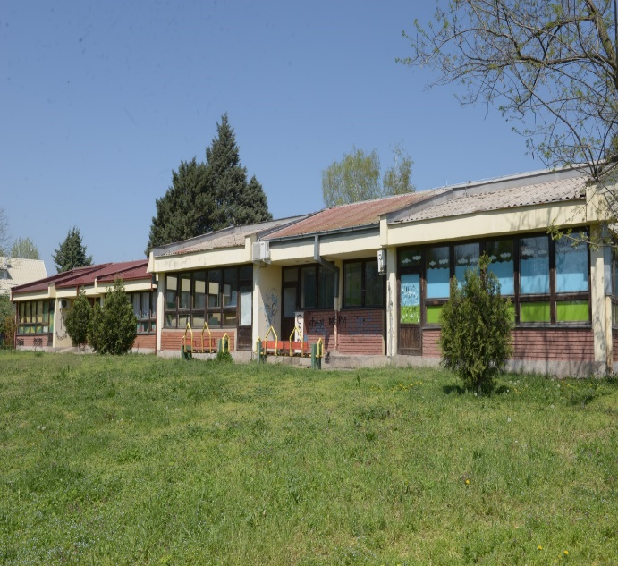
our kindergarten

Slide 8
Thank you for your attention

