Slide 2
Creating A Learning Love
Final Seminar Lohkva Lasteaed , Estonia
Project Leaflet and Website
Prepared by İsa REŞBER

Slide 3
PROJECT LEAFLET
At the preparing period of the project, partners decided that we can teach some objectives of the partner countries curriculum through playing games. We designed all the project activities with this motto. Also playing game in the school always fun for everybody.
Playing games is fun, playing games at school is even more fun.
3
Notes:
NOT: Bu slayttaki resimleri değiştirmek için, resmi seçin ve silin. Sonra, kendi resminizi eklemek için yer tutucudaki Resim Ekle simgesine tıklayın.

Slide 4
SUMMARY
At the result of the motionless life style is obezite.
During the pandemic period children stayed at home.
Nowadays, an increasingly motionless lifestyle is adopted due to technological developments. One of the age groups influenced by this lifestyle is children. Motion is very important for the physical development of a child. Playing games prevent being motionless and it has a vital role in the development of the children.
4
Notes:
NOT: Bu slayttaki resimleri değiştirmek için, resmi seçin ve silin. Sonra, kendi resminizi eklemek için yer tutucudaki Resim Ekle simgesine tıklayın.

Slide 5
Research in child development over decades as well as modern neuroscience clearly show that young children learn best when they are active. That means they get to put their hands on things, interact with other kids and adults, move a lot, create, play. Playing game is the most natural learning environment.
5
Notes:
NOT: Bu slayttaki resimleri değiştirmek için, resmi seçin ve silin. Sonra, kendi resminizi eklemek için yer tutucudaki Resim Ekle simgesine tıklayın.

Slide 6
OBJECTIVES OF THE PARTNERSHIP
General aim of our project is creating the right learning environment with carefully organised games where every child feels comfortable through cross-border cooperation to strengthen quality of preschool education on partner schools.
6

Slide 7
OBJECTIVES OF THE PARTNERSHIP
Also our aims;
-To develop games with observation forms to support the individuality, self-confidence and integrity of children
-To supporting children's language development through games
-To encourage children to feel sociable by helping each other to respect each other
-To improve pupil’s creativity and problem solving skills through games and coding
-To develop pupil's motor skills and muscles through games
-To prevent motionless life style with games
-To improve knowledge of the pupils, teachers and staff on European Union, European languages and cultural diversity
-To encourage educational staff to learn foreign language and promote respecting other cultures
7

Slide 8
TARGET GROUP AND METHODOLOGY
8
Notes:
NOT: Bu slayttaki resimleri değiştirmek için, resmi seçin ve silin. Sonra, kendi resminizi eklemek için yer tutucudaki Resim Ekle simgesine tıklayın.

Slide 9
EXPECTED IMPACT
9

Slide 10
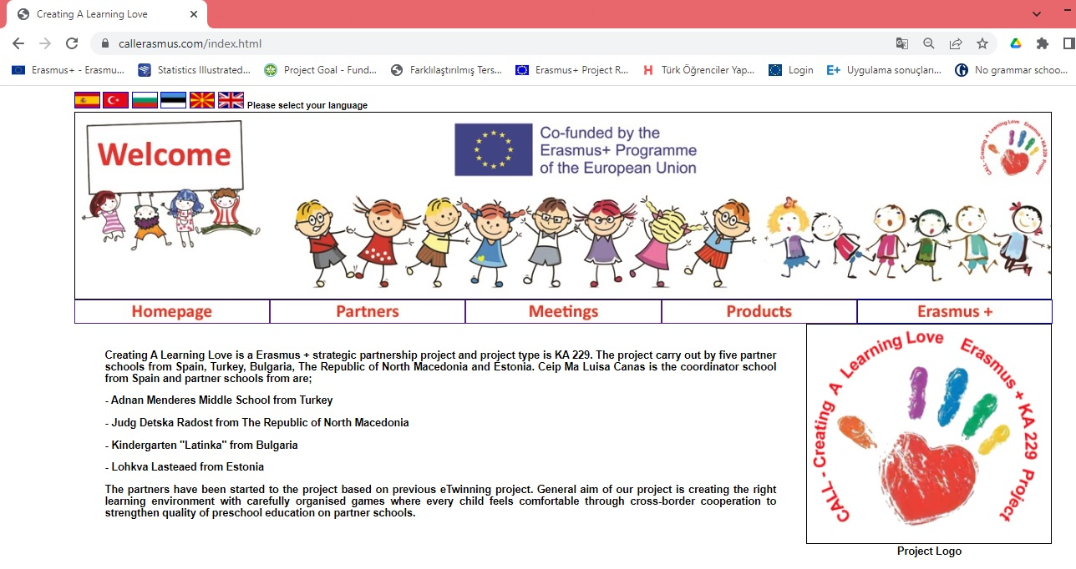
www.callerasmus.com
10

