Slide 1
Erasmus+ KA229 Strategic Partnerships
School Exchange Partnerships
Project :“Creating A Learning Love - CALL“
2019-2021

Slide 2
General Facts
The Education in Bulgaria is compulsory for children between 5 -16 years of age
Two-term school year
Educational levels:
pre-school education
primary school education
secondary school education/
high school education
tertiary education

Slide 3
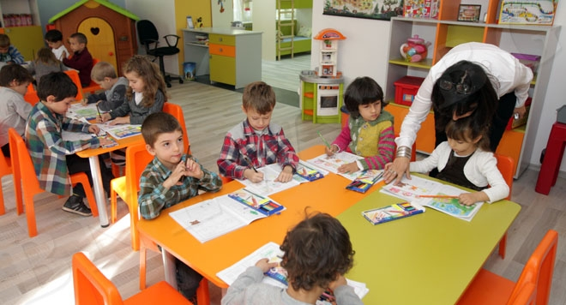
Pre-School Education
3-7-year-old children
95% state-owned
5% privately-owned
Financial expenses for the education are bared by the state

Slide 4
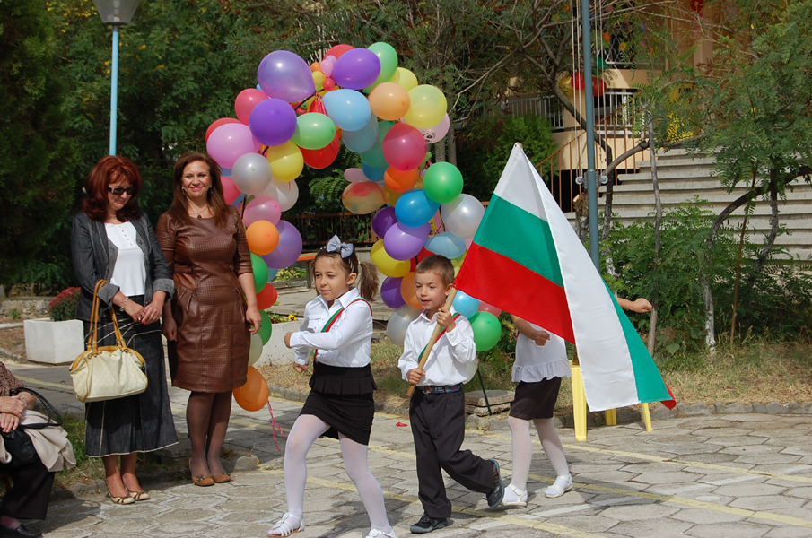
Primary School Education
Includes children from 1st to 8th grade
Basic education certificate after 4th grade
Primary school level certificate after 8th grade

Slide 5
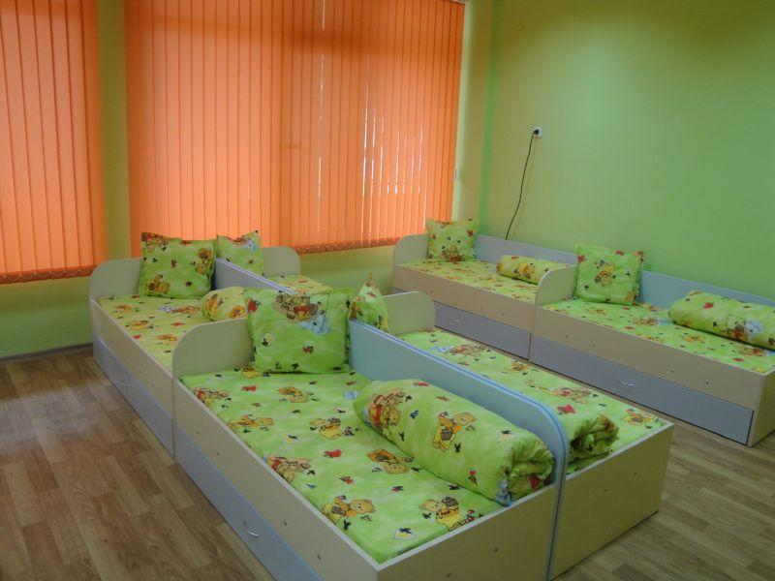
Pre-School Education
Pre-school day from 7:00am to 6:30pm.
Afternoon nap between 1:30pm and 3:30pm.
Obligatory educational sessions:
2/3 sessions until noon
and 1/2 in the afternoon.

Slide 6
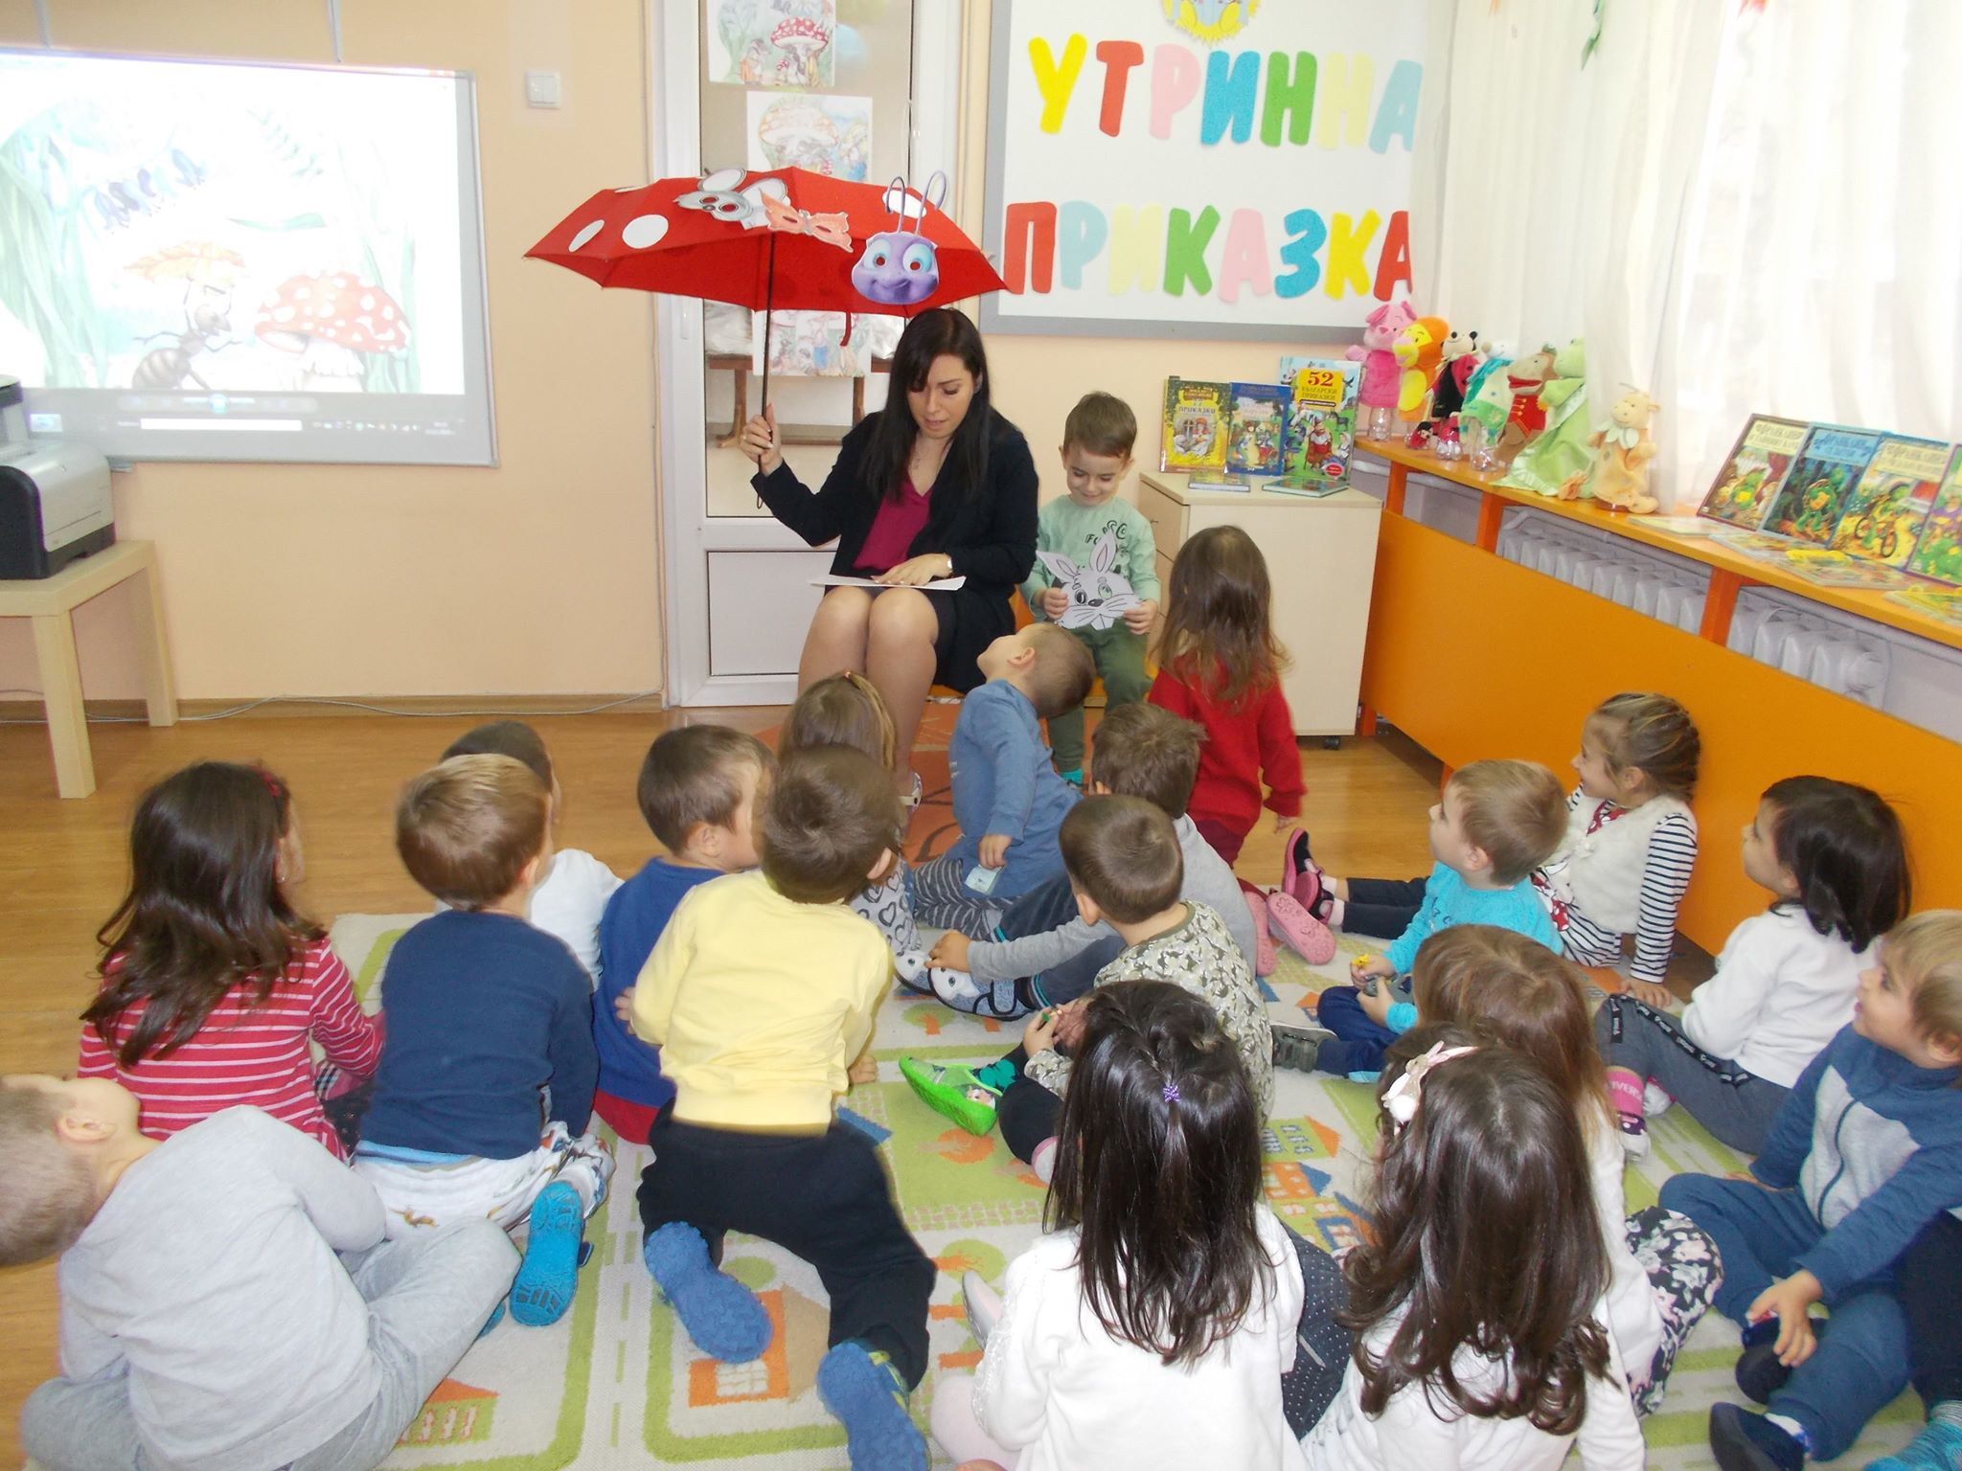
Pre-School Education
four age groups
3-4 year olds
4-5 year olds
5-6 year olds
6-7 year olds

Slide 7
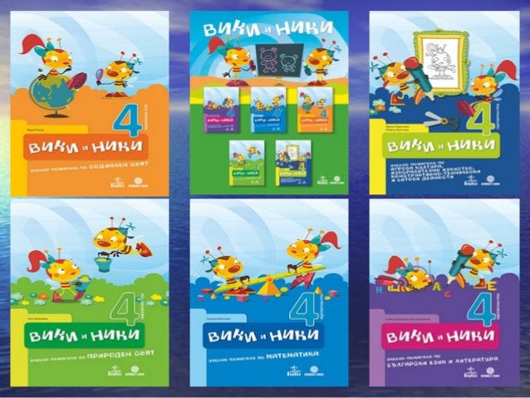
Children use educational books
Mathematics
Bulgarian language and literature
The world around me
Design and technology
Music
Physical education
Drawing

Slide 8
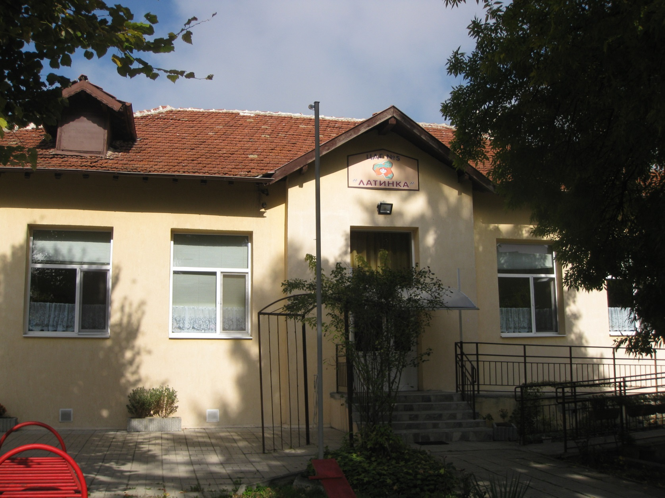
KINDERGARTEN “LATINKA” SHUMEN, BULGARIA

Slide 9
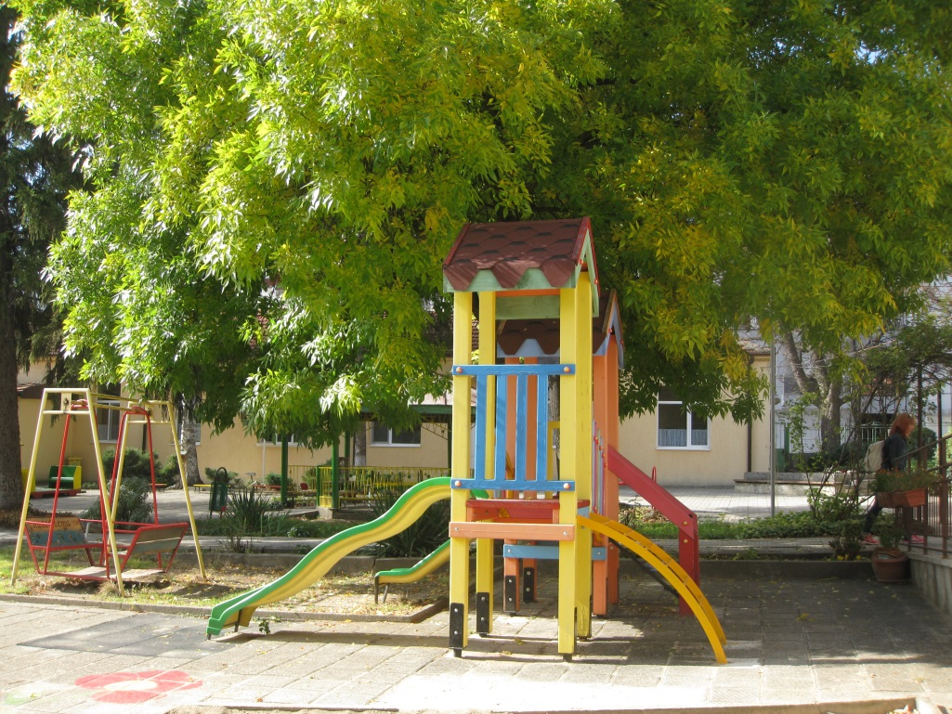
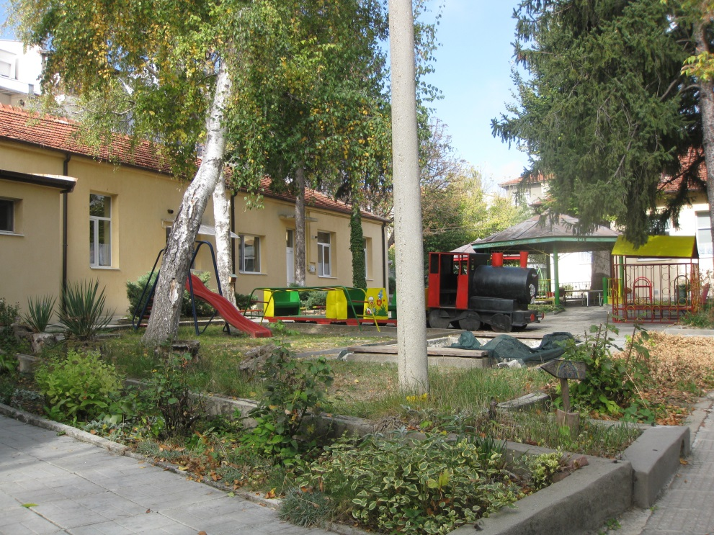
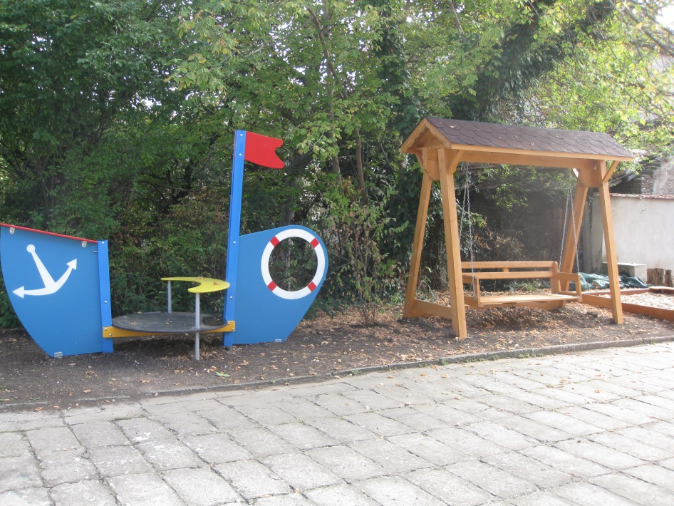
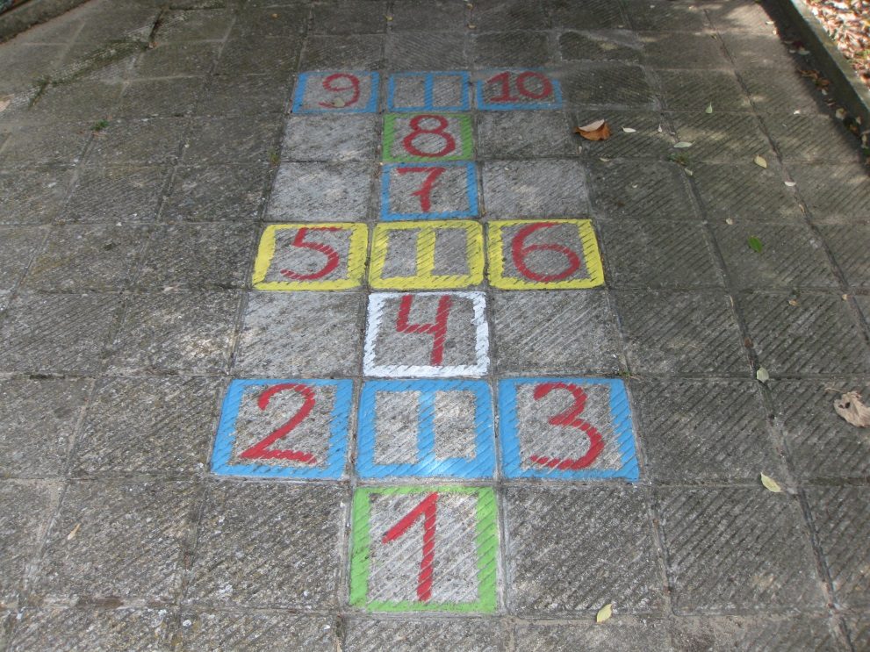
The kindergarten yard

Slide 10
WE ARE THE FLOWERS OF “LATINKA”

Slide 11
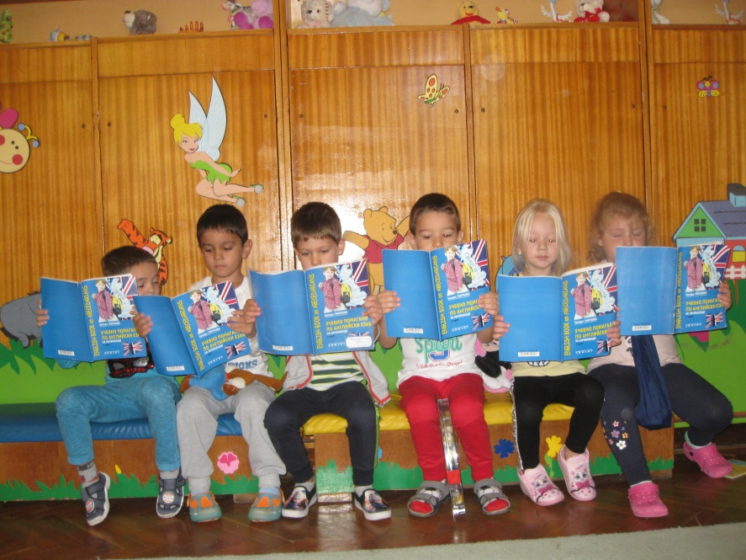
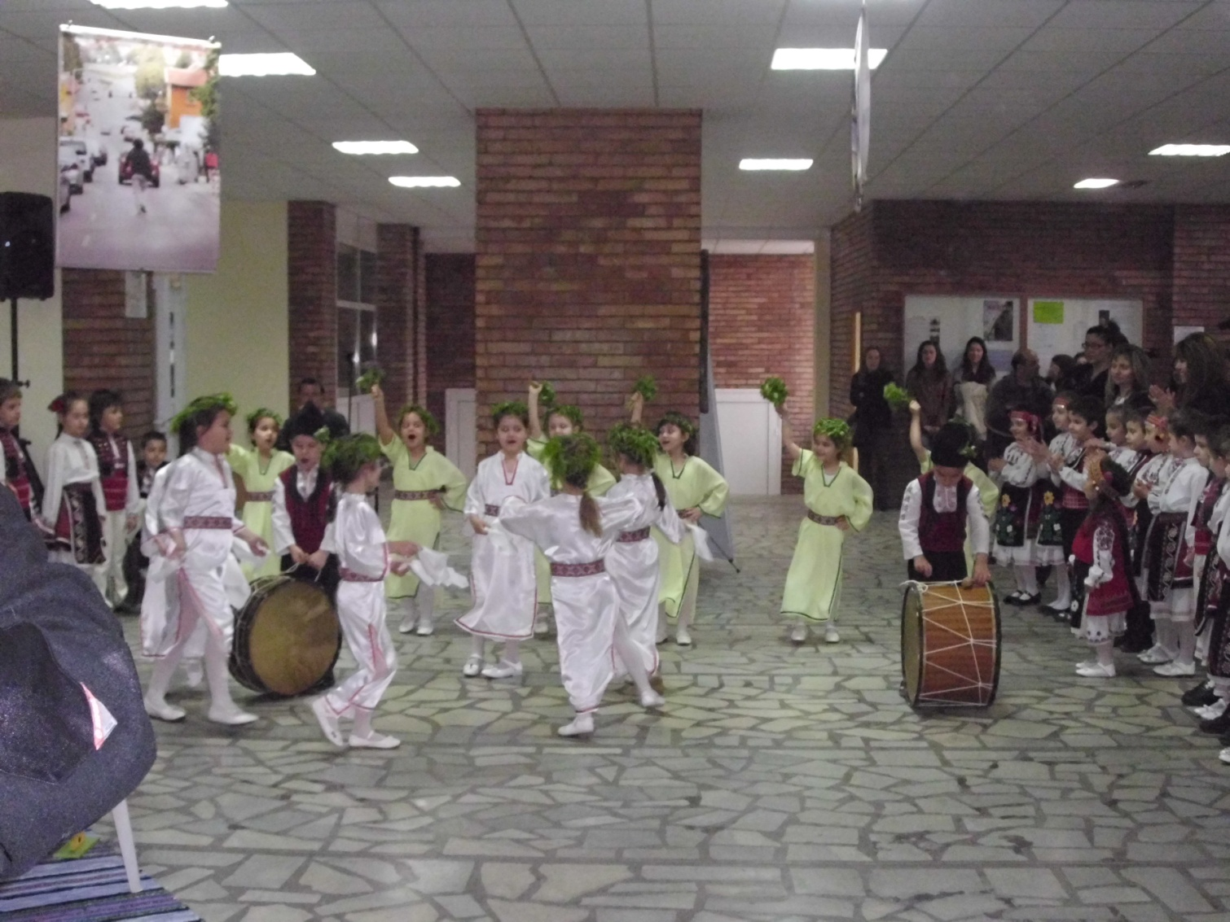
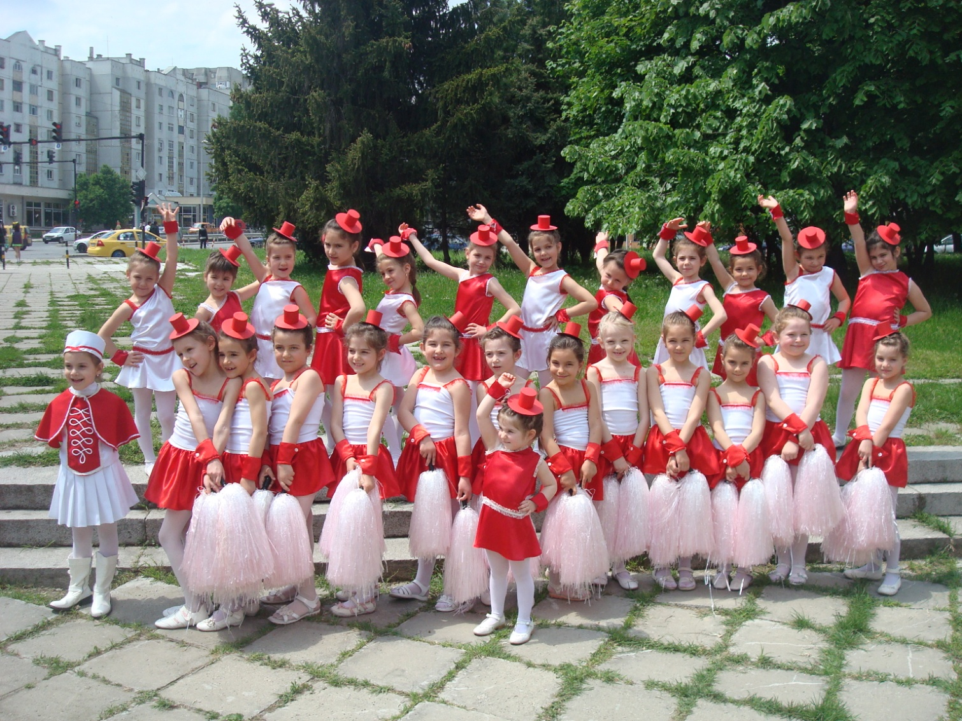
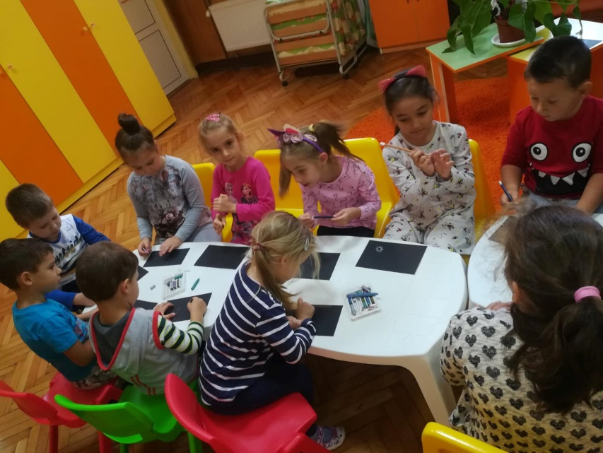
There are additional activities
in accordance with the wishes of the children and parents
English
Folk dances
Cheerleaders
Art studio

Slide 12
We love and keep save our nature
Ecology

Slide 13
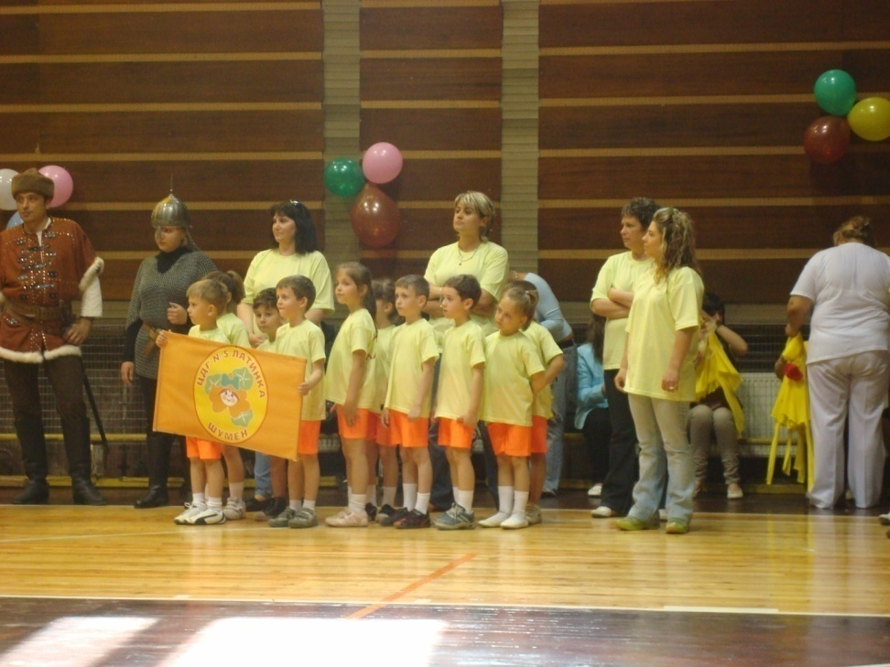
Fast, brave, skillful!
Sport

Slide 14
Holidays and entertainment
Fertility Festival
The gifts of autumn

Slide 15
We are actors
Pippi Longstocking dance with us

Slide 16
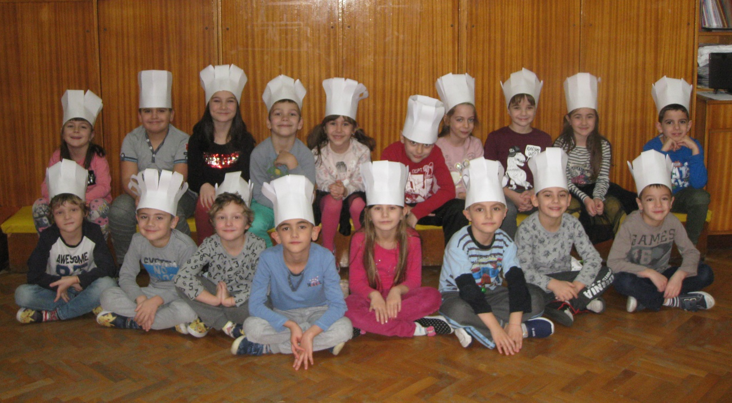
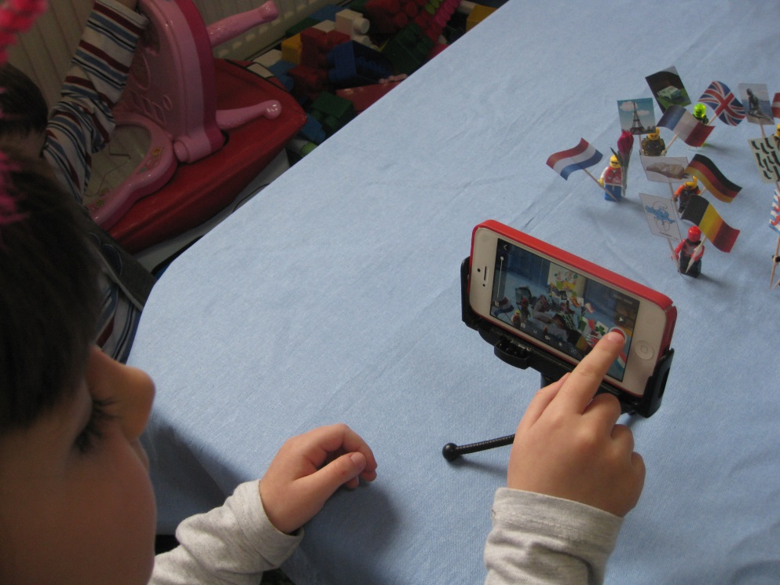
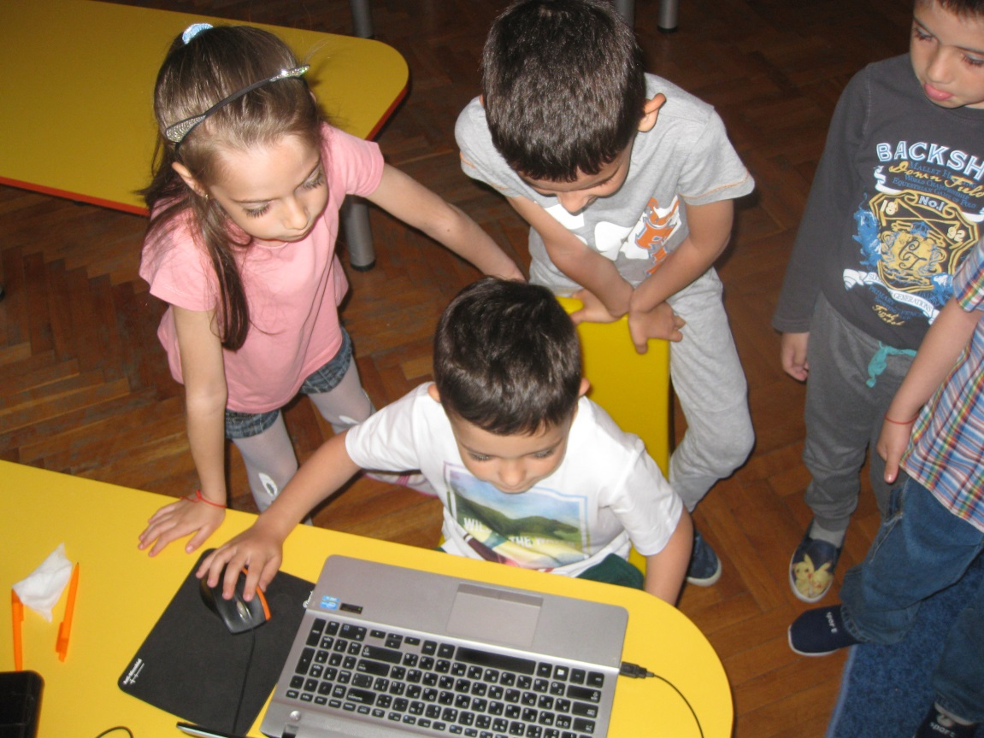
eTwinning projects

Slide 17
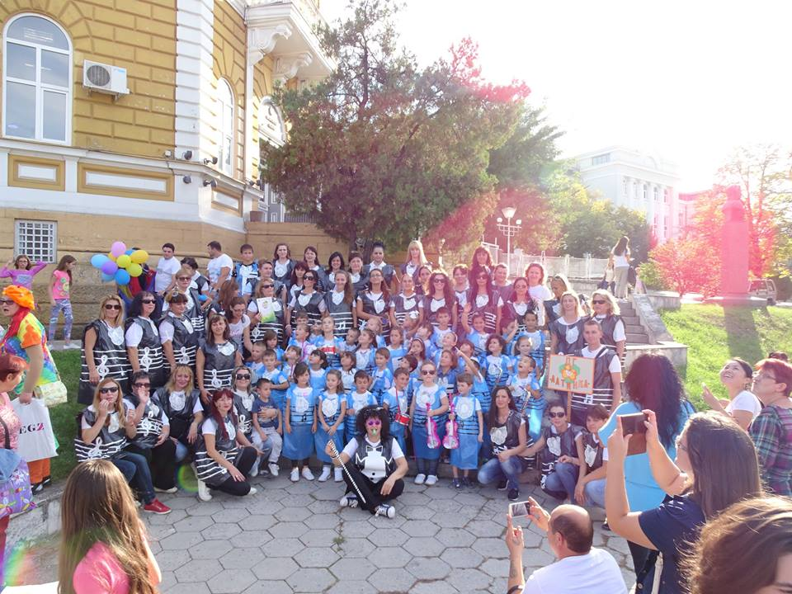
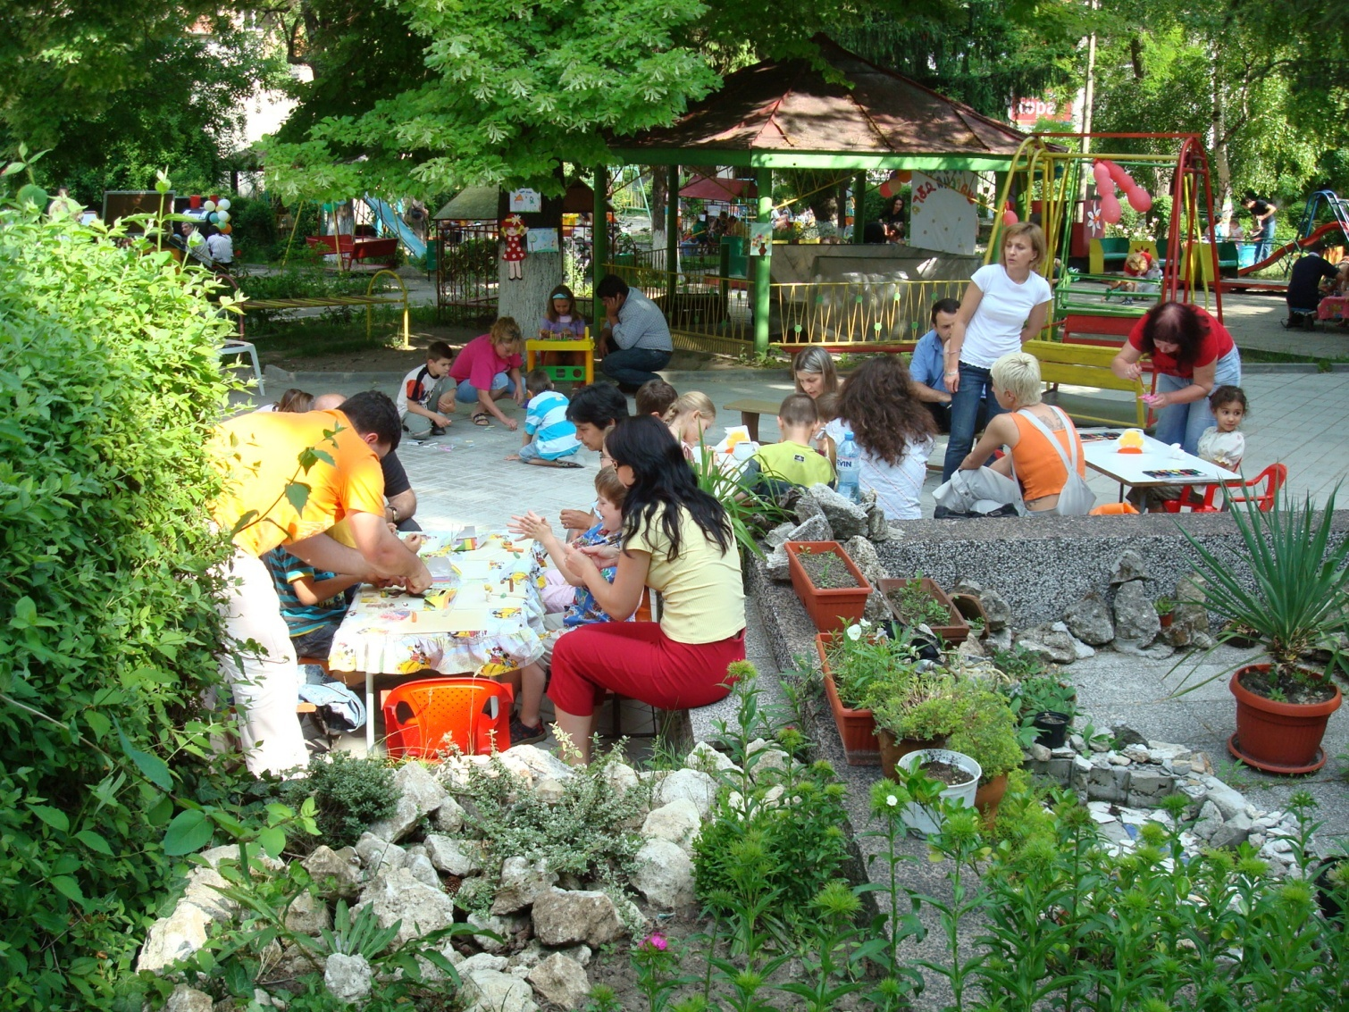
Our parents are partner

Slide 18
Golden autumn creators
International Day of Cooking

Slide 19
The Latinka Kindergarten Team

Slide 20
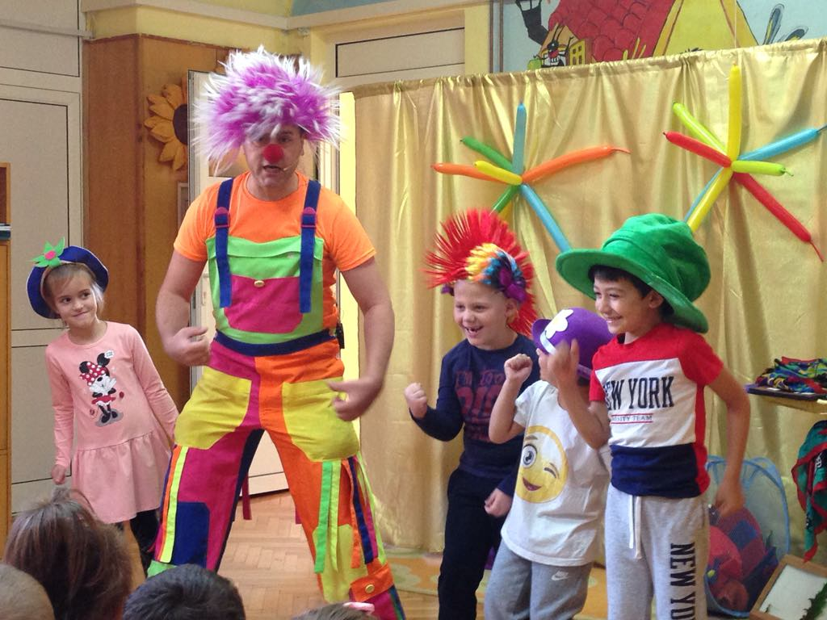
It's always fun with us…

Slide 21
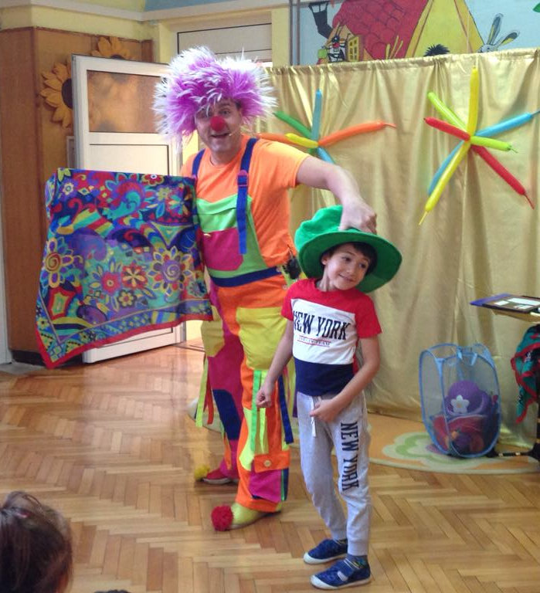
Thank you!

