Slide 1
LOS ALUMNOS DE 5º Y 6º DE ED. PRIMARIA
THE STUDENTS
OF 5th AND 6th
EDUCATION ELEMENTARY

Slide 2
PRESENTAN
PRESENT

Slide 3
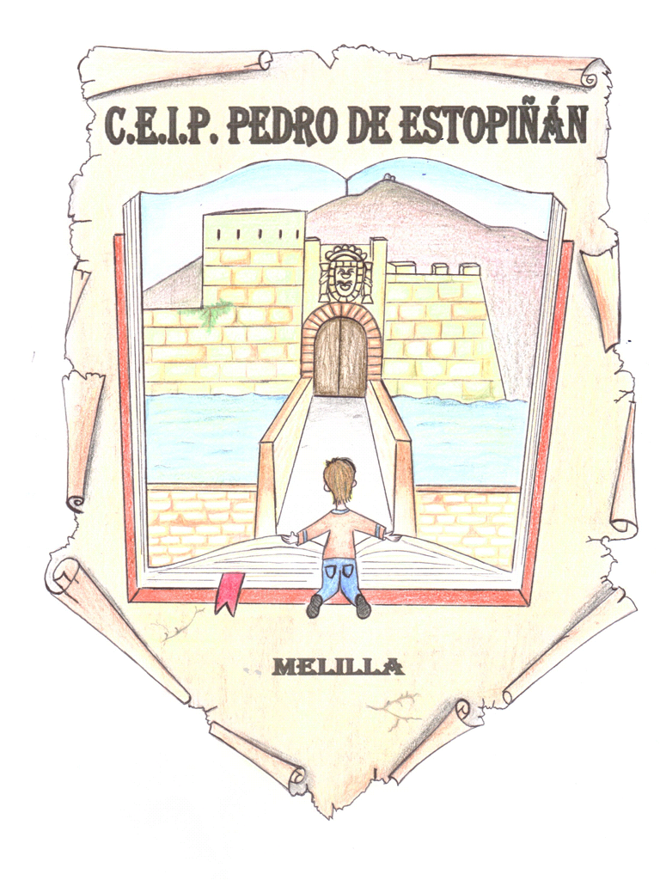
C.E.I.P. PEDRO DE ESTOPIÑÁN
MELILLA (Spain)

Slide 4
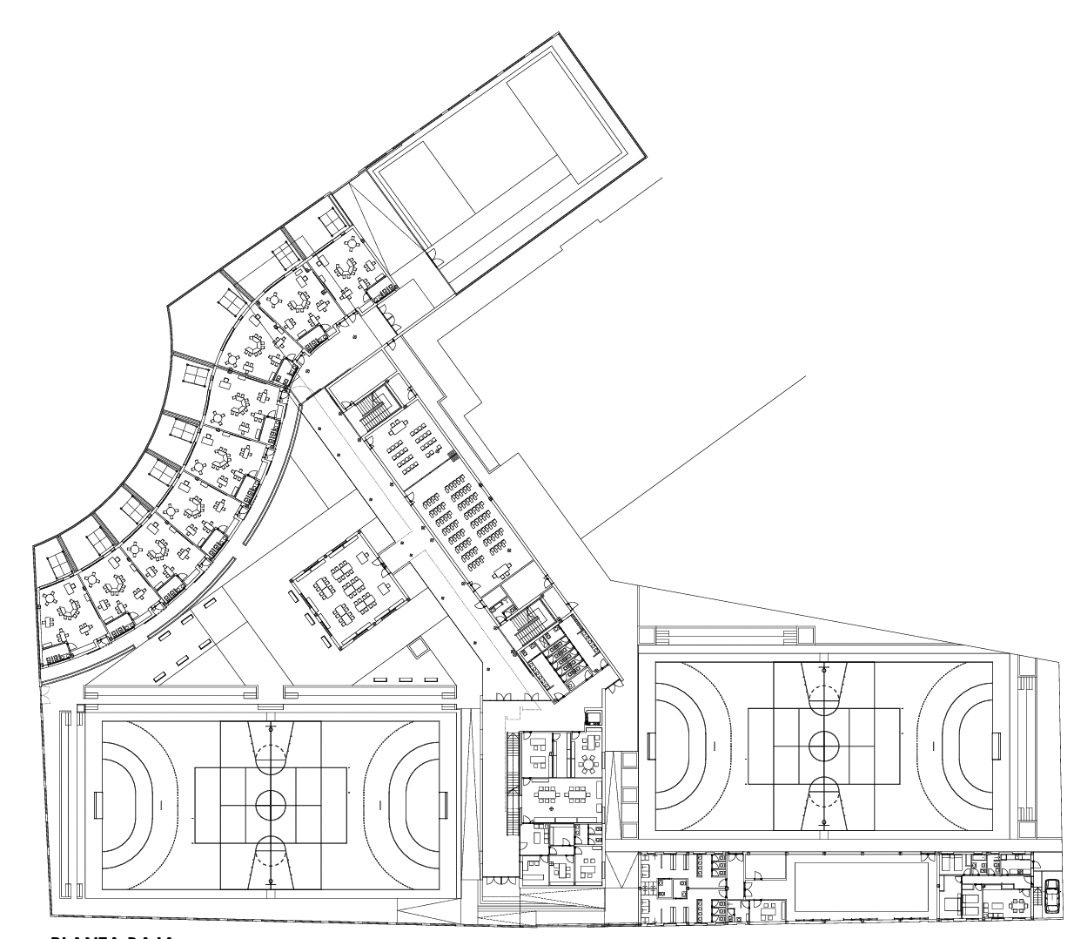
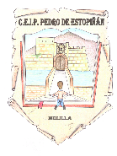
C.E.I.P. PEDRO DE ESTOPIÑÁN
CLICK ON ANY NUMBER TO SEE DIFFERENT PARTS OF THE SCHOOL
ON ANY SLIDE, CLICK ON "BACK TO THE PLANE" TO RETURN HERE
3
11
VIDEO DE PRESENTACIÓN DE MAESTRAS/O Y ALUMNOS
4
7
9
8
6
2
10
5
1

Slide 5
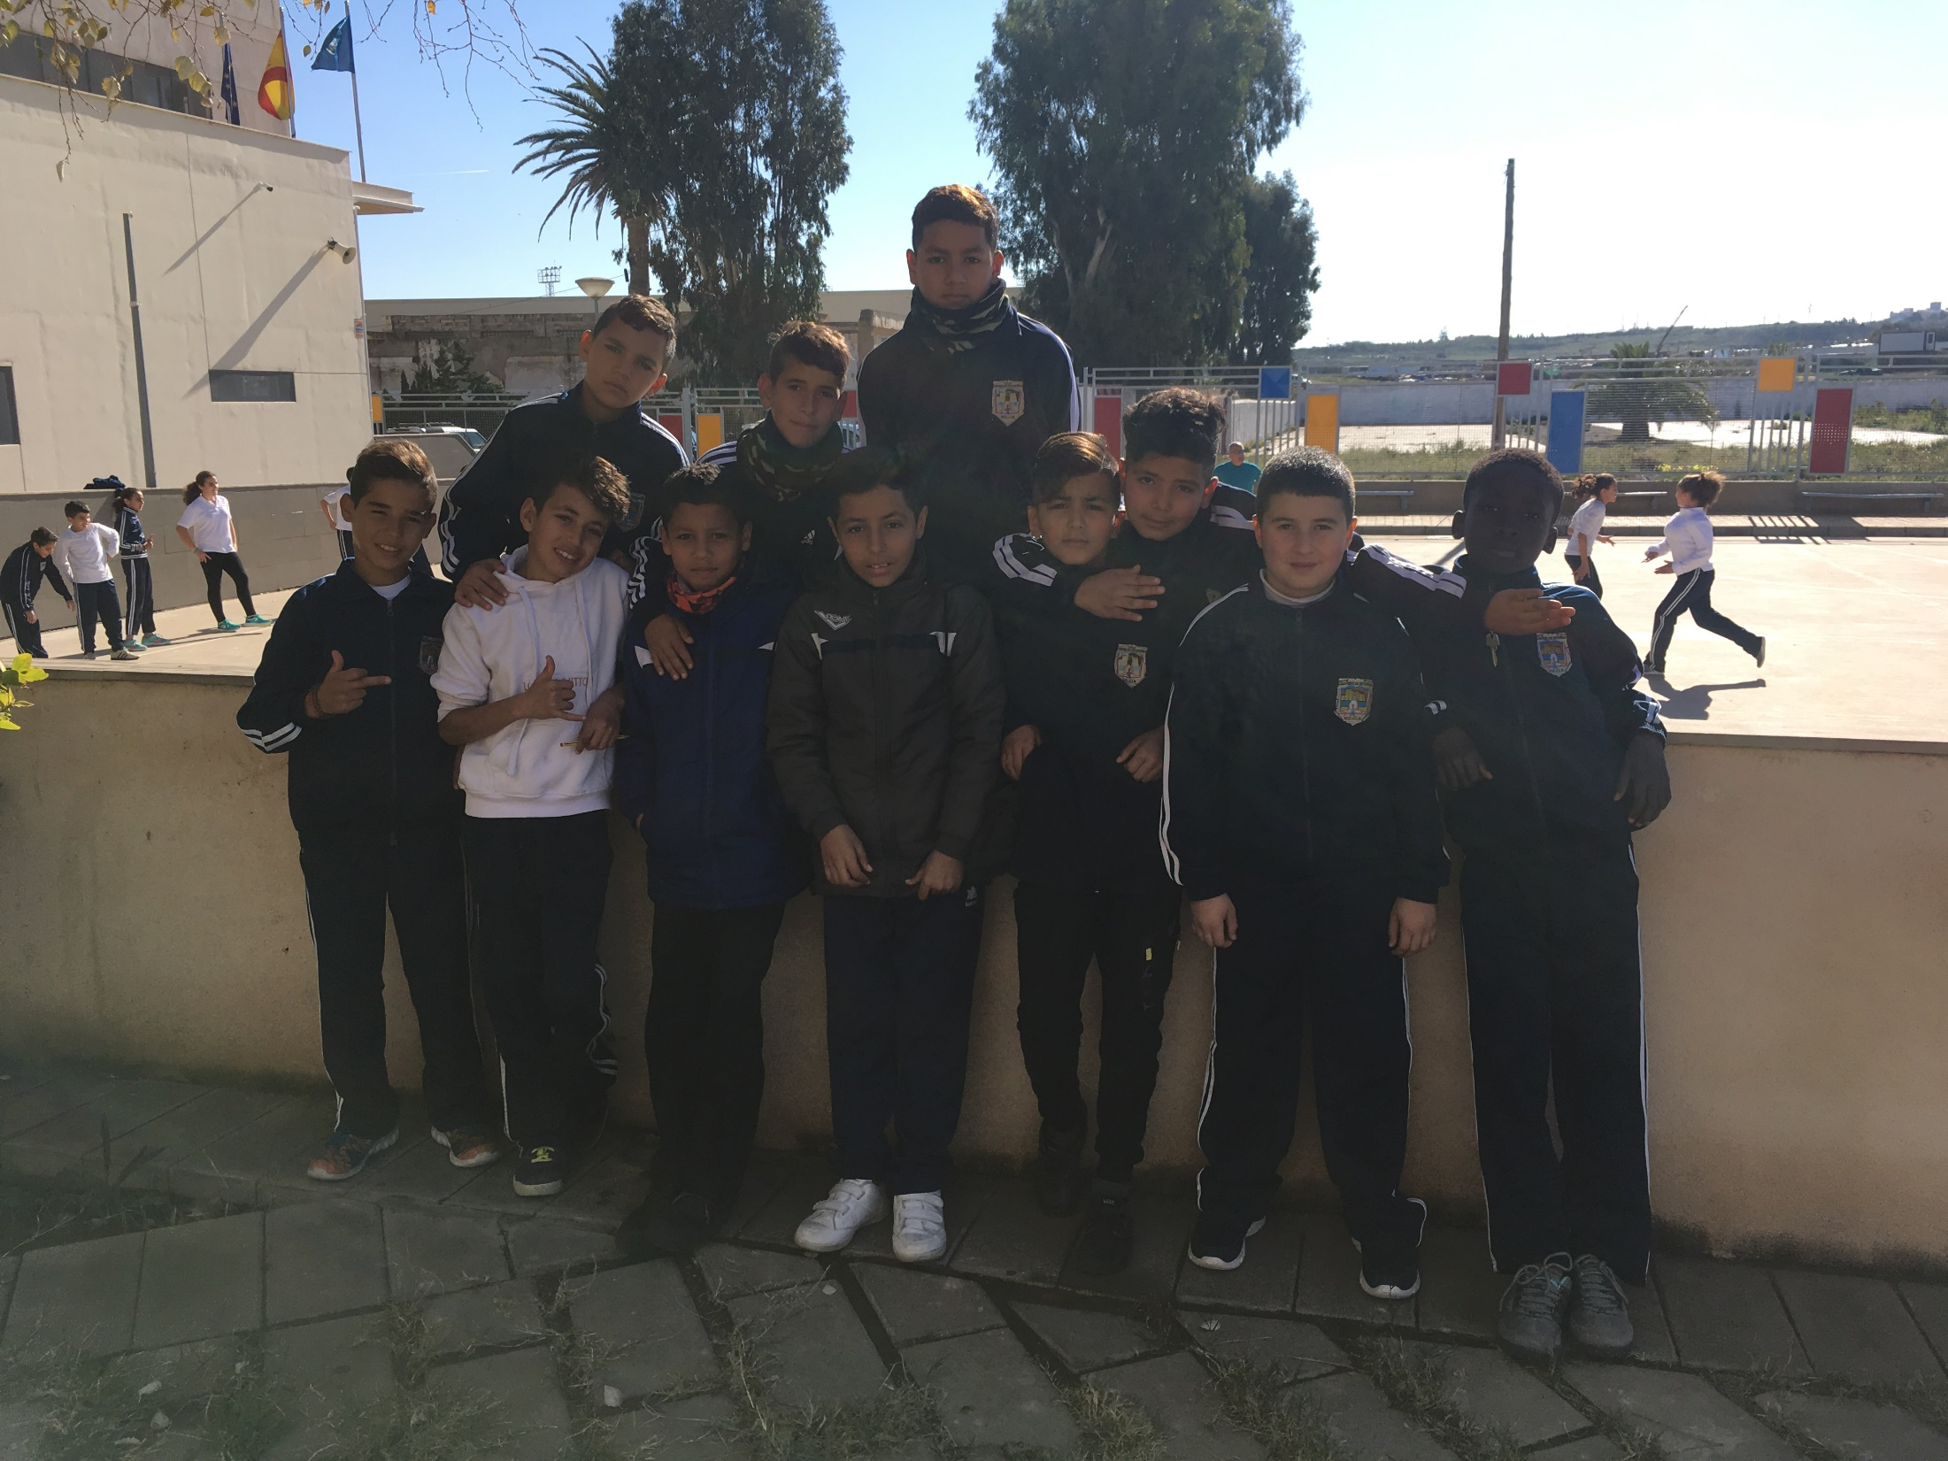
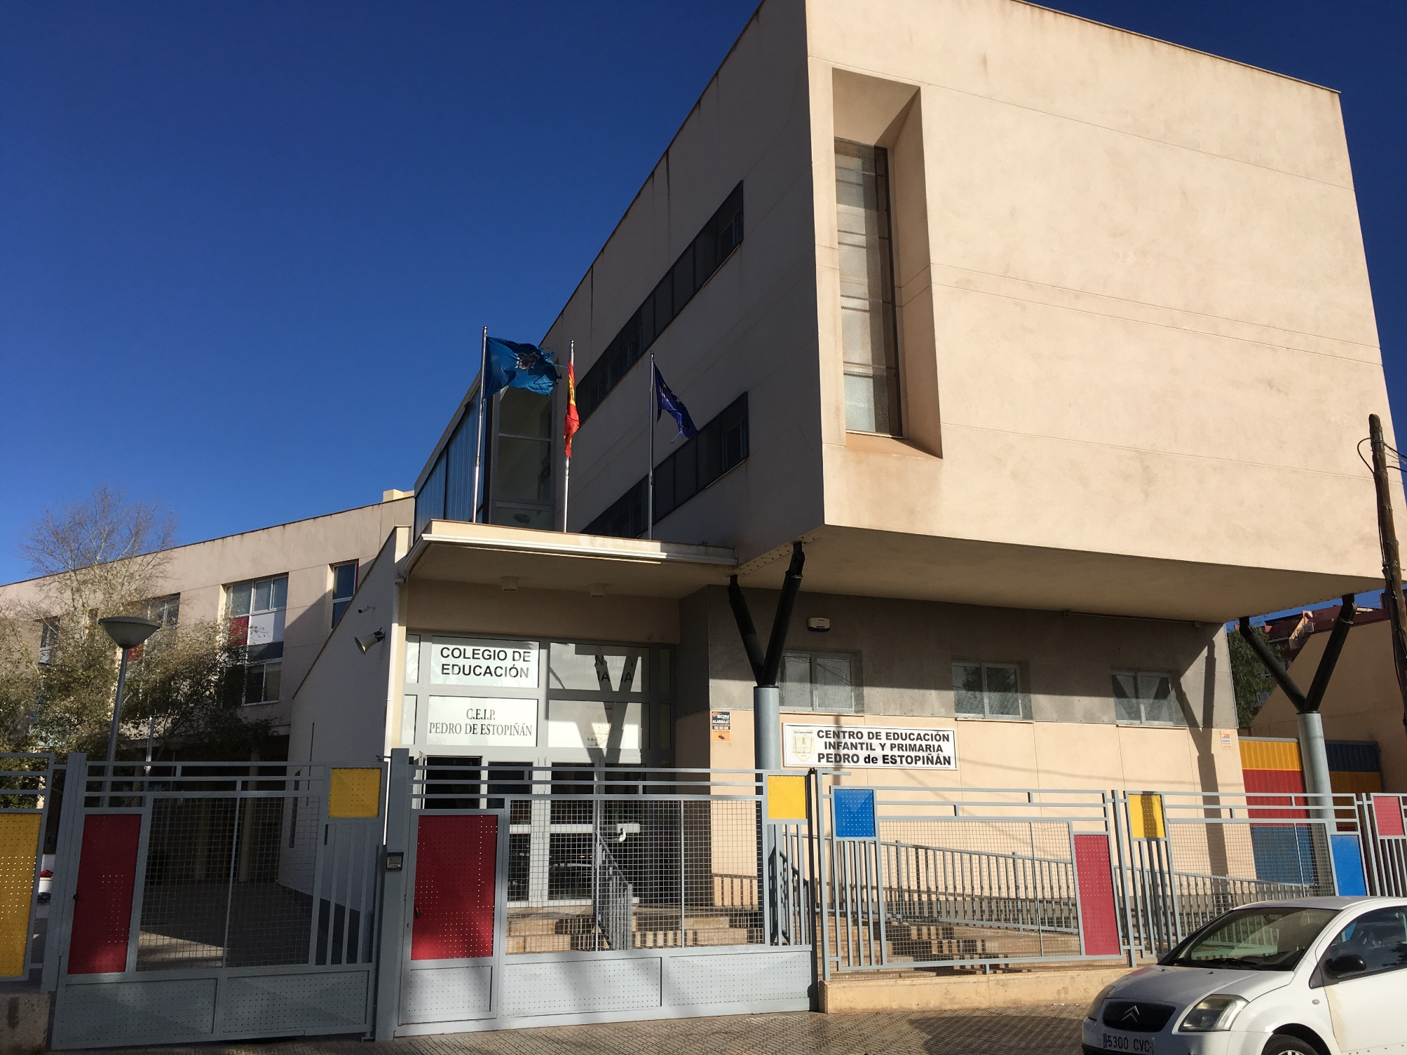
BACK TO THE PLANE

Slide 6
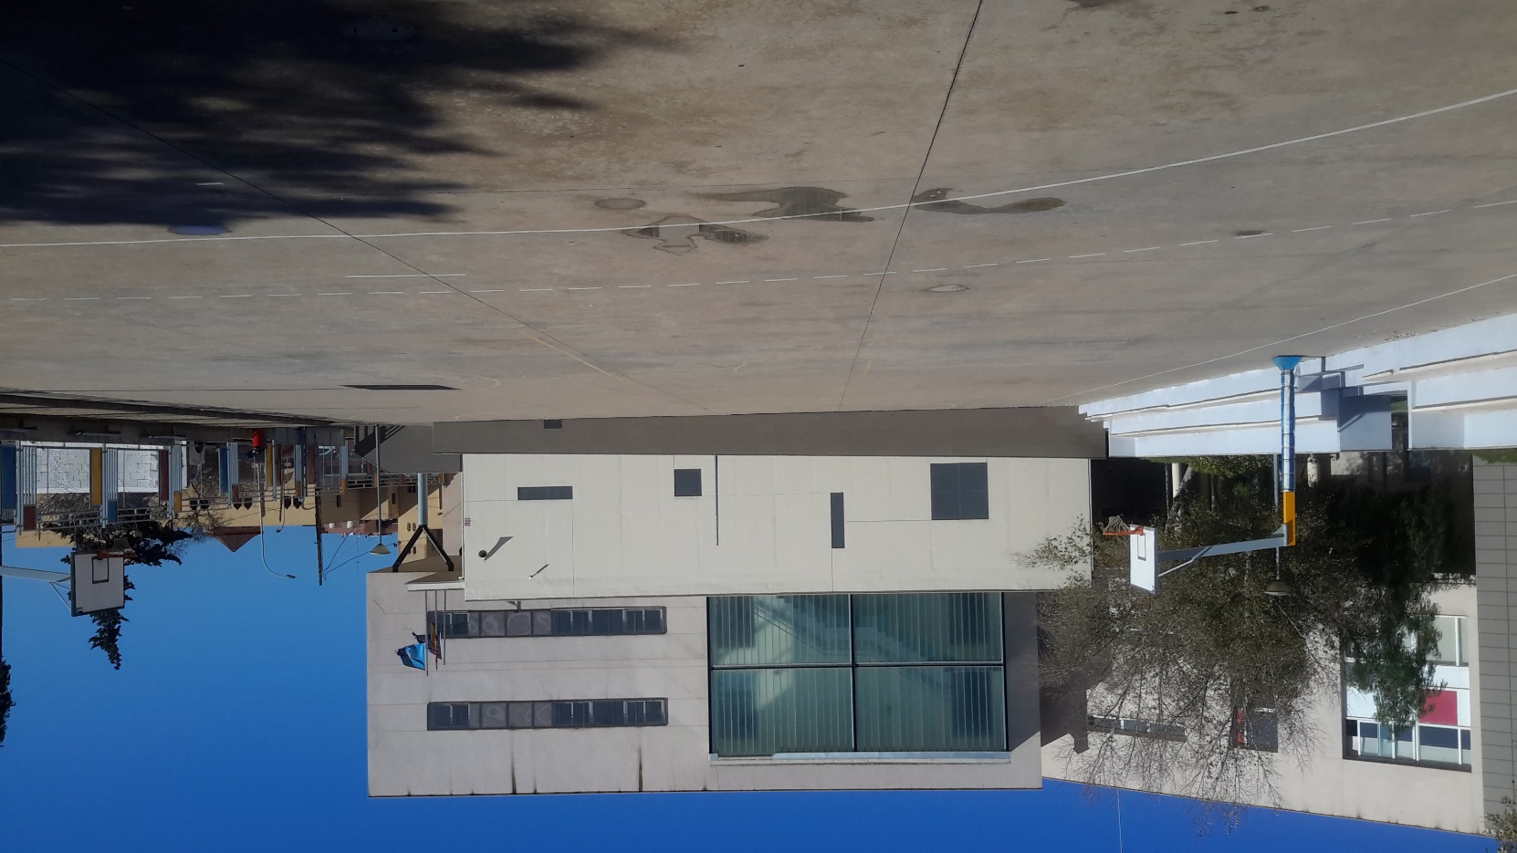
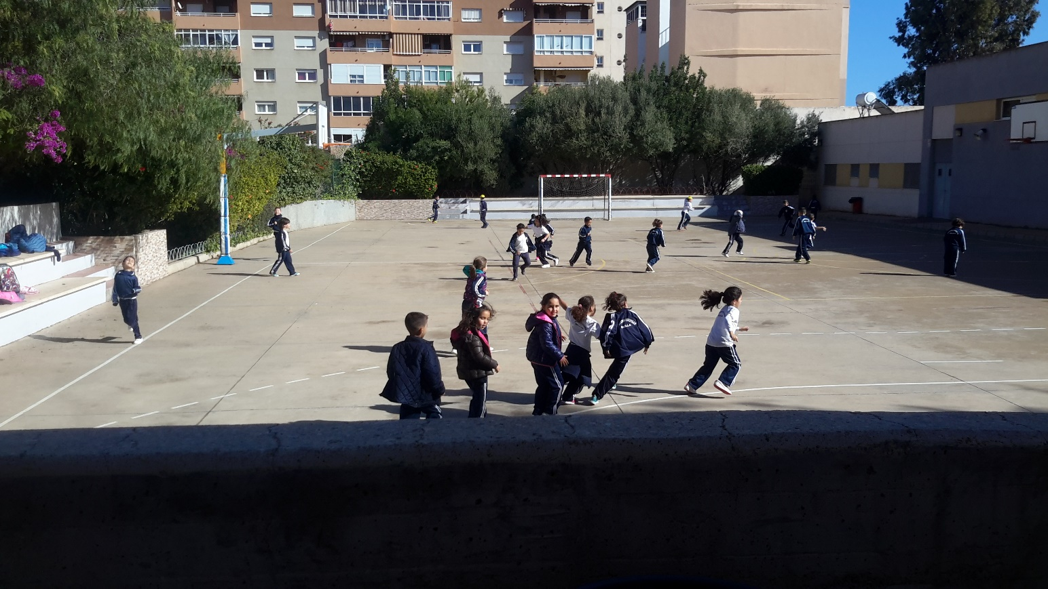
RECREATIONAL AND SPORTS PATIO
BACK TO THE PLANE

Slide 7
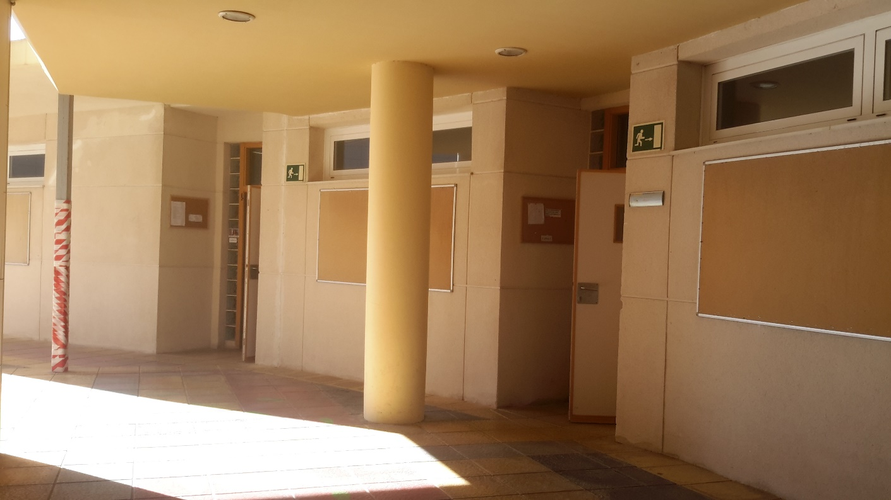
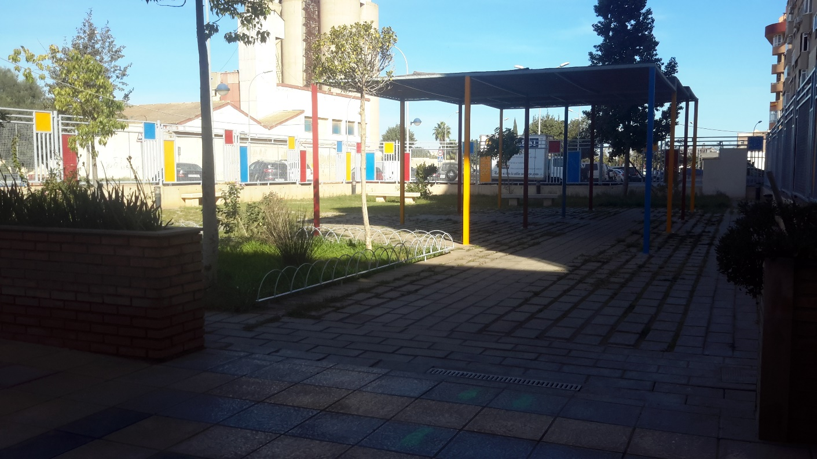
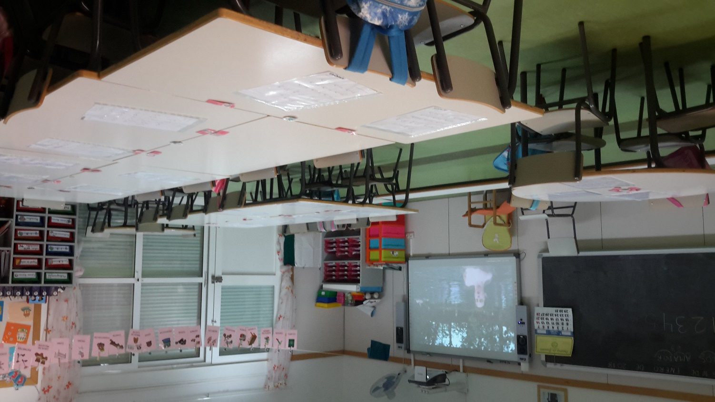
CHILDREN’S EDUCATION CLASSROOMS
BACK TO THE PLANE

Slide 8
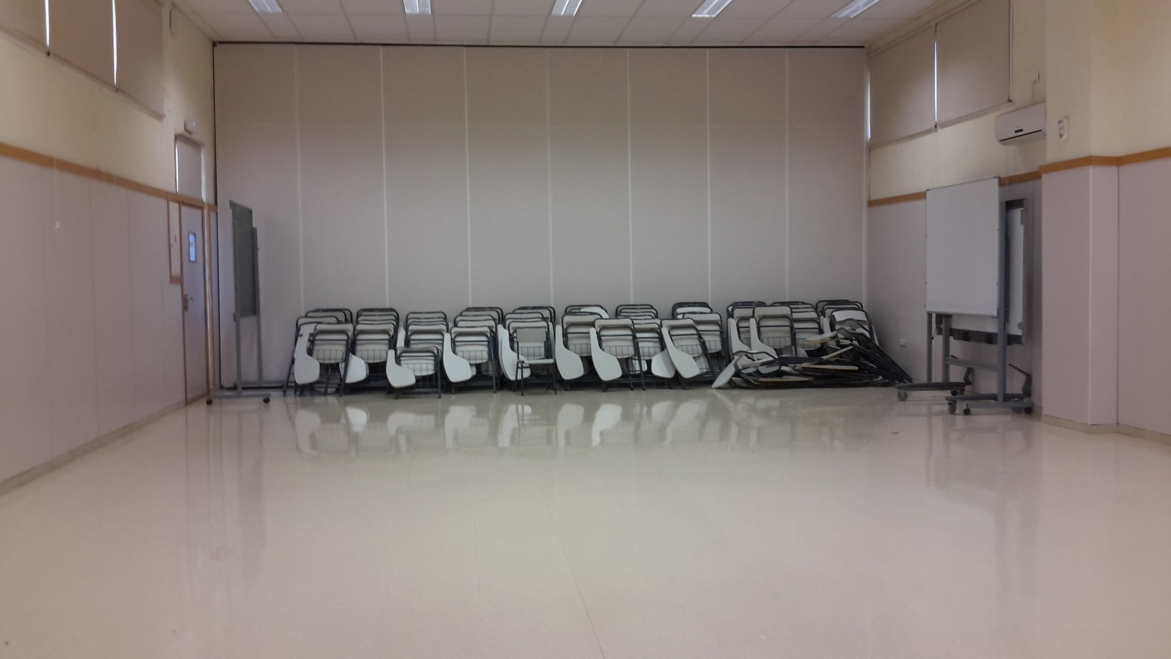
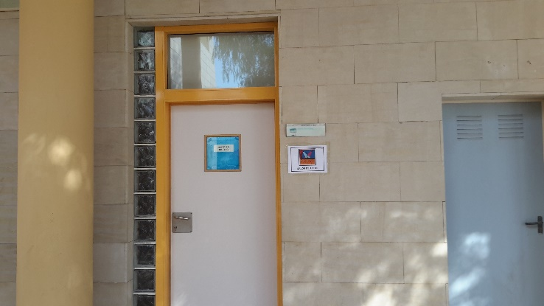
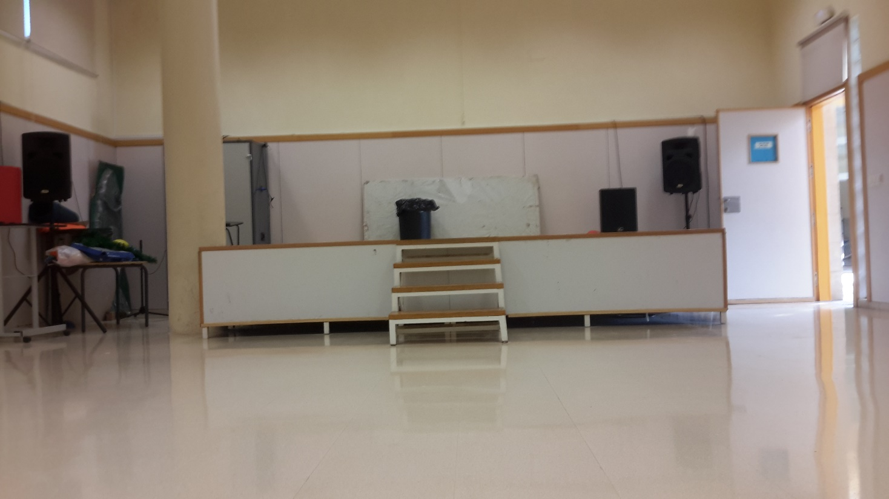
MULTIFUNCTIONAL ROOM
BACK TO THE PLANE

Slide 9
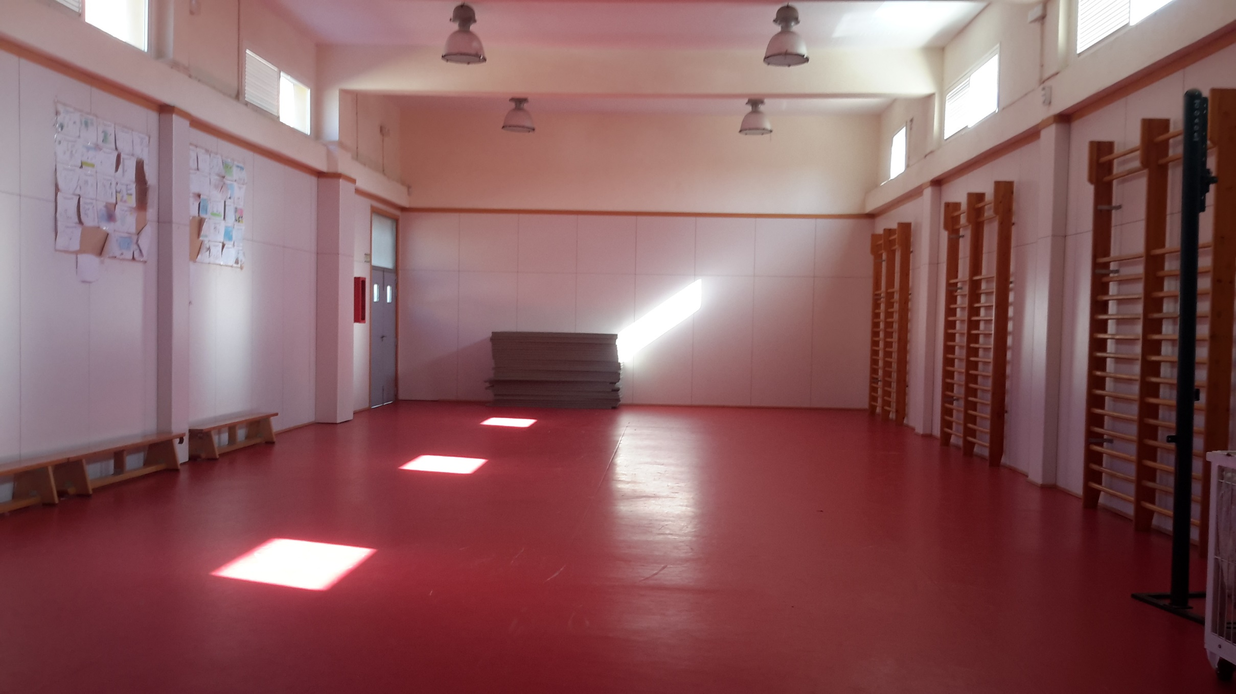
FITNESS CENTER
BACK TO THE PLANE

Slide 10
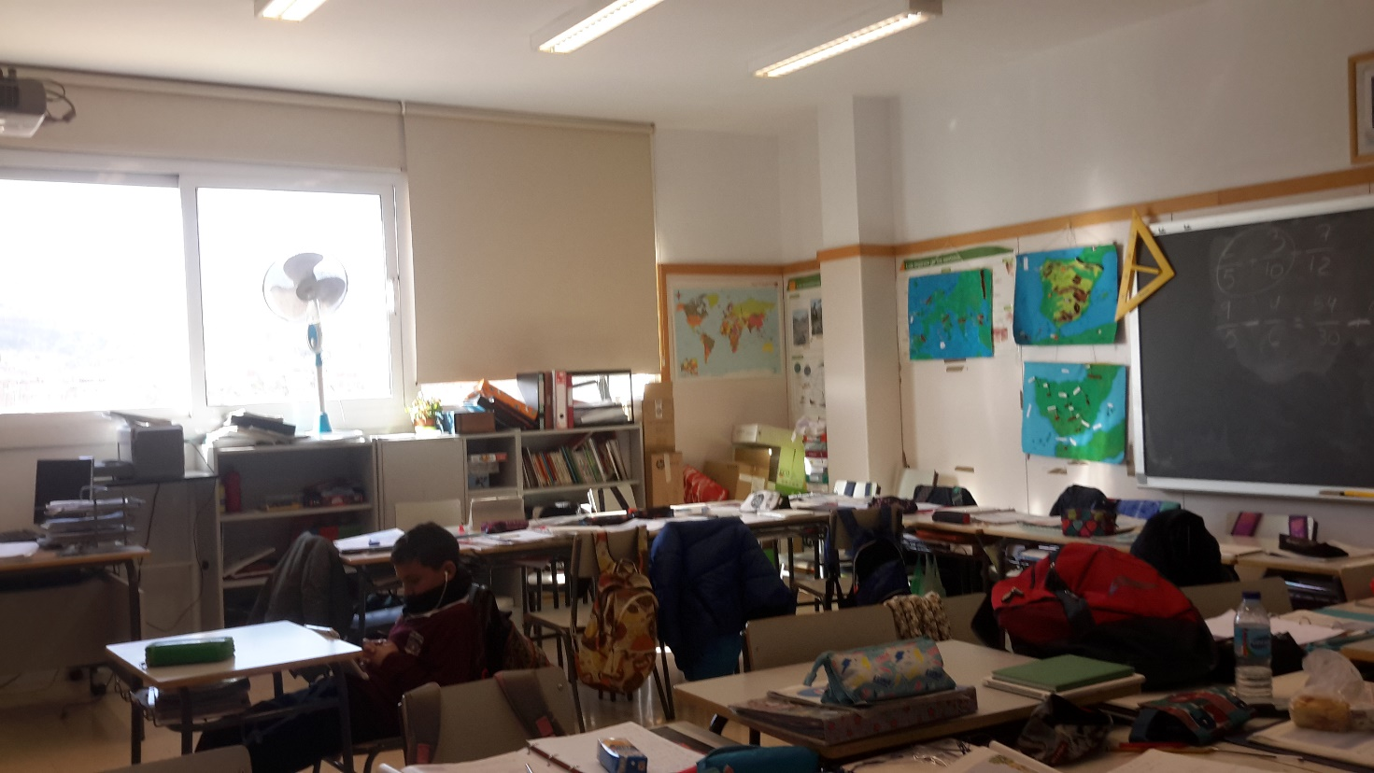
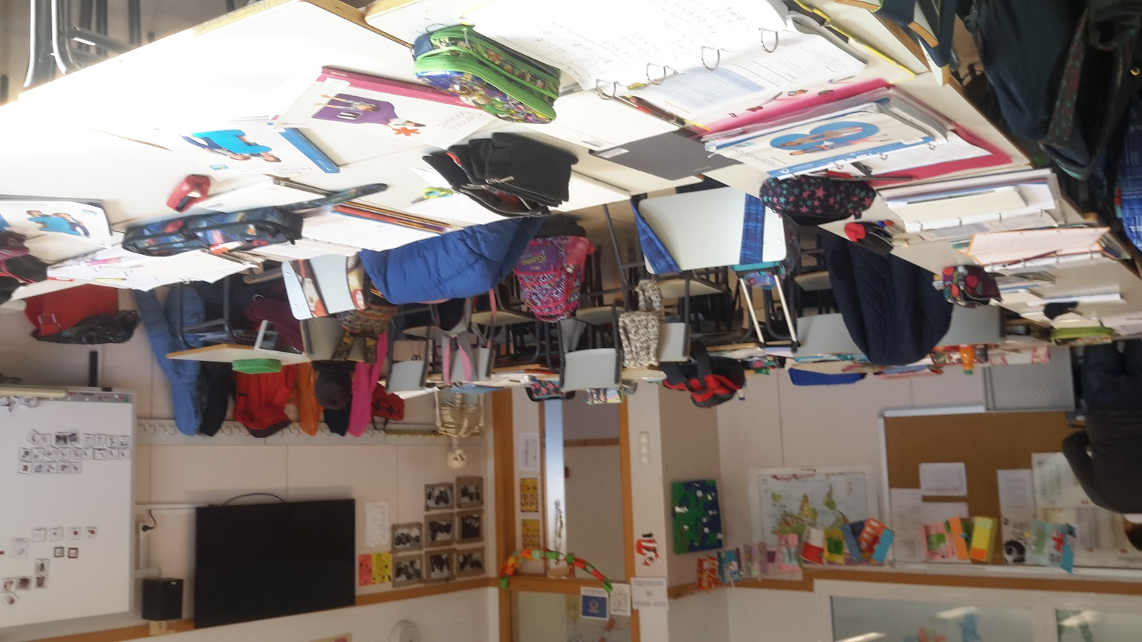
PRIMARY EDUCATION CLASSROOMS
BACK TO THE PLANE

Slide 11
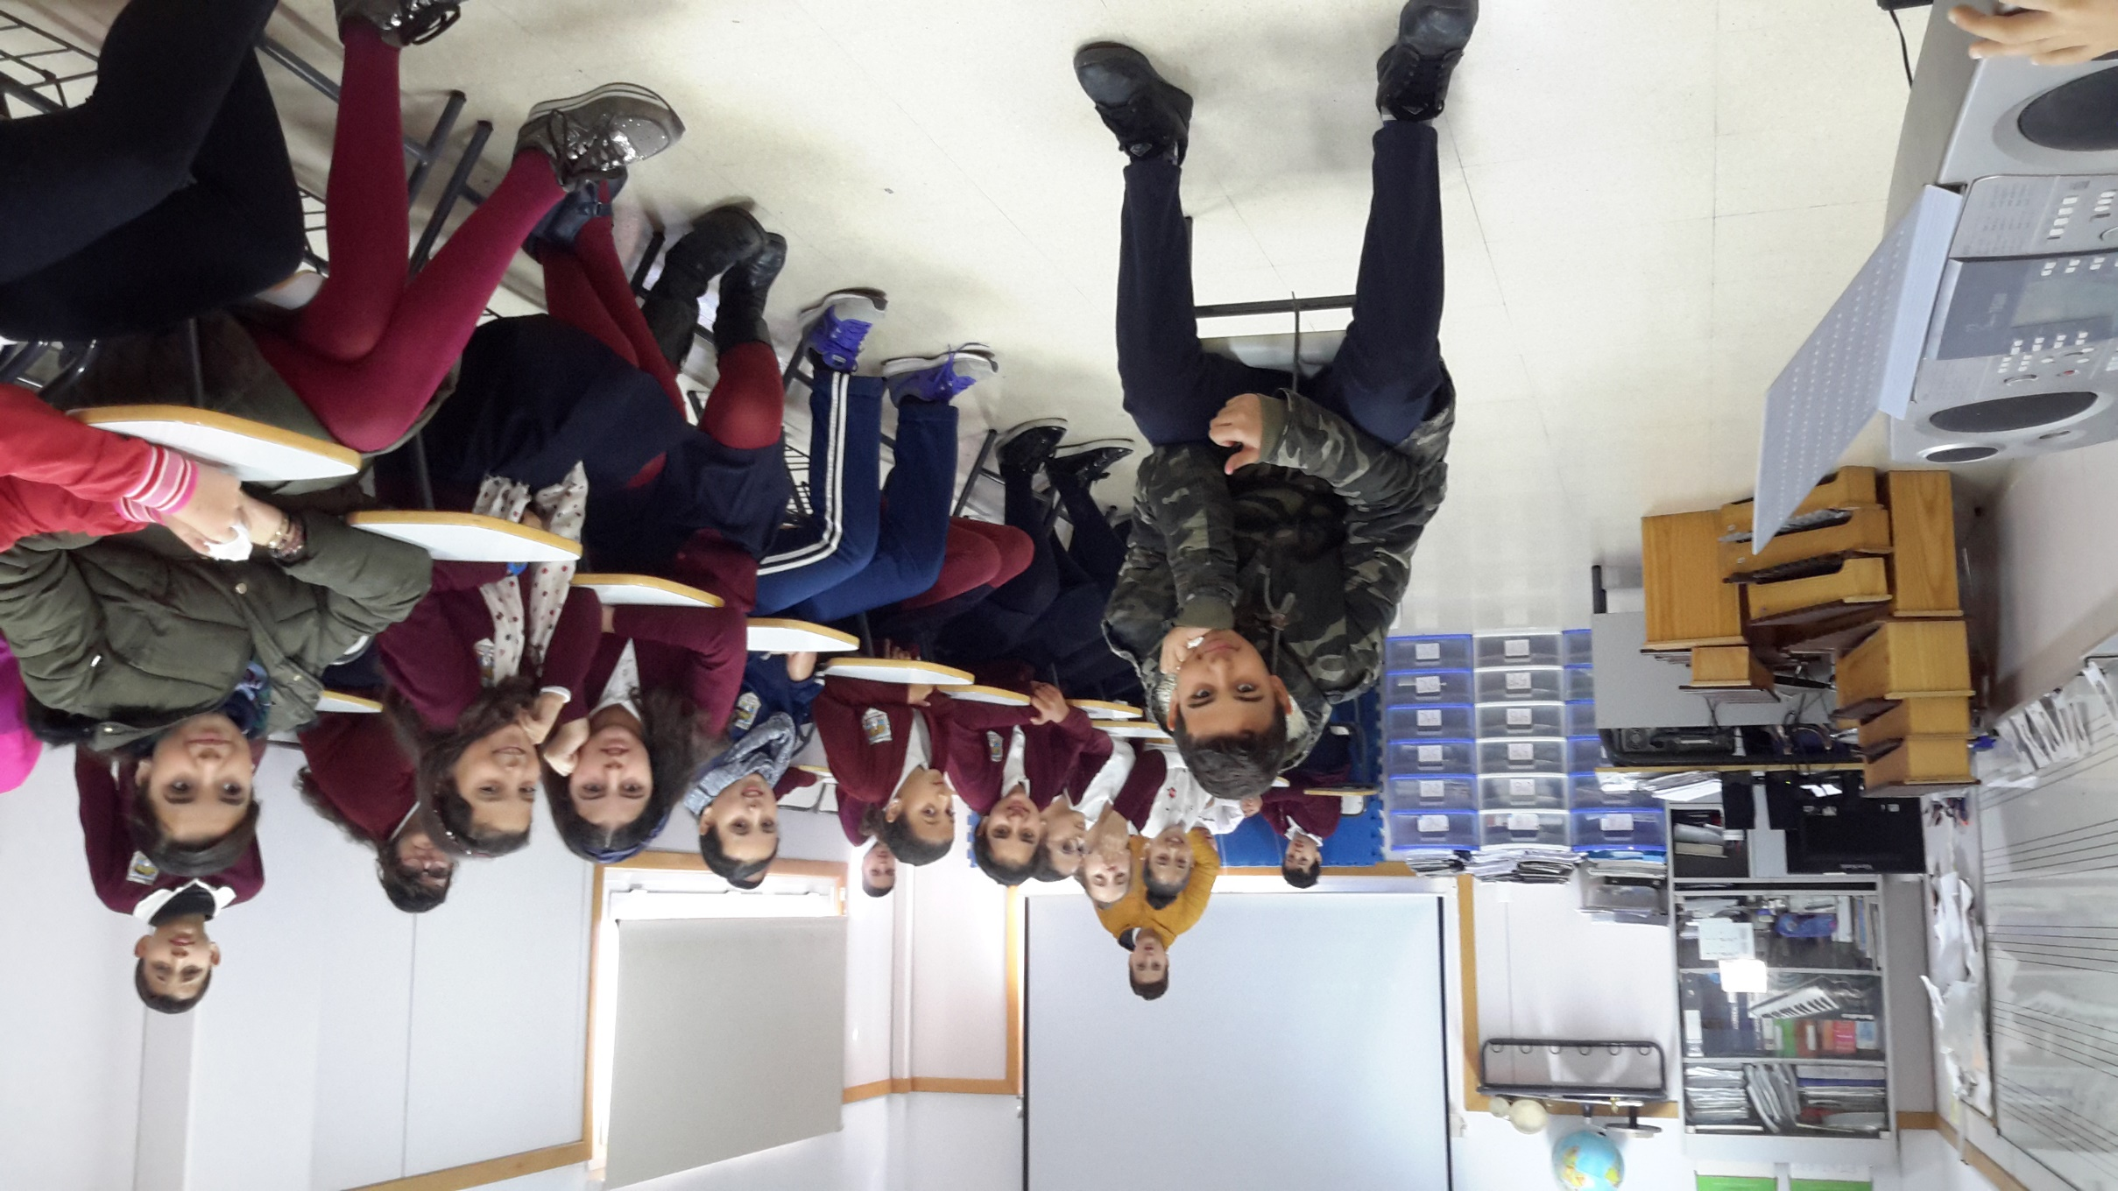
MUSIC ROOM
BACK TO THE PLANE

Slide 12
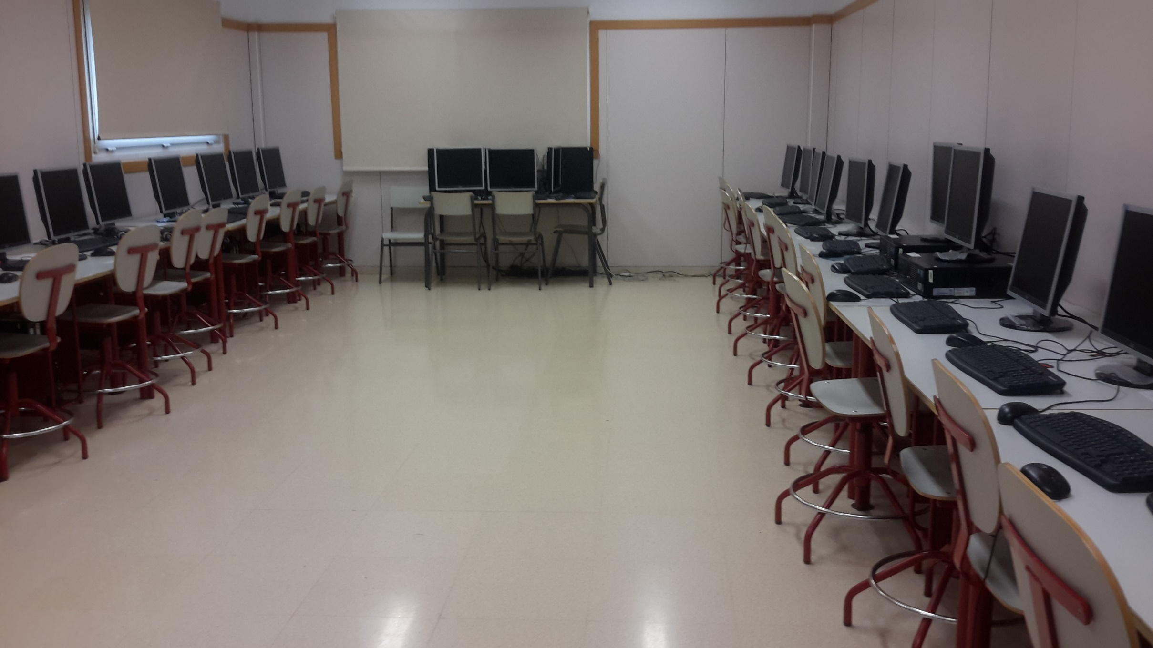
COMPUTER CLASSROOM
BACK TO THE PLANE

Slide 13
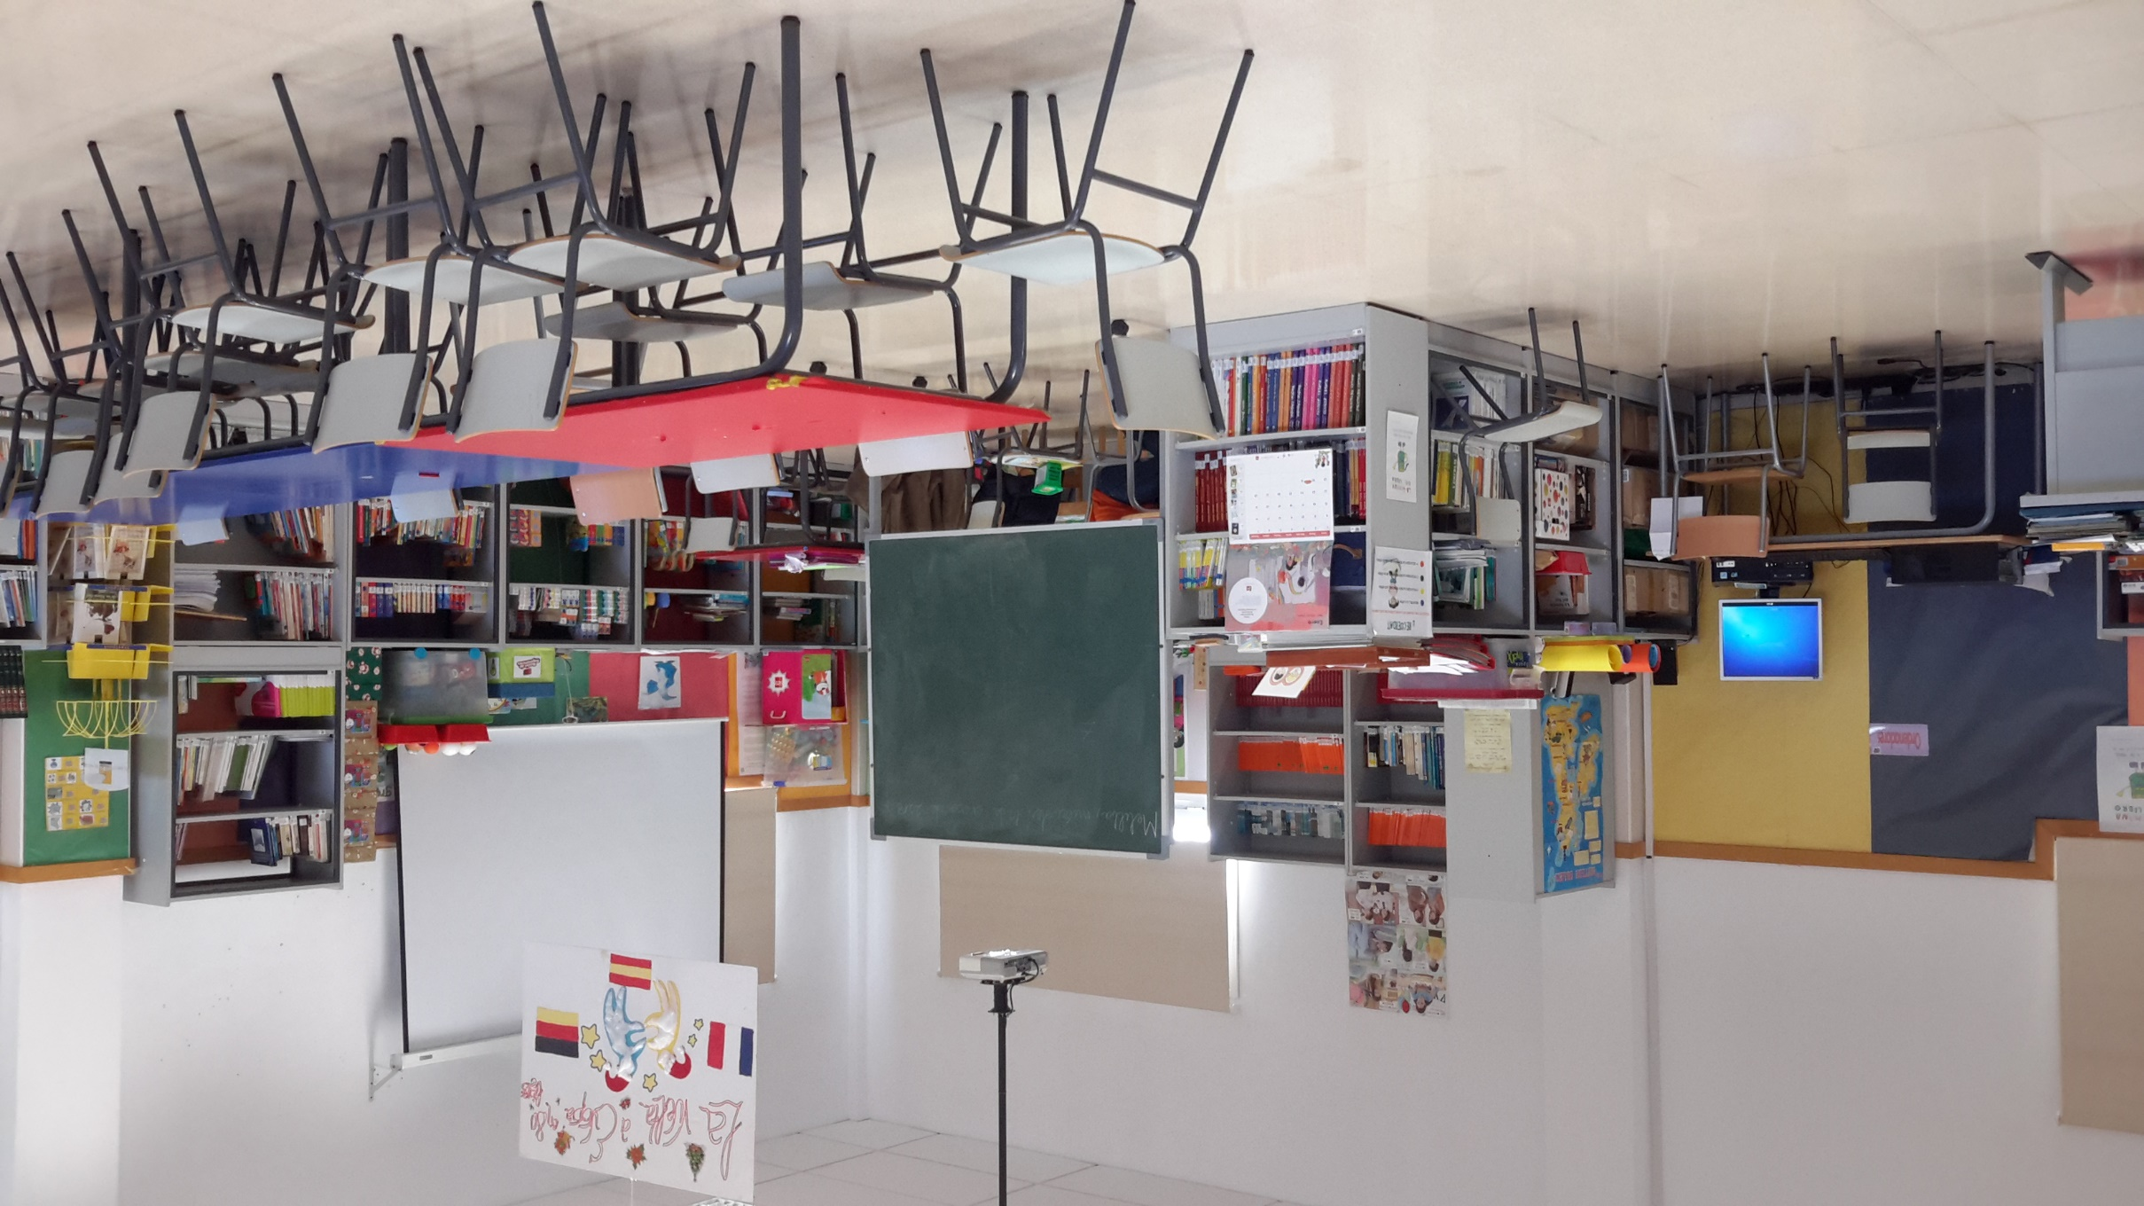
LIBRARY
BACK TO THE PLANE

Slide 14
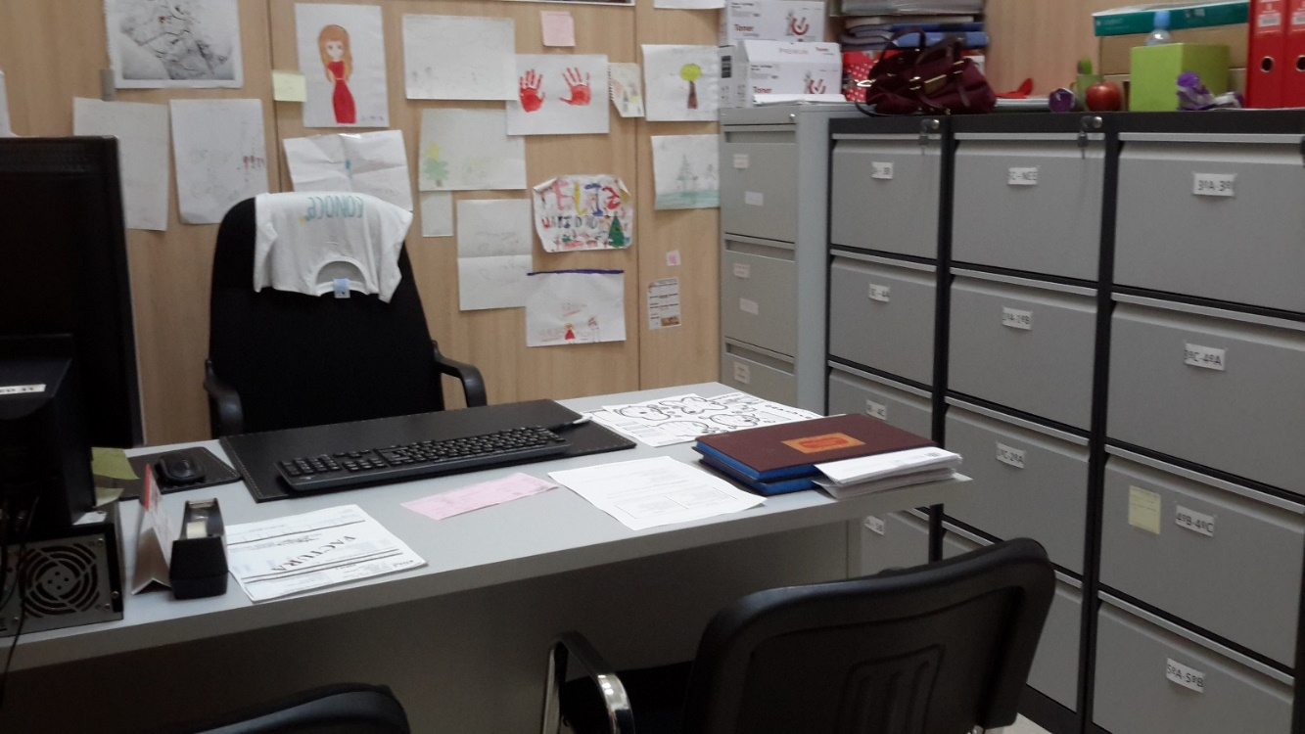
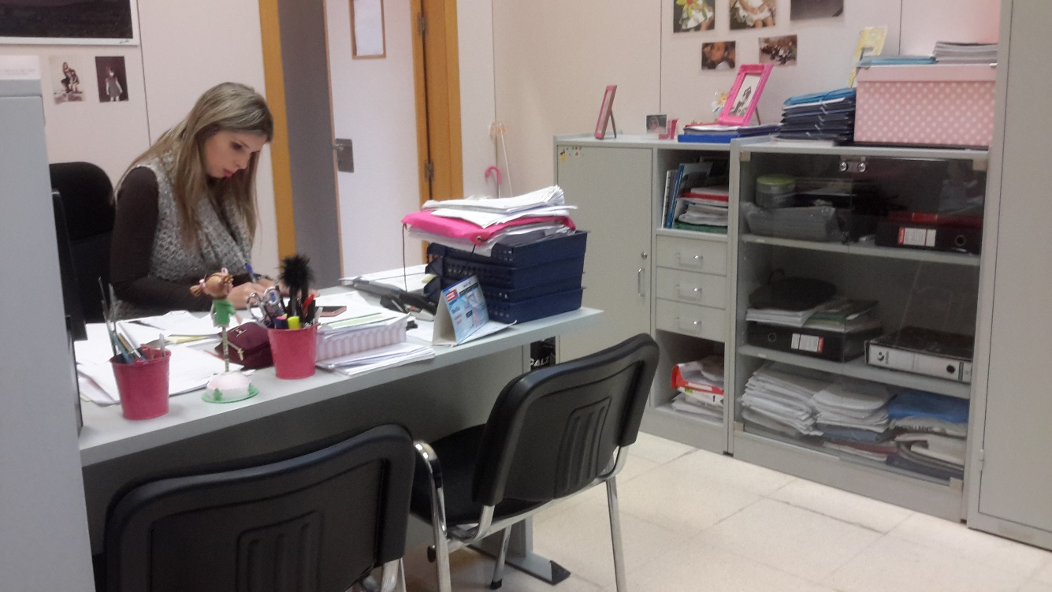
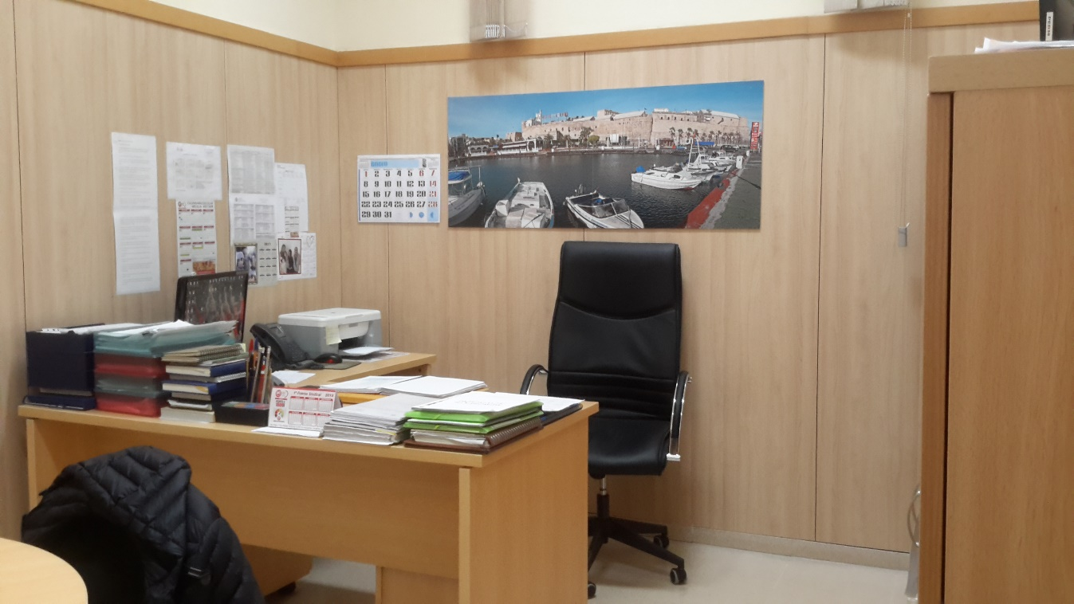
ADMINISTRATION
BACK TO THE PLANE

Slide 15
C.E.I.P. PEDRO DE ESTOPIÑÁN
CLICK ON ANY NUMBER TO SEE DIFFERENT PARTS OF THE SCHOOL
ON ANY SLIDE, CLICK ON "BACK TO THE PLANE" TO RETURN HERE
3
11
VIDEO DE PRESENTACIÓN DE MAESTRAS/O Y ALUMNOS
4
7
9
8
6
2
10
5
1

Slide 16
BACK TO THE PLANE

