Slide 1
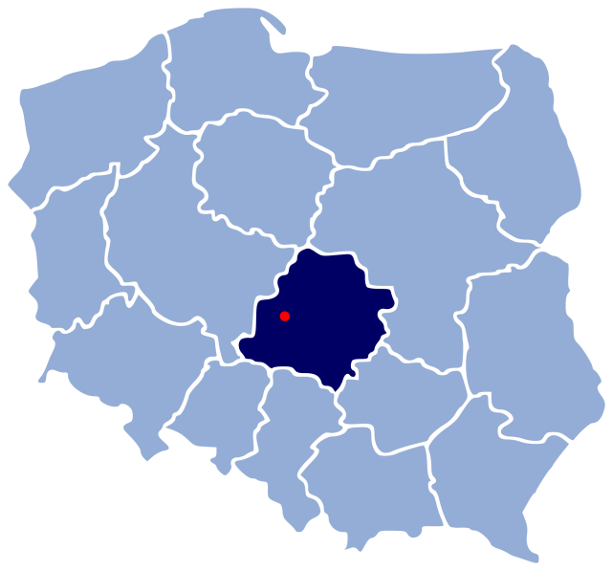
Sieradz
Our town

Slide 2
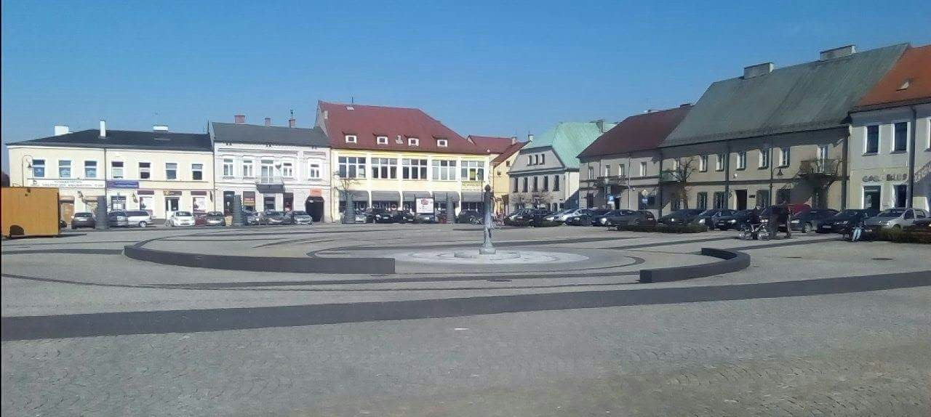
Market in Sieradz

Slide 3
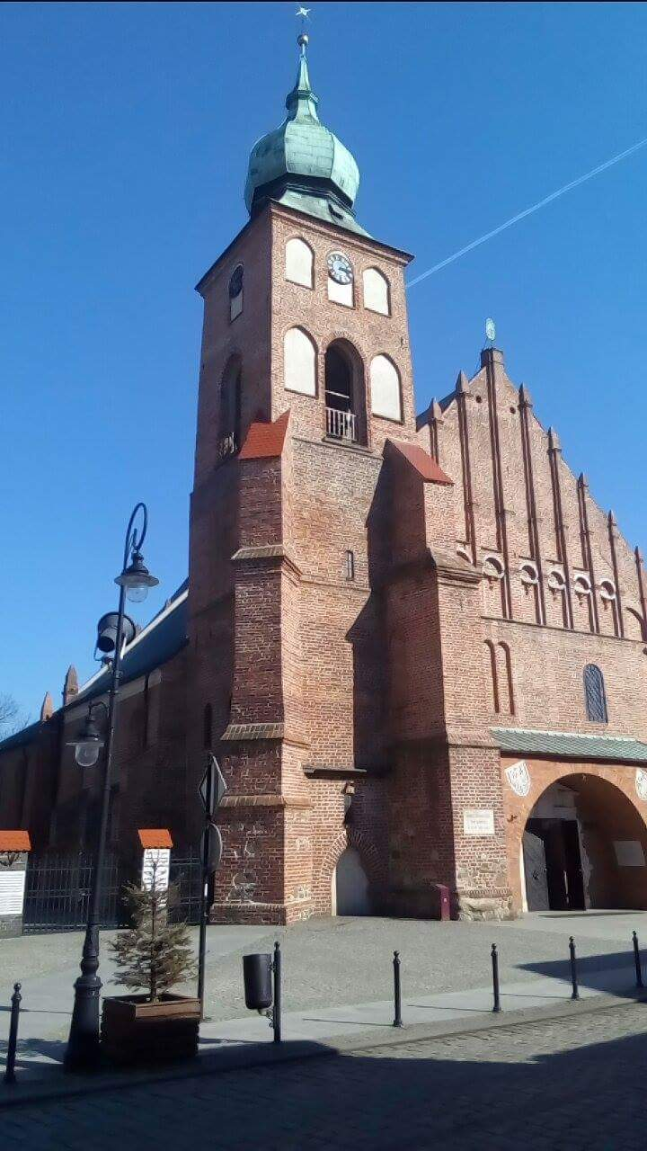
Parish Church

Slide 4
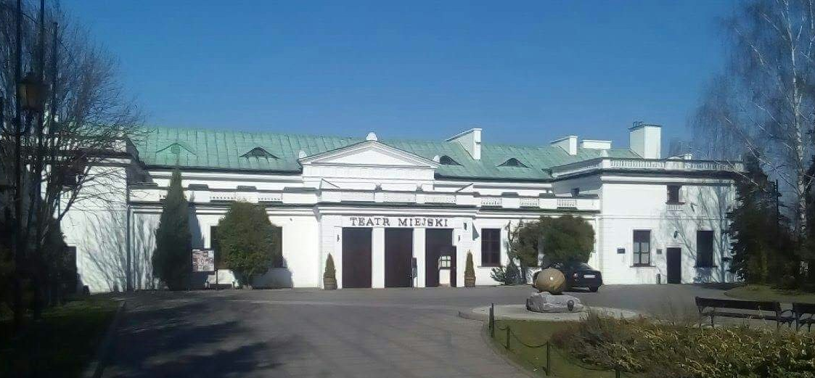
Theatre

Slide 5
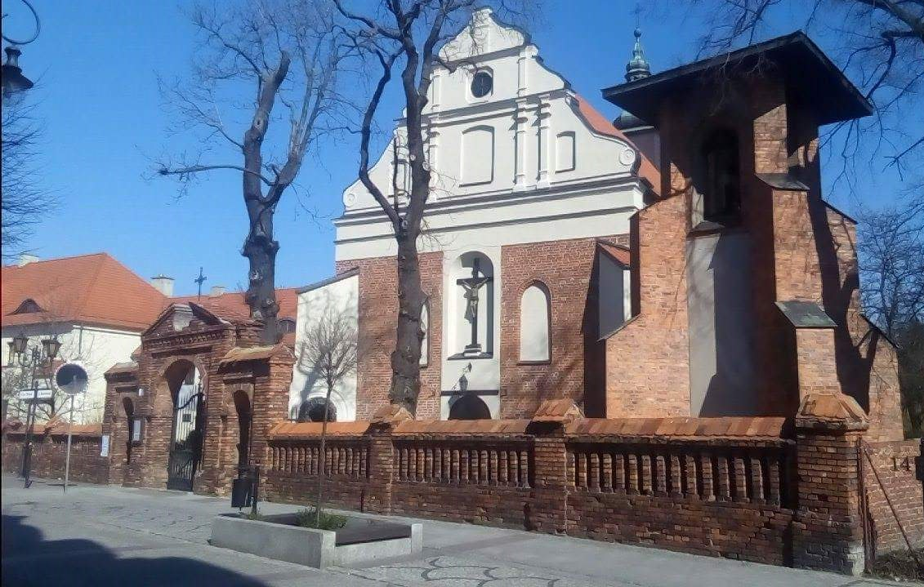
Ursulines’ Convent

Slide 6
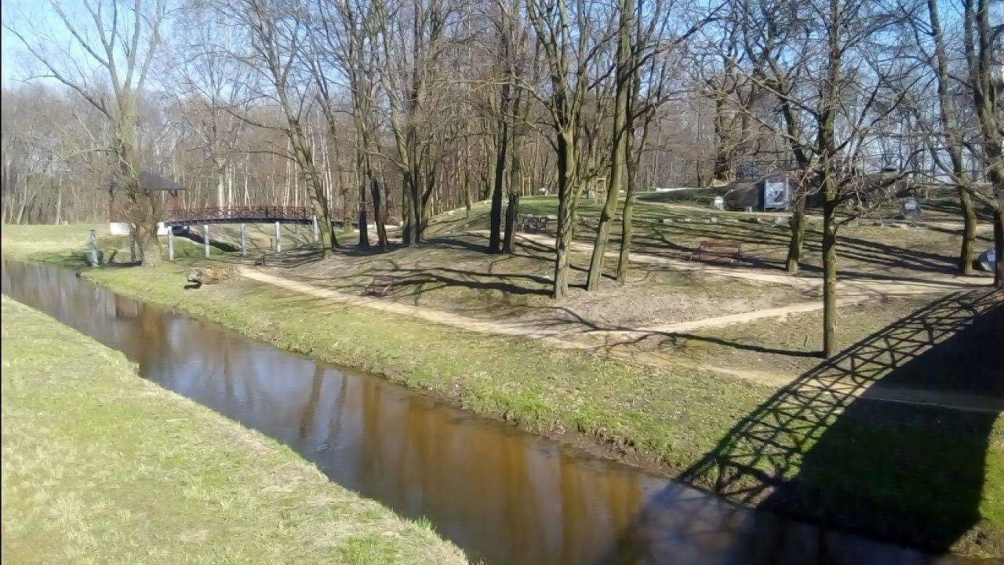
Ruins of the castle on the hill

Slide 7
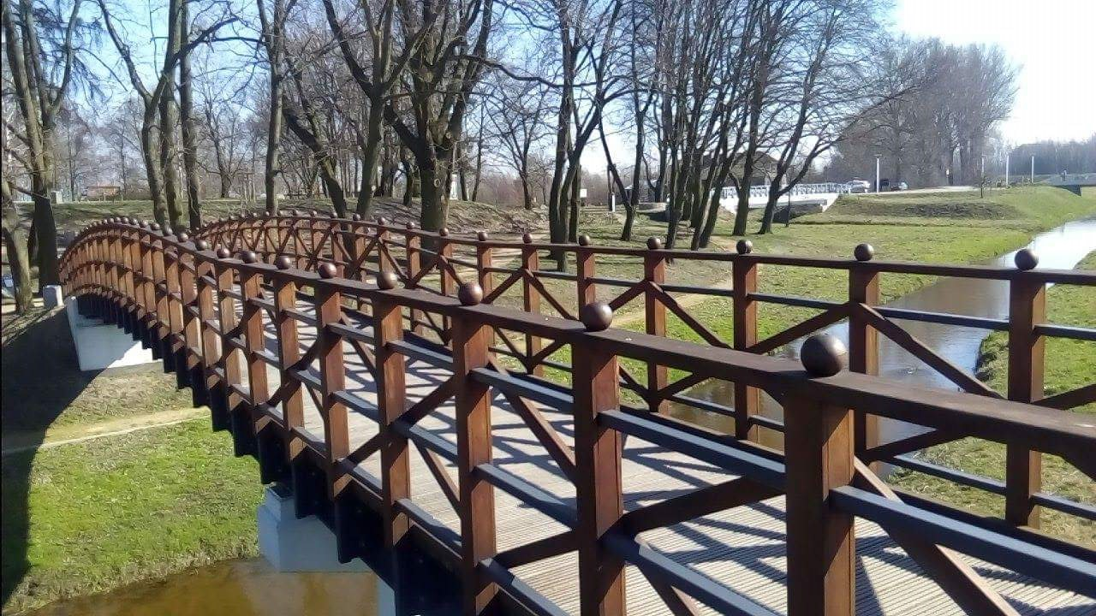

Slide 8
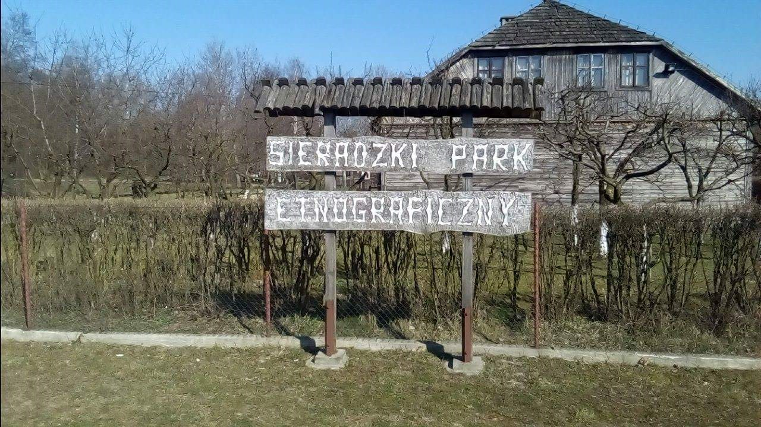
Open-air museum

Slide 9
Oldtown Park

Slide 11
The River Warta

Slide 13
The White Bridge at the River Warta

Slide 15
Oldtown Cemetery

Slide 17
Amphitheater

Slide 18
Presentation made by:
Mateusz Ciepłuch
Katarzyna Deka
Olga Szymczak
Kinga Witczak

