Slide 1
National Holidays in Albania

Slide 2
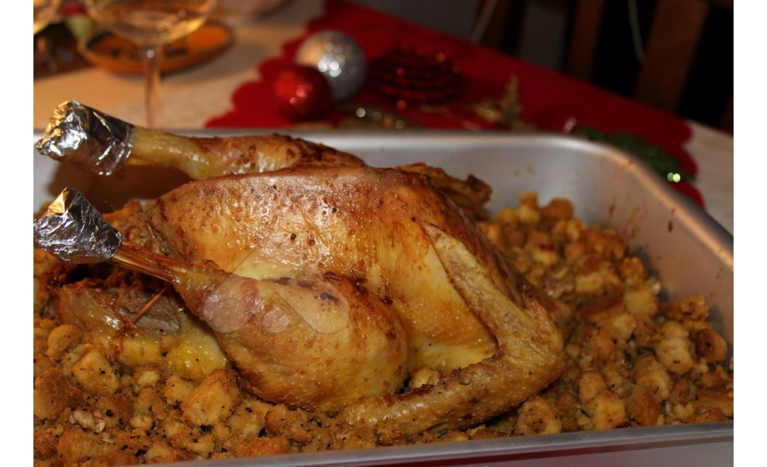
New Year
It’s a national holiday in Albania so government and all schools, banks and shops are closed for some days. All the families prepare the traditional dish “turkey”.

Slide 3
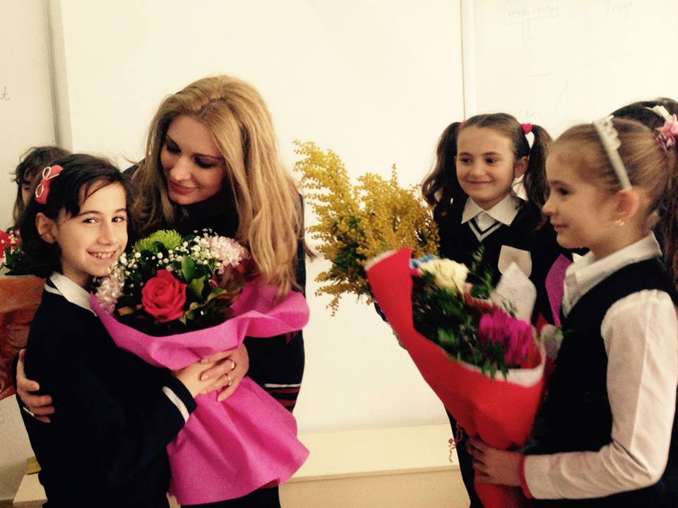
7th March
It’s national teachers day. It is a day dedicated to all the teachers in Albania. All the schools prepare concert in honor to their teachers. Students send flowers to their teachers.

Slide 4
8th March
It’s national women and mothers day in Albania! All the women in Albania doesn’t work that day. They celebrate this with each other or with their families!

Slide 5
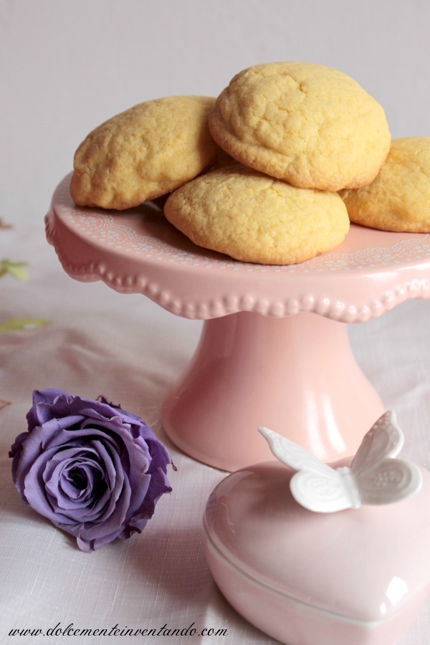
14th March
It’s summer national day in Albania. All the schools and banks are closed. In every city albanians celebrate this day with their families with barbecues. Also this day they cook a traditional food called “ballokume”.

Slide 6
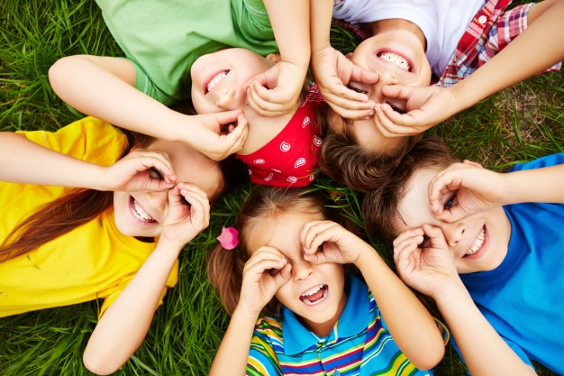
1st June
It’s the national children’s day. All the schools are closed. And the government organise activities for children.

Slide 7
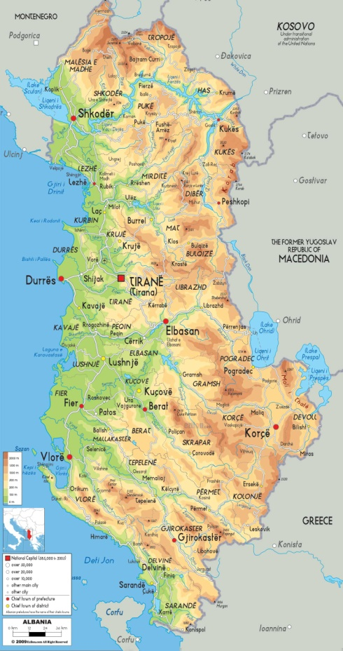
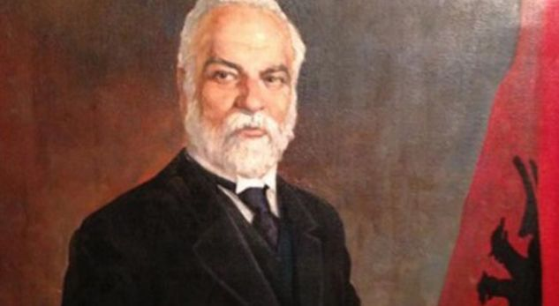
28th November
It’s the national independence day of Albania. This date is celebrate since 1912.

Slide 8
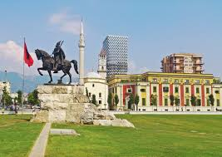
29th November
The Liberation Day (Albanian: Dita e Çlirimit) is commemorated as the day,November 29, 1944, in which Albania was liberated from Nazi Germany forces after the Albanian resistance during World War II.

Slide 9
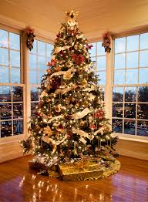
25th December
It’s a national holiday which the albanians celebrate at home with their families. They spend a lot of time during the holiday at home decorating the tree.

