Slide 1
Life style ☺

Slide 2
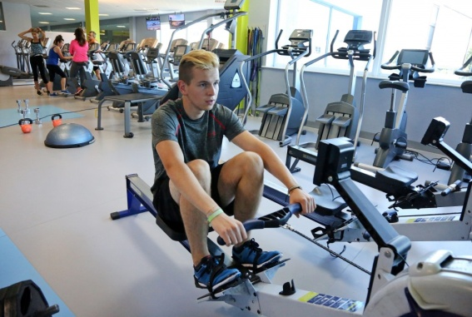
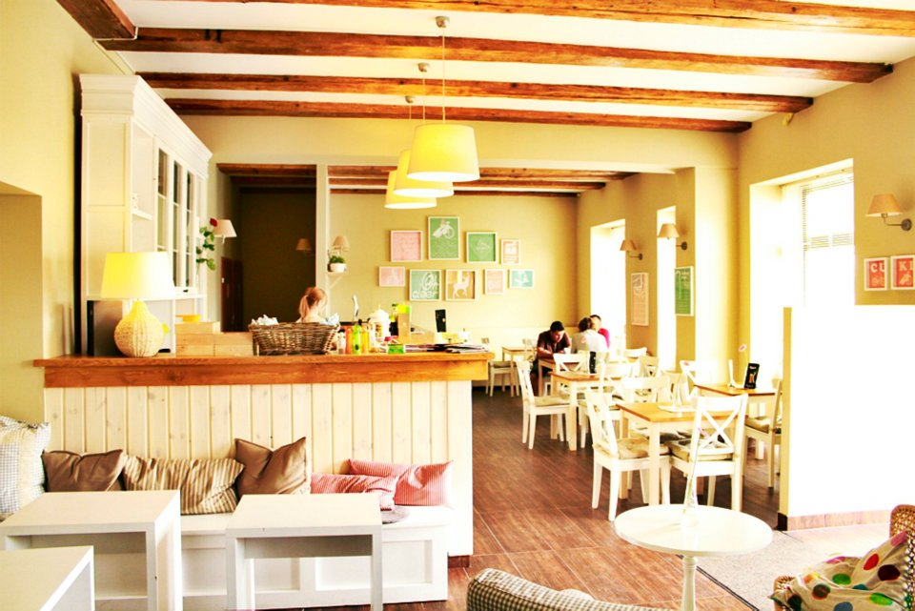
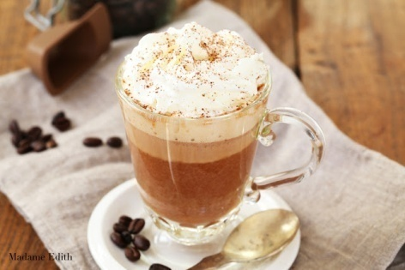
Free time
Teenagers in their free time meet friends. Often they go to Cafes and spent time together. Some people go to the gym and do excercises, because many of them care about their health. Teenagers like reading interesting books too.

Slide 3
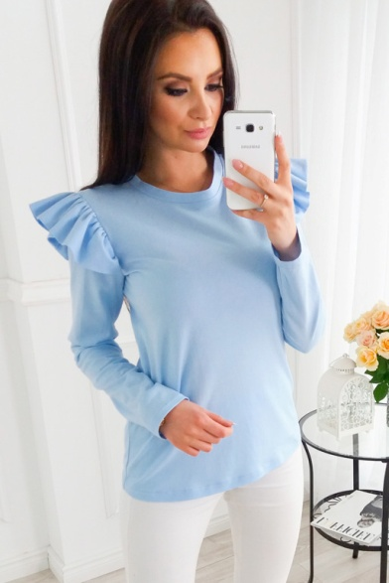
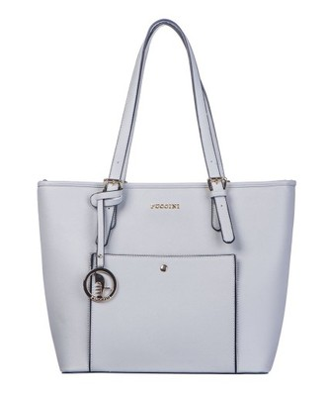
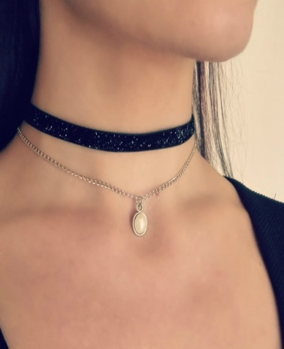
Clothes
At the moment pastel colours, like: pink, blue and white are trendy. Plain or lacy clothes are fashionable too. Some things with flounces are so attractive, for example: dresses and blouses. Recently chokers are more trendy. These are close-fitting necklaces worn around the neck.

Slide 4
Music
In ours time we have a wide access to Internet and we can find out plenty of music. We listen usually different kind of music. Most of teenagers prefer cutting edge Pop artists like Adele or Rihanna. A lot of young people especially boy like listening Rap.

Slide 5
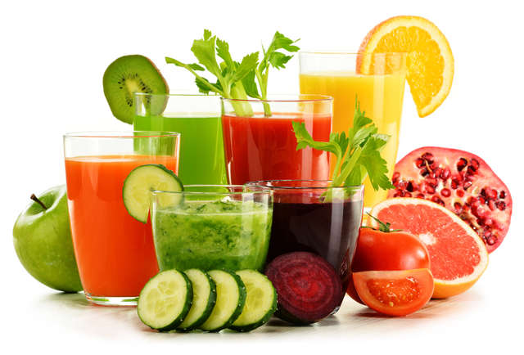
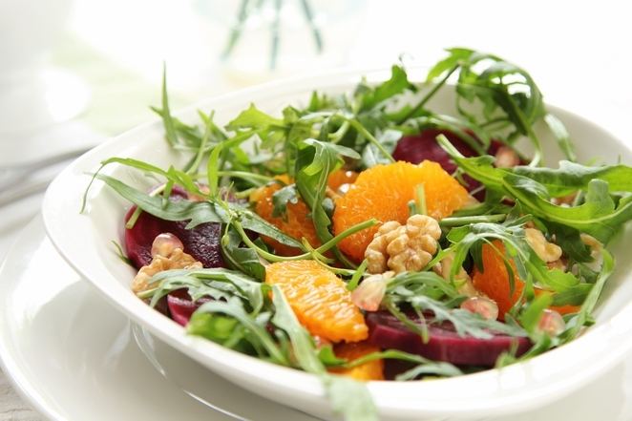
HEALTH
Healthy and fit life become more and more popular also for teenagers. They often do exercises themselves in home or they go to the gym. Teenagers eat more healthy food, like fruits and vegetables. A lot of them prepare dishes themselves at home.

Slide 6
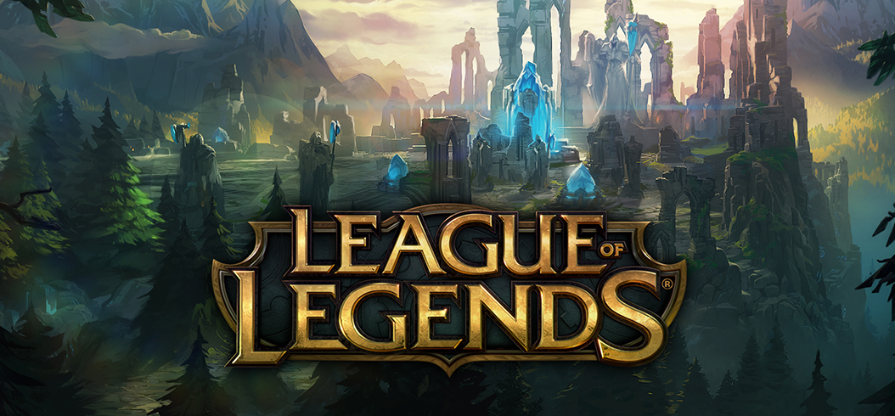
Some of us are intrested in video games like Overwatch or League of Legends. Not only boys play video games, there are some girls to ;).

Slide 7
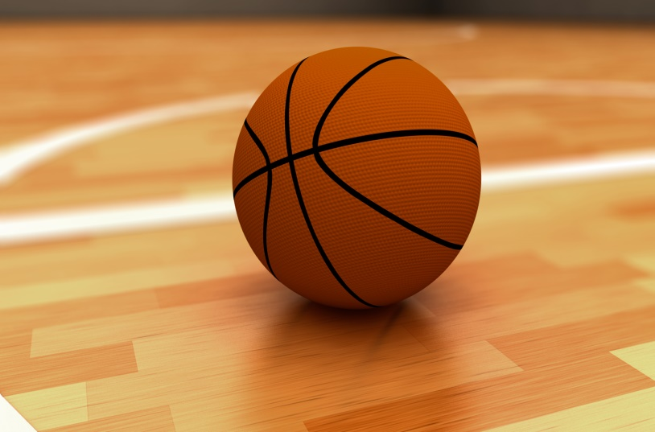
Sport
We like almost all of the sports. Basketball, baseball, football, volleyball. Even if we are not the best, we enjoy having fun with friends.

