Slide 1
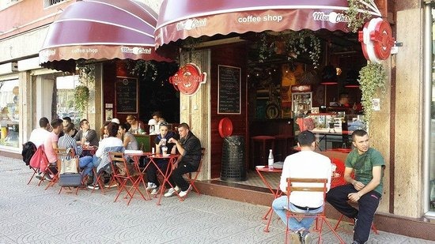
Albanian lifestyle

Slide 2
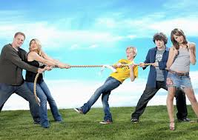
Teenagers lifestyle
Well, most of the teenagers in Albania have different habits from their parents.
Actually they disagree in everything. that is why we are called teenagers. If someone says DO NOT for us is KEEP DO IT.

Slide 3
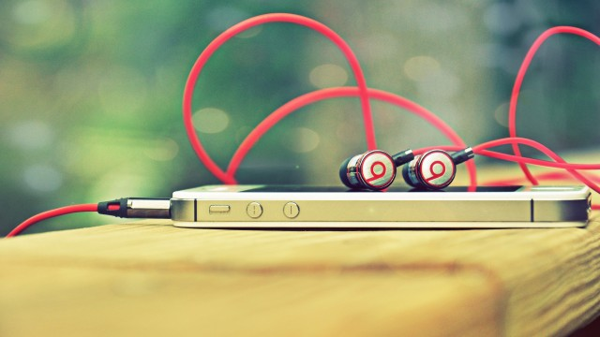
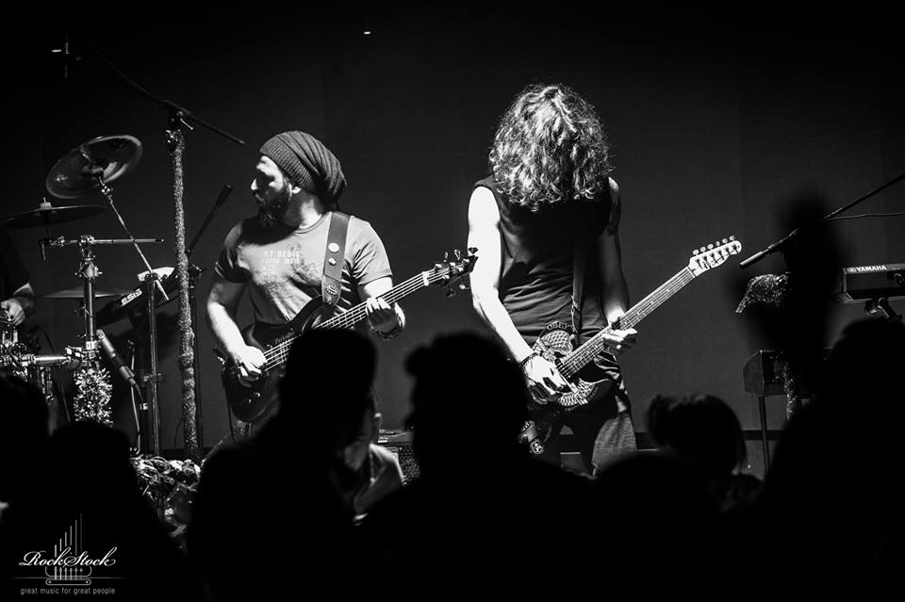
MUSIC TASTES
Music tastes are different for albanians teenagers.
Some loves rap music and others pop and pop rock.
It also exist those 2% who called themselves “rockers” who listen only hard rock music.
Some of these rockers form their own group and perform on the road or at bars.

Slide 4
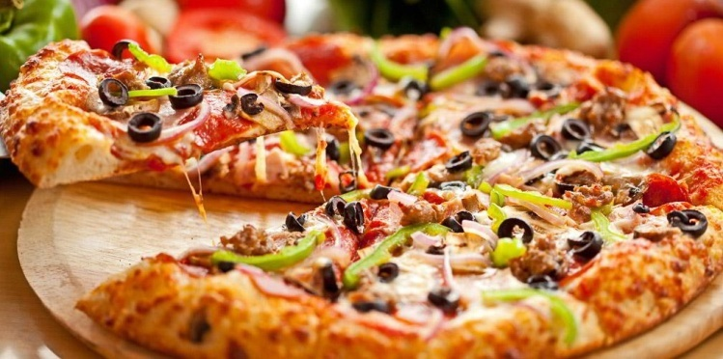
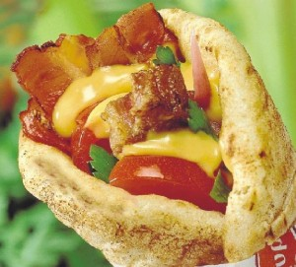
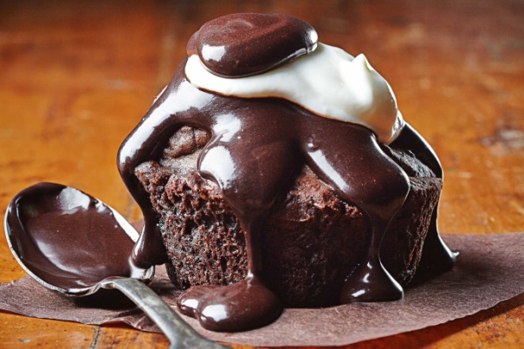
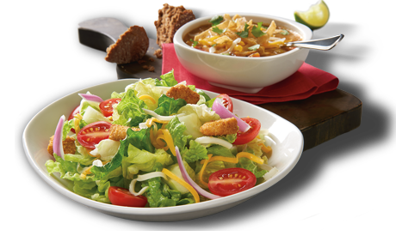
Food tastes
Albanians eat a lot of fast food especially pizza and souvlaki.
They like chocolates and a lot of junk food.
But most of the albanians teenagers eat balanced food such as salads or stews especially for lunch. Most of them avoid breakfast.

Slide 5
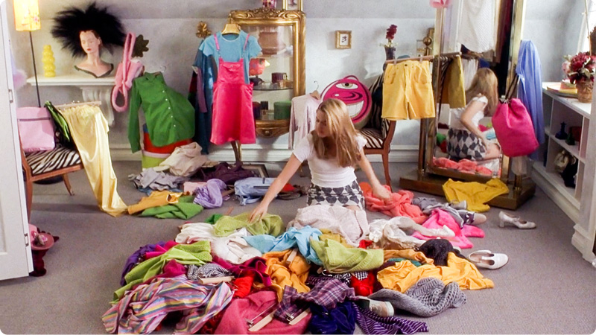
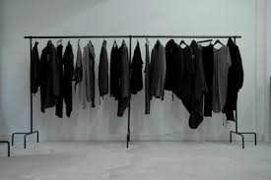
Lifestyle outfits
Almost 99% of the albanians teenagers loves trendy clothes. They follow the last tendency and try to be fashion.
It also exist that 1% who does not care what they are wearing. They just need a shirt and some jeans.
During a study about fashion teenagers loves black color.

Slide 6
Social media
Like every teenager of the world even the albanians teenagers adore social medias.
The most common social media are :Facebook,Whatsapp,Viber and Instagram.
Recently, teenagers are obsessed with snapchat and their emojis.

