Slide 1
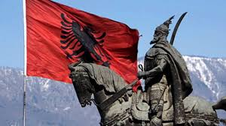
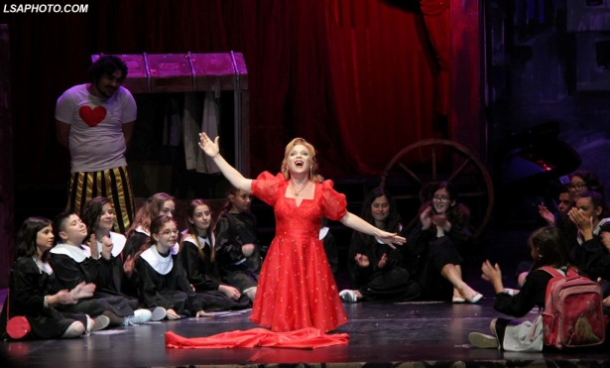
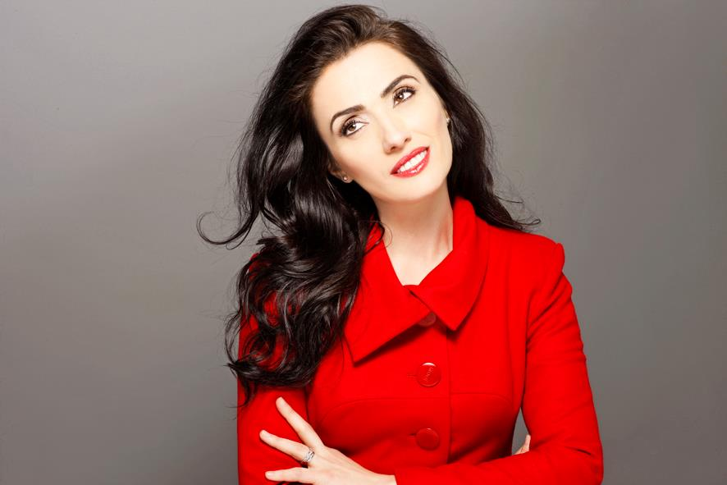
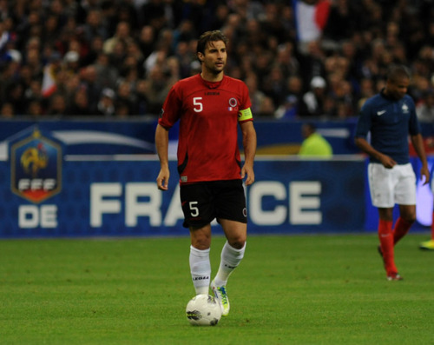
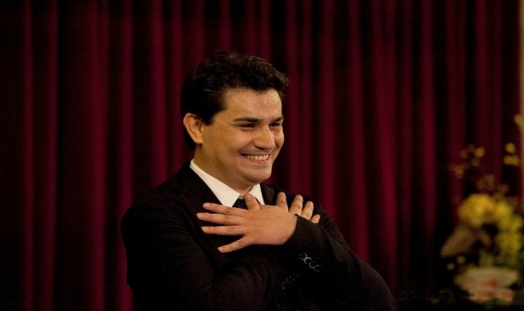
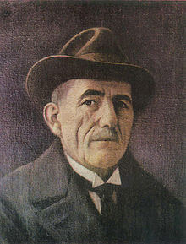
INTERESTING PEOPLE IN ALBANIA

Slide 2
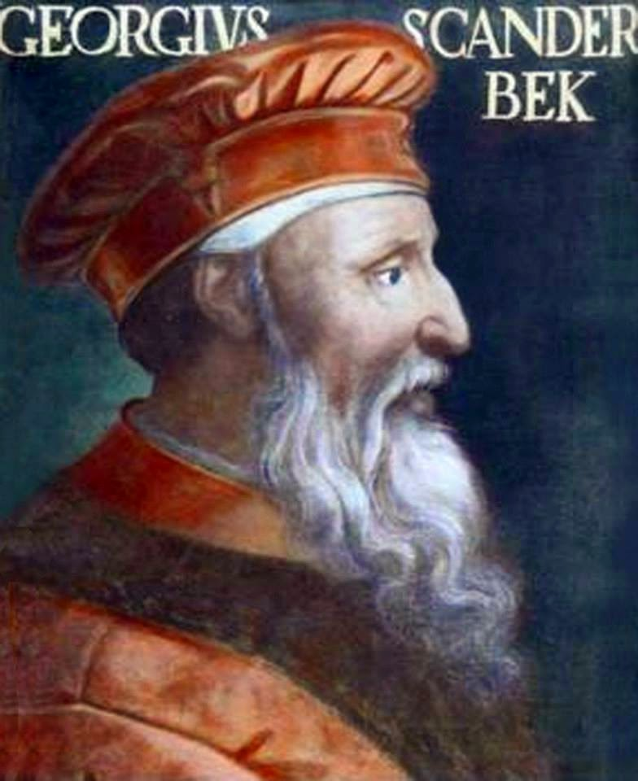
Skanderbeg
GeorgeCastriot (Albanian: Gjergj Kastrioti, 6 May 1405 – 17 January 1468), known as Skanderbeg (Albanian: Skënderbej or Skënderbeu , was an Albanian nobleman and military commander, who served the Ottoman Empire , the Republic of Venice , and lastly the Kingdom of Naples until his death. After leaving Ottoman service, he led a rebellion against the Ottoman Empire in Albania. Skanderbeg's military skills presented a major obstacle to Ottoman expansion, and he was considered by many in western Europe to be a model of Christian resistance against the Ottoman Muslims

Slide 3
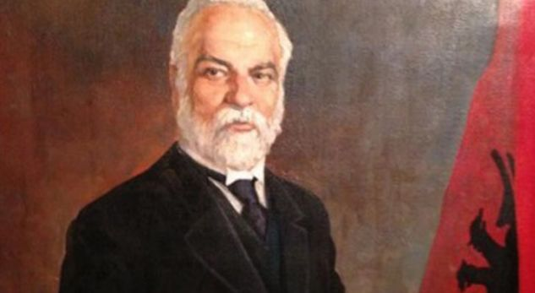
Ismail Qemali
Ismail Qemal Bej Vlora 16 October 1844 – 24 January 1919), commonly Ismail Qemali, was a member of the Albanian national movement. As founder of Independent Albania, he served as its first President, Prime Minister and Foreign Minister of the first government of Albania until January 1914, when he was forced to step aside by the International Commission of Control established by the six Great Powers.

Slide 4
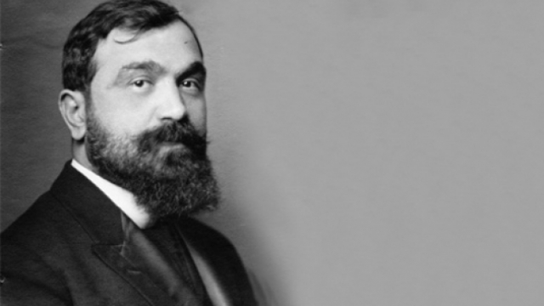
FAN NOLI
Theofan Stilian Noli, known as Fan Noli (6 January 1882 – 13 March 1965) was an Albanian writer, scholar, diplomat, politician, historian, orator and founder of the Orthodox Church of Albania, who served as Prime Minister and regent of Albania in 1924 during the June Revolution.
Fan Noli is venerated in Albania as a champion of literature, history, theology, diplomacy, journalism, music and national unity. He played an important role in the consolidation of Albanian as the national language of Albania.

Slide 5
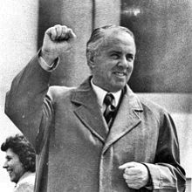
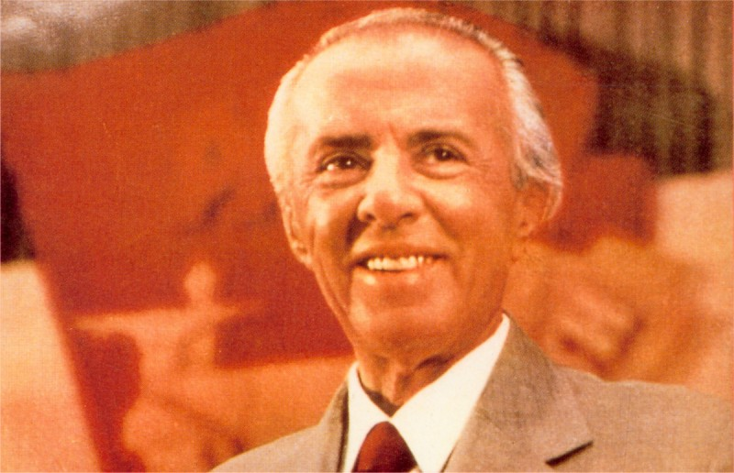
Enver Hoxha
Enver Hoxha was an Albanian communist politician who served as the head of state of Albania from 1944 until his death in 1985, as the First Secretary of the Party of Labour of Albania. He was chairman of the Democratic Front of Albania and commander-in-chief of the armed forces from 1944 until his death. During his 40-year-rule, Hoxha's regime committed a series of political repressions which included the establishment and use of forced labor camps, wrongful incarcerations, extrajudicial killings and executions that targeted and eliminated anti-communists and other dissidents, and evictions of families from their homes to remote villages strictly controlled by his secret police. His rule was also characterized by the use of Stalinist methods to destroy associates who threatened his power.

Slide 6
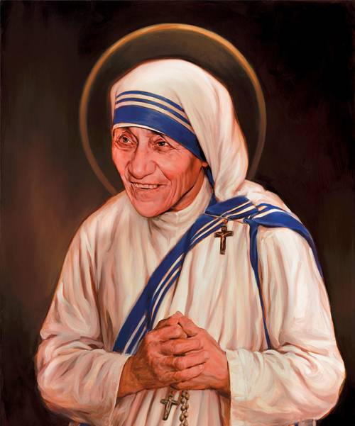
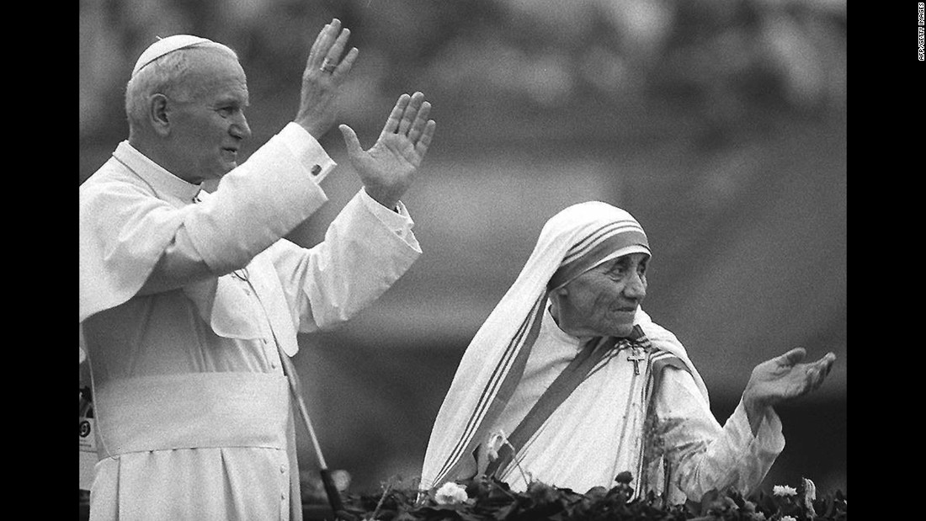
MOTHER TERESA
Mother Teresa, known in the Catholic Church as Saint Teresa of Calcutta (born Anjezë Gonxhe Bojaxhiu; (26 August 1910 – 5 September 1997), was an Albanian-Indian Roman Catholic nun and missionary. She was born in Skopje . After living in Macedonia for eighteen years she moved to Ireland and then to India, where she lived for most of her life.

Slide 7
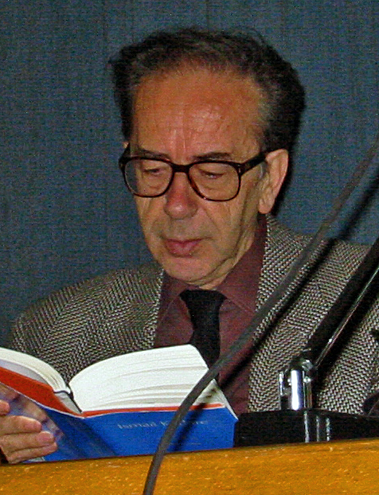
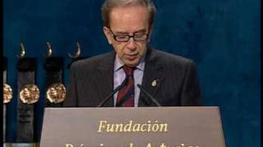
ISMAIL KADARE
Ismail Kadare ( born 28 January 1936) is an Albanian novelist and poet. He has been a leading literary figure in Albania since the 1960s. He focused on poetry until the publication of his first novel, The General of the Dead Army, which made him famous inside and outside of Albania. In 1996, he became a lifetime member of the Académie des Sciences Morales et Politiques of France. Kadare is regarded by some as one of the greatest European writers and intellectuals of the 20th century.

Slide 8
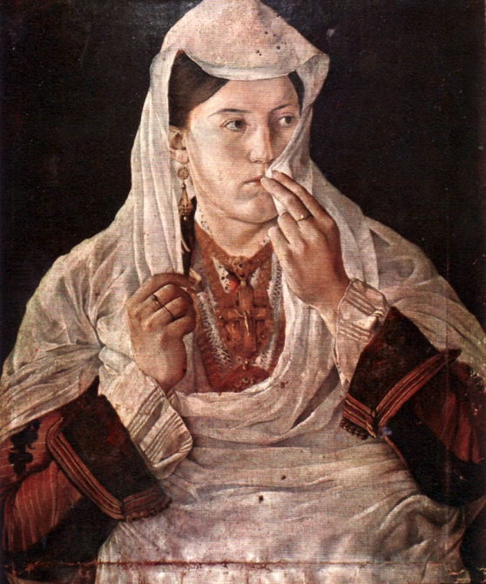
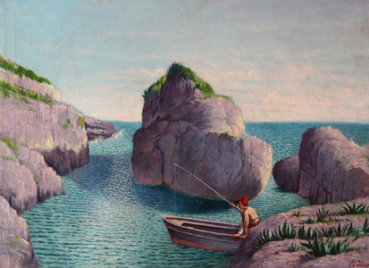
Kolë Idromeno
Kolë Idromeno (born Nikola Arsen Idromeno, 1860–1939) was an Albanian painter, sculptor, photographer, architect and engineer. Idromeno was the first painter to show motion pictures in Albania in 1912. He had kept up a correspondence with the Lumière brothers in Paris.
View from Ulcinj
Scodra Wedding

Slide 9
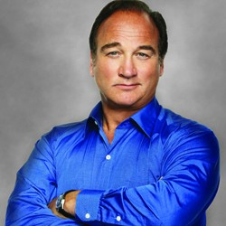
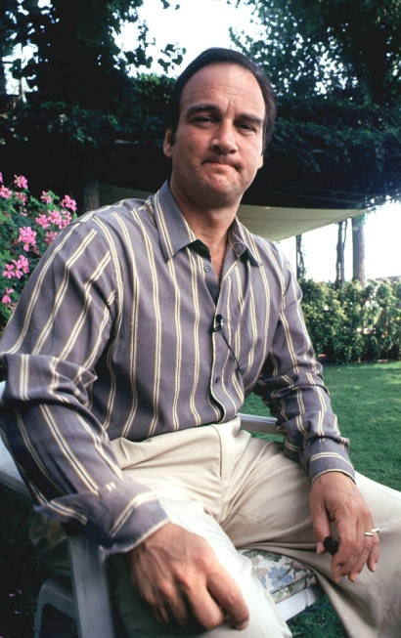
James Belushi
James Adam Belushi (born June 15, 1954) is an American comic actor, voice actor, comedian, singer and musician.
He is the younger brother of comic actor John Belushi and father of actor Robert Belushi. He played the role of Jim Orenthal on the sitcom According to Jim (2001–2009). His other television roles include Saturday Night Live , Wild Palms , Show Me a Hero and Twin Peaks.
Belushi has appeared in films such as Thief , Trading Places , About Last Night , Salvador, Red Heat and The Ghost Writer .

Slide 10
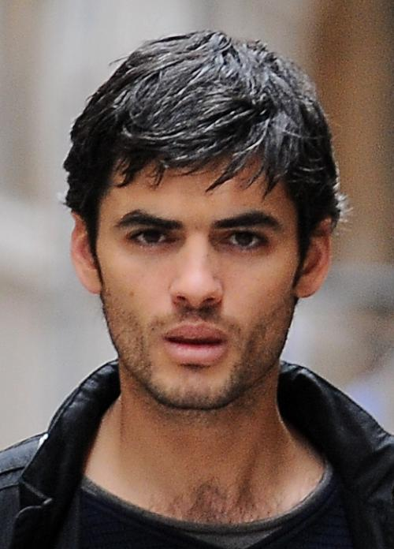
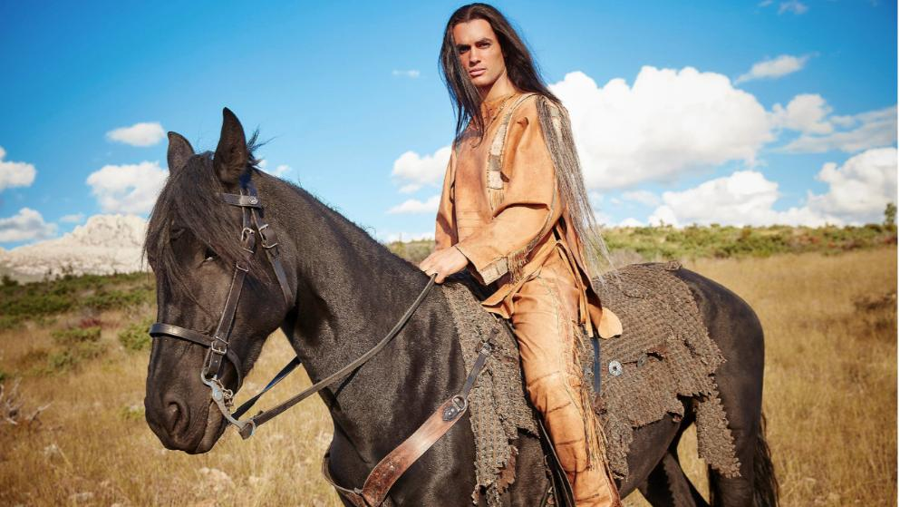
Nik Xhelilaj
Kreshnik Xhelilaj (born 5 March 1983,Tirana), better known by his stage name Nik Xhelilaj, is an Albanian film and stage actor. He began his international career with the movie The Sadness of Mrs. Snajdrova, directed by Pirro Milkani and was the leading actor in three critically acclaimed Albanian films of the last few years, of which two entered in the List of Albanian submissions for the Academy Award for Best Foreign Language Film in 2008 and 2009. Nik has collected several "Best Actor" Awards in various international film festivals.He is very famous in Germany and recently in Turkey.

Slide 11
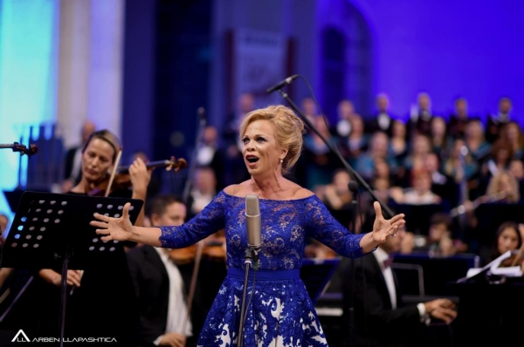
INVA MULA
Inva Mula (born June 27, 1963) is an Albanian opera lyric soprano. She began her soprano career at a very early age. Her father (Avni Mula) and mother (Nina Mula) were also opera singers. She is also widely known in popular culture for providing the voice of the Diva Plavalaguna in the film The Fifth Element. Mula has sung in Lucia di Lammermoor, La bohème, and Manon, among others. She is also a renowned Violetta in La Traviata, and has sung the role in many cities around the world, including Tokyo, Bilbao, Orange, Trieste, and Toronto.

Slide 12
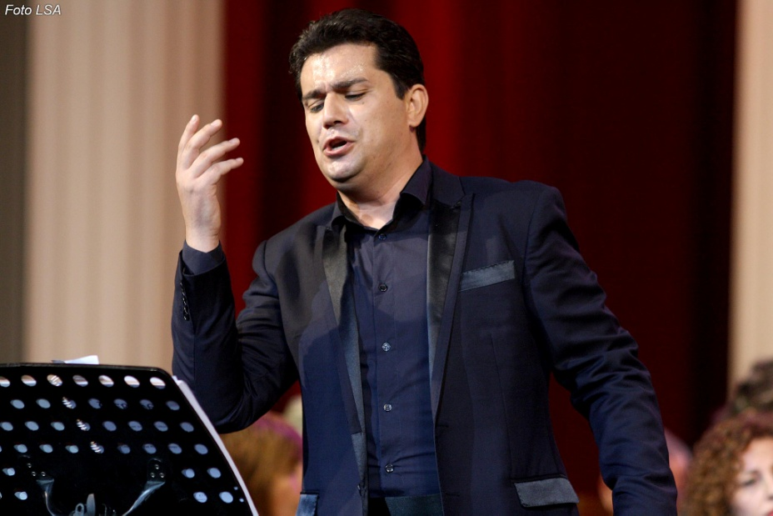
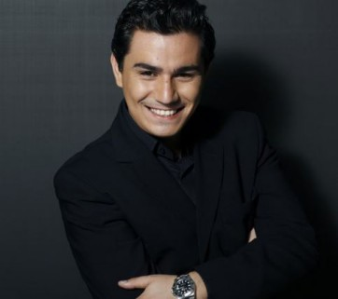
Saimir Pirgu
Saimir Pirgu (born 23 September 1981 in Elbasan) is an Albanian international opera singer (tenor). In 2014 he was awarded the Italian citizenship by the President of the Italian Republic Giorgio Napolitano. He graduated in singing at the Conservatory Claudio Monteverdi in Bolzano where he studied with Vito Maria Brunetti.
At the age of 22 he was discovered by Claudio Abbado who chose him to play the role of Ferrando in Mozart's Così fan tutte. Pirgu made his debut with Opera Australia in 2017.

Slide 13
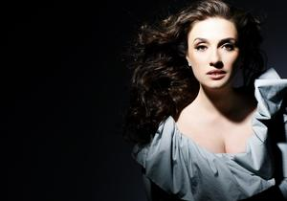
Ermonela Jaho
Ermonela Jaho is an Albanian soprano. She holds dual citizenship, Italian and Albanian. She has been described by The Economist as "the world’s most acclaimed soprano". She has won many international competitions including the Giacomo Puccini competition in Milan, Spontini International Competition in Ancona, Zandonai in Rovereto, and The Best Singer at the Wexford Festival. She has performed in opera houses worldwide including the Royal Opera in London, the Metropolitan Opera in New York City, the Berlin Staatsoper, the Paris Champs-Élysées, Opera Company of Philadelphia, Opéra de Marseille, Arena di Verona, Gran Teatre del Liceu, etc.

Slide 14
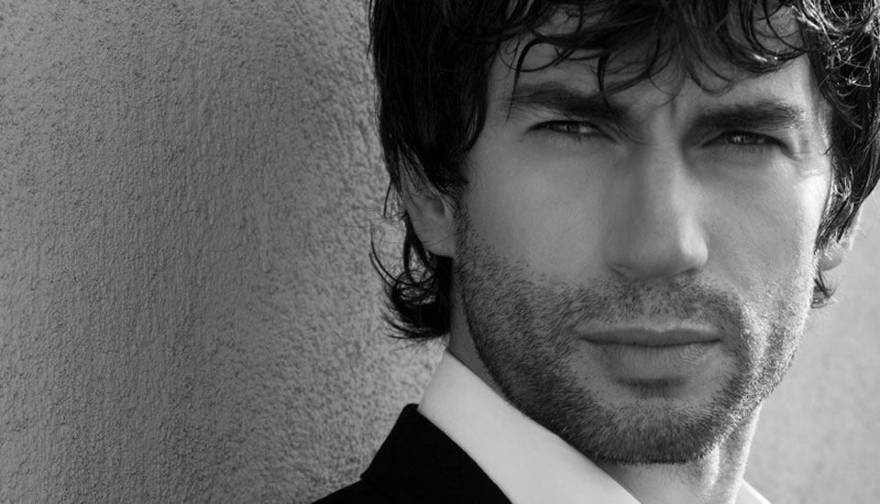
Kledi Kadiu
Kledi Kadiu (born 7 April 1974) is an Albanian-born, naturalized Italian dancer, actor, television personality, and author. He is a regular dancer on the popular talent show Amici di Maria De Filippi which is presented by Maria De Filippi on Mediaset's Canale 5. He starred in his first film Passa a Due in 2005. He is the founder of the Kledi Dance school in Rome.

Slide 15
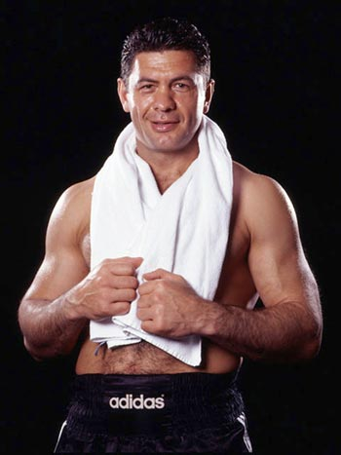
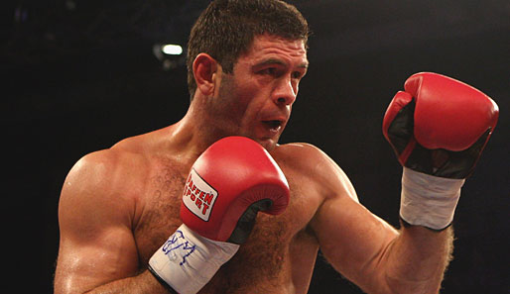
Luan Krasniqi
Luan Krasniqi (born 10 May 1971) is an Albanian-German former professional boxer. He held the Europeanheavyweight title and also challenged for the WBO world heavyweight title. The highlight of his career was the fight against Rene Monse, when he became European Champion. He was the first German European Champion after 29 years.

Slide 16
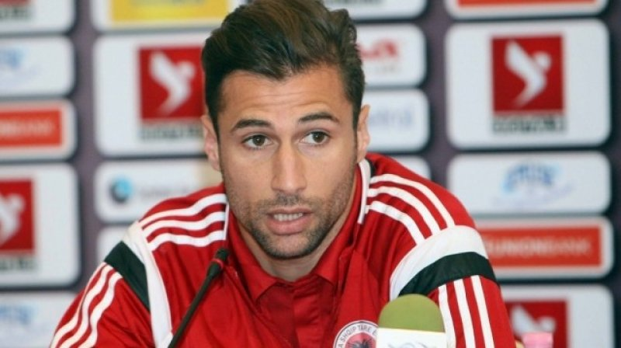
LORIK CANA
Lorik Agim Cana ( born 27 July 1983) is an Albanian former professional footballer. He played for Sunderland, Galatasaray, Lazio, FC Nantes,Paris Saint-Germain and captained Olympique de Marseille as well as the Albanian national team for which he held the appearance record for Albania's most capped player of all time, with 93 caps since he made his debut in 2003 until his retirement in 2016.

