Slide 1
Culture and traditions in our country
Vlășceanu Ancuța Roxana
Ștefan Andrada Mădălina

Slide 2
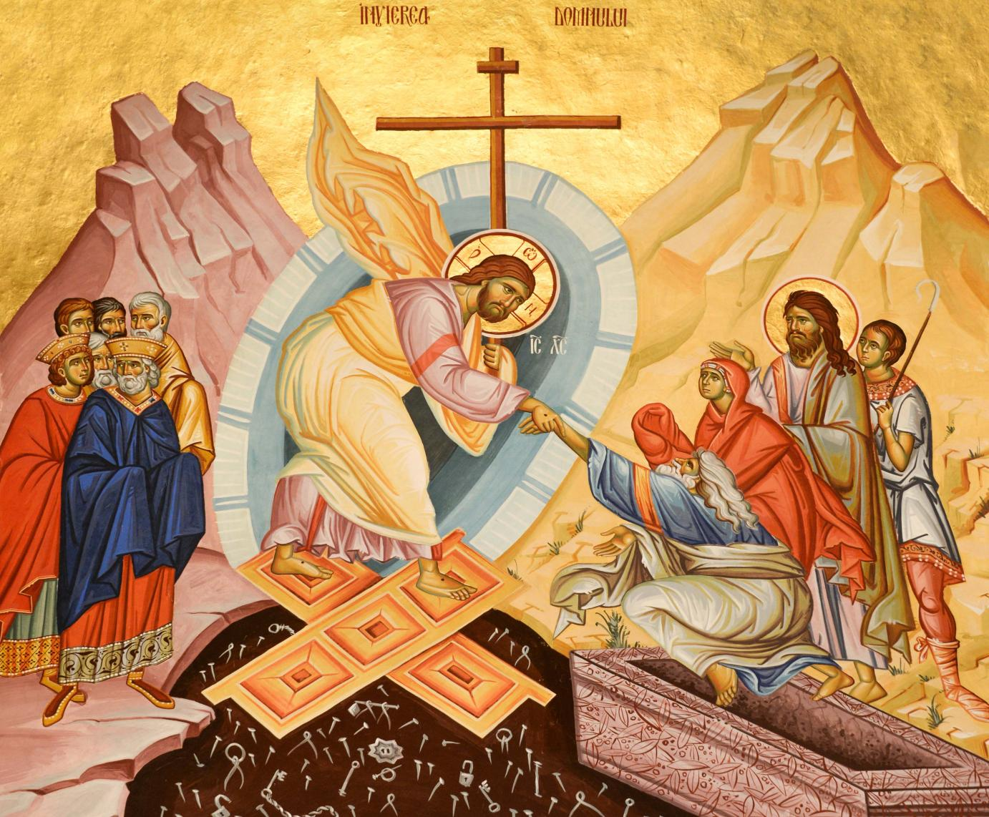
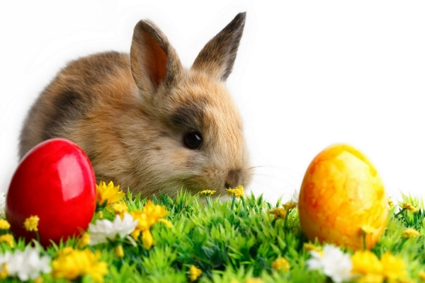
-Easter is an annual religious holiday, celebrated during spring, which has different meanings. Easter represents the resurrection of Jesus Christ and it's lasts for 3 days.

Slide 3
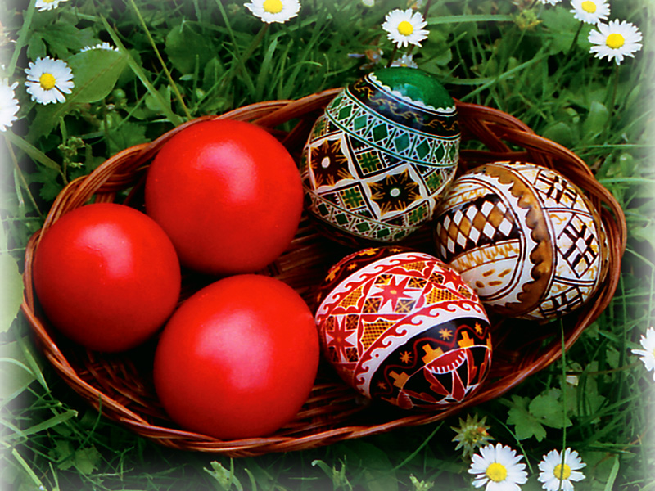
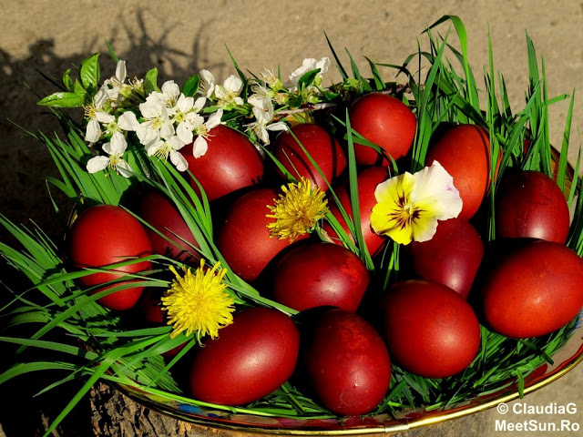
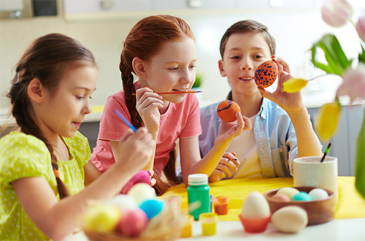
The most common easter tradition is dyeing the eggs in red.

Slide 4
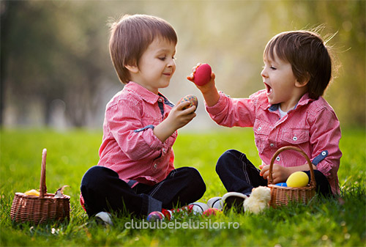
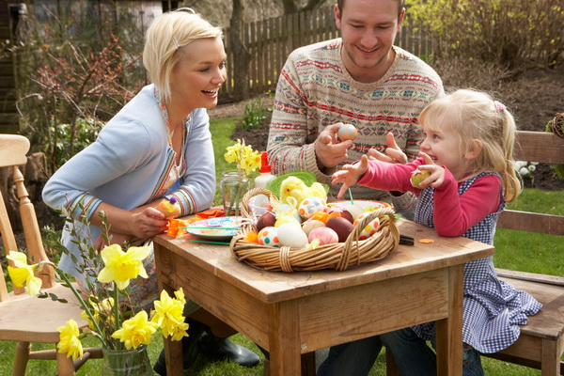
Elders say that the firts collided egg in easter must be eaten by all family members to stay always together.

Slide 5
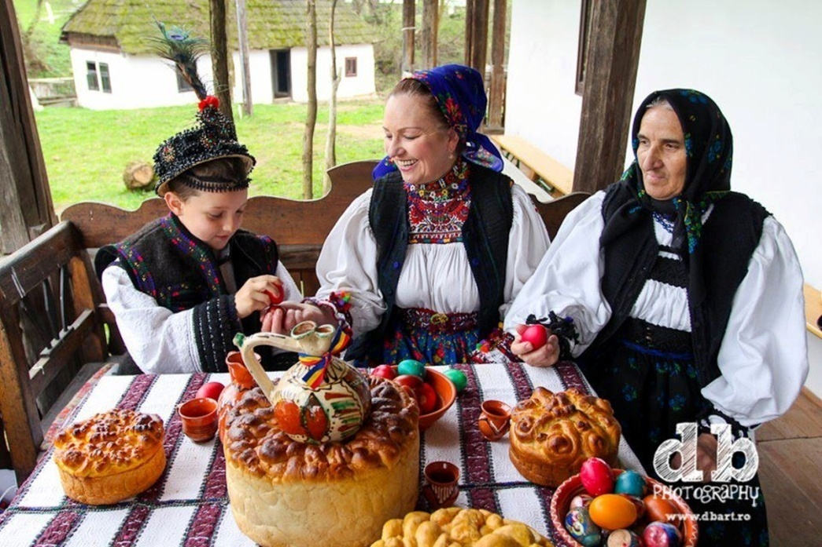
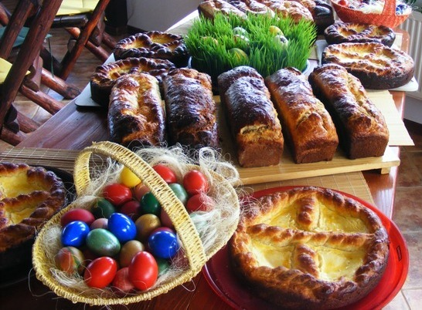
During the Easter Holiday all womens prepare traditional dishes.

Slide 6
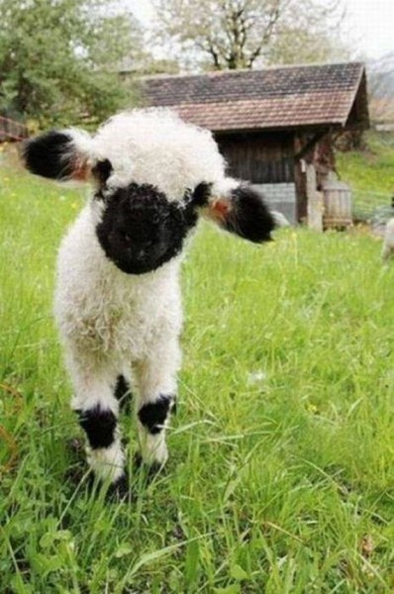
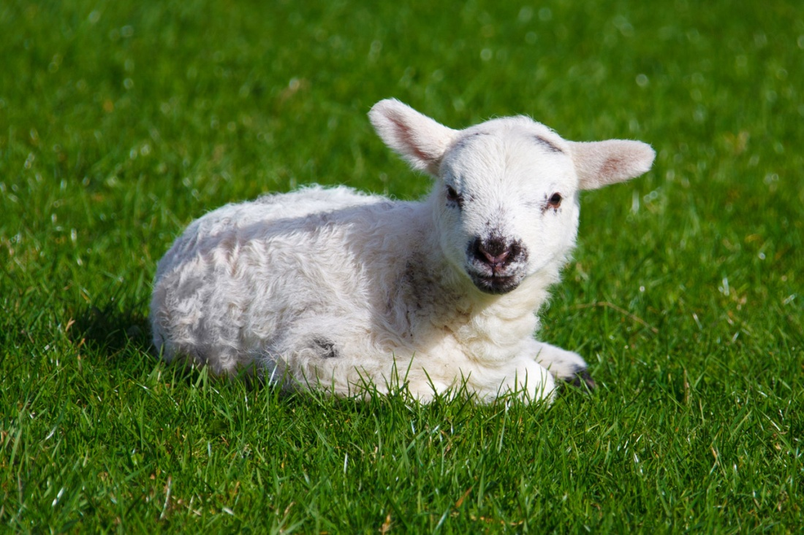
Roast lamb is the type of meat that is eaten during this holiday.

Slide 7
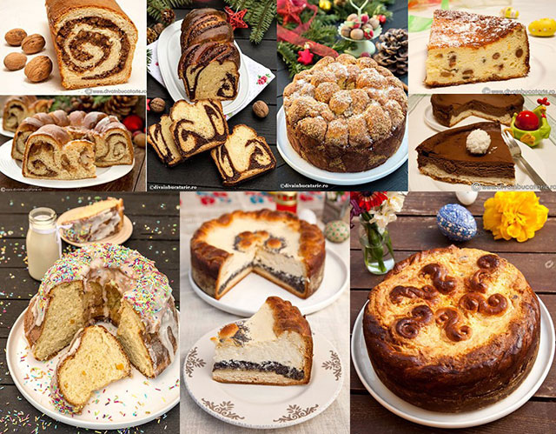
The traditional easter dishes are : pască; drobul; friptură de miel; cozonacul ;ouă roșii.

Slide 8
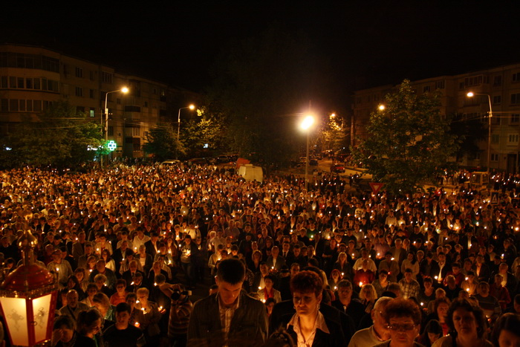
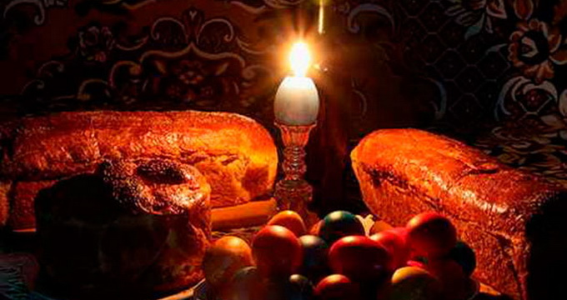
Around this holiday all christians are encouraged to go to church, and in the resurrection evening, to go to "take light" for their blessedness.

