Slide 1
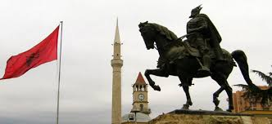
Albanian Culture and traditions

Slide 2
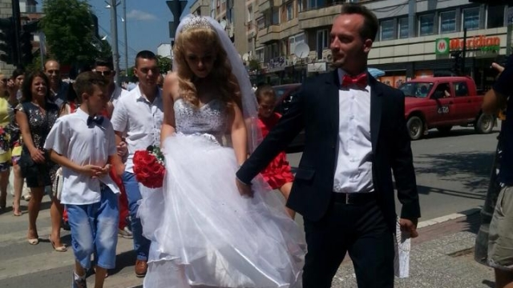
Weddings
The wedding day is a memorable day in almost every culture. But for centuries it has had a special place in Albanians life. There are some core events that compose the whole Wedding party.

Slide 3
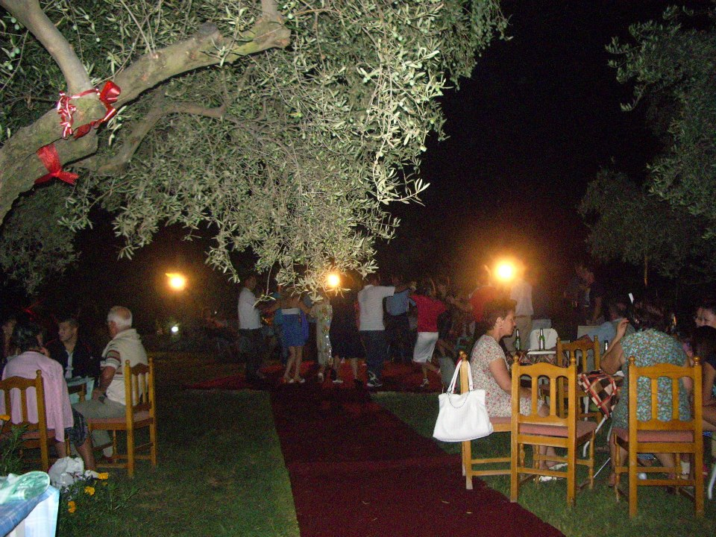
Weddings last one week.
Traditional Albanian weddings are rather epic – they begin seven days before the ceremony. Especially at the home of the groom the wedding starts one week before. The guests sing songs and dance characteristic dancing. It is like a big party that involves the whole village, or neighborhood. The wedding party of the brides usually is held on Wednesday or on Saturday. Whereas the groom’s wedding ceremony, one day after, on Thursday or on Sunday.

Slide 4
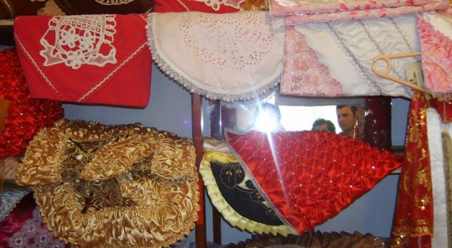
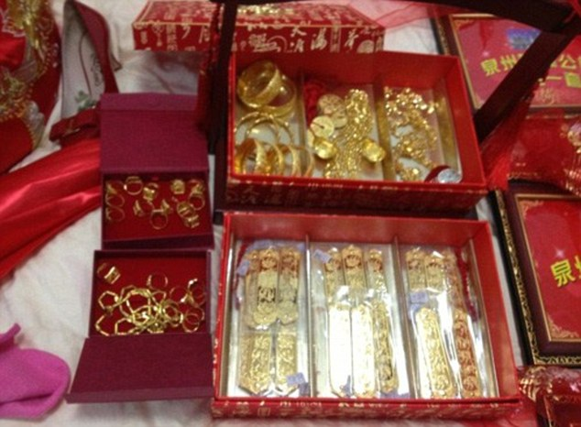
Bride’s Dowry
As a rule the bride brings to groom’s house her dowry. The dowry is not money but contains presents to all the groom’s relatives, different types of embroidery, pillows, blankets, carpets, even bedroom furnitures. But this tradition changes from region to region.
On the other hand, the groom has to send to the bride’s family presents and money. There are special presents to the bride such as: clothes for all four seasons, golden jewelry, expensive watch etc.

Slide 5
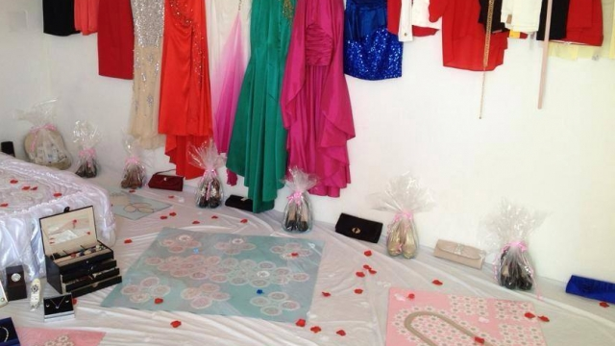
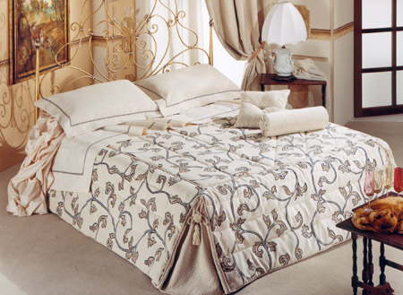
Paja(Paya)
“Paja" (pronounced paya) of the girl, which are the goods parents give to the daughter to wear, to furnish the house, gifts for her husband and the intimate cousins. Elements are typically made by weaving clothes using looms. The preparation of the "paja" for the parents of the bride is a pleasure which means also accomplishing the obligations toward the daughter. This is also an expression of the love of parents, but is connected with the economical conditions of the family. The groom‘s family goes into the bride’s house on Thursday to take the paya.

Slide 6
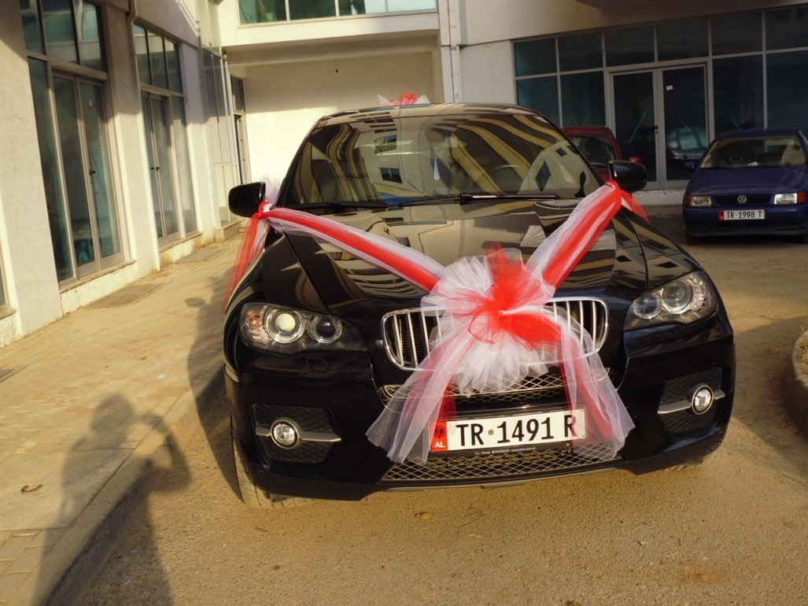
Krushqit (groom maids)
Krushqit are a type of groom’s maids. They accompany the groom and go to take the bride form her family, on the wedding day. The firs groom maid is his uncle, but the group is really big usually consisting of more than 10 people, singing and dancing. They travel to the bride in decorated cars. The main car is that of the new couple, and next to this comes a car, which holds the Albanian Flag.

Slide 7
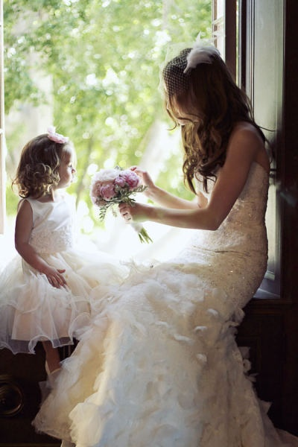
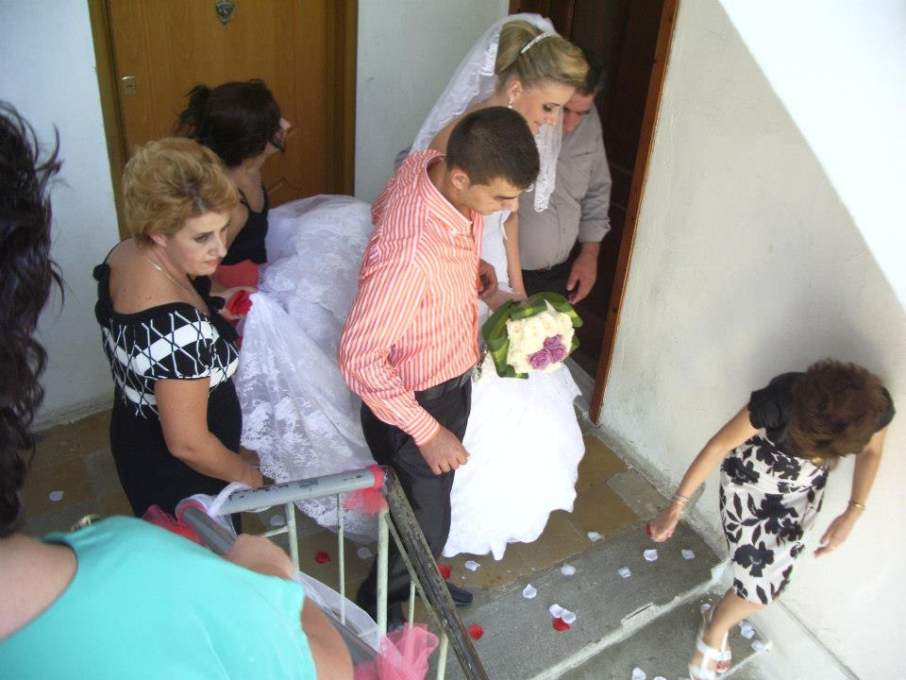
The flowers to the bride and Bride’s cry
A little kid, the youngest from the groom’s family holds a bunch of flowers to send them to the bride.
After the groom and his relatives arrive at bride’s home, they take her with them. This is a moving moment. Usually bride and her family cry altogether because the bride is leaving her father’s house to go to a new one.

Slide 8
Honey and Bread Money under the Sandals
At the door of the house, there stands the mother-in-law singing and waiting for the bride to give her honey and bread to eat. This is done wishing that their relationship is going to be sweet as the honey.
When the bride enters her new home, a little boy waits to take off her sandals. There he finds some money, hidden there intentionally. After that, the same boy is sit on the bride’s lap, to bring her good luck in giving birth to male children.

Slide 9
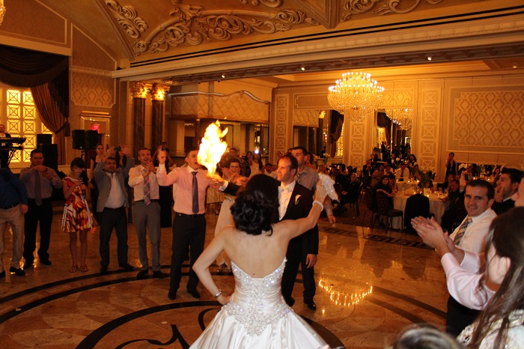
Traditional dance and a lot of money
The wedding ceremony involves a traditional bride-groom dance in which all the family and friends get involved, during the course of which everyone gives them money or attaches bank notes to them.
The couple dance a traditional song called “Napoloni” and “Shamia e beqarit” (bachelor’s headscarf) where the groom burns the headscarf. Everyone in the wedding dance the traditional songs especially the ones called “valle”.

Slide 10
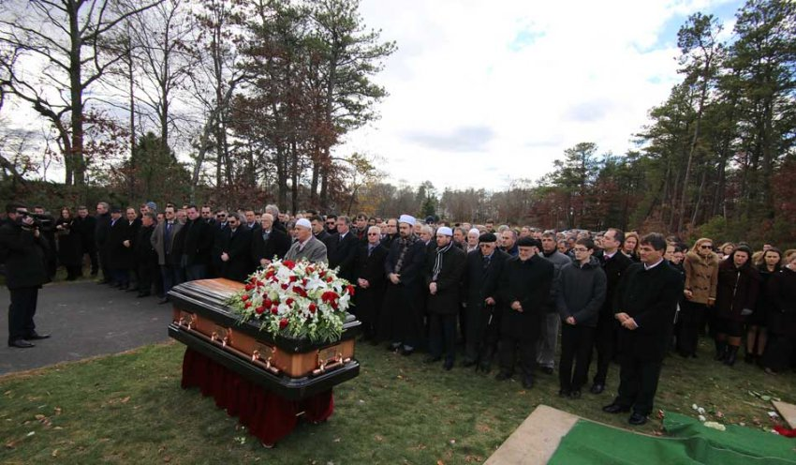
Death’s traditions
When someone dies in Albania all the relatives ,friends and family stay all the night in the dead’s house in his honor. The day after they bury him and after they eat lunch in his honor. Also they serve a dessert called “revani”.
The closest relative wear black clothes for 6 months or 1 year. It depends on the region of Albania.
Also, they have some special days called “perkujtimore” (commemoration) when all the relatives go to visit the tomb of the death person.
These dates are 3rd (te tretat) 7th ( for muslims:te shtatat) 9th (for christians:te nentat) and 40th (te dyzetat). Also, after 6 moths and after 1 year( qivuri-means bier).

Slide 11
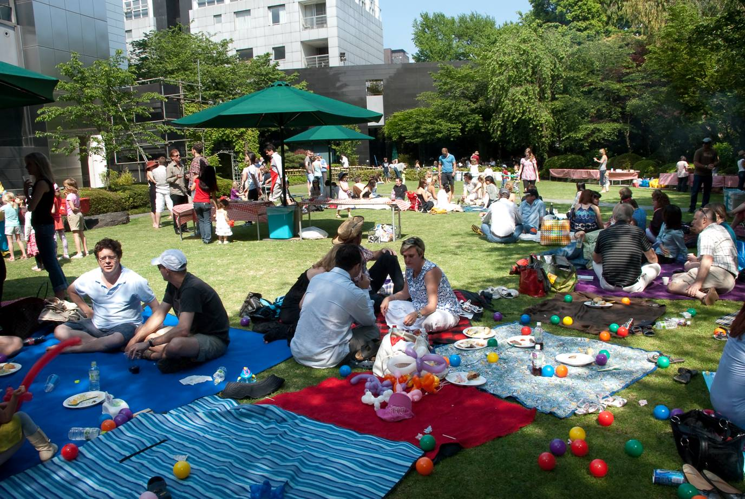
1st May
1st May for everyone in the world is Labor Day and they organize protestations. But for Albanians it is very different . This date they celebrate organizing picnics in the nature with relatives and families.

Slide 12
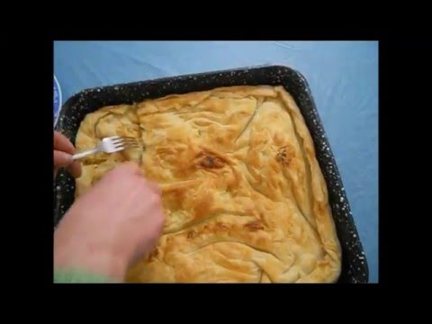
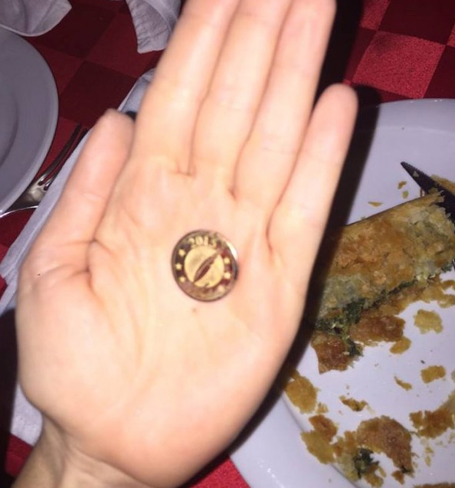
1st January
After celebrating the New Year on 31st of December, on the 1st January the albanians prepare a kind of pie where they put a coin and cut the pie in pieces of how many members has the family. Who gets the coin it means the he/she will have a lucky year.

